Slide 1
Overview of MCAS Administration Tasks for Technology Coordinators
The Office of Student Assessment Services
October 7, 2026

Slide 2
Presenters
Shannon Cullen, MCAS Test Administration Coordinator
Erma Brown, MCAS and ACCESS Test Administration Specialist
Kaelee Harper, eMetric Project Manager

Slide 3
Logistics for This Session
Use the Q&A feature to ask a question.
  We will answer some questions aloud at specified times during this training session, and we will email the Q&A afterwards.
  Use the thumbs-up icon to “upvote” someone else’s question.
  Email student-specific questions to mcas@mass.gov instead of asking here.
Closed captioning has been enabled for participants who need it.
This session is being interpreted into ASL. Our interpreting team will be onscreen with the presenters.
Please be advised that DESE does not authorize attendees to record or to use AI transcription tools during the meeting and DESE does not endorse any unauthorized transcripts created by third parties of its meetings.

Slide 4
Slides for This Session
Slides were emailed to participants before this session from MCASEvents@cognia.org.
Slides are now being posted in the chat.
    If you cannot access the slides in the chat, ask in the Q&A.
After the session, we will send the slides again to participants, and they will be posted in the MCAS Resource Center along with the recording.

Slide 5
Today’s Agenda
Updates for 2026–27
Overview of MCAS Computer-Based Testing
Tasks to Complete in Fall 2026
Tasks to Complete at least Two Months before Testing
Tasks to Complete at least Two Weeks before Testing
Troubleshooting Technology Issues during Testing
Resources, Support, and Next Steps

Slide 6
Poll Question 1
What is your role? (Select all that apply.)
  District test coordinator
  School test coordinator
  Principal
  Technology staff
  Other district staff
  Other school staff

Slide 7
Poll Question 2
How many years have you been involved in MCAS test administration?
  0–This is my first year
  1 year
  2–3 years
  4–5 years
  6+ years

Slide 8
1. Updates for 2026–27

Slide 9
Technology Updates
ChromeOS: Updated ChromeOS accessibility configuration guidance; refer to page 20 of the MCAS Student Kiosk Technology Guide for more information.
iPad: A new iPad external keyboard setting for full kiosk control and Magic Mouse compatibility; refer to page 25 of the MCAS Student Kiosk Technology Guide for more information. iPads now show in the MCAS Portal on the Site Readiness details page when conducting Site Readiness.
MacOS: Schools will need to uninstall the old kiosk before installing the new kiosk.
Linux: Revised Linux installation steps; refer to page 26 of the MCAS Student Kiosk Technology Guide for more information.
Windows: A new iTester Windows app option has been added for test delivery. The app will be available through the Microsoft Store and includes automatic updates, helping ensure devices stay current with minimal administrative effort. This app will follow a single-application model similar to the iPadOS kiosk where a location is selected upon first launch.
  Step-by-step instructions available in the MCAS Student Kiosk Technology Guide.
  The legacy Windows kiosk will still be available for download in the MCAS Portal and MCAS Resource Center.
  Schools will need to uninstall the old kiosk before downloading and installing the legacy Windows kiosk or the iTester Windows app.

Slide 10
MacOS Kiosk Installer Update
An issue was identified with macOS kiosk installer package version 3.57.3 for schools that use an MDM solution.
An updated macOS kiosk installer (version 3.58.4) was posted to the MCAS Resource Center and MCAS Portal on September 25.
Schools that downloaded and installed macOS kiosk version 3.57.3 through an MDM solution before September 25 may need to download the updated installer.
Schools do not need to download the updated installer if they:
  downloaded it after September 25
  do not use an MDM solution to manage kiosk deployments
  have not experienced issues installing and managing the kiosk
Expected to be announced in an upcoming Student Assessment Update.

Slide 11


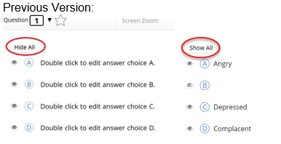
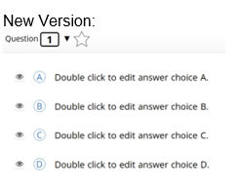
MCAS Student Kiosk Updates
The following updates are now available in the MCAS Student Kiosk:
Update | Screenshot
Students testing on battery-powered devices now have a battery status indicator at the top of the screen. Unavailable on iPadOS (the native battery indicator is visible in the system status bar).
The visibility of the online/offline status indicator has been updated to include a text label. “Online” or “Offline” now appear below the indicator.
The “Show All” and “Hide All” buttons have been removed from the answer masking feature on multiple-choice questions. Individual answer masking remains available, allowing students to reveal or hide individual answer choices as needed.

Slide 12
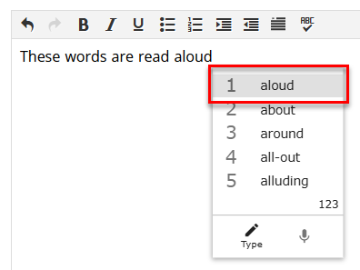
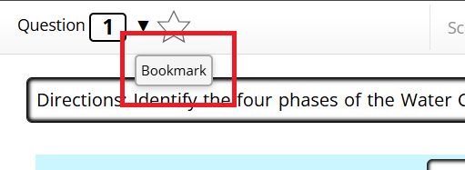
MCAS Student Kiosk Updates (continued)
The following updates are now available in the MCAS Student Kiosk:
Update | Screenshot
Students who have both the Word Prediction and Text-to-Speech (TTS) accommodations can now hear predicted words read aloud as they select them.
Tooltips now appear when hovering over on-screen tools on iPads with trackpads.

Slide 13
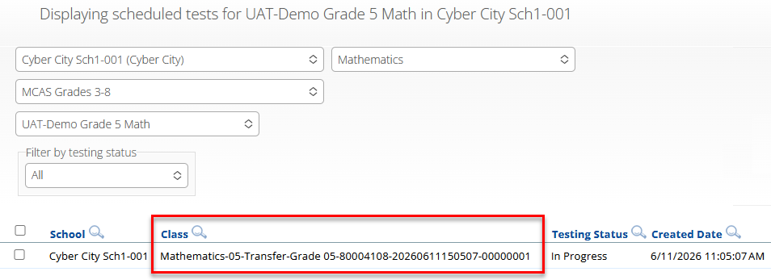

MCAS Portal Updates
The following updates are now available in the MCAS Portal:
Update | Screenshot
When using the Enrollment Transfer feature to transfer a student to a new organization, their test sessions will now automatically transfer with them. The new organization will see any In Progress and Completed test sessions from the prior school. The student will be automatically placed in a Transfer class; this class name will be used on the Classes page and Test Scheduling page, and in Test Status Exports.
School and district test coordinators are now able to change a student’s test status to Finished. Schools may want to use this feature if a student exits the kiosk instead of turning in the test when they have completed testing.

Slide 14
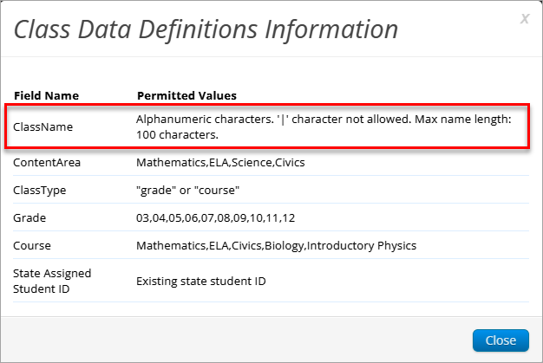
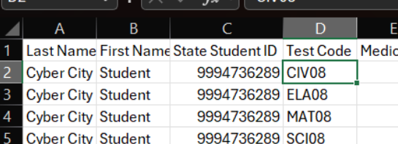
MCAS Portal Updates (continued)
The following additional updates are now available in the MCAS Portal:
Update | Screenshot
The class upload feature now has an increased maximum character limit of 100 characters for class names.
Portal users can now view the assigned test code in the accommodations export file available on the Students page of the MCAS Portal.

Slide 15
Upcoming MCAS Portal Updates
The following updates are expected to be implemented prior to the November high school tests:
Update
Students assigned the Spanish/English edition in Student Registration will automatically receive the Spanish/English edition when the test is scheduled. Schools do not need to schedule the Spanish/English edition separately on the Test Scheduling page. Note that when signing in to the test, students will still need to select Spanish or English from the Localization menu to choose the language for the MCAS Student Kiosk icons and directions.

Slide 16
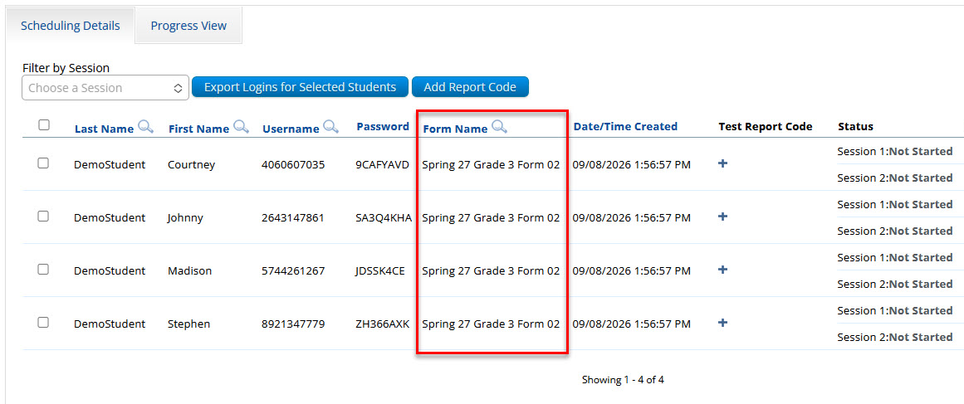
Upcoming MCAS Portal Updates (continued 1)
The following updates are expected to be implemented prior to the November high school tests:
Update | Screenshot
The Human Read-Aloud accommodation will no longer have a dedicated form displayed in the MCAS Portal. Students in the same class who have the Human Read-Aloud accommodation will receive the same test form number.

Slide 17
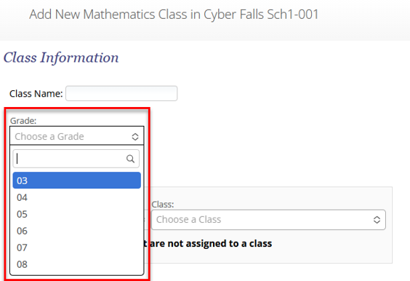
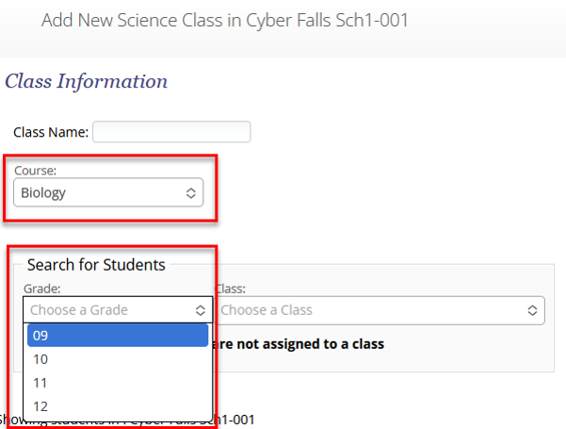
Upcoming MCAS Portal Updates (continued 2)
The following updates are expected to be implemented prior to the November high school tests:
Update | Screenshot
When creating classes, grade-level classes are limited to grades 3–8 and cannot be created for high school students. Course-level classes are limited to high school grade levels and courses, so they cannot be created for students in grades 3–8. When filtering for students, only those students in grades associated with the course will be allowed to be selected.

Slide 18
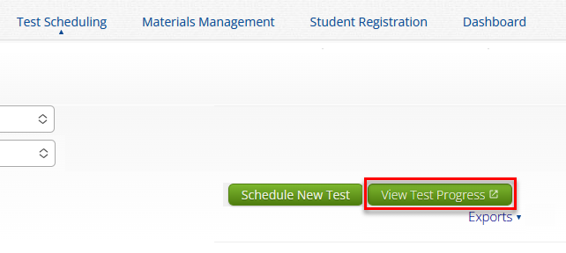
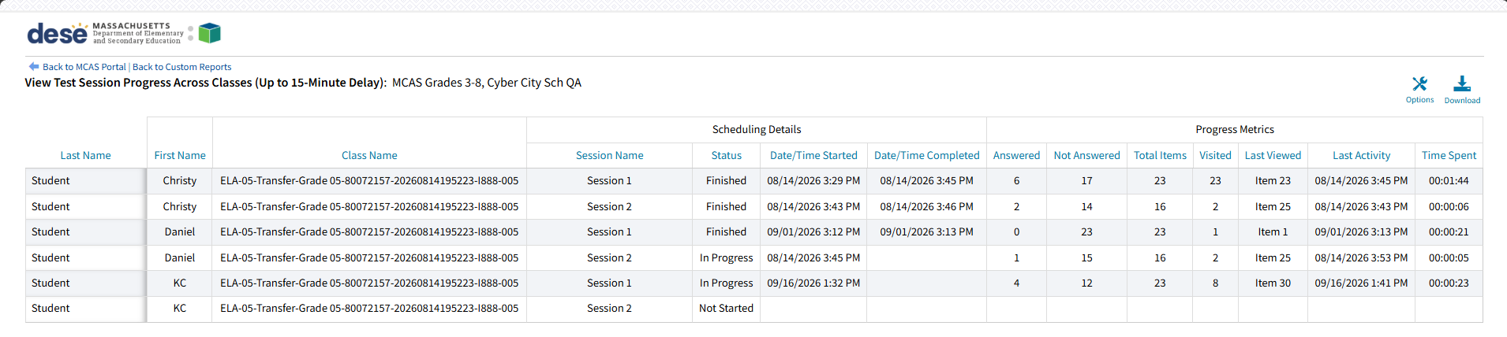
Upcoming MCAS Portal Updates (continued 3)
The following updates are expected to be implemented prior to the November high school tests:
Update | Screenshot
Test coordinators can view a report showing student test progress data across classes when they select View Test Progress on the Test Scheduling page.

Slide 19
Future Updates for the Student Kiosk and MCAS Portal
The following updates are under consideration for the future:
  Maintain highlighting and notepad after abrupt closure, pause, or log out of the MCAS Student Kiosk.
  Combining classes for make up testing
  Expanded test statuses to show the reason why the student exited the test (Paused, Timed Out, Exit)
  Test administrators can view students’ battery levels in the MCAS Portal.
  Preventing students from being scheduled for the same test more than once

Slide 20
2. Overview of MCAS Computer-Based Testing

Slide 21
MCAS Tests in 2026–27 School Year
Fall/Winter High School Tests
Spring 2027 Tests
Grades 3–8
  ELA – all grades
  Mathematics – all grades
  STE – grades 5 and 8
  Civics – grade 8
High School
  ELA – grade 10
  Mathematics – grade 10
  Biology and Introductory Physics
November
  ELA and Mathematics tests for students attempting to qualify for the Adams Scholarship, the Koplik Certificate of Mastery Award, and/or the Seal of Biliteracy
February
  Biology and Introductory Physics

Slide 22
Commonly Used Acronyms
CBT: Computer-based testing
PBT: Paper-based testing
EL: English learner
ELA: English Language Arts
STE: Science and Technology/Engineering
SIMS: Student Information Management System
TA: Test administrator
PWA: Progressive Web App (for ChromeOS)

Slide 23
Timeline for Technology Tasks in the MCAS Portal
Fall 2026
At least two months before testing
After updating the MCAS Student Kiosk
Become familiar with CBT components.
Review MCAS Student Kiosk Technology Guidelines.
Prepare the school’s technology.
Review cybersecurity guidance and establish a cybersecurity plan for your school.
Determine whether your school will participate in “Bring Your Own Device” (BYOD) for MCAS Testing.
Verify access to the MCAS Portal and MCAS Training Site.
Update MCAS Student Kiosk to most recent version (released September 14, 2026; for macOS, released September 25, 2026).
Conduct Site Readiness and complete Site Certification.

Slide 24
Timeline for Technology Tasks in the MCAS Portal (continued)
At least two weeks before testing
One week before testing
During testing
If any technology changes have been made since completing Site Readiness, run it again.
Prepare devices and materials.
Familiarize yourself with common issues that may arise during testing and how to troubleshoot.
Be available to troubleshoot technology situations as they arise.

Slide 25
3. Tasks to Complete in Fall 2026

Slide 26
Timeline for Technology Tasks in the MCAS Portal: Fall 2026
Fall 2026
At least two months prior to testing
After updating the MCAS Student Kiosk
Become familiar with CBT components.
Review MCAS Student Kiosk Technology Guidelines.
Prepare the school’s technology.
Review cybersecurity guidance and establish a cybersecurity plan for your school.
Determine whether your school will participate in “Bring Your Own Device” (BYOD) for MCAS Testing.
Verify access to the MCAS Portal and MCAS Training Site.
Update MCAS Student Kiosk to most recent version (released September 14, 2026; for macOS, released September 25, 2026).
Conduct Site Readiness and complete Site Certification.

Slide 27
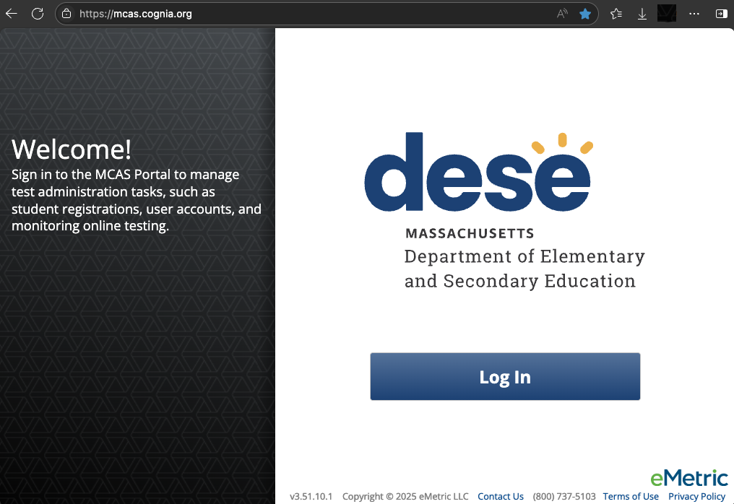
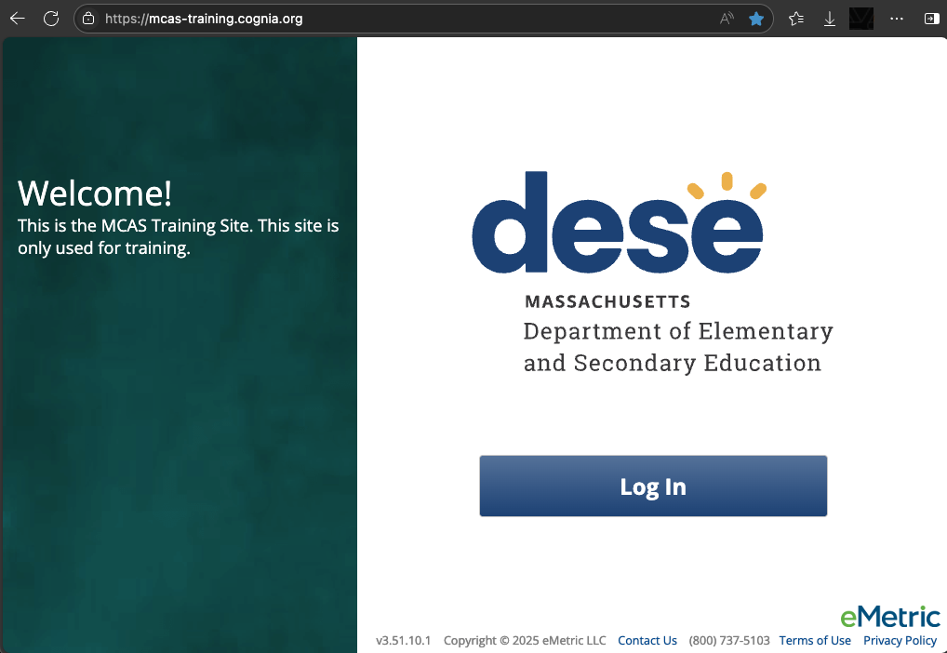
1. Become familiar with CBT components.
MCAS Portal
  Online test management system for principals, test coordinators, technology coordinators, and test administrators
    https://mcas.cognia.org/
MCAS Training Site
  Site where test coordinators, principals, technology coordinators, and test administrators can practice the tasks required in the MCAS Portal
    https://mcas-training.cognia.org

Slide 28
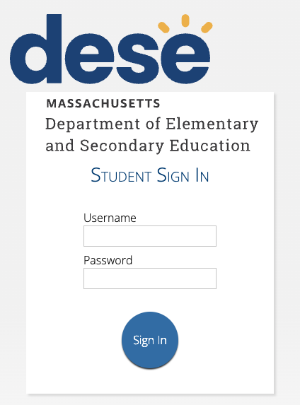
1. Become familiar with CBT components. (continued)
MCAS Student Kiosk
  Online testing platform used by students to take the computer-based MCAS assessments
    mcas.onlinehelp.cognia.org/
    technology-setup
Site Readiness
  Task completed by technology coordinators to verify that student devices are ready for testing.

Slide 29
2. Review MCAS Student Kiosk Technology Guidelines.
Part II of the MCAS Student Kiosk Technology Guide, available on the MCAS Resource Center on the Technology Setup page
Outlines the operating systems (OS) versions supported for testing, student kiosk device specifications, and MCAS Portal browser specifications
OS support
  As new OS versions and subversions are released throughout the school year, eMetric conducts testing to confirm that they will be supported for testing.
  Schools should not update device OS versions during testing windows.

Slide 30
Student Device Specifications
System Requirements – All Hardware
Connectivity | Student devices must be able to connect to the internet via wired or wireless networks.
Screen Size | 9.7” screen size or larger/“10-inch class” tablets or larger ”11-inch class” tablets or larger are highly recommended
Screen Resolution | 1024 x 768 or larger
Browser Requirements
Browsers (used for practice tests only) | Chrome 151 or newer Firefox 153 or newer Microsoft Edge 151 or newer Safari 26.6 or newer
Desktop and Laptop Specific Requirements
CPU | 1.3 GHz
Memory | 2 GB (4GB is strongly recommended for best performance)

Slide 31
Poll Question 3
Which operating systems will students in your school/district use for spring 2027 MCAS testing? (Select all that apply.)
  ChromeOS
  iPadOS
  Linux/Fedora
  macOS
  Windows
  Other

Slide 32
ChromeOS Support Plan
eMetric supports the versions of ChromeOS that are current as of July of each school year. These versions will be supported through the end of the school year (June). Schools are not recommended to use beta versions of ChromeOS, as this may result in errors.
Version | Version Release Date
150+ | July 2026
144+ LTS | April 2026
Refer to page 3 of the MCAS Student Kiosk Technology Guide.

Slide 33
iPadOS Support Plan
eMetric supports the latest three major versions that are supported by Apple.
Version | Version Release Date | End of Support Date
18.7+ | September 2024 | End of 2026–27 school year
26.5+ | September 2025 | End of 2027–28 school year
27 | Expected fall 2026 | End of 2028–29 school year
Refer to pages 3–4 of the MCAS Student Kiosk Technology Guide.

Slide 34
Support for macOS (64-bit only)
eMetric supports the latest three major versions that are supported by Apple.
Version | Version Release Date | End of Support Date
15.7+ | September 2024 | End of 2026–27 school year
26.5+ | September 2025 | End of 2027–28 school year
27 | Expected fall 2026 | End of 2028–29 school year
Refer to page 4 of the MCAS Student Kiosk Technology Guide.

Slide 35
Support for Linux and Windows
Operating System | Version | Version Release Date | End of Support Date | eMetric Support Policy
Linux, Fedora (64-bit only) | 44 | April 2026 | End of 2026–27 school year | eMetric supports the latest version of Fedora
Windows | 11 (24H2 Educator, Enterprise, IoT Enterprise, Enterprise Multi-Session; 25H2; 26H1; 26H2) | October 2021 | October 2031 | eMetric supports major versions of Windows that are supported by Microsoft. The latest supported minor versions of Windows are supported.
Refer to page 4 of the MCAS Student Kiosk Technology Guide.

Slide 36
3. Prepare the school’s technology.
Identify any gaps in technology capacity (e.g., test-taking devices that do not meet technology specifications) and address those gaps.
Plan to have enough devices for test administrators and students, including back-up devices that can be used if needed.
Update firewalls, proxy and content filter servers, and sandboxing applications.
Turn off operating system auto-updates during live administrations.

Slide 37
Network Requirements and Guidelines
Firewalls
Allow traffic through ports 80 and 443.
Proxy and Content Filter Servers
List of URLs to allow on ports 80 and 443 available on page 6 of the MCAS Student Kiosk Technology Guide
Sandboxing Applications
Choose network folder or local folder that is not touched by the sandboxing applications
Applicable for both stored response and kiosk installation folders
Refer to page 6 of the MCAS Student Kiosk Technology Guide
Turn off operating system auto-updates during live test administrations.

Slide 38
OneDrive
OneDrive notifications may interfere with the kiosk and student test-taking experience. If OneDrive attempts to steal the screen’s focus during testing, the kiosk will display a white screen.
The student will need to click anywhere on the screen to regain focus in the kiosk, and then they will be able to resume testing where they left off.
To prevent these interruptions, schools should use one of the following approaches:
  If OneDrive is not needed or used on student devices, schools are recommended to disable OneDrive during student testing.
  OR
  If OneDrive cannot be disabled, the technology coordinator should take the necessary steps to prevent any actions, including file sharing or synchronization and administration updates to OneDrive settings, that would trigger a OneDrive notification during student testing.

Slide 39
Accommodations with Supported OS
Certain accommodations in the MCAS Student Kiosk are only supported on specific operating systems as described in the table below.
Accommodation | Supported Operating System
Compatible Assistive Technology | Windows
Mouse Pointer | Windows, macOS, ChromeOS, iPadOS*
Screen Reader | Windows (NVDA, Jaws)
Speech-to-Text Standard and Special Access | Windows, macOS, ChromeOS, iPadOS
Word Prediction Standard and Special Access | Windows, macOS, ChromeOS, iPadOS
*iPadOS: It is highly recommended to use an external mouse.

Slide 40
Monitor Settings for Screen Zoom
Ensure that all monitors used for testing are set to the default color settings. If a student will use the screen zoom tool, review the recommended screen resolutions below.
Required Zoom Level for Student | Recommended Screen Resolution
100% (no zoom) | 1024 x 768 (or higher)
150% | 1920 x 1080 (or higher)
200% | 1920 x 1080 (or higher)
300% | 1920 x 1080 (or higher)
Note: These are recommended screen resolutions. Students should use the screen resolution they are most comfortable with. The student or test administrator can set the zoom level in the MCAS Student Kiosk when the student logs in for testing.

Slide 41
4. Review cybersecurity guidance and establish a cybersecurity plan for your school.
Review resources for cybersecurity planning to avoid issues that could arise during MCAS testing.
  Massachusetts Municipal Cybersecurity Roadmap
  Cybersecurity Best Practices
  Protecting Our Future: Partnering to Safeguard K–12 Organizations from Cybersecurity Threats
  National Institute of Standards and Technology (NIST) Cybersecurity Framework and NIST Cybersecurity Framework 2.0: Resource & Overview Guide
  K12 SIX Essentials Series and K12 Six School District Cybersecurity Self-Assessment: 2026
Email DESE’s Office of Educational Technology at k12edtech@mass.gov with questions.

Slide 42
5. Determine whether your school will participate in “Bring Your Own Device” (BYOD) for MCAS Testing.
A BYOD policy allows students to use their own devices for instruction.
If your school uses a BYOD policy and would like to use these devices for MCAS testing, email mcas@mass.gov for additional instructions by deadlines listed in Student Assessment Updates.
Schools will follow the instructions in the MCAS Student Kiosk Technology Guide to download the kiosk onto BYOD devices and will also have additional instructions that they will receive from DESE.

Slide 43
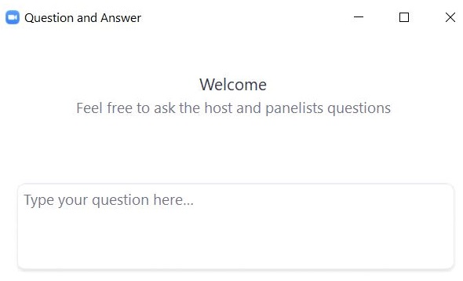
Questions & Answers 1
Use the “Q&A” feature
to ask questions.

Slide 44
4. Tasks to Complete at least Two Months Prior to Testing

Slide 45
Timeline for Technology Tasks in the MCAS Portal: At least two months prior to testing
Fall 2026
At least two months prior to testing
After updating the MCAS Student Kiosk
Become familiar with CBT components.
Review MCAS Student Kiosk Technology Guidelines.
Prepare the school’s technology.
Review cybersecurity guidance and establish a cybersecurity plan for your school.
Determine whether your school will participate in “Bring Your Own Device” (BYOD) for MCAS Testing.
Verify access to the MCAS Portal and MCAS Training Site.
Update MCAS Student Kiosk to most recent version (released September 14, 2026; for macOS, released September 25, 2026).
Conduct Site Readiness and complete Site Certification.

Slide 46
6. Verify access to the MCAS Portal and MCAS Training Site.
MCAS Portal: the test administration and management website for district test coordinators, technology coordinators, principals/school test coordinators, test administrators, and other staff as needed
MCAS Training Site: where test coordinators, principals, technology coordinators, and test administrators can practice the tasks required in the MCAS Portal
Accounts for each site are created separately.
Passwords for each site are set separately, but DESE recommends using the same password for both the MCAS Portal and the MCAS Training Site.

Slide 47
Poll Question 4
Who should you reach out to if you need an MCAS Portal or MCAS Training Site account?
  Your school test coordinator or principal
  Your district test coordinator
  MCAS Service Center
  All of the above

Slide 48
6. Verify access to the MCAS Portal and MCAS Training Site. (continued)
If you cannot access your MCAS Portal or MCAS Training Site account, are not able to access your school or district, or are new and need an account, users can request support as follows:
Role | Who to contact for support
Test administrators and school-level technology coordinators | Their principal or school test coordinator
Principals, school test coordinators, and district-level technology coordinators | Their district test coordinator
District test coordinators | MCAS Service Center

Slide 49
Getting Started: Logging In
Browser specifications for the MCAS Portal:
  Chrome™ 151 or newer
  Firefox® 153 or newer
  Microsoft Edge 151 or newer
  Safari® 26.6 or newer
Passwords are valid for 365 days.
  To reset your password, select “Forgot Password?” on the MCAS Portal log in page.
  For detailed steps, refer to Part II of the Guide to the MCAS Portal: MCAS Portal User Management.

Slide 50
7. Download and install the updated MCAS Student Kiosks.
Released September 14, 2026; for macOS, released September 25, 2026.
Detailed instructions for setting up the 2026–27 MCAS web app for ChromeOS and extension are provided in the MCAS Student Kiosk Technology Guide.
Available for download from the MCAS Portal for iPad, Linux, Mac, and Windows
  Use the direct links to access the apps on the Apple App Store and Windows Store.
  Be sure to download the correct MCAS Student Kiosk for each device type.
Scripted installations and other methods of installation are provided in the MCAS Student Kiosk Technology Guide.

Slide 51
Uninstalling 2025–26 Kiosks
Use the table below for student testing devices with the MCAS Student Kiosk installed from 2025–26. For step-by-step instructions, refer to the MCAS Student Kiosk Technology Guide.
Kiosk Installed in 2025–26 | Action Required for MCAS Testing in 2026–27
ChromeOS | Confirm that all previous configuration requirements remain in place and complete steps 10–13 in the ChromeOS instructions, which outline new steps to disable Chrome Accessibility features.
iPad | Manually update the kiosk if automatic updates are not enabled.
Linux | Uninstall the old kiosk and then download and install the new kiosk.
MacOS | New for 2026–27: Uninstall the old kiosk and then download and install the new kiosk.
Windows | New for 2026–27: If using the legacy Windows kiosk, uninstall the old kiosk and then download and install the new kiosk. If using the iTester for Windows app, uninstall the old kiosk and then download the new app directly from the Microsoft Store.

Slide 52
ChromeOS Kiosk Procedures
If you have the Progressive Web App (PWA) installed from 2025–26 school year, please review pages 20–22 of the MCAS Student Kiosk Technology Guide to ensure specific new accessibility settings are disabled.
  Verify that the app is working as expected by completing Site Readiness on the devices.
If you need to install the PWA, follow the step-by-step instructions for setup and configuration that are included in the MCAS Student Kiosk Technology Guide on pages 8–23. Every step must be followed; certain steps require careful typing or copying.
  Strongly recommended: Use the Installation Quick Copy document to assist with copying/pasting text while installing the PWA.
  Extension Pairing: The PWA will work alongside a Chrome extension to support secure kiosk testing.
  Test the app before administration starts: We strongly recommend schools and districts coordinate with their technology coordinators to install and test the PWA by completing Site Readiness on devices as soon as it is installed.

Slide 53
ChromeOS Application Common Errors
The PWA app was added to your ChromeOS management console but is not showing on the device.
  Ensure that the device is enrolled into the organization and the child organizational units (OU) inherit the app and policy settings from the parent OU.
  If inheritance is disabled, the kiosk app will not appear on devices in those child OUs and the policy settings and app must be installed locally in the correct child OU.

Slide 54
ChromeOS Application Common Errors (continued)
The PWA app is installed but not launching in kiosk mode.
  Pay close attention when copy/pasting during installation and configuration as any typos, missing hyphens, added spaces, or added characters will prevent the app from entering kiosk mode.
  When launching the PWA app ensure you are launching the app from the Chromebook sign in screen.
For both of these errors, refer to installation steps 3–10 (pages 9–12) and configuration steps 4 and 5 (pages 16–17) in the MCAS Student Kiosk Technology Guide.

Slide 55
8. After updating the MCAS Student Kiosk, conduct Site Readiness and Site Certification.
What are the purposes of conducting Site Readiness and Site Certification?
Site Readiness and Site Certification are procedures that confirm that the updated MCAS Student Kiosk has been properly installed on student devices, and that those devices have been properly configured prior to testing.
It is recommended to complete directly after installing the updated MCAS Student Kiosk.
If any changes to technology take place, it is strongly recommended to complete again prior to testing.
DESE will follow up with schools and districts that do not complete Site Readiness.
New for 2026–27: iPads now show in the MCAS Portal on the Site Readiness details page when conducting Site Readiness.

Slide 56
Site Readiness Tests
Site Readiness is a two-part test that allows technology coordinators to ensure the MCAS Student Kiosk has been properly installed.
Site Readiness Tests | Purpose of Test
System Set-Up Test | Verifies and confirms the following: network connectivity screen resolution text-to-speech how many students may begin testing at the same time
Student Interface Test | Provides sample test questions to determine whether the device is capable of correctly displaying and navigating test content in the MCAS Student Kiosk. The Student Interface Test also allows technology coordinators to test the student tools, including the Line Reader, Text Highlighter, and Notepad, to ensure those are functioning properly.

Slide 57
Demonstration
Retrieving Site Readiness credentials
Conducting the Site Readiness test
Certifying Site Readiness

Slide 58
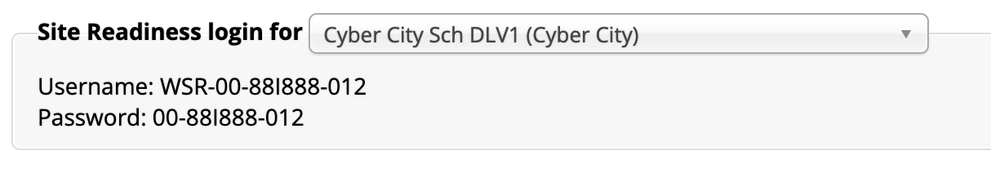
Retrieving Site Readiness Credentials
Log in to the MCAS Portal with your username and password.
On the Portal home page, click Administration. The Site Readiness account information appears at the bottom of the Administration home page.
Make a note of the username and password for the school, which you will use to log in to the MCAS Student Kiosk.

Slide 59
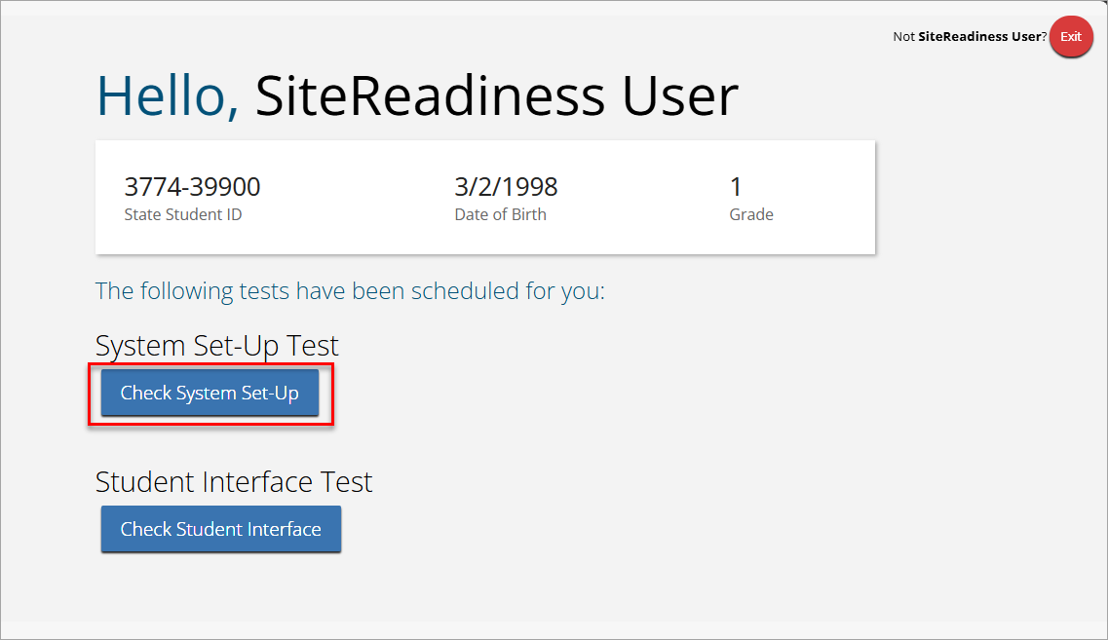
Conduct Site Readiness: System Set-Up Test
Launch the MCAS Student Kiosk on the device.
Log in to the MCAS Student Kiosk with the Site Readiness username and password provided for the school.
Under System Set-Up Test, click Check System Set-Up to begin the test.

Slide 60
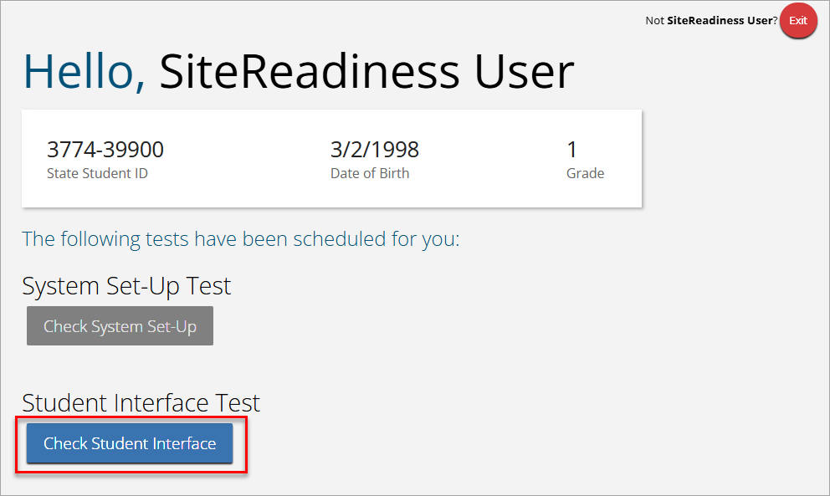
Conduct Site Readiness: Student Interface Test
If all the system checks succeed, you are ready to begin the next Site Readiness test.
  If one or more system checks fail, adjust your configuration as needed and re-run the System Set-Up test.
When the System Set-Up test is completed, click the blue Check Student Interface button.
Read the instructions on the page and then click Continue.
Confirm that you can respond to a few questions and try a few student tools.
On the last test question page, click Finish.
On the Test Review page, click Turn In to submit your test.

Slide 61

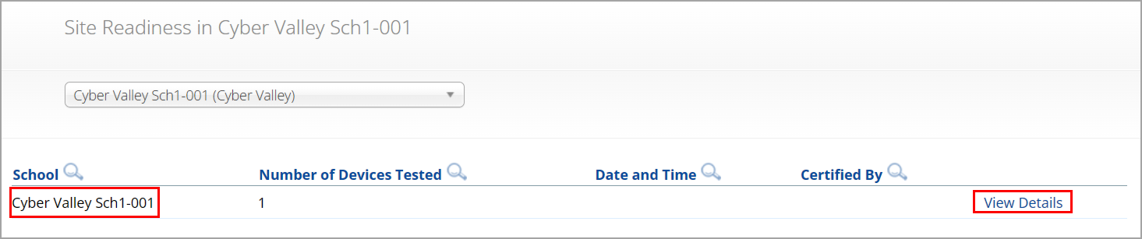
Certify Site Readiness
After all devices or device configurations for your school have successfully completed Site Readiness, the technology coordinator will certify the site for testing.
Log in to the MCAS Portal with your username and password.
  Note: Use your own username and password, not the Site Readiness credentials.
Click Administration.
Click Site Readiness at the top of the page.
On the Site Readiness page, locate the school to be certified, and then click View Details.

Slide 62
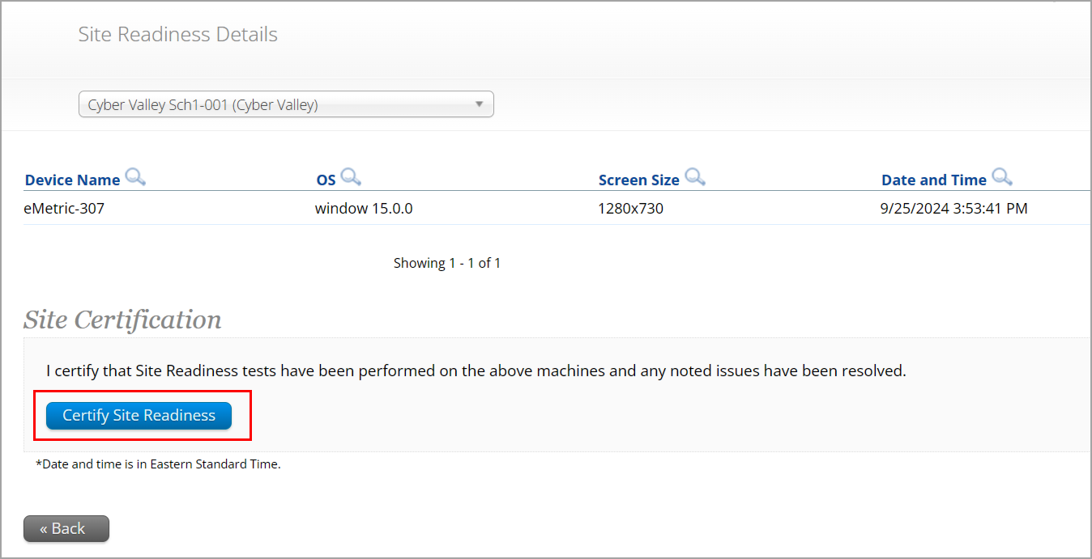
Certify Site Readiness (continued)
On the Site Readiness Details page, verify that all the devices or device configurations for the school have successfully run the Site Readiness tool and meet the technology requirements.
Click Certify Site Readiness and click Yes in the pop-up message to confirm.

Slide 63
Questions & Answers 2
Use the “Q&A” feature
to ask questions.

Slide 64
5. Tasks to Complete at least Two Weeks before Testing

Slide 65
Timeline for Technology Tasks in the MCAS Portal: At least two weeks before testing
At least two weeks before testing
One week before testing
During testing
If any technology changes have been made since completing Site Readiness, run it again.
Prepare devices and materials.
Familiarize yourself with common issues that may arise during testing and how to troubleshoot.
Be available to troubleshoot technology situations as they arise.

Slide 66
9. If any technology changes have been made since completing Site Readiness, complete it again.
We understand that technology setups at schools and districts may change over the course of the school year. If there are any changes such as those listed below, it is highly recommended to rerun Site Readiness testing.
  Operating system versions change
  New student testing devices are purchased
  New proxy, firewall, or other network setup changes have been made that could impact student testing
  New Wi-Fi or other internet setup changes have been made that could impact student testing

Slide 67
10. Prepare devices and materials.
Ensure all devices will be charged prior to each test session.
Have the following materials available, and confirm they are in working order:
  Power cords, power strips, extra batteries, extra computers
  If using tablets: external keyboards
  If students are using Text-to-Speech or screen reader: headphones (Students do not need headphones otherwise.)

Slide 68
6. Troubleshooting Technology Issues during Testing

Slide 69
Timeline for Technology Tasks in the MCAS Portal: One week before testing & during testing
At least two weeks before testing
One week before testing
During testing
If any technology changes have been made since completing Site Readiness, run it again.
Prepare devices and materials.
Familiarize yourself with common issues that may arise during testing and how to troubleshoot.
Be available to troubleshoot technology situations as they arise.

Slide 70
Troubleshooting Technology Issues during Testing
Technology coordinators are encouraged to familiarize themselves with common issues that may arise during testing and how to troubleshoot by reviewing Appendix A of the Principal’s Administration Manual (PAM) and Appendix B of the MCAS Student Kiosk Technology Guide.
Technology coordinators should plan to be available during testing to assist with technology issues if they arise.
For all technology issues, it is good practice to record the exact device the student is testing on. Keep student on the same device when possible. Escalate issues to the MCAS Service Center as needed.

Slide 71
Clearing the Application Cache
In some situations, technology coordinators may clear the MCAS Student Kiosk application cache as a first step towards resolving technology issues, including the following situations:
  If an image is not rendering correctly
  If a drag-and-drop item is not operating correctly
In these cases, technology coordinators can:
  Instruct the student to log out of the test.
  Select the Clear Cache link for Windows, macOS, Linux, and ChromeOS. For iPadOS close the iTester app completely on the iPad to clear the cache.
  Instruct the student to log back in to the test.

Slide 72
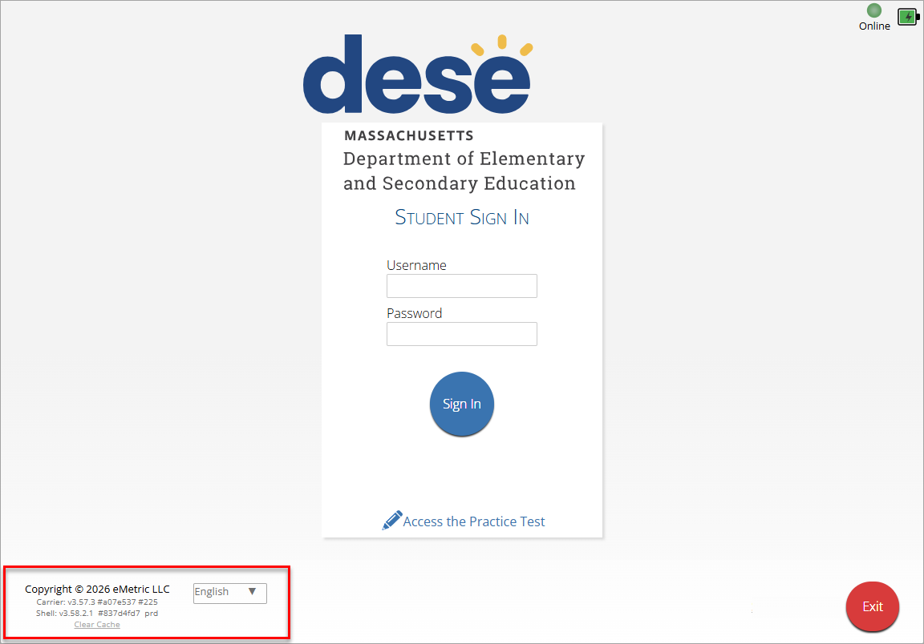


Clearing the Application Cache (continued)

Slide 73
Steps to Resolve Error Messages
If possible, do not power the device off until the student has exited the MCAS Student Kiosk.
Record the exact device the student is testing on.
  Note: It is generally best practice to keep a record of which devices students test on for each test session.
Troubleshoot the error according to the instructions in Appendix A of the PAM.
  If your school is experiencing a high volume of error messages, contact the MCAS Service Center.
When resuming a test after an error has exited the student from the kiosk, the original testing device should be used first.
  This is so that any unsent responses on the original device can be sent to eMetric.
If the original testing device cannot be used or if the original error is still occurring, contact the MCAS Service Center for support.

Slide 74
Common MCAS Student Kiosk Error Messages
Error Message | Resolution
Invalid username/password | The student is using the incorrect password or username when trying to log in to the MCAS Student Kiosk. Verify the correct username and password in the MCAS Portal and have the student try again.
We could not establish a connection to our server, please check your internet connection. | Internet connectivity was lost after the student entered their username and password. The MCAS Student Kiosk detected the loss of internet connectivity and will not allow the student to log in until internet connectivity is reestablished. Contact your technology coordinator.
Incorrect access code. Please try again. | The student is using the incorrect access code for the session selected or typing in the access code incorrectly. Verify the correct access code in the MCAS Portal and have the student try again.
Refer to Appendix A of the PAM for a full list of error messages and instructions.

Slide 75
Common MCAS Student Kiosk Error Messages (continued 1)
Error Message | Resolution
We were unable to get your Test Session. Please check your internet connection and try again. | Internet connectivity was lost after the student logged in. The MCAS Student Kiosk will not load the test sessions until a connection to the internet is reestablished. Click Retry. If internet connectivity is established, then the student will be directed to the test session. If an internet connection is not detected, contact your technology coordinator.
We could not establish a connection to our server, please check your internet connection. | The eMetric servers cannot reach the stored response folder location due to a network connectivity failure. Contact your technology coordinator.

Slide 76
Common MCAS Student Kiosk Error Messages (continued 2)
Error Message | Resolution
Please raise your hand; your test session has timed out. | The student has timed out of their test session, meaning they have been inactive in the test for 60 minutes or more. Click Exit to go back to the sign-in page. When the student is ready to continue testing, they will log back into the student testing interface and select the session, enter the access code, and the test administrator will enter the proctor password. The student will resume testing where they left off.
A connection to the network could not be established. Your test has been saved offline. | Internet connectivity was lost after the student began testing and was not restored by the time the student completed the test. The student’s responses are saved to the local folder configured when installing the MCAS Student Kiosk. Enter the proctor password to acknowledge the message. Note the student’s device ID. Contact your technology coordinator to establish internet connection. Relaunch the MCAS Student Kiosk on the student’s device.

Slide 77
MCAS Student Kiosk: Moving Devices
If a student’s device becomes unusable during a test while they are connected to the internet, follow these steps when moving them to a new device.
  If possible, verify that the number of responses showing as answered on the student’s device match the number answered on the Progress View tab on the View Details/Student logins page for the test.
    If not possible, or if the number of responses do not match, contact the MCAS Service Center.
  Have the student Pause and Exit the test.
  Move the student to a new device.
  Have the student log in with their username, password, and access code.
  Student should be able to continue where they left off.

Slide 78
MCAS Student Kiosk: Internet Connectivity
Internet connectivity is required during testing only as follows:
  At the beginning of the test to authenticate student login and download the test content
  At the end of the test to submit responses for scoring
Student responses sync with eMetric servers every 45–90 seconds.
Once a student has finished reading the test session directions and the content has downloaded onto the local device, the student may continue testing regardless of internet connectivity.
Note: For grades 5 and 8 STE, internet connectivity is required for the entirety of the test. Internet connectivity is also required for students using text-to-speech or ASL video accommodations.

Slide 79
Loss of Network Connectivity Procedure Summary
If a student’s device loses internet connectivity during testing:
  The student should keep testing on that device. Do not move a student to a new device when experiencing technical issues if the student has already begun testing.
  Student responses will be saved to the save response location indicated during MCAS Student Kiosk installation.
  Once internet connectivity resumes, the saved responses will automatically be synced to eMetric servers.
If a student finishes and is ready to turn in the test while offline (prior to the network being restored):
  Allow student to turn in test.
  The student will receive a message to notify the test administrator.
  Record the exact device the student is testing on.
  Ensure no network management tools or system maintenance will alter that device’s files or configuration.
  When network connectivity is restored, the test administrator will need to resume internet connectivity and relaunch the MCAS Student Kiosk on the original testing device. (If you can see the student login page, the saved responses have synced.)
  Verify the student now shows as Finished on the Test Scheduling page in the MCAS Portal for this test. The Progress View tab will also show all responses as answered.

Slide 80
Questions & Answers 3
Use the “Q&A” feature
to ask questions.

Slide 81
7. Resources, Support, and Next Steps

Slide 82
Additional Resources
Resource | Location
MCAS Resource Center | mcas.onlinehelp.cognia.org
MCAS Portal user guides | https://mcas.onlinehelp.cognia.org/portal/
Technology Information MCAS Student Kiosk Technology Guide (includes Technology Guidelines, instructions for downloading and installing updated kiosks, instructions for Site Readiness and Site Certification, and troubleshooting information) | https://mcas.onlinehelp.cognia.org/technology-setup/
Student Assessment Updates (Biweekly email with important updates about the MCAS program) | www.doe.mass.edu/mcas/updates.html If you do not already receive this email, subscribe using this link: http://eepurl.com/ghSOhH
Cybersecurity Resources | https://www.doe.mass.edu/mcas/testadmin/

Slide 83
Upcoming Trainings – Fall 2026
Training | Date
Overview of Conducting a Practice Test through the MCAS Training Site | Wednesday, November 18 at 9:30–11:00a.m.
MCAS Accessibility and Accommodations | Tuesday, December 8 at 9:30–11:00a.m.

Slide 84
Upcoming Trainings – January 2027
Training | Date
Overview of Student Registration | Wednesday, January 20
Office Hours – Accessibility and Accommodations | Thursday, January 21
Administering the MCAS Braille Tests | Thursday, January 21, at 12:00 p.m.
MCAS Test Administration for New Staff | Tuesday, January 26
MCAS Security Protocols for New Staff | Wednesday, January 27
MCAS Test Administration and Security Protocols for Returning Staff | Thursday, January 28
Sessions will begin at 9:30 a.m. unless otherwise noted.

Slide 85
Upcoming Trainings – February and March 2027
Training | Date
Overview of MCAS Administration Tasks for Technology Coordinators | Monday, February 1
Office Hours for Spring 2027 MCAS Tests | Friday, February 5
Office Hours for Technology Coordinators | Tuesday, February 9
Overview of Spanish/English MCAS Tests | Thursday, February 11
Tasks in the MCAS Portal Before Testing | Tuesday, March 2
Tasks in the MCAS Portal During Testing | Tuesday, March 9
Tasks in the MCAS Portal After Testing | Tuesday, March 16
Office Hours for MCAS Portal Tasks | Thursday, March 18
Sessions will begin at 9:30 a.m.

Slide 86
Next Steps
Today: Complete the evaluation form.
  Responses are associated with the name and email address used to log in.
  Email your input to mcas@mass.gov if you have problems accessing or completing the form.
Within one week:
  Receive an email with the Q&A from this session
  Recording will be available

Slide 87
Email and Phone Support
MCAS Service Center
DESE Student Assessment Services
Logistics and Technology Questions
  Web: https://mcas.onlinehelp.cognia.org/
  Email: mcas@cognia.org
  Phone: 800-737-5103
  TTY: 888-222-1671
  Live chat is available at the link on the bottom of the page at the MCAS Resource Center
Policy Questions
(e.g., student participation, accommodations)
  Web: www.doe.mass.edu/mcas
  Email: mcas@mass.gov
  Phone: 781-338-3625
  TTY: 800-439-2370

Slide 88
THANK YOU
The Office of Student Assessment Services
781-338-3625
mcas@mass.gov
www.doe.mass.edu/mcas
135 Santilli Highway, Everett, MA 02149

