Slide 1
MCAS Grades 5 and 8 Science and Technology/Engineering (STE) 2027 Revised Test Design Webinar
The Office of Student Assessment Services
October 2, 2026

Slide 2
Presenters
Sarah Boehm, Grade 5 and 8 STE Test Developer
Melissa Rice, Administrator for Science Test Development
Katie Bowler, Director of Test Development
Jodie Zalk, Manager of Test Administration and Publications

Slide 3
Logistics for This Session
Use the Q&A feature to ask a question.
  Type your question at any time, and we will answer some of the more common questions during the webinar.
  Some answers to your questions may be covered during the presentation and others may be available on the MCAS Grades 5 and 8 Assessment Transition webpage.
This session is being recorded and will be available in about a week on the MCAS Resource Center, along with the slides.
Closed captioning has been enabled for participants who need it.
This session is being interpreted into ASL. Our interpreting team will be onscreen with the presenters.
Please be advised that DESE does not authorize attendees to record or to use AI transcription tools during the meeting nor does DESE endorse any unauthorized transcripts of its meetings created by third parties.

Slide 4
Slides for This Session
Slides were emailed to participants before this session from MCASEvents@cognia.org.
Slides are now being posted in the chat.
    If you cannot access the slides in the chat, ask in the Q&A.
In about a week, we will send the slides and a link to the recording to participants.

Slide 5
Today’s Agenda
Timeline and Overview of Revised Tests
Performance Task Components
Revised Test Design
Resources and Updates
Questions and Answers

Slide 6
1. Timeline and Overview of Revised Tests

Slide 7
Grades 5 and 8 STE MCAS Transition Timeline
Timeframe | Activity
2021–2024 | Research and Pilot Phase STE Performance Assessment Pilots were administered
Spring 2025 and Spring 2026 | Field Test Phase Field test performance tasks were embedded in the spring operational computer-based tests
Spring 2027 | Revised Operational Tests First operational year of revised test design

Slide 8
Overview of 2027 Test Design Revisions
Grades 5 and 8 tests have the same design
Test is made up of performance tasks; no longer contains discrete items or modules
Tasks are based on a science phenomenon
Tasks include:
  Story scenes – include diverse characters engaging with the science phenomenon
  Interactive simulation – students collect data and/or make observations
  Test questions – both simulation-based and non-simulation-based items
    Selected-response and constructed-response test questions

Slide 9
2. Performance Task Components

Slide 10
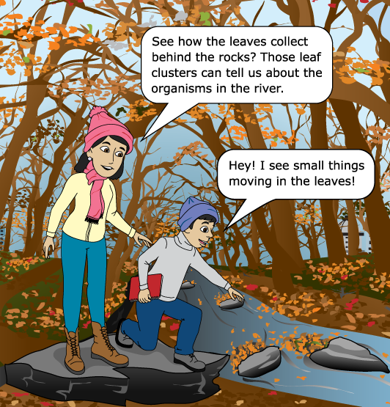
Science Storyline and Story Scenes
Each task begins with a story scene that describes a science or engineering phenomenon.
There are additional story scenes throughout the task that make up the storyline.
Each question is related to the storyline, but questions can be answered without the story scenes.

Slide 11
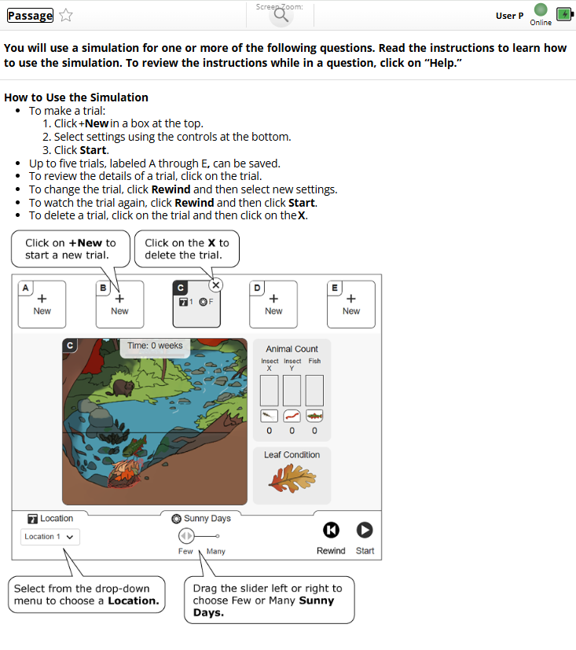
Simulation Support
Appears before first simulation item and as the “Help” tab with each simulation-based item
Provides students with directions for the specific simulation

Slide 12
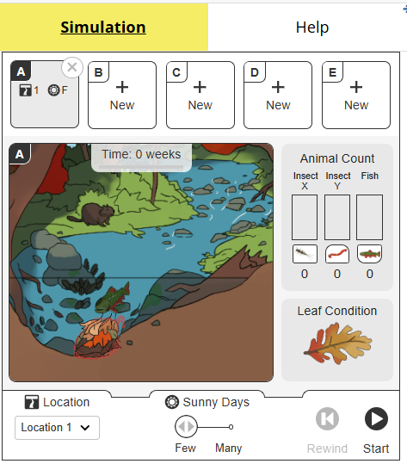
Simulation
Students interact
  with one simulation in a task
  with the simulation only in an associated test item
Most simulations will have:
  Inputs
  Outputs
  Saved models/trials

Slide 13
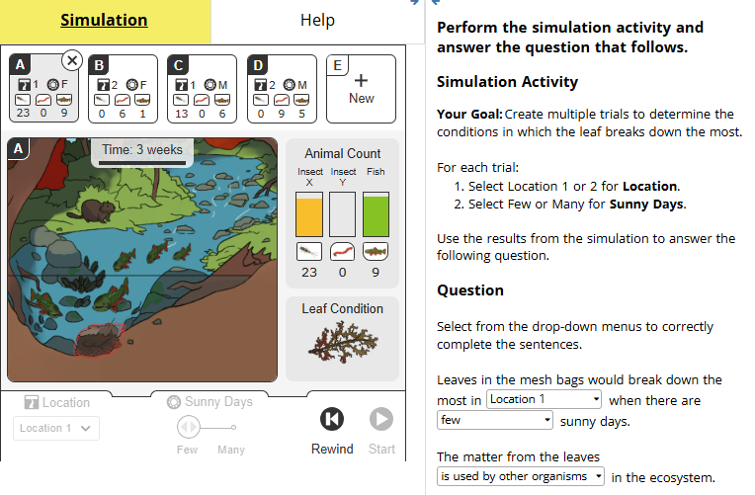
Simulation-based Item Example
Simulation appears on the left side of the screen
“Simulation Activity” with a goal and the simulation directions appear on the right side of the screen
Question appears under the Simulation Activity

Slide 14
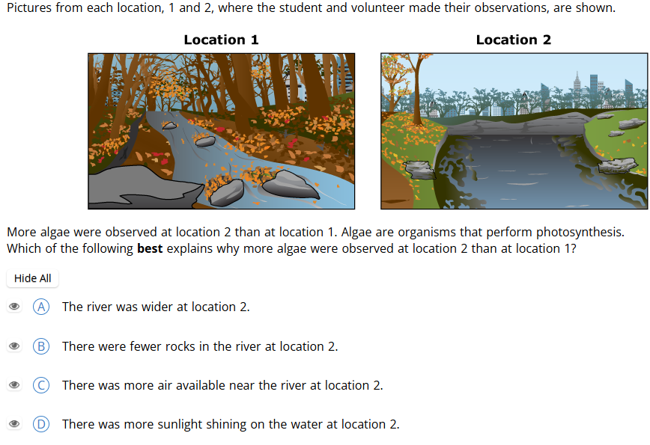
Example of Item without Simulation
Most items in a task will not include a simulation.
These items do not require any information from the simulation.

Slide 15
3. Revised Test Design

Slide 16
2027 Test Design: What Remains the Same
Two test sessions
Approximate total points on test
  2019-2026 Test: 54 pts. total
  2027 Test: 55 pts. total
Item types
  Selected response (SR)
    Multiple choice
    Multiple select
    Technology-enhanced (inline choice, drag and drop, etc.)
  Constructed response (CR)

Slide 17
2027 Test Items: What Remains the Same
2016 STE Framework
  All items continue to be aligned to the standards
Reporting Categories
  Earth and space science; life science; physical science; technology/engineering
Science Practices
  Investigations and questioning; mathematics and data; evidence, reasoning, and modeling
Cognitive Skill Levels
  Understanding; applying; analyzing and evaluating
Achievement Level Descriptors
  Exceeding; meeting; partial meeting; not meeting expectations

Slide 18
2027 Test Design: Points by Task
Each test will have two sessions, each with 3 tasks
Each individual task is worth a total of 11 points.
  6 1-pt selected-response test questions
  1 2-pt selected-response test question
  1 3-pt constructed-response test question
The test consists of
  5 common (operational) tasks which will count toward a student’s score (55 pts. total)
  1 field test task that will not count toward a student’s score

Slide 19
4. Resources and Updates

Slide 20
Practice Test Updates
Practice tests for grades 5 and 8 STE are available on the MCAS Resource Center
Computer-based test (CBT) versions (available now)
Paper-based test (PBT) versions (coming soon)
English-Spanish CBT and PBT versions (coming soon)

Slide 21
MCAS STE Resources
Grades 5 and 8 STE Transition webpage
test design
frequently asked questions (FAQs)
Instructional Guidelines
Local-Level Classroom STE Performance Assessment Tasks
Student Assessment Updates

Slide 22
5. Questions and Answers

Slide 23
Q & A
We will answer some questions now.
If we do not answer your question, please either email mcas@mass.gov or check the STE Transition webpage.

Slide 24
THANK YOU
The Office of Student Assessment Services
https://www.doe.mass.edu/mcas/tdd/sci.html
mcas@mass.gov
135 Santilli Highway, Everett, MA 02149
781-338-3625

