Slide 1
Overview of MCAS Administration Tasks for School and District Test Coordinators
The Office of Student Assessment Services
September 30, 2026

Slide 2
Presenters
Jodie Zalk, Manager of Test Administration and Publications
Shannon Cullen, MCAS Test Administration Coordinator
Erma Brown, MCAS and ACCESS Test Administration Specialist
Sharon Mathieu, MCAS Test Administration Specialist
Robert Pelychaty, Manager of Inclusive Assessment
Kaelee Harper, eMetric Project Manager

Slide 3
Logistics for This Session
Use the Q&A feature to ask a question.
  We will answer some questions aloud at specified times during this training session, and we will email the Q&A afterwards.
  Use the thumbs-up icon to “upvote” someone else’s question.
  Email student-specific questions to mcas@mass.gov instead of asking here.
Closed captioning has been enabled for participants who need it.
This session is being interpreted into ASL. Our interpreting team will be onscreen with the presenters. ​
Please be advised that DESE does not authorize attendees to record or to use AI transcription tools during the meeting and DESE does not endorse any unauthorized transcripts created by third parties of its meetings.

Slide 4
Slides for This Session
Slides were emailed to participants before this session from MCASEvents@cognia.org.
Slides are now being posted in the chat.
    If you cannot access the slides in the chat, ask in the Q&A.
After the session, we will send the slides again to participants, and they will be posted in the MCAS Resource Center along with the recording.

Slide 5
Today’s Agenda
Updates for 2026–27
Overview of Computer-Based Testing
Tasks to Complete Now
Tasks to Complete at least Two Months before Testing
Tasks to Complete One to Two Months before Testing
Tasks to Complete after Student Registration
Tasks to Complete at least Two Weeks before Testing
Tasks to Complete Two Weeks before Testing
Tasks to Complete up to One Week before Testing
Resources and Next Steps

Slide 6
Poll Question 1
What is your role (Select all that apply.)
  District test coordinator
  School test coordinator
  Principal
  School counselor
  Technology staff
  Other district staff
  Other school staff

Slide 7
Poll Question 2
How many years have you coordinated MCAS test administration?
  0–This is my first year
  1 year
  2–3 years
  4–5 years
  6+ years

Slide 8
1. Updates for 2026–27

Slide 9


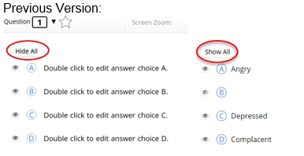
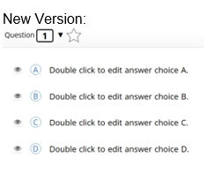
MCAS Student Kiosk Updates
The following updates are now available in the MCAS Student Kiosk:
Update | Screenshot
Students testing on battery-powered devices now have a battery status indicator at the top of the screen. Unavailable on iPadOS (the native battery indicator is visible in the system status bar).
The visibility of the online/offline status indicator has been updated to include a text label. “Online” or “Offline” now appear below the indicator.
The “Show All” and “Hide All” buttons have been removed from the answer masking feature on multiple-choice questions. Individual answer masking remains available, allowing students to reveal or hide individual answer choices as needed.

Slide 10
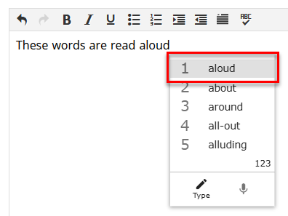
MCAS Student Kiosk Updates (continued)
The following updates are now available in the MCAS Student Kiosk:
Update | Screenshot
Students who have both the Word Prediction and Text-to-Speech (TTS) accommodations can now hear predicted words read aloud as they select them.
Tooltips now appear when hovering over on-screen tools on iPads with trackpads.

Slide 11
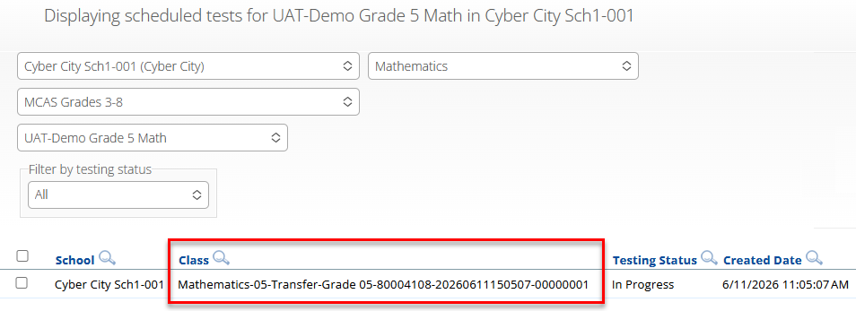

MCAS Portal Updates
The following updates are now available in the MCAS Portal:
Update | Screenshot
When using the Enrollment Transfer feature to transfer a student to a new organization, their test sessions will now automatically transfer with them. The new organization will see any In Progress and Completed test sessions from the prior school. The student will be automatically placed in a Transfer class; this class name will be used on the Classes page and Test Scheduling page, and in Test Status Exports.
School and district test coordinators are now able to change a student’s test status to Finished. Schools may want to use this feature if a student exits the kiosk instead of turning in the test when they have completed testing.

Slide 12
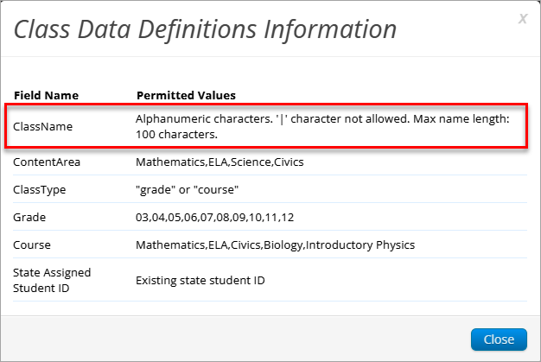
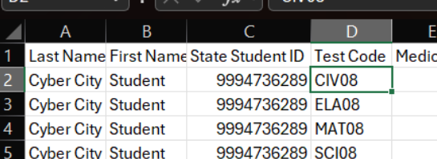
MCAS Portal Updates (continued)
The following additional updates are now available in the MCAS Portal:
Update | Screenshot
The class upload feature now has an increased maximum character limit of 100 characters for class names.
Portal users can now view the assigned test code in the accommodations export file available on the Students page of the MCAS Portal.

Slide 13
Upcoming MCAS Portal Updates
The following updates are expected to be implemented prior to the November high school tests:
Update
Students assigned the Spanish/English edition in Student Registration will automatically receive the Spanish/English edition when the test is scheduled. Schools do not need to schedule the Spanish/English edition separately on the Test Scheduling page. Note that when signing in to the test, students will still need to select Spanish or English from the Localization menu to choose the language for the MCAS Student Kiosk icons and directions.

Slide 14
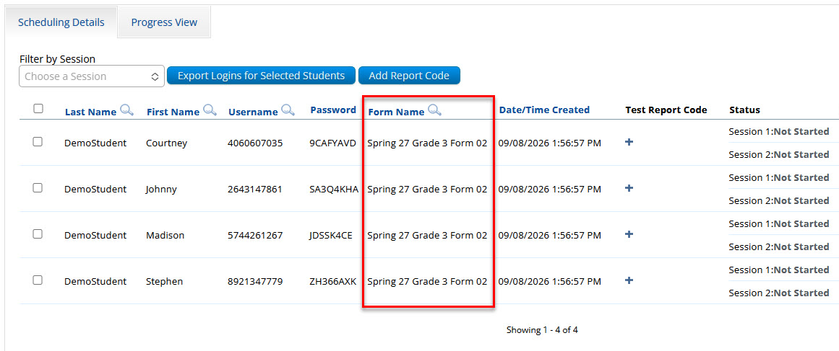
Upcoming MCAS Portal Updates (continued 1)
The following updates are expected to be implemented prior to the November high school tests:
Update | Screenshot
The Human Read-Aloud accommodation will no longer have a dedicated form displayed in the MCAS Portal. Students in the same class who have the Human Read-Aloud accommodation will receive the same test form number.

Slide 15
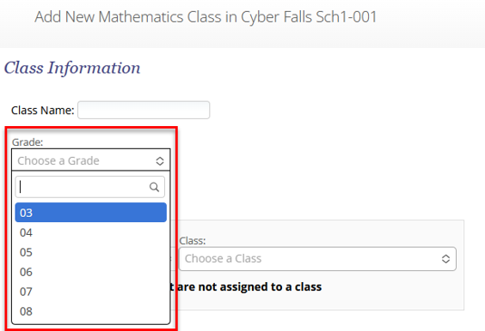
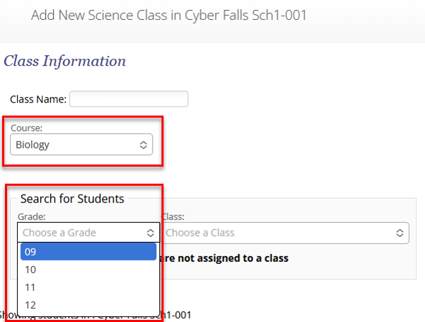
Upcoming MCAS Portal Updates (continued 2)
The following updates are expected to be implemented prior to the November high school tests:
Update | Screenshot
When creating classes, grade-level classes are limited to grades 3–8 and cannot be created for high school students. Course-level classes are limited to high school grade levels and courses, so they cannot be created for students in grades 3–8. When filtering for students, only those students in grades associated with the course will be allowed to be selected.

Slide 16
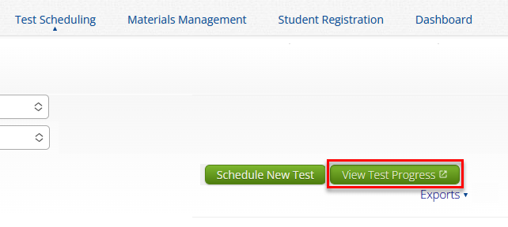
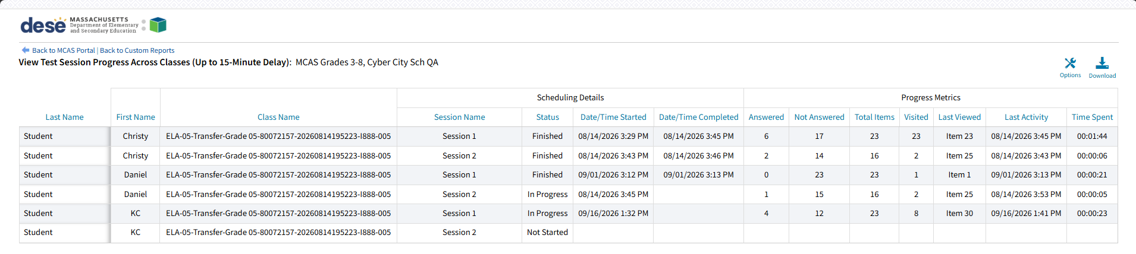
Upcoming MCAS Portal Updates (continued 3)
The following updates are expected to be implemented prior to the November high school tests:
Update | Screenshot
Test coordinators can view a report showing student test progress data across classes when they select View Test Progress on the Test Scheduling page.

Slide 17
Future Updates for the Student Kiosk and MCAS Portal
The following updates are under consideration for the future:
  Maintain highlighting and notepad after abrupt closure, pause, or log out of the MCAS Student Kiosk.
  Combining classes for make up testing
  Expanded test statuses to show the reason why the student exited the test (Paused, Timed Out, Exit)
  Test administrators can view students’ battery levels in the MCAS Portal.
  Preventing students from being scheduled for the same test more than once

Slide 18
2. Overview of Computer-Based Testing

Slide 19
MCAS Tests in the 2026–27 School Year
Fall/Winter High School Tests
Spring 2027 Tests
November
  ELA and Mathematics tests for students attempting to qualify for the Adams Scholarship, the Koplik Certificate of Mastery Award, and/or the Seal of Biliteracy
February
  Biology and Introductory Physics
Grades 3–8
  ELA – all grades
  Mathematics – all grades
  STE – grades 5 and 8
  Civics – grade 8
High School
  ELA – grade 10
  Mathematics – grade 10
  Biology and Introductory Physics
Participation guidelines for the high school tests

Slide 20
Commonly Used Acronyms
CBT: Computer-based testing
PBT: Paper-based testing
EL: English learner
ELA: English Language Arts
STE: Science and Technology/Engineering
SIMS: Student Information Management System
TA: Test administrator

Slide 21
Timeline for MCAS CBT
Pre-Administration Tasks
Fall 2026
(Ongoing) Read biweekly Student Assessment Updates.
At least 2 months before testing
View online modules and participate in training sessions.
Become familiar with CBT components.
Identify the school test administration team and establish a communication plan.
Update contact info with DESE.
Confirm your access to the MCAS Portal and update user accounts.
Technology Coordinator downloads and installs the updated MCAS Student Kiosk on student testing devices.
Begin planning for accessibility features and accommodations.

Slide 22
Timeline for MCAS CBT Pre-Administration Tasks (continued 1)
One to two months before testing
Complete Student Registration in the MCAS Portal.
After Student Registration, through testing window as needed.
Continue to update student information in the MCAS Portal.
Meet with the technology coordinator, who will review the technology guidelines and prepare the school’s technology.
Confirm that the technology coordinator has completed Site Readiness.
Submit and approve enrollment transfer requests as needed.
Administer student tutorial/practice tests.

Slide 23
Timeline for MCAS CBT
Pre-Administration Tasks (continued 2)
At least two weeks before testing
Prepare devices and materials.
Two weeks before testing
Create and assign students to classes in the MCAS Portal.
Up to one week before testing
Train test administrators in protocols and security requirements.
Verify assigned accommodations.
If necessary, create TA logins for Human Read-Aloud and Human Signer.
Track delivery of materials through Materials Management in the MCAS Portal.
Print student logins, summary sheets, and TA logins, if needed for Human Read-Aloud and Human Signer sessions.
Review instructions in the Principal’s Administration Manual.
Delivered to schools 2 weeks before spring ELA, and one week before each fall/winter administration
Available online beforehand
Verify form-dependent accommodations.
Refer to Part III of the Guide to the MCAS Portal: Student Registration, section E.
Schedule classes in the MCAS Portal.

Slide 24
Timeline for Technology Tasks in the MCAS Portal
Fall 2026
At least two months before testing
After updating the MCAS Student Kiosk
Become familiar with CBT components.
Review the MCAS Student Kiosk Technology Guide.
Prepare the school’s technology.
Review cybersecurity guidance and establish a cybersecurity plan for your school.
Determine whether your school will participate in “Bring Your Own Device” (BYOD) for MCAS Testing.
Verify access to the MCAS Portal and MCAS Training Site.
Update MCAS Student Kiosk to most recent version (released September 14, 2026).
Conduct Site Readiness and complete Site Certification.

Slide 25
Timeline for Technology Tasks in the MCAS Portal (continued)
At least two weeks before testing
One week before testing
During testing
If any technology changes have been made since completing Site Readiness, run it again.
Prepare devices and materials.
Familiarize yourself with common issues that may arise during testing and how to troubleshoot.
Be available to troubleshoot technology situations as they arise.

Slide 26
3. Tasks to Complete Now

Slide 27
Timeline for MCAS CBT
Pre-Administration Tasks: Fall 2026
Fall 2026
(Ongoing) Read biweekly Student Assessment Updates.
At least 2 months before testing
View online modules and participate in training sessions.
Become familiar with CBT components.
Identify the school test administration team and establish a communication plan.
Update contact info with DESE.
Confirm your access to the MCAS Portal and update user accounts.
Technology Coordinator downloads and installs the updated MCAS Student Kiosk on student testing devices.
Begin planning for accessibility features and accommodations.

Slide 28
1. Read Student Assessment Updates (ongoing)
Student Assessment Updates are biweekly emails with important updates about the MCAS program.
The following roles in School and District Profiles automatically receive these updates:
  Principals, MCAS test coordinators, special education directors, and EL program directors
If you do not already receive these updates, subscribe using this link: http://eepurl.com/ghSOhH

Slide 29
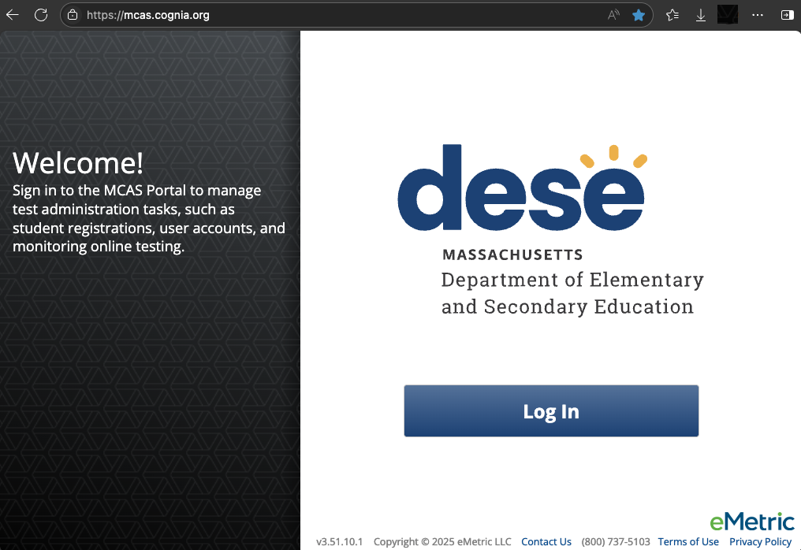
2. Become familiar with CBT components
MCAS Portal
  Online test management system for principals, test coordinators, technology coordinators, and test administrators
    https://mcas.cognia.org/
MCAS Training Site
  Site where test coordinators, principals, technology coordinators, and test administrators can practice the tasks required in the MCAS Portal
    https://mcas-training.cognia.org/

Slide 30
2. Become familiar with CBT components (continued)
MCAS Student Kiosk
  Online testing platform used by students to take the computer-based MCAS assessments
    mcas.onlinehelp.cognia.org/
    technology-setup
Site Readiness
  Task completed by technology coordinators to verify that student devices are ready for testing.

Slide 31
Demonstration
MCAS Portal and MCAS Training Site

Slide 32
MCAS Resource Center
Can be accessed at mcas.onlinehelp.cognia.org
This website provides access to test administration information, training, practice tests, and other resources to help schools and districts prepare for and administer the MCAS tests.
Contains links to download the MCAS Student Kiosk to student devices.

Slide 33
MCAS Resource Center (continued)
* Link to live chat at the bottom of each page

Slide 34
DESE Security Portal
Access Edwin and DropBox Central through the DESE Security Portal
Log in to the Security Portal at https://gateway.edu.state.ma.us/

Slide 35
3. Identify the test administration team and establish a communication plan
Identify staff members who can help with planning and management of CBT:
  Test coordination
  Accessibility features for all students
  Accommodations for students with disabilities and English learners
  Technology set-up
Determine local responsibilities:
  Who will schedule and manage test sessions?
  Who will configure devices for testing?
  How will information be shared across the team?

Slide 36
3. Identify the test administration team and establish a communication plan. (continued)
Principals, MCAS test coordinators, special education directors, and EL program directors automatically receive the Student Assessment Update.
Establish a plan for sharing applicable information from the Student Assessment Update with others as needed.
  How will information be shared across the test administration team?
  Encourage test coordinators and technology coordinators to subscribe.
  Communicate information with educators, IEP teams, guidance counselors, and school-based tech staff as needed.
Consider which resources from the DESE website and MCAS Resource Center would be helpful for technology staff as well as test administrators, and share accordingly.

Slide 37
4. Update contact information with DESE
DESE uses contact information in School and District Profiles to email the Student Assessment Update and other time-sensitive information.
Review contact information on the School and District Profiles page for:
  MCAS Test Coordinator (district- and school-level; can assign to multiple individuals)
  Educational Technology Director (district-level only)
  Principals
Public school districts, public schools, charter schools, collaboratives, approved special education schools, & alternative education programs | Test sites, adult education programs, out-of-state schools, SEIS-DYS programs
Submit updates to your District-Level Directory Administrator. | Email your updates to ESEDirectoryAdministrator@mass.gov. Be sure to include your 8-digit school code and school name.

Slide 38
5. Confirm your access to the MCAS Portal, and update user accounts.
MCAS Portal: the test administration and management website for district test coordinators, technology coordinators, principals/school test coordinators, test administrators, and other staff as needed
MCAS Training Site: where test coordinators, principals, technology coordinators, and test administrators can practice the tasks required in the MCAS Portal
Accounts for each site are created separately.
Passwords for each site are set separately, but DESE recommends using the same password for both the MCAS Portal and the MCAS Training Site.

Slide 39
5. Confirm your access to the MCAS Portal, and update user accounts. (continued 1)
Principals and school test coordinators should log in to the MCAS Portal to confirm access to the appropriate school(s). District test coordinators should log in to confirm access to the appropriate district(s).
If you are not able to access your MCAS Portal or MCAS Training Site account, are not able to access your school or district, or are new and need an account, users may request support as follows:
Role | Who to contact for support
Test administrators and school-level technology coordinators | Their principal or school test coordinator
Principals, school test coordinators, and district-level technology coordinators | Their district test coordinator
District test coordinators | MCAS Service Center

Slide 40
5. Confirm your access to the MCAS Portal, and update user accounts. (continued 2)
Different roles provide different levels of access in the MCAS Portal. Five roles are available:​
  District test coordinator​
  School test coordinator​
  Technology coordinator​
  Test administrator​
  Reports Access Only
Review Part II of the Guide to the MCAS Portal: MCAS Portal User Management for information on permissions available to each role.​
Schools/districts should be sure to deactivate accounts for any users who will not be participating in MCAS testing in 2026–27.

Slide 41
6. Begin planning for accessibility features (for all students) and accommodations for students with disabilities and English learners.
Review selected accessibility features for all students and accommodations for students with disabilities and ELs.
Include selected features and accommodations in Student Registration.
  Before testing: required for student to receive correct features or test forms
  After testing: to update features or accommodations used during testing
Resources:
  Accessibility and Accommodations Manual (to be available soon)
  Part III of the Guide to the MCAS Portal: Student Registration
  Register for the accessibility and accommodations training session
  Approved graphic organizers and supplemental Math and STE reference sheets

Slide 42
Resources: Tasks to Complete in Fall 2026
Task | Resources
(Ongoing) Read biweekly Student Assessment Updates. | https://www.doe.mass.edu/mcas/updates.html
Become familiar with CBT components. | Pre-Administration Guide Guide to the MCAS Portal (updated guide to be posted this fall)
Identify the school test administration team and establish a communication plan. | Pre-Administration Guide

Slide 43
Resources: Tasks to Complete in Fall 2026 (continued)
Task | Resources
Update contact info with DESE. | Pre-Administration Guide
Confirm your access to the MCAS Portal and update user accounts. | Part II of the Guide to the MCAS Portal: MCAS Portal User Management Modules: Creating and Editing MCAS Portal User Accounts Uploading & Exporting MCAS Portal User Accounts
Begin planning for accessibility features (for all students) and accommodations for students with disabilities and English learners. | Accessibility and Accommodations Manual (updated manual to be posted this fall)

Slide 44
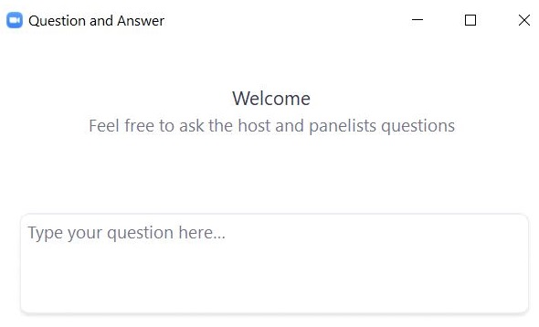
Questions & Answers 1
Use the “Q&A” feature
to ask questions.

Slide 45
4. Tasks to Complete at least Two Months before Testing

Slide 46
Timeline for MCAS CBT Pre-Administration Tasks: At least 2 months before testing
Fall 2026
(Ongoing) Read biweekly Student Assessment Updates.
At least 2 months before testing
View online modules and participate in training sessions.
Become familiar with CBT components.
Identify the school test administration team and establish a communication plan.
Update contact info with DESE.
Confirm your access to the MCAS Portal and update user accounts.
Technology Coordinator downloads and installs the updated MCAS Student Kiosk on student testing devices.
Begin planning for accessibility features and accommodations.

Slide 47
7. View online training modules and attend training sessions.
Visit the Training page on the MCAS Resource Center for modules as well as recordings/slides from previous live training sessions.
Modules
  Creating & Editing MCAS Portal User Accounts
  Uploading & Exporting MCAS Portal User Accounts
Previously recorded webinars
  Overview of Student Registration Tasks in the Portal: Spring 2026
  Tasks in the MCAS Portal Before Testing

Slide 48
Register for upcoming training sessions at www.doe.mass.edu/mcas/training.html

Slide 49
8. Technology coordinator downloads and installs the updated MCAS Student Kiosk on student testing devices.
Ensure that student devices have been updated with the most recent MCAS Student Kiosk.
It is recommended to download and install the updated MCAS Student Kiosk as soon as it is available in the fall.
Step-by-step instructions are available in the MCAS Student Kiosk Technology Guide.

Slide 50
8. Technology coordinator downloads and installs the updated MCAS Student Kiosk on student testing devices. (continued)
New for Windows OS: iTester Windows app option for test delivery. The app will be available through the Microsoft Store and includes automatic updates, helping ensure devices stay current with minimal administrative effort. This app will follow a single-application model similar to our iPadOS experience where a location is selected upon first launch.
  Step-by-step instructions available in the MCAS Student Kiosk Technology Guide.
  The legacy Windows kiosk will still be available.
Additional updates are described in the MCAS Student Kiosk Technology Guide.

Slide 51
Resources: Tasks to complete at least two months before testing
Task | Resources
View online modules and participate in training sessions. | View modules and previously recorded webinars Register for upcoming trainings
Technology Coordinator downloads and installs the updated MCAS Student Kiosk on student testing devices. | MCAS Student Kiosk Technology Guide

Slide 52
5. Tasks to Complete One to Two Months before Testing

Slide 53
Timeline for MCAS CBT Pre-Administration Tasks: One to two months before testing
One to two months before testing
Complete Student Registration in the MCAS Portal.
After Student Registration, through testing window as needed.
Continue to update student information in the MCAS Portal.
Meet with the technology coordinator, who will review the technology guidelines and prepare the school’s technology.
Confirm that the technology coordinator has completed Site Readiness.
Submit and approve enrollment transfer requests as needed.
Administer student tutorial/practice tests.

Slide 54
9. Complete Student Registration
Student Registration registers students for testing and places an initial order for PBT and for manuals.
Student Registration windows for each administration are listed in the Statewide Testing Schedule.
Windows are also typically announced in the Student Assessment Update.
Administration | Student Registration Window
November HS ELA and Math | September 21–October 2
February HS Science | December 7–18
Spring Grades 3–8 | January 25–February 5
Spring Grade 10 | February 1–12
Spring HS Science | April 9–27

Slide 55
Poll Question 3
Which two sites will you use to complete Student Registration?
  The MCAS Portal and the MCAS Training Site
  The MCAS Training Site and the MCAS Student Kiosk
  The DESE Security Portal and the MCAS Portal
  The DESE Security Portal and the MCAS Student Kiosk

Slide 56
9. Complete Student Registration (continued)
Steps for completing Student Registration include:
  Receiving the .CSV file from DESE in the DropBox in the DESE Security Portal
  Updating the .CSV file
  Importing the .CSV file into the MCAS Portal
Step-by-step instructions are available in Part III of the Guide to the MCAS Portal: Student Registration.
Additional resources are available
  Student Registration Data Definitions
  Student Registration Template
  Overview of Student Registration Tasks in the Portal: Spring 2026 – January 15, 2026
DESE will hold a training demonstrating the Student Registration process in January 2027.

Slide 57
10. Meet with the technology coordinator, review technology specifications, and prepare the school’s infrastructure.
11. Confirm that Site Readiness is complete.
Meet with the technology coordinator.
Review specifications and resources:
  MCAS Student Kiosk Technology Guide
  Note recent updates to the MCAS Portal and MCAS Student Kiosk
Confirm that the technology coordinator has completed Site Readiness on each device configuration in order to confirm that devices are ready for testing.
  It is recommended to complete Site Readiness directly after the updated MCAS Student Kiosk is downloaded in the fall, and again prior to testing.
  School and district test coordinators may view whether Site Readiness has been certified in the MCAS Portal. Refer to the MCAS Student Kiosk Technology Guide for instructions.

Slide 58
12. Administer the student tutorial and practice tests.
Ensure the curriculum incorporates digital learning; review the DLCS Curriculum Framework
Student Tutorial
  Demonstration of the navigation, tools, and features for CBT
  Students complete it independently (no audio).
Practice tests
  Simulation of the tools and features for CBT
  Include accessibility features and special editions:
    For example, students can gain familiarity with the text-to-speech and other accommodations that are available.

Slide 59
12. Administer the student tutorial and practice tests. (continued)
Updates to the practice tests:
  New practice tests for grades 3–8 ELA based on the new test design
  Grades 5 and 8 STE practice tests feature the tasks with simulations
Updates to the Student Tutorial:
  Clearer information about how to change your answer on a multiple-select question
  Clear presentation of the different types of equation editors used in Math and STE and how to use them
  More detail about how long highlighting and notes remain visible to students
  Updated screenshots of the speech-to-text and word prediction tools
  Updated sample ELA passage to show scrolling, gloss notes, and text highlight questions
  Updated image for graphing tool

Slide 60
Resources: Tasks to complete 1 to 2 months before testing
Task | Resources
Complete Student Registration in the MCAS Portal. | Part III of the Guide to the MCAS Portal: Student Registration Student Registration Data Definitions Student Registration Template Module: Student Registration for MCAS
Meet with the technology coordinator, who will review the technology guidelines and prepare the school’s technology. | MCAS Student Kiosk Technology Guide
Confirm that the technology coordinator has completed Site Readiness. | MCAS Student Kiosk Technology Guide Module: Certifying Site Readiness

Slide 61
6. Tasks to Complete after Student Registration, through the Testing Window as Needed

Slide 62
Timeline for MCAS CBT Pre-Administration Tasks: After Student Registration, through testing window as needed
One to two months before testing
Complete Student Registration in the MCAS Portal.
After Student Registration, through testing window as needed.
Continue to update student information in the MCAS Portal.
Meet with the technology coordinator, who will review the technology guidelines and prepare the school’s technology.
Confirm that the technology coordinator has completed Site Readiness.
Submit and approve enrollment transfer requests as needed.
Administer student tutorial/practice tests.

Slide 63
Poll Question 4
How should you update student information in the MCAS Portal if you need to add a new student or edit student information?
  Add or edit the student on the Students page in the MCAS Portal
  Add or edit the student in the MCAS Student Kiosk
  Add or edit the student using an updated Student Registration file
  A or C

Slide 64
13. Continue to update student information in the MCAS Portal as needed.
Schools should continue to update student information in the MCAS Portal, including:
  Adding new students
  Editing demographic information
  Adding or updating accommodations
There are two options for updating student information:
Refer to Part III of the Guide to the MCAS Portal: Student Registration for step-by-step instructions.
Options for updating student information | When would you use this option?
Option 1: Student Registration file export and import | When updating a large number of student records
Option 2: Manually add/edit students in the MCAS Portal user interface | When updating approximately 10 or fewer student records

Slide 65
14. Complete Enrollment Transfers as needed.
An enrollment transfer request is needed when a student transfers from one district to another, and the student has already been added to the MCAS Portal.
District test coordinators are able to update student enrollment in the MCAS Portal for students who transfer schools within the same district. An enrollment transfer request is not needed.
Refer to Part IV of the Guide to the MCAS Portal: Enrollment Transfers for step-by-step instructions.
New for 2026–27: When using the Enrollment Transfer feature to transfer a student to a new organization, their test sessions will now automatically transfer with them.

Slide 66
Resources: Tasks to complete after Student Registration
Task | Resources
Continue to update student information in the MCAS Portal. | Part III of the Guide to the MCAS Portal: Student Registration Module: (updated module to be posted this fall) Manually Adding a Student and Assigning Accommodations
Submit and approve enrollment transfer requests as needed. | Part IV of the Guide to the MCAS Portal: Enrollment Transfers

Slide 67
Questions & Answers 2
Use the “Q&A” feature
to ask questions.

Slide 68
7. Tasks to Complete at least Two Weeks before Testing

Slide 69
Timeline for MCAS CBT Pre-Administration Tasks: At least two weeks before testing
At least two weeks before testing
Prepare devices and materials.
Two weeks before testing
Create and assign students to classes in the MCAS Portal.
Up to one week before testing
Train test administrators in protocols and security requirements.
Verify assigned accommodations.
If necessary, create TA logins for Human Read-Aloud and Human Signer.
Track delivery of materials through Materials Management in the MCAS Portal.
Print student logins, summary sheets, and TA logins, if needed for Human Read-Aloud and Human Signer sessions.
Review instructions in the Principal’s Administration Manual.
Delivered to schools 2 weeks before spring ELA, and one week before each fall/winter administration
Available online beforehand
Verify form-dependent accommodations.
Refer to Part III of the Guide to the MCAS Portal: Student Registration, section E.
Schedule classes in the MCAS Portal.

Slide 70
15. Prepare devices and materials.
Plan to have enough devices for test administrators and for students.
Ensure all devices will be charged prior to each test session.
Have materials available (and check to see if they are in working order):
  Power cords, power strips, extra batteries, extra computers
  If using tablets: external keyboards
  If students are using text-to-speech: headphones
Schools may request to participate in BYOD (“bring your own device”) program by emailing mcas@mass.gov. More information will be provided in future Student Assessment Updates.

Slide 71
8. Tasks to Complete Two Weeks before Testing

Slide 72
Timeline for MCAS CBT Pre-Administration Tasks: Two weeks before testing
At least two weeks before testing
Prepare devices and materials.
Two weeks before testing
Create and assign students to classes in the MCAS Portal.
Up to one week before testing
Train test administrators in protocols and security requirements.
Verify assigned accommodations.
If necessary, create TA logins for Human Read-Aloud and Human Signer.
Track delivery of materials through Materials Management in the MCAS Portal.
Print student logins, summary sheets, and TA logins, if needed for Human Read-Aloud and Human Signer sessions.
Review instructions in the Principal’s Administration Manual.
Delivered to schools 2 weeks before spring ELA, and one week before each fall/winter administration
Available online beforehand
Verify form-dependent accommodations.
Refer to Part III of the Guide to the MCAS Portal: Student Registration, section E.
Schedule classes in the MCAS Portal.

Slide 73
16. Create and assign students to classes in the MCAS Portal.
A class is a group of students in the MCAS Portal who will take the same test together.
  Up to 250 students allowed in a class in the MCAS Portal.
Certain accommodations require that students are placed in a class only with other students that have the same accommodation (Human Read-Aloud, Human Signer).
Classes can be created using a Student Registration import/export, creating a Class Upload file, or manually one at a time through the MCAS Portal user interface.
Instructions available in the Part V of the Guide to the MCAS Portal: Creating and Managing Classes (updated guide expected to be available later this fall).
New for 2026–27: Class names can be up to 100 characters.

Slide 74
17. Verify assigned accommodations.
Test coordinators should review accommodations approximately two weeks prior to testing to ensure that they have been assigned correctly.
Prior to scheduling tests, accommodations can be verified:
  On the Edit Student page in the MCAS Portal.
  Through a Student Registration export.
  Through the Accommodations export on the Students page.
After scheduling tests, accommodations can be verified in additional ways. Refer to slides 81–82 for more information.
It is very important that accommodations are assigned accurately before students sign in to the test.

Slide 75
18. If necessary, create test administrator logins for Human Read-Aloud and Human Signer sessions.
For the human read-aloud and human signer accommodations for computer-based testing, schools may choose to have test administrators read the test over the student’s shoulder or create test administrator (TA) logins so that test administrators can sign in to their own test on their own device to read aloud.
There are two options for creating a TA login in the MCAS Portal.
  Option 1: Manually add a TA as a student to the MCAS Portal on the Students page using the field definitions outlined on the next slide.
  Option 2: Add the TA login as a student during the Student Registration file upload.
Note that TA logins should be created for each test, and must be voided by the test coordinator after testing.
Step-by-step instructions for creating TA logins are in the Accessibility and Accommodations Manual.

Slide 76
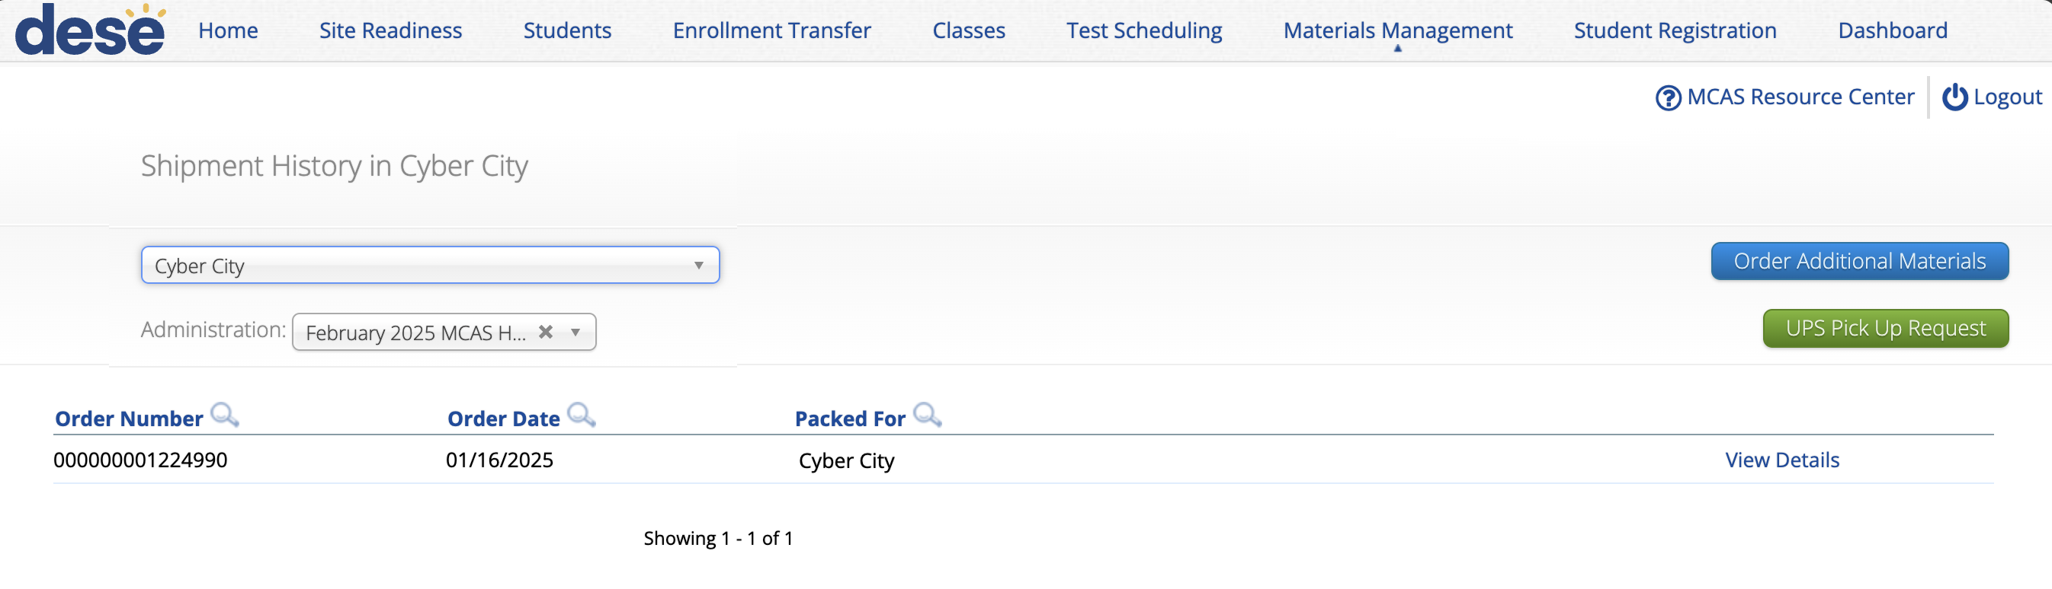
19. Track delivery of materials through Materials Management.
The Materials Management page in the MCAS Portal provides a view of shipments of materials being delivered to schools. Schools will be able to see materials shipments listed on this page once they are shipped.
This is an optional feature that schools may find useful to track shipments.
Additional information is in the Part VII of the Guide to the MCAS Portal: Materials Management (updated guide expected to be available later this fall).

Slide 77
Resources: Tasks to complete two weeks before testing
Task | Resources
Create and assign students to classes in the MCAS Portal. | Part V of the Guide to the MCAS Portal: Creating and Managing Classes (updated guide to be posted this fall) Module: (updated module to be posted this fall) Creating Classes for MCAS
If necessary, create TA logins for Human Read-Aloud and Human Signer. | Accessibility and Accommodations Manual (updated manual to be posted this fall)
Track delivery of materials through Materials Management in the MCAS Portal. | Part VII of the Guide to the MCAS Portal: Materials Management (updated guide to be posted this fall)

Slide 78
9. Tasks to Complete up to One Week before Testing

Slide 79
Timeline for MCAS CBT Pre-Administration Tasks: Up to one week before testing
At least two weeks before testing
Prepare devices and materials.
Two weeks before testing
Create and assign students to classes in the MCAS Portal.
Up to one week before testing
Train test administrators in protocols and security requirements.
Verify assigned accommodations.
If necessary, create TA logins for Human Read-Aloud and Human Signer.
Track delivery of materials through Materials Management in the MCAS Portal.
Print student logins, summary sheets, and TA logins, if needed for Human Read-Aloud and Human Signer sessions.
Review instructions in the Principal’s Administration Manual.
Delivered to schools 2 weeks before spring ELA, and one week before each fall/winter administration
Available online beforehand
Verify form-dependent accommodations.
Refer to Part III of the Guide to the MCAS Portal: Student Registration, section E.
Schedule classes in the MCAS Portal.

Slide 80
20. Train test administrators in protocols and security requirements.
A sample slide deck for training test administrators is posted to each administration’s Resources webpage prior to the testing window.
Refer to additional instructions in the Principal’s Administration Manual.

Slide 81
21. Schedule classes to take tests in the MCAS Portal.
Schools will need to “schedule” classes for tests to assign test forms and create student logins.
  Student logins cannot be printed until after tests are scheduled.
Test coordinators will need to schedule tests approximately one week prior to test administration.
  Scheduling tests is not available in the MCAS Portal until one week prior to test administration.
The Statewide Testing Schedule lists the dates that test scheduling should be completed for each administration.
Instructions available in Part VI of the Guide to the MCAS Portal: Scheduling Tests, Printing Student Logins, and Other Tasks on the Test Scheduling Page (updated guide to be posted this fall).

Slide 82
22. Print student logins, summary sheets, and test administrator logins, if necessary.
Student logins contain the sign-in information that students need to type in to begin each test session.
  Students use the same student login for each subject area test (e.g., Jon Ward has one login for grade 4 ELA sessions 1 and 2, and a different login for grade 4 Mathematics).
Schools may print student logins up to one week in advance; DESE recommends printing student logins one to two days in advance of testing.
  Student logins are considered secure and must be tracked.
Note: Test coordinators may also need to print test administrator logins for test administrators administering the Human Read-Aloud and Human Signer accommodations.
  Refer to Appendix H of the Accessibility and Accommodations Manual.
Instructions available in the Part VI of the Guide to the MCAS Portal: Scheduling Tests, Printing Student Logins, and Other Tasks on the Test Scheduling Page (updated guide to be posted this fall).

Slide 83
Poll Question 5
What will happen if form-dependent accommodations are not assigned correctly before testing?
  The student will not be able to complete testing.
  The MCAS Student Kiosk will shut down.
  The student will receive the wrong grade-level test.
  The student test will need to be stopped, a new test set up, and the student may need to retake a portion of the test.

Slide 84
23. Verify form-dependent accommodations.
The following accommodations are particularly important to verify prior to testing because they cannot be changed in the MCAS Portal after a student has signed in to a computer-based test. If a student begins testing and one of these accommodations has been assigned incorrectly, it may result in voiding the student’s test.
After classes have been scheduled, verify that students have been assigned the correct form for the following form-dependent accommodations:
  Spanish/English
  Human Read-Aloud (spring only)
  Human Signer
To verify these forms have been assigned correctly, navigate to:
Administration > Test Scheduling > find the scheduled class > View Details/Student Logins.
The Form Name column indicates which form a student has been assigned.
After classes have been scheduled, all accommodations can also be verified on the student summary page that is printed with student logins.
ASL
Screen Reader
Compatible Assistive Technology

Slide 85
23. Verify form-dependent accommodations. (continued)
Human Read-Aloud Class
(Check that all students have the same form number for spring only):
Mathematics Class:

Slide 86
Resources: Tasks to complete one week before testing
Task | Resources
Train test administrators in protocols and security requirements. | Principal’s Administration Manual and Test Administrator’s Manual (not yet available)
Schedule classes in the MCAS Portal. | Part VI of the Guide to the MCAS Portal: Scheduling Tests, Printing Student Logins, and Other Tasks on the Test Scheduling Page (updated guide to be posted this fall) Module: Scheduling Tests for MCAS (updated module to be posted this winter)
Print student logins, summary sheets, and TA logins, if needed for Human Read-Aloud and Human Signer sessions. | Part VI of the Guide to the MCAS Portal: Scheduling Tests, Printing Student Logins, and Other Tasks on the Test Scheduling Page (updated guide to be posted this fall) Module: Exporting and Printing Student Logins
Verify form-dependent accommodations. | Principal’s Administration Manual and Test Administrator’s Manual (not yet available)

Slide 87
Questions & Answers 3
Use the “Q&A” feature
to ask questions.

Slide 88
10. Resources, Support, and Next Steps

Slide 89
Additional Resources
Resource | Location
MCAS Resource Center | mcas.onlinehelp.cognia.org
Guide to the MCAS Portal | https://mcas.onlinehelp.cognia.org/portal/
Technology Information MCAS Student Kiosk Technology Guide | https://mcas.onlinehelp.cognia.org/technology-setup/
Student Assessment Updates (Biweekly email with important updates about the MCAS program) | www.doe.mass.edu/mcas/updates.html If you do not already receive this email, subscribe using this link: http://eepurl.com/ghSOhH

Slide 90
Upcoming Training – Fall 2026
Training | Date
Overview of MCAS Administration Tasks for Technology Coordinators | Wednesday, October 7 at 9:30–11:00a.m.
Overview of Conducting a Practice Test through the MCAS Training Site | Wednesday, November 18 at 9:30–11:00a.m.
MCAS Accessibility and Accommodations | Tuesday, December 8 at 9:30–11:00a.m.

Slide 91
Upcoming Trainings – January 2027
Training | Date
Overview of Student Registration | Wednesday, January 20
Office Hours – Accessibility and Accommodations | Thursday, January 21
Administering the MCAS Braille Tests | Thursday, January 21, at 12:00 p.m.
MCAS Test Administration for New Staff | Tuesday, January 26
MCAS Security Protocols for New Staff | Wednesday, January 27
MCAS Test Administration and Security Protocols for Returning Staff | Thursday, January 28
Sessions will begin at 9:30 a.m. unless otherwise noted.

Slide 92
Upcoming Trainings – February and March 2027
Training | Date
Overview of MCAS Administration Tasks for Technology Coordinators | Monday, February 1
Office Hours for Spring 2027 MCAS Tests | Friday, February 5
Office Hours for Technology Coordinators | Tuesday, February 9
Overview of Spanish/English MCAS Tests | Thursday, February 11
Tasks in the MCAS Portal Before Testing | Tuesday, March 2
Tasks in the MCAS Portal During Testing | Tuesday, March 9
Tasks in the MCAS Portal After Testing | Tuesday, March 16
Office Hours for MCAS Portal Tasks | Thursday, March 18
Sessions will begin at 9:30 a.m. unless otherwise noted.

Slide 93
Next Steps
Today: Complete the evaluation form.
  Responses are associated with the name and email address used to log in.
  Email your input to mcas@mass.gov if you have problems accessing or completing the form.
Within one week:
  Receive an email with the Q&A from this session
  Recording will be available

Slide 94
Email and Phone Support
MCAS Service Center
DESE Student Assessment Services
Logistics and Technology Questions
  Web: https://mcas.onlinehelp.cognia.org/
  Email: mcas@cognia.org
  Phone: 800-737-5103
  TTY: 888-222-1671
  Live chat is available at the link on the bottom of the page at the MCAS Resource Center
Policy Questions
(e.g., student participation, accommodations)
  Web: www.doe.mass.edu/mcas
  Email: mcas@mass.gov
  Phone: 781-338-3625
  TTY: 800-439-2370

Slide 95
THANK YOU
The Office of Student Assessment Services
781-338-3625
mcas@mass.gov
www.doe.mass.edu/mcas
135 Santilli Highway, Everett, MA 02149

