Slide 1
Office Hours for November High School ELA and Math Tests
The Office of Student Assessment Services
September 23, 2026

Slide 2
Presenters
Jodie Zalk, Manager of Test Administration and Publications
Shannon Cullen, MCAS Test Administration Coordinator
Kaelee Harper, eMetric Project Manager

Slide 3
Logistics for This Session
Use the Q&A feature to ask a question.
  We will answer some questions aloud at specified times during this training session, and we will email the Q&A afterwards.
  Use the thumbs-up icon to “upvote” someone else’s question.
  Email student-specific questions to mcas@mass.gov instead of asking here.
Closed captioning has been enabled for participants who need it.
This session is being interpreted into ASL. Our interpreting team will be onscreen with the presenters.
Please be advised that DESE does not authorize attendees to record or to use AI transcription tools during the meeting and DESE does not endorse any unauthorized transcripts created by third parties of its meetings.

Slide 4
Slides for This Session
Slides were emailed to participants before this session from MCASEvents@cognia.org.
Slides are now being posted in the chat.
    If you cannot access the slides in the chat, ask in the Q&A.
After the session, we will send the slides again to participants, and they will be posted in the MCAS Resource Center along with the recording.

Slide 5
Today’s Agenda
General Information for the November 2026 High School MCAS Tests
Student Registration
Resources
Q&A and Demonstrations
Additional Resources and Next Steps

Slide 6
1. General Information for the November 2026 High School MCAS Tests

Slide 7
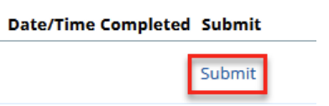
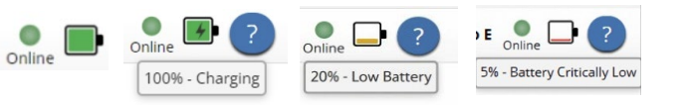
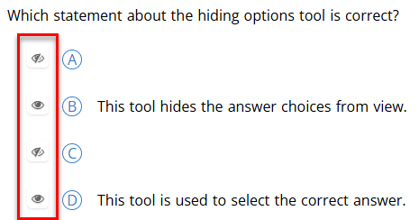
Fall 2026 Updates: MCAS Portal and Student Kiosk
MCAS Portal Updates
  When a student transfers between organizations in the MCAS Portal through the Enrollment Transfer feature, their test sessions will now automatically transfer with them to the new organization.
  School and district test coordinators will be able to move tests from “In Progress” to “Finished” status in the MCAS Portal, if the student does not correctly submit their test at the end of testing.
MCAS Student Kiosk Updates
  Students will now see battery level status in the top right of their screen.
  “Hide all” button no longer available.

Slide 8
Fall 2026 Updates: MCAS Portal and Student Kiosk (continued)
Updated MCAS Student Kiosk now available for download
Refer to the Updates to the MCAS Student Kiosk and MCAS Portal document for additional information.
More information will be shared during the upcoming Overview of MCAS Administration Tasks webinars.

Slide 9
Tasks to Complete Once Annually for MCAS Testing
Staff Responsible | Task | Timeframe
District and school test coordinators | Update and edit MCAS Portal and MCAS Training Site user accounts For detailed steps, refer to Part II of the Guide to the MCAS Portal: MCAS Portal User Management. | Recommended deadlines: September 2026: Deactivate accounts of all staff who will not be involved with MCAS testing in 2026–27. September 2026: Update/edit test coordinator, principal, and technology coordinator accounts At least three weeks prior to test administration: (to update/edit test administrator accounts)
Technology coordinators | Download and install the updated MCAS Student Kiosk on student testing devices. Conduct Site Readiness to ensure devices and network are configured for testing. For detailed steps, refer to the MCAS Student Kiosk Technology Guide. | Available: September 14 Recommended deadline: At least two months prior to testing

Slide 10
November High School Administration Deadlines – Before Testing
Tasks | Dates
Complete the pre-administration student registration process | September 21–October 2
Extended pre-administration student registration window for CBT | October 5–November 3
Create and assign students to “classes” in the MCAS Portal for CBT | Recommended deadline: October 21
Receive manuals and PBT materials (PBT materials are available as an accommodation.) | October 28 (PDFs expected to be posted to the DESE website by early to mid-October)
“Schedule” classes in the MCAS Portal for CBT | ELA: October 28–November 3 Math: November 3–9
If necessary, order additional manuals and PBT materials, and report packing discrepancies for PBT shipments | ELA: October 28–November 2 Math: October 28–November 6

Slide 11
November High School Administration Deadlines – Test Administration
Administration | Dates
ELA Testing Window ELA Session 1 ELA Session 2 | November 4–17 Recommended dates: November 4 November 5
Mathematics Testing Window Mathematics Session 1 Mathematics Session 2 | November 10–17 Recommended dates: November 10 November 12
Note: The MCAS Student Kiosk will not be available on Tuesday, November 11, in observance of Veterans Day.

Slide 12
November High School Administration Deadlines – After Testing
Tasks | Dates
Deadline to update student registration information, if necessary | November 17
Deadline to complete the PCPA (one PCPA for both subject areas) | November 17
(PBT only) Pre-scheduled UPS pickup | November 18
Refer to the Statewide Testing Schedule and the MCAS Pre-Administration Guide for additional information.

Slide 13
2. Student Registration

Slide 14
November Student Registration Deadlines
Initial Student Registration Window: September 21–October 2
  Important in order to receive manuals for CBT and PBT, and PBT materials and student labels
Extended pre-administration student registration window for CBT: October 5–November 3
  Schools will not receive an automatic shipment of PBT materials or manuals for students registered after October 2; schools will need to manually place an additional materials order through the MCAS Service Center website.

Slide 15
Confirm your access to the MCAS Portal and DESE Security Portal
Principals and school test coordinators will retrieve the .CSV file for November Student Registration from the MCAS 2026 data folder in the DESE Security Portal, and import it into the MCAS Portal by the Student Registration deadline.
If you are not able to access the DESE Security Portal, contact your District Directory Administrator.
If you are not able to access your MCAS Portal account, are not able to access your school or district, or are new and need an account, users may request support as follows:
Role | Who to contact for support
Test administrators and school-level technology coordinators | Their principal or school test coordinator
Principals, school test coordinators, and district-level technology coordinators | Their district test coordinator
District test coordinators | MCAS Service Center

Slide 16
November High School MCAS Student Registration Resources
MCAS Resource Center
  Guide to the MCAS Portal, Part III: Student Registration
  Student Registration Data Definitions
  Student Registration Template
November High School MCAS Participation Guidelines
Accessibility and Accommodations Manual (updated manual will be posted soon)
  Refer to Appendix A for a crosswalk of accessibility features and accommodations and their corresponding columns in the Student Registration file.

Slide 17
November High School MCAS Participation
DESE offers high school tests in ELA and Mathematics in November to students who are attempting to qualify for the John and Abigail Adams Scholarship, the Stanley Z. Koplik Certificate of Mastery Award, and/or the Seal of Biliteracy.
Students do not need to take November MCAS high school tests for any other reasons than those listed above. Students are not required to take the tests if they were absent during grade 10 testing in spring 2026 (medically documented or not) or if they are new to Massachusetts in grade 11 or 12 and have never taken MCAS tests.

Slide 18
November High School MCAS Participation FAQ
Q: Are grade 11 and 12 students required to participate in the November 2026 MCAS high school tests if they have not yet participated in ELA and/or Mathematics MCAS testing?
A: No. Students are not required to participate.
Students in grades 11 and 12 are eligible to participate if they would like to qualify for the Adams Scholarship, the Koplik Certificate of Mastery, and the Seal of Biliteracy (these are the only purposes for participation).

Slide 19
November High School MCAS Participation FAQ​
(continued 1)
Q: Can grade 11 and 12 students participate in the spring 2027 grade 10 ELA and Math tests instead of November high school MCAS tests?
A: Students in grade 11 or 12 who were reported as grade 9 students in the prior school year are required to participate in spring 2027 grade 10 ELA and Mathematics testing for accountability purposes. All other grades 11 and 12 students are not required to participate in spring 2027.
  Students in grade 11 are eligible to participate in the spring grade 10 ELA and Mathematics tests if they are attempting to qualify for scholarship purposes or the Seal of Biliteracy.
  Students in grade 12 are not eligible to participate in spring grade 10 tests for scholarship purposes or the Seal of Biliteracy.
  Additional details provided in the spring grade 10 MCAS participation guidelines.

Slide 20
November High School MCAS Participation FAQ​
(continued 2)
Q. Can a grade 12 student who is new to Massachusetts take the November tests for scholarship purposes?
A: To qualify for the Adams Scholarship or the Koplik Award, students need scores in math, ELA, and science. Because grade 12 students may not participate in the February 2027 science administration for scholarship purposes, grade 12 students who have not already taken a high school Science test cannot qualify for these awards and therefore should not participate in the November administration.

Slide 21
3. Resources

Slide 22
Resources to Use Before Testing
Resource | Location
MCAS Resource Center | mcas.onlinehelp.cognia.org
Guide to the MCAS Portal Part II: MCAS Portal User Management (2026–27 update available now) Part III of the Guide to the MCAS Portal: Student Registration (2026–27 update available now) Part IV: Enrollment Transfer Guide Part V: Creating and Managing Classes Part VI: Scheduling Tests, Printing Student Logins, and Other Tasks on the Test Scheduling Page | https://mcas.onlinehelp.cognia.org/portal/ Updated guides expected within approximately the next month
MCAS Training Site Guide Guide to Conducting a Practice Test through the MCAS Training Site | https://mcas.onlinehelp.cognia.org/portal/ Updated guide expected in October

Slide 23
Resources to Use During and After Testing
Resource | Location
Guide to the MCAS Portal Part VII: Materials Management Guide Part VIII: MCAS Portal Dashboards Guide | https://mcas.onlinehelp.cognia.org/portal/ Updated guides expected in October

Slide 24
Additional Resources
Resource | Location
MCAS Portal Modules and Video Demonstrations | https://mcas.onlinehelp.cognia.org/training-modules/
MCAS Student Kiosk Technology Guide Technology Guidelines for MCAS Computer-Based Testing Installing the MCAS Student Kiosk and Conducting Site Readiness Error Messages | https://mcas.onlinehelp.cognia.org/ technology-setup/
Student Assessment Updates (Biweekly email with important updates about the MCAS program) | www.doe.mass.edu/mcas/updates.html If you do not already receive this email, subscribe using this link: http://eepurl.com/ghSOhH

Slide 25
4. Q&A and Demonstrations

Slide 26
What demonstrations would you like to see?
Examples of demonstration requests
  Can you demonstrate how to update and import the Student Registration file?
  Can you demonstrate how to manually update or add a student to the MCAS Portal?
  I have new staff members who will be administering the November high school tests – can you demonstrate how to add a new user to the MCAS Portal?

Slide 27
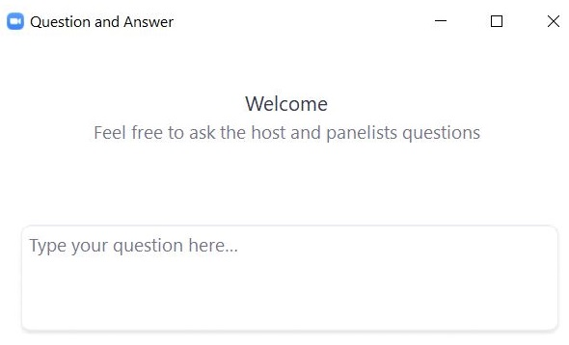
Questions & Answers
Use the “Q&A” feature
to ask questions.

Slide 28
5. Additional Resources and Next Steps

Slide 29
Upcoming Trainings
Training | Date/Time
Overview of MCAS Administration Tasks for School and District Test Coordinators | Wednesday, September 30 9:30–11:00 a.m.
Overview of MCAS Administration Tasks for Technology Coordinators | Wednesday, October 7 9:30–11:00 a.m.

Slide 30
Upcoming Trainings for Grades 3–8
Training | Date/Time
Grades 5 and 8 STE 2027 Revised Test Design Webinar | Friday, October 2 11:00 a.m.–12:00 p.m.
Grades 3–5 ELA 2027 Revised Test Design Webinar | Monday, November 2 11:00 a.m.–12:00 p.m.
Grades 6–8 ELA 2027 Revised Test Design Webinar | Friday, November 6 11:00 a.m.–12:00 p.m.

Slide 31
Next Steps
Today: Complete the evaluation form.
  Responses are associated with the name and email address used to log in.
  Email your input to mcas@mass.gov if you have problems accessing or completing the form.
Within one week:
  Receive an email with the Q&A from this session
  Recording will be available

Slide 32
Email and Phone Support
MCAS Service Center
DESE Student Assessment Services
Logistics and Technology Questions
  Web: https://mcas.onlinehelp.cognia.org/
  Email: mcas@cognia.org
  Phone: 800-737-5103
  TTY: 888-222-1671
  Live chat is available at the link on the bottom of the page at the MCAS Resource Center
Policy Questions
(e.g., student participation, accommodations)
  Web: www.doe.mass.edu/mcas
  Email: mcas@mass.gov
  Phone: 781-338-3625
  TTY: 800-439-2370

Slide 33
THANK YOU
The Office of Student Assessment Services
781-338-3625
mcas@mass.gov
www.doe.mass.edu/mcas
135 Santilli Highway, Everett, MA 02149

