Slide 1
Overview of the MCAS Family Portal, Spring 2026
The Office of Student Assessment Services
June 12, 2026

Slide 2
Presenters
Robert Curtin, Deputy Commissioner
Jodie Zalk, Manager of Test Administration & Publications
Shannon Cullen, MCAS Test Administration Coordinator
Sadeq Sohrabie, Manager of Assessment, Reporting, and Analysis
Abbie Currier, eMetric Sr. Project Manager
Rob Ford, Lincoln Public Schools, Director of Educational Operations and Technology

Slide 3
Logistics for This Session
Use the Q&A feature to ask a question.
  We will answer some questions aloud during the Q&A section, and we will email the Q&A afterwards.
  Use the thumbs-up icon to “upvote” someone else’s question.
  Email student-specific questions to mcas@mass.gov instead of asking here.
Closed captioning has been enabled for participants who need it.
This session is being interpreted into ASL. Our interpreting team will be onscreen with the presenters.
Please be advised that DESE does not authorize attendees to record or to use AI transcription tools during the meeting, and DESE does not endorse any unauthorized transcripts created by third parties of its meetings.

Slide 4
Slides for This Session
Slides were emailed to participants before this session from MCASEvents@cognia.org.
Slides are now being posted in the chat.
    If you cannot access the slides in the chat, ask in the Q&A.
After the session, we will send the slides again to participants, and they will be posted in the MCAS Resource Center along with the recording.

Slide 5
Today’s Agenda
Overview of the MCAS Family Portal
MCAS Family Portal Accounts
MCAS Family Portal Navigation and Reports
MCAS Family Portal Pilot:
A District Perspective from Lincoln Public Schools
Next Steps and Support

Slide 6
1. Overview of the MCAS Family Portal

Slide 7
Overview
DESE is rolling out a platform to give families earlier access to their students’ MCAS and MCAS-Alt results: https://mcasfamilyportal.emetric.net/
The portal is available in English and Spanish, and resource materials are being translated into the 15 most common languages in Massachusetts.
  DESE is looking into translations of the site for future years.
Some concerns during the initially planned launch are now resolved.
  Family portal now uses registration codes instead of SASIDs to access accounts to alleviate student privacy concerns.
  Districts will be able to monitor if a registration code was used.
  DESE conducted a small-scale pilot this spring with a representative sample of districts to learn from their experiences.

Slide 8
Overview (continued)
Educators will continue to use the MCAS Portal to access school or district results instead of the family portal.
The MCAS Family Portal is a mobile-friendly secure site:
  Supported browsers include Microsoft Edge, Google Chrome, Apple Safari, and Mozilla Firefox on desktop, laptop, tablet, and mobile devices.
  Note: this portal is a website – not an app.

Slide 9
Prior Results in the Portal
MCAS:
Spring 2023
Spring 2024
Spring 2025
November Retest 2025
February High School Science 2026
MCAS-Alt:
Spring 2023
Spring 2024
Spring 2025

Slide 10
2. MCAS Family Portal Accounts

Slide 11
Account Setup
Families will direct their browser to https://mcasfamilyportal.emetric.net
To set up their account, first-time users will enter their student’s
  registration code
  date of birth
Returning users will be able to log in with their email address and password once their account is set up.
If a user forgets their password, they can use the Forgot Password link on the log in page.
Once the account is created, additional students can be added.
  Each parent or guardian can create their own account, and up to 3 adults can add the same student.
  The account holder must be 14 years old or older.

Slide 12
Accessing Student Registration Codes
Registration codes in Edwin Analytics on DESE’s Security Portal
  Report PE622 (“MCAS Family Portal Registration Code”)
Report can be run as a PDF (to use DESE’s template letter) or Excel (as a list)
Report can be run in three different ways:
  pre-claimed or claimed students, which contain current students (preferred)
  students who participated in MCAS testing in their school since 2023
  students reported in the school/district SIMS since 2023
DESE suggests sending registration codes to parents/guardians of current students and following local procedures for former students.
  Students will have a registration code if they took an MCAS test in 2026 or one of the prior years in the Family Portal or receive a not-tested status in the spring 2026 data file.
Questions on accessing Edwin should be directed to district-level Directory Administrators

Slide 13
Providing Registration Codes to Families
Options for districts to provide registration codes to families:
  Using district’s family communication platform to provide instructions on accessing the registration code letter
  Posting the registration code letter in the district communication platform directly
  Sending registration code letters via U.S. mail or backpacks
  Providing the codes through other methods typically used to communicate with families about student grades and important matters
Communication about the family portal is a local decision between the outplacement and the sending district, but sending districts are ultimately responsible for ensuring that parents receive the information.

Slide 14
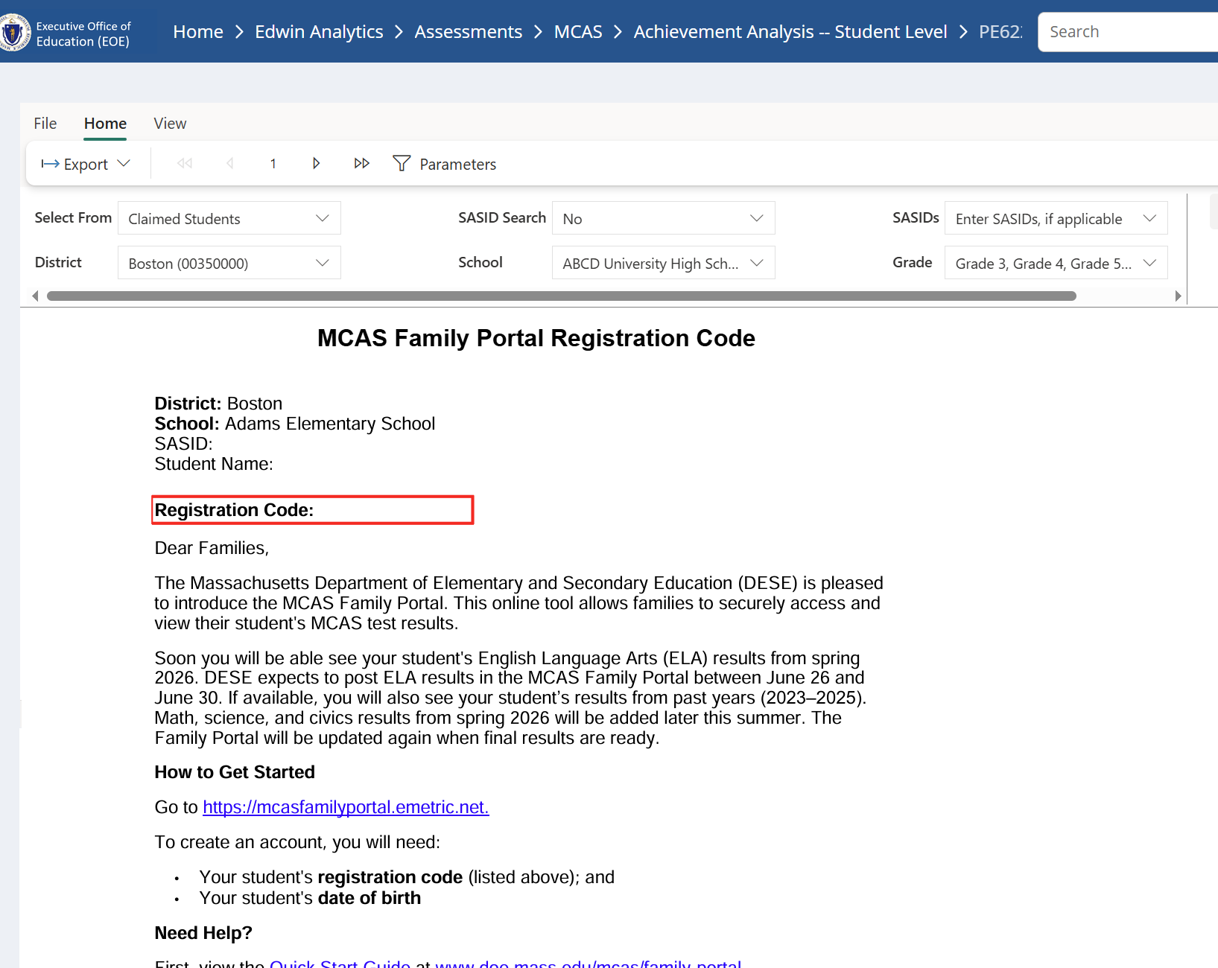
Edwin Analytics Report PE622
Note the path to access Report PE622 on Edwin Analytics on DESE’s Security Portal
Users can export the family portal letters (PDF format) or the Excel file of all the registration codes using the Export menu.
PDF letters are sorted by school, grade, last name, first name.

Slide 15
Resources for Families
MCAS Family Portal Resources webpage on DESE website www.doe.mass.edu/mcas/family-portal/
Materials are currently available, and translations of resources for parents/guardians will be posted as available:
Resources for Parents/Guardians
  Letter from Commissioner Martinez to Parents/Guardians
  Letter with Instructions to Access the Family Portal
  Quick Start Guide
  Help Guide (same guide as the one within the family portal)

Slide 16
Translations of the Letter with Instructions to Access the Family Portal
Translations will be posted on DESE website for districts to mail-merge
Letters will be posted in Microsoft Word at www.doe.mass.edu/mcas/family-portal
Translations of the 15 most common languages in Massachusetts:
  Albanian, Arabic, Cape Verdean, Traditional Chinese, French, Gujarati, Haitian French Creole, Hindi, Khmer, Portuguese, Russian, Spanish, Telugu, Twi, Vietnamese

Slide 17
Demonstrations 1
Accessing the Spanish translation of the MCAS Family Portal
Logging in for the first time
Adding students to and removing students from an account
Logging in as a returning user

Slide 18
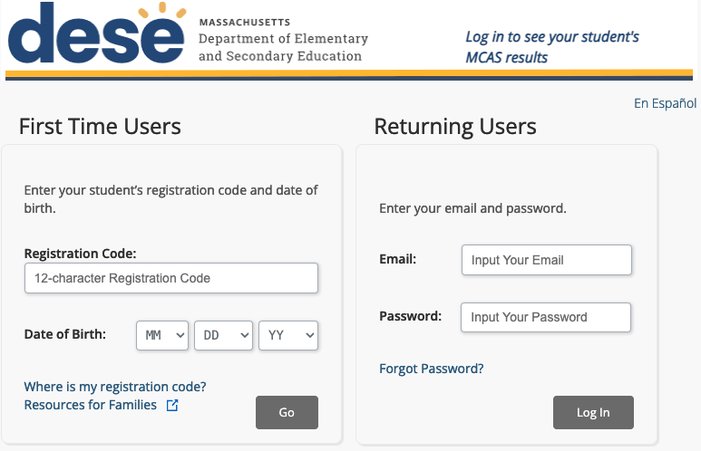
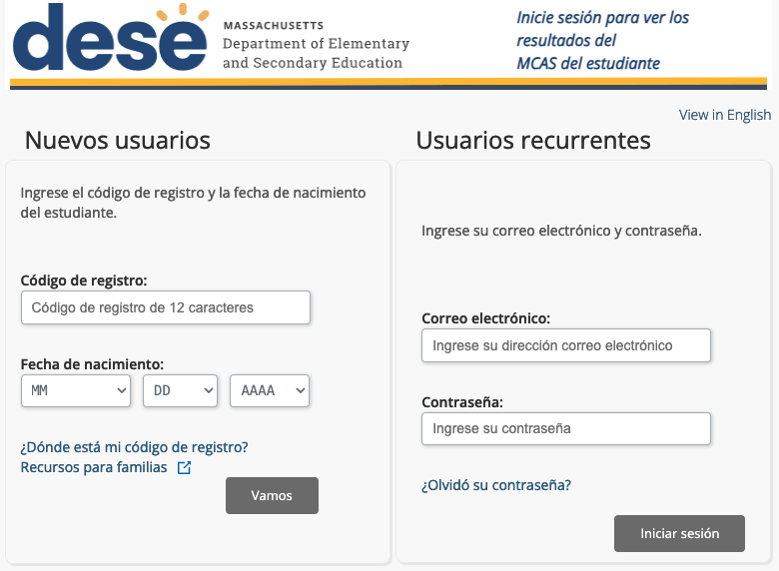
Accessing the Spanish Translation
In the top right corner of the screen, users can select to view the MCAS Family Portal in either English or Spanish.

Slide 19
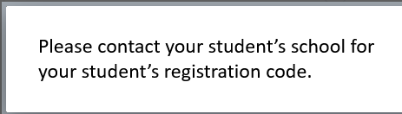
Logging In for the First Time
Enter the student’s registration code and date of birth.
Click Go.
Note: If unsure of the student’s registration code,
click Where is my registration code?
This box will pop up:

Slide 20
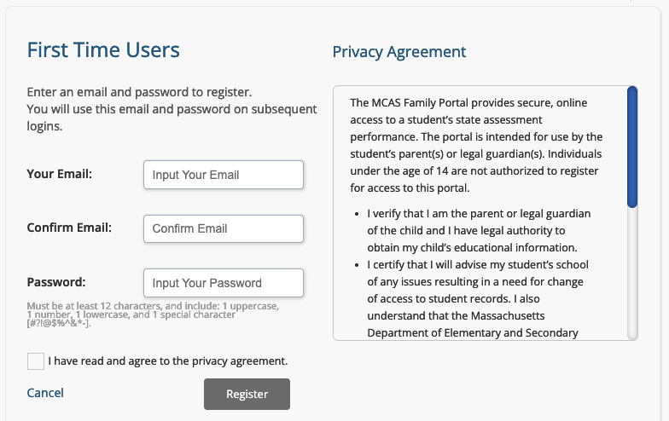
Logging In for the First Time (continued)
Enter the email address and create a password.
Read the privacy agreement on the right.
  The full privacy agreement text shown on the next slide.
Check the box indicating you have read and agree to the privacy agreement.
Click Register.

Slide 21
Privacy Agreement
Privacy Agreement
The MCAS Family Portal provides secure, online access to a student’s state assessment performance. The portal is intended for use by the student’s parent(s) or legal guardian(s). Individuals under the age of 14 are not authorized to register for access to this portal.
I verify that I am the parent or legal guardian of the child and I have legal authority to obtain my child’s educational information.
I certify that I will advise my student’s school of any issues resulting in a need for change of access to student records. I also understand that the Massachusetts Department of Elementary and Secondary Education reserves the right to grant or deny access to the portal in accordance with the U.S. Family Educational Rights and Privacy Act (FERPA) and any court order.
User Registration
In order for you to register for access to the portal, your valid email address is required. Your email address will not be made available to anyone but eMetric and Cognia (the MCAS testing contractors), and the Massachusetts Department of Elementary and Secondary Education. eMetric will not use your email address for marketing purposes or share your email address with third parties except as required by law.

Slide 22
Logging In as a Returning User
Enter the email address and password used when registering.
Click Log In.

Slide 23
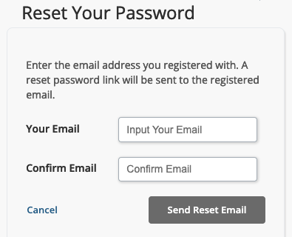
Resetting a Password as a Returning User
On the log in page, click Forgot Password?
Enter the email address registered to the account and confirm. Click Send Reset Email.
Click OK.
Follow the link provided in the email received to be prompted to reset the password.

Slide 24
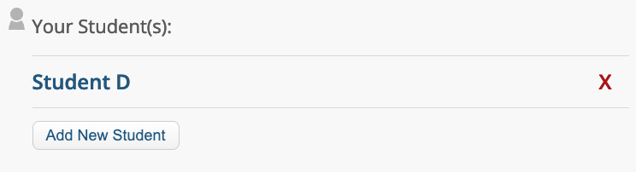
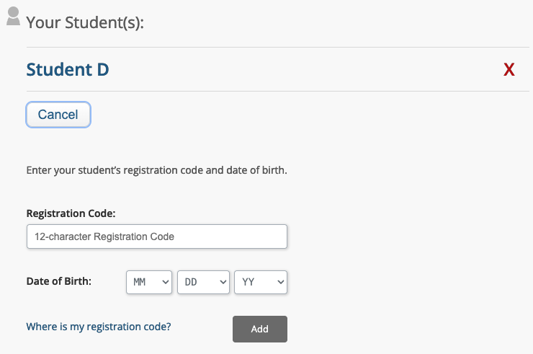
Adding Students to an Account
After logging in, click Add New Student.
Enter the additional student’s registration code and date of birth.
Click Add.
Note:
Parents/guardians with multiple children will use a registration code for one of their children to create an MCAS Family Portal account.
Once they create an account, other students can be added using their registration codes.
Each account can have a maximum of ten students.

Slide 25
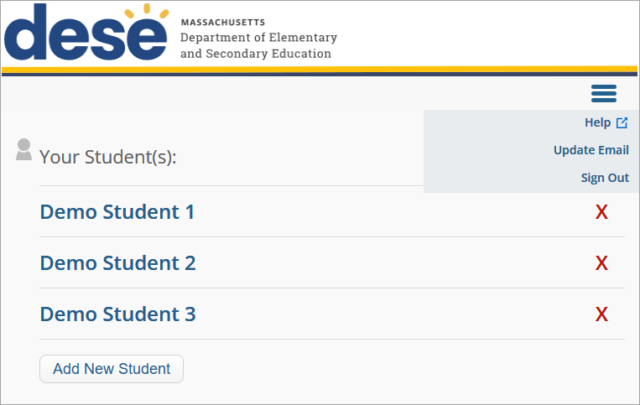
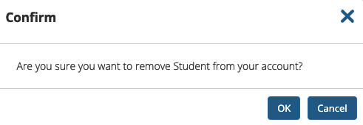
Removing Students from an Account
After logging in, click the red X next to the student’s name you wish to delete.
On the confirmation message, click OK.

Slide 26

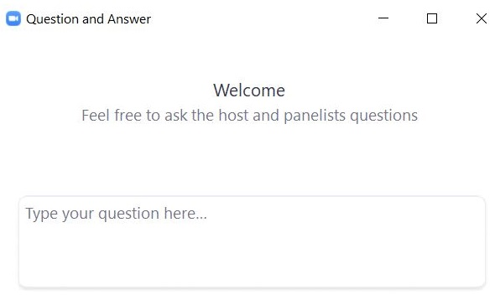
Questions and Answers 1
Use the “Q&A” feature to ask questions.

Slide 27
3. MCAS Family Portal Navigation and Reports

Slide 28
Family Portal Navigation
Test History – an overview of the student’s results based on the selected school year, including the scaled score and achievement level
Test Results – shows the student’s results on the selected test, including an overview of the test, the student’s achievement level, and the student’s scaled score
Detailed Results – shows the student’s performance on each test question and the percent of students who responded correctly to each question at the school, district, and state levels
Resources – additional information and resources related to the MCAS testing program

Slide 29
Demonstrations 2
Viewing reports for a selected student
  Test History
  Test Results
  Detailed Results
Resources tab
Viewing results for MCAS-Alt
Support within the MCAS Family Portal

Slide 30
Support in the MCAS Family Portal
Select the hamburger menu
on the landing page:
To access the help guide
To update your email address
To sign out of the MCAS Family Portal

Slide 31
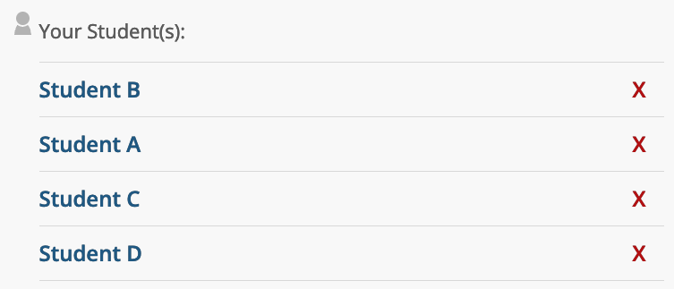
Selecting a Student
Upon logging in to the MCAS Family Portal, view a list of students connected to the account.
Select a particular student to view their testing history.

Slide 32
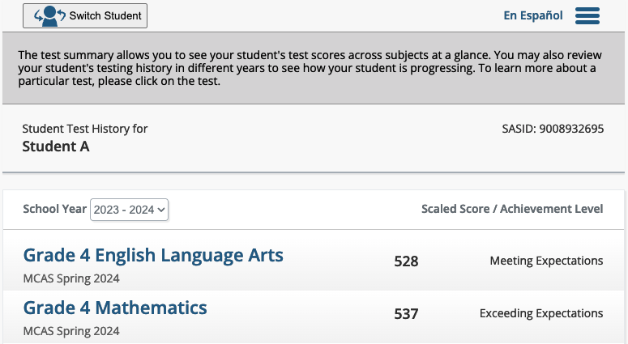
Viewing a Student’s Overall Test History
After selecting a student, you will be directed to their test history page.
For more detailed information, click a test name.
To change the school year, select a different school year in the drop-down menu.
To navigate between students, click the Switch Student button.
3
2
1

Slide 33
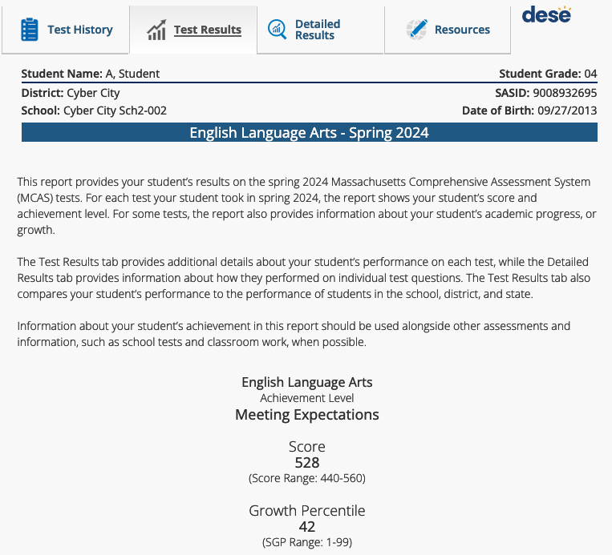
Viewing a Student’s Test Results
The Test Results tab shows the student’s results on the selected test including an overview of the test, the student’s achievement level, and the scaled score.

Slide 34
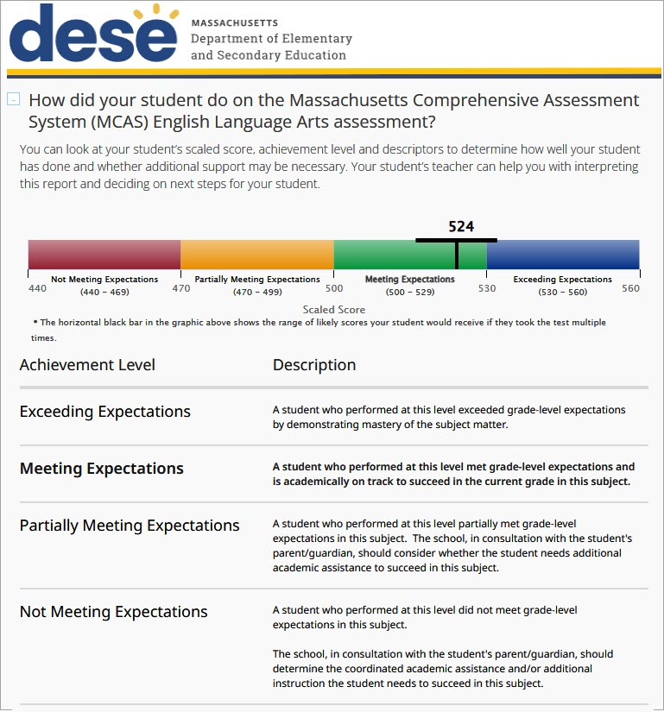
Viewing a Student’s Test Results (continued 1)
Scroll down to view additional information, including:
  A bar chart showing how the student scored on the range of all possible scores
  A list of all the MCAS achievement levels (This may help identify if additional support may be necessary.)

Slide 35
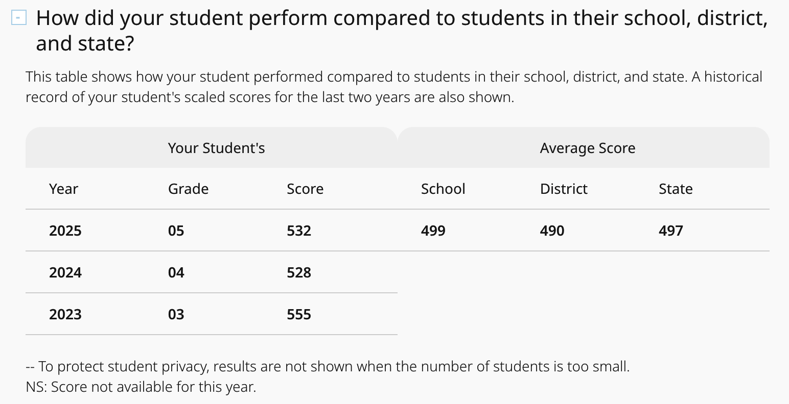
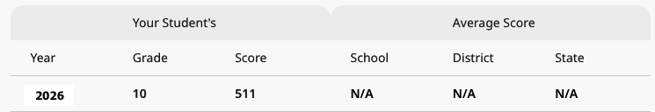
Viewing a Student’s Test Results (continued 2)
Scroll down to view additional information, including:
  A comparison of the student’s performance compared to the school, district, and state
  A comparison of the student’s results year over year in this subject
  Note: Summary data is not provided during preliminary reporting but will be included for official MCAS reporting.

Slide 36
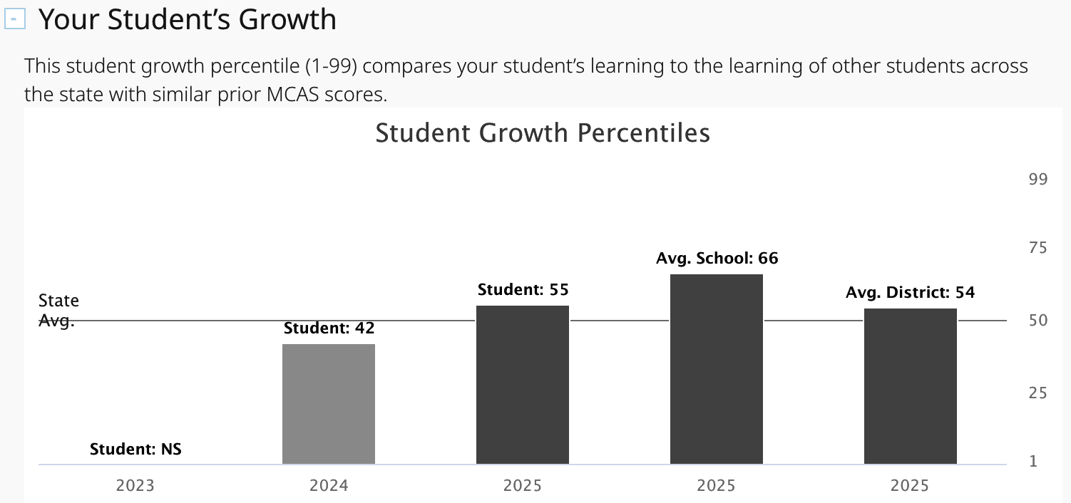
Viewing a Student’s Test Results (continued 3)
Scroll down to view the student growth percentile (SGP).
  SGP (1–99) compares the student’s learning to the learning of other students across the state with similar prior MCAS scores.
Note: Summary data is not provided during preliminary reporting but will be included for official MCAS reporting. The section for Student Growth Percentiles will be hidden during the preliminary data releases.

Slide 37
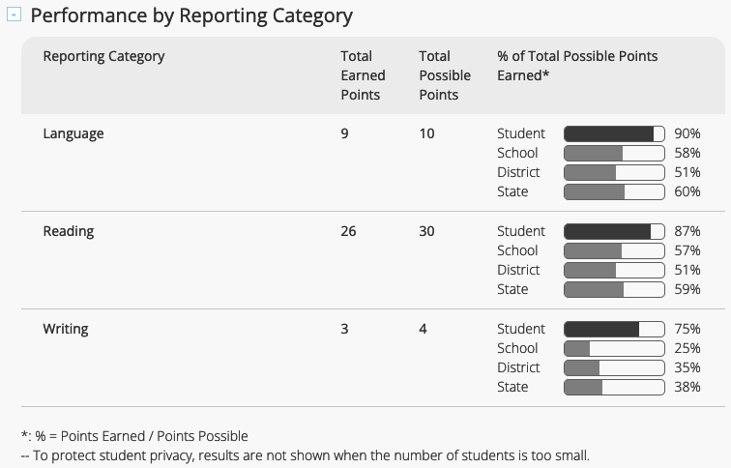
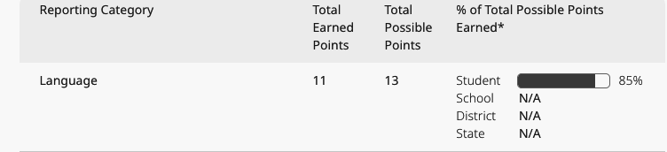
Viewing a Student’s Test Results (continued 4)
Scroll down to view the student’s performance in each reporting category, including:
  The total number of earned points
  The total number of possible points
  The percent of total possible points earned
Notes:
Compare the student’s percent of possible points earned to those of other students in the school, district, and state.
Summary data is not provided during preliminary reporting but will be included for official MCAS reporting.

Slide 38
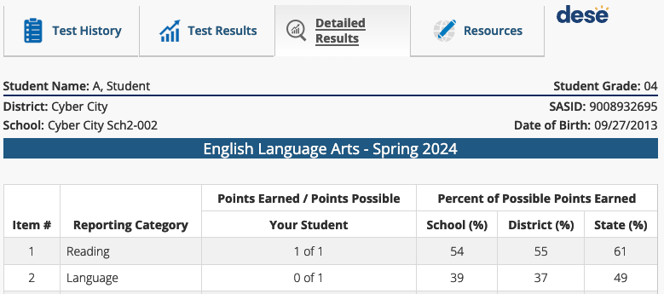
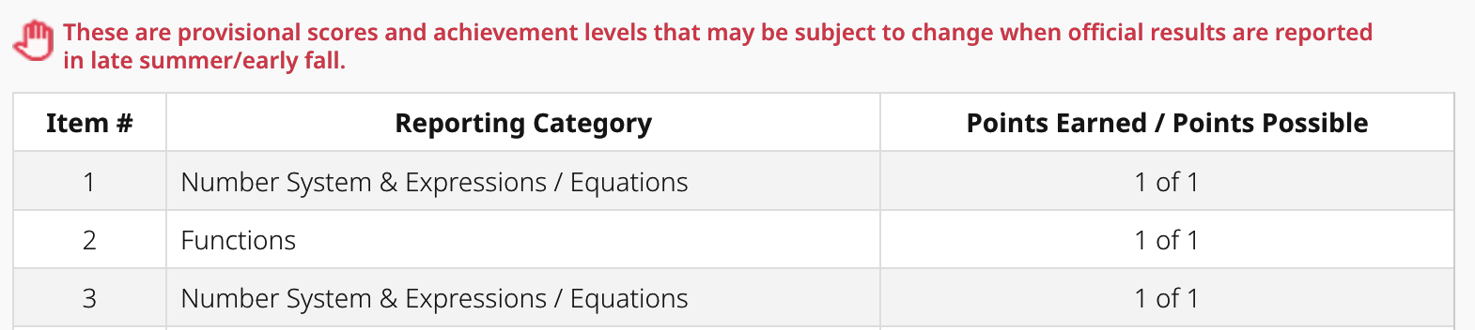
Viewing a Student’s Detailed Results
At the top of the page, click the Detailed Results tab to view:
  How the student performed on each question in the test
  The percent of points earned on each question at the school, district, and state levels
  Note: Summary data is not provided during preliminary reporting but will be included for official MCAS reporting.

Slide 39
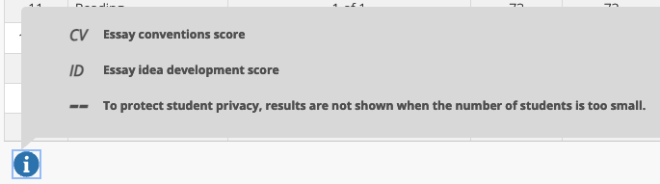
Viewing a Student’s Detailed Results (continued)
Click the information icon (“i”) at the bottom of the student’s
Detailed Results report to view the key to abbreviations and notations.

Slide 40
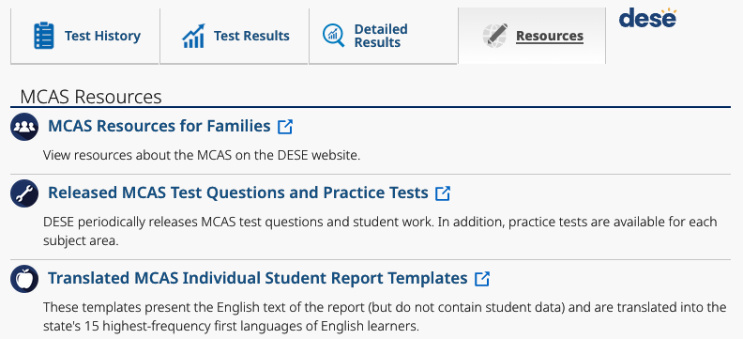
Resources in the MCAS Family Portal
At the top of the page, click the Resources tab to access resources that can help families understand their student’s MCAS results.

Slide 41
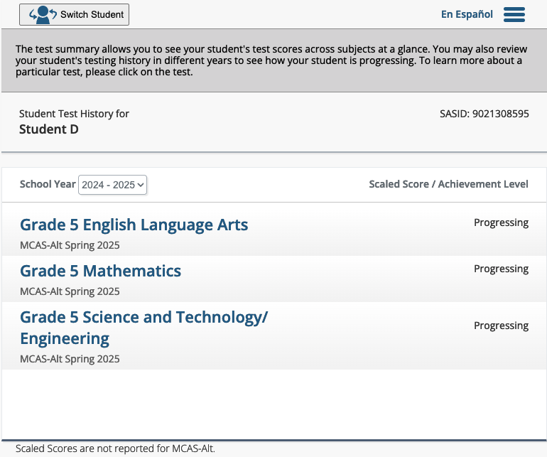
MCAS-Alt Results: Test History
MCAS-Alt results will be reported in the same MCAS Family Portal as standard MCAS results.
Students will be added to family accounts in the same method.
MCAS-Alt results will display the Student’s Test History. Select a test to view additional information.
If students test MCAS some years and MCAS-Alt other years, they will have all their results available in the MCAS Family Portal.

Slide 42
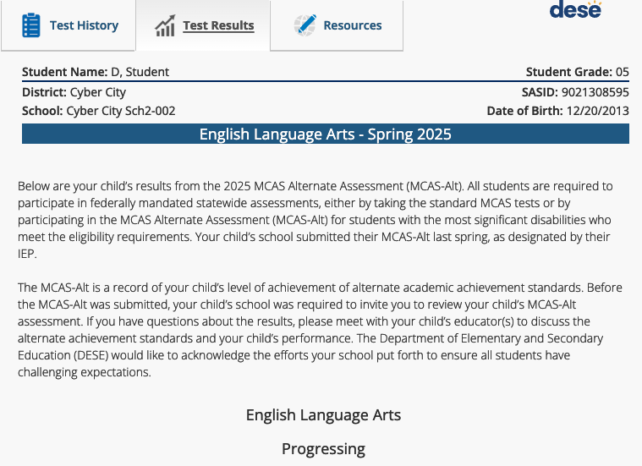
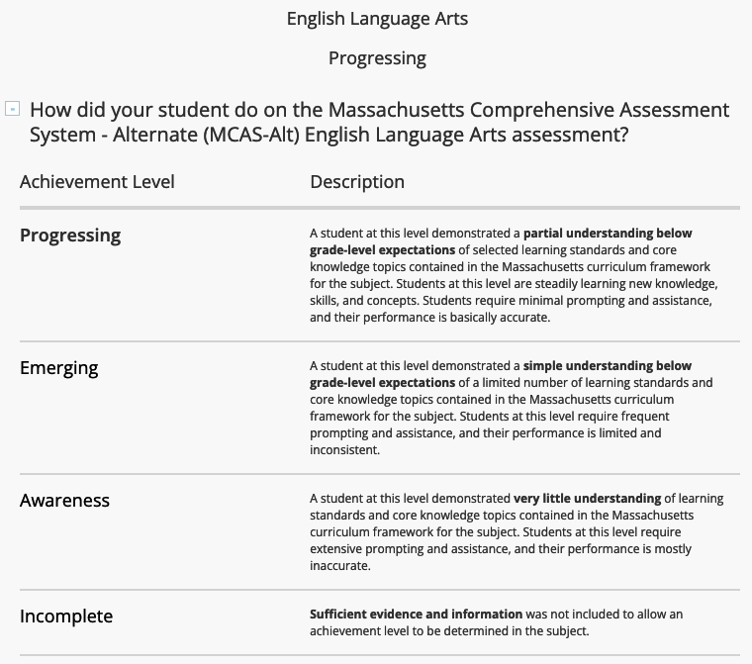
MCAS-Alt Results: Test Results
After selecting a test name, the MCAS-Alt results will appear.
Scroll down to view additional information, including:
  The student’s achievement level and achievement level descriptions

Slide 43
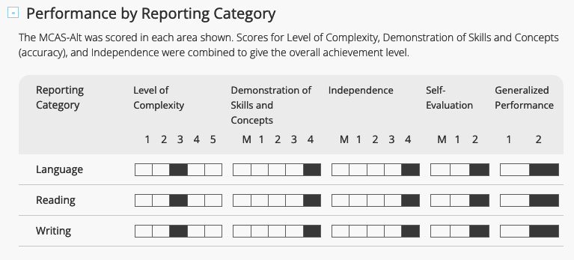
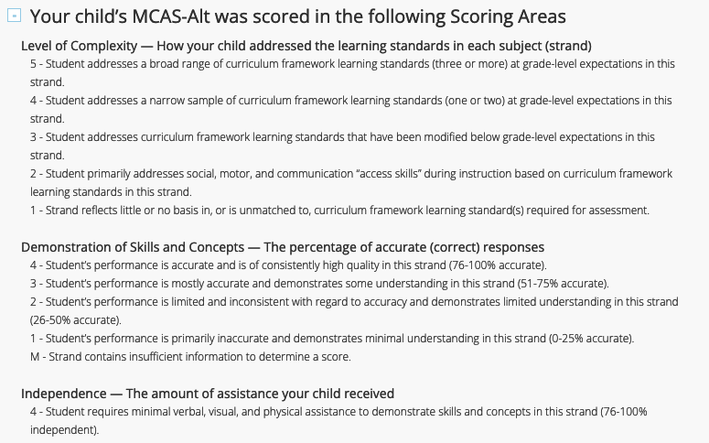
MCAS-Alt Results: Test Results (continued)
Scroll down to view additional information, including:
  The student’s performance by reporting category
  Information about the scoring areas for the MCAS-Alt

Slide 44
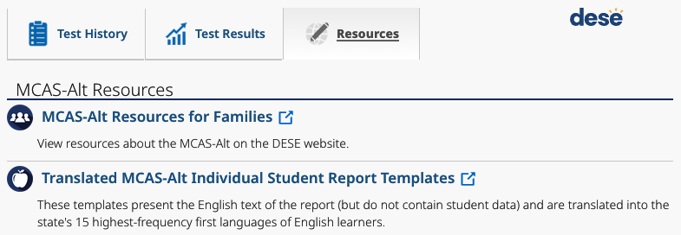
MCAS-Alt Results: Resources
Click the Resources tab at the top of the screen to view additional information for families.

Slide 45
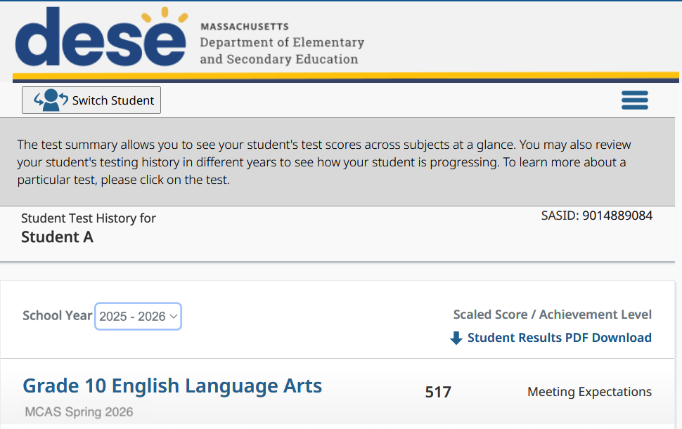
Downloading Individual Student Report (ISR) PDFs
In September, PDF versions of Individual Student Reports (ISRs) will be available for download from the “Test History” page.
To download the PDF, click Student Results PDF Download.
In the future, two years of PDFs will be available (i.e., the current year and the previous year).

Slide 46
Frequently Asked Questions
Q. How do noncustodial parents access the MCAS Family Portal? Do they need to share an account?
A. Each adult will create their own account to access their student’s results. Up to three adults can have the same student in their account.
Q. How do districts manage MCAS Family Portal accounts for students who transfer into their district?
A. Once districts claim the students in the “Student Claiming” App on DESE’s Security Portal, they can access these students’ registration codes in PE622 the next day.

Slide 47
Frequently Asked Questions (continued)
Q. Will parents/guardians still be able to access their account if they move to another school or district?
A. A student’s MCAS test history is maintained in their account, regardless of which district(s) they tested in. (If parents/guardians already have an MCAS Family Portal account, a student who moves between districts will not need a new registration code). The MCAS Family Portal can be accessed anywhere within the U.S. but not from another country.
Q. Can districts monitor whether registration codes are used?
A. DESE is planning to include a flag in Edwin report PE622 in the updated August report on whether a registration code has been used. Districts can filter on whether or not a code has been used.
View additional FAQs on DESE’s website

Slide 48
Questions and Answers 2
Use the “Q&A” feature to ask questions.

Slide 49

4. MCAS Family Portal Pilot
A District Perspective from Lincoln Public Schools
Rob Ford
Director of Educational Operations and Technology
Lincoln Public Schools
rford@lincnet.org

Slide 50
Our Pilot Goals
Help DESE pilot the family portal
Encourage parent participation
Minimize impact on school staff

Slide 51
Our Approach
Hand-carried paper:
  DESE letter from Edwin
  One-pager with instructions for setting up account
  Cover letter encouraging pilot participation with feedback URL
Why paper?
  PK-8 district: have SIS-based options, but not heavily used
  In the process of rolling out ParentSquare, but not launched yet
  Hoping to encourage participation

Slide 52
Process
Exported DESE letters from Edwin
Printed by grade, collated, and stuffed envelopes by homeroom (at district)
Distributed to schools
~5 hours of labor for ~500 students
Communication to families:
  Email sent day-of to let parents know the letter was coming home
  Follow-up communication/reminders from Superintendent and Principals in weekly bulletin

Slide 53
Lessons Learned
Collating by homeroom was the most time-consuming part of producing materials
  Next time will likely export the access codes and print letters with a mail merge instead of directly from the portal.
Minimal support impact
  Prepare to support mobile and desktop
Low participation/interest
  Caveat: No new results = low incentive to try it out

Slide 54
Family Feedback
100% were able to register
71% said reports were clear and helpful
Preference for paper reports among some parents

Slide 55
5. Next Steps and Support

Slide 56
Next Steps
Today: Complete the evaluation form.
  Responses are associated with the name and email address used to log in.
  Email your input to mcas@mass.gov if you have problems accessing or completing the form.
Within one week:
  Receive an email with the Q&A from this session
  Recording will be available

Slide 57
Support for the MCAS Family Portal
Support for parents and guardians:
  Families will contact their student’s school.
Support for schools and districts:
  Questions on portal functionality and technology issues
    Email: mcas@cognia.org
    Phone: 800-737-5103
    Live chat is available at the link on the bottom of the page at the MCAS Resource Center
  MCAS policy questions
    Email: mcas@mass.gov
    Phone: 781-338-3625
    TTY: 800-439-2370
  Questions on access to Edwin
    Contact your district-level Directory Administrator

Slide 58
Questions and Answers 3
Use the “Q&A” feature to ask questions.

Slide 59
Poll Question—
Which demonstrations would you like to see again?
Registration Codes in Edwin Analytics
Accessing the Spanish translation
Logging in as a first-time user
Adding students to and removing students from an account
Logging in as a returning user
Viewing a student’s test results
Additional Resources tab
Viewing MCAS-Alt results
Support within the MCAS Family Portal

Slide 60
THANK YOU
The Office of Student Assessment Services
781-338-3625
mcas@mass.gov
www.doe.mass.edu/mcas
135 Santilli Highway, Everett, MA 02149

