Slide 1
MCAS Early Release Data
2026 Reporting
The Office of Student Assessment Services
June 9, 2026

Slide 2
Presenters
Julia English, Data Analyst
Sarah Jo Torgrimson, Coordinator of Research & Psychometrics
Jodie Zalk, Manager of Test Administration & Publications

Slide 3
Logistics for This Session
Use the Q&A feature to ask a question.
  We will answer some questions aloud at specified times during this training session, and we will email the Q&A afterwards.
  Use the thumbs-up icon to “upvote” someone else’s question.
  Email student-specific questions to mcas@mass.gov instead of asking here.
Closed captioning has been enabled for participants who need it.
This session is being interpreted into ASL. Our interpreting team will be onscreen with the presenters.
Please be advised that DESE does not authorize attendees to record or to use AI transcription tools during the meeting and DESE does not endorse any unauthorized transcripts created by third parties of its meetings.

Slide 4
Slides for This Session
Slides were emailed to participants before this session from MCASEvents@cognia.org.
Slides are now being posted in the chat.
  If you cannot access the slides in the chat, ask in the Q&A.
After the session, we will send the slides again to participants, and they will be posted in the MCAS Resource Center along with the recording.

Slide 5
Today’s Agenda
Overview of Early Release MCAS Data
Using Item Analysis Templates
Discrepancy Reporting with Preliminary Results
Resources & Support

Slide 6
1. Overview of Early Release MCAS Data

Slide 7
Early Release MCAS Data
    Include data files (.CSV), student rosters (PDF), and released essay responses
    May include discrepancies that can be resolved (e.g., student demographics, identifications) or may be otherwise incomplete
    Should only be used for instructional planning and reporting data discrepancies
    During the embargo period, results may only be shared with staff within your school or district. Do not share results outside your organization.

Slide 8
MCAS Data Release Timeline (Embargoed Data)
V1 Data by Subject
Spring
Only reports computer-based testing (CBT)
V2 Data by Subject
Summer
CBT and paper-based testing (PBT)
Preliminary MCAS Data
Mid-August
Student results for all MCAS tests are reported together
Official MCAS Data
September
Includes scores for all items including SR, constructed response (CR), and essays
Only reports scores for selected response (SR) items
Includes scaled scores and achievement levels that factor in student test status
Includes scaled scores and preliminary achievement levels
Only includes raw score subtotals
File used for reporting data discrepancies
Final data that is used to create public reporting of MCAS data
Still embargoed until the official release of data
Incorporates changes in test status and achievement levels due to data discrepancy reports

Slide 9
MCAS Public Release Ends Embargo
MCAS public release aligns with the September Board of Education meeting, typically the last Tuesday of September.
Until MCAS public release, all MCAS data are embargoed.
Embargoed MCAS data should only be used for instructional planning and reporting data discrepancies.
Do not share embargoed data with anyone outside of staff at your school or district.

Slide 10
Data Locations
MCAS Portal:
DropBox Central:
V1 and V2 .CSVs
Item Result Templates
PDF Rosters
Early Release Essay Reports
Item Result Templates
Item Score Summaries
Preliminary MCAS .CSV files

Slide 11
Data in the MCAS Portal: Overview
Early Release Files
Version Information
.CSV files
PDF rosters (school level)
Early release essay reports
Separated by school and district
Staggered release by grade span and MCAS subject
V1: Only raw score data for CBT test takers, does not include CR or essays
V2: Scaled scores and preliminary achievement levels for all MCAS test takers

Slide 12
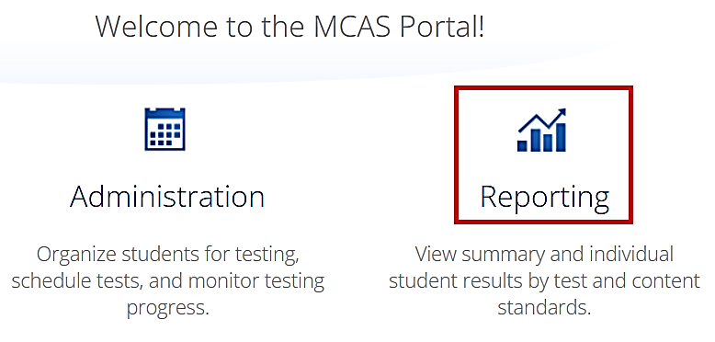
Accessing Data in the MCAS Portal
Navigate to the MCAS Portal.
Click on the Reporting icon.
Make selections to download the desired report.
Selections for Report Download
Program: MCAS
Report: Early Release Data Files or Early Release Rosters
Year: 2025-2026
Admin: Spring
Grade: Select grade
Subject: Select subject
Organization: Select your school or district

Slide 13
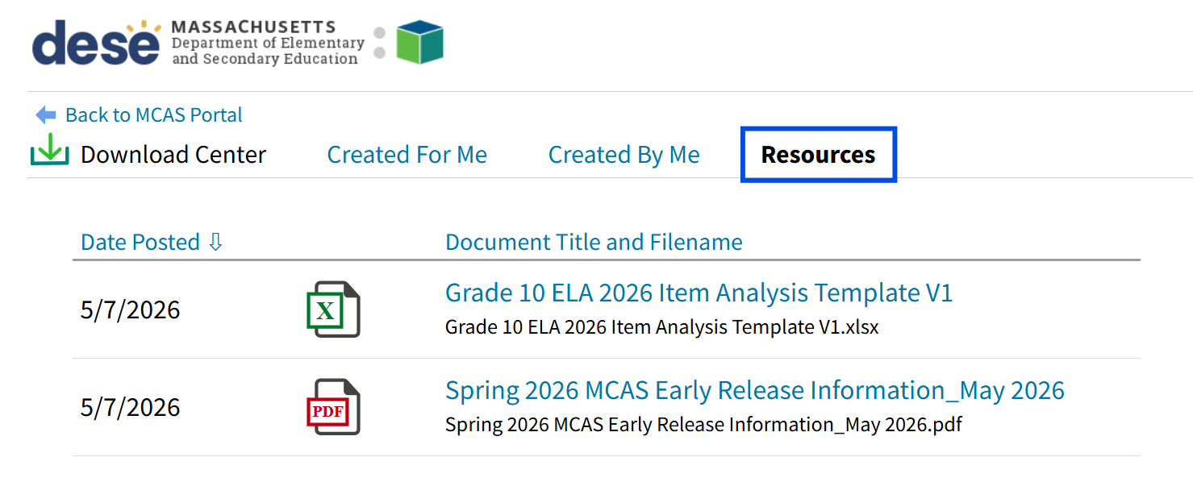
Resources in the MCAS Portal
DESE provides both the item template and guide to MCAS early release.
Navigate to the MCAS Portal.
Click Reporting.
Choose the Resources tab to find relevant files.

Slide 14
Demonstration: MCAS Portal Data
Review how to download .CSV data, PDF rosters, and released essay reports.
Review how to find resources in the MCAS Portal.

Slide 15
Q&A
Check-In #1

Slide 16
2. Using Item Analysis Templates

Slide 17
Item Level Data in DropBox Central
Early Release Files
Version Information
Item result templates
Item score summaries
Separated by school and district
Staggered release by grade span and MCAS subject
V1: Only CBT results for selected response (SR) items
V2: Results for all items for CBT and PBT MCAS test takers

Slide 18
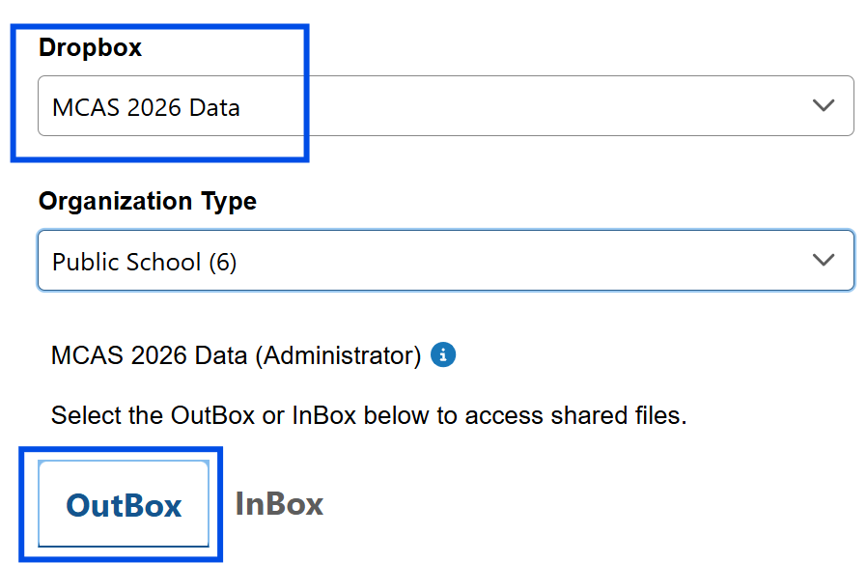
Accessing Dropbox Central Data
Navigate to DESE’s Security Portal.
Click on Dropbox Central.
Make selections to download the desired report.
Selections for Report Download
Dropbox: MCAS 2026 Data
OutBox
Please check all pages of the outbox for the desired data.
For assistance accessing Dropbox, please reach out to your directory administrator.

Slide 19
Item Analysis Template Sheets
Sheet | Description
Item Level Data (by grade) | Used to view differences between item averages by school, district, and state
Reporting Category Data | Used to view differences between category point averages by school, district, and state
Reporting Categories 2026 | Provides information on reporting categories by grade span and subject
File Layout 2026 | Provides the file layout for early release .CSV files available in MCAS Portal
Resources | Provides links to released item information and scoring rubrics for essays

Slide 20
Demonstration: Item Analysis Template
Review layout of a Grades 3-8 ELA V1 item analysis template.
Identify columns and sheets where schools will paste item and reporting category averages for school and district.

Slide 21
New for 2026: Item Aggregation Files
DESE is now providing item averages for schools and districts, pre-populated to copy and paste into item templates.
Column | Definition
sprp_dis | District code
sprp_sch | School code
Type | Filter and select either “Item” or “Reporting Category”
Level | Filter and select either “District” or “School”
Item | Item number or reporting category label
*N_Blank | Number of students with no response; not included in average points
*N_Included | Number of students that answered item
*AvgPoints | Average number of points earned on selected item or reporting category
*Each grade has its own columns for item statistics.

Slide 22
Demonstration: Using Average Aggregation Files
Create a filter for data. Filter data by type (reporting category or item) and level (school or district).
Copy data and put into appropriate spaces in worksheets.
Investigate trends in data.
  Overall, how are students in my school comparing to the students across the state? To students in our district?
  Are there particular items where students are performing better or worse than the state or district averages? What are the reporting categories and standards associated with these items?

Slide 23
Investigating Trends in Average Data
Use School-State Diff. columns to look at differences in averages between the school and the state.
Negative differences in percent possible points indicates that your school did not perform as well as the state average.
Positive differences in percent possible points indicates that your school performed better than the state average.
Use the line graph on Item Level Data sheet to compare performance between school, district, and state on items.

Slide 24
Q&A
Check-In #2

Slide 25
3. Discrepancy Reporting

Slide 26
Use V1 and V2 Data to Identify Data Discrepancies
Immediately report missing tests via the MCAS Service Center.
Report any student name changes or student demographic errors to your district SIMS contact for resolution prior to end-of-year (June) SIMS reporting. You can find your district SIMS contact on People Search.
Save discrepancies related to student participation or test accommodations for the data discrepancy window.
Note: Records in the MCAS Portal cannot be updated.

Slide 27
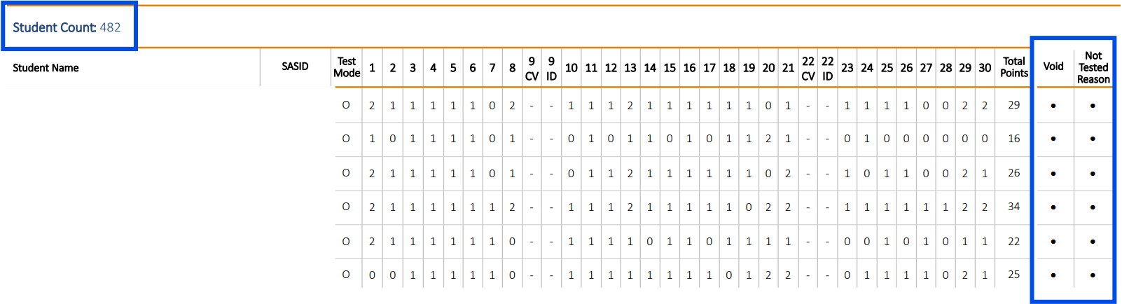

Discrepancy Reporting Example V1

Slide 28
Use Preliminary MCAS .CSV File to Identify Data Discrepancies
Discrepancy reporting period (Early August)
Access DropBox Central; if you need access, confirm with your directory administrator.
  Preliminary MCAS .CSV file
  Password for Data Discrepancy Tool
Log in to MCAS Service Center Data Discrepancy Tool.

Slide 29
Using the Data Discrepancy Tool
Report data discrepancies related to:
Student SASID
Special Access Accommodations
Participation Status due to: Medically Documented Absence (MED), First-Year EL Status (NTL), Student Transfers between Districts (TRN)
Duplicates
Refer to the Data Discrepancy User Guide for more information.

Slide 30
Q&A
Check-In #3

Slide 31
4. Resources & Support

Slide 32
Helpful Links
Resource
MCAS Resource Center
MCAS Portal, Portal Guide, User Guide
Recordings of Previous Trainings
Released Item Information and Student Work
Student Assessment Updates
Subscribe to Student Assessment Update
Discrepancy Reporting

Slide 33
Email and Phone Support
MCAS Service Center
DESE Student Assessment Services
Questions on logistics and using the discrepancy reporting tool
  Web: https://mcas.onlinehelp.cognia.org/
  Email: mcas@cognia.org
  Phone: 800-737-5103
  TTY: 888-222-1671
  Live chat is available at the link on the bottom of the page at the MCAS Resource Center.
Policy questions
  Web: www.doe.mass.edu/mcas
  Email: mcas@mass.gov
  Phone: 781-338-3625
  TTY: 800-439-2370

Slide 34
THANK YOU
The Office of Student Assessment Services
781-338-3625
mcas@mass.gov
www.doe.mass.edu/mcas
135 Santilli Highway, Everett, MA 02149

