Slide 1
Tasks in the MCAS Portal During and After Testing
The Office of Student Assessment Services
March 12, 2026

Slide 2
Presenters
Shannon Cullen, MCAS Test Administration Coordinator
Erma Brown, MCAS and ACCESS Test Administration Specialist
Abbie Currier, eMetric Sr. Project Manager

Slide 3
Logistics for This Session
Use the Q&A feature to ask a question.
We will answer some questions aloud at specified times during this training session, and we will email the Q&A afterwards.
Use the thumbs-up icon to “upvote” someone else’s question.
Email student-specific questions to mcas@mass.gov instead of asking here.
Closed captioning has been enabled for participants who need it.
This session is being interpreted into ASL. Our interpreting team will be onscreen with the presenters.
Please be advised that DESE does not authorize attendees to record or to use AI transcription tools during the meeting and DESE does not endorse any unauthorized transcripts created by third parties of its meetings.

Slide 4
Slides for This Session
Slides were emailed to participants before this session from MCASEvents@cognia.org.
Slides are now being posted in the chat.
If you cannot access the slides in the chat, ask in the Q&A.
After the session, we will send the slides again to participants, and they will be posted in the MCAS Resource Center along with the recording.

Slide 5
Today’s Agenda
Timeline of Tasks in the MCAS Portal
Monitoring Student Testing
Resolving Incorrect Accommodations
Procedures for Students Who Do Not Test
Additional Tasks During Testing
Tasks After All Testing Is Completed
Test Administrator Tasks During and After Testing
Resources, Support, and Next Steps
Live “Sandbox” Time with Additional Demonstrations

Slide 6

Poll Question
What is your role? (Check all that apply)
District test coordinator
School test coordinator
Principal
Guidance counselor
Technology staff
Other district staff
Other school staff

Slide 7
Poll Question
How many years have you coordinated MCAS test administration?
0–This is my first year.
1 year
2–3 years
4–5 years
6+ years
7

Slide 8
1. Timeline of Tasks in the MCAS Portal

Slide 9
Timeline of Tasks in the MCAS Portal to Complete Before Testing for Principals/Test Coordinators
2 weeks before testing
●Create and assign students to classes
●Verify accommodations in the MCAS Portal
●Create test administrator logins if necessary (for certain accom.)
●Track delivery of materials through Materials Management
Up to one week before testing
●Schedule classes to tests
●Print student logins and summary sheets
Now
●Continue to update student registration information
●Enrollment Transfer Requests (as needed)
Refer to the recording of the Tasks in the MCAS Portal Before Testing training webinar, available on the Training Webinars page of the MCAS Resource Center.

Slide 10
Timeline of Tasks in the MCAS Portal to Complete During and After Testing for Principals/Test Coordinators
During Testing
●Resolve incorrect accommodations
●Manage make-up testing
●Void tests as needed
●Unlock locked test questions (in certain circumstances)
After Testing
●Fill in Report codes as needed
●Void tests as needed
Test Day
●Distribute student logins and summary sheets to test administrators
●Monitor student testing status in the MCAS Portal

Slide 11
Timeline of Tasks in the MCAS Portal to Complete Before and During Testing for Test Administrators
Up to 2 days before testing
Test Day
●Verify accommodations
●Verify student roster
●Distribute student logins to students
●Provide access codes to students
●Enter proctor password as needed
●Monitor student testing status in the MCAS Portal
●Assist with testing issues as needed
MCAS Portal Overview for Test Administrators module now available on the Training Modules page of the MCAS Resource Center

Slide 12
Timeline of Tasks to Complete for Technology Coordinators
●Review Appendix A of the PAM
●Review technology guidelines to verify that devices meet technology requirements
●Install updated kiosks if needed
●Verify access to MCAS Portal and MCAS Training Site
During Testing
●Troubleshoot issues as they arise
●Contact the MCAS Service Center with technology questions
Fall 2025
●Verify that devices meet the technology requirements
●Add provided URLs to exempt lists
●Download and install the updated MCAS Student Kiosk
●Conduct Site Readiness and Site Certification
Winter 2026
Additional information was shared in the MCAS Tasks for Technology Coordinators training on February 2, available on the MCAS Resource Center.

Slide 13
New for 2025–26
Progress view is available on the Test Scheduling page to monitor student progress during testing.
Session access codes are now referred to as access codes.
Schools can now print student logins in bulk.
Schools may export a new Export Accommodations report to review accommodations prior to testing.
Only test coordinators and technology coordinators are able to add test report codes and session report codes to student tests.
Course-level and grade-level classes: Grades 3–8 students must be assigned to grade-level classes and high school students must be assigned to course-level classes.
Additional information was covered in the March 4 Tasks in the MCAS Portal Before Testing training webinar, available on the Training Webinars page of the MCAS Resource Center.
Refer to the Updates to the MCAS Student Kiosk and MCAS Portal for 2025–26 for additional information.

Slide 14
2. Monitoring Student Testing

Slide 15
Monitoring Student Testing in the MCAS Portal
Test coordinators can monitor student testing status in the following ways in the MCAS Portal:
New for 2025–26: Progress View from the Test Scheduling page
Exporting reports from the Test Scheduling page
Viewing the dashboards on the Dashboard page

Slide 16
Exports in the MCAS Portal
Schools may find the following reports useful in tracking preparation and completion of testing.
District and school test coordinators and technology coordinators are able to export these reports.
Export Test Status: a .CSV file listing every student and their completion status per session of the selected school and test.
Export Test Status for All Tests: a .CSV file listing every student and their completion status per session for all tests in the selected district/school, program, and content area.
Export Students Not Scheduled: a .CSV file listing every student not scheduled for the selected school and test. (Only available at the school level).

Slide 17
Demonstration
Monitoring test status and progress view on the Test Scheduling page
Exports on the Test Scheduling page

Slide 18
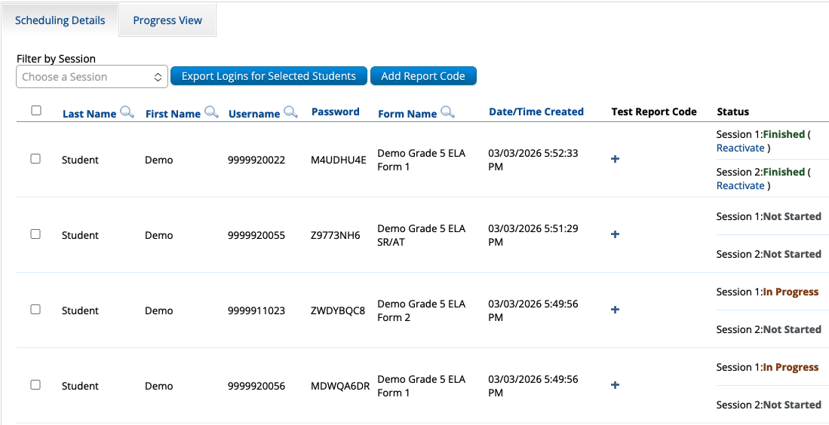
Monitoring Tests
Log in to the MCAS Portal and click Administration.
Select the Test Scheduling page.
Select the school, content area, program (grades 3–8 or high school), and test name.
Locate the test session you wish to monitor and click View Details/Student Logins.
Select the Scheduling Details tab.

Slide 19
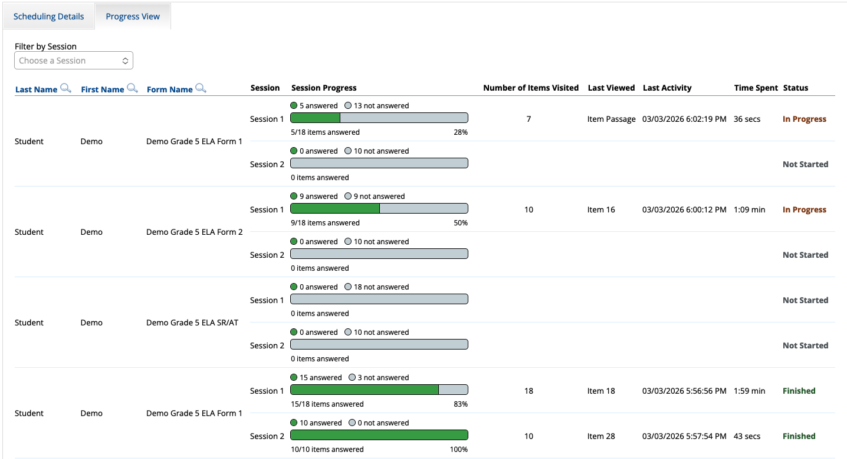
Progress View
Follow the steps on the previous slide, and then select the Progress View tab.

Slide 20
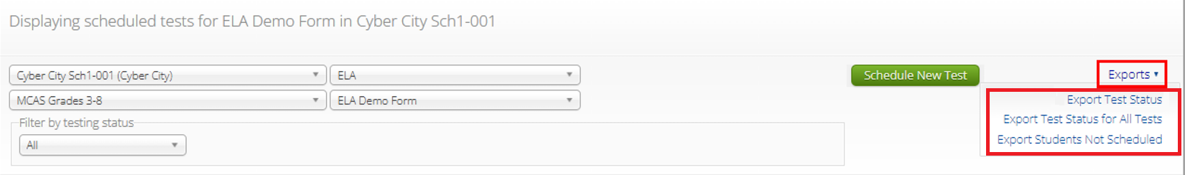
Exports on the Test Scheduling Page
Log in to the MCAS Portal.
Select Administration.
Select Test Scheduling.
Use the drop-down menus (Organization, Program, Subject, and Test Name) to filter for the scheduled test.
Select Exports and select the export from the drop-down menu.

Slide 21
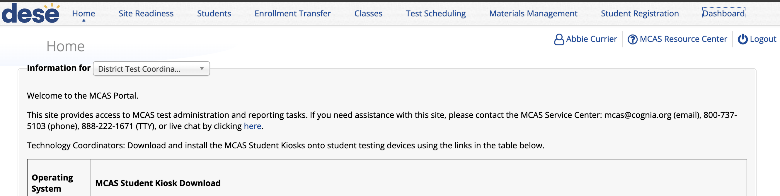
MCAS Portal Dashboards
A dashboard is available for test coordinators to monitor overall testing progress through the testing window.
After logging in to the MCAS Portal, select Administration and select Dashboard in the top menu bar.
Note: Dashboards only become available when the testing window opens.

Slide 22
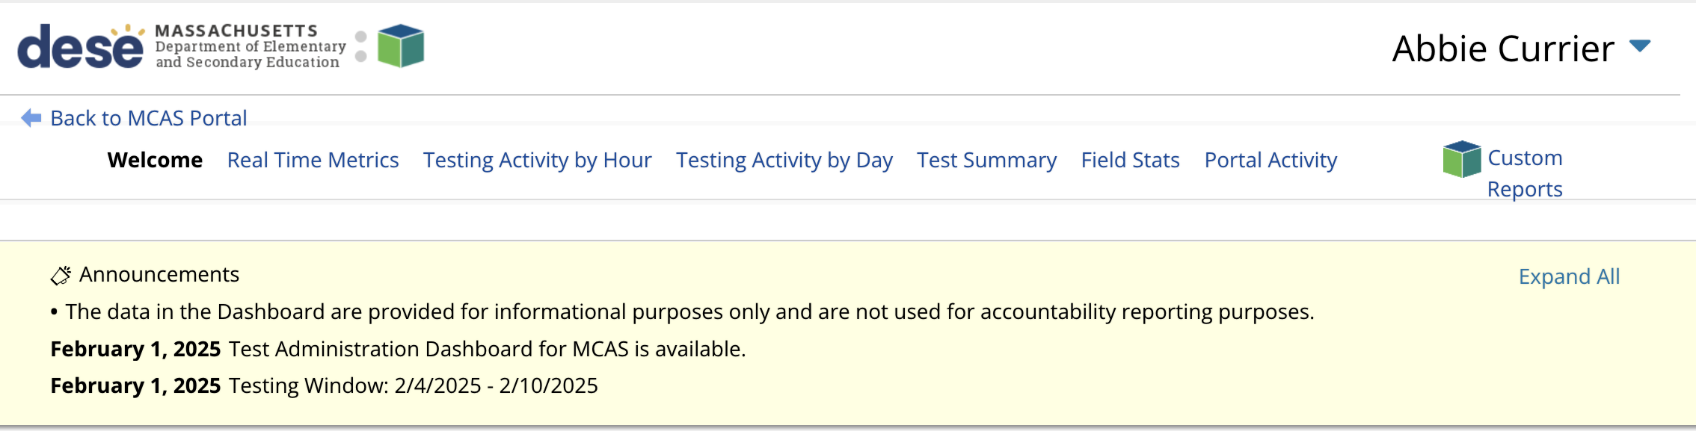
MCAS Portal Dashboards (continued)
A series of graphs and reports are available to district test coordinators, school test coordinators, and technology coordinators.
Refer to the Guide to the MCAS Portal, Part VIII: MCAS Portal Dashboards, located on the MCAS Portal page of the MCAS Resource Center.
Note: Dashboards are not available on the MCAS Training Site.

Slide 23
MCAS Portal Dashboards
Report | Details | Updated
Real Time Metrics | Displays a line graph of the number of students actively testing by hour for the program and organization selected. | Every 2 minutes
Testing Activity by Hour | Displays three charts: Tests Started by Hour, Tests Completed by Hour, and Tests Paused by Hour for the program, organization, and date selected | Hourly
Testing Activity by Day | Displays a chart of the Tests Started and Completed by Day for the program, organization, and date selected | Hourly
Test Summary | Displays two charts: Tests Scheduled and Completed and the Percent of Tests Completed for the program and organization selected | Hourly
Field Stats | Displays an Operating Systems Summary and Site Readiness Information for the program and organization selected. | Hourly
Portal Activity | Portal Activity will display the Number of Portal Users by Day for the selected organization and by date | Hourly

Slide 24
Resources
MCAS Portal Guides
Guide to the MCAS Portal, Part VI: Scheduling Tests, Printing Student Logins and Other Tasks on the Test Scheduling Page
Guide to the MCAS Portal, Part VIII: MCAS Portal Dashboards
Training Modules
Exporting Administration Reports
MCAS Portal Overview for Test Administrators (for information on Progress View)

Slide 25

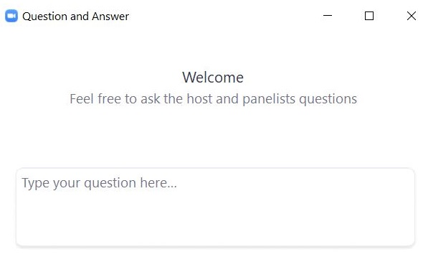
Questions and Answers
Use the “Q&A” feature to ask questions.

Slide 26
3. Resolving Incorrect Accommodations

Slide 27
Resolving Incorrect Accommodations
Test coordinators and test administrators are encouraged to review accommodations prior to testing to avoid situations in which a student begins a test with the incorrect accommodations.
If a test administrator or test coordinator finds that an accommodation was assigned incorrectly, there are different instructions to follow based on whether:
the accommodation is a form-dependent accommodation – i.e., human read aloud, human signer, ASL, Spanish/English, screen reader/compatible assistive technology (AT)
the student has signed in to the test

Slide 28
Resolving Incorrect Accommodations (continued)
Scenario | Resolution if the student has not logged in to the test | Resolution if the student has logged in to the test
Student is assigned an accommodation they should not have or student is missing an accommodation they should have and the accommodation is form-dependent (human read aloud, human signer, ASL, Spanish/English, screen reader/compatible AT). | Edit the student’s incorrect accommodation(s). Return to the test session details page and click the “Add/update student(s)” button. Print the student’s new login. | Have the student log out of the test completely. Edit the student’s incorrect accommodation(s). Add the Void report code for the test session the student already logged into. Add the student to a new class. Schedule the new class to take the test and print the student’s new login. (Note that students taking the Spanish/English test must be scheduled for the Spanish/English test on the Test Scheduling page).
Student is assigned an accommodation they should not have or student is missing an accommodation they should have and the accommodation is not form-dependent. | Edit the student’s incorrect accommodation(s). Reprint the student’s login (if you want the summary sheet updated with the correct accommodation[s]). | Have the student log out of the test completely. Edit the student’s incorrect accommodation(s). Have the student log back in to the test and resume testing.

Slide 29
Demonstration
Resolving incorrect form-dependent accommodations
Before a student logs in
After a student logs in

Slide 30
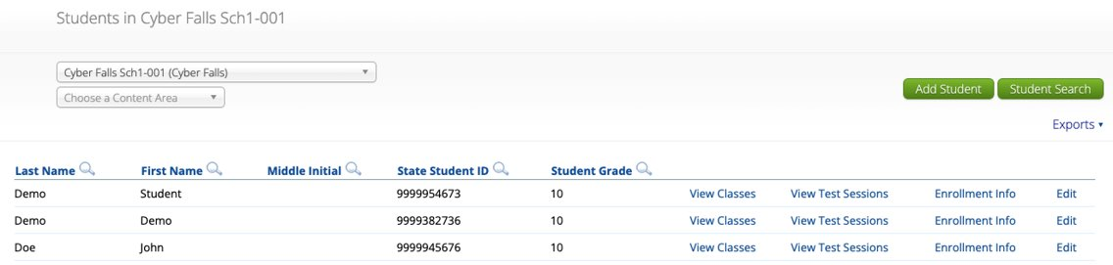
Resolving Incorrect Form-Dependent Accommodations: Before a Student Logs In
Step 1: Edit the student’s incorrect accommodation(s).
Log in to the MCAS Portal and click Administration.
Click Students in the top menu bar.
Locate the student you wish to edit and click Edit.
Update the accommodation for the student and click Save.

Slide 31
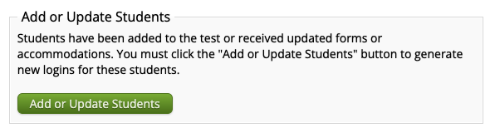
Resolving Incorrect Form-Dependent Accommodations: Before a Student Logs In (continued)
Step 2: Return to the test session details page and click the “Add or Update Students” button.
Click Test Scheduling in the top menu.
Select the correct school, content area, program (grades 3–8 or high school), and test name.
Locate the test session you wish to update and click View Details/Student Logins.
Click Add or Update Students.

Slide 32
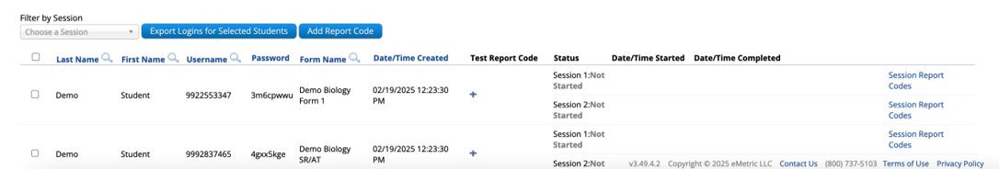
Resolving Incorrect Form-Dependent Accommodations: Before a Student Logs In (continued)
Step 3: Print the student’s new login.
Select the checkbox next to the student with the updated accommodation.
Click Export Logins for Selected Students.
Select PDF or CSV.
Click Export.

Slide 33
Resolving Incorrect Form-Dependent Accommodations: After a Student Logs In
Step 1: Have the student log out of the MCAS Student Kiosk completely.
Step 2: Edit the student’s incorrect accommodation(s).
Log in to the MCAS Portal and click Administration.
Click Students in the top menu bar.
Locate the student you wish to edit and click Edit.
Update the accommodation for the student and click Save.

Slide 34
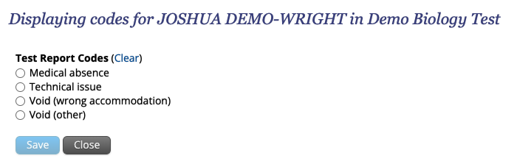
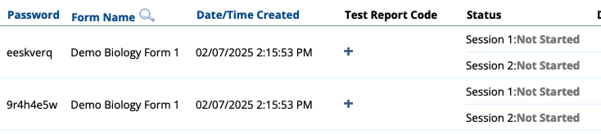
Resolving Incorrect Form-Dependent Accommodations: After a Student Logs In (continued)
Step 3: Add the Void report code for the test session the student already logged into.
Click Test Scheduling in the top menu.
Select the correct school, content area, program (grades 3–8 or high school), and test name.
Locate the class you wish to update and click View Details/Student Logins.
Locate the student with the incorrect accommodation. Click the + button to add a void report code for that test.
Select Void (wrong accommodation) and click Save.
Note: The student’s test will remain In Progress.

Slide 35
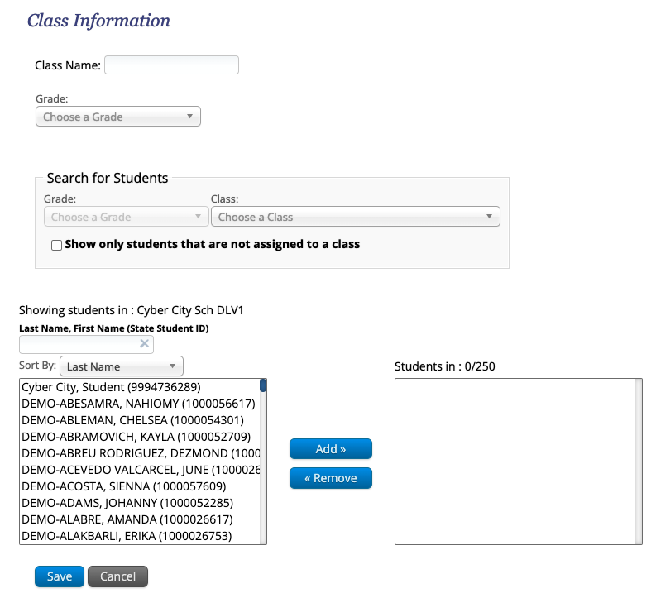
Resolving Incorrect Form-Dependent Accommodations: After a Student Logs In (continued)
Step 4: Add the student to a new class.
Click Classes in the top menu.
Select an organization from the organization drop-down list, and then select a subject from the subject drop-down list.
Select either the Course Level or Grade Level tab.
Note: Refer to the March 4 Tasks in the MCAS Portal Before Testing training webinar for information on grade-level and course-level classes.
Select Create Class.
Type the name of the class in the Class Name field.
Select a grade or course from the drop-down list.
Unselect the checkbox for “Show only students that are not assigned to a class” so that you can locate the student you need to add to the class.
Select the student and click Add.
Click Save.

Slide 36
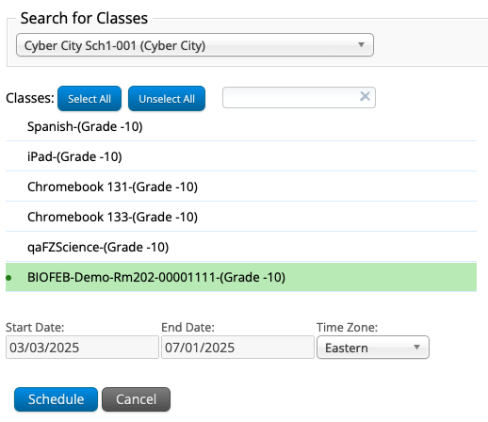
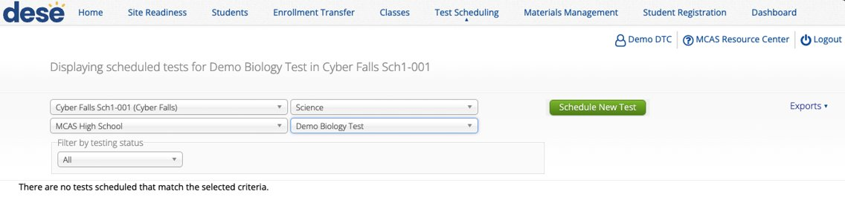
Resolving Incorrect Form-Dependent Accommodations: After a Student Logs In (continued)
Step 5: Schedule the new class to take the test and print the student’s new login.
Select Test Scheduling in the top menu.
Select the correct school, content area (ELA, mathematics, science, or civics), program (grades 3–8 or high school), and test name.
Note: Select the Spanish/English test from the drop-down menu for students taking this form.
Select Schedule New Test.
Select the name of the class just created and click Schedule.

Slide 37
Resources
Manuals
PAM, pages 68–71
CBT TAM, pages 133–135
Accessibility and Accommodations Manual

Slide 38
Questions and Answers
Use the “Q&A” feature
to ask questions.

Slide 39
4. Procedures for Students Who Do Not Test

Slide 40
Students Who Do Not Participate
If a student does not participate in testing, including first-year EL students for ELA, schools may choose to remove the student from any classes they have been assigned to in the MCAS Portal.
No additional steps are required.
Students who do not participate for medical reasons should have the MED report code added to their test.
Refer to steps on slide 72.

Slide 41
Logistics for Make-Up Testing
Students who are absent on the day of testing should be scheduled to make up the session.
All make-up testing must be completed within the windows listed in the Statewide Testing Schedule.
If a student has started testing, the school must leave that student in their original class.
Moving students between classes after they have started testing would create duplicate student records that must be removed.
If a student has not started testing, the school may choose to move the student to a new make-up class or leave them in the original class.
Refer to pages 26 and 50–51 of the PAM.

Slide 42
Moving Students Between Classes
Students should ONLY be moved between classes if they will be testing in a different group than the one originally assigned and they have not started testing.
Students who are moved to a new class will need a new student login.
Only principals/test coordinators and technology coordinators are able to move students between classes; test administrators do not have this permission in the MCAS Portal.

Slide 43
Demonstration
Moving a student between classes

Slide 44
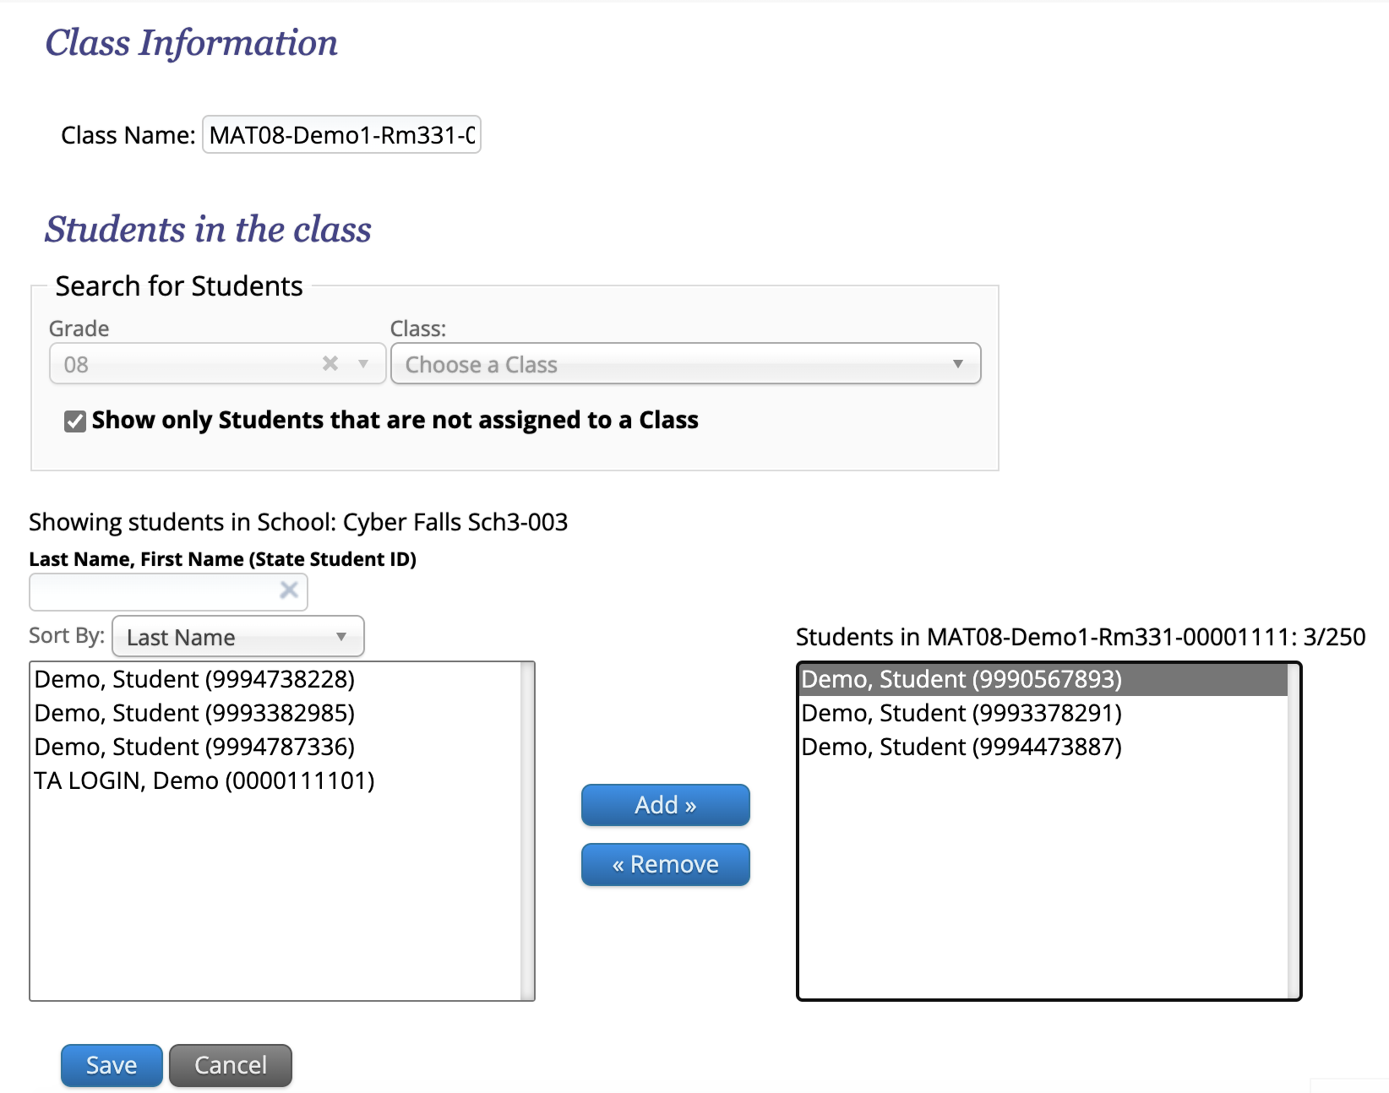
Before Testing Only: Remove the Student from the Original Class
Log in to the MCAS Portal and click Administration.
Click Classes in the top menu.
Select an organization and subject.
Select the Grade Level or Course Level tab.
Locate the class the student is currently assigned to.
Click Edit.
Select the student name from the list on the right.
Click Remove.
Click Save.

Slide 45
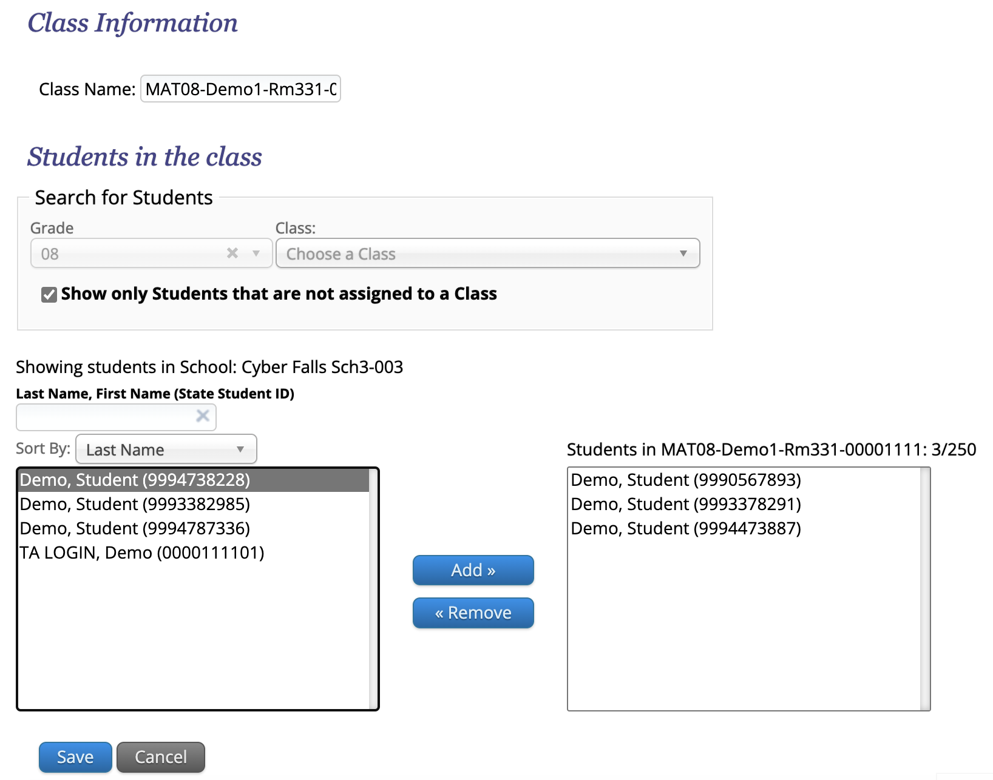
Adding a Student to an Existing Class
Log in to the MCAS Portal and select Administration.
Click Classes in the top menu.
Select an organization and subject.
Select the Grade Level or Course Level tab.
Locate the class the student should be added to.
Click Edit.
Select the student name in the list on the left.
You may need to uncheck the option “Show only students that are not assigned to a Class”
Click Add.
Click Save.

Slide 46
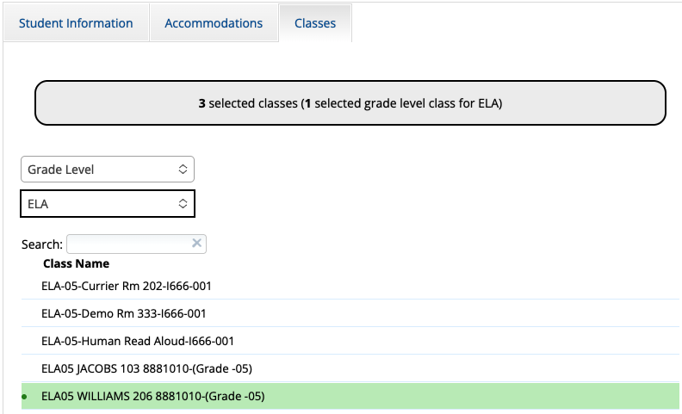
Moving a Student on the Students Page
Log in to the MCAS Portal, select Administration and click Students in the top menu.
Locate the student who needs to be moved from one class to another. Click Edit.
Select the Classes tab and select the appropriate class type and content area.
The class highlighted in green is the student’s current class assignment. Click this class to remove the student from that class.
The other classes listed are the possible classes the student can be moved to. Click the class to add the student to that class.
Click Save.

Slide 47
Resources
MCAS Portal Guides
Guide to the MCAS Portal, Part V: Creating and Managing Classes for Grades 3–8
Guide to the MCAS Portal, Appendix A: Creating and Managing Classes for High School Tests

Slide 48
5. Additional Tasks During Testing

Slide 49
Additional Tasks During Testing
Schools may need to complete the following tasks during testing:
Task | What roles are able to complete this task?
Access the proctor password | DTCs, STCs, test administrators, technology coordinators
Change the proctor password | DTCs, STCs
Unlock locked test questions | DTCs, STCs
Unlock test sections for grades 5 and 8 STE and grade 8 Civics | DTCs, STCs, test administrators, technology coordinators
Reactivate tests | DTCs
Add session or test report code | DTCs, STCs, technology coordinators

Slide 50
What is a proctor password and when is it needed?
A proctor password is an extra security measure, separate from a student’s individual password located on their student login. A proctor password is required in any of the following situations:
A student is idle in the test for more than 60 minutes. A student is “idle” if they do not interact in any way with the kiosk. This includes the use of any accommodation or tool, navigating through the test, or interacting with any of the on-screen widgets and answer choices.
A student pauses or exits the test and attempts to log back in to the test after more than 60 minutes have passed.
The MCAS Student Kiosk has experienced an abrupt closure, such as a loss of power, or the device is turned off while testing.
The proctor password will always be required on the Options page for students with the accommodation “Compatible Assistive Technology.”
The proctor password is available to test coordinators, test administrators, and technology coordinators in the MCAS Portal.

Slide 51
Updating the Proctor Password
The proctor password is the same for the whole school and is reset nightly.
If an individual student or a small group of students need to enter the proctor password, the test administrator should type it in for them.
If a larger group (such as a whole class) needs to enter the proctor password, then it can be read aloud or written on the board.
If the proctor password is given to a large group of students, it should subsequently be changed in the MCAS Portal by the principal or test coordinator.

Slide 52
Demonstration
Viewing the proctor password
Changing the proctor password

Slide 53

Proctor Password
To view the proctor password:
Log in to the MCAS Portal and select Administration.
Scroll to the bottom of the home page.
Locate the proctor password for the school.
To change the proctor password:
Log in to the MCAS Portal and select Administration.
Scroll to the bottom of the home page.
Locate the proctor password for the school and click Change.
Note: The proctor passwords are automatically updated nightly.

Slide 54
Unlocking Student Test Questions
In certain circumstances, a student may need to re-enter a test in the MCAS Student Kiosk.
In some cases (described on the next slide), questions that a student has previously answered will be automatically locked when the student signs back in. The student will not be able to return to those questions unless they are unlocked by a school or district test coordinator.

Slide 55
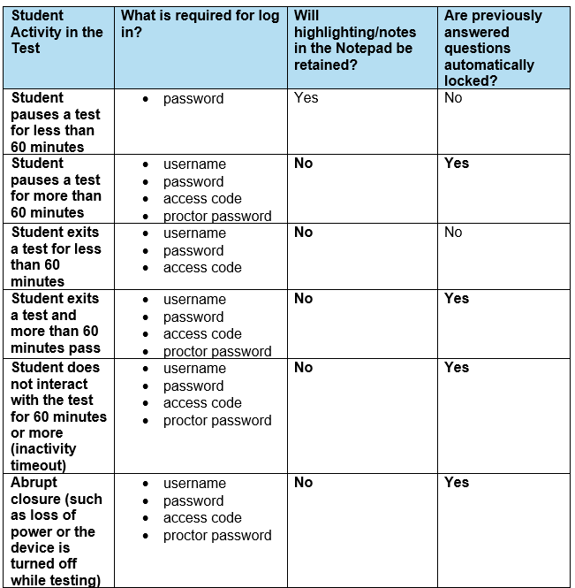
When will test questions lock?

Slide 56
Reactivating Student Test Sessions
If a student accidentally submits their test prior to finishing, district test coordinators are able to reactivate the test to allow the student to sign back in.
Only users with the district test coordinator role have this ability in the MCAS Portal.
Schools should contact their district test coordinator who can reactivate the test with the steps on slide 60.

Slide 57
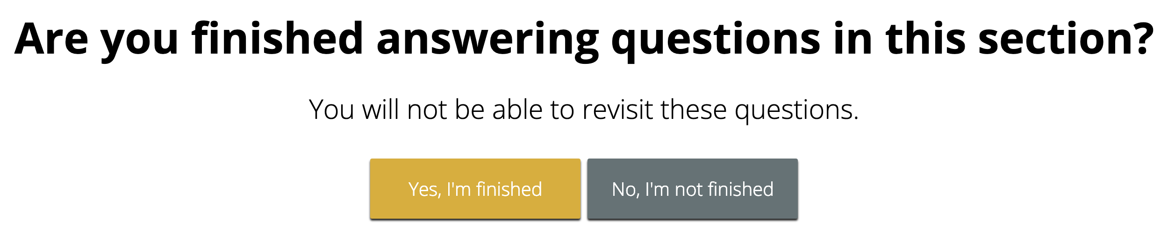
Section Unlocking – Grades 5 and 8 STE and Grade 8 Civics
Within the grades 5 and 8 STE and grade 8 Civics tests, there are two sessions (Session 1 and Session 2 for STE, the State-Level Performance Task and the End-of-Course (EOC) for Civics).
Within each session, there are two sections. Once a student has completed the first section, they will not be able to return to it.
The student will see a message at the end of the section:
If a student accidentally continues past the section but did not actually finish it, the test coordinator or test administrator may unlock the student’s section.

Slide 58
Demonstration
Unlocking locked questions
Reactivating test sessions
Unlock a test section for grades 5 and 8 STE and grade 8 Civics

Slide 59
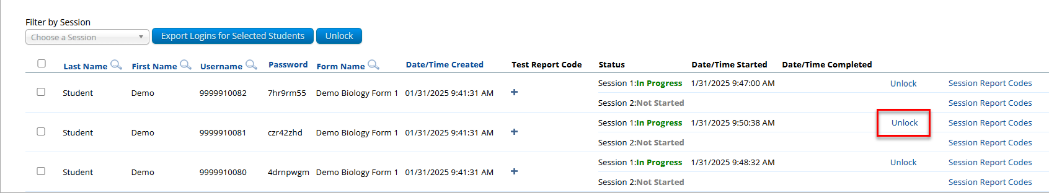
Unlocking Locked Questions
The test coordinator will unlock the test session.
Log in to the MCAS Portal and click Administration.
Click Test Scheduling.
Select the school, content area, program (grades 3–8 or high school), and test.
Locate the student’s class and click View Details/Student Logins.
Locate the student and click Unlock.
Then, the student will log in to the test again.

Slide 60
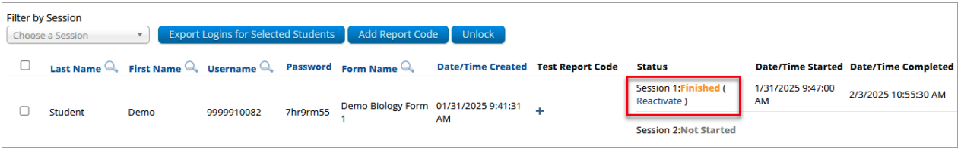
Reactivating Test Sessions
Log in to the MCAS Portal and click Administration.
Click Test Scheduling.
Select the school, content area, program (grades 3–8 or high school), and test.
Locate the student’s class and click View Details/Student Logins.
Locate the student and click Reactivate.

Slide 61
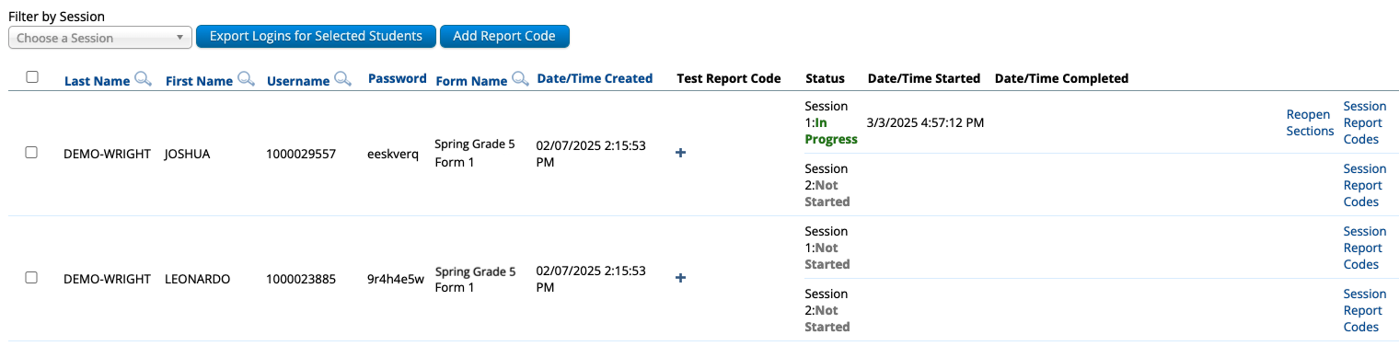
Section Unlocking for Grades 5 and 8 STE and Grade 8 Civics
Log in to the MCAS Portal and click Administration.
Select Test Scheduling in the top menu.
Select the correct school, content area, program (grades 3–8), and test name.
Locate the class the student is in and select View Details/Student Logins.
Locate the student and select Reopen Sections.
Ask the student to pause and exit the test and log back in.

Slide 62
Troubleshooting Scenarios that May Occur During Testing
Scenario | Issue | Resolution
The student is logging in to the test and sees the following message on the sign in page: Invalid username/password | The student is using the incorrect password or username when trying to log into the MCAS Student Kiosk. | Verify the correct username and password in the MCAS Portal and have the student retry. Note that student passwords will be printed in all caps, but the passwords themselves are case insensitive.
The student has successfully logged in with their username and password. On the student profile page, the student receives a message after entering the access code: Incorrect access code. Please try again. | The student is using the incorrect access code for the session selected or typing in the access code incorrectly. | Verify the correct access code in MCAS Portal and have the student retry.
Refer to Appendix A of the PAM for a full list of error messages.

Slide 63
Troubleshooting Scenarios that May Occur During Testing (continued)
Scenario | Issue | Resolution
While the student is taking the test, the student sees the message: Please raise your hand; your test session has timed out. | The student has timed out of their test session, meaning they have been inactive in the test for 60 minutes. | Click Exit and you will be brought back to the student testing interface sign in page. When the student is ready to continue testing, they will log back into the student testing interface and select the session they wish to continue and the proctor will enter the proctor password. The student will resume testing where they left off.
When the student turns in the test, the student sees the message: A connection to the network could not be established. Your test has been saved offline. | Internet connectivity was lost after the student began testing and was not restored by the time the student completed the test. The student completed the test session and clicked Turn in Test. The student’s responses will be saved to the local folder configured when the MCAS Student Kiosk was initially installed. | Enter the proctor password to acknowledge the message. Note the student’s device ID. Contact your technology coordinator to establish internet connection. Relaunch the MCAS Student Kiosk on the student’s device.

Slide 64
Student Questionnaire
The questionnaire should be administered after the final test session:
Mathematics Session 2 for grades 4 and 10
STE Session 2 for grades 5 and 8
Students will need to enter a separate access code in order to sign in to the questionnaire.
If a school is not administering the questionnaire, there are no additional steps to take in the MCAS Portal.

Slide 65
Resources
MCAS Portal Guides
Guide to the MCAS Portal, Part VI: Scheduling Tests, Printing Student Logins, and Other Tasks on the Test Scheduling Page

Slide 66
Questions and Answers
Use the “Q&A” feature
to ask questions.

Slide 67
6. Tasks After All Testing Is Completed

Slide 68
Updating Accommodations After Testing for Students Who Did Not Use an Accommodation
Update accommodations in the MCAS Portal for each content area test if a student refused or did not use an accommodation.
Test coordinators may edit the individual student by going to the Students page, locating the student and clicking Edit, or export the student registration file and re-import with updated accommodations.
Accommodations can also be updated during the discrepancy period.
More information about the 2026 discrepancy period will be shared in future Student Assessment Updates.
Important for accurate data reporting.

Slide 69
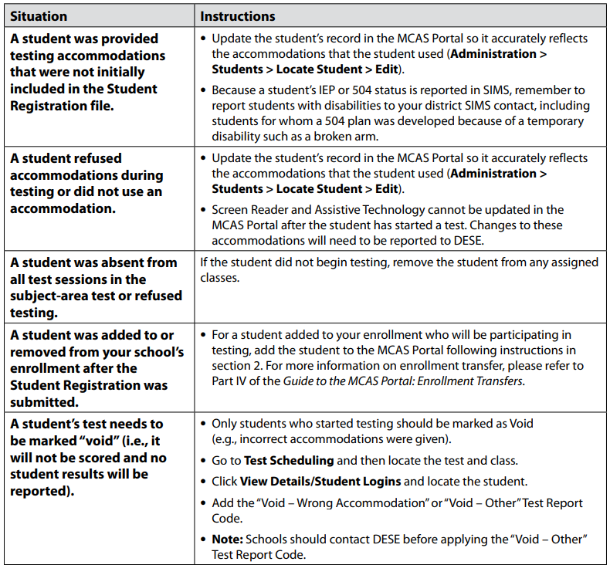
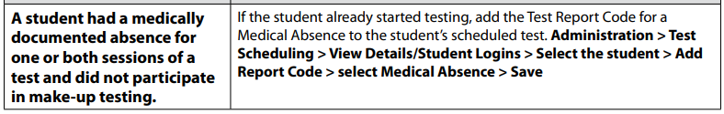
Confirming All Students Participated in Testing and Updating Student Information
Check rosters and confirm that all students participated in testing.
Refer to table on page 131–132 of the PAM for instructions on updating student information.

Slide 70
Adding Report Codes
In some circumstances, test coordinators may need to add report codes to students tests or test sessions.
Adding report codes will not change a student’s testing status (e.g., if a report code is added and the student is listed as In Progress, adding the report code will not change the student’s status to Finished).
Tests marked with the report codes listed below will not be scored.
Code | When to use it
Void (wrong accommodation) (VWA) | In situations involving incorrectly assigned form-dependent accommodations as described in slides 26-37
Void (other) (VO) | When voiding Test Administrator Logins In all other situations, schools must contact DESE before using this report code.
Medical absence (MED) | Students may be considered medically absent if they did not participate in MCAS testing for medical reasons and have medical documentation, even if they were physically present in school on MCAS testing days.
Technical Issue (TEC) | Schools must contact DESE before using this report code.

Slide 71
Demonstration
Adding test and session report codes
Medical absence
Technical issue
Void (wrong accommodation)
Void (other)
Bulk-adding report codes for one or more students

Slide 72
Adding a Test Report Code
If necessary, add a test report code for the test the student already logged into.
Select Test Scheduling in the top menu.
Select the correct school, content area, program (grades 3–8 or high school), and test name.
Locate the class you wish to update and click View Details/Student Logins.
Locate the student who requires the test be voided and click the + button.
Select the test report code and click Save.
Schools should contact DESE before selecting Technical issue or Void (other)

Slide 73
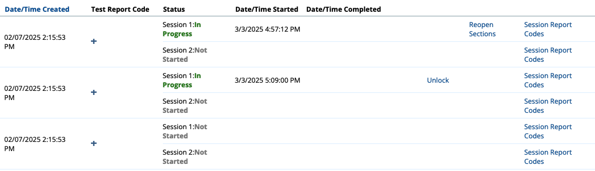
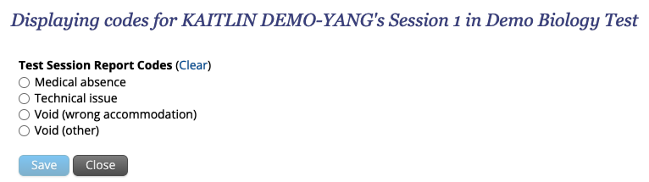
Adding a Session Report Code
If necessary, add a session report code for the test session the student already logged into.
Select Test Scheduling in the top menu.
Select the correct school, content area, program (grades 3–8 or high school), and test name.
Locate the test session you wish to update and click View Details/Student Logins.
Locate the student who requires the test session be voided. Click Session Report Codes.
Select the appropriate code and click Save.

Slide 74
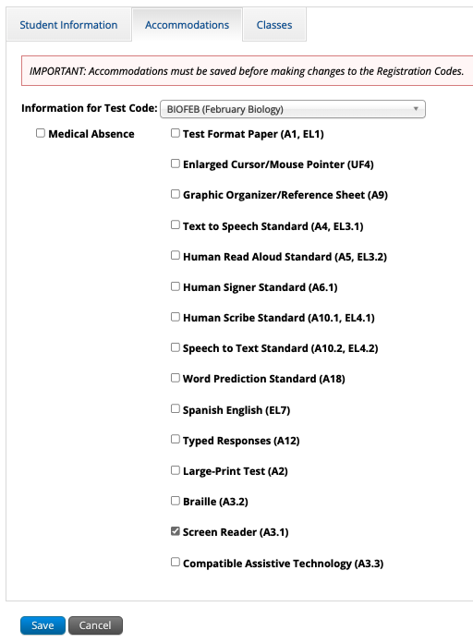
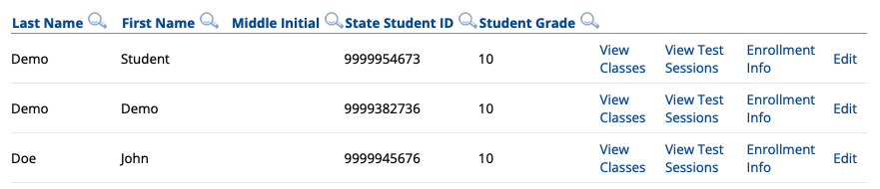
Adding Medical Absence for an Individual Student
Log in to the MCAS Portal and select Administration.
Select Students in the top menu.
Locate the student to be edited and click Edit.
On the Accommodations tab, check the box for Medical Absence for the correct test code and click Save.

Slide 75
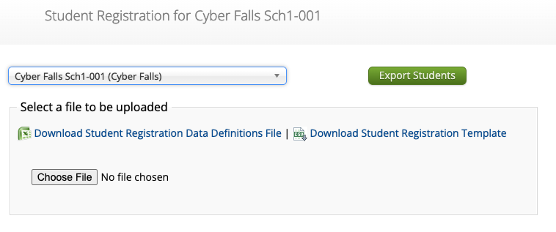
Bulk-Adding Medical Absence
Log in to the MCAS Portal and select Administration.
Select Student Registration in the top menu.
Select the school or district and click Export Students.
Update column M, Not_Tested_Reason, for the appropriate students.
Y = medical absence, blank = no medical absence.
Import the edited file on the Student Registration page.

Slide 76
Additional Tasks After Test Administration
Follow the steps listed in the PAM for all the tasks to complete after test administration.
Checklist of tasks after test administration appears on page 40.
The steps/descriptions begin on page 52.
Steps for completing the Principal’s Certification of Proper Test Administration (PCPA) and updating Student Registration are provided in the PAM, and the deadline dates for completing these tasks are included in the Statewide Testing Schedule.
Continue reading the Student Assessment Update and watch for announcements on the reporting schedule, including reporting discrepancies.

Slide 77
Deadlines to Complete the Principal’s Certification of Proper Test Administration (PCPA)
Administration | PCPA Deadline
Spring Grades 3–8 (ELA, Mathematics, STE, and Civics) | June 8
Grade 10 ELA and Mathematics | May 28
Spring High School Science | June 11

Slide 78
Resources
MCAS Portal Guides
Guide to the MCAS Portal, Part VI: Scheduling Tests, Printing Student Logins, and Other Tasks on the Test Scheduling Page

Slide 79
7. Test Administrator Tasks During and After Testing

Slide 80
Timeline of Tasks in the MCAS Portal to Complete Before and During Testing for Test Administrators
Up to 2 days before testing
Test Day
●Verify accommodations
● Verify student roster
● Distribute student logins to students
● Provide access codes to students
● Enter proctor password as needed
● Monitor student testing status in the MCAS Portal
● Assist with testing issues as needed
Note: Schools may choose to have the test coordinator complete these tasks instead of test administrators.

Slide 81
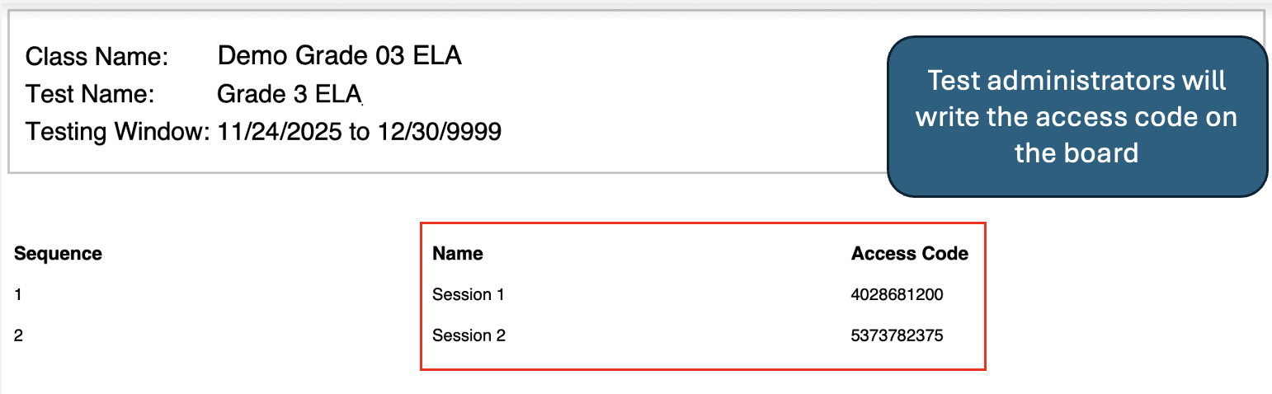
Access Codes
Test administrators will provide students with an access code to enter while signing in to each test.
Test administrators may not provide access codes for a session other than the one being administered.
Access codes are available:
On the View Details/Student Logins page in the MCAS Portal
On the student summary page (first page of PDF of printed student logins)

Slide 82
Tasks During Testing for Test Administrators
Test administrators may need to enter the proctor password in certain circumstances (slides 50–53)
Test administrators may monitor student testing status on the View Details/Student Progress page of the MCAS Portal (slides 18–19).
Test administrators should verify that all students in their class are in Finished status at the end of each test session.
Refer to the MCAS Portal Overview for Test Administrators module, available on the Training Modules page of the MCAS Resource Center.

Slide 83
Questions and Answers
Use the “Q&A” feature to ask questions.

Slide 84
8. Resources, Support, and Next Steps

Slide 85
Additional Resources
Resource | Location
MCAS Resource Center | mcas.onlinehelp.cognia.org
MCAS Portal user guides | https://mcas.onlinehelp.cognia.org/portal/
Technology Information | https://mcas.onlinehelp.cognia.org/technology-setup/
Student Assessment Updates (Biweekly email with important updates about the MCAS program) | www.doe.mass.edu/mcas/updates.html If you do not already receive this email, subscribe using this link: http://eepurl.com/ghSOhH

Slide 86
Upcoming Office Hours Session
Session | Date and Registration Link | Recommended Read-Ahead Materials
Office Hours: MCAS Portal Tasks | Thursday, March 19 at 9:30–10:30 a.m. | Guide to the MCAS Portal, located on the MCAS Portal page of the MCAS Resource Center

Slide 87
Next Steps
Today: Complete the evaluation form.
Responses are associated with the name and email address used to log in.
Email your input to mcas@mass.gov if you have problems accessing or completing the form.
Within one week:
Receive an email with the Q&A from this session
Recording will be available

Slide 88
Email and Phone Support
DESE Student Assessment Services
MCAS Service Center
Questions on logistics and technology
Web: https://mcas.onlinehelp.cognia.org/
Email: mcas@cognia.org
Phone: 800-737-5103
TTY: 888-222-1671
Live chat is available at the link on the bottom of the page at the MCAS Resource Center
Policy questions (e.g., student participation, accommodations)
Web: www.doe.mass.edu/mcas
Email: mcas@mass.gov
Phone: 781-338-3625
TTY: 800-439-2370

Slide 89
9. Live “Sandbox Time”

Slide 90
Poll Question
Which demonstrations would you like to see again?
Monitoring test status and exports on the Test Scheduling page
Resolving incorrect form-dependent accommodations
Move a student between classes
Adding report codes (Medical absence, Void)
Reactivating test sessions, unlocking locked questions, unlocking test section for grades 5 and 8 STE and grade 8 Civics

Slide 91




THANK YOU
The Office of Student Assessment Services
781-338-3625
mcas@mass.gov
www.doe.mass.edu/mcas
135 Santilli Highway, Everett, MA 02149

