Slide 1
Tasks in the MCAS Portal Before Testing
The Office of Student Assessment Services
March 4, 2026

Slide 2
Presenters
Jodie Zalk, Manager of Test Administration and Publications
Shannon Cullen, MCAS Test Administration Coordinator
Erma Brown, MCAS and ACCESS Test Administration Specialist
Abbie Currier, eMetric Sr. Project Manager

Slide 3
Logistics for This Session
Use the Q&A feature to ask a question.
We will answer some questions aloud at specified times during this training session, and we will email the Q&A afterwards.
Use the thumbs-up icon to “upvote” someone else’s question.
Email student-specific questions to mcas@mass.gov instead of asking here.
Closed captioning has been enabled for participants who need it.
This session is being interpreted into ASL. Our interpreting team will be onscreen with the presenters.
Please be advised that DESE does not authorize attendees to record or to use AI transcription tools during the meeting and DESE does not endorse any unauthorized transcripts created by third parties of its meetings.

Slide 4
Slides for This Session
Slides were emailed to participants before this session from MCASEvents@cognia.org.
Slides are now being posted in the chat.
If you cannot access the slides in the chat, ask in the Q&A.
After the session, we will send the slides again to participants, and they will be posted in the MCAS Resource Center along with the recording.

Slide 5
Today’s Agenda
Timeline of Tasks in the MCAS Portal
Updates to Student Registration
Creating and Managing Classes
Scheduling Tests and Printing Student Logins
Materials Management
Accessibility and Accommodations
Test Administrator Tasks Before Testing
Resources and Next Steps
Live “Sandbox” Time with Additional Demonstrations

Slide 6
Poll Question—3
What is your role? (Check all that apply.)
District test coordinator
School test coordinator
Principal
School counselor
Technology staff
Other district staff
Other school staff

Slide 7
Poll Question—3
How many years have you coordinated MCAS test administration?
0–This is my first year.
1 year
2–3 years
4–5 years
6+ years

Slide 8
1. Timeline of Tasks in the MCAS Portal

Slide 9
Timeline of Tasks in the MCAS Portal to Complete Before Testing for Principals/Test Coordinators
2 weeks before testing
●Create and assign students to classes
●Verify accommodations in the MCAS Portal
●Create test administrator logins if necessary (for certain accom.)
●Track delivery of materials through Materials Management
Up to one week before testing
●Schedule classes to tests
●Print student logins and summary sheets
Now
●Continue to update student registration information
●Enrollment Transfer Requests (as needed)

Slide 10
Timeline of Tasks in the MCAS Portal to Complete During and After Testing for Principals/Test Coordinators
During Testing
●Resolve incorrect accommodations
●Manage make-up testing
●Void tests as needed
●Unlock locked test questions (in certain circumstances)
After Testing
●Fill in Report codes as needed
●Void tests as needed
Test Day
●Distribute student logins and summary sheets to test administrators
●Monitor student testing status in the MCAS Portal

Slide 11
Timeline of Tasks in the MCAS Portal to Complete Before and During Testing for Test Administrators
Up to 2 days before testing
Test Day
●Verify accommodations
●Verify student roster
●Distribute student logins to students
●Provide access codes to students
●Enter proctor password as needed
●Monitor student testing status in the MCAS Portal
●Assist with testing issues as needed
MCAS Portal Overview for Test Administrators module now available on the Training Modules page of the MCAS Resource Center.

Slide 12
Timeline of Tasks to Complete for Technology Coordinators
●Review Appendix A of the PAM
●Review technology guidelines to verify that devices meet technology requirements
●Install updated kiosks if needed
●Verify access to MCAS Portal and MCAS Training Site
During Testing
●Troubleshoot issues as they arise
●Contact the MCAS Service Center with technology questions
Fall 2025
●Verify that devices meet the technology requirements
●Add provided URLs to exempt lists
●Download and install the updated MCAS Student Kiosk
●Conduct Site Readiness and Site Certification
Winter 2026
Additional information was shared in the MCAS Tasks for Technology Coordinators training on February 2, available on the MCAS Resource Center.

Slide 13
2. Updates to Student Registration

Slide 14
Manually Updating Student Information
Recommended when adding or updating fewer than 10 student records
Log in to the MCAS Portal with your username and password.
Select Administration.​
Select Students.
Select the Add Student button or locate the student to be edited and select Edit.
Add/edit student information as needed.
If the student has accommodations, select the Accommodations tab to enter the accommodations by test code. ​Note that students with accommodations for multiple tests will need the accommodations entered for multiple test codes.
Select Save.
Note:
The same fields provided through the student registration file may be entered manually.
If schools add or update a student taking PBT after the Student Registration deadline, they may need to place an additional materials order. See Appendix B of the PAM: Procedures for Paper-Based Testing for information.

Slide 15
Exporting and Reimporting Student Registration Files
Recommended when updating more than 10 student records
Log in to the MCAS Portal with your username and password.
On the MCAS Portal homepage, select Administration.
Select Student Registration from the top menu bar.
Select the organization from the organization drop-down.
Select Export Students. The exported file will be downloaded locally.
Use the Student Registration Data Definitions File to assist in updating the exported Student Registration file.
Update the fields in the Student Registration export file that need updating.
Save the file as a .CSV. The file is now ready for import.
Additional information is available as follows.
Overview of Student Registration training webinar, located on the Training Webinars page of the MCAS Resource Center
Guide to the MCAS Portal, Part III: Student Registration, located on the MCAS Portal page of the MCAS Resource Center

Slide 16
Overview of Enrollment Transfers
Students are loaded to the MCAS Portal once per school year, regardless of which administration(s) they are taking.
Schools will use the Enrollment Transfer feature in the MCAS Portal for transfer students who need to be registered for testing at their new school, who already exist in the MCAS Portal.

Slide 17
Overview of Enrollment Transfers (continued)
Schools will use the Enrollment Transfer page in the Portal as the first step when receiving a new student to determine whether the student exists in the MCAS Portal.
This page will tell you whether the student already exists in the MCAS Portal.
All school and district test coordinators associated with the sending school will receive email notifications for pending enrollment transfer requests.
Student test sessions do not transfer from one school to another. The sending school will use the Transfer Notes feature to indicate which sessions a student has already completed.
The receiving school will use this information to determine which test(s), if any, have already been taken.

Slide 18
Enrollment Transfer Overview
Tasks to Complete | Who will complete these tasks?
Request to transfer a student into your school and district. | STCs and DTCs may request to transfer a student.
Approve transfers other schools and districts have requested. | STCs and DTCs may approve student transfers. If a student does not currently belong to an organization, the MCAS Service Center will approve student transfers.
When a receiving school requests a student transfer, the DTC and STC users associated with the sending school will receive an email notification.

Slide 19
Demonstration
Transferring students within your district
Transferring students outside your district
Requesting student transfers
Approving student transfer requests
Entering and reviewing transfer notes

Slide 20
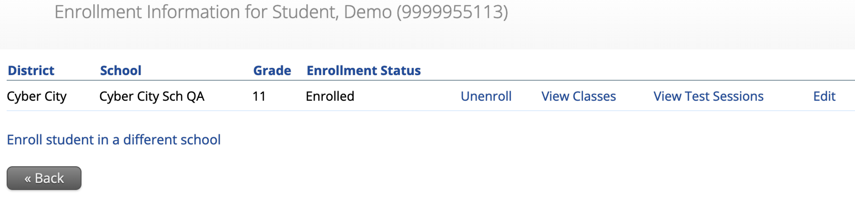
Transferring Students within a District
These steps can only be completed by a district test coordinator.
Sign in to the MCAS Portal and select Administration.
Click Students.
Locate the student you wish to update and click Enrollment Info.
Click Unenroll to unenroll the student from the current school and click Yes to confirm.

Slide 21
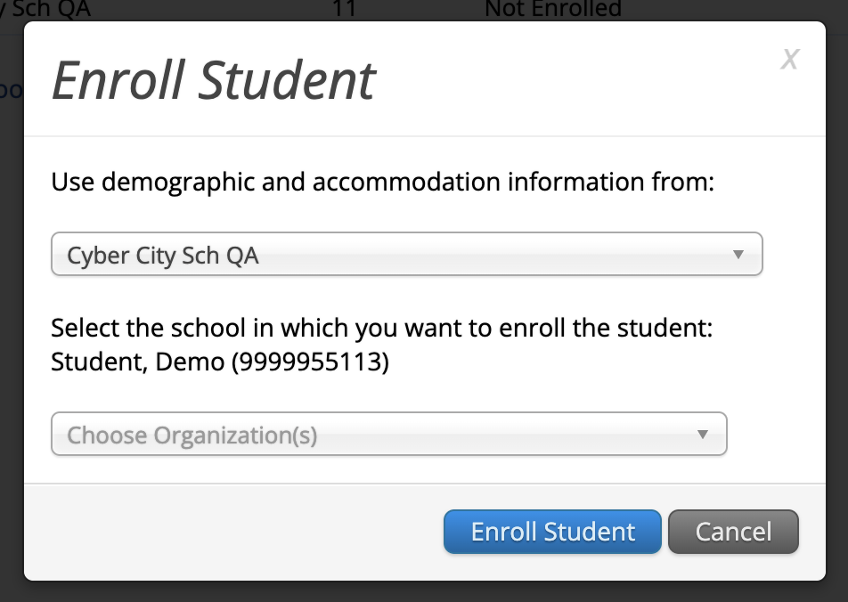
Transferring Students within a District (continued)
5. Click Enroll student in a different school.
6. Select the new school from the organization drop-down and click Enroll Student.
7. Ensure the student’s information is correct and click Save.
Note that only District Test Coordinators may transfer students within a district. School test coordinators should contact their DTC for assistance.

Slide 22
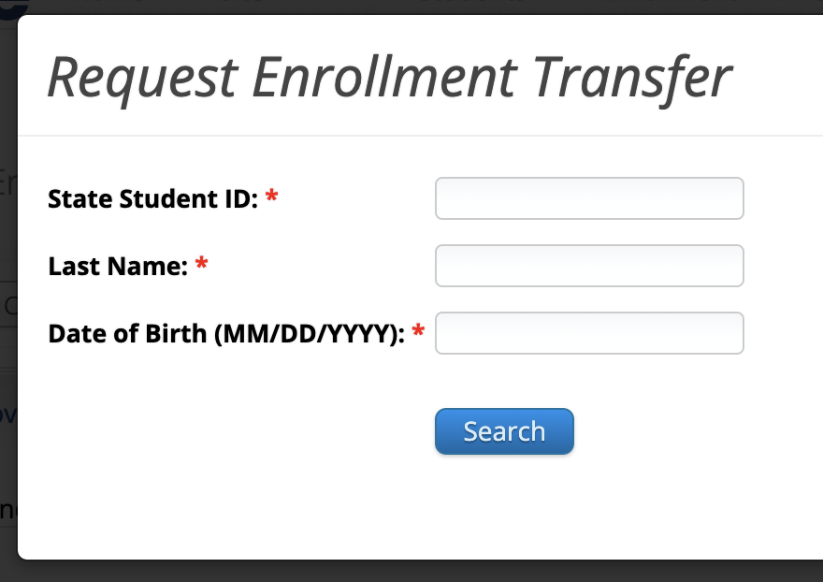
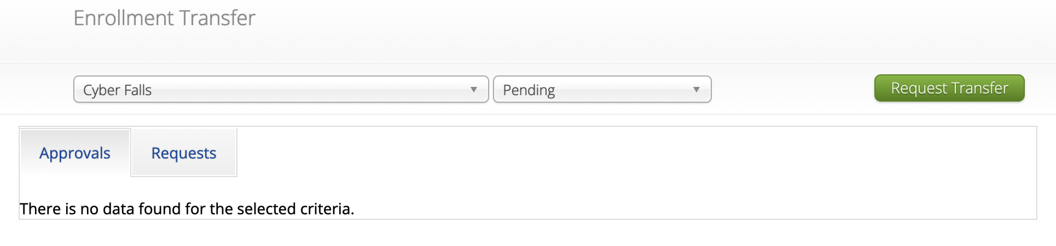
Transferring Students from Outside Your District: Requesting a Student Enrollment Transfer
Sign in to the MCAS Portal and select Administration.
Select Enrollment Transfer.
On the Enrollment Transfer page, select Request Transfer.
Enter the student’s SASID, last name, and date of birth.
Select Search.

Slide 23
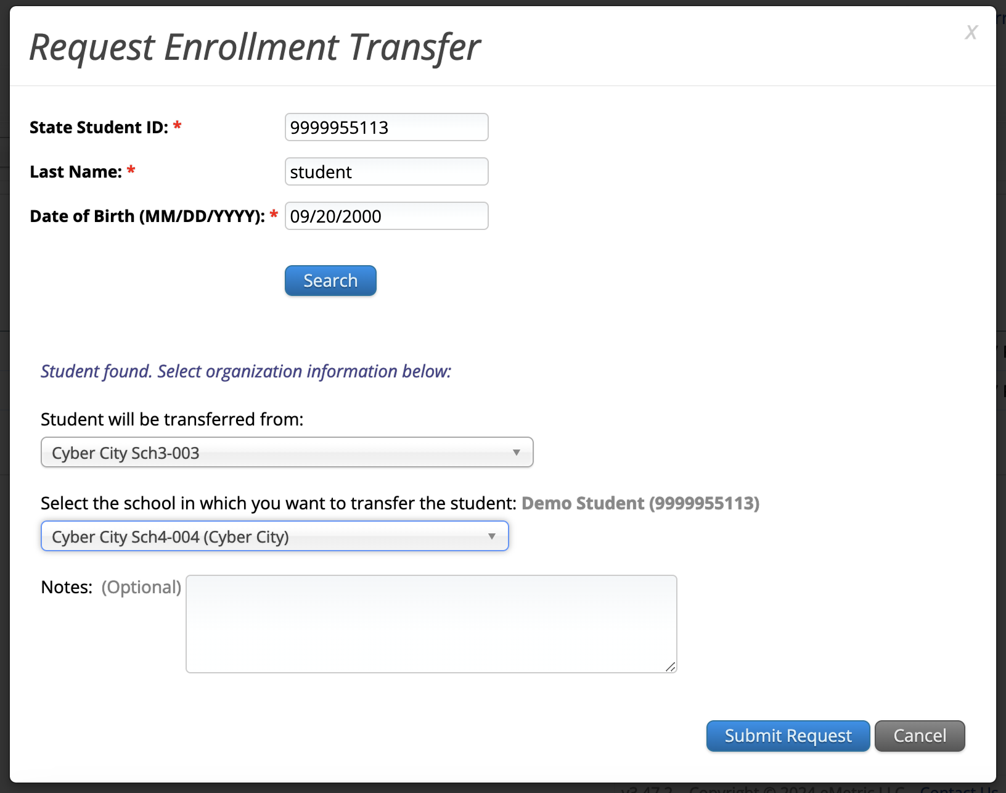
Transferring Students from Outside Your District: Requesting a Student Enrollment Transfer (continued)
If the student is found, select the school into which you want to transfer the student.
If this request is during the testing window, use the Notes to ask questions as needed.
Select Submit Request.

Slide 24
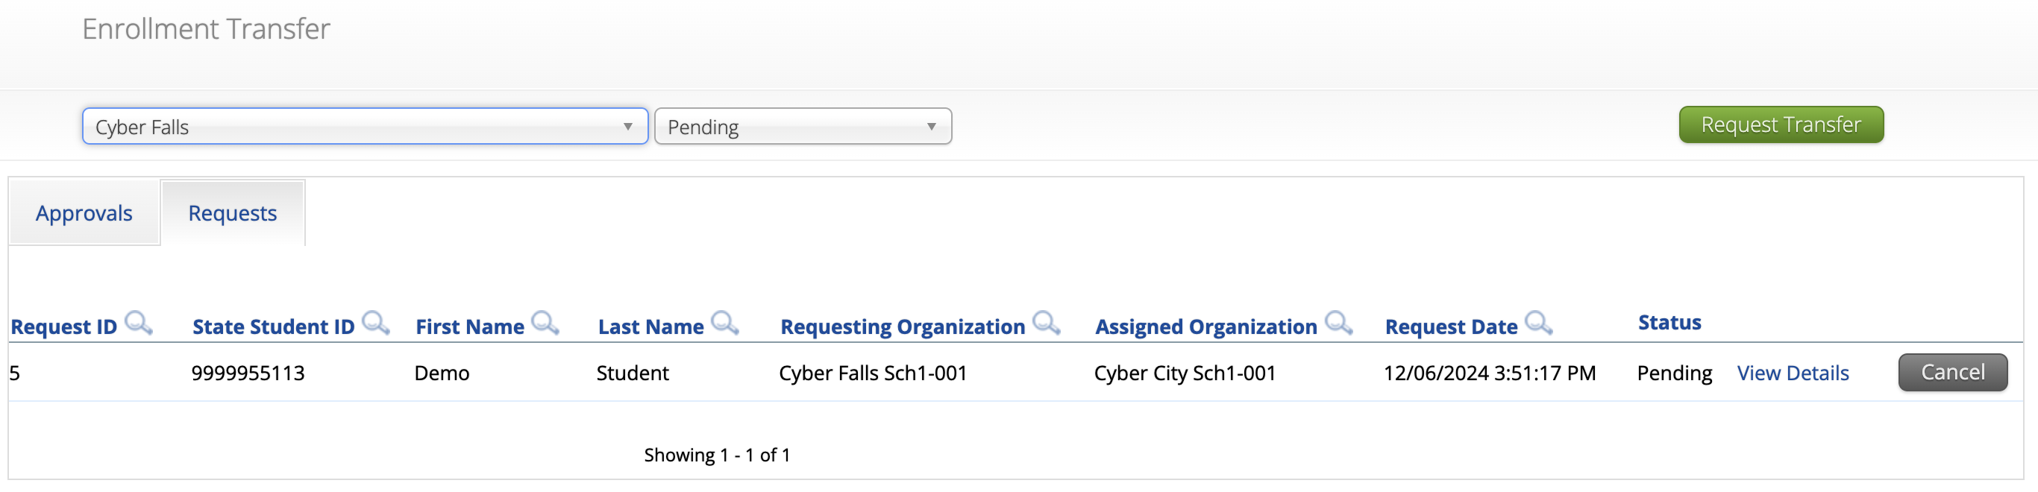
Transferring Students from Outside Your District: Requesting a Student Enrollment Transfer (continued)
Any student transfers you have initiated will appear on the Requests tab.
Select Cancel to cancel the transfer request.

Slide 25
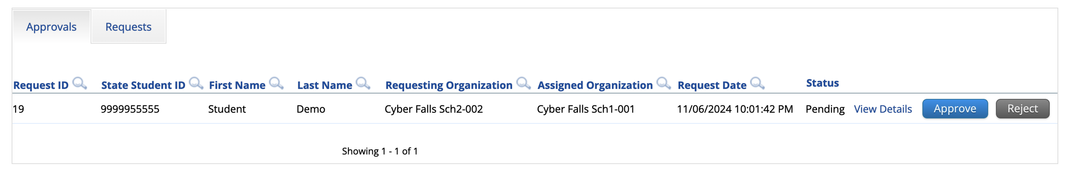
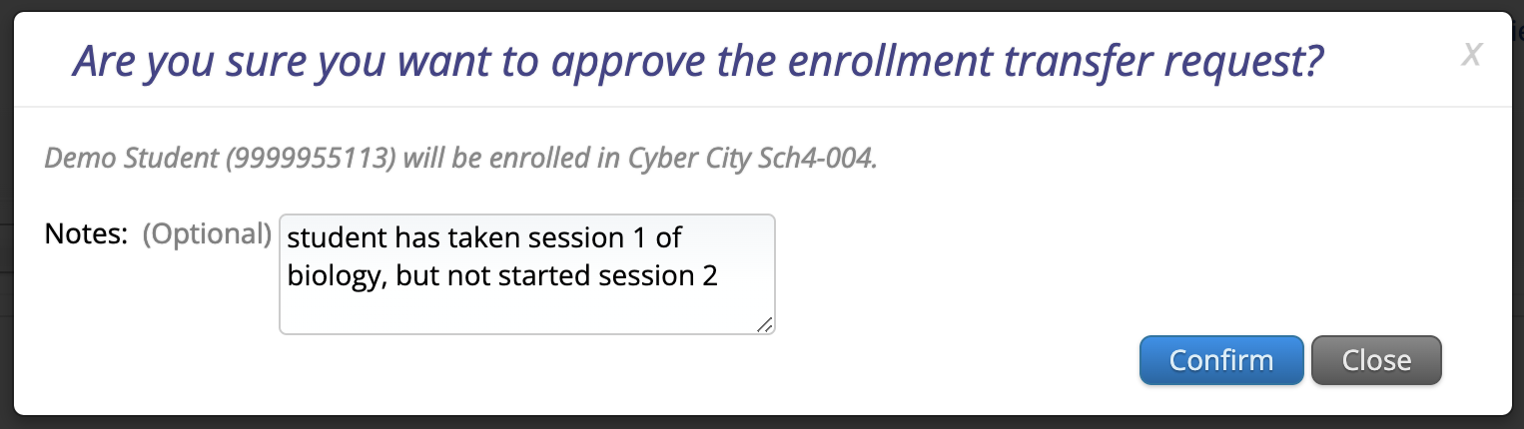
Approving a Student Enrollment Transfer
Any student transfers waiting for your approval will appear on the Approvals tab.
DTCs and STCs will be notified of enrollment transfers that need their review via email and on the Administration home page.
Review the request and add transfer notes. Click Approve to approve the transfer or click Reject to reject the request.

Slide 26
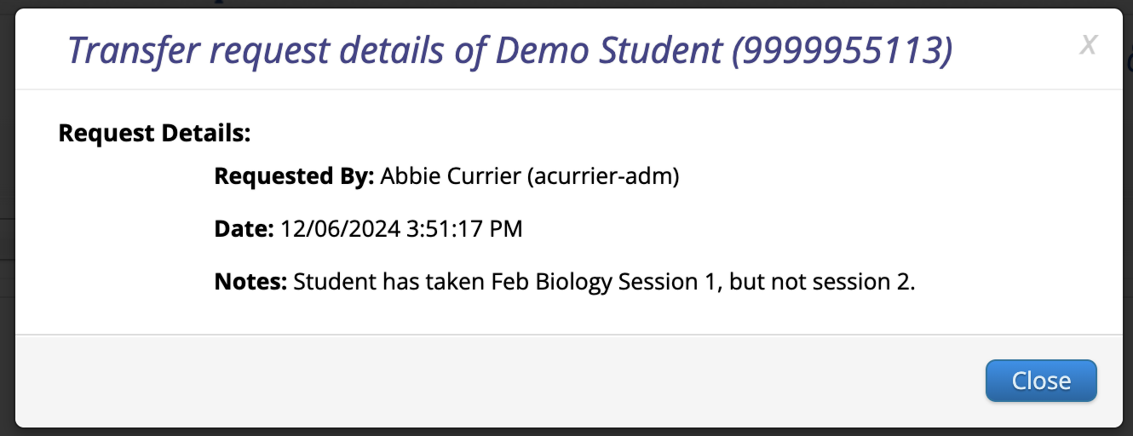
View Details
Student test sessions do not move from one school to another in the MCAS Portal. Schools will use the Transfer Notes feature to note any test sessions the student has already completed.
Schools can refer to the View Details screen at any time to view the Transfer Notes for an enrollment transfer.

Slide 27
Resources
MCAS Portal Guides and Guidance Documents | Student Registration Guide to the MCAS Portal, Part III: Student Registration Student Registration Data Definitions Student Registration Template Enrollment Transfers Guide to the MCAS Portal, Part IV: Enrollment Transfers
Training Modules | Student Registration for MCAS Transferring Students within a School District Transferring Students Between School Districts
Recordings of previous training sessions | Overview of Student Registration Tasks in the Portal: Spring 2026 Student Registration Office Hours

Slide 28
3. Creating and Managing Classes

Slide 29
What are classes in the MCAS Portal?
A class is a group of students in the MCAS Portal who will take the same test together.
Up to 250 students allowed in a class in the MCAS Portal.
Each class is subject specific.
For the following accommodations, students are required to be assigned to a separate class specifically designated for that accommodation:
Human Read Aloud
Human Signer
Spanish/English
Classes can be created during or anytime after student registration. DESE recommends creating classes approximately two weeks before testing to minimize changes needed.

Slide 30
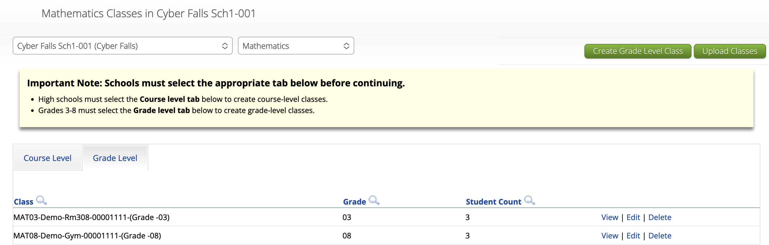
Course and Grade Level Classes
New for 2026, on the Classes page, there are two tabs for selection: Course Level and Grade Level.
Grades 3–8 must select the Grade Level tab to create and manage grade-level classes. Only students in that grade can be placed in each grade-level class.
High schools must select the Course Level tab to create and manage course-level classes. This allows high school students from any grade to be placed into the same class.

Slide 31
Creating Classes
There are three ways to create classes in the MCAS Portal.
For additional information on creating, editing, and deleting classes, see the Guide to the MCAS Portal, located on the MCAS Portal page of the MCAS Resource Center.
Part V: Creating and Managing Classes for Grades 3–8
Appendix A: Creating and Managing Classes for High School Tests.
Option to create classes | When would you use this option?
Option 1: Manually create classes one at a time in the MCAS Portal user interface | Recommended when creating four or fewer classes or when working with a small number of students
Option 2: Export the Student Registration file, enter the class names in column K of the file, and reupload the file. | Recommended when creating five or more classes or when working with a large number of students
Option 3: Create and upload a class upload file. | Recommended when creating five or more classes or when working with a large number of students

Slide 32
Class Naming Conventions
When creating classes, DESE recommends that schools use a naming convention that will help test administrators quickly and easily find the test they are administering.
It is suggested that class names include the following information:
test code
Refer to information on test codes on pages 45 and 46 of the Guide to the MCAS Portal, Part III: Student Registration, located on the MCAS Portal page of the MCAS Resource Center.
test administrator name
testing location
Note: When creating classes through the Student Registration file import, schools are recommended to include only the test administrator name and testing location in the class name field; the MCAS Portal will automatically add the test code to the class name.

Slide 33
Demonstration
Course-level vs. grade-level classes
Manually creating a class
Uploading multiple classes via Class Upload file
Uploading multiple classes via Student Registration file

Slide 34
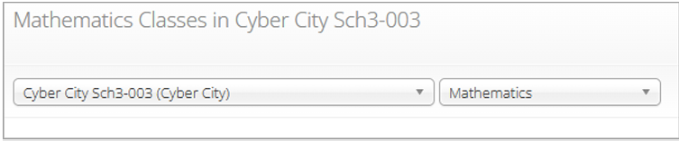
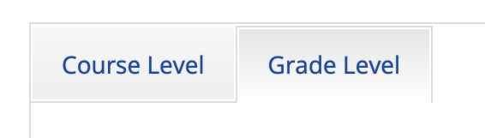

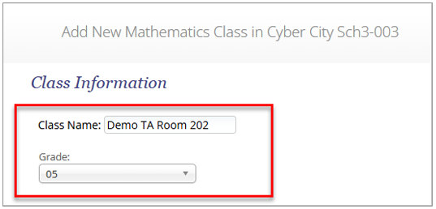
Manually Create a Class in the MCAS Portal
Log in to the MCAS Portal.
Select Administration.
Select Classes from the top menu bar.
Select an organization from the organization drop-down list, and then select a subject from the subject drop-down list.
Select either the Course Level or Grade Level tab.
Select Create Class.
Type the name of the class in the Class Name field and select a grade or course from the drop-down list.

Slide 35
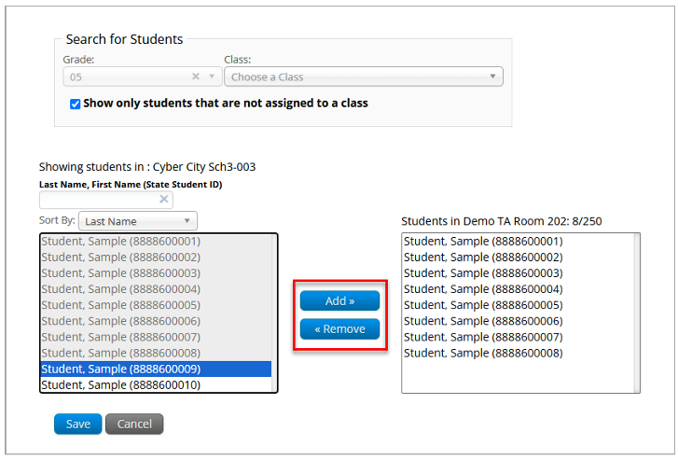
Manually Create a Class in the MCAS Portal
By default, the Show only students that are not assigned to a class checkbox is checked. Schools should keep this checkbox checked when assigning students to classes so that students are not mistakenly assigned to multiple classes for the same subject.
Note: Students can be added to multiple classes per subject in the Portal. Schools need to check that each student is only assigned to one class per subject area.

Slide 36
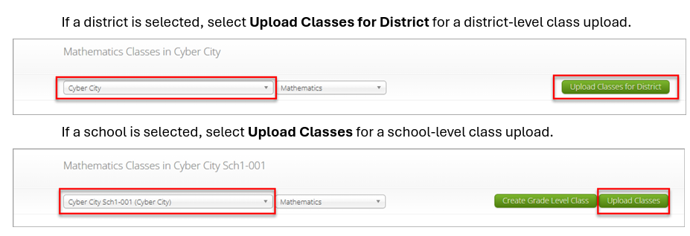
Uploading Multiple Classes via Class Upload file
Log in to the MCAS Portal.
Select Administration.
Select Classes.
Select a school or district from the organization drop-down menu. If a district is selected, select Upload Classes for District for a district-level class upload.

Slide 37
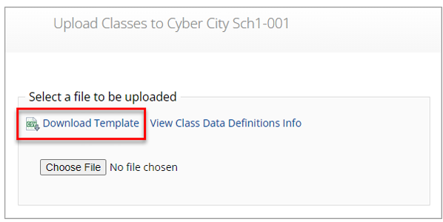
Uploading Multiple Classes via Class Upload file
On the Upload Classes page, select Download Template. Note that there are two separate templates: one for schools and one for districts.
Populate the fields in the template using the permitted values as outlined in the Class Data Definitions Info.
On the Upload Classes page, select View Class Data Definitions Info to view the headers and permitted values for each column in your Class Upload file.
The district template includes an additional column for the school code. The school code can be found on the School and District Profiles website if needed.
Save the file in CSV format.
Note: there is a limit of 10,000 records for each upload file.

Slide 38
Class Data Definitions Information
Class Name: Enter a class name. Refer to the Class Naming Conventions in section A1 of the Guide to the MCAS Portal, Part V: Creating and Managing Classes for Grades 3–8 and Appendix A: Creating and Managing Classes for High School Tests on the MCAS Portal page of the MCAS Resource Center for additional information.
Content Area: Enter the content area for the class: Mathematics, ELA, Science, or Civics.
ClassType: Enter “grade” or “course” for class type.
Grade/Course: For grades 3–8: Enter the grade. Leading zeros will be required.
For high school: Enter the course (Mathematics, ELA, Biology, Introductory Physics)
School Code: Only applicable to district-level class uploads. The School Code column will require the format of “district code-school code”. For example, if the district code is 00990000 and the school code is 00999987, the School Code column should be entered as 00990000-00999987.
State Student ID: Enter the students’ SASID.

Slide 39
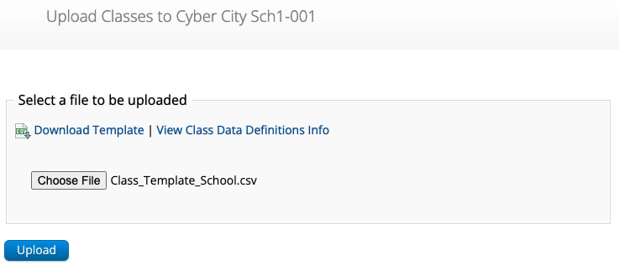
Uploading Multiple Classes via Class Upload File (continued)
On the Upload Classes page in the MCAS Portal, click Choose File, select the .CSV file you saved locally, and then click Upload.

Slide 40
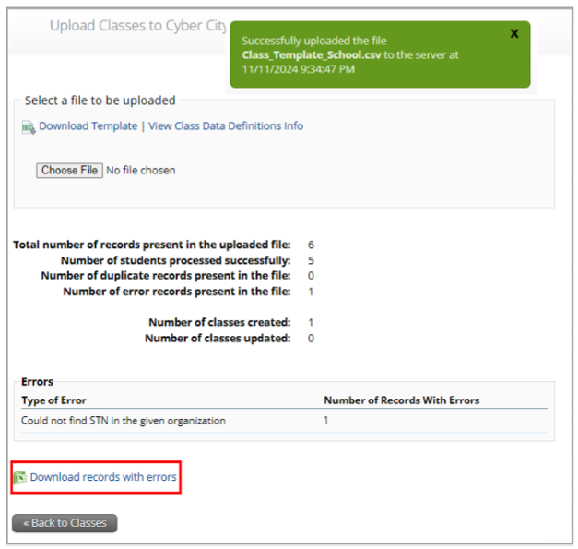
Uploading Multiple Classes via Class Upload File (continued)
After the upload has been processed, you will see the following information on the screen:
A green success message at the top of the page letting you know that your file has been uploaded and processed.
Number of students processed successfully
Number of duplicate records present in the file
Number of error records present in the file
A table showing the records in the file.
Click Download records with errors to download a file of the errors found.

Slide 41
Class File Upload: Error Messages
Error | How to Resolve the Error
The uploaded file is not in the expected format. Please download and use the template provided via the Download Template link. | Verify that the file is in .CSV format, and make sure the headers in the file match the template.
Could not find SASID in the given organization | Correct the student’s SASID in the .CSV file.
Length of class name cannot exceed 50 characters | Update the Class name(s) in the .CSV file to a name with 50 characters or less.
Class name is missing | Add the Class name(s) to the .CSV file.
Class name cannot contain a ‘|’ character | Remove the ‘|’ character from the class name.
Grade does not exist or Invalid Grade | Correct the Grade to a permitted grade number. (03, 04, 05, 06, 07, 08)
Grade is missing | Add a valid Grade.

Slide 42
Class File Upload: Error Messages (continued)
Error | How to Resolve the Error
Invalid ClassType | Correct the ClassType to grade.
Invalid ContentArea | Correct the ContentArea to a permitted value. Content areas must match the Class Data Definitions exactly.
Student grade does not match with class grade | Verify that the student’s grade matches the grade of the class being created.
Course does not exist | Correct the course to a permitted value.
CourseCode is missing | Add a course.
Course does not belong to subject | Correct the course to a permitted value.
Invalid Grade/Course | Correct the grade or course to a permitted value. For grades 3–8, leading zeros are required.

Slide 43
Uploading Classes via Student Registration Export/Import
Log in to the MCAS Portal with your username and password.
On the MCAS Portal homepage, select Administration.
Select Student Registration from the top menu bar.
Select the organization from the organization drop-down.
Select Export Students. The exported file will be downloaded locally.
Fill in column K with the class names.
Save the file as a .CSV.
Follow the instructions in the Guide to the MCAS Portal, Part III: Student Registration, located on the MCAS Portal page of the MCAS Resource Center, to import the updated file.

Slide 44
Creating Classes FAQs
Q. Why do I need to wait until two weeks before testing to create classes?
A. Test coordinators may create classes at any time during or after Student Registration up until testing. DESE recommends waiting until two weeks before testing to minimize the changes needed to class assignments.
Q. Can I create classes via Student Registration export/import now for ELA, and then do another export/import later for Math, STE, and Civics?
A. Yes.
Q. Do small groups need to be placed in separate classes?
A. A class is meant to be a group of students testing in the same place at the same time, so typically each group of students testing in a separate location would be its own class.
Q. Can a class name be changed after students have been assigned to the class?
A. Yes, after a class has been created, the class name can be updated in the MCAS Portal user interface. Class names cannot be changed through the student registration file upload.

Slide 45
Creating Classes FAQs (continued)
Q. How do we move students from one class to another?
A. This must be done manually in the MCAS Portal user interface, on the Classes page. You would remove the student from one class and then add them to the next class.
Q. Can a class have students from different grade levels?
A. Only for high school tests. Grades 3–8 classes are grade-level only, and so they are grade-specific.

Slide 46
Resources
MCAS Portal Guides
Guide to the MCAS Portal, Part V: Creating and Managing Classes for Grades 3–8
Guide to the MCAS Portal, Appendix A: Creating and Managing Classes for High School Tests
Training Modules
Creating Classes for MCAS (updated version for 2026 to be available soon)

Slide 47
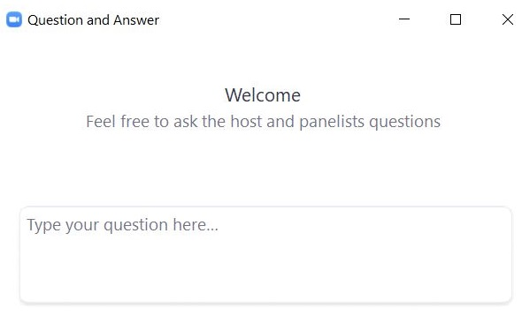
Questions & Answers
Use the “Q&A” feature to ask questions.

Slide 48
4. Scheduling Tests and Printing Student Logins

Slide 49
Scheduling Tests
Schools will need to “schedule” classes for tests in order to assign test forms and create student logins.
Student logins cannot be printed until after tests are scheduled.
Test coordinators will need to schedule tests approximately one week prior to test administration.
The Statewide Testing Schedule lists the dates that test scheduling should be completed for each administration.

Slide 50
Printing Student Logins
Student logins contain the sign-in information that students need to type in to begin each test session.
Students use the same student login for each subject area test (e.g., Jon Ward has one login for grade 4 ELA sessions 1 and 2, and a different login for grade 4 Mathematics).
Schools may print student logins up to one week in advance; DESE recommends printing student logins one to two days in advance of testing.
Student logins are considered secure and must be tracked.
Note: Test coordinators may also need to create and print test administrator logins for test administrators administering the Human Read-Aloud and Human Signer accommodations.
See instructions in Appendix C of the PAM.

Slide 51
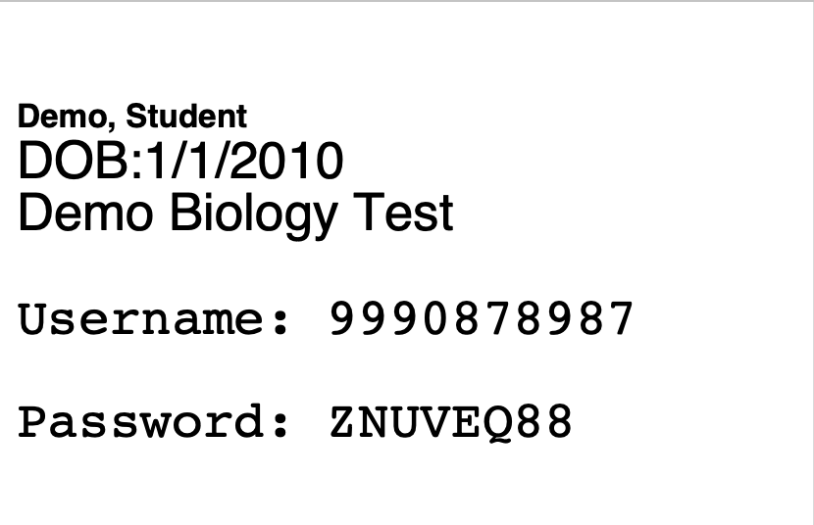
Student Logins
Advise your test administrators to check that each student has the correct student login.
Students should verify their name and date of birth on the student login.
Students can also verify their name on the Hello screen in the MCAS Student Kiosk.

Slide 52
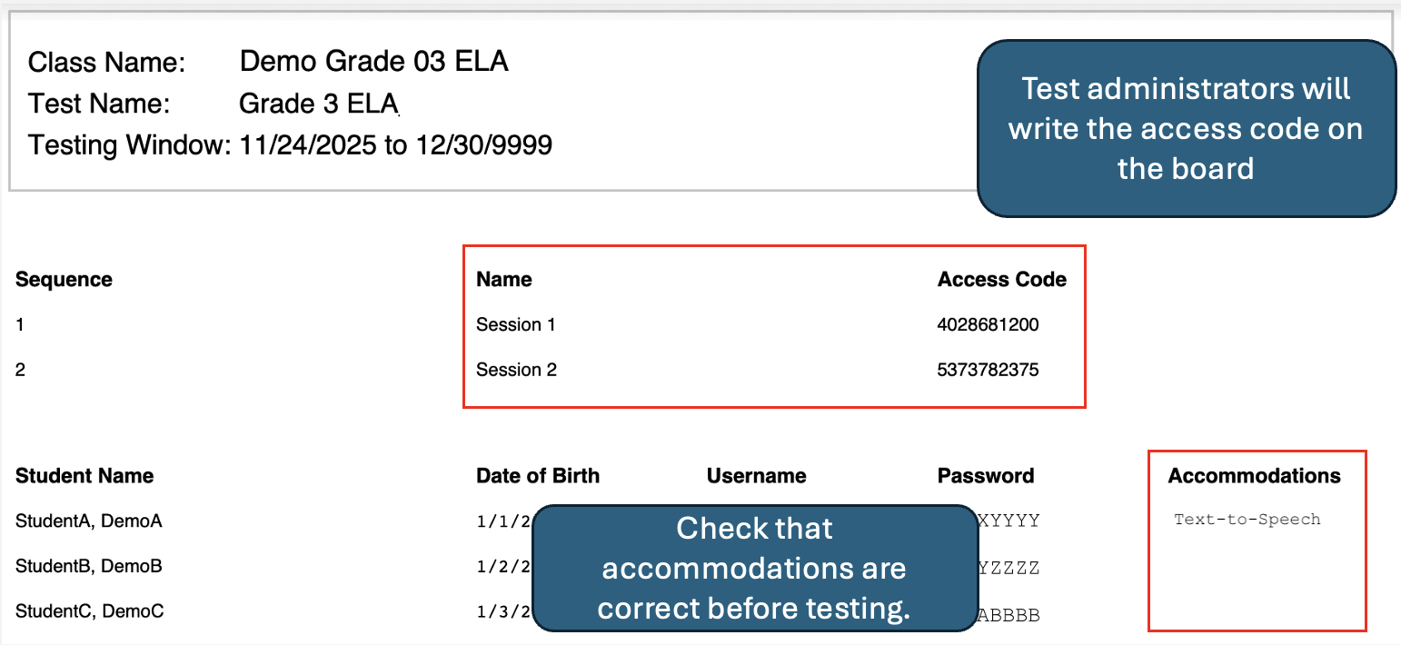
Student Summary Pages
When printing student logins as a PDF, the first page of the document will be a student summary page.
Test administrators can use this page to find the access codes and verify the student roster, usernames and passwords, and accommodations.

Slide 53
Demonstration
Scheduling a test for multiple classes
Scheduling a Spanish/English test
Printing student logins and summary pages
Printing student logins in bulk

Slide 54
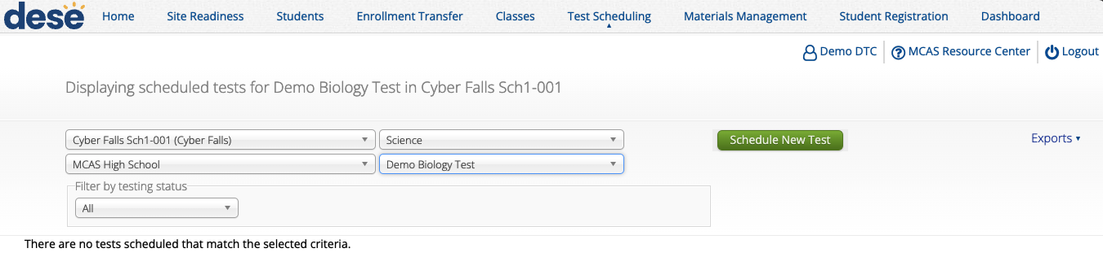
Scheduling a test for multiple classes
Log in to the MCAS Portal and select Administration.
Select Test Scheduling.
Select the correct school, content area (ELA, mathematics, science, or civics), program (high school or grades 3–8), and test name.
Select Schedule New Test.

Slide 55
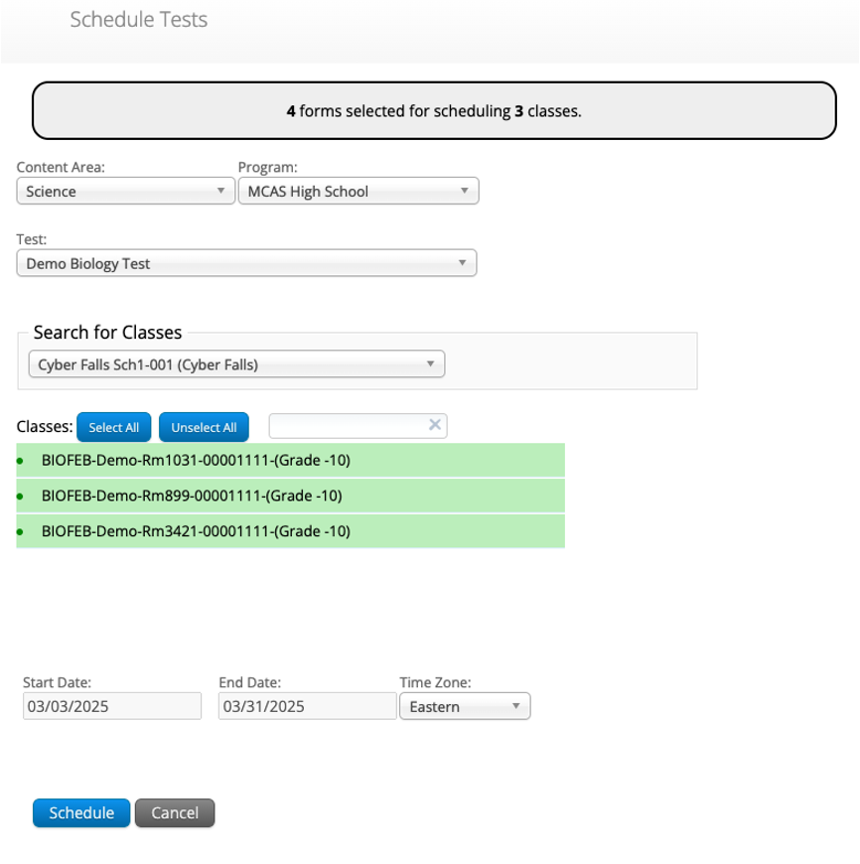
Scheduling a test for multiple classes (continued)
5. Select the classes to be scheduled.
6. Click Schedule.

Slide 56
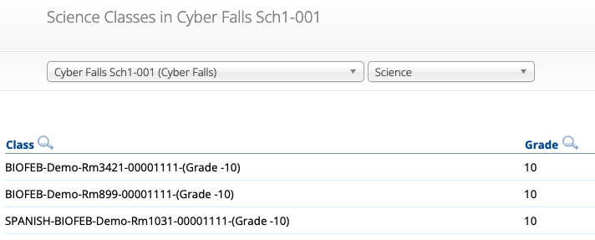
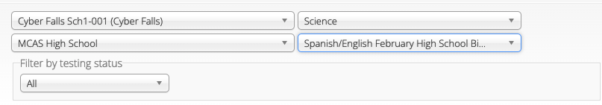
Scheduling a Spanish/English test
Create a separate class for all students taking a Spanish/English test for that grade and content area.
Include the word “SPANISH” at the beginning of the class name.
Schedule the Spanish class to take the Spanish/English test.
Ensure the correct class is scheduled for the correct test.
The class name should include the word “SPANISH.”
The test name should include the words “Spanish/English.”
Refer to the recording of the Overview of the Spanish/English MCAS Tests training webinar on the Training Webinars page of the MCAS Resource Center.

Slide 57
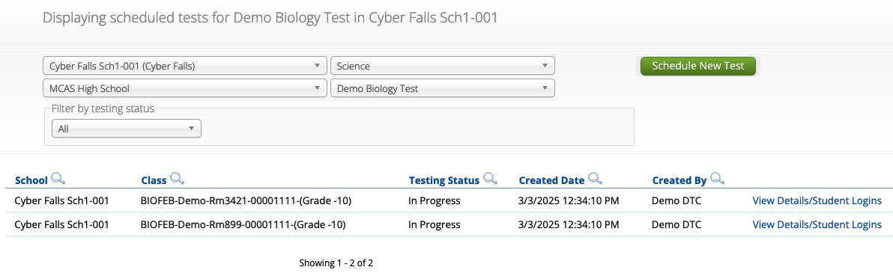
Printing Student Logins by Class
Log in to the MCAS Portal and select Administration.
Select Test Scheduling.
Select the correct school, content area (ELA, mathematics, science, or civics), program (high school or grades 3–8), and test name.
Select View Details/Student Logins.

Slide 58
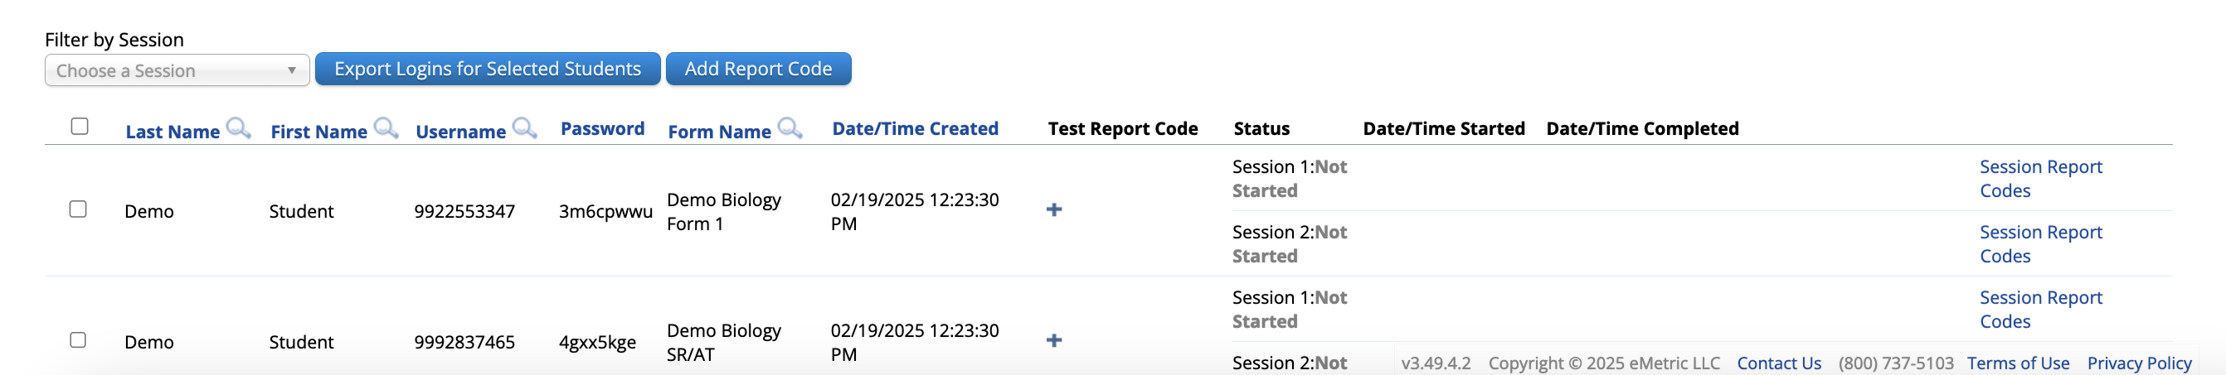
Printing Student Logins by Class (continued)
Select the student logins to print or select the checkmark in the column heading to select all students.
Select Export Logins for Selected Students.
Select either a PDF or CSV file.
When selecting PDF, select 1, 8, or 27 student logins per page.

Slide 59
Printing Student Logins in Bulk
New for 2025–26: Student logins can be exported in bulk on the Test Scheduling page as a PDF or .CSV in two ways:
for a selected school and test (e.g., all grade 5 Math).
for all tests scheduled within a selected subject for the selected school (e.g., all Mathematics tests for the whole school).
When exporting logins in PDF format, all student logins will be included in a single file, with a summary page break separating each class. The logins will be organized alphanumerically by class name, and then alphabetically by student last name.
When exporting in .CSV format, all session logins will also be combined into one file, with the class name inserted between each class to indicate the separation.

Slide 60
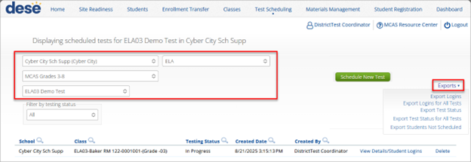
Printing Student Logins in Bulk (continued)
To export student logins in bulk as a PDF/.CSV for a scheduled test, follow the steps below:
On the Test Scheduling page, select the organization from the Organization drop-down menu.
Select the program from the Program drop-down menu (MCAS Grades 3–8 or MCAS High School).
Select the subject from the Subject drop-down menu.
If printing for a selected test, select a test from the Test drop-down menu. If printing for a content area, skip to step 5.
Then select Exports to expand the exports menu.

Slide 61
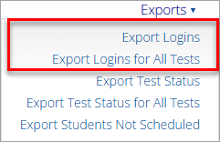
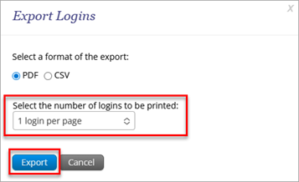

Printing Student Logins in Bulk (continued)
If printing for a selected test, select Export Logins. If printing for a content area, select Export Logins for All Tests.
A pop-up will be shown with the option of choosing PDF or CSV. Select PDF or CSV.
Select the number of student logins to be printed per page (1, 8, or 27 logins per page) if PDF was selected, and then click Export.
A pop-up message will appear to notify the user that the results are available in Downloads and will contain a clickable link to access Downloads.
To download the login export, navigate to the Downloads section from the MCAS Portal homepage to access the file.

Slide 62
Scheduling Tests & Printing Logins FAQs
Q. If accommodations change after tests are scheduled and logins are printed, do we need to reschedule the test and reprint the student’s login?
A. If a student has a form-dependent accommodation that is updated, a new login will need to be printed.
Q. Do tests need to be scheduled before I can print student logins?
A. Yes.

Slide 63
Resources
MCAS Portal Guides
Guide to the MCAS Portal, Part VI: Scheduling Tests, Printing Student Logins, and Other Tasks in the Test Scheduling Page
Training Module:
Scheduling Tests
Exporting and Printing Student Logins

Slide 64
Questions & Answers
Use the “Q&A” feature to ask questions.

Slide 65
5. Materials Management

Slide 66
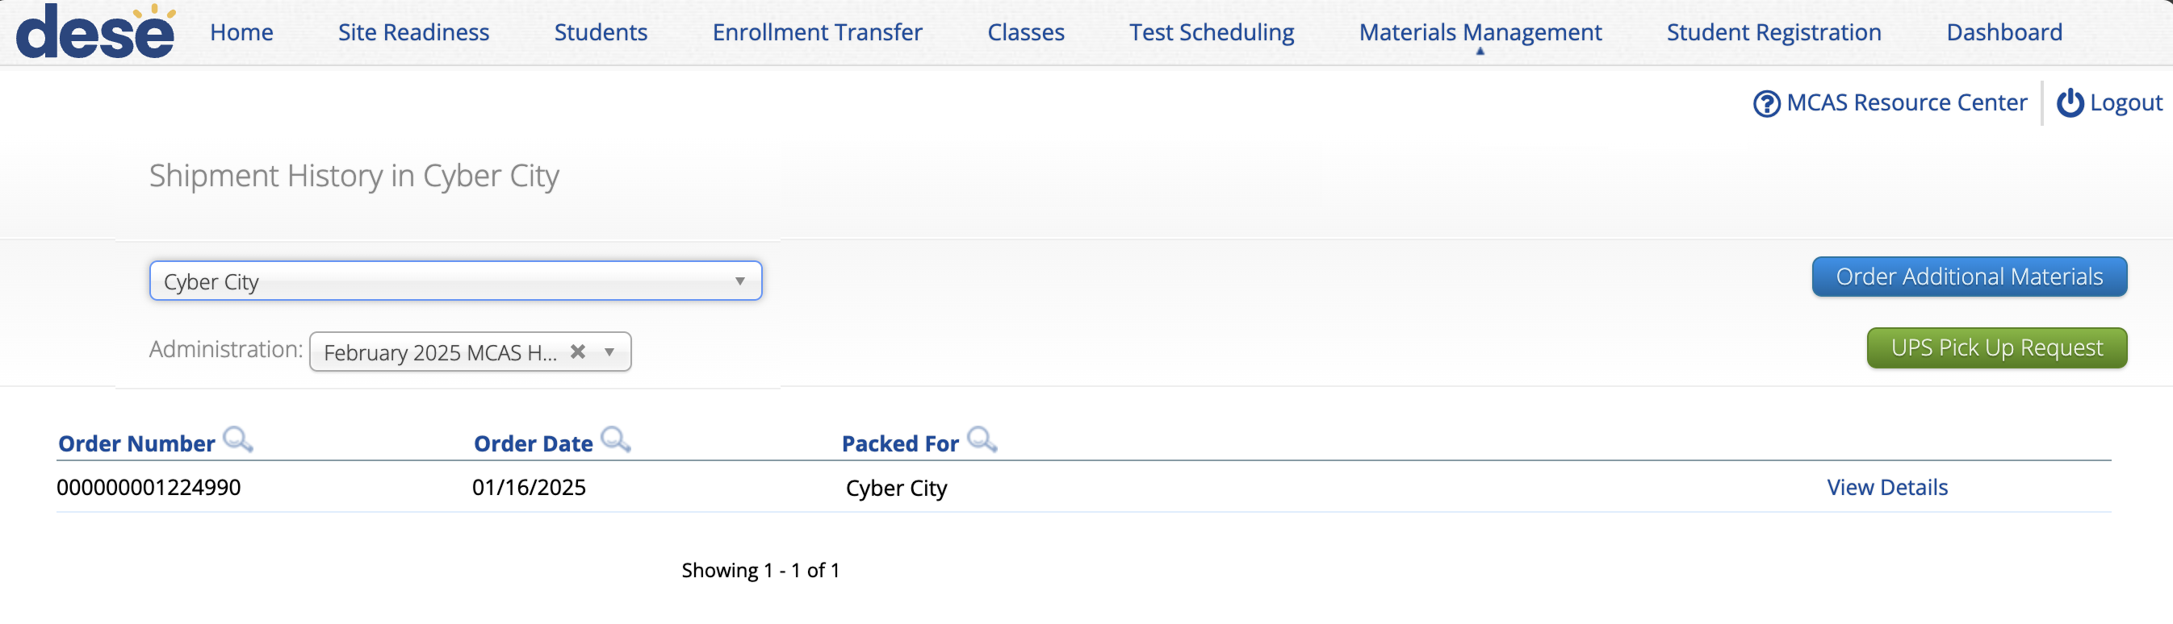
Materials Management
The Materials Management page in the MCAS Portal provides a view of shipments of materials being delivered to schools. Schools will be able to see materials shipments listed on this page once they are shipped.
This is an optional feature that schools may find useful to track shipments.

Slide 67
Materials Management
Select the Order Additional Materials or UPS Pick Up Request buttons to navigate to the MCAS Service Center to complete these tasks.
Schools may also continue to navigate to the MCAS Service Center website directly to complete these tasks as in previous years.
Select View Details to view the Shipment Details page for each shipment. The Shipment Details table displays the following information about your order:
Box ID Number: the ID number of the individual boxes in the order. The Box ID Number, also known as the MP Ship Code, will be needed to place an additional materials order.
Shipped Date: date when the order was shipped
Last Updated: the date and time when the shipment information was last updated by UPS.
Item Code, Quantity, and Description: information about the contents of each box in your order. Note the Item Code will not be used by schools.
UPS Tracking: the UPS tracking number, with a link to the UPS tracking website

Slide 68
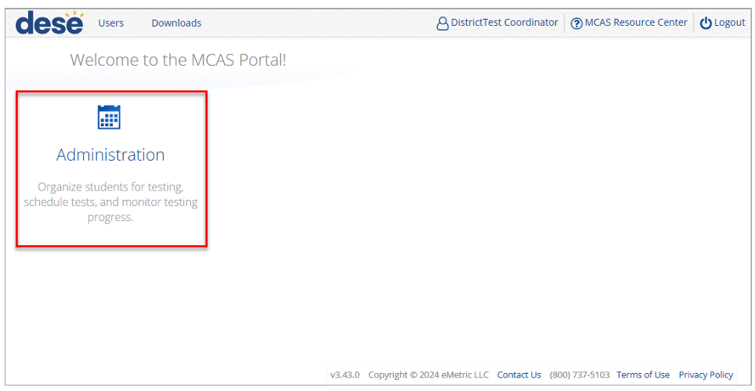

Navigating the Materials Management Page
To access the Materials Management page, follow the steps below:
1. Log in to the MCAS Portal with your username and password.
2. On the MCAS Portal homepage, select Administration.
3. Select Materials Management from the top menu bar.

Slide 69
Resources
MCAS Portal Guides
Guide to the MCAS Portal, Part VII: Materials Management

Slide 70
6. Accessibility and Accommodations

Slide 71
Verifying Accommodations
Test coordinators should review accommodations approximately two weeks prior to testing to ensure that they have been assigned correctly.
Accommodations can be verified in five ways:
New for 2026: Through an Accommodations export.
On the Edit Student page in the MCAS Portal.
Through a Student Registration export.
On the summary page that is printed with student logins.
Form-dependent accommodations, i.e., Spanish/English, Screen Reader, Compatible Assistive Technology, ASL, Human Read-Aloud, and Human Signer, can be confirmed on the View Details/Student Logins page in the MCAS Portal.

Slide 72
Demonstration
Verifying accommodations

Slide 73
Verifying Form-Dependent Accommodations
Log in to the MCAS Portal and select Administration.
Select Test Scheduling.
Select the correct school, content area (ELA, mathematics, science, or civics), program (high school or grades 3–8), and test name.
Select View Details/Student Logins.

Slide 74
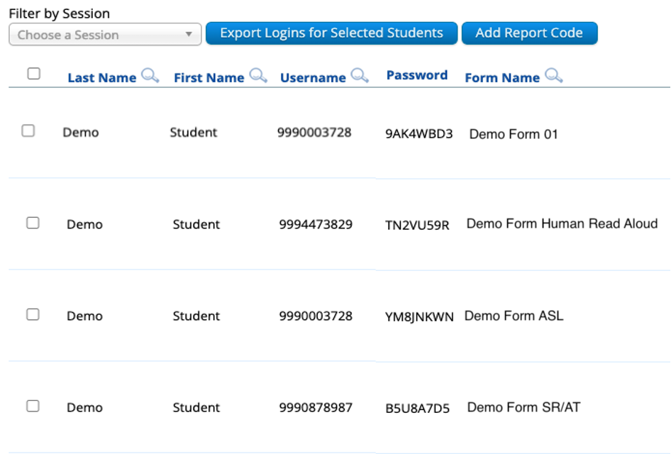
Verifying Form-Dependent Accommodations (continued)
5. Review the "Form Name" column and ensure the form-dependent accommodations are indicated in the form name (i.e., human read aloud, human signer, screen reader, ASL, compatible assistive technology, Spanish/English).

Slide 75
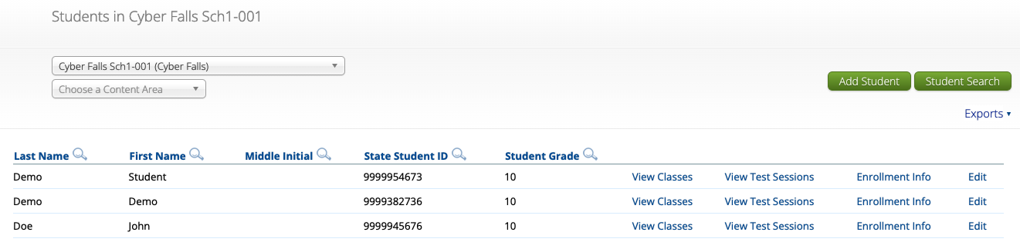
Verifying Accommodations: Single Student
Log in to the MCAS Portal and select Administration.
Select Students.
Locate the student you wish to review and click Edit.
Select the Accommodations tab.
Review and edit the accommodations as necessary.
Select Save.

Slide 76
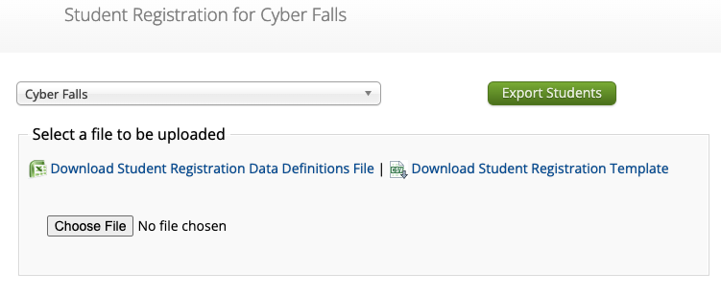
Verifying Accommodations: Student Registration Export
Log in to the MCAS Portal and select Administration.
Select Student Registration.
Select the correct school or district.
Select Export Students.
Review the accommodations for each student in the export.

Slide 77

Verifying Accommodations: Accommodations Export
Log in to the MCAS Portal and select Administration.
Select Students.
Select Exports and click Export Accommodations.
Review the accommodations for each student in the export.

Slide 78
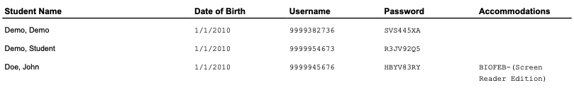
Verifying Accommodations: Summary Sheet
Follow the steps in slides 57–61 to print student logins.
Note: Be sure to print the student logins as a PDF. The first page of the PDF will be a summary page that lists students’ accommodations.

Slide 79
Test Administrator Logins
For the human read aloud and human signer accommodations for computer-based testing, schools may choose to have test administrators read the test over the student’s shoulder, or create test administrator logins so that test administrators can log in to their own test on their own device in order to read aloud.
There are two options for creating a test administrator login in the MCAS Portal.
Option 1: Manually add a student to the MCAS Portal on the Students page using the field definitions outlined on the next slide.
Option 2: Add the test administrator login as a student during the Student Registration file upload.

Slide 80
Test Administrator Logins
Column of Student Registration File | Field Name | Field notes
A | District code | The testing district
B | School code | The testing school
C | SASID | Begin with your 8-digit school code. Add “01”, “02”, etc. to the end of your school code for each test administrator login needed. Example: For a school whose code is 77665555, their test administrator login SASIDs would be 7766555501, 7766555502, 7766555503, etc.
D | Student grade | The grade level for the test that is being administered
E | Last name | Enter in “TA LOGIN”
F | First name | The test administrator’s first name
I | Date of birth | Enter in “01/01/1900”
J | Test code | The test code for the test that is being administered
L | Test format | “O”
T | Human Read Aloud Standard | “Y” if administering Math, STE, or Civics
Z | Human Read Aloud Special | “Y” if administering ELA
U | Human Signer Standard | “Y” if administering Math, STE, or Civics
AA | Human Signer Special | “Y” if administering ELA

Slide 81
Test Administrator Logins
Once the test administrator logins have been added to the MCAS Portal, create a class for the students requiring a human read aloud or human signer accommodation for that content area.
Add the appropriate student(s) to the class.
Add the test administrator login to the class.
Save the class.
Schedule the class to take the appropriate test.

Slide 82
Test Administrator Logins – After Testing
Once testing is complete, all test administrator login tests should be voided.
Refer to the Guide to the MCAS Portal, Part VI: Scheduling Tests, Printing Student Logins, and Other Tasks on the Test Scheduling Page, located on the MCAS Portal page of the MCAS Resource Center, for instructions on voiding a test.

Slide 83
Resources
Principal’s Administration Manual
Verifying accommodations: pages 47–48
Test administrator logins: pages 115–116

Slide 84
7. Test Administrator Tasks Before Testing

Slide 85
Timeline of Tasks in the MCAS Portal to Complete Before and During Testing for Test Administrators
Up to 2 days before testing
Test Day
● Verify accommodations
●Verify student roster
● Distribute student logins to students
● Provide access codes to students
● Enter proctor password as needed
● Monitor student testing status in the MCAS Portal
● Assist with testing issues as needed
MCAS Portal Overview for Test Administrators module now available on the Training Modules page of the MCAS Resource Center.

Slide 86
Verifying Accommodations
Test administrators should review accommodations prior to testing to ensure that they have been assigned correctly.
Test administrators can verify form-dependent accommodations on the View Details/Student Logins page.
Test administrators can verify other accommodations on the student summary page (the first page of the PDF of exported student logins).

Slide 87
Questions & Answers
Use the “Q&A” feature to ask questions.

Slide 88
8. Resources, Support, and Next Steps

Slide 89
Additional Resources
Resource | Location
MCAS Resource Center | mcas.onlinehelp.cognia.org
Guide to the MCAS Portal Part III: Student Registration Part IV: Enrollment Transfers Part V: Creating and Managing Classes for Grades 3–8 Part VI: Scheduling Tests, Printing Student Logins, and Other Tasks on the Test Scheduling Page Part VII: Materials Management Appendix A: Creating and Managing Classes for High School Tests | https://mcas.onlinehelp.cognia.org/portal/
Student Assessment Updates (Biweekly email with important updates about the MCAS program) | www.doe.mass.edu/mcas/updates.html If you do not already receive this email, subscribe using this link: http://eepurl.com/ghSOhH

Slide 90
Upcoming Training Webinars
Session | Date and Registration Link | Recommended Read-Ahead Materials
Tasks in the MCAS Portal During and After Testing | Thursday, March 12 at 9:30–11:00 a.m. | Guide to the MCAS Portal, located on the MCAS Portal page of the MCAS Resource Center
Office Hours: MCAS Portal Tasks | Thursday, March 19 at 9:30–10:30 a.m. | Guide to the MCAS Portal, located on the MCAS Portal page of the MCAS Resource Center

Slide 91
Next Steps
Today: Complete the evaluation form.
Responses are associated with the name and email address used to log in.
Email your input to mcas@mass.gov if you have problems accessing or completing the form.
Within one week:
Receive an email with the Q&A from this session
Recording will be available

Slide 92
Email and Phone Support
MCAS Service Center
DESE Student Assessment Services
Questions on logistics and technology
Web: https://mcas.onlinehelp.cognia.org/
Email: mcas@cognia.org
Phone: 800-737-5103
TTY: 888-222-1671
Live chat is available at the link on the bottom of the page at the MCAS Resource Center
Policy questions (e.g., student participation, accommodations)
Web: www.doe.mass.edu/mcas
Email: mcas@mass.gov
Phone: 781-338-3625
TTY: 800-439-2370

Slide 93
9. Live “Sandbox Time”

Slide 94
Poll Question—
Which demonstrations would you like to see again?
Transferring students within your district
Transferring students between districts
Manually creating a class
Uploading multiple classes via Class Upload file
Uploading multiple classes via Student Registration file
Scheduling a test for multiple classes
Scheduling a Spanish/English test
Printing student logins and summary pages
Printing student logins in bulk
Verifying accommodations
Creating test administrator logins

Slide 95




THANK YOU
The Office of Student Assessment Services
781-338-3625
mcas@mass.gov
www.doe.mass.edu/mcas
135 Santilli Highway, Everett, MA 02149

