Slide 1
MCAS Test Administration and Security Protocols for New Staff
The Office of Student Assessment Services
January 29, 2026

Slide 2
Presenters
Shannon Cullen, Test Administration Coordinator
Robert Pelychaty, Manager of Inclusive Assessment
David Ragsdale, Test Security Specialist
Jodie Zalk, Manager of Test Administration and Publications
Marco Andrade, Director of Research and Accountability at Worcester Public Schools

Slide 3
Logistics for This Session
Use the Q&A feature to ask a question.
We will answer some questions aloud at specified times during this training session, and we will email the Q&A afterwards.
Use the thumbs-up icon to “upvote” someone else’s question.
Email student-specific questions to mcas@mass.gov instead of asking here.
Closed captioning has been enabled for participants who need it.
This session is being interpreted into ASL. Our interpreting team will be onscreen with the presenters.
Please be advised that DESE does not authorize attendees to record or to use AI transcription tools during the meeting and DESE does not endorse any unauthorized transcripts created by third parties of its meetings.

Slide 4
Slides for This Session
Slides were emailed to participants before this session from MCASEvents@cognia.org.
Slides are now being posted in the chat.
If you cannot access the slides in the chat, ask in the Q&A.
After the session, we will send the slides again to participants, and they will be posted in the MCAS Resource Center along with the recording.

Slide 5
Today’s Agenda
Introduction and Resources
Test Administration Protocols
Preparation for Computer-Based Testing
Test Security Requirements
Accessibility and Accommodations
A District’s Perspective: Worcester Public Schools
Additional Resources, Support, and Next Steps
Protocols for Paper-Based Testing (PBT)

Slide 6
Poll Question
Have you attended any of DESE’s MCAS training sessions this school year?
3 or more
1 or 2
This is my first one.

Slide 7
1. Introduction and Resources

Slide 8
Introduction to MCAS Computer-Based Testing
MCAS Portal: The test administration and management website used by test coordinators, technology coordinators, and test administrators.
MCAS Training Site: Test coordinators, technology coordinators, and test administrators may use this site to practice with MCAS Portal tasks and administer practice tests.
MCAS Student Kiosk: Student testing platform

Slide 9
Commonly Used Acronyms
CBT: Computer-based testing
PBT: Paper-based testing
SIMS: Student Information Management System
EL: English learner
ELA: English Language Arts
STE: Science and Technology/Engineering

Slide 10
Commonly Used Terminology
Form-Dependent Accommodation: A subset of accommodations that are particularly important to assign correctly before a student begins testing, including ASL, Compatible Assistive Technology, Human Read-Aloud, Human Signer, Screen Reader, and Spanish/English for CBT, and Large Print, Braille, and Spanish/English for PBT.
MCAS Portal Terminology
Class: A group of students in the MCAS Portal taking the same test at the same time in the same place. Schools group students into “classes” in the MCAS Portal before testing.
Proctor password: A proctor password is an additional security measure that is required in certain situations. The proctor password is available on the MCAS Portal Administration home page.

Slide 11
Delivery Dates for Manuals and Materials for Paper-Based Testing (PBT)
Grades 3–8:
March 9: Receive all manuals, and ELA PBT materials
April 13: Receive Math/STE/Civics PBT materials
Grade 10:
March 10: Receive manuals for ELA and Math, and ELA PBT materials
May 5: Receive Math PBT materials
High School Science:
May 19: Receive manuals and PBT materials

Slide 12
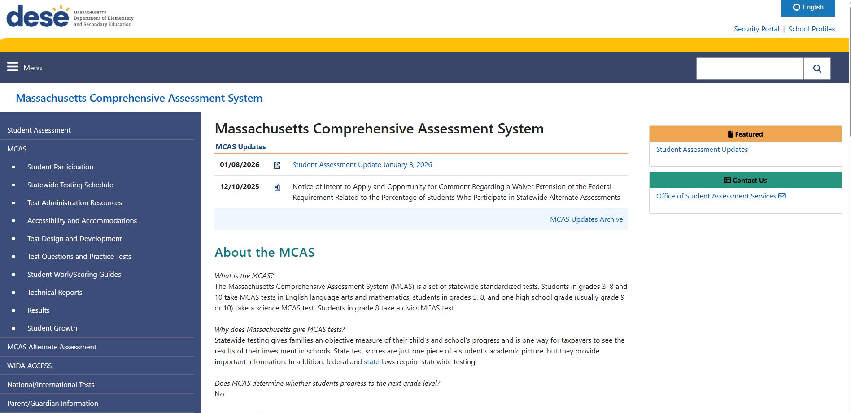
MCAS Page on the DESE Website

Slide 13
Spring 2026 MCAS Test Administration Resources for Grades 3–8 and High School
MCAS Pre-Administration Guide 2025–26
Test Administration Manuals
Principal’s Administration Manual (PAM) and Test Administrator’s Manuals (TAMs) available now
Spanish/English scripts to be available soon
Test Administration Sample Forms and Materials
Additional Policies/Resources
Technology-Related Resources for Computer-Based Testing
High School Participation Guidelines

Slide 14
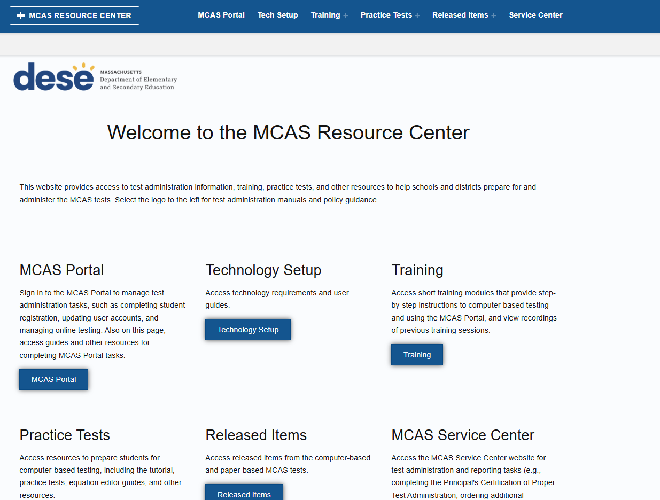
MCAS Resource Center

Slide 15
MCAS Resource Center
MCAS Portal page
Live links to the MCAS Portal and MCAS Training Site
Guide to the MCAS Portal and excerpts
Technology Setup page
Download links for the MCAS Student Kiosk
MCAS Student Kiosk Technology Guide and excerpts
Training page
Contains links to previously recorded webinars and accompanying slides and training modules
Practice Tests page
CBT and PBT practice tests, tutorial, and other resources

Slide 16
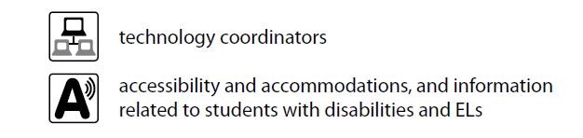
Orientation to the Principal’s Administration Manual (PAM)
Front matter | purpose of the PAM, contact information and information on online accounts, testing schedule, updates
Part I | MCAS Test Security Requirements | page 1
Part II | Student Participation | page 11
Page III | MCAS Test Administration Protocols | page 15
Part IV | Tasks to Complete for Test Administration Checklist of tasks | page 37 page 38
Appendix A | Tasks and Guidance for Technology Coordinators | page 55
Appendix B | Procedures for Paper-Based testing | page 73
Appendix C | Accessibility and Accommodations | page 93
Appendix D | Procedures Related to Student Information and Guidance on Reporting | page 129
Appendix E | Selected Forms | page 137
Icons:

Slide 17
2. Test Administration Protocols

Slide 18
General Timeline for MCAS CBT
Pre-Administration Tasks
Beginning in Fall 2025
(Ongoing) Read biweekly Student Assessment Updates.
At least 2 months before testing
Update user accounts in the MCAS Portal and create additional accounts.
At least 2 weeks before testing
Become familiar with CBT components.
Identify the school test administration team.
Update contact info with DESE.
View online modules and participate in training sessions.
Meet with the technology coordinator, who will review the tech specs and prepare the school’s technology, including Site Readiness.
Review instructions in the Principal’s Administration Manual.
Prepare devices and materials.
Delivered to schools 2 weeks before spring ELA, and one week before each fall/winter administration. Available online beforehand.
Train test administrators in protocols and security requirements.
Establish a communication plan with the test administration team.
Complete Student Registration.
Begin planning for accessibility features and accommodations.
Administer the student tutorial and practice tests.

Slide 19
Identify Your Test Administration Team
Meet with the technology coordinator and begin technology preparations.
Consider assignments for test administrators.
Develop your communication plan for technology and administration.
Update contact information with DESE and in the MCAS Portal as needed.
See the Guide to the MCAS Portal, Part II: MCAS Portal User Management for guidance on updating MCAS Portal accounts.

Slide 20
Identify “Who,” “Where,” and “When” (Late Winter/Early Spring)
Particularly for high schools, identify all students participating in each grade’s tests.
High school participation guidelines available
Assign accessibility features and accommodations.
Plan for where accommodations will be administered (e.g., students with a one-to-one administration).
Determine which staff members will administer accommodations requiring the Nondisclosure Acknowledgment form.
Establish testing locations and develop staffing plans.
Prepare list of test administrators and students for school records, and assign/update user roles in the MCAS Portal (details on upcoming slide).
Begin training plans for test administrators and staff.
Plan for secure testing environments.
Slide template for training test administrators to be updated in early Feb.; template for February Science available

Slide 21
Scheduling Considerations
The MCAS Student Kiosk will be available between 7:00 a.m. and 4:00 p.m., Monday–Friday, except the week of April school vacation; request special access to test outside these hours (see PAM page 24).
Grades 4 and 10 Math, and grades 5 and 8 STE:
Decide whether to administer the optional questionnaire directly after Session 2 or another time.
Plan logistics related to scheduling.
One break per session, around 3–5 minutes, at test administrator’s discretion.
Make plans for students who finish early and students who need extra time, including students who work through lunch; consider using dismissal waves.

Slide 22
Scheduling Considerations (cont’d)
If needed for efficiency, you can group together students in different grades taking the same subject-area test for make-up testing, as long as the TAM script matches.
ELA: Grades 3–8
Math: Grades 3 and 4, grades 5 and 6, grades 7 and 8
STE: Grades 5 and 8
Do not group together students doing CBT and any students doing PBT.

Slide 23
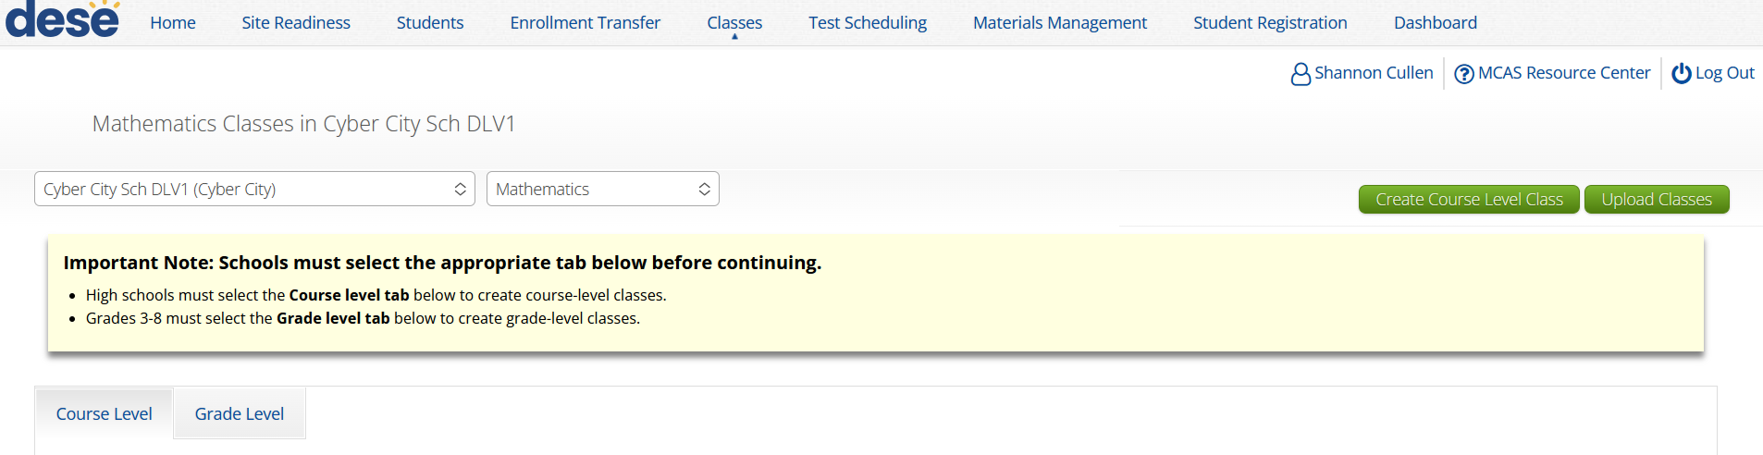
Scheduling Considerations (cont’d)
Note that in the MCAS Portal, classes are grade and subject-specific for grades 3–8. New for 2026, high school classes are subject-specific; students from multiple grade levels taking the same test can be placed in the same class.

Slide 24
Scheduling Considerations for Spanish/English Tests
As staffing permits, DESE recommends separate testing locations for students taking a Spanish/English and students taking an English test. Why?
If both groups of students will test at the same time, both scripts must be read to all students (this will extend the time needed for testing).
Test administrators will also need to manage two separate “classes” and access codes in the MCAS Portal (students taking the Spanish/English tests must be assigned to a separate class).

Slide 25
Update Student Information
In SIMS (DESE Student Information Management System)
In the MCAS Portal
Go to the People Search page on the Profiles website, select SIMS Contact from the Function menu, and click Get Results
Data source: School Interoperability Framework (SIF) for Student Registration for districts that use SIF (October SIMS for non-SIF districts)
Pre-administration Student Registration deadlines for PBT test materials and CBT/PBT manuals are as follows:
January 30 for grades 3–8
February 6 for grade 10 ELA and Mathematics
April 28 for High school Science
January 15 Overview of Student Registration Webinar

Slide 26
Poll Question
Where do you work?
At an elementary school
At a middle school
At a combined middle/high school
At a high school
At a district office
Other

Slide 27
2026 Grades 3–8 Administration Schedule
ELA testing window | March 23–April 17 (Note that ELA will be administered earlier than Mathematics and STE.)
Mathematics testing window | April 27–May 22
STE testing window (grades 5 and 8) | April 27–May 22
Civics testing window (grade 8) | April 27–June 5
These testing windows include all make-up testing.
The sequence for administering tests should be as follows, when possible
first ELA
followed by Mathematics
followed by STE
Civics can be administered at any time between April 27 and June 5.

Slide 28
Recommended Testing Times for Grades 3–8
MCAS Subject Area Test for Grades 3–8 | Recommended Testing Times for Spring 2026 (2 sessions per test)
ELA | 2 to 2½ hours per session
Mathematics | 1½ hours per session
Grades 5 and 8 STE | 1 to 1½ hours per session
Grade 8 Civics | State-level performance task: 1 hour End-of-course (EOC) test: 1 hour
Each test session must be administered simultaneously to all students taking that particular test in your school except for students who receive DF10 (Specific Time of Day) or DF3 (Frequent Breaks). See Part III, section C, of the PAM for scheduling guidance.

Slide 29
2026 Grade 10 Administration Schedule
ELA Testing Window Recommended dates: ELA Session 1 ELA Session 2 | March 24–April 2 March 24 March 25
Mathematics Testing Window Recommended dates: Mathematics Session 1 Mathematics Session 2 | May 19–27 May 19 May 20
New for 2025–26: High school tests now have testing windows and DESE is providing recommended dates instead of prescribed dates.

Slide 30
2026 High School Science Administration Schedule
High School Science Testing Window Recommended dates: High School Science Session 1 High School Science Session 2 | June 2–10 June 2 June 3
New for 2025–26: High school tests now have testing windows and DESE is providing recommended dates instead of prescribed dates.

Slide 31
Recommended Testing Times for High Schools
MCAS Subject Area Test for High School | Recommended Testing Times for Spring 2026 (2 sessions per test)
Grade 10 ELA | Session 1: 2½ hours Session 2: 1½ to 2 hours
Grade 10 Mathematics | 1½ to 2 hours per session
High School Science | 1½ hours per session

Slide 32
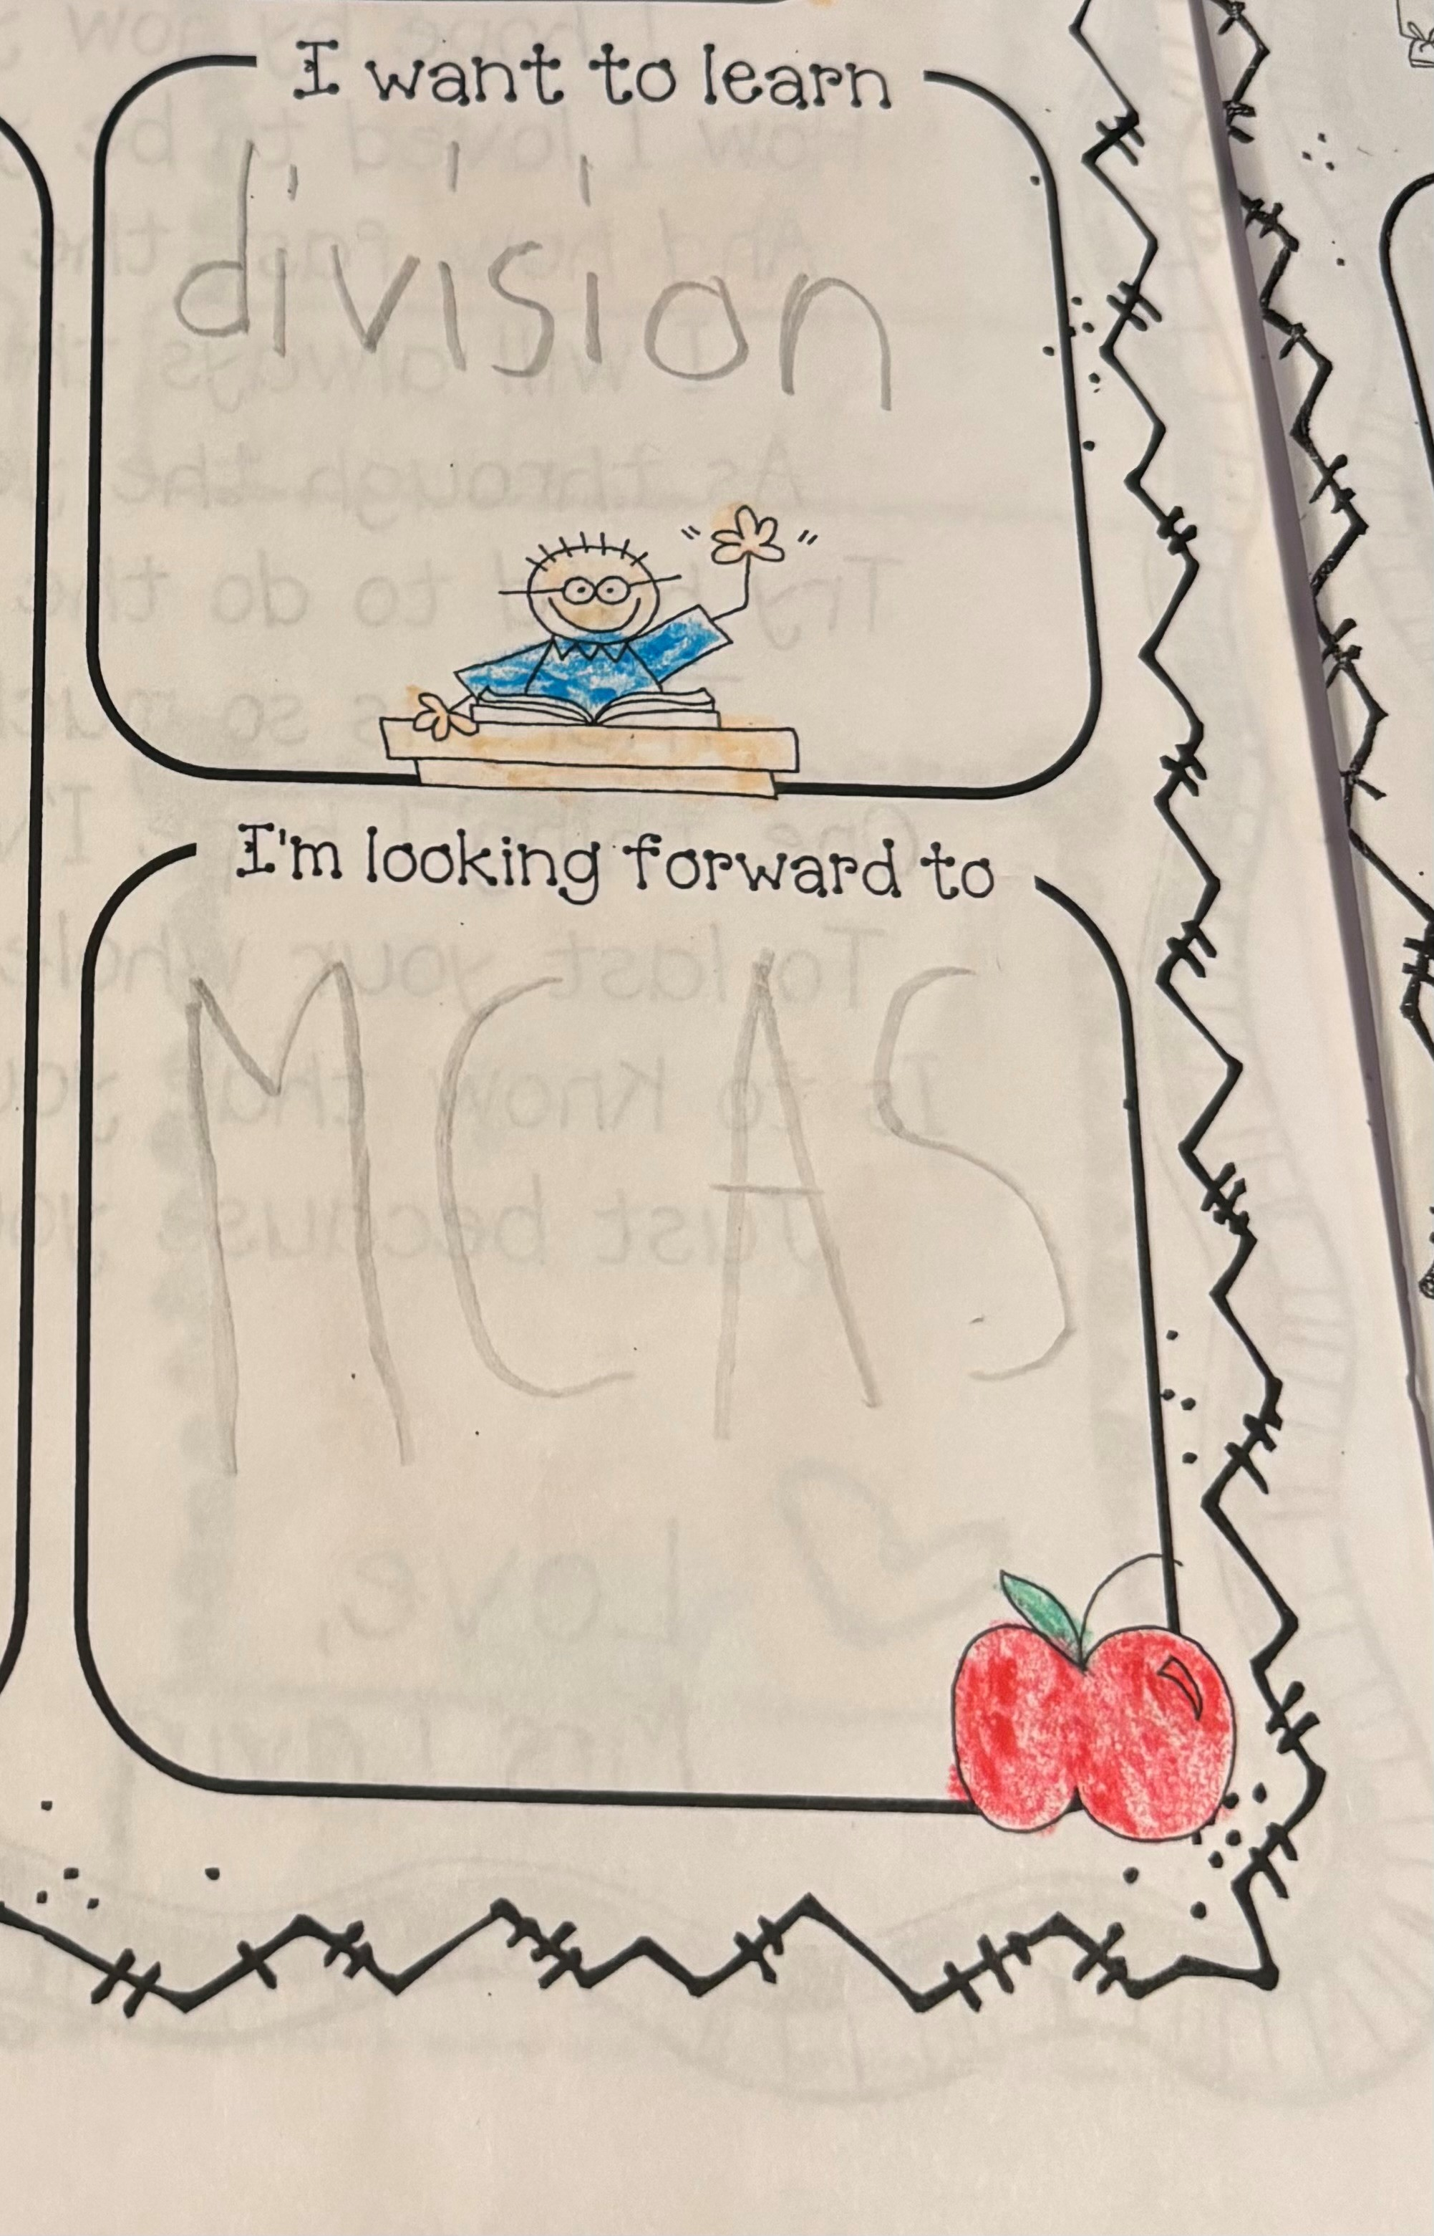
Preparing Students and Families for CBT
Student tutorial
Demonstration of the navigation, tools, and features for CBT
Students complete it independently (no audio)
Practice tests
Simulation of the tools and features for CBT
Include accessibility features and accommodated test forms
Equation editor guides and reference sheets for Math and STE
MCAS Item Library (previously released items)
Sample student work from previous MCAS tests
Resources for parents/guardians
Topics in the PAM for students and parents/guardians; newsletter or meetings (pages 32–35)

Slide 33
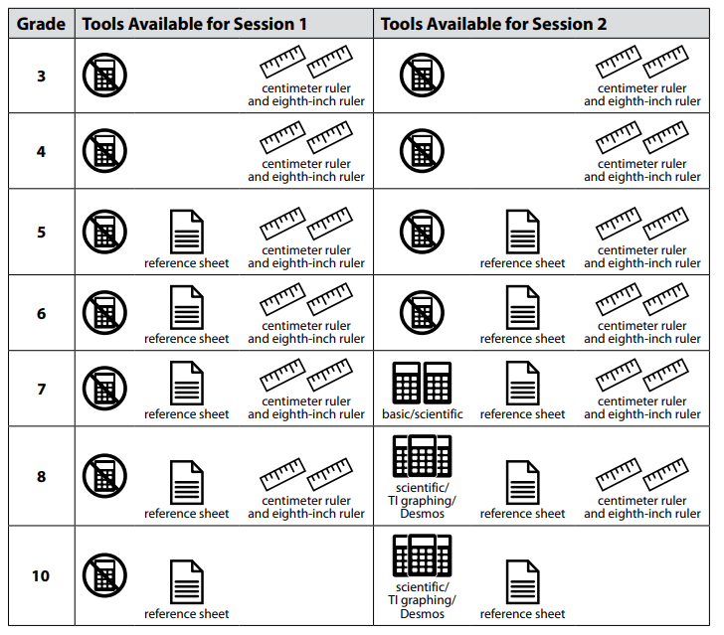
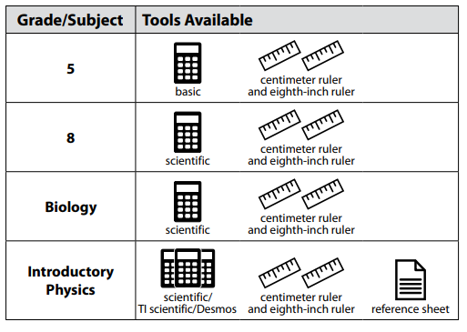
Prepare Materials that Your School Will Provide to Students
For the list of materials that are required or permitted for testing, and materials prohibited from testing, refer to the PAM beginning on page 17.

Slide 34
3. Preparation for Computer-Based Testing

Slide 35
Test Coordinator Tasks in the MCAS Portal – Before Testing
Fall 2025
●Create/update MCAS Portal user accounts
●Download the updated MCAS Student Kiosk to student devices and conduct Site Readiness (tech. coordinators)
Approx. 2 months before testing
Submit Student Registration
Approx. 2 weeks before testing
●Create classes in the MCAS Portal
●Verify accommodations
One week before testing
Schedule classes to tests
Up to one week before testing
Print student logins (DESE recommends 1–2 days)

Slide 36
Test Coordinator Tasks in the MCAS Portal – During and After Testing
During Testing
●Resolve incorrect accommodations and other issues
●Manage makeup testing
●Void tests as needed
After Testing
●Fill in not tested codes
●Void tests as needed

Slide 37
Poll Question
As a principal or school test coordinator, who should you contact if you don’t have an MCAS Portal account?
Another principal or test coordinator
Technology coordinator
Call the MCAS Service Center
District test coordinator

Slide 38
MCAS Portal Accounts
MCAS Portal accounts do not expire automatically. Districts and schools are responsible for updating and deactivating user accounts as needed.
MCAS Portal passwords expire every 365 days. Users will need to reset their password after this time frame.
For assistance with MCAS Portal accounts, users should request support as described below.
Role | Who to contact for support
Test administrators and school-level technology coordinators | Their principal or school test coordinator
Principals, school test coordinators, and district-level technology coordinators | Their district test coordinator
District test coordinators | MCAS Service Center

Slide 39
CBT Technology Preparations – Technology Coordinator
Technology Coordinator tasks include:
Review the MCAS Student Kiosk Technology Guide
Includes technology setup and guidelines, kiosk installation instructions, and site readiness instructions.
Install the updated MCAS Student Kiosk on testing devices (fall 2025).
Schools using Chromebooks: Technology coordinators will follow the instructions to install the new PWA.
Refer to Part IV A of the MCAS Student Kiosk Technology Guide and the recording of the January 13 ChromeOS Kiosk Installation webinar for step-by-step instructions.
Conduct Site Readiness (fall 2025).
Review Appendix A of the PAM for additional tasks.
Review the Overview of MCAS Administration Tasks for Technology Coordinators training session.

Slide 40
CBT Technology Preparations – Principal/Test Coordinator
Principals/test coordinators should meet with the technology coordinator to confirm they have completed the tasks listed above, and plan for set-up and troubleshooting during test administration.
See PAM page 42 (section B, step 1), and Appendix A (page 55).
Prepare devices, hardware, and network settings.
Can use the Computer-based Testing Device Planner
e.g., power strips, battery adapters, extension cords, extra devices for each testing area, external keyboards for tablets, headphones for text-to-speech accommodation

Slide 41
Site Readiness
Site readiness is a two-step process (Site Readiness Testing and Site Certification) conducted by technology coordinators to:
Confirm that installation of the updated MCAS Student Kiosk was done correctly on student devices
Confirm that testing devices meet the minimum requirements and have been properly configured
Confirm that test content reaches student devices without issue
Identify any potential technology-related issues before testing begins
Site readiness should have been conducted in fall 2025. Please confirm with your technology coordinators.
If the school’s technology setup has changed since conducting Site Readiness, it is recommended to conduct Site Readiness again prior to testing.

Slide 42
Site Readiness (cont’d)
General steps for Site Readiness:
Technology coordinators complete two-part test on each device type
Technology coordinators certify Site Readiness in the MCAS Portal.
School and district test coordinators confirm that technology coordinators have completed Site Certification.
DESE will follow up with schools that do not complete Site Readiness.

Slide 43
Test Administrator Tasks in the MCAS Portal
Approx. 3 weeks before testing
Verify access to MCAS Portal account
Up to 2 days before testing
Verify that students have the correct form-dependent accommodations in the MCAS Portal (slide 45)
Before students arrive
●Verify student roster
●Verify accommodations on student summary page
During testing
●Distribute student logins
●Monitor student testing status in the MCAS Portal
●Enter proctor password as needed
Note: Schools may choose to have the test coordinator complete these tasks instead of test administrators.

Slide 44
CBT Preparations – Test Administrators
Familiarize test administrators with tasks they may need to complete in the MCAS Portal
Instructions and troubleshooting steps: CBT TAM Appendix E
If there is a technology situation in which a student is waiting more than 15–20 minutes, schedule the student to complete the session at another time, after calling the MCAS Service Center for support (800-737-5103).
Overview of the MCAS Portal for Test Administrators module to be available on the MCAS Resource Center soon.

Slide 45
Test Administrator Tasks in the MCAS Portal
Refer to the pages in the Guide to the MCAS Portal listed below for further details and screenshots.
Accessing the proctor password (pages 9–10)
Viewing scheduled tests (pages 110–113)
Verifying accommodated form assignments (pages 111–112)
Verifying accommodations on student summary sheet (page 115)
Accessing the access codes (pages 111–112, 115)
Monitoring student testing status (pages 126–127)

Slide 46
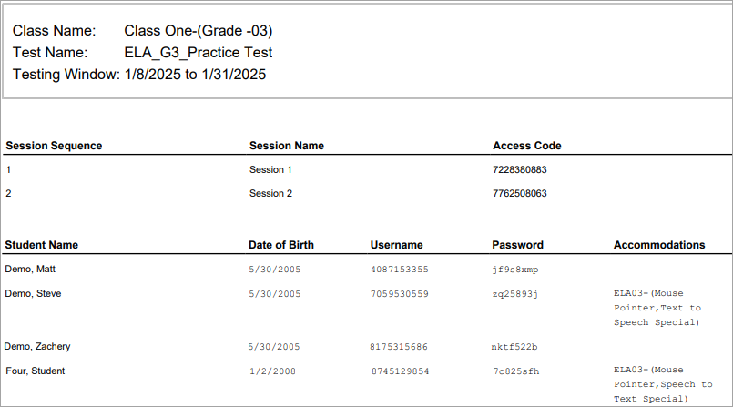
Sample Student Summary Page
Test administrators will write the access code on the board.
Check that accommodations are correct before testing.

Slide 47
Steps to Complete for Principals/Test Coordinators During and After Testing
CBT tasks for principals/test coordinators:
Tasks to complete during testing: beginning on PAM page 49
Tasks to complete after testing: beginning on PAM page 52
Ask the district SIMS contact to update student data as necessary.
Be prepared to check preliminary data according to the reporting schedule, which will be provided in a spring edition of the Student Assessment Update.
Additional training sessions will be held later this winter.

Slide 48
Go online to the MCAS Service Center website to complete the PCPA.
Principals must complete the PCPA to certify that the school has followed proper MCAS test security protocols.
See PAM page 52 (section I, step 4) for steps to complete the PCPAs.
Note: The PCPA may not be completed by a designee.
Use your school’s 2026 password for the MCAS Service Center website to access the PCPA.
Password letters are in DropBox Central in DESE’s Security Portal.
See the Dec. 10 Student Assessment Update for details.
Schools that do not find their password in their DropBox should email mcas@mass.gov, and questions about completing the PCPA should be sent to mcas@cognia.org.
Deadline dates for submitting the PCPAs:
Grades 3–8: June 8
Grade 10 ELA and Math: May 28
High school Science: June 11

Slide 49
Resources for MCAS Portal Tasks
General MCAS Portal Resources
Guide to the MCAS Portal
Recordings of recent training sessions
Register for future trainings and office hours sessions
Resources for Completing (and Updating) Student Registration
Guide to the MCAS Portal Part III: Student Registration
Guide to the MCAS Portal Part IV: Enrollment Transfers
Student Registration Data Definitions
Student Registration Template
Resources for Pre-Administration Tasks in the MCAS Portal
Guide to the MCAS Portal Part V: Creating and Managing Classes
Guide to the MCAS Portal Part VI: Scheduling Tests, Printing Student Logins, and Other Tasks on the Test Scheduling Page
Modules

Slide 50

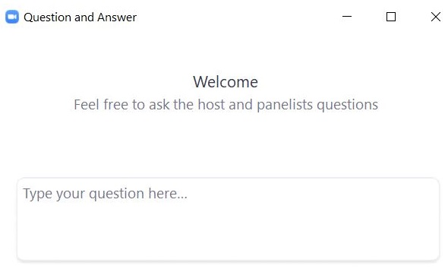
Questions and Answers
Use the “Q&A” feature to ask questions.

Slide 51
4. Test Security Requirements

Slide 52
Poll Question
Which of these are testing irregularities? (Select all that apply.)
wearing a smartwatch during testing
a student with accommodation A9 using a filled-in supplemental reference sheet for Introductory Physics
using a handheld calculator on a computer-based Science test
students passing notes during testing
photographing the computer screen and using an AI app to solve a question
listening to music with wireless earbuds during testing
reading a word aloud to a student (who requests it) on the grade 8 Civics test

Slide 53
The Importance of Leadership
Staff and students take their cues from above – leaders set the tone.
Superintendents
should review their principals’ test security plans and be comfortable with the procedures in their buildings (PAM, page 3)
are encouraged to visit their schools and observe testing
Principals
must establish school-wide expectations for a proper test administration
must ensure that test administrators are properly trained
must ensure that MCAS protocols are being followed
must ensure that accommodations are correctly given
must sign the Principal’s Certification of Proper Test Administration (PCPA) at the end of testing and attest to a proper test administration

Slide 54
Poll Question
Which of the following materials are secure? (Select all that apply.)
blank scratch paper
used scratch paper
student logins
supplemental reference sheets for students with accommodation A9
test & answer booklets
summary pages

Slide 55
Secure Content and Materials for CBT
Secure content
MCAS questions not publicly released by DESE
including reading passages, diagrams, writing prompts and other information on testing screens and (for PBT) in testing booklets
student responses to test questions
Secure materials
student logins and test administrator logins
summary pages from the student login PDFs
used scratch paper after testing (until it is securely destroyed)
booklets containing test content or student responses (for PBT)

Slide 56
Confidentiality of Secure Test Content
Principals, test administrators, and others are prohibited from
Viewing test content (on screens or in booklets)
Duplicating or reproducing test content
Technology staff may not take photographs of computer screens.
Discussing test content with anyone before, during, or after testing
Exception for a student reporting a concern about a test question (refer to instructions in the PAM)

Slide 57
Exceptions to Prohibition of Test Administrators Viewing MCAS Content
Administering certain accommodations (MCAS Nondisclosure Acknowledgment required) listed on page 99 of the PAM.
Accommodations A2, A3.1, A3.2, A3.3, A5, A6.1, A8, A10.1, A10.2, A11, A12, A13, A14, A15
Special access accommodations SAA1.2, SAA2, SAA3.1, SAA3.2, SAA6
English learner accommodations EL3.2, EL4.1, EL4.2
Assisting a student with the computer interface during testing
Reading a word or phrase aloud on Mathematics, Science, or Civics tests – Universal Accessibility Feature 11 (UF11)
See page 95 of the PAM for the description of UF11

Slide 58
Handling and Storage of Secure Materials
Store all secure materials in a secure central location.
locked when tests are not being administered
restricted access
Maintain the chain of custody of materials during test administration.
Internal tracking forms
Schools can develop their own tracking forms, as long as they adhere to the requirements described on pages 16–17 of the PAM.
Independent counts of secure materials
Do not leave materials unattended.

Slide 59
A Secure Testing Environment – Out of the Room
Students must be supervised when out of the testing room.
e.g., using the restroom, visiting the nurse, moving to a test completion room or supervised lunch
A few options
hallway monitors
monitors stationed at restrooms with lines of sight to testing rooms
staff who escort students to and from the restroom
Optional scripts in Test Administrator’s Manuals (TAMs)
the transition to a test completion room
a supervised lunch break
students visiting the restroom

Slide 60
A Secure Testing Environment – In the Room
Cover or remove prohibited classroom displays.
No unauthorized visitors in testing rooms
parents, media, non-testing students
teachers not assigned to the room as test administrators
Testing rooms may be entered by
technology staff for troubleshooting
school administrators (including the testing coordinator)
district personnel
DESE observers
When possible, use two test administrators in the room.

Slide 61
Secure Room Set-up for Computer-Based Testing
Students must not be able to view any screen but their own.
Set up rooms in advance to test out different seating arrangements (e.g., spreading desks out, staggering desks, turning desks in different directions).
Consider physical barriers (partitions, privacy screens, cardboard taped to the side of monitors).
Have an administrator walk around at the start of testing and check all the rooms.

Slide 62
Prohibited Materials
Make sure students understand they are not allowed to have
cell phones and other electronic devices (e.g., wireless ear buds, smartwatches)
calculators on noncalculator tests and sessions
notes or reference material beyond what they’re given, such as additional reference sheets, graphic organizers, multiplication grids (exceptions for certain accommodations)
smart glasses
A poster showing examples of prohibited materials is available for download and printing.

Slide 63
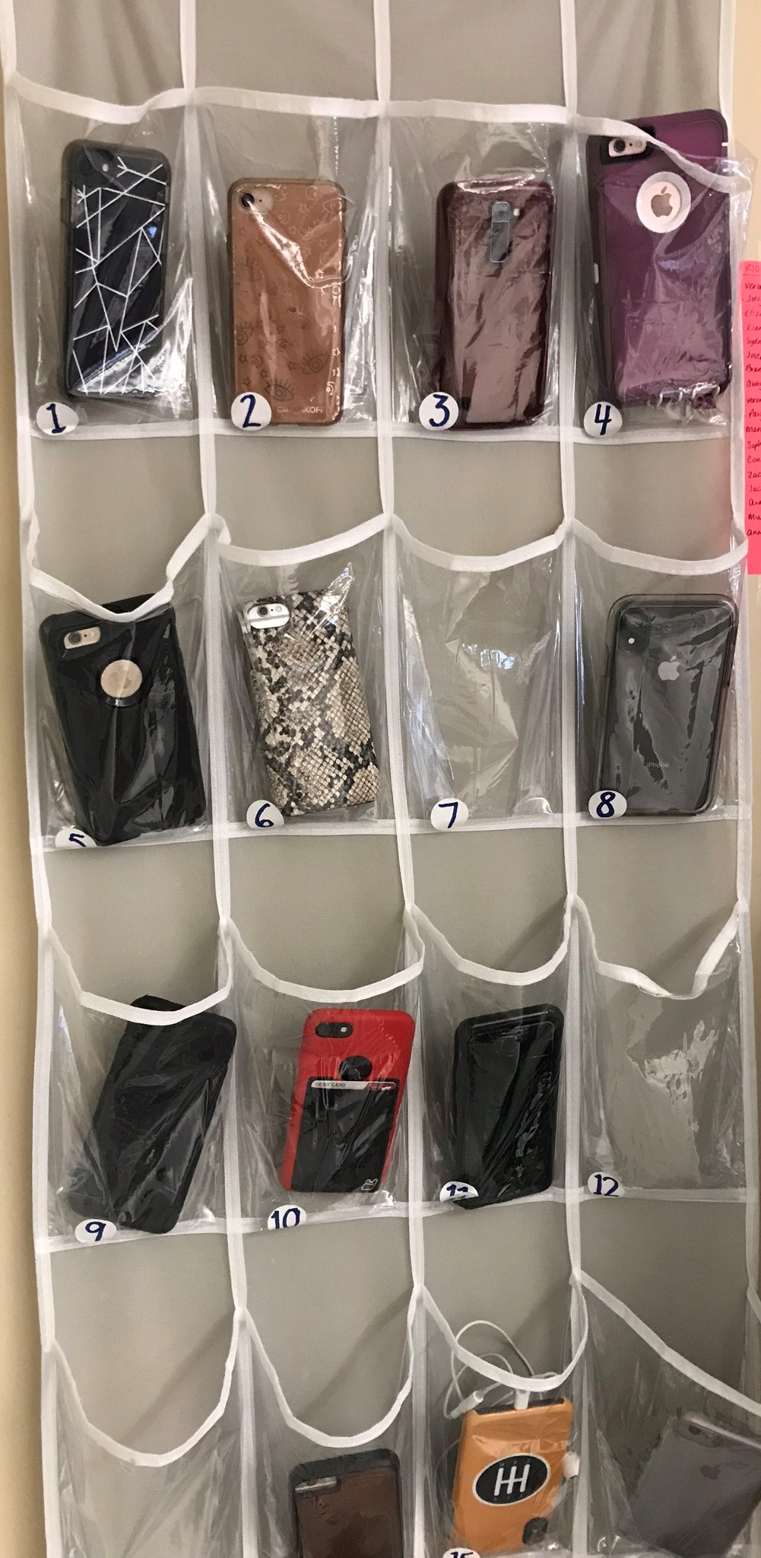
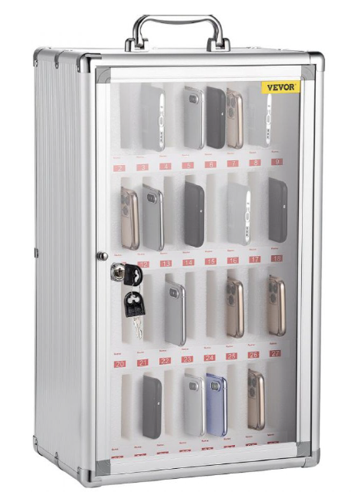
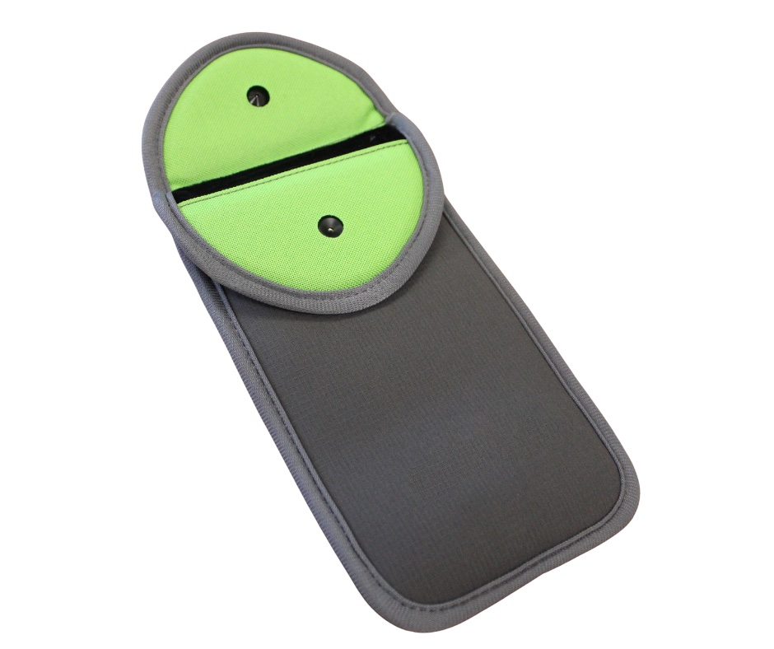
Examples of Collecting Cell Phones
Thanks to Swampscott High School
Thanks to Lowell High School
Pouch example

Slide 64
Poll Question
How do you ensure students don’t have access to cell phones during testing? (Select all that apply.)
Students put phones in backpacks and put backpacks to the side/back of the room.
Phones are collected and kept at the front of the room with the test administrator.
Phones are put in lockers and not allowed in the testing room.
Students are not allowed to have phones at school.
Student phones are locked away during the school day (e.g., in storage cases or magnetically sealed pouches).
Other

Slide 65
Training Test Administrators and Other Personnel
All individuals involved in MCAS administration must participate in a school-provided training session that covers
MCAS test security requirements (Part I of the PAM)
MCAS test administration protocols (Part III of the PAM)
School-specific procedures and logistics
Trainings should be live and synchronous (although they can be virtual).
Sample slides for training test administrators will be posted soon.

Slide 66
Training Test Administrators and Other Personnel – Documentation
Test administrators must sign forms to acknowledge the following:
participation in training
receipt of TAMs
combined sample form
Test administrators who will administer certain accommodations to students with disabilities or ELs must sign an MCAS Nondisclosure Acknowledgment
See page 22 of the CBT TAM, page 20 of the PBT TAM, or page 99 of the PAM for the list of accommodations this requirement applies to (also listed on slide 57).

Slide 67
Test Administrator Responsibilities
Test administrators must
Maintain the chain of custody of secure materials.
Make sure students have the correct materials for each session.
Follow instructions in the TAMs and read scripts verbatim.
Circulate throughout the room to prevent cheating and the use of prohibited materials – active proctoring.
Focus their full attention on the testing room.
Refrain from coaching students or influencing their responses in any way.

Slide 68
What is Coaching?
Providing hints or clues
“Break down the problem using the steps we covered in class last week.” “What’s the acronym for order of operations?” “Consider it from the main character’s perspective.” “Don’t forget to use specific examples in your essay.”
Indicating in any way that a student has answered a question incorrectly:
“You should look at that one again.”
“Check your work” (to a specific student on a specific question)
Defining or spelling words
Explaining, simplifying, or paraphrasing any part of the test
Suggesting that a student write more
Influencing a student’s response through gestures, facial expressions, nods, body language, or changes in voice inflection

Slide 69
What is Permitted?
Assisting students with technology-related problems
helping a student sign in to the MCAS Student Kiosk (this is the only situation in which a test administrator may type directly into a student’s test)
pointing to a tool button if a student is unable to find it
explaining to a student how to enter a result in the equation editor
explaining how to navigate to the review screen
Re-reading part of the TAM script to students
E.g., as students finish, TAs can re-read the script about checking their work.
Encouraging students:
“Just do your best.” “Just give your best effort.” “Do the best you can.” "Just answer it as well as you can."

Slide 70
Test Security Requirements for Students
Students’ results may be invalidated if they engage in any of the following activities:
duplicating any portion of secure test content
accessing prohibited materials such as cell phones or other electronic devices
communicating with other students (e.g., talking, whispering, writing notes)
looking at any other student’s computer screen or answer booklet
asking for or receiving help from anyone
providing help to another student
consulting notes, books, or instructional materials during testing
See sample form for students and a sample letter to send to parents (recommended for grades 6 and up)

Slide 71
Poll Question
What should you do first if a testing irregularity happens at your school?
Call DESE’s Office of Student Assessment Services.
Call the MCAS Service Center.
Contact the student’s parents/guardians.
Email an irregularity report to DESE.

Slide 72
Steps to Take after a Security Incident or Irregularity
Investigate the incident.
Talk to the test administrator(s) involved.
Talk to any students involved.
Determine whether the incident occurred during testing or after the student had completed testing.
Collect documents (e.g., notes, extra reference sheets).
If reporting a read-aloud or text-to-speech violation, determine how much of the test was read.
If reporting an incident involving a calculator or prohibited math tool (e.g., a multiplication chart), determine which items were solved with the tool.
Call DESE at 781-338-3625.
Submit a report if instructed to.
Take any local action that is appropriate.

Slide 73
Poll Question
Which are the four most commonly reported testing irregularities? (Select all that apply.)
Accessing cell phones
Wearing wireless ear buds
Students without accommodation A9 using a supplemental reference sheet
Students accessing prohibited reference materials (e.g., multiplication charts, classwork, homework)
Students copying answers from each other
Test administrators coaching students
Students passing notes

Slide 74
Questions and Answers
Use the “Q&A” feature to ask questions.

Slide 75
5. Accessibility and Accommodations

Slide 76
Resources for Accessibility and Accommodations
Category | Resources
Test administration manuals | Appendix C of the PAM Appendices B, C, and D of the CBT TAM Appendices A–F of the PBT TAM
Other guidance materials | Accessibility and Accommodations Manual, including excerpts and other resources Procedures During Testing for Students Who Use a Cell Phone or Smartwatch to Monitor Medical Information Guide to the MCAS Portal, Section E of Part III: Form-Dependent Accommodations
Previous trainings and modules | Recordings and slides in the MCAS Resource Center on the Training page January 15: Overview of Student Registration January 22: MCAS Accessibility and Accommodations

Slide 77
Participation of Students with Disabilities and EL Students
Students with disabilities
Participate according to IEP or 504 plan
Paper-based tests are available as an accommodation for students with disabilities who are unable to use a computer for testing.
English learners (ELs) are required to participate in MCAS or MCAS-Alt in all subjects required for their grade.
Exception: First-year ELs have option to participate in ELA testing for diagnostic purposes only.
“First-year EL” is a student whose name does not appear in March 2025 SIMS.
Paper-based tests available as an accommodation for first-year ELs unfamiliar with technology
Bilingual word-to-word dictionaries available for current ELs and students who were ever EL
Spanish/English tests available for all grades and subjects except ELA
See Appendix C of the PAM for more information.

Slide 78
Test Preparation
Students should:
Become familiar with features and basic functionality of MCAS Student Kiosk.
Review student tutorial and take online practice tests prior to test administration.
Schools should:
Plan for testing students with accommodations.
Schedule testing locations, test administrators, and testing time.
Set up specialized computers/Assistive Technology (AT) after reviewing IEPs, 504 plans, and local EL accommodations forms.
Plan to monitor accommodations.

Slide 79
Prohibitions for Accommodations
Test administrators may NOT:
Students’ results may be invalidated for these situations:
Provide accommodations not listed in
a student’s IEP or 504 plan
Appendix C of the PAM, without prior DESE approval
Provide a student with a modified version of a test or a test for a different grade.
Coach or assist a student with their responses
E.g., “Write more” or “Go back and review”
Provide clues/assistance/definitions
Using an English-language dictionary for ELA
Reading aloud the ELA test to a student who does not have this Special Access accommodation in their IEP
Giving a calculator on noncalculator session of the Mathematics test to a student who does not have this Special Access accommodation in their IEP
Test administrator coaching or assisting a student

Slide 80
Questions and Answers
Use the “Q&A” feature to ask questions.

Slide 81

6. A District’s Perspective: Sharing Notes on How Worcester Public Schools Approached the New Test Administration Process
Marco Andrade
Director of Research and Accountability
Worcester Public Schools
andradem@worcesterschools.net

Slide 82
Team Structure
District Test Coordinator | District Tech Coordinator
Points of contact at elementary/middle schools Assessment Coordinators at high schools | Tech contacts at schools
Provides training Makes info available Communicates relevant info Troubleshoots & supports administration Monitors/site visits | Updates to devices Site surveys Communicates with school PoC to make sure devices are updated Connects on testing day to troubleshoot devices & testing Ensures our devices can run the test throughout the year - to minimize pushing out updates (primarily Chromebooks but some MacBooks)
Notes:
Source: DESE School and District Profiles

Slide 83
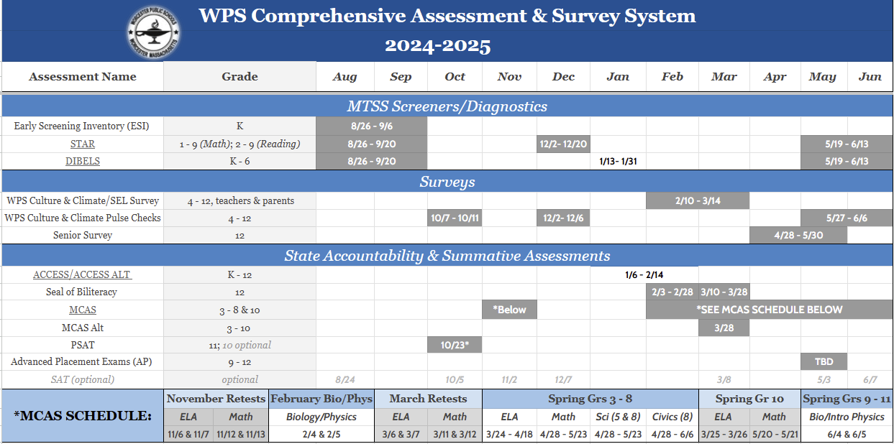
Notes:
Source: DESE School and District Profiles

Slide 84
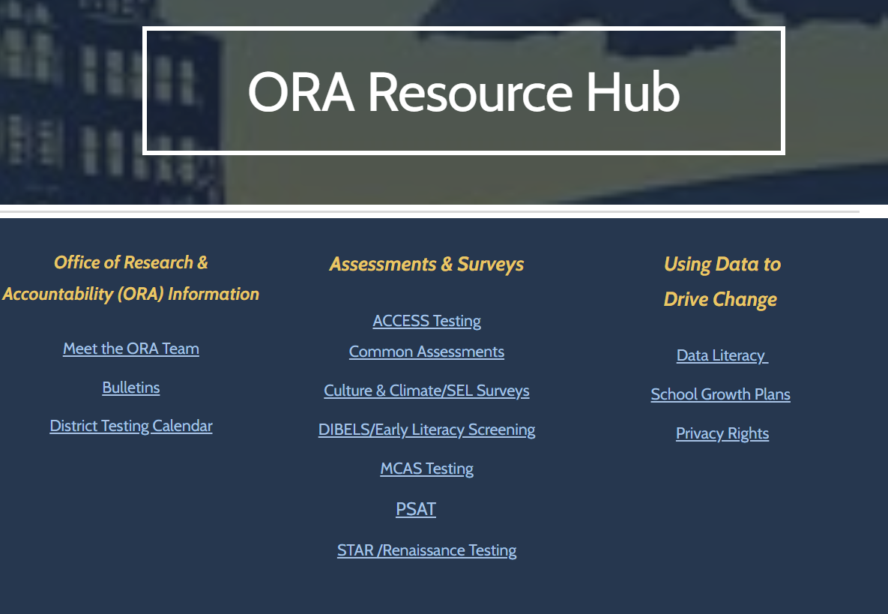
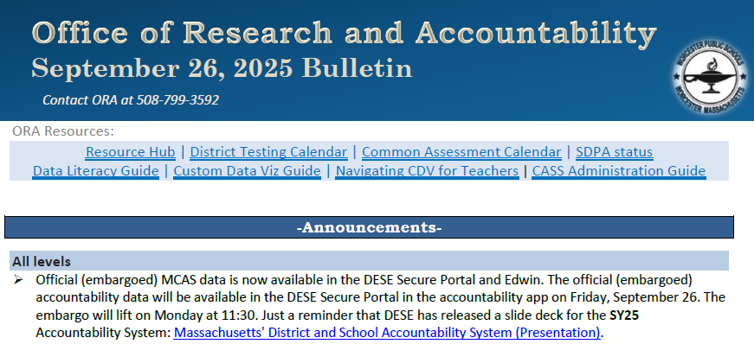
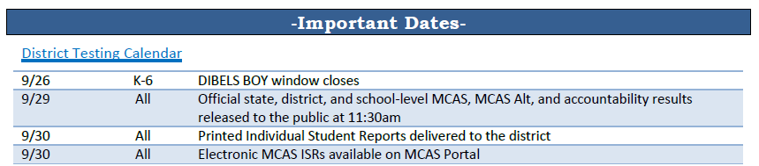
Communication
Weekly bulletins
Office of Research and Accountability (ORA) Hub
Notes:
Source: DESE School and District Profiles

Slide 85
Test Admin Support
With the new platform/portal and some new processes, needed to organize the information in a more accessible way
Google doc with links was embedded in the Resource Hub
Tried to sequence the when/what by time
Notes:
Source: DESE School and District Profiles

Slide 86
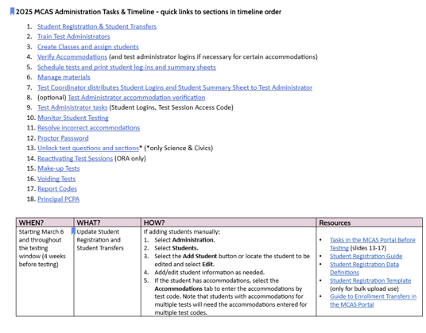
Test Admin Support
Notes:
Source: DESE School and District Profiles

Slide 87
7. Additional Resources, Support, and Next Steps

Slide 88
Additional Resources
Resource | Description
ELA | Mathematics | Science | Civics | Test designs
Civics topic assignment | Grade 8 Civics topic assignment and resources for schools

Slide 89
Upcoming Training Sessions
Session | Date | Intended Audience | Recommended Read-Ahead Materials
Technology Coordinator Training | Monday, February 2, 9:30–11:00 a.m. | Technology Coordinators | MCAS Student Kiosk Technology Guide
Office Hours for Accessibility and Accommodations | Friday, February 6, 9:30–10:30 a.m. Note new date. | Principals and school test coordinators, district test coordinators, special education supervisors | Accessibility and Accommodations Manual for the 2025-26 Test Administrations
Overview of the Spanish/English Tests | Tuesday, February 10, 9:30–11:00 a.m. | Principals and school test coordinators, district test coordinators, EL directors, dual-language bilingual education directors | Accessibility and Accommodations Manual for the 2025–26 Test Administrations

Slide 90
Upcoming Training Sessions (cont’d)
Session | Date | Intended Audience | Recommended Read-Ahead Materials
Tasks in the MCAS Portal Before Testing All levels of experience | Wednesday, March 4 at 9:30–11:00 a.m. | Principals and STCs, DTCs | Guide to the MCAS Portal
Tasks in the MCAS Portal During and After Testing All levels of experience | Thursday, March 12 at 9:30–11:00 a.m. | Principals and STCs, DTCs | Guide to the MCAS Portal
Office Hours — MCAS Portal Tasks | Thursday, March 19 at 9:30–10:30 a.m. | Principals and STCs, DTCs | Guide to the MCAS Portal

Slide 91
Next Steps
Today: Complete the evaluation form.
Responses are associated with the name and email address used to log in.
Email your input to mcas@mass.gov if you have problems accessing or completing the form.
Within one week:
Receive an email with the Q&A from this session
Recording will be available

Slide 92
Email and Phone Support
DESE Student Assessment Services
MCAS Service Center
Questions on logistics and technology
Web: https://mcas.onlinehelp.cognia.org/
Email: mcas@cognia.org
Phone: 800-737-5103
TTY: 888-222-1671
Live chat is available at the link on the bottom of the page at the MCAS Resource Center
Policy questions (e.g., student participation, accommodations)
Web: www.doe.mass.edu/mcas
Email: mcas@mass.gov
Phone: 781-338-3625
TTY: 800-439-2370

Slide 93
8. Protocols for PBT - Accommodations A1 and EL1

Slide 94
Booklets for Spring 2026
Grades/Subjects | Type of booklets | # of booklets and description
Grades 3–8 tests | Combined test & answer booklets | One booklet per subject (both sessions for each subject in a single booklet)
Grade 10 ELA and Mathematics, Biology and Introductory Physics | Combined test & answer booklets | One booklet per session (two booklets total)
Spanish/English editions (grades 3–8 and 10 Mathematics, grades 5 and 8 STE, grade 8 Civics, high school Biology and Introductory Physics) | Separate test booklets and answer booklets | One test booklet for each session, and one answer booklet for each session (four booklets total)
Large-print booklets are also available for students using accommodation A2.
Test & answer booklets are secure materials.

Slide 95
Receive Test Materials and Prepare for Distribution
Account for secure materials using ID #s on packing slips, and document the counts on internal tracking forms and Materials Summary.
DESE recommends having two people present to count materials upon receipt.
Affix Student ID Labels to answer booklets before testing
Labels based on SIMS/SIF as well as Student Registration updates
Can open packages of answer booklets up to two days prior to apply labels
Can open packages of test & answer booklets one day prior to apply labels, and then seal in envelopes until the day of testing. Document the count on the envelopes.
See PAM page 83, step 5.

Slide 96
Order Materials for Newly Enrolled Students
A small overage is shipped to schools; check your shipment to determine if you have extra materials.
Order additional materials if the overage doesn’t cover your testing needs
Materials are shipped for receipt on the following business day if the order is received before 12:00 p.m. (two business days otherwise).
Remember to update Student Registration in the MCAS Portal.

Slide 97
Additional Preparations for PBT
Additional resources for preparing students
Released PBT questions
Gridded response guidelines for Mathematics
PBT edition of the student questionnaire
Tools available for students taking Mathematics and STE
Lists on pages 78–80 of the PAM

Slide 98
Steps During and After Testing
After each test session, verify that all materials have been returned to you.
Independently count materials after each test administrator counts their materials.
Double-check central storage area.
In the bottom of a bin and in between file folders
Find original shipping cartons to return materials.
See the PAM for packing instructions and lists of materials for school files, to recycle/discard, and to securely destroy.

Slide 99
Important Reminders for Packing PBT Materials
Review “Special Instructions” included with braille and large-print materials to avoid problems with scoring.
Review tables in the PAM on pages 86 and 87 to determine whether to assign booklets for students, and instructions on student information on booklet covers.
If necessary, return the following materials in the Special Handling Envelope:
All large-print booklets, along with corresponding standard booklets with transcribed work
Typed responses, printed and slipped inside standard booklets (see pages 118–120 of the PAM for the header information for each page).
If necessary, return booklets that should not be scored in the Void Envelope.
Fill in “void booklet” circle on outside back cover (follow transcription instructions if needed).
Return all other used and unused booklets (except for braille) in the Return Envelope marked with the corresponding subject.
All materials will be shipped back to the contractor in their original packing cartons.

Slide 100
The Return Shipment
Complete the Materials Summary and retain it for school files.
Reconcile quantities of secure materials received vs. returned.
Maintain security of materials while preparing for pickup.
Use correct UPS labels.
Do not take materials to UPS or remove from building.
Do not leave materials unattended.
Prescheduled automatic pickups
A UPS driver will automatically come to the school on the pickup deadline date for each administration. Schedule earlier pickup if ready.
Grades 3–8 ELA: April 28; Grades 3–8 Math/STE: May 27; Grade 8 Civics: June 9
Grade 10 ELA: April 7
Grade 10 Mathematics: May 29
High School Science: June 11

Slide 101




THANK YOU
The Office of Student Assessment Services
781-338-3625
mcas@mass.gov
www.doe.mass.edu/mcas
135 Santilli Highway, Everett, MA 02149

