Slide 1
Student Registration Office Hours
The Office of Student Assessment Services
January 28, 2026

Slide 2
Presenters
Jodie Zalk, Manager of Test Administration and Publications
Shannon Cullen, MCAS Test Administration Coordinator
Erma Brown, MCAS and ACCESS Test Administration Specialist
Abbie Currier, eMetric Sr. Project Manager

Slide 3
Logistics for This Session
Use the Q&A feature to ask a question.
We will answer some questions aloud at specified times during this training session, and we will email the Q&A afterwards.
Use the thumbs-up icon to “upvote” someone else’s question.
Email student-specific questions to mcas@mass.gov instead of asking here.
Closed captioning has been enabled for participants who need it.
This session is being interpreted into ASL. Our interpreting team will be onscreen with the presenters.
Please be advised that DESE does not authorize attendees to record or to use AI transcription tools during the meeting and DESE does not endorse any unauthorized transcripts created by third parties of its meetings.

Slide 4
Slides for This Session
Slides were emailed to participants before this session from MCASEvents@cognia.org.
Slides are now being posted in the chat.
If you cannot access the slides in the chat, ask in the Q&A.
After the session, we will send the slides again to participants, and they will be posted in the MCAS Resource Center along with the recording.

Slide 5
Today’s Agenda
Important Reminders
Q&A and Additional Demonstrations

Slide 6
1. Important Reminders

Slide 7
Important Reminders
Student registration .CSV files are placed in MCAS 2026 folders in DropBoxes in the DESE Security Portal on the first day of each student registration window.
If you are not able to access the DropBox, contact your Directory Administrator.
Step-by-step instructions for completing student registration are in the Guide to the MCAS Portal, Part III: Student Registration.
Make sure leading 0s are kept for district and school codes and grade level. Date of birth must be in mm/dd/yyyy format.

Slide 8
Resources
Resource | Location
MCAS Resource Center | mcas.onlinehelp.cognia.org
Guide to the MCAS Portal Part III: Student Registration Other Student Registration resources, including: Student Registration Template Student Registration Data Definitions File | https://mcas.onlinehelp.cognia.org/portal/
MCAS Portal Modules and Video Demonstrations Student Registration | https://mcas.onlinehelp.cognia.org/training-modules/
MCAS Student Kiosk Technology Guide | https://mcas.onlinehelp.cognia.org/ technology-setup/
Student Assessment Updates (Biweekly email with important updates about the MCAS program) | www.doe.mass.edu/mcas/updates.html If you do not already receive this email, subscribe using this link: http://eepurl.com/ghSOhH

Slide 9
2. Q & A and Additional Demonstrations

Slide 10
Poll Question
Which demonstrations would you like to see on screen?
Adding/removing rows for students in the file​
Adding a student’s accommodations in the initial .CSV file​
Ensuring that the cell formatting is correct in the initial file​
Importing the file​
Resolving validation errors​
Manually adding/editing a student on the Students page​ (including accommodations)
Updating a large number of student records via export/import​
Exporting accommodations
Enrollment transfers

Slide 11
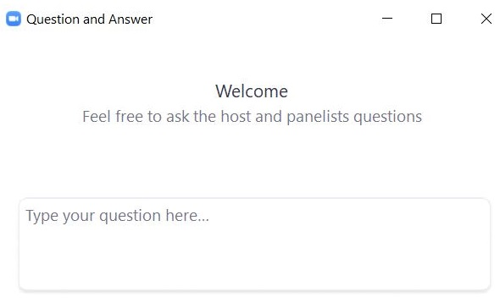
Questions & Answers
Use the “Q&A” feature to ask questions.

Slide 12
Next Steps
Today: Complete the evaluation form.
Responses are associated with the name and email address used to log in.
Email your input to mcas@mass.gov if you have problems accessing or completing the form.
Within one week:
Receive an email with the Q&A from this session
Recording will be available

Slide 13
Email and Phone Support
MCAS Service Center
DESE Student Assessment Services
Questions on logistics and technology
Web: https://mcas.onlinehelp.cognia.org/
Email: mcas@cognia.org
Phone: 800-737-5103
TTY: 888-222-1671
Live chat is available at the link on the bottom of the page at the MCAS Resource Center
Policy questions (e.g., student participation, accommodations)
Web: www.doe.mass.edu/mcas
Email: mcas@mass.gov
Phone: 781-338-3625
TTY: 800-439-2370

Slide 14




THANK YOU
The Office of Student Assessment Services
781-338-3625
mcas@mass.gov
www.doe.mass.edu/mcas
135 Santilli Highway, Everett, MA 02149

