Slide 1
Overview of the Spanish/English MCAS Tests
The Office of Student Assessment Services and
The Office of Language Acquisition
February 10, 2026

Slide 2
Presenters
Shannon Cullen
Jodie Zalk
Elenita Irizarry-Ramos
Robert Pelychaty
Office of Student Assessment Services
Test Administration Coordinator
Office of Student Assessment Services
Office of Student Assessment Services
Bilingual Education Lead
Office of Language Acquisition
Manager of Test Administration and Publications
Manager of Inclusive Assessment
Faith McAuliffe
Keyla Veloz-Sanchez
Sara Hamerla
Waltham Public Schools
Abbie Currier
Sr. Project Manager
eMetric (MCAS Online Testing Subcontractor)

Slide 3
Logistics for This Session
Use the Q&A feature to ask a question.
  We will answer some questions aloud at specified times during this training session, and we will email the Q&A afterwards.
  Use the thumbs-up icon to “upvote” someone else’s question.
  Email student-specific questions to mcas@mass.gov instead of asking here, and email questions about Dual Language Bilingual Education programs to el@doe.mass.edu.
Closed captioning has been enabled for participants who need it, and this session is being interpreted into ASL. Our interpreting team will be onscreen with the presenters.
Please be advised that DESE does not authorize attendees to record or to use AI transcription tools during the meeting and DESE does not endorse any unauthorized transcripts created by third parties of its meetings.

Slide 4
Slides for This Session
Slides were emailed to participants before this session from MCASEvents@cognia.org.
Slides are now being posted in the chat.
    If you cannot access the slides in the chat, ask in the Q&A.
After the session, we will send the slides again to participants, and they will be posted in the MCAS Resource Center along with the recording.
  OLA will share the recording and slides in their OLA Notice and in their Nuestro Puente Newsletter.

Slide 5
Today’s Agenda
Overview of the Spanish/English Tests
Participation Guidelines
A District’s Perspective: Waltham Public Schools
Assigning and Scheduling the Spanish/English Editions in the MCAS Portal
Special Considerations
Resources, Support, and Next Steps
Live “Sandbox” Time with Additional Demonstrations

Slide 6
Poll Question
Have you previously administered MCAS Spanish/English tests?
Yes
No

Slide 7
Poll Question
What is your role?
  Principal or school test coordinator
  District test coordinator
  EL director
  Dual-language bilingual education director
  Other

Slide 8
1. Overview of the Spanish/English Tests

Slide 9
Introduction
This session is geared toward
  EL directors
  Dual language coordinators
  Test coordinators
Spanish/English edition available for
  Mathematics – grades 3–8 and 10/retest
  Science and Technology/Engineering – grades 5, 8, high school Biology and Introductory Physics (February and June)
  Civics – grade 8
Test administration schedule

Slide 10
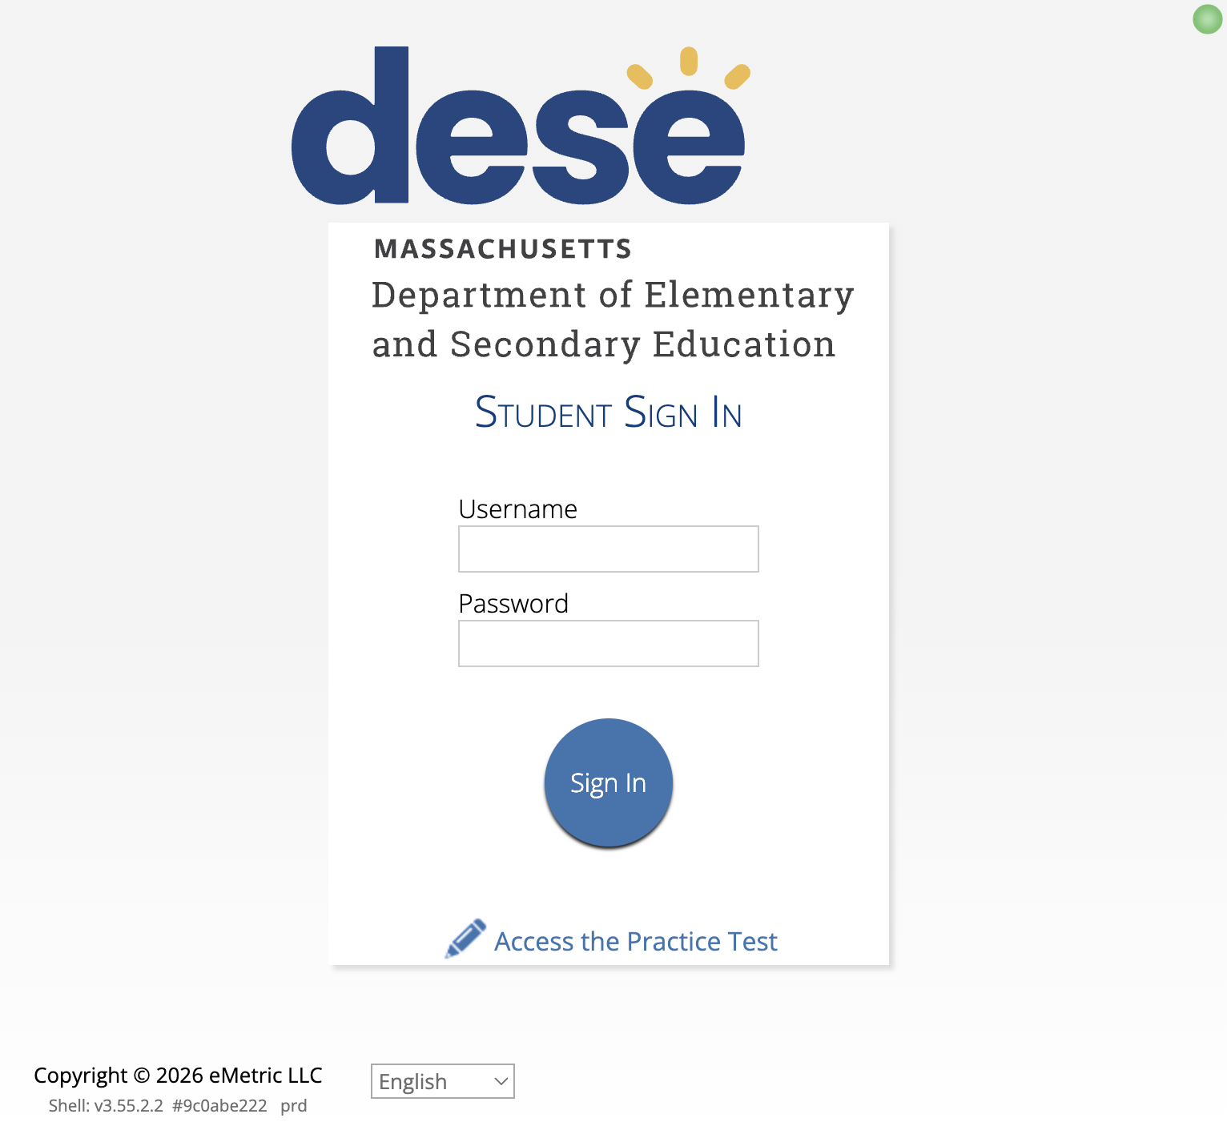
Test Format for Computer-Based Testing
Computer-based test (CBT) for most students, with a paper-based test (PBT) available as an accommodation
CBT consists of stacked text, Spanish text above English text, as shown on the next slide.
When signing in to the computer-based Spanish/English test, prior to entering the test, students may select the language (Spanish or English) in which they would like to see the MCAS Student Kiosk icons and directions.

Slide 11
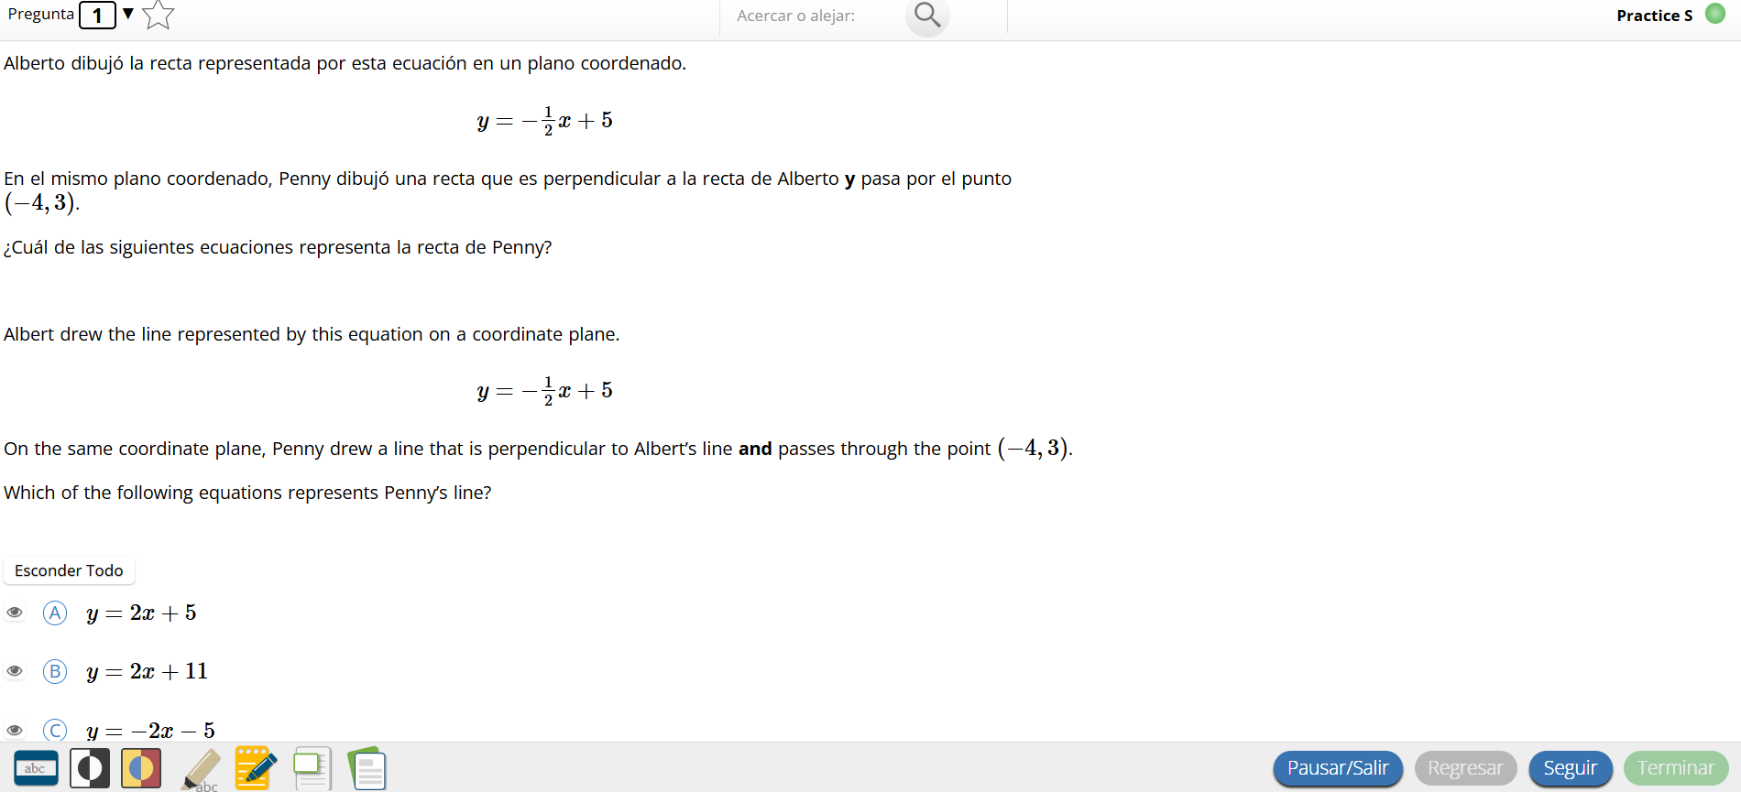
Test Format for CBT (continued)

Slide 12
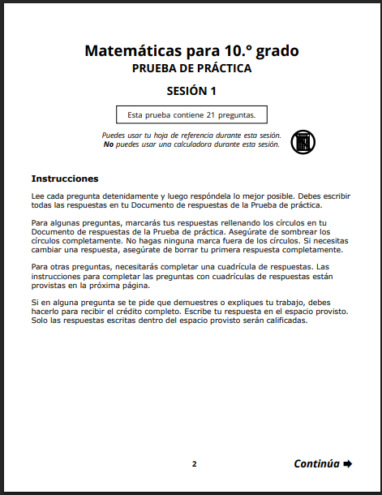
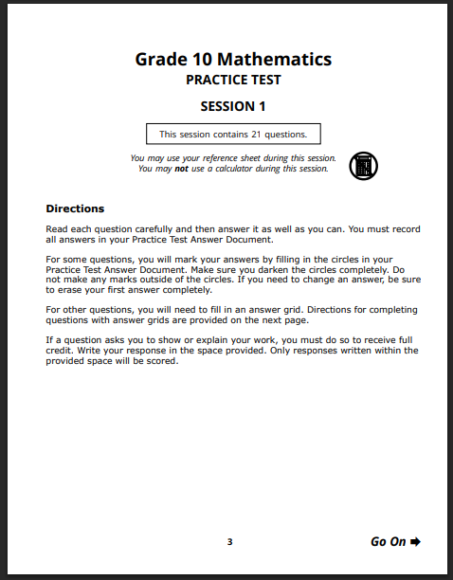
Test Format for Paper-Based Testing
  Spanish/English tests are printed with Spanish on the left-hand pages, and English on the right-hand pages.
  Spanish/English materials are printed as separate test booklets and answer documents.
    The standard PBT tests are in a combined test & answer booklet, which contains the test questions as well as the answer space.

Slide 13
Demonstrations
  Practice Tests webpage on the MCAS Resource Center for Spanish editions
  https://mcas.onlinehelp.cognia.org/practice/
    Student tutorial
    Practice tests
    Math and STE reference sheets
    Math and STE equation editor guides and symbol keys
    Math gridded response guidelines for PBT
  Released items on the MCAS Resource Center
  https://mcas.onlinehelp.cognia.org/released-items/
    Spanish/English released items for Math, STE, and Civics

Slide 14
2. Participation Guidelines

Slide 15
Eligibility Guidelines
DESE currently has a Spanish/English edition.
  DESE routinely reviews the prevalence of other languages in Massachusetts and is working towards making translations available when feasible.
The Spanish/English editions are intended for:
  Spanish-speaking ELs who have been in the U.S. less than 3 years
    Recommended for ELs at the beginning or intermediate levels of English proficiency who regularly access materials presented in Spanish
  Spanish/English editions may not be appropriate for ELs with advanced proficiency in English.
Students enrolled in Spanish/English Dual Language programs who have received instruction in Spanish in the same content area as the assessment may be considered for the Spanish/English edition.

Slide 16
Participation of EL Students and students with Disabilities
English learners (ELs) are required to participate in MCAS or MCAS-Alt in all subjects required for their grade.
  Exception: First-year ELs have option to participate in ELA testing for diagnostic purposes only.
    “First-year EL” is a student whose name does not appear in March 2025 SIMS.
  Paper-based tests available as an accommodation for first-year ELs unfamiliar with technology
  Bilingual word-to-word dictionaries available for current ELs and students who were ever EL
  Spanish/English tests available for all grades and subjects except ELA
  See Appendix C of the Principal’s Administration Manual (PAM) for more information.
Students with disabilities participate according to IEP or 504 plan
  Paper-based tests are available as an accommodation for students with disabilities who are unable to use a computer for testing.
Students should be provided time prior to testing to become familiarized with available accessibility features and accommodations.

Slide 17



3. A District’s Perspective:
Waltham
Dual Language School
Sara Hamerla
Administrator of the Multilingual Department
sarahamerla@walthampublicschools.org
Faith McAuliffe
Multilingual Teacher
Keyla Veloz-Sanchez
Math Coach

Slide 18
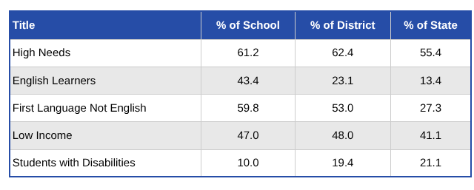
Dual Language Elementary School
Waltham: School of Recognition 2024–2025
Program Model
Dual language education provides literacy and content instruction to all students through two languages and that promotes bilingualism and biliteracy, grade-level academic achievement, and sociocultural competence.
The numbers of Dual Language (DL) students in grades 3–5 who participated in the MCAS-Spanish online in 2025:
Mathematics:
  Grade 3 = 14
  Grade 4 = 2
  Grade 5 = 1
Grades 5 STE = 1

Slide 19
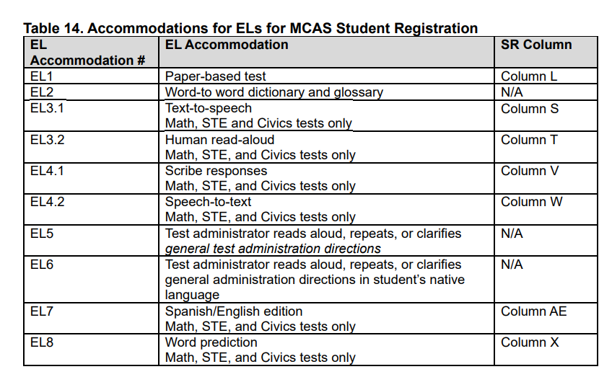
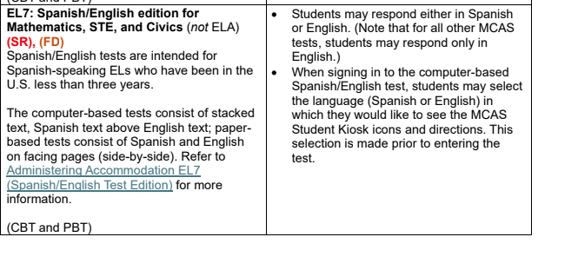
Criteria for Selection for Bilingual Online MCAS (Waltham’s Journey)
The Spanish/English editions are intended for:
Spanish-speaking ELs who have been in the U.S. less than 3 years, and recommended for use by ELs at the beginning or intermediate levels of English proficiency who regularly access materials presented in Spanish. The Spanish/English editions may not be appropriate for ELs with advanced proficiency in English.
Students enrolled in Spanish/English Dual Language programs who have received instruction in Spanish, in the same content area as the assessment, may be considered for the Spanish/English edition.

Slide 20
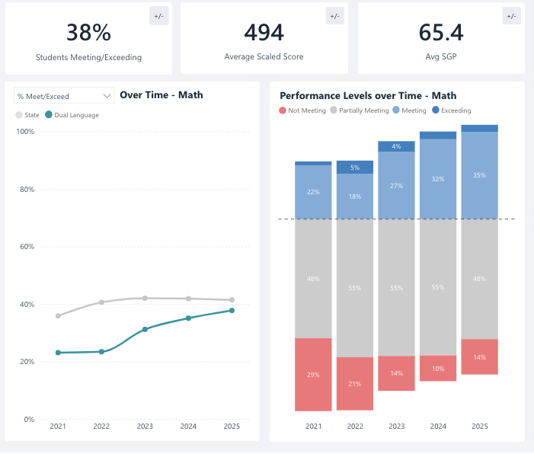
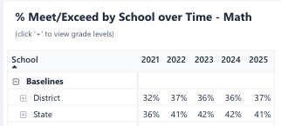
Waltham’s Spring 2025 MCAS Results
Notes:
cience

Slide 21
Waltham’s Protocol
Language Assessment Team (LAT) will identify possible participation according to DESE criteria.
Collaboration across departments: ESL, SPED, Math Coach, Science teacher.
Family and student communication.
Instructional Leadership Team (ILT) designs professional development on formative assessments.
Instruction aligns with assessment.
Notes:
cience

Slide 22
Waltham’s Advice for Other Districts
Evaluate the CBT format prior to testing to determine if it would be helpful for MLs, based on using practice tests and other information.
Educators tested the word prediction option before assigning to students.
Look at considerations for students who need text-to-speech.
Make sure to schedule enough time for students.
Notes:
cience

Slide 23
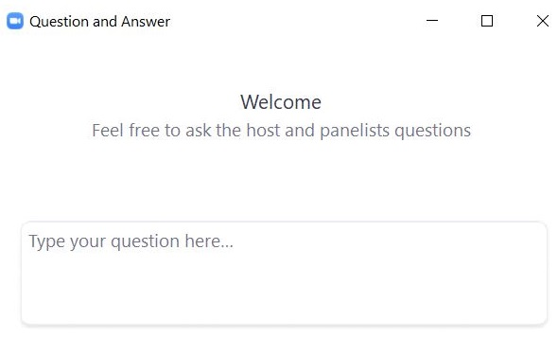
Questions & Answers
Use the “Q&A” feature
to ask questions.

Slide 24
4. Assigning and Scheduling the Spanish/English Tests in the MCAS Portal

Slide 25
General Timeline for MCAS Portal Tasks
Complete Student Registration.
Around 2 months prior to testing
Assign “Classes” in the MCAS Portal.
2 weeks prior to testing
“Schedule” tests in the MCAS Portal.
1 week prior to testing
Verify correct test assignments.
On test day
Assign the Spanish/
English test in Student Registration.
Create separate classes for students taking the Spanish/
English edition.
Select Spanish/
English tests when scheduling tests (this assigns test forms).
Verify details before students start testing.

Slide 26
Assigning the Spanish/English Tests in the MCAS Portal
Test coordinators complete Student Registration in the MCAS Portal
CBT
Students must be assigned the Spanish/English accommodation in Student Registration AND be scheduled for the Spanish/English test.
PBT
Students must be assigned the Spanish/English accommodation in Student Registration by the initial Student Registration deadline.
  If students are assigned the Spanish/English test after the initial deadline, schools should place an additional materials order.

Slide 27
Demonstrations
Assigning the Spanish/English edition during Student Registration
Assigning the Spanish/English edition manually in the MCAS Portal user interface

Slide 28
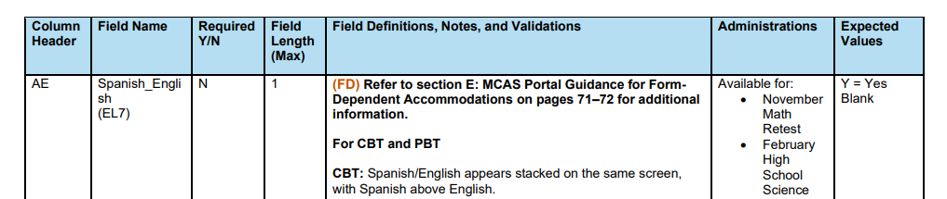
Assigning the Spanish/English Tests in Student Registration (Both PBT and CBT)
When submitting the Student Registration file in the MCAS Portal, use “Y” in column AE: Spanish_English for students who should receive the Spanish/English edition.
Guide to the MCAS Portal, Part III: Student Registration
Student Registration Data Definitions
Student Registration Template

Slide 29
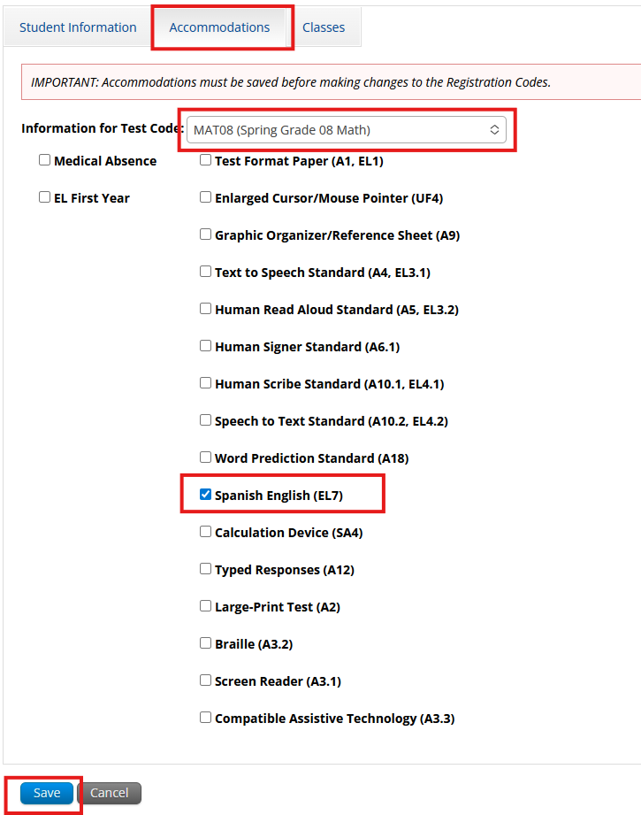
Assigning the Spanish/English Tests Manually in the MCAS Portal User Interface (Both PBT and CBT)
Navigate to the Students tab.
Find the student and select Edit.
Select the Accommodations tab.
Select the subject area test for which the student needs the Spanish/English edition.
Check the box to the left of Spanish English (EL7).
Select Save.

Slide 30
Assigning Classes for the Spanish/English Test (CBT only)
“Classes” are groups of students in the MCAS Portal that will take the same test at the same time (this is different from the testing location).
Students taking the Spanish/English test must be placed into a separate class specifically for the Spanish/English test.
It is recommended to use “Spanish” in the class name to identify these classes (e.g., Smith Rm 105 Spanish).
  Note that the grade, course, and school code are automatically added to each class name in the MCAS Portal. (e.g., Smith Rm 105 Spanish becomes Mathematics-07 SMITH RM 105 SPANISH-88888888)

Slide 31
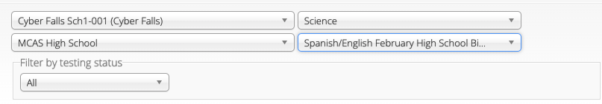
Scheduling Tests for the Spanish/English Test (CBT only)
Test scheduling begins one week before each administration.
When scheduling the Spanish/English classes for tests, the test coordinator must select the Spanish/English test from the drop-down menu on the Test Scheduling page.
  This is what assigns students the Spanish/English test form.

Slide 32
Demonstration
Scheduling Spanish/English Classes

Slide 33
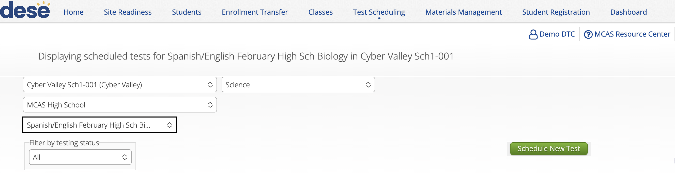
Scheduling Tests for the Spanish/English Test (CBT only)
In Administration, go to Test Scheduling, select the Spanish test, and click Schedule New Test.

Slide 34
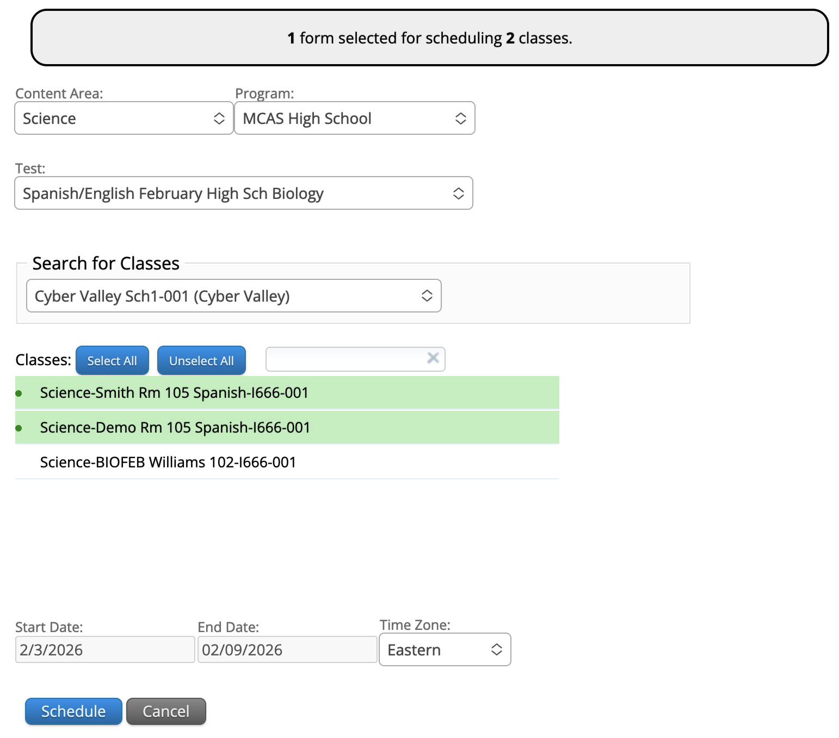
Scheduling Tests for the Spanish/English Test (CBT only)
Ensure the Spanish test has been selected.
Select the Spanish classes.
Click Schedule.

Slide 35
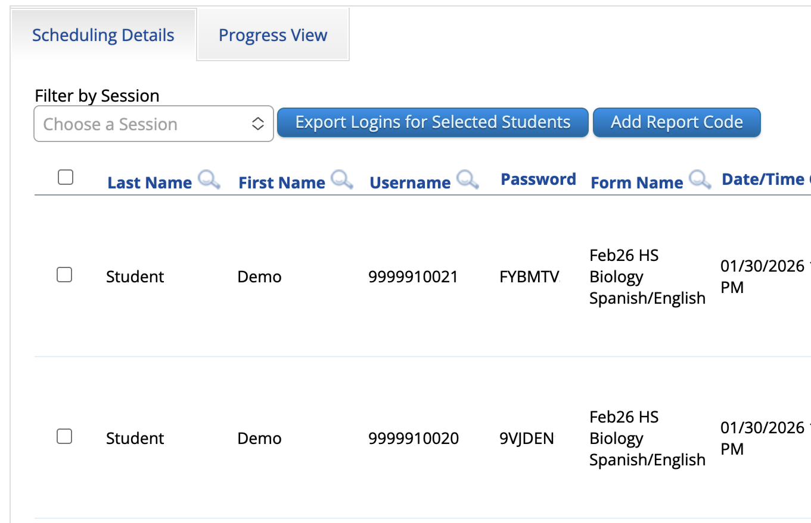
Verifying Spanish/English Form Assignment (CBT only)
Before students sign in to test, verify that they have been correctly assigned the Spanish/English form on the View Details/Student Logins page.
  Navigate to the Test Scheduling page.
  Find the class and select View Details/Student Logins.
  Verify that the Spanish/English form is listed.

Slide 36
Poll Question—
Where do test coordinators go in the MCAS Portal to select the Spanish/English test?
(Hint: It’s in a drop-down on this page.)
On the Classes page, when creating classes
On the Dashboard page, when reviewing the dashboards
On the Test Scheduling page, when scheduling tests
On the Enrollment Transfer page, when transferring a student

Slide 37
5. Special Considerations

Slide 38
Test Administration Considerations
DESE recommends separate testing locations for students taking a Spanish/English and students taking an English test. Why?
  If both groups of students will test at the same time, both scripts must be read to all students (this will extend the time needed for testing).
  Test administrators will also need to manage two separate “classes” and access codes in the MCAS Portal (students taking the Spanish/English tests must be assigned to a separate class).
New for 2026: Spanish scripts are in a separate Test Administrator’s Manual (TAM) for all subjects and grades, for both CBT and PBT.
  Test administrators will use these during test administration and refer to the TAMs for additional procedures and policy guidance.

Slide 39
Student Considerations
Translanguaging and how bilingual student responses will be evaluated:
  Q: Do students need to use correct Spanish grammar/conventions on the Spanish/English tests?
  A: No, they do not need to use correct grammar/conventions as long as their responses can be understood. Nonetheless, special characters (á, é, í, ó, ú, ñ) are available for students to use with alt shortcuts in the open responses boxes.
  Q: Can students respond bilingually in English and Spanish in the same response for Math, STE, and Civics for the Spanish/English edition tests?
  For example: Some students may know key math terms in Spanish, which may lead to a response like The raíz cuadrada of 9 is 3.
  A: Yes, students can respond in a mix of Spanish and English on both the Spanish/English edition tests, unlike the standard edition (English).
Additional accommodations available for English learners (with or without disabilities):
  See the Accessibility and Accommodations Manual for details.

Slide 40
Questions & Answers
Use the “Q&A” feature
to ask questions.

Slide 41
6. Resources, Support, and Next Steps

Slide 42
Upcoming Training Sessions
Session | Date and Registration Link | Intended Audience | Recommended Read-Ahead Materials
Tasks in the MCAS Portal Before Testing All levels of experience | Wednesday, March 4 at 9:30–11:00 a.m. | Principals and School Test Coordinators (STCs), District Test Coordinators (DTCs) | Guide to the MCAS Portal
Tasks in the MCAS Portal During and After Testing All levels of experience | Thursday, March 12 at 9:30–11:00 a.m. | Principals and STCs, DTCs | Guide to the MCAS Portal
Office Hours — MCAS Portal Tasks | Thursday, March 19 at 9:30–10:30 a.m. | Principals and STCs, DTCs | Guide to the MCAS Portal

Slide 43
Additional Resources
Resource | Location
MCAS Resource Center | mcas.onlinehelp.cognia.org
Test Administration Resources | www.doe.mass.edu/mcas/admin.html
Accessibility and Accommodations Manual | www.doe.mass.edu/mcas/accessibility/default.html
Student Assessment Updates (Biweekly email with important updates about the MCAS program) | www.doe.mass.edu/mcas/updates.html If you do not already receive this email, subscribe using this link: http://eepurl.com/ghSOhH
OLA Notice & Nuestro Puente Newsletter | If you do not already receive this email, subscribe using this link: OLA Mailing List Registration

Slide 44
Next Steps
Today: Complete the evaluation form.
  Responses are associated with the name and email address used to log in.
  Email your input to mcas@mass.gov if you have problems accessing or completing the form.
Within one week:
  Receive an email with the Q&A from this session
  Recording will be available

Slide 45
Email and Phone Support
MCAS Service Center
DESE
Questions on logistics and technology
  Web: https://mcas.onlinehelp.cognia.org/
  Email: mcas@cognia.org
  Phone: 800-737-5103
  TTY: 888-222-1671
  Live chat is available at the link on the bottom of the page at the MCAS Resource Center
Office of Student Assessment Services
Policy questions (e.g., student participation, accommodations)
Web: www.doe.mass.edu/mcas
  Email: mcas@mass.gov
  Phone: 781-338-3625
  TTY: 800-439-2370
Office of Language Acquisition
Questions about dual language bilingual education
  Email: el@doe.mass.edu

Slide 46
7. Live “Sandbox” Time

Slide 47
Poll Question—
Which demonstrations would you like to see again?
Navigating the MCAS Resource Center
Assigning the Spanish/English edition during Student Registration
Assigning the Spanish/English edition manually in the MCAS Portal user interface
Scheduling Spanish/English classes in the MCAS Portal

Slide 48




THANK YOU
The Office of Student Assessment Services
781-338-3625
mcas@mass.gov
www.doe.mass.edu/mcas
135 Santilli Highway, Everett, MA 02149

