Slide 1
Accessibility and Accommodations Office Hours
The Office of Student Assessment Services
February 6, 2026

Slide 2
Presenters
Erma Brown, MCAS and ACCESS Test Administration Specialist
Robert Pelychaty, Manager of Inclusive Assessment
Shannon Cullen, MCAS Test Administration Coordinator
Abbie Currier, eMetric Sr. Project Manager

Slide 3
Logistics for This Session
Use the Q&A feature to ask a question.
We will answer some questions aloud at specified times during this training session, and we will email the Q&A afterwards.
Use the thumbs-up icon to “upvote” someone else’s question.
Email student-specific questions to mcas@mass.gov instead of asking here.
Closed captioning has been enabled for participants who need it.
This session is being interpreted into ASL. Our interpreting team will be onscreen with the presenters.
Please be advised that DESE does not authorize attendees to record or to use AI transcription tools during the meeting and DESE does not endorse any unauthorized transcripts created by third parties of its meetings.

Slide 4
Slides for This Session
Slides were emailed to participants before this session from MCASEvents@cognia.org.
Slides are now being posted in the chat.
If you cannot access the slides in the chat, ask in the Q&A.
After the session, we will send the slides again to participants, and they will be posted in the MCAS Resource Center along with the recording.

Slide 5
Today’s Agenda
Resources
Q&A and Additional Demonstrations
Support and Next Steps

Slide 6
1. Resources

Slide 7
Additional Resources
Resource | Location
Accessibility and Accommodations Manual | https://www.doe.mass.edu/mcas/accessibility/default.html
MCAS Resource Center | mcas.onlinehelp.cognia.org
MCAS Portal Guides Guide to the MCAS Portal – refer to Part III: Student Registration | https://mcas.onlinehelp.cognia.org/ portal/
Student Assessment Updates (Biweekly email with important updates about the MCAS program) | www.doe.mass.edu/mcas/updates. html If you do not already receive this email, subscribe using this link: http://eepurl.com/ghSOhH

Slide 8
2. Q&A and Additional Demonstrations
8

Slide 9
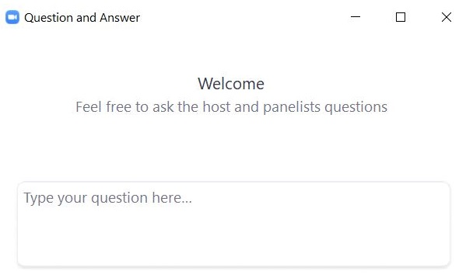
Questions & Answers
Use the “Q&A” feature to ask questions.

Slide 10
3. Support and Next Steps
10

Slide 11
Next Steps
Today: Complete the evaluation form.
Responses are associated with the name and email address used to log in.
Email your input to mcas@mass.gov if you have problems accessing or completing the form.
Within one week:
Receive an email with the Q&A from this session
Recording will be available

Slide 12
Email and Phone Support
MCAS Service Center
DESE Student Assessment Services
Questions on logistics and technology
Web: https://mcas.onlinehelp.cognia.org/
Email: mcas@cognia.org
Phone: 800-737-5103
TTY: 888-222-1671
Live chat is available at the link on the bottom of the page at the MCAS Resource Center
Policy questions (e.g., student participation, accommodations)
Web: www.doe.mass.edu/mcas
Email: mcas@mass.gov
Phone: 781-338-3625
TTY: 800-439-2370

Slide 13




THANK YOU
The Office of Student Assessment Services
781-338-3625
mcas@mass.gov
www.doe.mass.edu/mcas
135 Santilli Highway, Everett, MA 02149

