Slide 1
MCAS Tasks for Technology Coordinators
The Office of Student Assessment Services
February 2, 2026

Slide 2
Presenters
Jodie Zalk, Manager of Test Administration and Publications
Shannon Cullen, MCAS Test Administration Coordinator
Abbie Currier, eMetric Sr. Project Manager

Slide 3
Logistics for This Session
Use the Q&A feature to ask a question.
We will answer some questions aloud at specified times during this training session, and we will email the Q&A afterwards.
Use the thumbs-up icon to “upvote” someone else’s question.
Email specific questions about your organization’s technology to mcas@cognia.org instead of asking here.
Closed captioning has been enabled for participants who need it.
This session is being interpreted into ASL. Our interpreting team will be onscreen with the presenters.
Please be advised that DESE does not authorize attendees to record or to use AI transcription tools during the meeting and DESE does not endorse any unauthorized transcripts created by third parties of its meetings.

Slide 4
Slides for This Session
Slides were emailed to participants before this session from MCASEvents@cognia.org.
Slides are now being posted in the chat.
If you cannot access the slides in the chat, ask in the Q&A.
After the session, we will send the slides again to participants, and they will be posted in the MCAS Resource Center along with the recording.

Slide 5
Today’s Agenda
Technology Staff Responsibilities
Technology Guidelines
MCAS Student Kiosk Updates and Site Readiness
Troubleshooting during Testing: Internet Connectivity and Error Messages
Resources and Next Steps

Slide 6
Poll Question
What is your role?
School technology coordinator
District technology coordinator
School or district test coordinator
Other

Slide 7
Poll Question
How many years have you been the technology coordinator for MCAS test administration at your school or district?
6 or more years
3 to 5 years
1 to 2 years
This is my first year.

Slide 8
1. Technology Staff Responsibilities

Slide 9
Technology Updates for MCAS Testing 2025–26
Windows 10 is no longer supported.
The ChromeOS support policy has been updated to support a larger number of versions each year.
Schools using ChromeOS will use the new Progressive Web App (PWA) for the kiosk.
Installation steps for ChromeOS have been updated in the MCAS Student Kiosk Technology Guide to more clearly identify the steps required for installation.
Refer to the January 13 ChromeOS Kiosk Installation training for additional information.
Note that the PWA became available in fall 2025. Schools who participated in the November Retest will have already used this updated kiosk.

Slide 10
Pre-Administration Checklist for Technology Staff
Review the technology coordinator responsibilities in Appendix A of the Principal’s Administration Manual and the MCAS Student Kiosk Technology Guide.
Establish communication plan with principal/test coordinators.
Verify access to MCAS Portal and MCAS Training Site.
Verify all student devices meet technology requirements, and ensure external hardware is available (e.g., headphones, chargers).
Configure devices.

Slide 11
Pre-Administration Checklist for Technology Staff (continued)
Add provided URLs to the exempt list in any applicable network appliance or software (e.g., content filters, firewalls, proxy servers, anti-virus solutions).
Download and install the updated MCAS Student Kiosk on student devices.
Conduct Site Readiness.
Reach out to the MCAS Service Center with technology questions.
Make plan to be available during testing for troubleshooting technology issues.

Slide 12
Bring Your Own Device (BYOD)
Schools that intend to use BYOD for MCAS should inform DESE by emailing MCAS@mass.gov. Further instructions will be provided.
Deadline was January 16 for spring administrations.
Recommendations
Use devices managed by the school/district.
Confirm that devices meet technology requirements.
Note that unmanaged Chromebooks cannot be used for BYOD.

Slide 13
2. Technology Guidelines

Slide 14
Technology Guidelines for MCAS Computer-Based Testing
Part II of the MCAS Student Kiosk Technology Guide: available on the MCAS Resource Center on the Technology Setup page
Outlines the operating systems (OS) versions supported for testing, student kiosk device specifications, and MCAS Portal browser specifications
OS support
As new OS versions and subversions are released throughout the school year, eMetric conducts testing to confirm that they will be supported for testing.
Any updates to technology guidelines will be shared in a Student Assessment Update and listed on page 1 of the guide under Document updates.
Schools should not update device OS versions during spring testing windows. If schools updated device OS versions after running Site Readiness in the fall, they should run Site Readiness again prior to spring testing.

Slide 15
Poll Question
Which operating systems will students in your school/district use for spring 2026 MCAS testing? (Select all that apply.)
ChromeOS
iPadOS
Linux/Fedora
macOS
Windows
Other

Slide 16
Student Device Specifications
System Requirements – All Hardware
Connectivity | Student devices must be able to connect to the internet via wired or wireless networks.
Screen Size | 9.7” screen size or larger/“10-inch class” tablets or larger
Screen Resolution | 1024 x 768 or larger
Browser Requirements
Browsers (used for practice tests only) | Chrome 143 or newer Firefox 146 or newer Microsoft Edge 143 or newer Safari 26.2 or newer
Desktop and Laptop Specific Requirements
CPU | 1.3 GHz
Memory | 2 GB (4GB is strongly recommended for best performance)
Note: Only the browser requirements have changed since spring 2025.

Slide 17
ChromeOS Support Plan
eMetric supports the versions of ChromeOS that are current as of July of each school year. These versions will be supported through the end of the school year (June).
Schools are not recommended to use beta versions of ChromeOS, as this may result in errors.
Students testing on devices that do not meet the technology guidelines may encounter performance-related issues during testing.
As of July 1, 2025 the following versions are supported through June 30, 2026:
Stable Channel: 138+ (released July 2025)
LTS Channel: 132+ (released April 2025)
Refer to Part II of the MCAS Student Kiosk Technology Guide.

Slide 18
iPadOS Support Plan
eMetric supports the latest three major versions that are supported by Apple.
Version | Version Release Date | End of Support Date
17.7+ | September 2024 | End of 2025–26 school year
18.5+ | September 2024 | End of 2026–27 school year
26 | September 2025 | End of 2027–28 school year
Refer to Part II of the MCAS Student Kiosk Technology Guide.

Slide 19
Support for macOS
Version | Version Release Date | End of Support Date | eMetric Support Policy
14.7+ | September 2023 | End of 2025–26 school year | eMetric supports the latest three major versions that are supported by Apple. The latest subversion will be specified in the table below after being fully tested.
15.5+ | September 2024 | End of 2026–27 school year
26 | September 2025 | End of 2027–28 school year
Refer to Part II of the MCAS Student Kiosk Technology Guide.

Slide 20
Support for Linux and Windows
Operating System | Version | Version Release Date | End of Support Date | eMetric Support Policy
Linux®, Fedora™ | 42 | April 2025 | End of 2025–26 school year | eMetric supports the latest version of Fedora.
Windows® | 11 (22H2, 23H2, 24H2) | October 2021 | October 2031 | eMetric supports major versions of Windows that are supported by Microsoft. The latest supported minor versions of Windows are supported.
Refer to Part II of the MCAS Student Kiosk Technology Guide.

Slide 21
Network Requirements and Guidelines
Firewalls
Allow traffic through ports 80 and 443
Proxy and Content Filter Servers
List of URLs to allow on ports 80 and 443 available in Part III of the MCAS Student Kiosk Technology Guide
Sandboxing Applications
Choose network folder or local folder that is not touched by the sandboxing applications
Applicable for both stored response and kiosk installation folders
Refer to Part III of the MCAS Student Kiosk Technology Guide.
Turn off operating system auto-updates (recommended).

Slide 22
OneDrive
OneDrive notifications may interfere with the kiosk and student test-taking experience. If OneDrive attempts to steal the screen’s focus during testing, the kiosk will display a white screen.
The student will need to click anywhere on the screen to regain focus in the kiosk, and then they will be able to resume testing where they left off.
To prevent these interruptions, schools should use one of the following approaches:
If OneDrive is not needed or used on student devices, schools are recommended to disable OneDrive during student testing. OR
If OneDrive cannot be disabled, the technology coordinator should take the necessary steps to prevent any actions, including file sharing or synchronization and administration updates to OneDrive settings, that would trigger a OneDrive notification during student testing.

Slide 23
Supported OS for Accessibility Features/Accommodations
Accommodation | Supported Operating System
Compatible Assistive Technology | Windows
Mouse Pointer | Windows, macOS, ChromeOS, and iPadOS*
Screen Reader | Windows (NVDA, JAWS)
Speech-to-Text Standard | Windows, macOS, ChromeOS, and iPadOS
Speech-to-Text Special Access | Windows, macOS, ChromeOS, and iPadOS
Word Prediction Standard | Windows, macOS, ChromeOS, and iPadOS
Word Prediction Special Access | Windows, macOS, ChromeOS, and iPadOS
*iPadOS: It is recommended to use an external mouse.
Notes:
For students requiring the Screen Zoom tool, see the MCAS Student Kiosk Technology Guide, Part III, D. Monitor Settings.
All other accessibility features and accommodations are supported by Windows, MacOS, ChromeOS, and iPadOS.

Slide 24
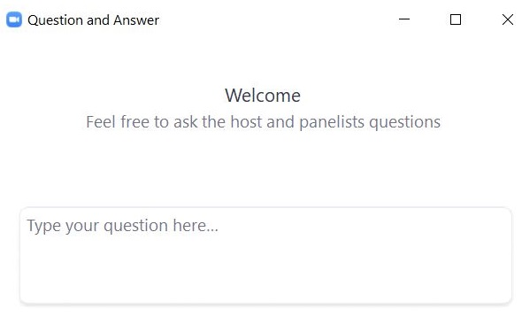
Questions & Answers
Use the “Q&A” feature to ask questions.

Slide 25
3. MCAS Student Kiosk Updates and Site Readiness

Slide 26
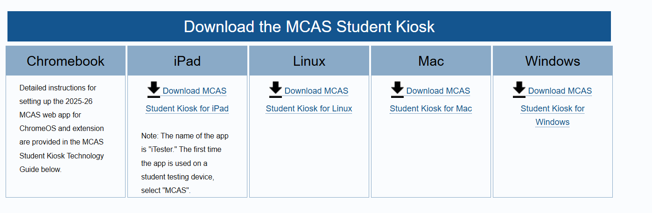
Download and Install Updated MCAS Student Kiosks
Schools should have downloaded and installed the updated MCAS Student Kiosk in fall 2025.
Available for download from the MCAS Portal and MCAS Resource Center for Linux, Mac, and Windows
For iPadOS and ChromeOS, access the apps on the Apple App Store and Chrome Web Store. Information is available in the MCAS Portal and MCAS Resource Center.

Slide 27
Download and Install Updated MCAS Student Kiosks (continued)
Be sure to download the correct MCAS Student Kiosk for each device type.
Scripted installations and other methods of installation are provided in Part IV of the MCAS Student Kiosk Technology Guide.

Slide 28
PWA for ChromeOS
New for 2025–26: As part of Google’s ongoing updates to ChromeOS, support for legacy ChromeOS Apps, including the MCAS Chrome app, is being phased out. Starting in the 2025–26 school year, a new Progressive Web App (PWA) is required for all online testing on ChromeOS devices.
The PWA will work alongside a Chrome extension to support secure kiosk testing.
Resources:
ChromeOS Kiosk Installation Instructions
January 13 ChromeOS Kiosk Installation training webinar
MCAS Student Kiosk ChromeOS Application Installation Quick Copy

Slide 29
MCAS Student Kiosk: Update for MacOS
MacOS – Additional instructions for setup
Technology coordinators need to turn off the Force Click (3D Touch) on Mac TrackPad for student testing devices.
Instructions for turning off this setting are located on page 37 of the MCAS Student Kiosk Technology Guide.

Slide 30
Overview of Site Readiness
What are the purposes of conducting Site Readiness and Site Certification?
For technology coordinators to:
Confirm that installation of the MCAS Student Kiosk was done correctly on student devices
Confirm that testing devices meet the minimum requirements and have been properly configured
Confirm that test content reaches student devices without issue
Identify any potential technology-related issues before testing begins
For communication of these steps to district and school test coordinators that testing devices are ready
When is Site Readiness conducted?
Schools should have completed Site Readiness in fall 2025.
Schools should complete Site Readiness again prior to testing if they have updated any technology.

Slide 31
Site Readiness Testing and Site Certification
After installing the updated MCAS Student Kiosk, all schools and districts must conduct site readiness testing. The Site Readiness tool includes the System Set-Up Test and the Student Interface Test and both parts must be completed.
The System Set-Up Test tests bandwidth, connectivity, screen resolution, and the text-to-speech function.
The Student Interface Test provides sample test questions to determine whether the device is capable of correctly displaying and navigating test content in the MCAS Student Kiosk.
Refer to section V of the MCAS Student Kiosk Technology Guide for more information.

Slide 32
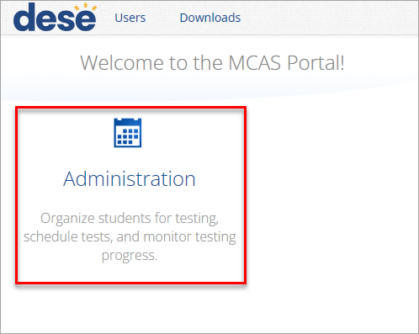
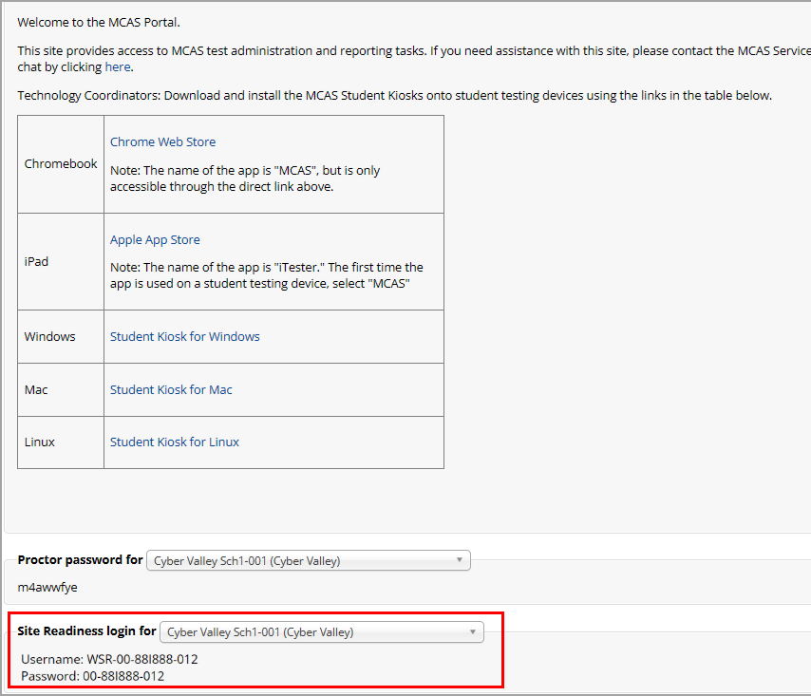
Begin Site Readiness Testing
Locate the Site Readiness credentials in the MCAS Portal.
Log in to the MCAS Portal with your username and password.
On the Portal home page, click Administration.
The Site Readiness account information appears at the bottom of the Administration home page.
Make a note of the username and password for the school, which you will use to log in to the MCAS Student Kiosk.

Slide 33
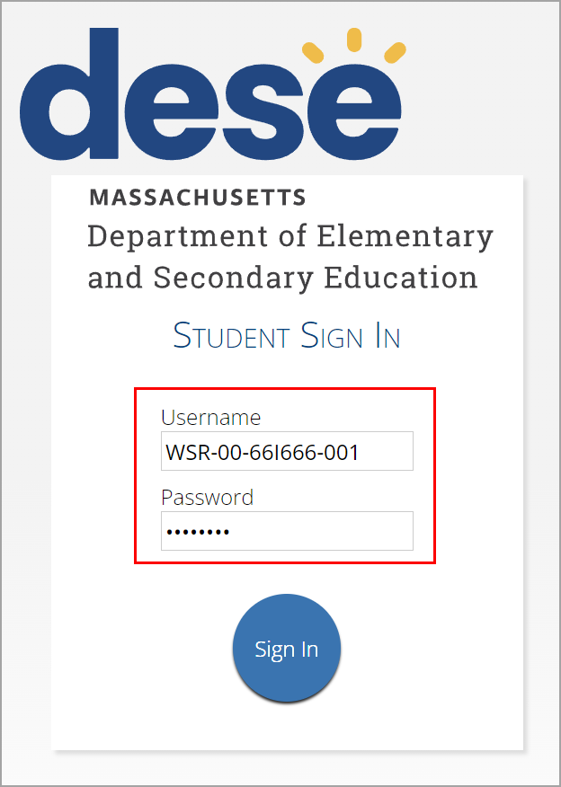
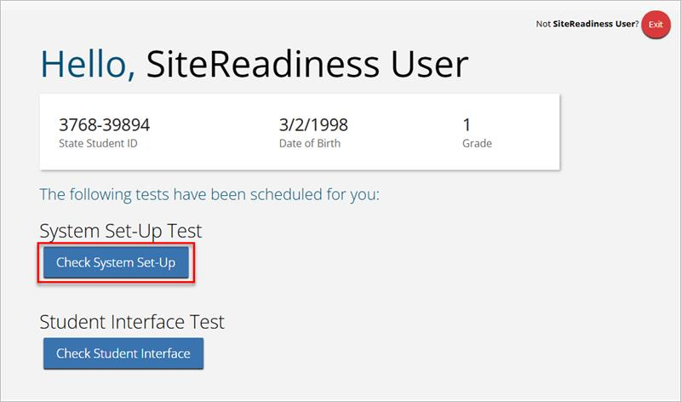
Site Readiness Testing continued
2. Conduct site readiness on every device configuration.
Launch the MCAS Student Kiosk on the device.
Log in to the MCAS Student Kiosk with the Site Readiness username and password provided for the school (see slide 29).
Under System Set-Up Test, click Check System Set-Up to begin the test.

Slide 34
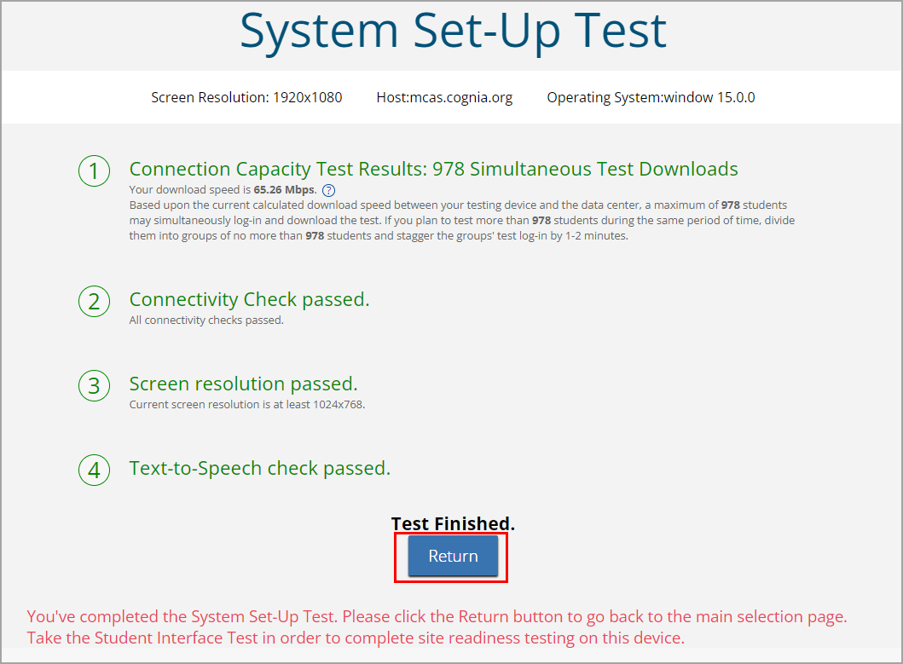
Site Readiness: System Set-Up Test
2. Conduct site readiness on every device configuration (continued)
The screen resolution, host URL (mcas.cognia.org), and operating system for the device are listed at the top of the System Set-Up Test page.
The System Set-Up Test consists of four parts: the Connection Capacity Test, the Connectivity Check, the Screen resolution check, and the Text-to-Speech check.
The results of each test appear as soon as it is completed.

Slide 35
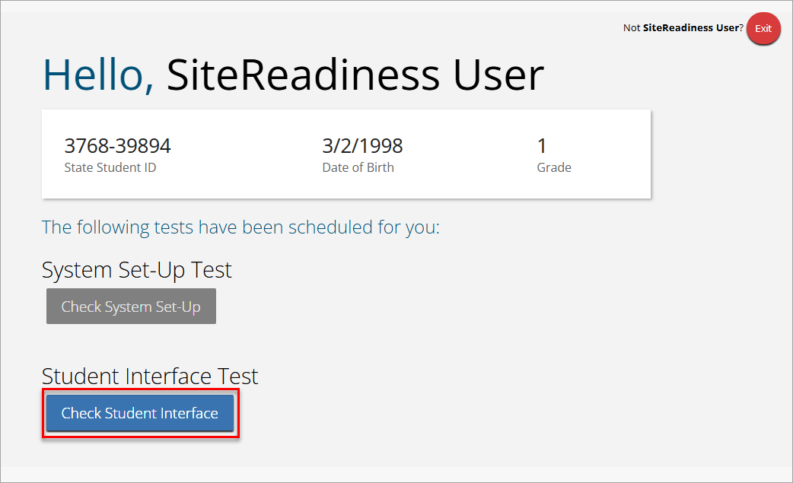
Site Readiness: Student Interface Test
2. Conduct site readiness on every device configuration (continued)
When the System Set-Up test is completed, click the blue Check Student Interface button.
Note: If you run the Check Student Interface test on a Chromebook and you receive the error message “This test must be taken with the kiosk or mobile app”, this is an indication that the MCAS web app and extension are not installed correctly in Google Admin console.

Slide 36
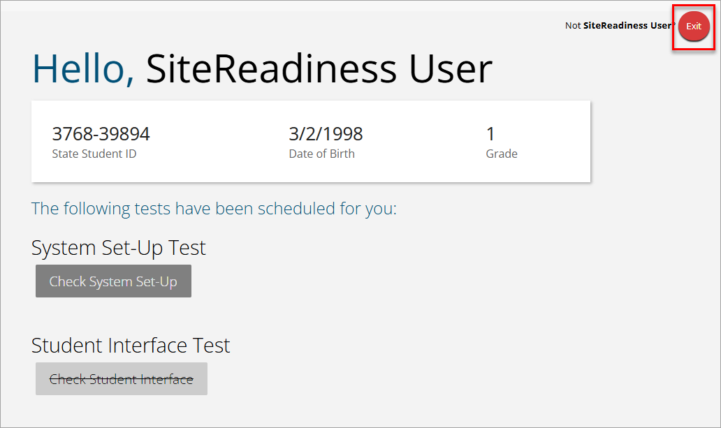
Student Interface Test continued
2. Conduct site readiness on every device configuration (continued)
Walk through the steps for the Student Interface Test.
To exit the Site Readiness tool, click Exit in the top right corner of the page.

Slide 37
Demonstration
Site readiness and site certification

Slide 38

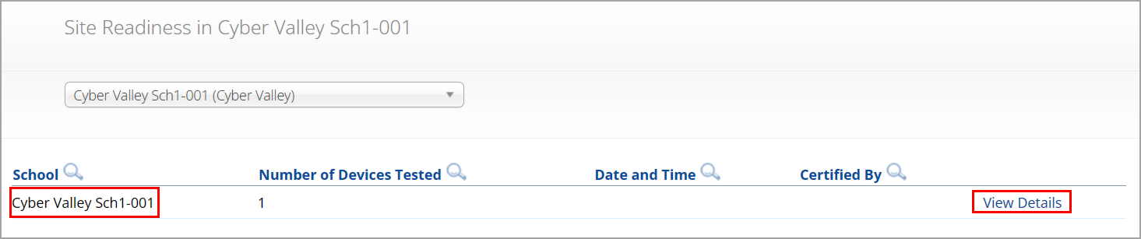
Site Certification
After all device configurations for your school have successfully completed Site Readiness, the technology coordinator must certify the site for testing.
Log in to the MCAS Portal with your username and password.
Click Administration.
Click Site Readiness at the top of the page.
On the Site Readiness page, locate the school to be certified, and then click View Details.

Slide 39
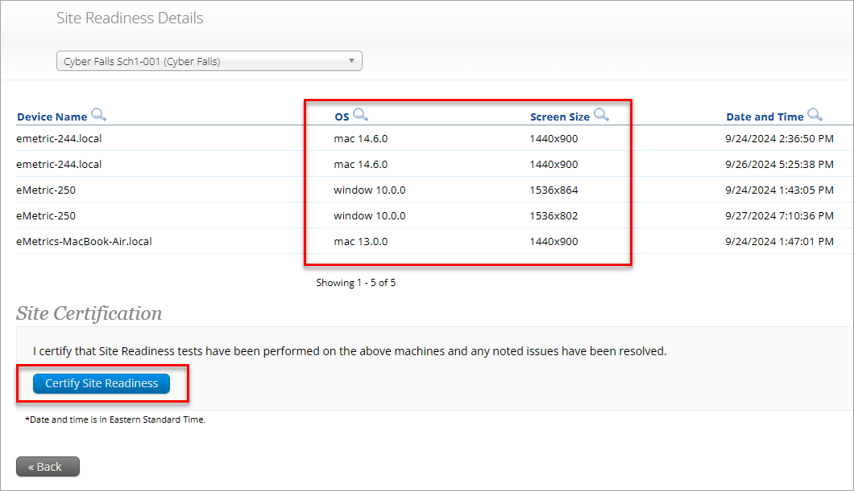
Site Certification continued
On the Site Readiness Details page, verify that all the devices or device configurations for this location have successfully run the Site Readiness tool and meet the technology requirements.
Click Certify Site Readiness and click Yes to confirm in the pop-up window.
Note: Results for Site Readiness testing will only display if both parts of the Site Readiness test are taken.

Slide 40

Questions and Answers
Use the “Q&A” feature
to ask questions.

Slide 41
4. Troubleshooting during Testing: Internet Connectivity and Other Error Messages

Slide 42
MCAS Student Kiosk: Internet Connectivity
For grades 5 and 8 STE, internet connectivity is required.
For any tests with the text-to-speech or ASL accommodations, internet connectivity is required.
For all other tests, internet connectivity is required during testing only as follows:
At the beginning of each test session to authenticate student login and download the test content
At the end of each test session to submit responses for scoring
Once a student has finished reading the test session directions and the content has downloaded onto the local device, the student may continue testing regardless of internet connectivity.

Slide 43
MCAS Student Kiosk: Internet Connectivity (continued)
If a student’s device loses internet connectivity:
The student should keep testing on that device.
Do not move a student to a new device when experiencing technical issues if the student has already begun testing.
Student responses will be saved to the save response location indicated during MCAS Student Kiosk installation.
Once internet connectivity resumes, the saved responses will automatically be synced to eMetric servers.
If the student turns in the test offline, the student will receive a message to notify the test administrator.

Slide 44



MCAS Student Kiosk:
Internet Connectivity (continued)
When is internet connectivity required?
Beginning of Test:
Authenticate login
Download test content
eMetric Servers
End of Test:
1. Submit responses for scoring

Slide 45





MCAS Student Kiosk: Loss of Internet
Connectivity During Testing
Internet connectivity indicator
Responses Sync Every 45-90 seconds
Student with Internet Connectivity
eMetric Servers
Student with No Internet Connectivity
eMetric Servers
Student with Restored Internet Connectivity
eMetric Servers

Slide 46

MCAS Student Kiosk:
Finish the Test with No Connectivity
Internet connectivity indicator
Student turns in test and receives prompt to notify test administrator
Student Finishes Test with No Internet Connectivity
Test Administrator on Student Device with Internet Connectivity
eMetric Servers
Test administrator uses student testing device and relaunches the MCAS Student Kiosk

Slide 47
Loss of Network Connectivity
Procedure Summary
If a student finishes and is ready to turn in the test while offline (prior to the network being restored):
Allow student to turn in test.
The student will receive a message to notify the test administrator.
Record the exact device the student is testing on.
Ensure no network management tools or system maintenance will alter that device’s files or configuration.
When network connectivity is restored, the test administrator will need to resume internet connectivity and relaunch the MCAS Student Kiosk. (If you can see the student login page, the saved responses have synced.)
Test administrators should confirm student test status is Finished at the end of the test session.
If you are unsure of the status of the student responses, call the MCAS Service Center.
Step-by-step instructions are in Appendix A of the PAM.

Slide 48
Steps to Resolve Error Messages
If possible, do not power the device off until the student has exited the MCAS Student Kiosk.
Record the exact device the student is testing on.
Troubleshoot the error according to the instructions in Appendix A of the PAM.
If your school is experiencing a high volume of error messages, contact the MCAS Service Center.
When resuming a test after an error has exited the student from the kiosk, the original testing device should be used first.
This is so that any unsent responses on the original device can be sent to eMetric.
If the original testing device cannot be used or if the original error is still occurring, contact the MCAS Service Center for support.

Slide 49
Common MCAS Student
Kiosk Error Messages
Error Message | Resolution
Invalid username/password | The student is using the incorrect password or username when trying to log into the MCAS Student Kiosk. Verify the correct username and password in the MCAS Portal and have the student try again.
We could not establish a connection to our server, please check your internet connection. | Internet connectivity was lost after the student entered their username and password. The MCAS Student Kiosk detected the loss of internet connectivity and will not allow the student to log in until internet connectivity is reestablished. Restore internet connectivity and try again.
Incorrect access code. Please try again. | The student is using the incorrect access code for the session selected or typing in the access code incorrectly. Verify the correct access code in the MCAS Portal and have the student try again.
Refer to Appendix A of the PAM for a full list of error messages and instructions.

Slide 50
Common MCAS Student
Kiosk Error Messages (continued)
Error Message | Resolution
We were unable to get your Test Session. Please check your internet connection and try again. | Internet connectivity was lost after the student logged in. The MCAS Student Kiosk will not load the test sessions until a connection to the internet is reestablished. Click Retry. If internet connectivity is established, then the student will be directed to the test session. If an internet connection is not detected, restore internet connectivity and try again.
We could not establish a connection to our server, please check your internet connection. | The eMetric servers cannot reach the stored response folder location due to a network connectivity failure. Reestablish network connection.

Slide 51
Common MCAS Student
Kiosk Error Messages (continued)
Error Message | Resolution
Please raise your hand; your test session has timed out. | The student has timed out of their test session, meaning they have been inactive in the test for 60 minutes or more. Click Exit to go back to the sign-in page. When the student is ready to continue testing, they will log back into the student testing interface and select the session, enter the access code, and the test administrator will enter the proctor password. The student will resume testing where they left off.
A connection to the network could not be established. Your test has been saved offline. | Internet connectivity was lost after the student began testing and was not restored by the time the student completed the test. The student’s responses are saved to the local folder configured when installing the MCAS Student Kiosk. Enter the proctor password to acknowledge the message. Note the student’s device ID. Contact your technology coordinator to establish internet connection. Relaunch the MCAS Student Kiosk on the student’s device.

Slide 52
Common MCAS Student
Kiosk Error Messages (continued)
Error Message | Resolution
This test must be taken with the kiosk or mobile app. | The MCAS Student Kiosk has not been installed correctly. The technology coordinator will need to verify the kiosk has been installed correctly and all device settings have been set correctly.

Slide 53
Questions and Answers
Use the “Q&A” feature
to ask questions.

Slide 54
5. Resources, Support, and Next Steps

Slide 55
Additional Resources
Resource | Location
MCAS Resource Center | mcas.onlinehelp.cognia.org
Guide to the MCAS Portal | https://mcas.onlinehelp.cognia.org/portal/
MCAS Student Kiosk Technology Guide | https://mcas.onlinehelp.cognia.org/technology-setup/
Student Assessment Updates (Biweekly email with important updates about the MCAS program) | www.doe.mass.edu/mcas/updates.html If you do not already receive this email, subscribe using this link: http://eepurl.com/ghSOhH
Cybersecurity Resources | https://www.doe.mass.edu/mcas/testadmin/

Slide 56
Next Steps
Today: Complete the evaluation form.
Responses are associated with the name and email address used to log in.
Email your input to mcas@mass.gov if you have problems accessing or completing the form.
Within one week:
Receive an email with the Q&A from this session
Recording will be available

Slide 57
Email and Phone Support
MCAS Service Center
DESE Student Assessment Services
Questions on logistics and technology
Web: https://mcas.onlinehelp.cognia.org/
Email: mcas@cognia.org
Phone: 800-737-5103
TTY: 888-222-1671
Live chat is available at the link on the bottom of the page at the MCAS Resource Center
Policy questions (e.g., student participation, accommodations)
Web: www.doe.mass.edu/mcas
Email: mcas@mass.gov
Phone: 781-338-3625
TTY: 800-439-2370

Slide 58

