Slide 1
Overview of Student Registration Tasks for the Spring 2026 MCAS Tests
The Office of Student Assessment Services
January 15, 2026

Slide 2
Presenters
Jodie Zalk, Manager of Test Administration and Publications
Julia English, Data and Reporting Specialist
Shannon Cullen, MCAS Test Administration Coordinator
Abbie Currier, eMetric Sr. Project Manager

Slide 3
Logistics for This Session
Use the Q&A feature to ask a question.
We will answer some questions aloud at specified times during this training session, and we will email the Q&A afterwards.
Use the thumbs-up icon to “upvote” someone else’s question.
Email student-specific questions to mcas@mass.gov instead of asking here.
Closed captioning has been enabled for participants who need it.
This session is being interpreted into ASL. Our interpreting team will be onscreen with the presenters.
Please be advised that DESE does not authorize attendees to record or to use AI transcription tools during the meeting and DESE does not endorse any unauthorized transcripts created by third parties of its meetings.

Slide 4
Slides for This Session
Slides were emailed to participants before this session from MCASEvents@cognia.org.
Slides are now being posted in the chat.
If you cannot access the slides in the chat, ask in the Q&A.
After the session, we will send the slides again to participants, and they will be posted in the MCAS Resource Center along with the recording.

Slide 5
Today’s Agenda
Overview of the Student Registration Process
Preparing the Initial File for Import
Steps for Completing the Initial Import
Steps After the Initial Import
Resources, Support, and Next Steps
Live “Sandbox” Time with Additional Demonstrations
Note: This training will not cover enrollment transfers, creating classes, test scheduling, or navigating the MCAS Student Kiosk. These topics will be covered in future training sessions.

Slide 6
Poll Question—3
What is your role? (Check all that apply.)
District test coordinator
School test coordinator
Principal
School counselor
Technology staff
Other district staff
Other school staff

Slide 7
Poll Question—3
How many years have you coordinated MCAS test administration?
0–This is my first year.
1 year
2–3 years
4–5 years
6+ years

Slide 8
1. Overview of the Student Registration Process

Slide 9
What’s New for 2026?
The Student Registration process remains the same as spring 2025.
An accommodations export has been added on the Students page for test coordinators to verify that accommodations have been assigned correctly.
A description of all MCAS Portal and MCAS Student Kiosk updates is available on the DESE website.

Slide 10
Tasks to Complete in the MCAS Portal During Test Administration for School Test Coordinators
Approx. 2 months before testing
Student Registration
During Student Registration and throughout testing
Assign and manage accommodations
Approx. 2 weeks before testing
Create and assign students to classes
One week before testing
Schedule classes
Available one week before testing (recommended 1-2 days before testing)
Print student logins

Slide 11
What is Student Registration?
Student Registration is a collection of student-level data, including
student demographic data
information on selected accommodations that a student will use during testing
Student Registration must be completed to determine the basis for the initial shipment of materials to schools, including
test administration manuals (CBT and PBT)
Student ID Labels for paper-based tests (PBT)
PBT test and answer booklets, including Form-Dependent accommodations (view slide 18 for details on these accommodations)
Student Registration determines initial test orders and provides a record of students tested and the accommodations they used.
District and school test coordinators and technology coordinators have permissions in the MCAS Portal to upload and edit student data.

Slide 12
Resources for Completing Student Registration
Part III of the Guide to the MCAS Portal: Student Registration (previously named the Student Registration Guide)
Instructions for completing the initial process
Instructions for updating student information after the initial file upload
Section D: Student Registration File Data Definitions section:
Describes each of the columns in the Student Registration file.
Indicates which columns are required for import.
Includes details on test codes (column J)
Describe eligibility to receive the accommodation and describe how to complete that field.
Expected Values indicate options for column input.
Section E: MCAS Portal Guidance for Form-Dependent Accommodations
Student Registration Data Definitions
Includes the same information as Part D of the MCAS Student Registration Guide
Student Registration Template
All resources are available on the MCAS Resource Center.

Slide 13
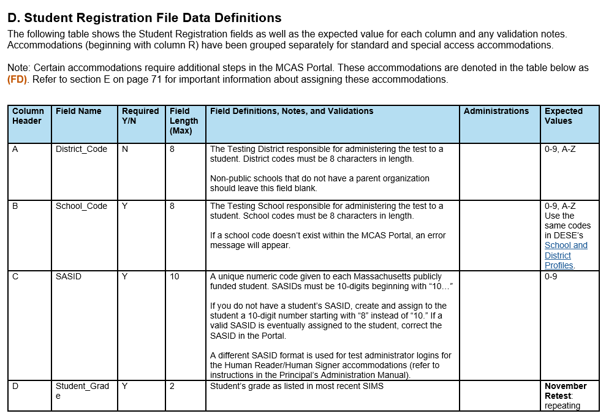
Field Definitions, Notes, and Validations

Slide 14
Overview of Steps to Complete Student Registration
Download the .CSV file prepared by DESE from Dropbox Central in the DESE Security Portal (available on the first day of each Student Registration window).
Delete students from the file who are no longer enrolled in your school and add rows for students who were not included in the file and will be testing.
Verify and update students’ accessibility features and accommodations.
Save as a .CSV file and import file into the MCAS Portal.
Resolve any errors that occur.
Update student information as needed, through file export/import process or through the user interface.

Slide 15
For what reasons and when should we update Student Registration?
1. Initial Student Registration Window
2. Extended Student Registration Window for CBT
3. Test Administration Window
4. Deadline for Updating Student Registration information
Add students.
Remove students/ test assignments.
Edit accommodations.
Edit demographic info.
Same as 1, but additional steps are required for some accommodations (see slide 18)
Same as 1, but may need to order additional paper-based tests
Edit accommodations that were not used.
Edit demographic info.

Slide 16
Student Registration Deadlines
See the Statewide Testing Schedule for the following:
Extended deadlines for CBT
Deadlines for updating student registration information (as needed) after administration
If a high school will not have any students participating in an administration, the school needs to email mcas@cognia.org to let them know by the deadlines listed in the table above.
Administration | Initial Student Registration Window Important for receiving manuals on time and Student ID Labels for PBT
Spring Grades 3–8 (ELA, Mathematics, STE, and Civics) | January 20–30
Grade 10 ELA and Mathematics | January 26–February 6
Spring High School Science | April 10–28

Slide 17
MCAS Accessibility and Accommodations
Accessibility features and Accommodations are described in the Accessibility and Accommodations Manual
Accessibility features: available to all students
Accommodations: only for students with disabilities and ELs
All accommodations with the “SR” designation in the Accessibility and Accommodations Manual must be selected prior to testing.
Form-Dependent (FD) accommodations are particularly important to assign correctly before testing, as described on the next slide.
Appendix A in the Accessibility and Accommodations Manual provides a crosswalk of accessibility feature and accommodation numbers and the Student Registration codes for each column.

Slide 18
Form-Dependent Accommodations
The following accommodations must be assigned correctly before testing. If not assigned correctly, a student’s test will need to be stopped and a new test will need to be set up, and the student may need to retake a portion of the test.
Form-dependent (FD) accommodations for CBT:
ASL video (spring grade 10 Math and June high school Science)
Compatible assistive technology
Human read-aloud
Human signer
Screen reader
Spanish/English (Math, Science, and Civics)
Form-dependent accommodations for PBT:
Large print
Braille
Spanish/English (Math, Science, and Civics)

Slide 19
Accessibility Features and Accommodations That Must Be Included in Student Registration Prior to Testing
Accommodation # | Description
UF4 | Enlarged cursor/Mouse pointer tool
A1 or EL1 | Paper-based edition (for students unable to use a computer)
A2 (FD) | Large-print edition
A3.1 or A3.2 (FD) | Screen reader or Braille edition for a student who is blind or visually impaired
A3.3 (FD) | Assistive Technology
A4 or EL3.1 | Text-to-speech (TTS) for Mathematics, STE, and Civics (not ELA)
A5 or EL3.2 (FD) | Human read-aloud for Mathematics, STE, and Civics (not ELA)
(FD): Refer to Part III section E: MCAS Portal Guidance for Form-Dependent Accommodations of the Guide to the MCAS Portal for a list of the form-dependent accommodations.

Slide 20
Accessibility Features and Accommodations That Must Be Included in Student Registration Prior to Testing
Accommodation # | Description
A6.1 or A6.2 (FD) | Human signer for Math, STE, Civics, or ELA test questions only (but not ELA reading passages) or ASL video for spring grade 10 Math and June high school Science – CBT only
A9 | Graphic organizer, checklist, or supplemental reference sheet
A10.1 or A10.2 EL4.1 or EL4.2 | Scribe responses or speech-to-text for Mathematics, STE, and Civics (not ELA)
A12 | Typed responses – PBT only
A18 or EL8 | Word prediction for Mathematics, Science, and Civics (not ELA)
EL7 (FD) | Spanish/English editions of the Mathematics, STE, or Civics tests
(FD): Refer to Part III section E: MCAS Portal Guidance for Form-Dependent Accommodations of the Guide to the MCAS Portal for a list of the form-dependent accommodations.

Slide 21
Special Access Accommodations That Must Be Included in Student Registration Prior to Testing
Accommodation # | Description
SA1.1 | Text-to-speech for ELA only
SA1.2 (FD) | Human read-aloud for ELA only
SA2 (FD) | Human signer for ELA only
SA3.1 or SA3.2 | Human scribe or speech-to-text device for ELA only
SA4 | Calculator device (or arithmetic table) for noncalculator Math session
SA5 | Spell-checker for ELA only
SA6 | Word prediction for ELA only
(FD): Refer to Part III section E: MCAS Portal Guidance for Form-Dependent Accommodations of the Guide to the MCAS Portal for a list of the form-dependent accommodations.

Slide 22
Poll Question—3
What will happen if form-dependent accommodations are not assigned correctly prior to testing?
The student will not be able to complete testing.
The MCAS Student Kiosk will shut down.
The student will receive the wrong grade-level test.
The student test will need to be stopped, a new test set up, and the student may need to retake a portion of the test.

Slide 23
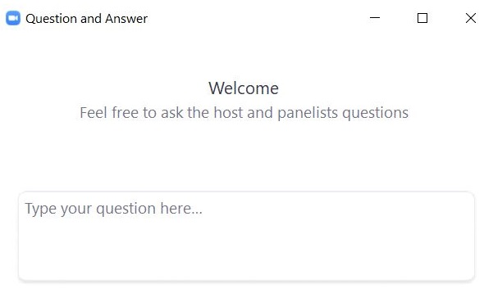
Questions & Answers
Use the “Q&A” feature to ask questions.

Slide 24
2. Preparing the Initial File for Import

Slide 25
Overview of Steps to Complete Student Registration
Download the .CSV file prepared by DESE from DropBox Central in the DESE Security Portal (available on the first day of each Student Registration window).
Delete students from the file who are no longer enrolled in your school, and add rows for students who were not included in the file and will be testing.
Verify and update students’ accessibility features and accommodations.
Save as a .CSV file, and import file into the MCAS Portal.
Resolve any errors that occur.
Update student information as needed, through file export/import process or through the user interface.

Slide 26
Secure Websites for this Process
DESE Security Portal: where to find the .CSV files that can be used as the basis for the Student Registration file
https://gateway.edu.state.ma.us/
If you cannot access the Security Portal, contact your Directory Administrator (www.doe.mass.edu/InfoServices/data/diradmin/list.aspx).
MCAS Portal: where to import the student registration file
https://mcas.cognia.org/ (black login page)
For operational testing, please be sure to use the MCAS Portal and not the MCAS Training Site (green login page).

Slide 27
Frequently Asked Questions
What if I am not able to log in to the MCAS Portal?
If you know your username but not your password, you can use the “Forgot Password” link on the Log In page.
Then, users may request support as follows:
What if I need to create more users for the MCAS Portal?
Refer part II of the Guide to the MCAS Portal: MCAS Portal User Management.
What if I’m unable to log in to the DESE Security Portal?
Contact your District Directory Administrator.
What if I don’t have access to DropBox within the DESE Security Portal?
Contact your District Directory Administrator.
Role | Who to contact for support
Test administrators and school-level technology coordinators | Their principal or school test coordinator
Principals, school test coordinators, and district-level technology coordinators | Their district test coordinator
District test coordinators | MCAS Service Center

Slide 28
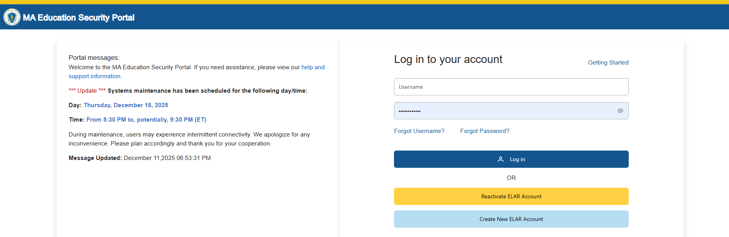
Logging in to the DESE Security Portal
Log in to the Security Portal at https://gateway.edu.state.ma.us/

Slide 29
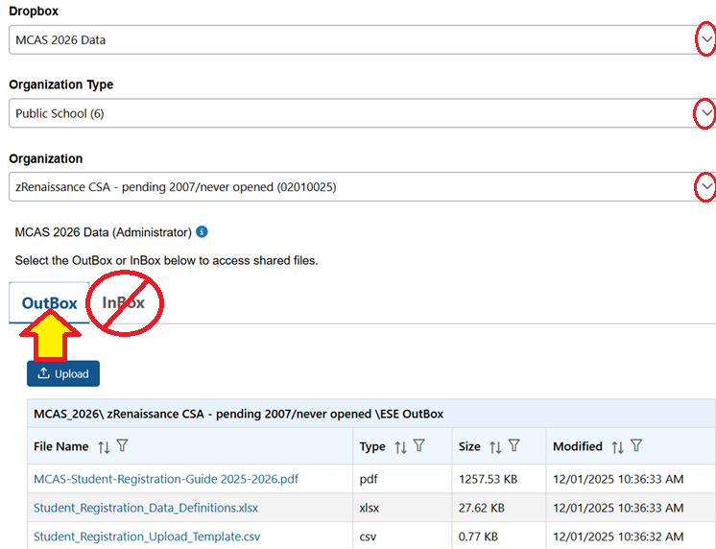
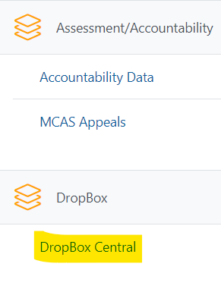
Accessing DropBox Central in the Security Portal
Enter your username and password.
You will then see an Application List.
Select DropBox Central.
Select MCAS 2026 Data.
Click OutBox.

Slide 30
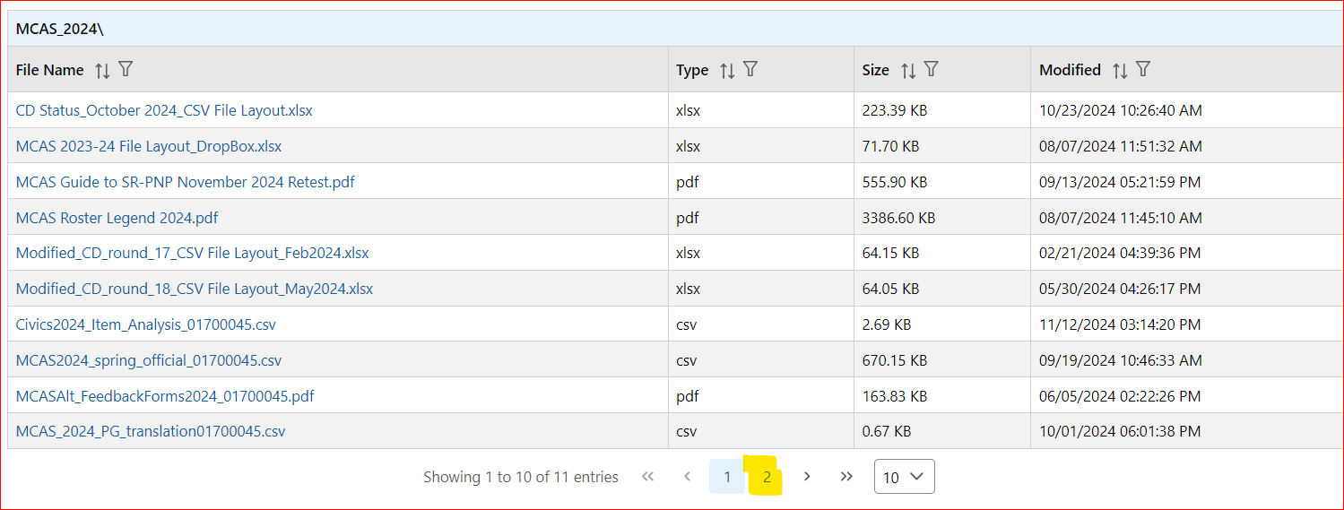
Accessing DropBox Central in the Security Portal (cont’d)
Scroll down to the bottom to click additional page numbers, if needed.

Slide 31
The .CSV File for MCAS Test Coordinators
Locate the .CSV file in DropBoxes (e.g., “Spring2026…Registration available on the first day of the Student Registration window of each administration) and save it to your computer.
The .CSV files reflect enrollment as of approximately 2–3 weeks before the opening of each window.
A first-year EL status flag, based on historical SIMS, is populated in column P for your reference.
Selected accommodations are prepopulated as follows (note: grade 3 accommodations are not prepopulated).
Subject | Spring 2026 Grades | Source of Accommodations Data
ELA and Math | Grades 4–8 | Grades 3–7 Spring 2025 in those subjects
ELA and Math | Grade 10 | Grade 8 Spring 2024 in those subjects
STE for grades 5 and 8 | Grades 5 and 8 | Grades 4 and 7 Math Spring 2025
Civics | Grade 8 | Grade 7 Math Spring 2025
High School Science | Grades 9 and 10 | Grade 8 STE Spring 2025

Slide 32
Frequently Asked Questions
What if a student doesn’t have a SASID?
Search for claimed students in Edwin Analytics Student Profile Report (PR600).
If not found in PR600, call your district SIMS contact to create a new SASID, or locate the student’s existing SASID from the prior school, if applicable.
If you do not have a student’s SASID by the file import deadline, assign a placeholder 10-digit SASID starting with “8” (instead of “10”). Update the SASID in the MCAS Portal as soon as you receive the actual SASID.

Slide 33
Demonstrations: Tasks Before Importing the File
Locating Part III of the Guide to the MCAS Portal: Student Registration
Opening the .CSV file downloaded from DropBox Central
Retain leading zeros if prompted
Adding/removing rows for students who will or will not participate
Optional: using column P to identify and remove first-year ELs who will not participate in the ELA test as needed
Add test codes (only needed for high school Science)
Updating a student’s accommodations
Ensure formatting of cells is correct
Retain leading zeros for district code, school code, and grade
Ensure DOB is in proper format
Saving the .CSV file

Slide 34
Student Registration Initial Import – Step A: Prepare the File
Log in to the Security Portal (https://gateway.edu.state.ma.us/) to find the .CSV file posted in DropBox Central in the MCAS 2026 folder.
District and school files are available the same day that the Student Registration window opens.
Your spreadsheet program may prompt you to “remove leading zeros” when opening the file. Always select “No.”
Delete rows of students who will not participate; add rows for new students who will participate.
Optional: Use column P to remove first-year ELs who will not participate in the ELA test.
Column P shows the student’s first-year EL status projected to March 1, 2026, based on historical SIMS and mid-January SIF.
Note that first-year ELs must participate in spring Mathematics, STE, and Civics.
Update accommodations, as needed.
(High School Science only) Add test codes for the high school science subject test.
Save the updated file as a .CSV file.

Slide 35
Poll Question
Which two sites will you use to complete Student Registration?
The MCAS Portal and the MCAS Training Site
The MCAS Training Site and the MCAS Student Kiosk
The DESE Security Portal and the MCAS Portal
The DESE Security Portal and the MCAS Student Kiosk

Slide 36
Questions & Answers
Use the “Q&A” feature to ask questions.

Slide 37
3. Steps for Completing the Initial Import

Slide 38
Overview of Steps to Complete Student Registration
Download the .CSV file prepared by DESE from DropBox Central in the DESE Security Portal (available on the first day of each Student Registration window).
Delete students from the file who are no longer enrolled in your school, and add rows for students who were not included in the file and will be testing.
Verify and update students’ accessibility features and accommodations.
Save as a .CSV file, and import file into the MCAS Portal.
Resolve any errors that occur.
Update student information as needed, through file export/import process or through the user interface.

Slide 39
Demonstration
Initial file import
Resolving errors

Slide 40
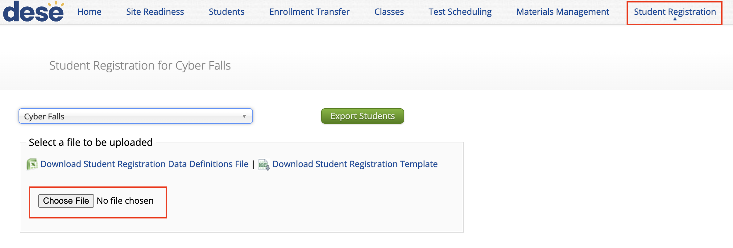
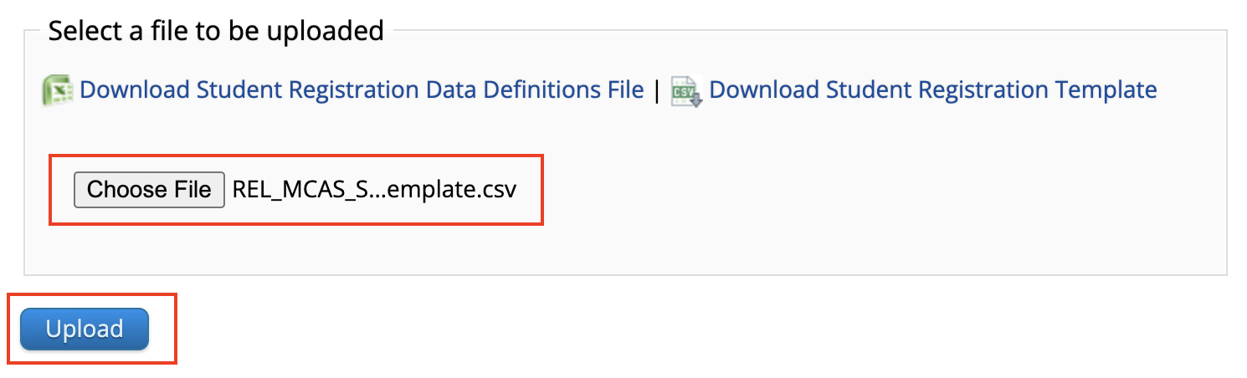
Student Registration: Import the File
In the MCAS Portal, select Administration and then Student Registration.
Select Choose File and select the previously saved file on your computer.
Select Upload.
Confirm that all records have been successfully imported.

Slide 41
Initial File Import
Once the file has been uploaded, processing may take about 5–10 minutes (depending on its size).
The file status will be “Pending” until the file is processed.
Users will need to refresh the page to see the updated status of the file.
Once the file is processed, you will see one of these statuses:
“Processed” if there are no errors. If your file is “Processed”, there are no further steps to take.
“Validation Errors” if there are errors. If your file has “Validation Errors”, download the Validation Errors link for a list of errors to correct.
“Error: Contact eMetric” – If your file receives this status, contact the MCAS Service Center at 800-737-5103.

Slide 42
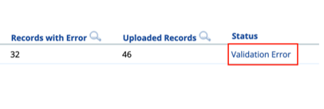
Addressing File Errors
If your file returns the status of “Validation Error,” click the link for Validation Error to view a list of errors for each record in the file.
Using the Data Definitions File, address each error in the file by updating the Validation Error file or the initial Student Registration file.
“Student Enrollment” error: if a student record returns this error, remove that row and complete an Enrollment Transfer Request.
View step-by-step instructions in Part IV of the Guide to the MCAS Portal: Enrollment Transfers.
Save the new file once all errors have been addressed.
Upload the updated file to the MCAS Portal.

Slide 43
Important Notes
Schools and districts can upload up to 75,000 student records in one Student Registration file.
DESE recommends leaving column K (Class name) blank during the initial import.
Schools can export the file, add Class names, and reimport the file approximately two weeks prior to testing.
Part V of the Guide to the MCAS Portal: Creating and Managing Classes is available on the MCAS Resource Center and contains additional information.
After Student Registration and prior to testing, it is recommended to export all of your student registration information to verify accuracy.
This can be done using the Export Students button on the Student Registration page in the MCAS Portal.
Test coordinators should confirm that their files have been processed in the MCAS Portal after uploading. Automated confirmation emails are not sent after processing.

Slide 44
Poll Question
Why should the initial Student Registration file import be completed by the initial window deadlines?
Students cannot be registered after the initial window deadlines.
The import must be done by the initial deadlines for schools to receive an initial order of manuals (for PBT and CBT) as well as PBT tests and Student ID Labels.
For CBT students, import must be done by the initial deadlines for schools to receive Student ID labels.
For all students, accommodations cannot be entered after the initial Student Registration deadlines.

Slide 45
Important Reminders
For operational testing, confirm you are in the MCAS Portal and not the MCAS Training Site.
School and district test coordinators and technology coordinators can import a Student Registration file.
Test administrators do not have permission to do so.
If columns are hidden or frozen, be sure to unhide and unfreeze them prior to import.
Do not make changes to the format of the file.
Do not add a title to the file using row 1 of the spreadsheet – this will cause an error during upload.
Schools may edit the file in Google Sheets, but the file must be imported as a .CSV file.
Make sure leading 0s are kept for district and school codes and grade level. Date of birth must be in mm/dd/yyyy format.

Slide 46
Questions & Answers
Use the “Q&A” feature to ask questions.

Slide 47
4. Steps After the Initial Import

Slide 48
Overview of Steps to Complete Student Registration
Download the .CSV file prepared by DESE from DropBox Central in the DESE Security Portal (available on the first day of each Student Registration window).
Delete students from the file who are no longer enrolled in your school, and add rows for students who were not included in the file and will be testing.
Verify and update students’ accessibility features and accommodations.
Save as a .CSV file, and import file into the MCAS Portal.
Resolve any errors that occur.
Update student information as needed, through file export/import process or through the user interface.

Slide 49
Update SIMS Data
If you update any student demographic data in the MCAS Portal (SASID, spelling of student’s name, grade, DOB, first-year EL status), you must also update student information in SIMS.
Contact the district’s SIMS contact.
To find the contact for your district, go to https://profiles.doe.mass.edu/search/search.aspx?leftNavId=11239.
Select “SIMS Contact” from the Function menu, and click “Get Results.”

Slide 50
First-year English Learner Status
DESE populates students' first-year EL status in column P using historical SIMS. This flag can facilitate the removal of ELA registrations for first-year ELs who will not participate in spring ELA testing and for whom testing in ELA is optional.
Note that first-year ELs are required to participate in Mathematics, STE, and Civics.
If you believe a student should have first-year EL status but column P is blank, your district SIMS contact must update their EL status prior to end-of year (June 2026) SIMS. Note that EL status can only be updated in SIMS and not in the student registration file.
SIMS contacts can be found on your district’s directory profile at profiles.doe.mass.edu

Slide 51
Managing Students
When adding or editing student records in the MCAS Portal, schools are recommended to manually add/edit students in the user interface for a small number of students. For adding/editing ten or more students, schools are recommended to do a Student Registration file export/import.
On the Students page, users can manually add a new student, edit an existing student, and add or edit student accommodations.
The same fields provided through the student registration file may be entered manually.
Accommodations are entered for each test code. Students with accommodations for multiple tests will need the accommodations entered for multiple test codes.

Slide 52
Demonstration
Manually adding a new student
Updating an existing student
Exporting accommodations

Slide 53
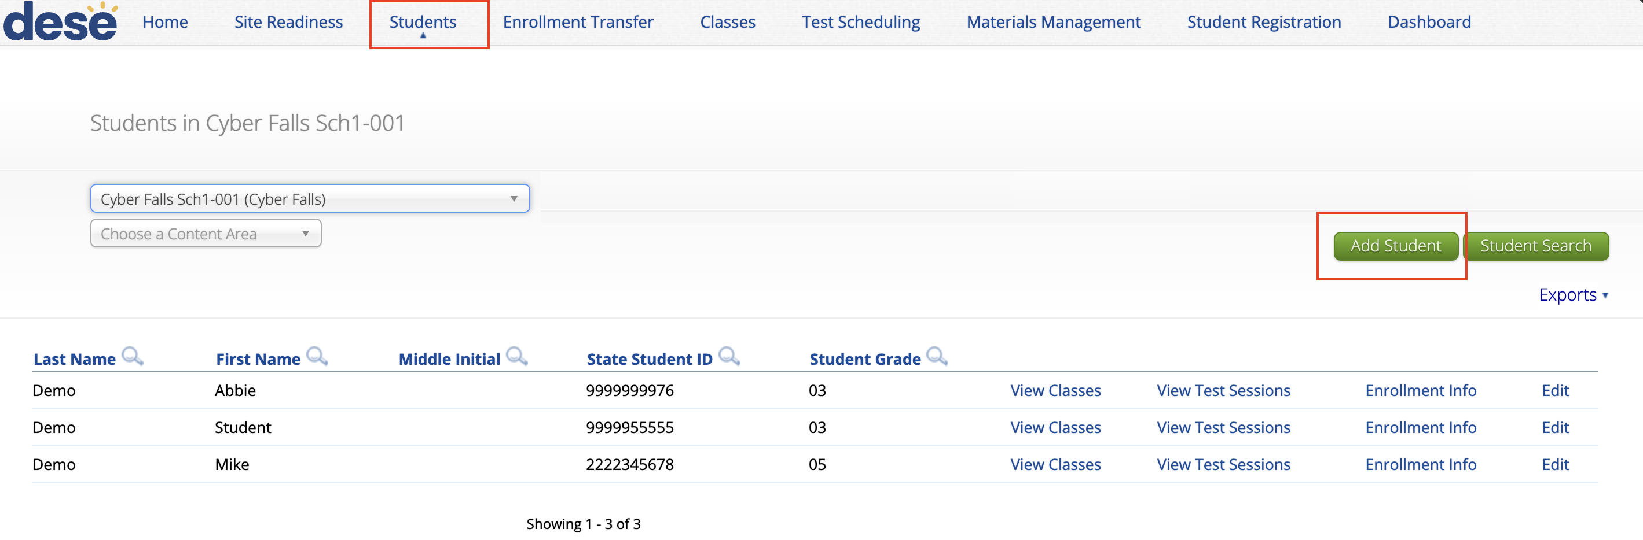
Manually Adding a Student
Log in to the MCAS Portal.
Select Administration.
Select Students
Select the Add Student button.

Slide 54
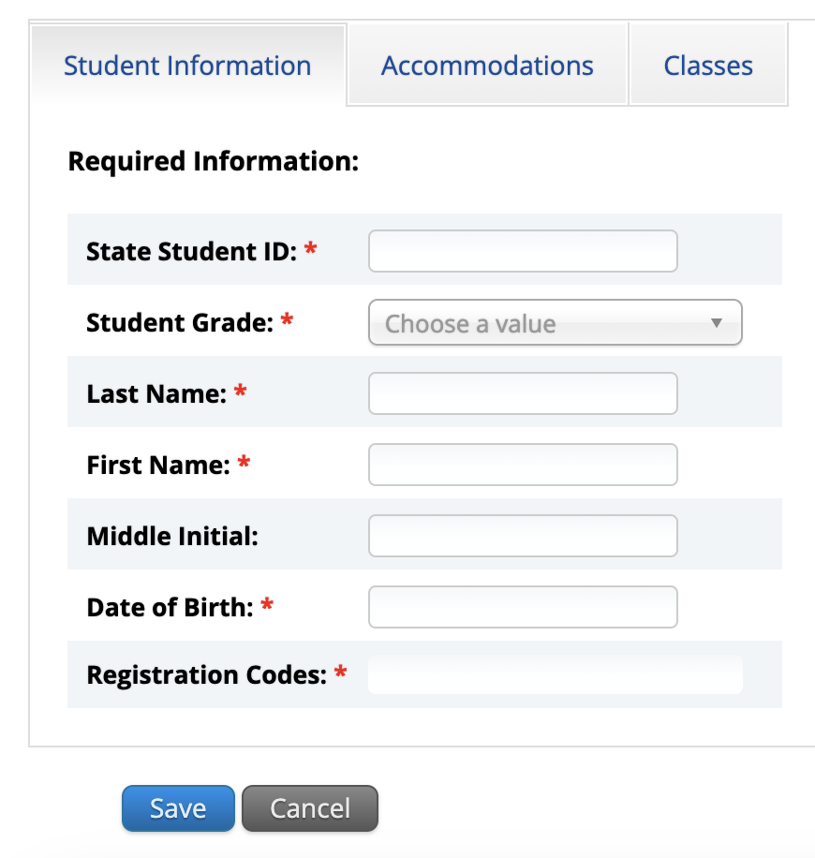
Manually Adding a Student
5. Add student information in the required fields marked with a red asterisk.
Be sure to enter the registration codes (test codes) for every test the student will take.
Test codes are listed in column J in Part III, section D in the Guide to the MCAS Portal.

Slide 55
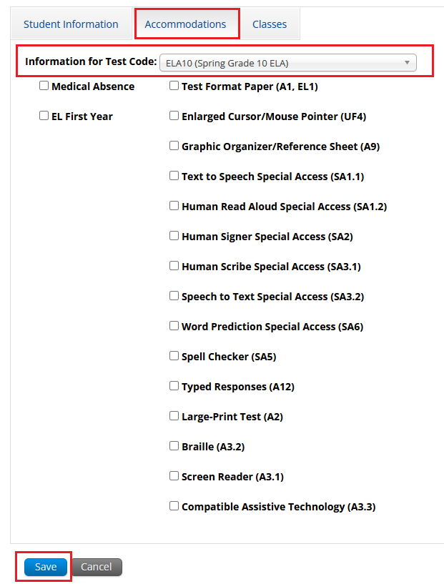
Manually Adding a Student
6. If the student has accommodations, select the Accommodations tab to enter the accommodations by test code.
7.Select Save.

Slide 56
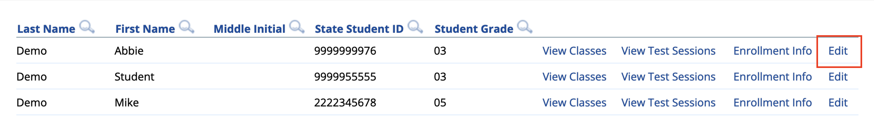
Editing a Student in the MCAS Portal
On the Students page, locate the student record to be edited.
Select Edit.

Slide 57
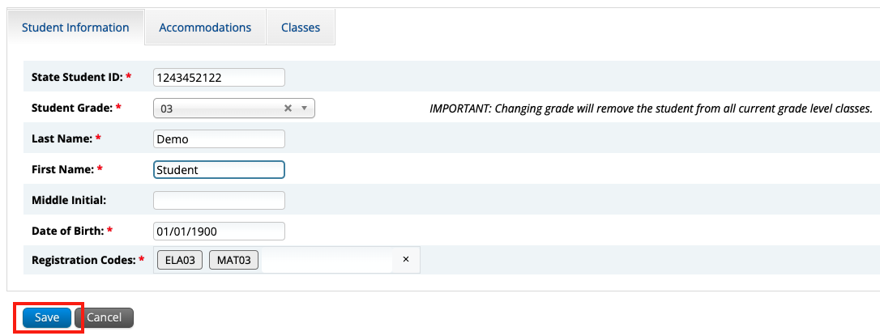
Editing a Student in the MCAS Portal
3. Update the student information.
4. Click Save.

Slide 58
Adding/Editing Student Accommodations
On the Students page, locate the student record to be edited.
Select Edit.

Slide 59
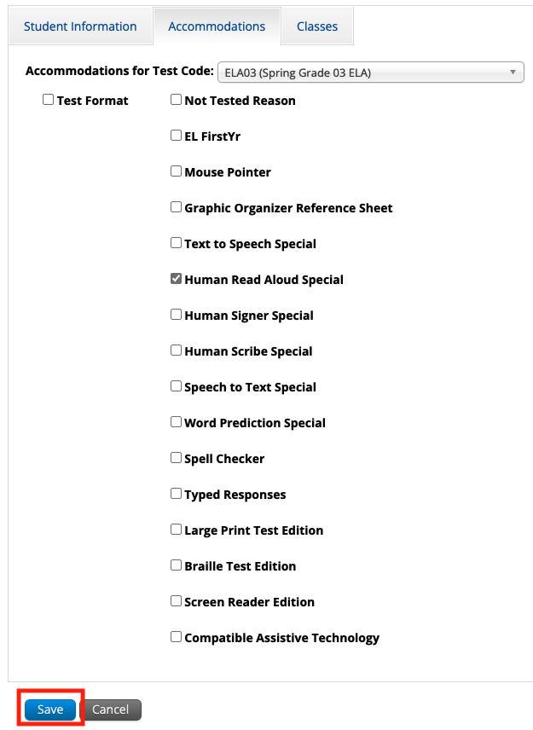
Adding/Editing Student Accommodations
3. Update the student’s accommodation for each test code. Use the drop-down to update accommodations for another subject area test.
4. Select Save.

Slide 60
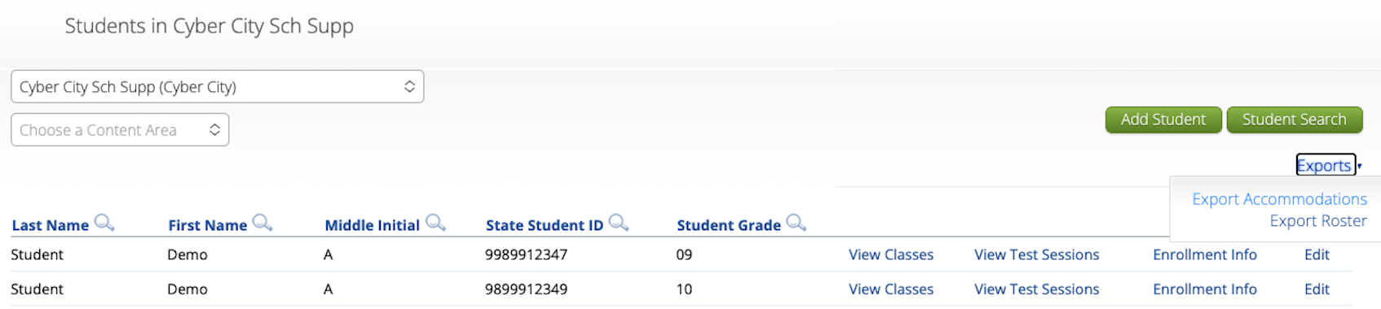
New for 2026: Exporting Accommodations
On the Students page, click Exports and select Export Accommodations.
A .CSV file will be downloaded to your computer containing the students’ first and last names, SASIDs, and a 1 the column for each accommodation selected for each student.

Slide 61
Updating PBT Tests
After the initial Student Registration window, if you need to add a student taking PBT, or if you need to update a student’s PBT test accommodations, you may need to place an additional materials order through the MCAS Service Center.
Schools may need to order additional PBT materials if a student taking PBT transfers in after the initial Student Registration deadline, or if a student’s IEP changes after the initial Student Registration deadline.
See Appendix B of the Principal’s Administration Manual (PAM): Procedures for Paper-Based Testing for information.
The Spring 2026 PAM is expected to be available later this month at www.doe.mass.edu/mcas/testadmin/manual/.

Slide 62
Demonstration
Exporting and reimporting Student Registration

Slide 63
Exporting and Reimporting Student Registration Files
Recommended when updating more than 10 student records
Log in to the MCAS Portal with your username and password.
On the MCAS Portal homepage, select Administration.
Select Student Registration from the top menu bar.
Select the organization from the organization drop-down.
Select Export Students. The exported file will be downloaded locally.
Use the Student Registration Data Definitions File to assist in updating the exported Student Registration file.
Update the fields in the Student Registration export file that need updating.
Save the file as a .CSV. The file is now ready for import.

Slide 64
Questions & Answers
Use the “Q&A” feature to ask questions.

Slide 65
5. Resources, Support, and Next Steps

Slide 66
Upcoming Training Sessions
Session | Date and Registration Link | Intended Audience | Recommended Read-Ahead Materials
MCAS Accessibility and Accommodations All levels of experience | Thursday, January 22 at 9:30–11:00 a.m. | Principals and STCs, DTCs, special education supervisors | Accessibility and Accommodations Manual
MCAS Test Security and Administration Protocols for Returning Staff | Tuesday, January 27 at 9:30–11:15 a.m. | Principals and STCs, DTCs | The Spring 2026 MCAS Principal's Administration Manual is planned to be available in advance of this session. Participants are encouraged to review Part I — MCAS Test Security Requirements prior to the training session.
MCAS Test Security and Administration Protocols for New Staff | Thursday, January 29 at 9:30–11:15 a.m. | Principals and STCs, DTCs | Same as above

Slide 67
Upcoming Training Sessions
Session | Date and Registration Link | Intended Audience | Recommended Read-Ahead Materials
Technology Coordinator Training All levels of experience | Monday, February 2 at 9:30–11:00 a.m. | Technology coordinators | MCAS Student Kiosk Technology Guide
Overview of the Spanish/English MCAS Tests All levels of experience | Tuesday, February 10 at 9:30–11:00 a.m. | Principals and STCs, DTCs, EL directors, Dual Language program directors | Accessibility and Accommodations Manual for the 2025–26 Test Administrations
Tasks in the MCAS Portal Before Testing All levels of experience | Wednesday, March 4 at 9:30–11:00 a.m. | Principals and STCs, DTCs | Guide to the MCAS Portal
Tasks in the MCAS Portal During and After Testing All levels of experience | Thursday, March 12 at 9:30–11:00 a.m. | Principals and STCs, DTCs | Guide to the MCAS Portal

Slide 68
Upcoming “Office Hours” Sessions
Session | Date and Registration Link | Intended Audience | Recommended Read-Ahead Materials
Office Hours for Accessibility and Accommodations | Monday, January 26 at 9:30–10:30 a.m. | Principals and STCs, DTCs, special education supervisors | Accessibility and Accommodations Manual
Student Registration Office Hours | Wednesday, January 28 at 9:30–10:30 a.m. | Principals and STCs, DTCs | Part III of the Guide to the MCAS Portal: Student Registration
Office Hours — MCAS Portal Tasks | Thursday, March 19 at 9:30–10:30 a.m. | Principals and STCs, DTCs | Guide to the MCAS Portal

Slide 69
Additional Resources
Resource | Location
MCAS Resource Center | mcas.onlinehelp.cognia.org
MCAS Portal Guide Guide to the MCAS Portal – refer to Part III: Student Registration | https://mcas.onlinehelp.cognia.org/ portal/
Technology Information MCAS Student Kiosk Technology Guide | https://mcas.onlinehelp.cognia.org/ technology-setup/
Student Assessment Updates (Biweekly email with important updates about the MCAS program) | www.doe.mass.edu/mcas/updates. html If you do not already receive this email, subscribe using this link: http://eepurl.com/ghSOhH

Slide 70
Next Steps
Today: Complete the evaluation form.
Responses are associated with the name and email address used to log in.
Email your input to mcas@mass.gov if you have problems accessing or completing the form.
Within one week:
Receive an email with the Q&A from this session
Recording will be available

Slide 71
Email and Phone Support
DESE Student Assessment Services
MCAS Service Center
Questions on logistics and technology
Web: https://mcas.onlinehelp.cognia.org/
Email: mcas@cognia.org
Phone: 800-737-5103
TTY: 888-222-1671
Live chat is available at the link on the bottom of the page at the MCAS Resource Center
Policy questions (e.g., student participation, accommodations)
Web: www.doe.mass.edu/mcas
Email: mcas@mass.gov
Phone: 781-338-3625
TTY: 800-439-2370

Slide 72
7. Live Sandbox Time

Slide 73
Poll Question—
Which demonstrations would you like to see again?
Adding/removing rows for students in the file
Adding a student’s accommodations in the initial .CSV file
Ensuring that the cell formatting is correct in the initial file
Importing the file
Resolving validation errors
Manually adding/editing a student on the Students page
Updating a large number of student records via export/import
Exporting accommodations

Slide 74




THANK YOU
The Office of Student Assessment Services
781-338-3625
mcas@mass.gov
www.doe.mass.edu/mcas
135 Santilli Highway, Everett, MA 02149

