Slide 1
MCAS Accessibility and Accommodations for the 2026 MCAS Tests
The Office of Student Assessment Services
January 22, 2026

Slide 2
Presenters
Robert Pelychaty, DESE Manager of Inclusive Assessment
Shannon Cullen, DESE MCAS Test Administration Coordinator
Abbie Currier, eMetric Senior Project Manager

Slide 3
Logistics for This Session
Use the Q&A feature to ask a question.
We will answer some questions aloud at specified times during this training session, and we will email the Q&A afterwards.
Use the thumbs-up icon to “upvote” someone else’s question.
Email student-specific questions to mcas@mass.gov instead of asking here.
Closed captioning has been enabled for participants who need it.
This session is being interpreted into ASL. Our interpreting team will be onscreen with the presenters.
Please be advised that DESE does not authorize attendees to record or to use AI transcription tools during the meeting and DESE does not endorse any unauthorized transcripts created by third parties of its meetings.

Slide 4
Slides for This Session
Slides were emailed to participants before this session from MCASevents@cognia.org.
Slides are now being posted in the chat.
If you cannot access the slides in the chat, ask in the Q&A.
After the session, we will send the slides again to participants, and they will be posted in the MCAS Resource Center along with the recording.

Slide 5
Today’s Agenda
Participation Requirements
Important Updates and Reminders
Student Registration
Accessibility Features and Accommodations
Preparation for Testing
Resources, Support, and Next Steps
Live “Sandbox Time”

Slide 6
1. Participation Requirements

Slide 7
MCAS Participation Requirements
All publicly-funded students must participate in MCAS tests required for their grade.
Includes students in public schools, charter schools, virtual schools, out-of-district placements, SEIS, DYS, and other students receiving instruction with public funds.
IEP teams determine necessary accommodations for students with disabilities. IEPs and 504 plans list accommodations decisions. Only Students with the Most Significant Cognitive Disabilities may participate in the MCAS-Alt.
Refer to the updated Accessibility and Accommodations Manual available at www.doe.mass.edu/mcas/accessibility/.

Slide 8
English Learners – Participation Guidelines
ELs are required to participate in all MCAS tests scheduled for their grade, with one exception:
First-year ELs are not required to take the MCAS ELA test but may participate at principal’s discretion.
First-year ELs are those who enrolled after March 1, 2025. Check status in SIMS.
EL accommodations: School staff familiar with the student should meet and
Review available accessibility features and accommodations for ELs.
Consider EL students’ language needs, learning characteristics, and preferences.

Slide 9
Poll Question
What are you most interested in learning about?
How to assign accommodations and accessibility features to students in the Student Registration system
A general overview of accommodations and accessibility options for MCAS tests
A review of how accessibility features and accommodations appear in the MCAS Student Kiosk
Eligibility for Special Access Accommodations

Slide 10
2. Important Updates and Reminders

Slide 11
Important Updates and Reminders
Answer eliminator is no longer available; the “Hiding Options” tool provides the same support
Students can click an icon of an eye to toggle between hiding answer choices and having them reappear (shown later)
Additional universal accessibility features: general masking and reverse contrast, notepad tool for all tests
New names for color contrast selections (e.g., yellow on red)
Bilingual Spanish/English test for Mathematics, Science, and Civics (grades 3–8 and high school)
MCAS ELA tests are not translated
DESE will provide an additional webinar (dates provided at end of slides) for schools with questions about the Spanish/English edition.
New for 2026: There will be a separate Spanish/English manual for test administrators that will include all of the Spanish/English scripts.

Slide 12
Important Updates and Reminders (continued)
Text-to-speech (TTS) is no longer a form-dependent accommodation. TTS can be added or removed during testing, if necessary, without voiding the student’s test.
Embedded Speech-to-Text and Word Prediction accommodation tools are available on MCAS Mathematics, Science, and Civics tests, in addition to ELA tests.
New Accessibility and Accommodations Manual organization
CBT and PBT accommodations are grouped separately.
Appendices include greater detailed instructions and clarifications.

Slide 13
IEP Team Decisions Needed Before Testing
Team members should review all accessibility and accommodations policies.
Important decisions required for each student with (and without) a disability taking spring test(s):
All students are eligible for accessibility features.
Which accessibility features and accommodations will be needed?
For students with disabilities:
Before testing and making decisions, give opportunity to view a student tutorial and take practice tests (updated practice tests expected by end of this month).
If read-aloud is needed, use text-to-speech (TTS) or human read-aloud. Schools may list “text-to-speech is preferable, but human reader is acceptable.”
Paper-based tests are available and must be listed as an accommodation in IEP or 504 plan for students unable to take computer-based tests.

Slide 14
3. Student Registration (SR)

Slide 15
What is the Student Registration Process (SR)?
Student Registration is a collection of student-level test data, including
students’ demographic information
registration information for specific tests
necessary for selected accommodations used for MCAS tests
Accommodations listed with the designation of (SR) in Accessibility and Accommodations Manual must be identified in the Student Registration prior to the start of testing. (Note: Some information can be changed up until end of testing window)
Used as the basis for initial shipment of test materials to schools, which includes:
Student ID Labels
Test Administration Manuals
Standard booklets, if needed
Special test editions (large-print, Braille, Spanish/English, etc.)
Use Appendix A in the Accessibility and Accommodations Manual for a crosswalk of accessibility feature and accommodation numbers and the Student Registration column to assign them correctly.

Slide 16
SR: Special Test Forms and Selected Accessibility Features and Accommodations
Special Test Forms
Large Print Test Edition
Braille Test Edition
Screen Reader Edition
Compatible Assistive Technology
American Sign Language Video (ASL edition)
Spanish/English (Math, STE, Civics)
Human Read-Aloud
Human Read-Aloud (Special Access - ELA)
Human Signer
Human Signer (Special Access - ELA)
Selected Accommodations
Text-to-Speech Special Access ELA
Text-to-Speech (Math, STE, Civics)
Human Scribe (Math, STE, Civics)
Human Scribe (Special Access - ELA)
Speech-to-Text (Math, STE, Civics)
Speech-to-Text (Special Access - ELA)
Graphic Organizer/Reference Sheet
Typed Responses
Calculation Device on Non-Calculator test session(s) (Math only)
Spell-Checker (Special Access - ELA)
Word Prediction (Math, STE, Civics)
Word Prediction (Special Access - ELA)
Accessibility Features
Alternate Mouse/Cursor

Slide 17
Form-Dependent Accommodations
The following accommodations must be assigned correctly before testing. If not assigned correctly, a student’s test will need to be stopped and a new test will need to be set up, and the student may need to retake a portion of the test.
Form-dependent (FD) accommodations for CBT:
ASL video (spring grade 10 Math and June high school Science)
Compatible assistive technology
Human read-aloud
Human signer
Screen reader
Spanish/English (Math, Science, and Civics)
Form-dependent accommodations for PBT:
Large print
Braille
Spanish/English (Math, Science, and Civics)

Slide 18
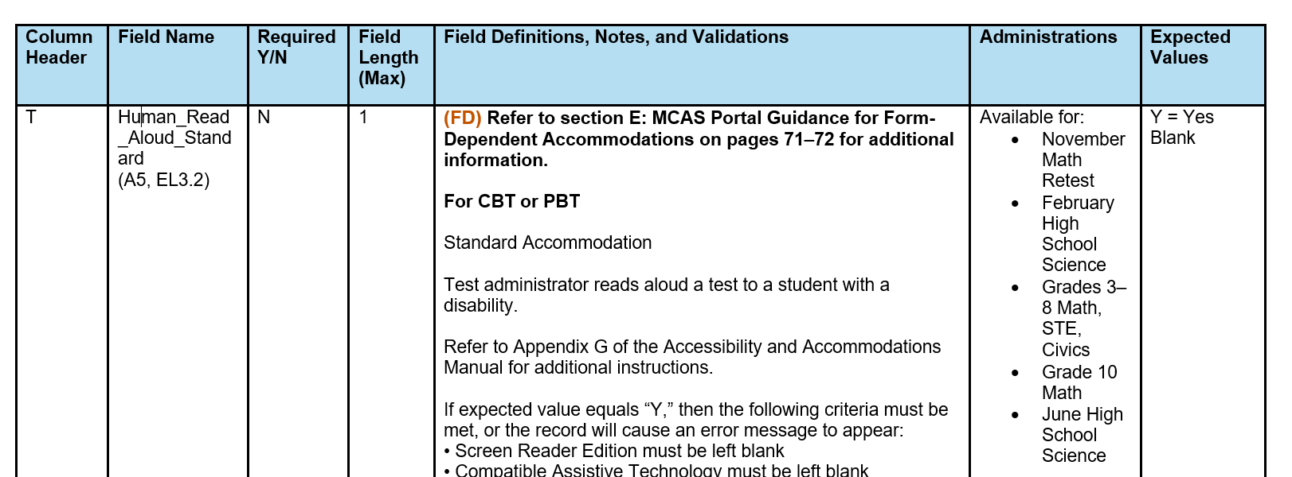
Guide to the MCAS Portal Part III: Student Registration
Available on the MCAS Resource Center
Field Definitions, Notes, and Validations column describes each accommodation and indicates other accommodations that cannot be co-selected.
Administrations lists availability on specific tests.
Expected Values indicates options for column input.

Slide 19
4. Accessibility Features and Accommodations

Slide 20
Accessibility Features and Accommodations
Refer to the Accessibility and Accommodations Manual for a list of:
Universal Accessibility Features (UF): Available to all students, either on computer-based tests or as a paper-based equivalent
Designated Accessibility Features (DF): Flexible test administration procedures available to any student, at the discretion of principal
Includes changes in test location, group size, seating, scheduling
Accommodations (A): Specific supports available only to students with disabilities and English learners
Special Access Accommodations (SAA): These accommodations may be only be provided to students who meet specific criteria.

Slide 21
Universal Accessibility Features (UF) for All Students
Computer | Paper
Highlighter | Same as computer
Color contrast | Colored overlays
Screen zoom tool | Magnification tool/device
Enlarged Cursor/Mouse (SR) | Enlarged pencil/modified writing instrument
Line Reader | Tracking device/straight edge
General masking | Mask using blank card
Hiding options tool | Use pencil to eliminate answer choices
Item flag/bookmark | Place marker
Audio aids | Same as computer
Notepad | Scratch paper
Human read-aloud (or sign) selected words as requested by student (not permitted for ELA tests) | Human read-aloud (or sign) selected words as requested by student (not permitted for ELA tests)
Redirects student’s attention to test | Same as computer
Test administrator repeats/clarifies test direction | Same as computer

Slide 22
Demonstration
Universal accessibility features

Slide 23
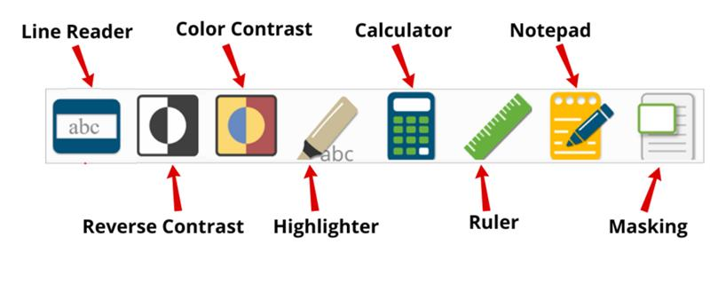
General Tools for All Students

Slide 24
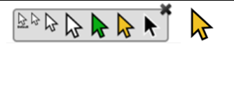
Enlarged Cursor (SR)
The enlarged cursor/mouse is selected in Student Registration prior to the student logging into the test.
Students with this tool may select the size and color of the mouse pointer at any time during the test. Students do NOT need to log out.

Slide 25
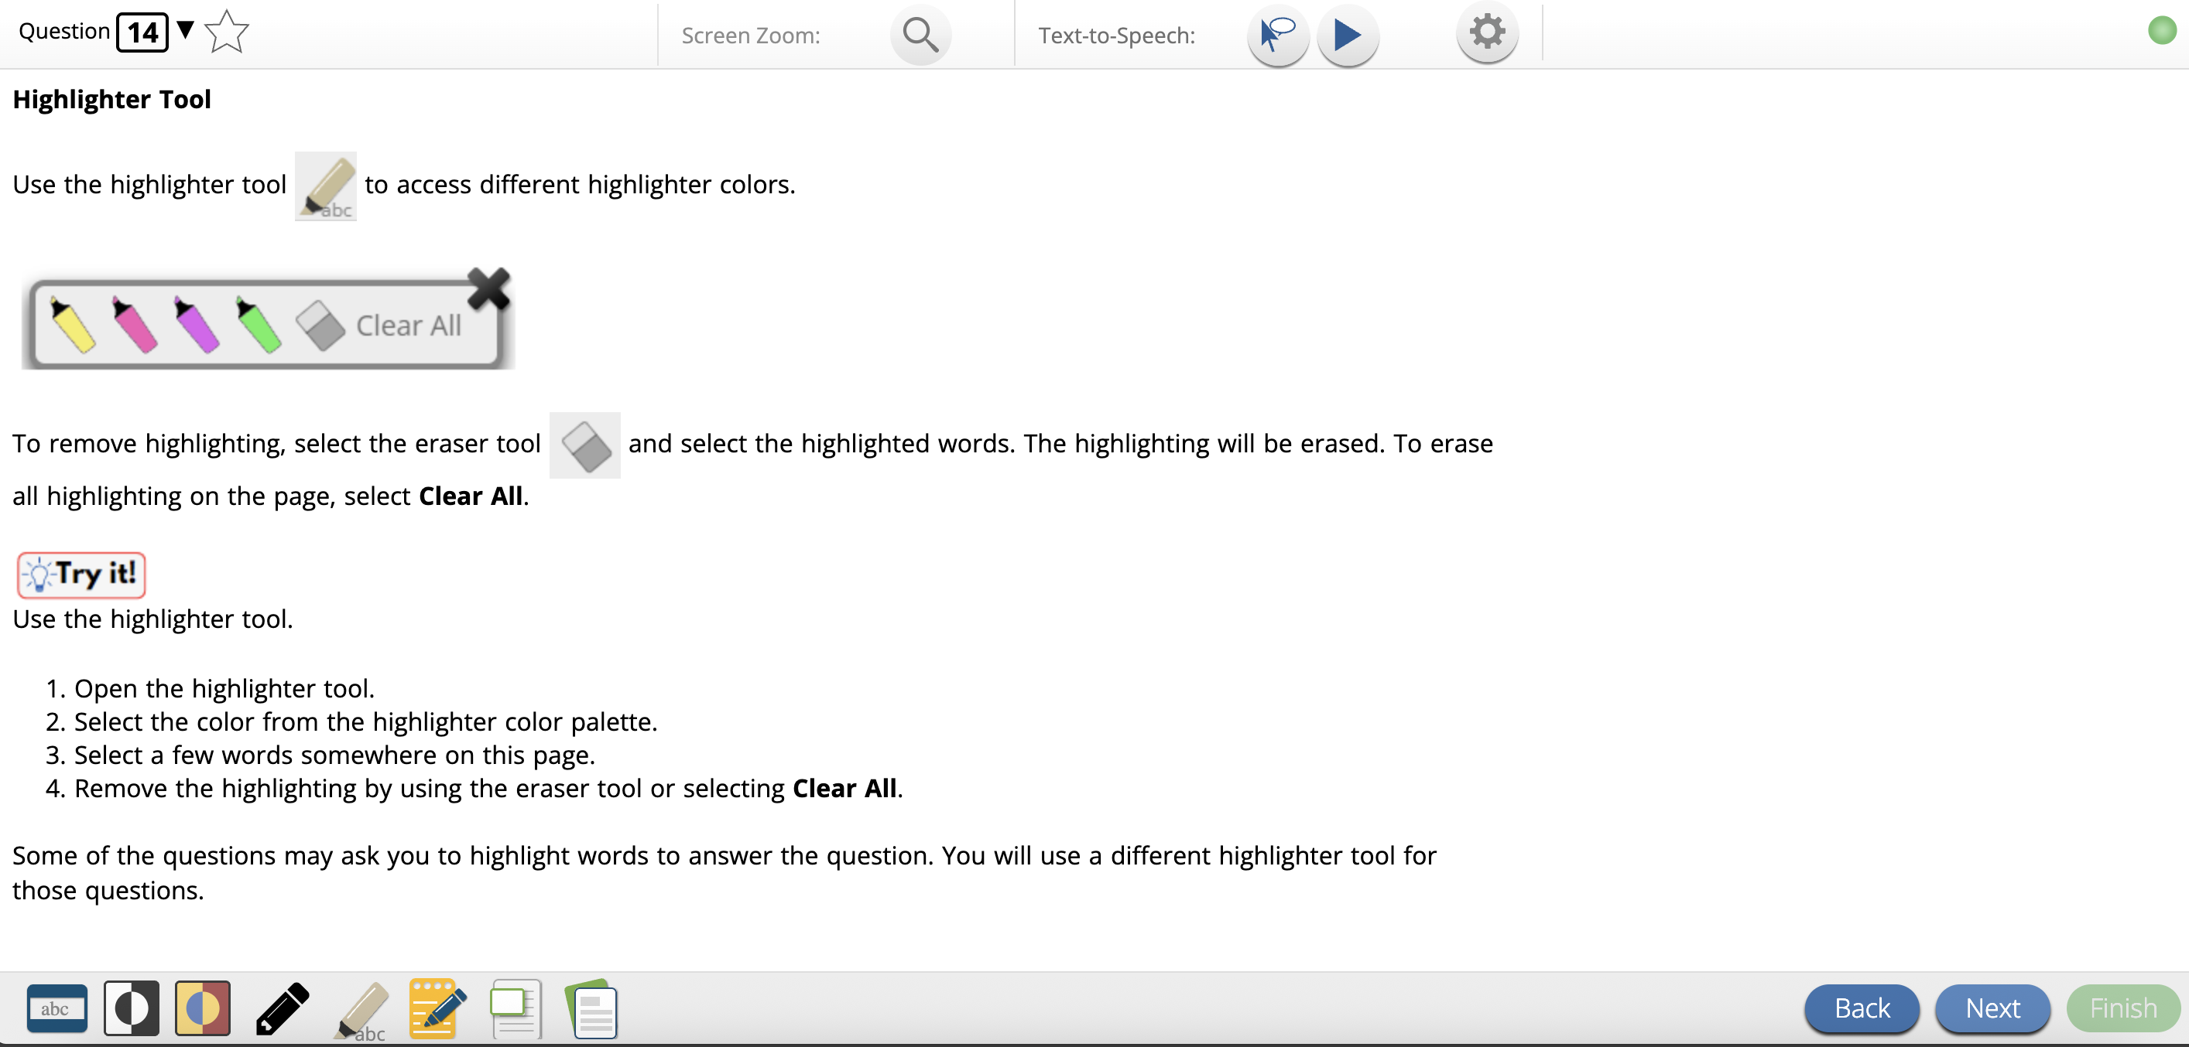
Highlighter

Slide 26
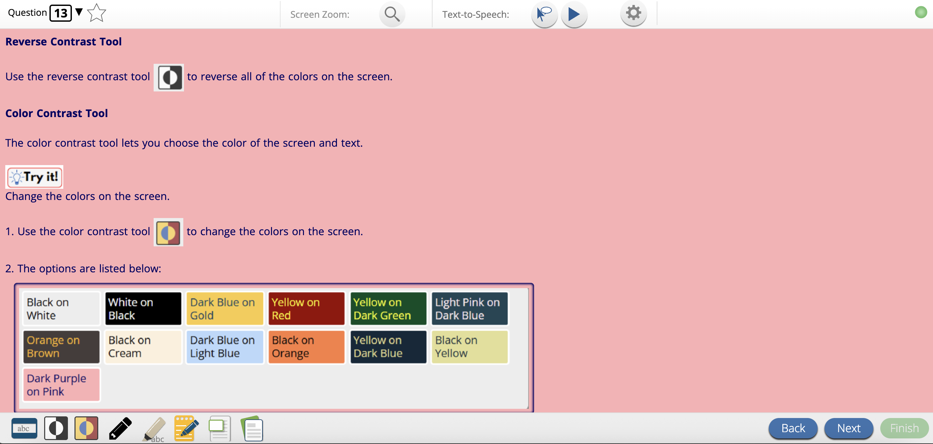
Color Contrast

Slide 27
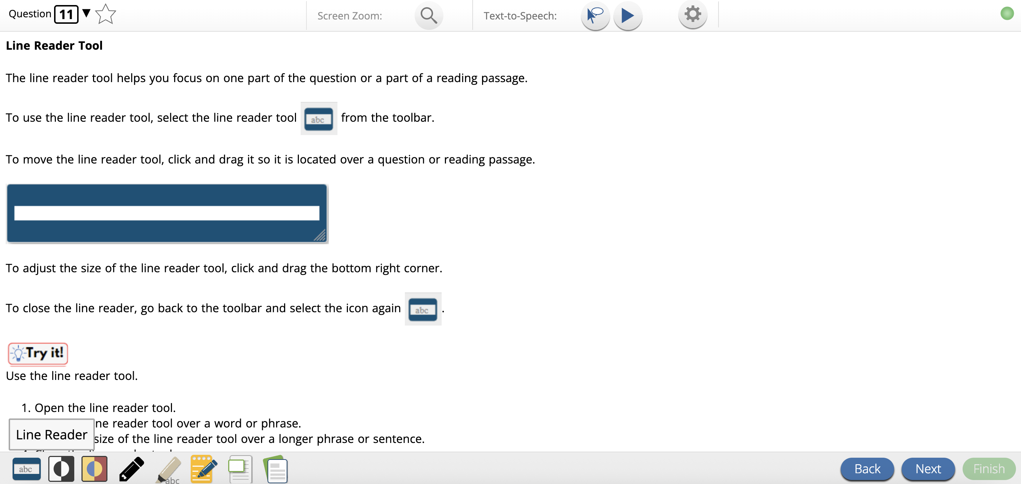
Line Reader

Slide 28
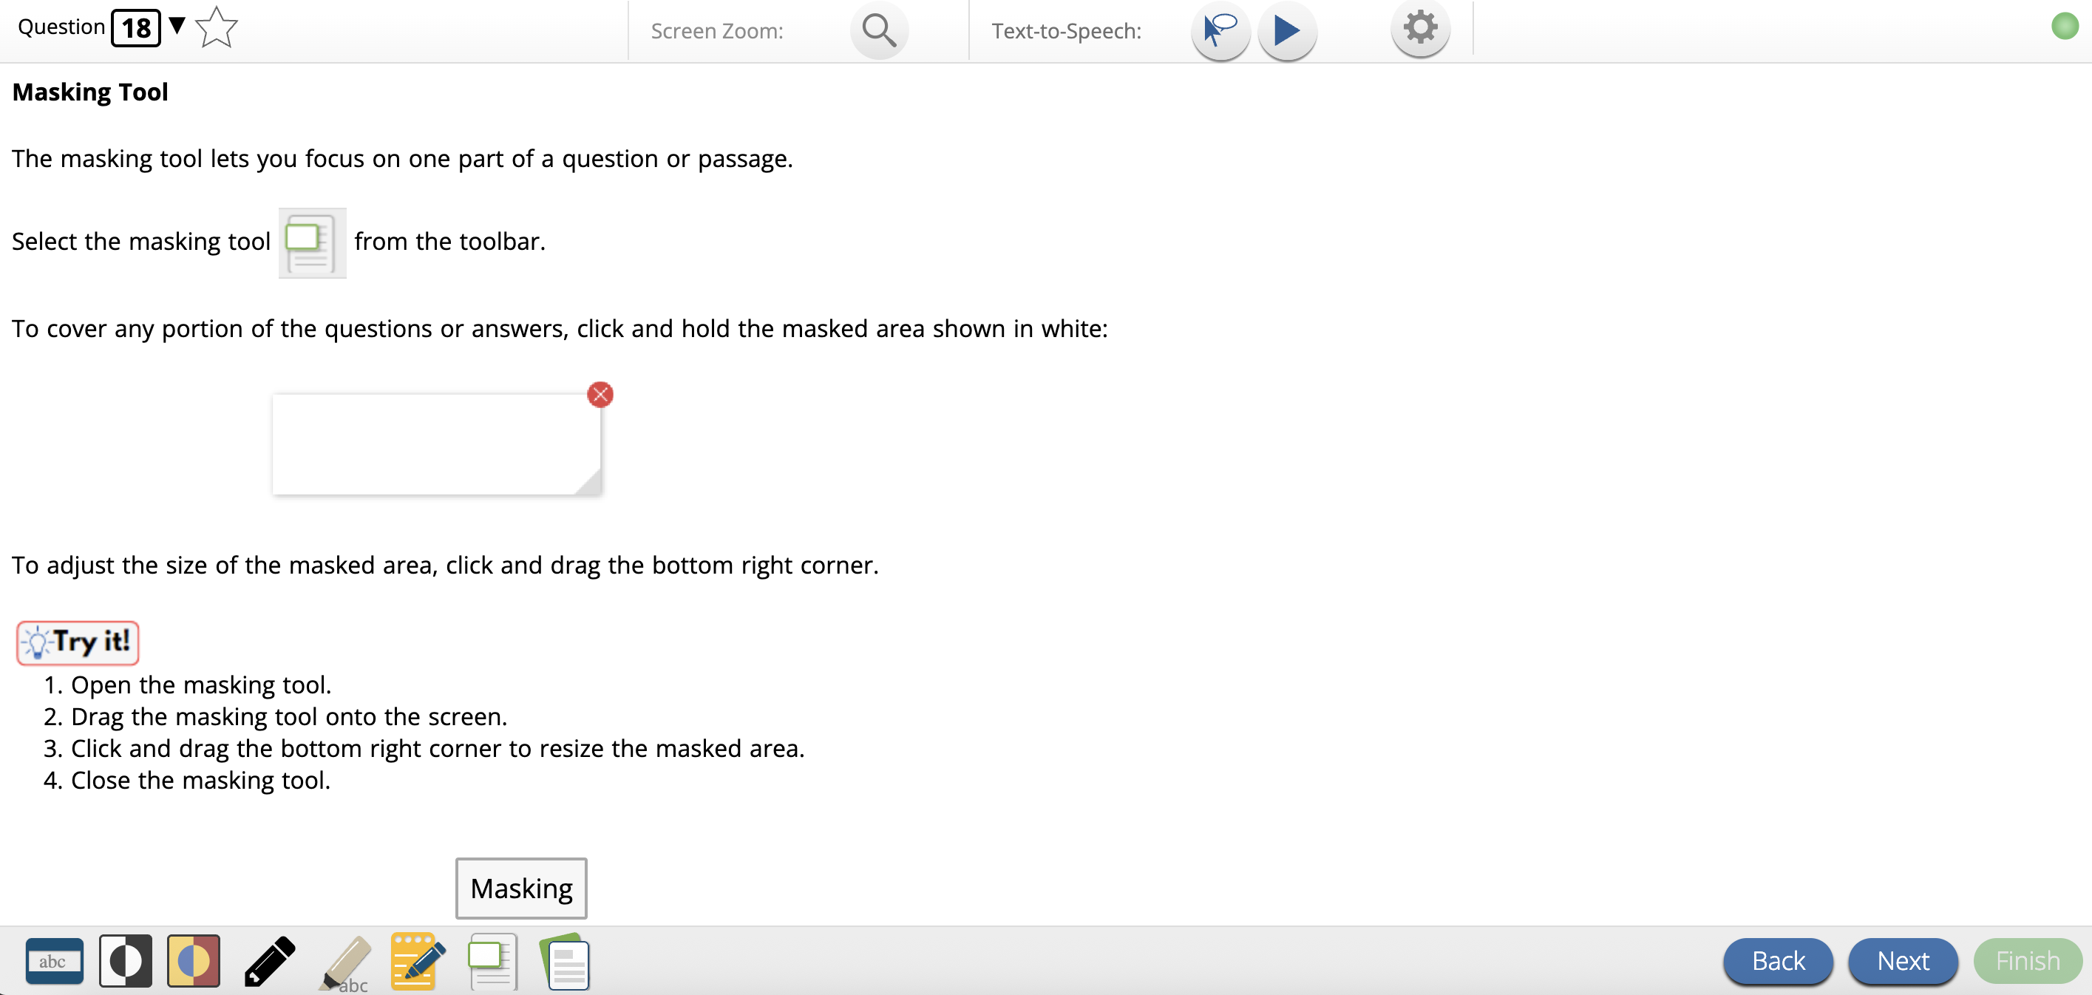
Masking tool

Slide 29

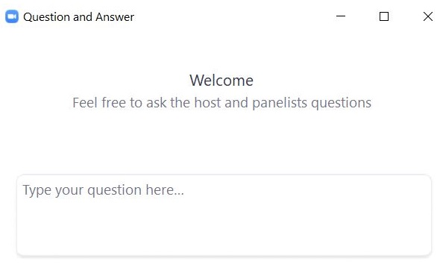
Questions and Answers
Use the “Q&A” feature
to ask questions.

Slide 30
Designated Accessibility Features (DF) for Any Student, at Principal’s Discretion
Computer or Paper
Small group test administration (up to 10 students)
Individual (one-to-one) test administration
Frequent supervised breaks
Test in separate location
Seating in a specified area of room, including study carrel
Adaptive or specialized furniture or lighting
Noise buffer/noise-cancelling earmuffs/headphones (no music)
Familiar test administrator
Student reads test aloud to self
Specific time of day
“Stop Testing” policy: If student is not responding to test questions after 15–20 minutes, test administrator may ask if student is finished. If so, collect the student’s test materials. Student may sit quietly or be excused.

Slide 31
Presentation Accommodations for Students with Disabilities
Computer-Based | Paper-Based
Paper test, if unable to use computer (SR) | N/A
N/A | Large print test (SR) (FD)
Screen reader only for student who is blind and uses a school owned program (SR) (FD) | Braille test (SR) (FD)
Text-to-Speech or Human read-aloud for Math, STE, or Civics (SR) (FD for Human read-aloud only) | Human read-aloud for Math, STE, or Civics (SR) (FD)
Human signer for Math, STE, Civics and test questions only for ELA or ASL test forms available of grade 10 math and June Science (SR) (FD) | Human signer for Math, STE, Civics and test questions only for ELA (SR) (FD)
Test administrator helps student track test items | Test administrator helps student track test items

Slide 32
Response Accommodations for Students with Disabilities
Computer-Based | Paper-Based
Department-provided ELA graphic organizer or Math/STE reference sheets (SR) (For STE, Customized reference sheet allowed, if approved by DESE) | Same as computer
Human scribe or speech-to-text device for Math/Science/Civics (SR) | Same as computer
Word Prediction for Mathematics, Science, and Civics (not ELA) Note: Refer to Appendix E of the Accessibility and Accommodations Manual. (SR) | Same as computer
Answers recorded in test booklet or special paper | Same as computer
N/A | Typed responses (SR) (Transcription not needed)
Responses recorded (audio or video), then transcribed by student during playback | Same as computer
Monitor placement of test responses | Same as computer

Slide 33
Special Access Accommodations
Computer and Paper
Text-to-speech/Human reader for ELA (SR) (FD – Human reader only)
Signing the ELA reading passages (SR) (FD)
Scribe responses or speech-to-text for ELA (SR)
Calculator or other mathematics tool, device, or manipulatives on noncalculator session of Math (SR)
Spell-checker for ELA (SR) (Note: available to all students for Math, STE, and Civics)
Word prediction for ELA (SR)

Slide 34
Criteria for Providing Special Access Accommodations
Special Access Accommodations may be provided only to a limited number of students who:
Demonstrated substantial deficits in reading, calculating, writing, or spelling AND
Receive ongoing intervention for these skills
Require the supports to consistently access classroom work.
Special Access Accommodations may not be provided if student is simply performing “below grade level.”
Scores may be invalidated if ineligible students are provided Special Access Accommodations.
Use of Special Access Accommodations will be reported with a notation on
Individual Student Reports (ISRs)
School and District Rosters

Slide 35
Poll Question
Do students need their own software/web-application for text-to-speech, speech-to-text or word prediction MCAS CBT accommodations?
Yes
No

Slide 36
Demonstration
Text-to-speech
Spell-checker
Speech-to-text
Word prediction

Slide 37
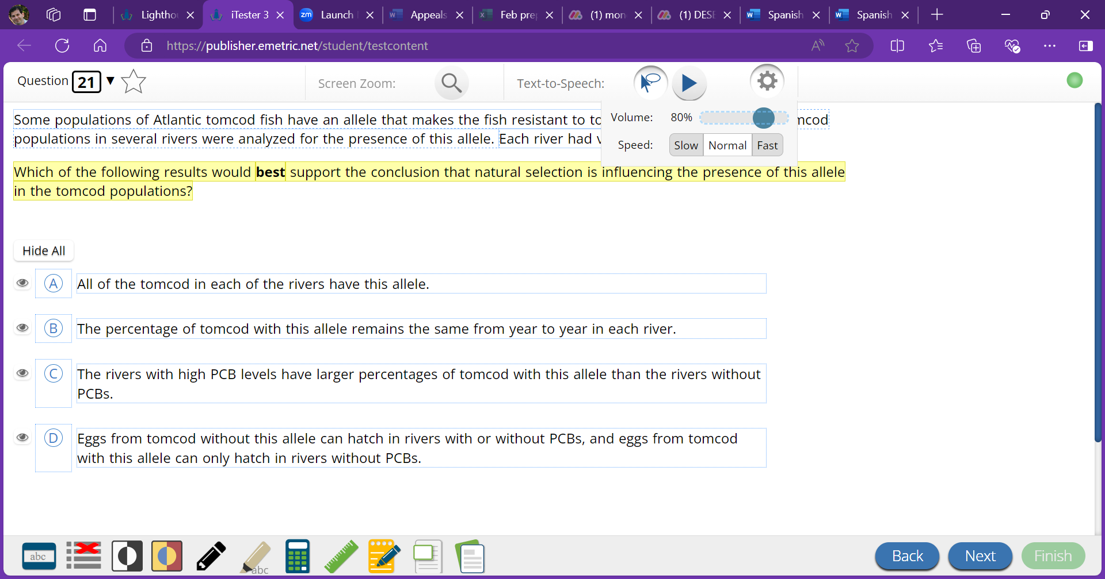
Text-to-Speech (SR)
Text-to-Speech Selector
Play/Pause
Speech Settings

Slide 38
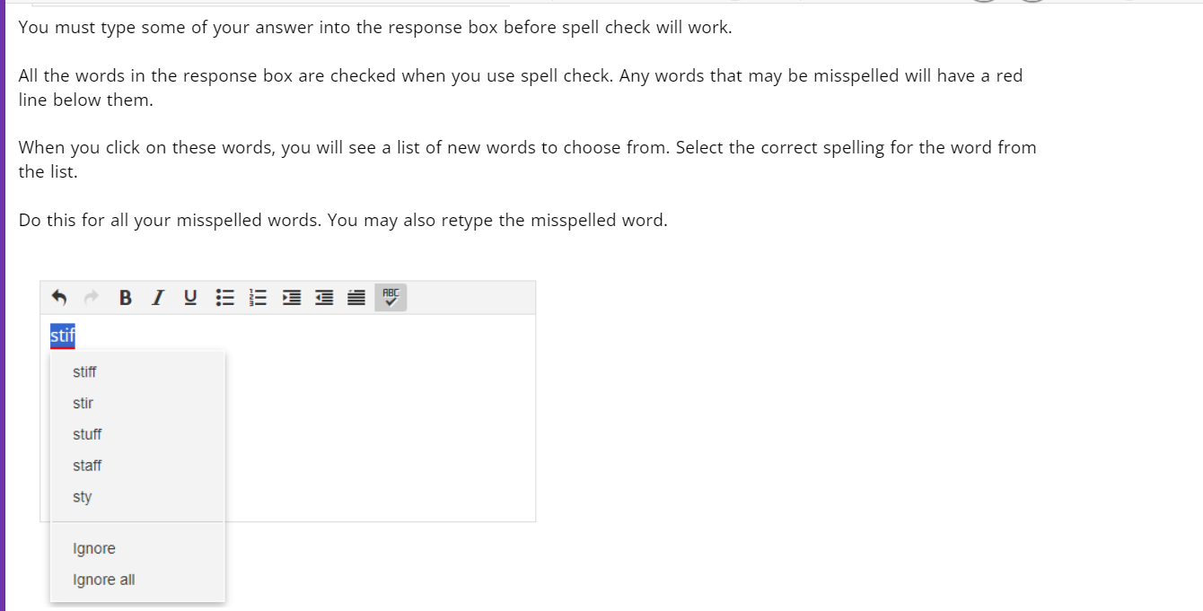
Spell-Checker (SR)
Spell-checker is automatically available for Math, Science and Civics.

Slide 39
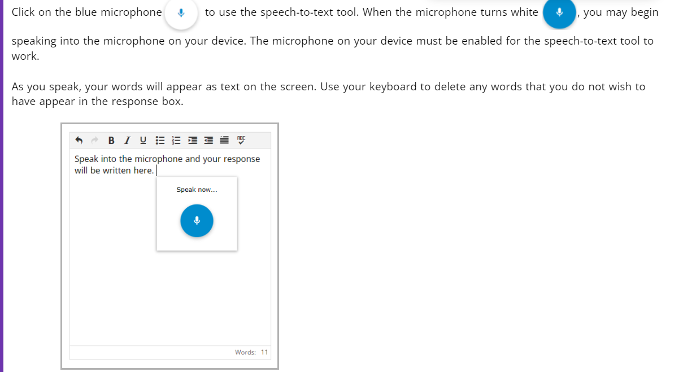
Speech-to-text (SR)
Student must be tested in separated space.
Student should be familiar with speech-to-text prior to providing as an accommodation.
Standard accommodation for available for Math, Science, and Civics

Slide 40
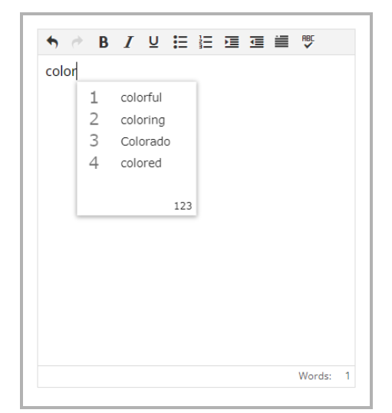
Word Prediction (SR)
As student types, a choice of words becomes available.
Student should have experience using word prediction prior to testing.
Standard accommodation available for Math, Science, and Civics

Slide 41
Accommodations for English Learners (ELs)
Computer and Paper
Approved Bilingual Word-to-Word Dictionary or Glossary (also available for Former English Learners)
Paper-based Test (SR)
Text-to-speech/human reader for Math, Science, and Civics (in English) (SR) (FD for human reader only)
Scribe/Speech-to-text for Math, Science, Civics (SR)
Word Prediction for Math, Science, Civics (SR)
Spanish/English edition of Math, Science and Civics (if enrolled for less than 3 years) (SR) (FD)
Read aloud/repeat/clarify test directions in student’s native language
“Stop testing” policy

Slide 42
5. Preparation for Testing

Slide 43
Poll Question
How does your school generally review, assign, and verify accommodations for your students?
The test coordinator manages assigning all accommodations in the MCAS Portal (editing DESE's .CSV file and uploading student registration, or making updates directly in the MCAS Portal user interface).
The special education director does the steps in A above.
The special education director reviews and verifies IEP information, and then sends the data to the test coordinator to assign accommodations in the MCAS Portal.
The test coordinator and special education director meet to review, assign, and verify all student accommodations together.
Other (Please type your answer in the Q&A.)

Slide 44
Demonstration
New Export Accommodations feature

Slide 45
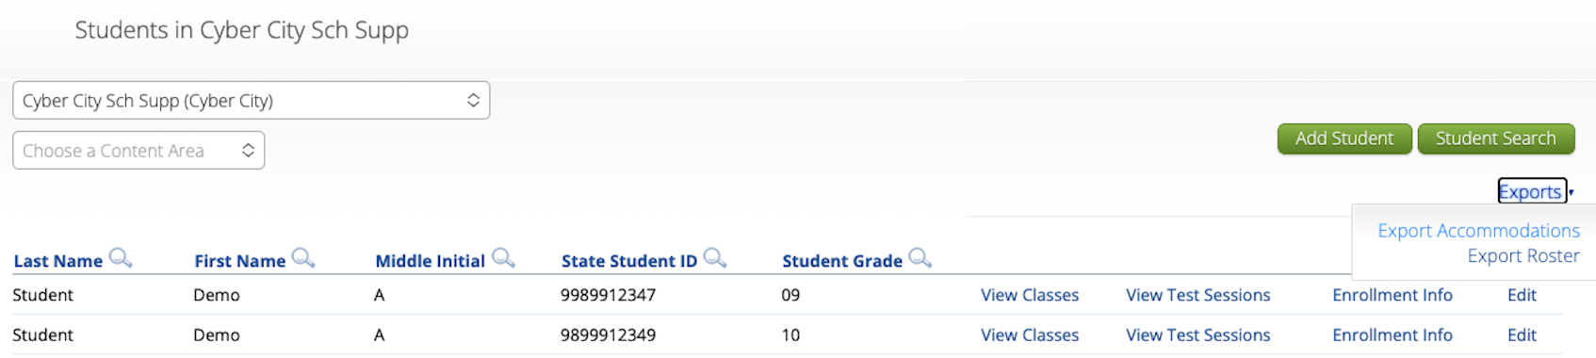
New Export Accommodations Feature
New for 2026: Test coordinators can verify accommodations using the Export Accommodations feature on the Students page in the MCAS Portal. (Administration > Students > Export Accommodations)
A .CSV file will be downloaded to your computer containing the students’ first and last names, SASIDs, and a 1 in the column for each accommodation selected for each student.

Slide 46
Ensuring Accommodations Are Assigned
Test coordinators and test administrators can view all assigned accommodations for each CBT class on the summary page that is provided with student logins.
Test coordinators and test administrators can view assigned accommodated forms for CBT on the View Details/Student Logins page in the MCAS Portal. (Administration > Test Scheduling > select the scheduled test > View Details/Student Logins)
Individual student accommodations can be viewed on the Edit Students page in the MCAS Portal. (Administration > Students > search for the student > Edit)

Slide 47
Preparing for Test Administration
Provide training to those who will provide accommodations.
Test administrators
Other professional staff
Develop plan to monitor accommodations that require 1:1 test administration.
Provide students opportunities to view the Student Tutorial and take online Practice tests using accommodated format, if appropriate.
Attend DESE trainings listed on the Training Opportunities webpage.

Slide 48
REMINDER: Provide to all students during testing
Untimed test sessions
Blank scratch paper (including blank, lined, or graph paper)
Assistance from test administrator, as needed, to navigate the computer-based testing platform

Slide 49
Reminders for Paper-Based Testing
Review and follow Special Instructions included with special test forms (e.g., braille, large-print) to ensure tests are scored properly.
Designate test administrators to transcribe large-print, braille, and other responses into standard booklet and include with original in Special Handling Envelope.
Refer to the Procedures for Scribing and Transcribing Student Responses (Appendix C) of the Accessibility and Accommodation Manual
Typed responses:
One item response per page
Each response must not exceed one page
Each page must include all parts of each item (e.g., a., b., c., d…)
Include student information in header/footer according to Appendix C of the Principal’s Administration Manual

Slide 50
If a Student Refuses an Accommodation…
Document student’s refusal in writing; keep in student’s file.
Sample refusal form — available at www.doe.mass.edu/mcas/accessibility/
Continue to make accommodation available, if needed, for remainder of test administration.
Do not make student sign waiver of their right to receive the accommodation.
Notify parent/guardian of student’s refusal.
Amend IEP/504 plan for future testing.
If appropriate, list accommodation in the IEP/504 plan “as requested by student,” or remove it.
Update the information in student’s Student Registration if an accommodation was entered incorrectly or was not used.

Slide 51
Questions and Answers
Use the “Q&A” feature
to ask questions.

Slide 52
6. Resources, Support, and Next Steps

Slide 53
Upcoming Training Sessions
Session | Date and Registration Link | Intended Audience | Recommended Read-Ahead Materials
MCAS Test Security and Administration Protocols for Returning Staff | Tuesday, Jan. 27 at 9:30–11:15 a.m. | Principals and STCs, DTCs | The Spring 2026 MCAS Principal's Administration Manual is planned to be available in advance of this session. Participants are encouraged to review Part I — MCAS Test Security Requirements prior to the training session.
MCAS Test Security and Administration Protocols for New Staff | Thursday, Jan. 29 at 9:30–11:15 a.m. | Principals and STCs, DTCs | Same as above

Slide 54
Upcoming Training Sessions
Session | Date and Registration Link | Intended Audience | Recommended Read-Ahead Materials
Technology Coordinator Training All levels of experience | Monday, February 2 at 9:30–11:00 a.m. | Technology coordinators | MCAS Student Kiosk Technology Guide
Overview of the Spanish/English MCAS Tests All levels of experience | Tuesday, February 10 at 9:30–11:00 a.m. | Principals and STCs, DTCs, EL directors, Dual Language program directors | Accessibility and Accommodations Manual for the 2025–26 Test Administrations
Tasks in the MCAS Portal Before Testing All levels of experience | Wednesday, March 4 at 9:30–11:00 a.m. | Principals and STCs, DTCs | Guide to the MCAS Portal
Tasks in the MCAS Portal During and After Testing All levels of experience | Thursday, March 12 at 9:30–11:00 a.m. | Principals and STCs, DTCs | Guide to the MCAS Portal

Slide 55
Upcoming “Office Hours” Sessions
Session | Date and Registration Link | Intended Audience | Recommended Read-Ahead Materials
Office Hours for Accessibility and Accommodations | Monday, Jan. 26 at 9:30–10:30 a.m. | Principals and STCs, DTCs, special education supervisors | Accessibility and Accommodations Manual
Student Registration Office Hours | Wednesday, Jan. 28 at 9:30–10:30 a.m. | Principals and STCs, DTCs | Part III of the Guide to the MCAS Portal: Student Registration
Office Hours — MCAS Portal Tasks | Thursday, March 19 at 9:30–10:30 a.m. | Principals and STCs, DTCs | Guide to the MCAS Portal

Slide 56
Additional Resources
Resource | Location
Accessibility and Accommodations Manual | www.doe.mass.edu/mcas/accessibility/default.html
MCAS Resource Center | mcas.onlinehelp.cognia.org
MCAS Portal Guides Guide to the MCAS Portal – refer to Part III: Student Registration | https://mcas.onlinehelp.cognia.org/ portal/
Student Assessment Updates (Biweekly email with important updates about the MCAS program) | www.doe.mass.edu/mcas/updates. html If you do not already receive this email, subscribe using this link: http://eepurl.com/ghSOhH

Slide 57
Next Steps
Today: Complete the evaluation form.
Responses are associated with the name and email address used to log in.
Email your input to mcas@mass.gov with any questions.
Next week:
Receive an email with the Q&A from this session
Recording will be available on the MCAS Resource Center.

Slide 58
Email and Phone Support
DESE Student Assessment Services
MCAS Service Center
Questions on logistics and technology
Web: https://mcas.onlinehelp.cognia.org/
Email: mcas@cognia.org
Phone: 800-737-5103
TTY: 888-222-1671
Live chat is available at the link on the
bottom of the page at the MCAS Resource Center
Policy questions (e.g., student participation, accommodations)
Web: www.doe.mass.edu/mcas
Email: mcas@mass.gov
Phone: 781-338-3625
TTY: 800-439-2370

Slide 59
7. Live “Sandbox” Time

Slide 60
Poll Question—
Which would you like to see more information on?
How students use text-to-speech
How students use speech-to-text
The online tools and features available for all students
How to ensure accommodations are correctly assigned

Slide 61




THANK YOU
The Office of Student Assessment Services
781-338-3625
mcas@mass.gov
www.doe.mass.edu/mcas
135 Santilli Highway, Everett, MA 02149

