Slide 1
Office Hours: February Science Student Registration
The Office of Student Assessment Services
November 20, 2025

Slide 2
Presenters
Erma Brown, MCAS and ACCESS Test Administration Specialist
Shannon Cullen, MCAS Test Administration Coordinator
Abbie Currier, eMetric Sr. Project Manager

Slide 3
Logistics for This Session
Use the Q&A feature to ask a question.
We will answer some questions aloud at specified times during this training session, and we will email the Q&A afterwards.
Type your questions anytime, but we may not answer them in real time as some questions may be covered during the presentation.
Use the thumbs-up icon to “upvote” someone else’s question.
Email student-specific questions to mcas@mass.gov instead of asking here.
This session is being recorded and will be available in about a week in the MCAS Resource Center, along with the slides.
Closed captioning has been enabled for participants who need it.
This session is being interpreted into ASL. Our interpreting team will be onscreen with the presenters.
Please be advised that DESE does not authorize attendees to record or to use AI transcription tools during the meeting and DESE does not endorse any unauthorized transcripts created by third parties of its meetings.

Slide 4
Slides for This Session
Slides were emailed to participants before this session from MCASEvents@cognia.org.
Slides are now being posted in the chat.
If you cannot access the slides in the chat, ask in the Q&A.
After the session, we will send the slides again to participants, and they will be posted in the MCAS Resource Center along with the recording.

Slide 5
Today’s Agenda
Updates to Classes in the MCAS Portal
Batch Printing Student Logins
Q&A and Additional Demonstrations
Resources, Support, and Next Steps

Slide 6
1. Updates to Classes in the MCAS Portal

Slide 7
Overview of Classes
What is not changing?
A class is a group of students in the MCAS Portal who will take the same test in the same place at the same time.
Up to 250 students allowed in a class in the MCAS Portal.
Classes can be created using one of three methods:
Student Registration import/export
Class Upload file
manually one at a time through the MCAS Portal user interface
DESE recommends waiting until approximately two weeks before test administration to place students into classes in the MCAS Portal.
Certain accommodations require that students are placed in a class only with other students that have the same accommodation (Spanish/English, Human Read-Aloud, Human Signer).

Slide 8
Course-Level Classes
New for 2026, beginning with the February Science administration: High schools will use course-level instead of grade-level classes in the MCAS Portal.
What is a course-level class?
A course-level class is a class in the MCAS Portal grouped by test subject, not grade level.
e.g., Grade 9 and grade 10 students taking Biology at the same time in the same classroom will now be placed into the same class in the MCAS Portal, and will have the same access code.
Why this change?
This will allow high schools to group students in multiple grade levels taking the same test in the same class. Students in the same class have the same access code.
High schools must use course-level classes for all 2026 administrations, not grade-level classes.
Instructions will be in the Guide to Creating Course-Level Classes, which will be available by January 2026.

Slide 9
Course-Level Class Naming Convention
Class naming convention
Course-level classes created manually and classes created through the class upload file will have the content area and school code automatically added to the class name.
These class names will follow the naming convention: content area-class name-school code
Example: Science-Demo Class-00001111
Course-level classes created through Student Registration will also include test code.
These class names will follow the naming convention: test code-content area-class name-school code
Example: BIOFEB-Science-Demo Class-00001111

Slide 10
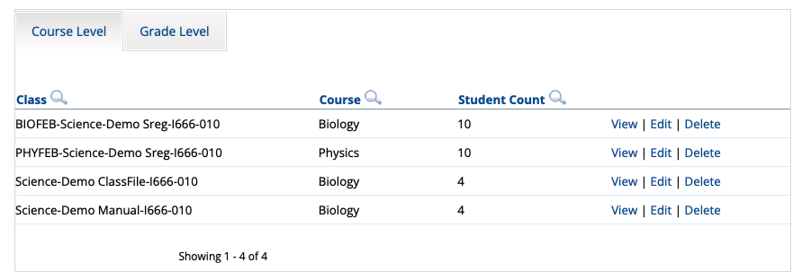
Course-Level Class Naming Convention
Below are examples of what these classes will look like in the MCAS Portal.

Slide 11
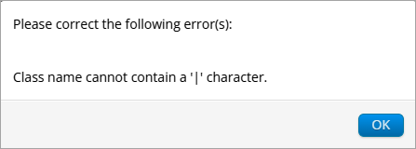
Updates to Class Names
Pipe delimiter characters
To ensure compatibility with reporting systems, pipe delimiter characters in class names are now prohibited.
Example: Science|BIOFEB|SMITH 205-88888888

Slide 12
Demonstration
Creating course-level classes through the Student Registration file
Uploading course-level classes via the Class Upload file
Manually creating course-level classes

Slide 13
Uploading Course-Level Classes via the Class Upload file
Log in to the MCAS Portal.
Select Administration.
Select Classes.
On the Classes page, select the district or a school from the organization drop-down list.
Select Upload Classes.

Slide 14
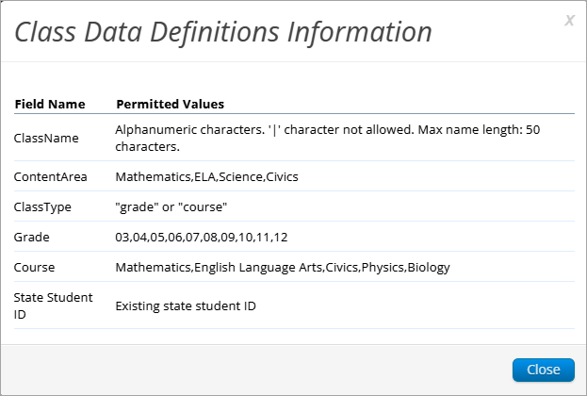
Uploading Course-Level Classes via the Class Upload file
Click the link Download Template
Enter class information in the template using the Class Data Definitions Information.
In column C, enter “course”.
In column D, enter the course name as listed in the Definitions Information.
Save the file as a .CSV.
Select Choose File.
Select Upload.

Slide 15
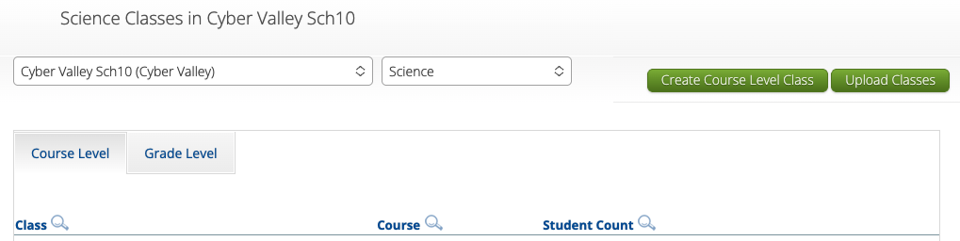
Manually Creating Course-Level Classes
Log in to the MCAS Portal.
Select Administration.
Select Classes.
On the Classes page, select an organization from the organization drop-down list, and then select a subject from the subject drop-down list.
Select the Course Level tab.
Select Create Course Level Class to create a new class.

Slide 16
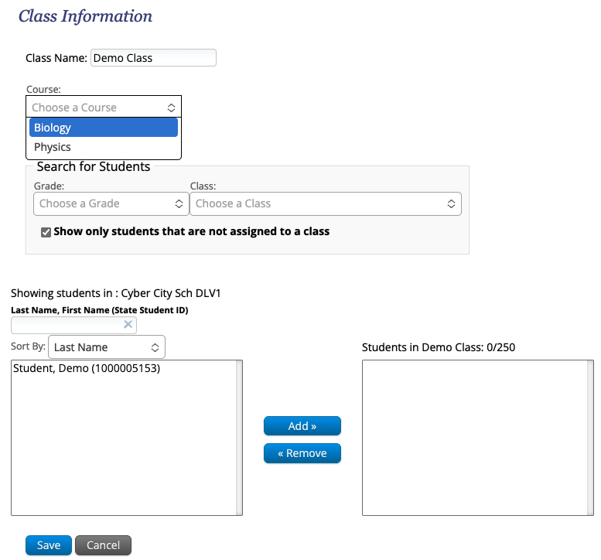
Manually Creating Course-Level Classes
7. Type the name of the class in the Class Name field.
8. Select a course from the Choose a Course drop-down list.
9. Add students to a class by selecting one or more students from the list on the left and selecting Add. If you need to remove students from the class list, select one or more students from the list on the right and select Remove.
10. Click Save to create the class.

Slide 17
Creating Course-Level Classes through the Student Registration File
Log in to the MCAS Portal.
Select Administration.
Select Student Registration.
Select the organization from the organization drop-down list.
Select Export Students. The exported file will be downloaded locally.
Fill in column K with the class names.
Save the file as a .CSV.
Follow the instructions in the Student Registration Guide to import the updated file.

Slide 18
2. Batch Printing Student Logins

Slide 19
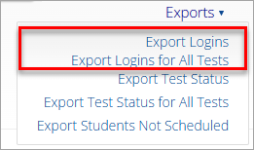
Batch Printing Student Logins
New for 2025–26: Users are able to export student logins from the MCAS Portal for the selected test/school or export all student logins for all tests within the selected content area and school, in addition to the ability to export student logins for a single scheduled class.

Slide 20
Demonstration
Batch printing student logins

Slide 21
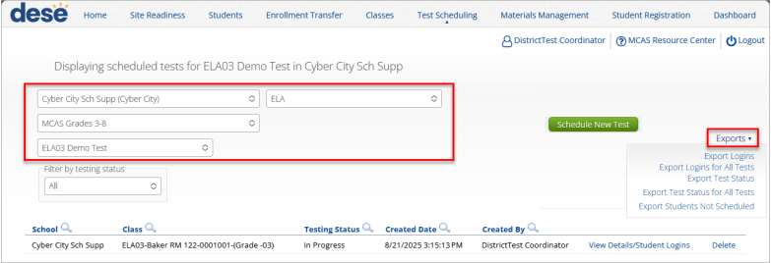
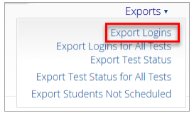
Batch Printing Student Logins for a Selected Test
Log in to the MCAS Portal.
Select Administration
Select Test Scheduling
Select the organization, subject, program, and test from the drop-down lists.
Click Exports.
Select Export Logins.

Slide 22
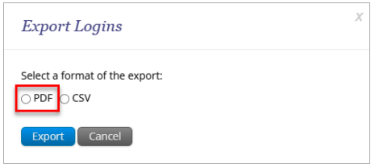
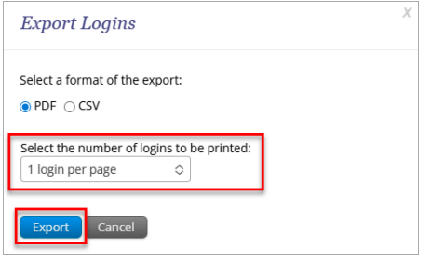
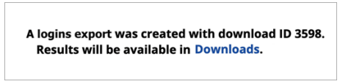
Batch Printing Student Logins for a Selected Test
A pop-up will be shown with the option of choosing PDF or CSV. Select PDF.
Select the number of logins per page (1, 8, or 27).
Click Export.
Click Downloads in the pop-up window or navigate to Downloads on the portal homepage.
Click Download Result for the Export Logins file.
Student logins will be organized alphabetically by class name and then by student last name.

Slide 23
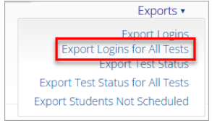
Batch Printing Student Logins for a Selected Subject
Log in to the MCAS Portal.
Select Administration.
Select Test Scheduling.
Select the organization, subject, program, and test from the drop-down lists.
Click Exports.
Select Export Logins for All Tests.

Slide 24
Batch Printing Student Logins for a Selected Subject
A pop-up will be shown with the option of choosing PDF or CSV. Select PDF.
Select the number of logins per page (1, 8, or 27).
Click Export.
Click Downloads in the pop-up window or navigate to Downloads on the portal homepage.
Click Download Result for the Export Logins file.
Student logins will be organized alphabetically by test name, then class name, and then by student last name.

Slide 25
3. Q&A and Additional Demonstrations

Slide 26
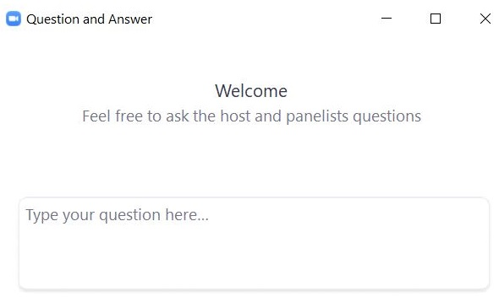
Questions & Answers
Use the “Q&A” feature to ask questions.

Slide 27
Poll Question
Which demonstrations would you like to see again?
Manually creating course-level classes
Creating course-level classes via Class Upload file
Creating course-level classes via Student Registration export/import
Batch printing student testing tickets

Slide 28
4. Resources, Support, and Next Steps

Slide 29
Additional Resources
Resource | Location
MCAS Resource Center | mcas.onlinehelp.cognia.org
MCAS Student Registration Guide Guide to Creating and Managing Classes Guide to Scheduling Tests and Printing Student Logins | https://mcas.onlinehelp.cognia.org/portal/
Technology Information MCAS Student Kiosk Technology Guide | https://mcas.onlinehelp.cognia.org/ technology-setup/
Student Assessment Updates (Biweekly email with important updates about the MCAS program) | www.doe.mass.edu/mcas/updates.html If you do not already receive this email, subscribe using this link: http://eepurl.com/ghSOhH

Slide 30
Upcoming Trainings – January 2026
Training | Date
Overview of Student Registration | Thursday, January 15
Accessibility and Accommodations | Thursday, January 22
Office Hours – Accessibility and Accommodations | Monday, January 26
MCAS Test Administration and Security Protocols for Returning Staff | Tuesday, January 27
Office Hours – Student Registration | Wednesday, January 28
MCAS Test Administration and Security Protocols for New Staff | Thursday, January 29
Registration is available.

Slide 31
Upcoming Trainings – February and March 2026
Training | Date
Technology Coordinator Training | Monday, February 2
Tasks in the MCAS Portal Before Testing | Wednesday, March 4
Tasks in the MCAS Portal During and After Testing | Thursday, March 12
Office Hours – MCAS Portal Tasks | Thursday, March 19
Registration is available.

Slide 32
Next Steps
Today: Complete the evaluation form.
Responses are associated with the name and email address used to log in.
Email your input to mcas@mass.gov if you have problems accessing or completing the form.
Within one week:
Receive an email with the Q&A from this session
Recording will be available

Slide 33
Email and Phone Support
MCAS Service Center
DESE Student Assessment Services
Questions on logistics and technology
Web: https://mcas.onlinehelp.cognia.org/
Email: mcas@cognia.org
Phone: 800-737-5103
TTY: 888-222-1671
Live chat is available at the link on the bottom of the page at the MCAS Resource Center
Policy questions (e.g., student participation, accommodations)
Web: www.doe.mass.edu/mcas
Email: mcas@mass.gov
Phone: 781-338-3625
TTY: 800-439-2370

Slide 34




THANK YOU
The Office of Student Assessment Services
781-338-3625
mcas@mass.gov
www.doe.mass.edu/mcas
135 Santilli Highway, Everett, MA 02149

