Slide 1
Overview of MCAS Administration Tasks for Technology Coordinators
The Office of Student Assessment Services
October 7, 2025

Slide 2
Presenters
Jodie Zalk, Manager of Test Administration and Publications
Shannon Cullen, MCAS Test Administration Coordinator
Kaelee Harper, eMetric Sr. Support Manager

Slide 3
Logistics for This Session
Use the Q&A feature to ask a question.
  We will answer some questions aloud at specified times during this training session, and we will email the Q&A afterwards.
  Type your questions anytime, but we may not answer them in real time as some questions may be covered during the presentation.
  Use the thumbs-up icon to “upvote” someone else’s question.
  Email student-specific questions to mcas@mass.gov instead of asking here.
This session is being recorded and will be available in about a week in the MCAS Resource Center, along with the slides.
  Slides were also emailed out beforehand, and are being posted in the chat.
Closed captioning has been enabled for participants who need it.
This session is being interpreted into ASL. Our interpreting team will be onscreen with the presenters.
Please be advised that DESE does not authorize attendees to record or to use AI transcription tools during the meeting and DESE does not endorse any unauthorized transcripts created by third parties of its meetings.

Slide 4
Slides for This Session
Slides were emailed to participants before this session from MCASEvents@cognia.org.
Slides are now being posted in the chat.
    If you cannot access the slides in the chat, ask in the Q&A.
After the session, we will send the slides again to participants, and they will be posted in the MCAS Resource Center along with the recording.

Slide 5
Today’s Agenda
Updates for 2025–26
Overview of MCAS Computer-Based Testing
Tasks to Complete in Fall 2025
Tasks to Complete at least Two Months before Testing
Tasks to Complete at least Two Weeks before Testing
Troubleshooting Technology Issues during Testing
Resources, Support, and Next Steps

Slide 6
Poll Question—3
What is your role? (Check all that apply)
  District test coordinator
  School test coordinator
  Principal
  Technology staff
  Other district staff
  Other school staff

Slide 7
Poll Question—3
How many years have you been involved in MCAS test administration?
  0–This is my first year
  1 year
  2–3 years
  4–5 years
  6+ years

Slide 8
1. Updates for 2025–26

Slide 9
MCAS Policy Updates
Prescribed windows with recommended dates for high school tests​
  The November 2025 retests may be administered anytime during the window of November 5–18 for ELA and November 12–18 for Math. Recommended dates are:
    November 5: ELA Session 1
    November 6: ELA Session 2
    November 12: Math Session 1
    November 13: Math Session 2
Updated Competency Determination (CD)
  Students may not earn the CD through participation in the MCAS tests. ​
  Please email questions about the CD to Competency.Determination@mass.gov.

Slide 10
Technology Updates
eMetric now supports the versions of ChromeOS that are current as of July before each school year. These versions will be supported through the end of the school year in June.
  Schools are not recommended to use beta versions of ChromeOS, as this may result in error.
As part of Google’s ongoing updates to ChromeOS, support for legacy ChromeOS Apps, including the MCAS Chrome app, is being phased out. Starting in the 2025–26 school year, a new Progressive Web App (PWA) will be required for all online testing on ChromeOS devices.
  More information will be provided on slides 47–52.
Microsoft will end support for Windows 10 in October 2025. Windows 10 will no longer be a supported operating system version for 2025–26.
  Windows 11 is still supported for 2025–26.

Slide 11
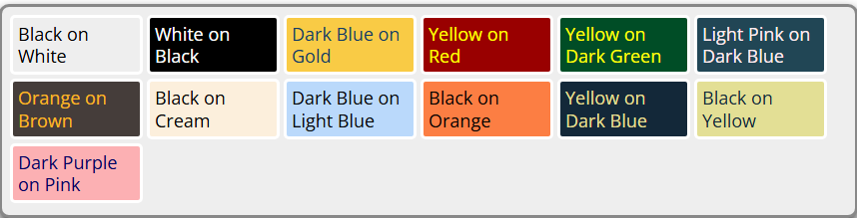
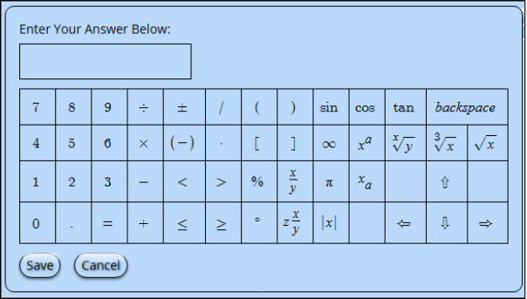

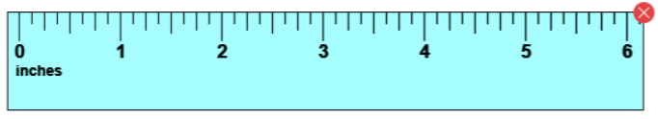
MCAS Student Kiosk Updates
The following updates are now available in the MCAS Student Kiosk:
Update | Screenshot
The names of the color contrast options have been updated to be more descriptive.
When a student has selected a color contrast option, the math response questions, equation editor, and reference sheets will be in the same selected color contrast.
The rulers have been updated for better visibility and clarity. The color is now blue, the numbers have been enlarged, and the tick marks have been darkened.

Slide 12
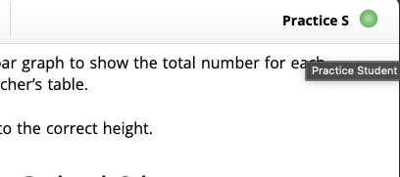
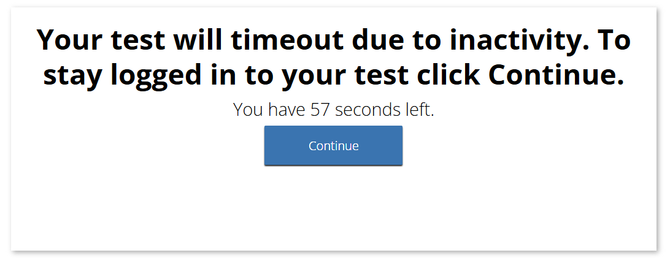
MCAS Student Kiosk Updates(cont’d)
The following additional are now available in the MCAS Student Kiosk:
Update | Screenshot
The student's name will now appear in the top right corner of the item and directions pages within a test. Hovering over the student’s first name and last initial will display the full name.
Students will be given a warning before timing out of a test, which happens after 60 minutes of inactivity. A timeout popup will appear when there are 60 seconds before the student times out of their test due to inactivity. The warning timer will count down from 60 seconds. The student may click Continue to continue testing.
All three calculator brands, TI, Desmos, and eMetric calculators have been updated to the latest versions of the calculators, and they default to degrees, not radians. | N/A
Answer eliminator is no longer available. | N/A

Slide 13

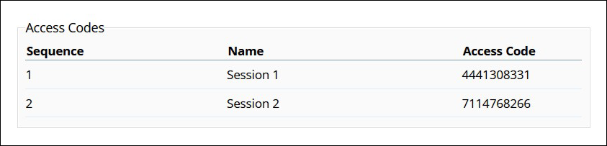
MCAS Student Kiosk Updates (cont’d)
The following additional updates are expected to be implemented prior to the November 2025 retests:
Update | Screenshot
“Session Access Code”, the code that test administrators write on the board and that students type into the Kiosk to begin their test, will be renamed “Access Code.”

Slide 14
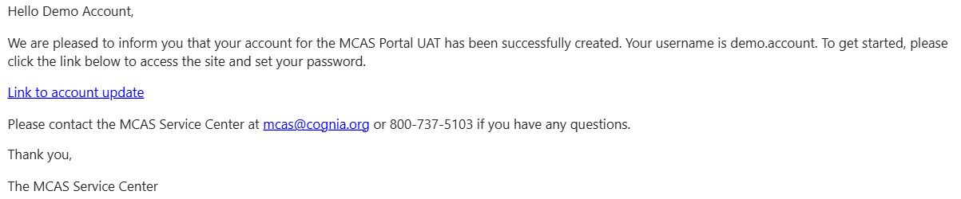
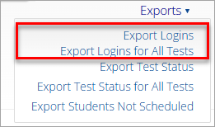
MCAS Portal Updates
The following updates are expected to be implemented prior to the November retests:
Update | Screenshot
New users will only receive one email that provides them with their username and a link to set their password, instead of two separate emails.
Users will be able to export student logins from the MCAS Portal for a single class/test, export all student logins for the selected test/school, or export all student logins for all tests within the selected content area and school.

Slide 15
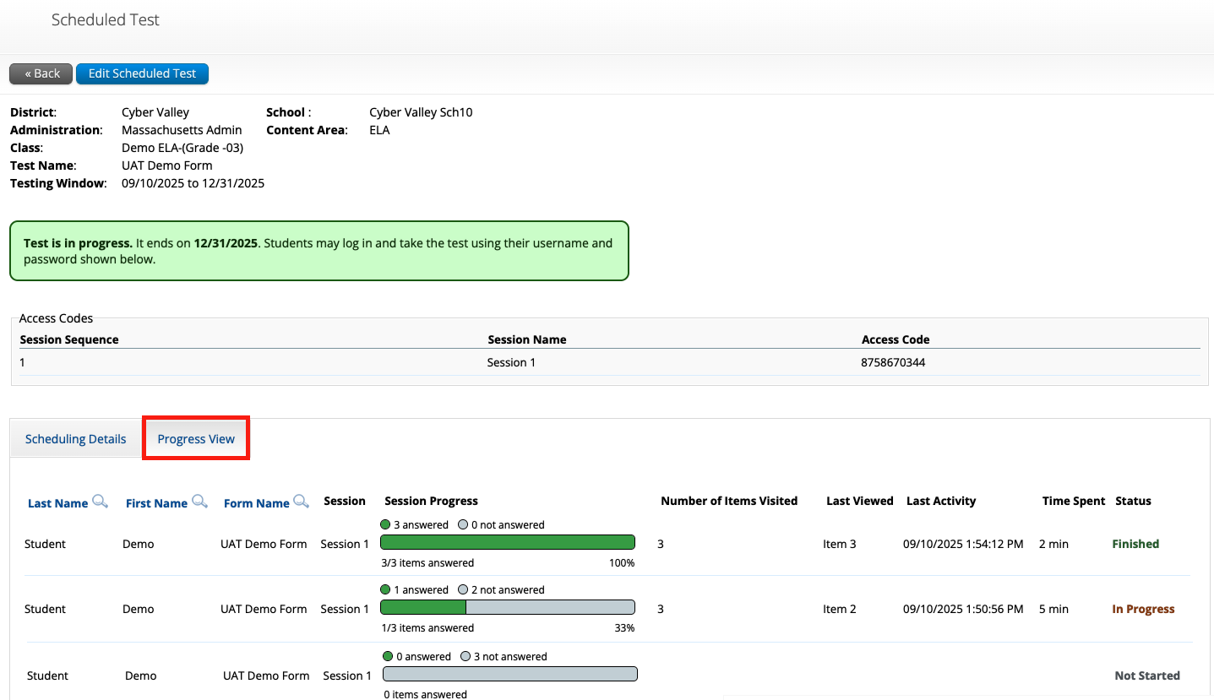
MCAS Portal Updates (cont’d)
The following update is available in the MCAS Portal:
Update | Screenshot
Test session progress metrics will be displayed for each student’s test sessions on the View Details/Student Logins screen.

Slide 16
Demonstration
Session progress metrics

Slide 17
2. Overview of MCAS Computer-Based Testing

Slide 18
MCAS Tests in 2025–26 School Year
Fall/Winter High School Tests
Spring 2026 Tests
Grades 3–8
  ELA – all grades
  Mathematics – all grades
  STE – grades 5 and 8
  Civics – grade 8
High School
  ELA – grade 10
  Mathematics – grade 10
  Biology and Introductory Physics
November
  ELA and Mathematics retests for students attempting to qualify for the Adams Scholarship, the Koplik Certificate of Mastery Award, and/or the Seal of Biliteracy.
  Students may not earn the Competency Determination through MCAS participation.
February
  Biology and Introductory Physics
Note: March retests are being discontinued.

Slide 19
Commonly Used Acronyms
CBT: Computer-based testing
PBT: Paper-based testing
EL: English learner
ELA: English Language Arts
STE: Science and Technology/Engineering
SIMS: Student Information Management System
TA: Test administrator

Slide 20
Timeline for Technology Tasks in the MCAS Portal
Fall 2025
At least two months before testing
After updating the MCAS Student Kiosk
Become familiar with CBT components.
Review MCAS Student Kiosk Technology Guidelines.
Prepare the school’s technology.
Review cybersecurity guidance and establish a cybersecurity plan for your school.
Determine whether your school will participate in “Bring Your Own Device” (BYOD) for MCAS Testing.
Verify access to the MCAS Portal and MCAS Training Site.
Update MCAS Student Kiosk to most recent version (released September 15, 2025).
Conduct Site Readiness and complete Site Certification.

Slide 21
Timeline for Technology Tasks in the MCAS Portal
At least two weeks before testing
One week before testing
During testing
If any technology changes have been made since completing Site Readiness, run it again.
Prepare devices and materials.
Familiarize yourself with common issues that may arise during testing and how to troubleshoot.
Be available to troubleshoot technology situations as they arise.

Slide 22
3. Tasks to Complete in Fall 2025

Slide 23
Timeline for Technology Tasks in the MCAS Portal
Fall 2025
At least two months prior to testing
After updating the MCAS Student Kiosk
Become familiar with CBT components.
Review MCAS Student Kiosk Technology Guidelines.
Prepare the school’s technology.
Review cybersecurity guidance and establish a cybersecurity plan for your school.
Determine whether your school will participate in “Bring Your Own Device” (BYOD) for MCAS Testing.
Verify access to the MCAS Portal and MCAS Training Site.
Update MCAS Student Kiosk to most recent version (released September 15, 2025).
Conduct Site Readiness and complete Site Certification.

Slide 24
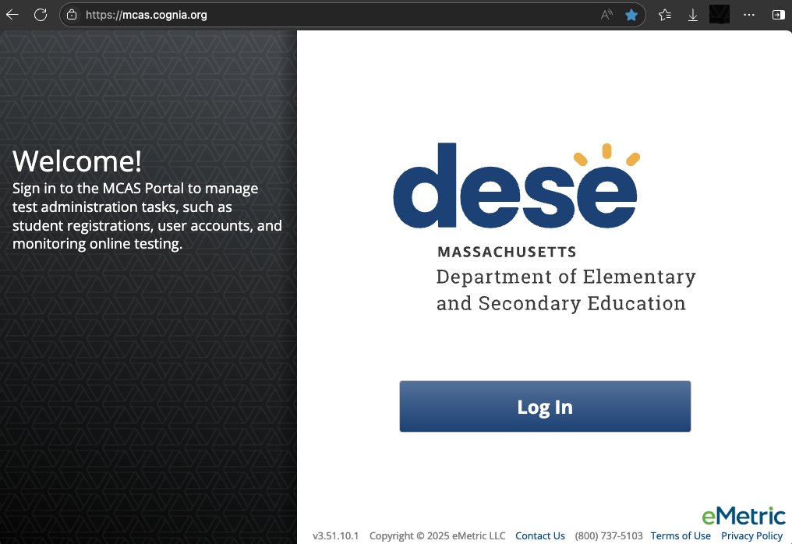
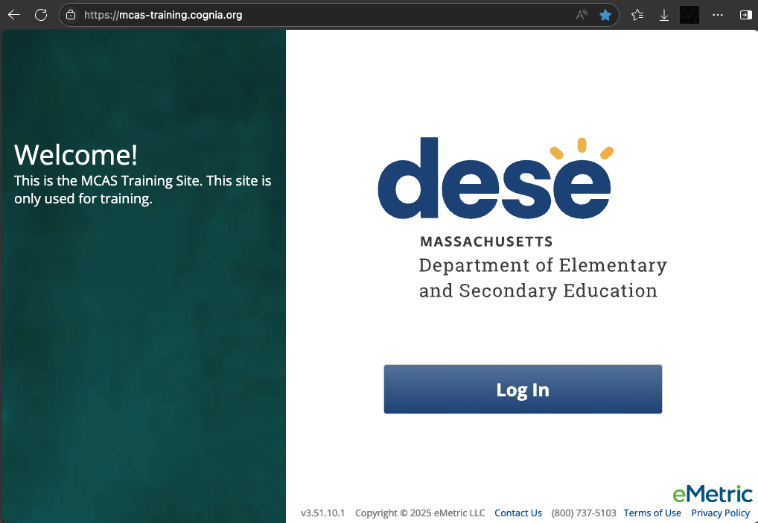
1. Become familiar with CBT components.
MCAS Portal
  Online test management system for principals, test coordinators, technology coordinators, and test administrators
    https://mcas.cognia.org/
MCAS Training Site
  Site where test coordinators, principals, technology coordinators, and test administrators can practice the tasks required in the MCAS Portal
    https://mcas-training.cognia.org

Slide 25
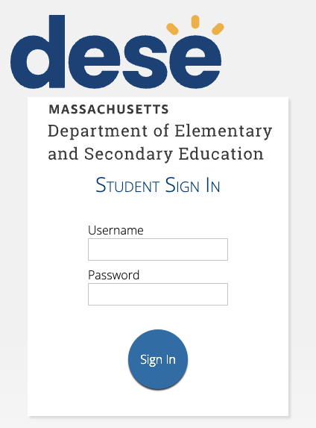
1. Become familiar with CBT components. (cont’d)
MCAS Student Kiosk
  Online testing platform used by students to take the computer-based MCAS assessments
    mcas.onlinehelp.cognia.org/
    technology-setup
Site Readiness
  Task completed by technology coordinators to verify that student devices are ready for testing.

Slide 26
2. Review MCAS Student Kiosk Technology Guidelines.
Part II of the MCAS Student Kiosk Technology Guide, available on the MCAS Resource Center on the Technology Setup page
Outlines the operating systems (OS) versions supported for testing, student kiosk device specifications, and MCAS Portal browser specifications
OS support
  As new OS versions and subversions are released throughout the school year, eMetric conducts testing to confirm that they will be supported for testing.
  Schools should not update device OS versions during testing windows.

Slide 27
Student Device Specifications
System Requirements – All Hardware
Connectivity | Student devices must be able to connect to the internet via wired or wireless networks.
Screen Size | 9.7” screen size or larger/“10-inch class” tablets or larger ”11-inch class” tablets or larger are highly recommended
Screen Resolution | 1024 x 768 or larger
Browser Requirements
Browsers (used for practice tests only) | Chrome 138 or newer Firefox 140 or newer Microsoft Edge 138 or newer Safari 18.5 or newer
Desktop and Laptop Specific Requirements
CPU | 1.3 GHz
Memory | 2 GB (4GB is strongly recommended for best performance)

Slide 28
ChromeOS Support Plan
New for 2025–26: eMetric supports the versions of ChromeOS that are current as of July of each school year. These versions will be supported through the end of the school year (June). Schools are not recommended to use beta versions of ChromeOS, as this may result in errors.
Version | Version Release Date
138+ | July 2025
132+ LTS | April 2025
Refer to page 7 of the MCAS Student Kiosk Technology Guide.

Slide 29
iPadOS Support Plan
eMetric supports the latest three major versions that are supported by Apple.
Version | Version Release Date | End of Support Date
17.7+ | May 2024 | End of 2025–26 school year
18.5+ | September 2024 | End of 2026–27 school year
26 | Expected fall 2025 | End of 2027–28 school year
Refer to page 7 of the MCAS Student Kiosk Technology Guide.

Slide 30
Support for macOS (64-bit only)
eMetric supports the latest three major versions that are supported by Apple.
Version | Version Release Date | End of Support Date
14.7+ | September 2023 | End of 2025–26 school year
15.5+ | September 2024 | End of 2026–27 school year
26 | Expected fall 2025 | End of 2027–28 school year
Refer to page 7 of the MCAS Student Kiosk Technology Guide.

Slide 31
Support for Linux and Windows
Operating System | Version | Version Release Date | End of Support Date | eMetric Support Policy
Linux, Fedora (64-bit only) | 42 | April 2025 | End of 2025–26 school year | eMetric supports the latest version of Fedora
Windows | 11 (22H2, 23H2, 24H2) | October 2021 | October 2031 | eMetric supports major versions of Windows that are supported by Microsoft. The latest supported minor versions of Windows are supported.
Refer to page 7 of the MCAS Student Kiosk Technology Guide.

Slide 32
3. Prepare the school’s technology.
Identify any gaps in technology capacity (e.g., test-taking devices that do not meet technology specifications) and address those gaps.
Plan to have enough devices for test administrators and students, including back-up devices that can be used if needed.
Update firewalls, proxy and content filter servers, and sandboxing applications.
Turn off operating system auto-updates during live administrations.

Slide 33
Network Requirements and Guidelines
Firewalls
Allow traffic through ports 80 and 443.
Proxy and Content Filter Servers
List of URLs to allow on ports 80 and 443 available on page 5 of the MCAS Student Kiosk Technology Guide
Sandboxing Applications
Choose network folder or local folder that is not touched by the sandboxing applications
Applicable for both stored response and kiosk installation folders
See page 5 of the MCAS Student Kiosk Technology Guide
Turn off operating system auto-updates during live test administrations.

Slide 34
OneDrive
OneDrive notifications may interfere with the kiosk and student test-taking experience. If OneDrive attempts to steal the screen’s focus during testing, the kiosk will display a white screen.
The student will need to click anywhere on the screen to regain focus in the kiosk, and then they will be able to resume testing where they left off.
To prevent these interruptions, schools should use one of the following approaches:
  If OneDrive is not needed or used on student devices, schools are recommended to disable OneDrive during student testing.
  OR
  If OneDrive cannot be disabled, the technology coordinator should take the necessary steps to prevent any actions, including file sharing or synchronization and administration updates to OneDrive settings, that would trigger a OneDrive notification during student testing.

Slide 35
Accommodations with Supported OS
Certain accommodations in the MCAS Student Kiosk are only supported on specific operating systems as described in the table below.
Accommodation | Supported Operating System
Compatible Assistive Technology | Windows
Mouse Pointer | Windows, macOS, ChromeOS, iPadOS*
Screen Reader | Windows (NVDA, Jaws)
Speech-to-Text Standard Speech-to-Text Special Access | Windows, macOS, ChromeOS, iPadOS
Word Prediction Standard Word Prediction Special Access | Windows, macOS, ChromeOS, iPadOS
*iPadOS: It is highly recommended to use an external mouse.

Slide 36
Monitor Settings for Screen Zoom
Ensure that all monitors used for testing are set to the default color settings. If a student will use the screen zoom tool, review the recommended screen resolutions below.
Required Zoom Level for Student | Recommended Screen Resolution
100% (no zoom) | 1024 x 768 (or higher)
150% | 1920 x 1080 (or higher)
200% | 1920 x 1080 (or higher)
300% | 1920 x 1080 (or higher)
Note: These are only recommended screen resolutions. Use the screen resolution the student is most comfortable with. The student or test administrator may set the zoom level within the MCAS Student Kiosk when the student logs in at the time of testing.

Slide 37
4. Review cybersecurity guidance and establish a cybersecurity plan for your school.
Review resources for cybersecurity planning to avoid issues that could arise during MCAS testing.
  Massachusetts Municipal Cybersecurity Roadmap
  Cybersecurity Best Practices
  Protecting Our Future: Partnering to Safeguard K–12 Organizations from Cybersecurity Threats
  National Institute of Standards and Technology (NIST) Cybersecurity Framework
  K12 SIX Essentials Series
  CISA Cyber Essentials Starter Kit
Email DESE’s Office of Educational Technology at k12edtech@mass.gov with questions.

Slide 38
5. Determine whether your school will participate in “Bring Your Own Device” (BYOD) for MCAS Testing.
A BYOD policy allows students to use their own devices for instruction.
If your school uses a BYOD policy and would like to use these devices for MCAS testing, email mcas@mass.gov for additional instructions.

Slide 39
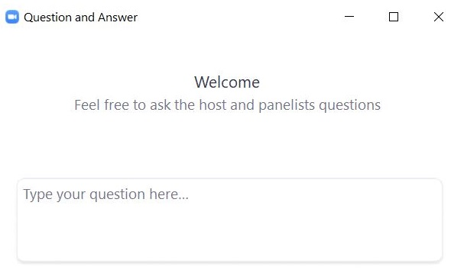
Questions & Answers
Use the “Q&A” feature
to ask questions.

Slide 40
4. Tasks to Complete at least Two Months Prior to Testing

Slide 41
Timeline for Technology Tasks in the MCAS Portal
Fall 2025
At least two months prior to testing
After updating the MCAS Student Kiosk
Become familiar with CBT components.
Review MCAS Student Kiosk Technology Guidelines.
Prepare the school’s technology.
Review cybersecurity guidance and establish a cybersecurity plan for your school.
Determine whether your school will participate in “Bring Your Own Device” (BYOD) for MCAS Testing.
Verify access to the MCAS Portal and MCAS Training Site.
Update MCAS Student Kiosk to most recent version (released September 15, 2025).
Conduct Site Readiness and complete Site Certification.

Slide 42
6. Verify access to the MCAS Portal and MCAS Training Site.
MCAS Portal: the test administration and management website for district test coordinators, technology coordinators, principals/school test coordinators, test administrators, and other staff as needed
MCAS Training Site: where test coordinators, principals, technology coordinators, and test administrators can practice the tasks required in the MCAS Portal
Accounts for each site are created separately.
Passwords for each site are set separately, but DESE recommends using the same password for both the MCAS Portal and the MCAS Training Site.

Slide 43
6. Verify access to the MCAS Portal and MCAS Training Site. (cont’d)
If you cannot access your MCAS Portal or MCAS Training Site account, are not able to access your school or district, or are new and need an account, users may request support as follows:
Role | Who to contact for support
Test administrators and school-level technology coordinators | Their principal or school test coordinator
Principals, school test coordinators, and district-level technology coordinators | Their district test coordinator
District test coordinators | MCAS Service Center

Slide 44
Getting Started: Logging In
Browser specifications for the MCAS Portal*:
  Chrome™ 138 or newer
  Firefox® 140 or newer
  Microsoft Edge 138 or newer
  Safari® 18.5 or newer
  *Refer to the MCAS Student Kiosk Technology Guide posted on the MCAS Resource Center for latest updates.
Passwords are valid for 365 days.

Slide 45
7. Download and install the updated MCAS Student Kiosks.
Released September 15, 2025
Detailed instructions for setting up the 2025–26 MCAS web app for ChromeOS and extension are provided in the MCAS Student Kiosk Technology Guide.
Available for download from the MCAS Portal for iPad, Linux, Mac, and Windows
  Use the direct links to access the apps on the Apple App Store.
  Be sure to download the correct MCAS Student Kiosk for each device type.
Scripted installations and other methods of installation are provided in the MCAS Student Kiosk Technology Guide.

Slide 46
Uninstalling 2024–25 Kiosks
If your student testing devices have the MCAS Student Kiosk installed from the 2024–25 school year, please see the table below.
See the MCAS Student Kiosk Technology Guide for step-by-step instructions.
Kiosk Installed in 2024–25 | Action Required for MCAS Testing in 2025–26
ChromeOS | Uninstall the old MCAS kiosk app from the ChromeOS management console. Add the new MCAS web app and extension.
iPad | Manually update the kiosk if automatic updates are not enabled.
Linux | Uninstall the old kiosk and then download and install the new kiosk.
MacOS | Schools are not required to uninstall the old kiosk. They will need to download and install the new one.
Windows | Schools are not required to uninstall the old kiosk. They will need to download and install the new one.

Slide 47
ChromeOS Application Installation
What You Need to Know
  New App Required: The new PWA must be installed on all ChromeOS devices used for testing.
  Setup: Step-by-step instructions for setup and configuration are included in the MCAS Student Kiosk Technology Guide on pages 11–22. Every step must be followed.
  Extension Pairing: The PWA will work alongside a Chrome extension to support secure kiosk testing.
  Test the new app before administration starts: We strongly recommend schools and districts coordinate with their technology coordinators to install and test the new PWA by completing Site Readiness on devices as soon as it is installed.

Slide 48
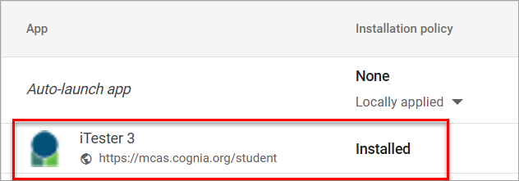
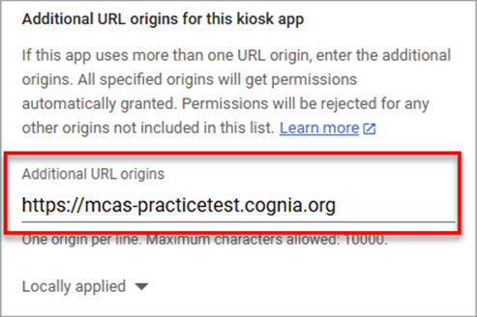
ChromeOS Application Installation
Overview of Steps in ChromeOS management console
  In Devices > Chrome > Apps and Extensions > Kiosks select Add by URL and enter https://mcas.cognia.org/student and select Save.
  Select the iTester 3 MCAS App and scroll down to Additional URL origins for this kiosk app and enter https://mcas-practicetest.cognia.org

Slide 49
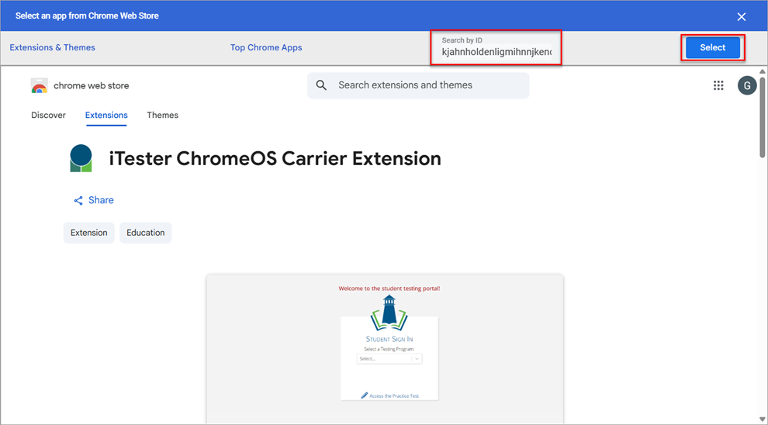
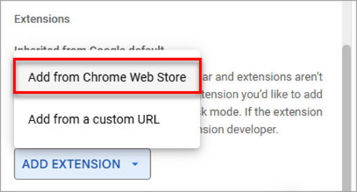
ChromeOS Application Installation
  Scroll to the Extension section and select Add from Chrome Web Store and then enter iTester ChromeOS Carrier extension ID in the Search by ID text box and click Select.

Slide 50
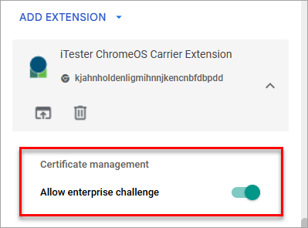
ChromeOS Application Installation
  After the iTester ChromeOS Carrier Extension has been added, enable Allow enterprise challenge.

Slide 51
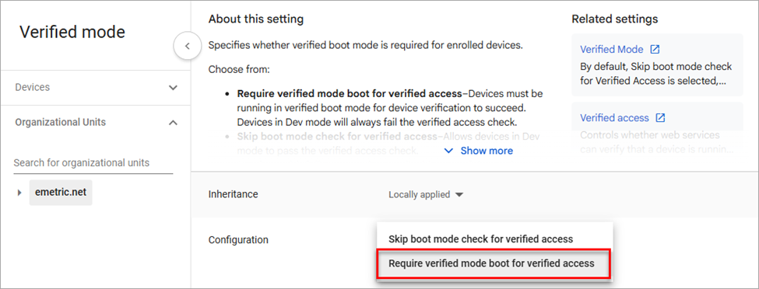
ChromeOS Application Installation
  Set up Verified Mode Devices > Chrome > Settings > Organizational Unit
  In Device Settings under Enrollment and access, select Verified Mode and set the configuration to Require verified mode boot for verified access.

Slide 52
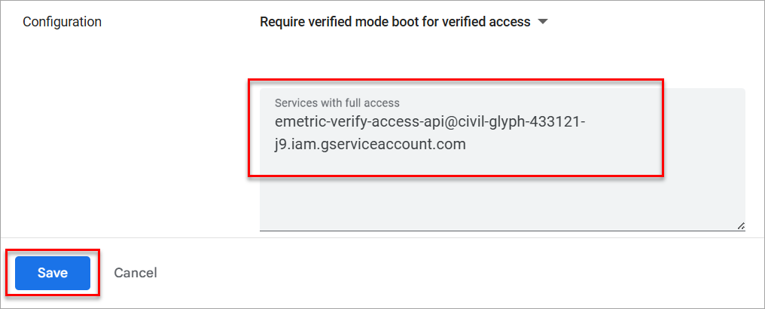
ChromeOS Application Installation
  Under Services with full access, add the verified access service account and select Save.
    emetric-verify-access-api@civil-glyph-433121-j9.iam.gserviceaccount.com

Slide 53
8. After updating the MCAS Student Kiosk, conduct Site Readiness and Site Certification.
What are the purposes of conducting Site Readiness and Site Certification?
For technology coordinators to:
  Confirm that installation and updating of the MCAS Student Kiosk was done correctly on student devices
  Confirm that testing devices meet the minimum requirements and have been properly configured
  Confirm that test content reaches student devices without issue
  Identify any potential technology-related issues before testing begins
For communication of these steps to district and school test coordinators that testing devices are ready
When is Site Readiness conducted?
Recommended to complete directly after installing the updated MCAS Student Kiosk
If any changes to technology take place, recommended to complete again prior to testing

Slide 54
8. Conduct Site Readiness and Site Certification.
What are the general steps involved?
Technology coordinators will sign in to the MCAS Portal to retrieve their Site Readiness credentials (i.e., username and password).
  Credentials are school-specific. District technology coordinators will need to select the school from their drop-down to see a location’s credentials.
Technology coordinators launch the MCAS Student Kiosk on each student testing device configuration (i.e., each device type and operating system).
  Use the Site Readiness credentials to run the test.
  Note: Site Readiness tests must be conducted using the secure MCAS Student Kiosk.
    Site Readiness will not be conducted on browser-based practice tests in the MCAS Resource Center and the MCAS Training Site.
Technology coordinators complete the two-part test on each device type:
  System Set-Up Test
  Student Interface Test

Slide 55
8. Conduct Site Readiness and Site Certification. (cont’d)
What are the general steps involved (continued)?
Technology coordinators go back to the MCAS Portal to complete the Site Certification step.
Technology coordinators communicate with their principal/school test coordinator to let them know Site Readiness has been completed and certified.
School and district coordinators confirm that their technology coordinators have completed the Site Certification for their schools by recommended timeline.
The Site Readiness procedures take approximately 5–10 minutes per device.
iPadOS information does not populate in the Site Readiness tab in the MCAS Portal.
It is recommended to conduct Site Readiness again prior to testing if your school experiences any changes to technology.
Step-by-step instructions available in Part V of the MCAS Student Kiosk Technology Guide.

Slide 56
Site Readiness Tests
Site Readiness is a two-part test that allows technology coordinators to ensure the MCAS Student Kiosk has been properly installed.
Site Readiness Tests | Purpose of Test
System Set-Up Test | Verifies and confirms the following: network connectivity screen resolution text-to-speech how many students may begin testing at the same time
Student Interface Test | Provides sample test questions to determine whether the device is capable of correctly displaying and navigating test content in the MCAS Student Kiosk. The Student Interface Test also allows technology coordinators to test the student tools, including the Line Reader, Text Highlighter, and Notepad, to ensure those are functioning properly.

Slide 57
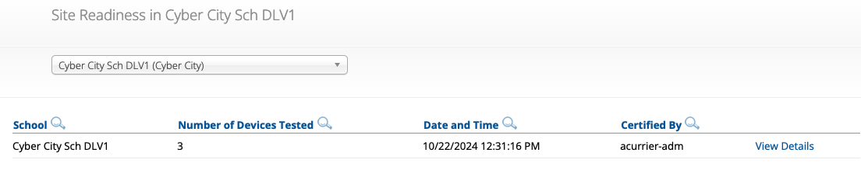
Certifying Site Readiness
After all device configurations for your school have successfully completed Site Readiness, certify the site for testing.
Site Certification is done in the MCAS Portal.
  Technology coordinators certify Site Readiness to signal to school and district test coordinators that the school technology has been confirmed as ready for testing.
  See Part V of the MCAS Student Kiosk Technology Guide.
DESE will follow up with schools that do not complete Site Readiness.
Demonstration available in the Certifying Site Readiness module.

Slide 58
Demonstration
Retrieving Site Readiness credentials
Conducting the Site Readiness test
Certifying Site Readiness

Slide 59
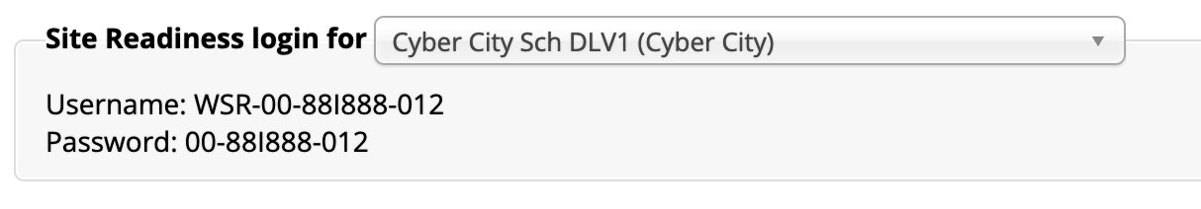
Retrieving Site Readiness Credentials
Log in to the MCAS Portal with your username and password.
On the Portal home page, click Administration. The Site Readiness account information appears at the bottom of the Administration home page.
Make a note of the username and password for the school, which you will use to log in to the MCAS Student Kiosk.

Slide 60
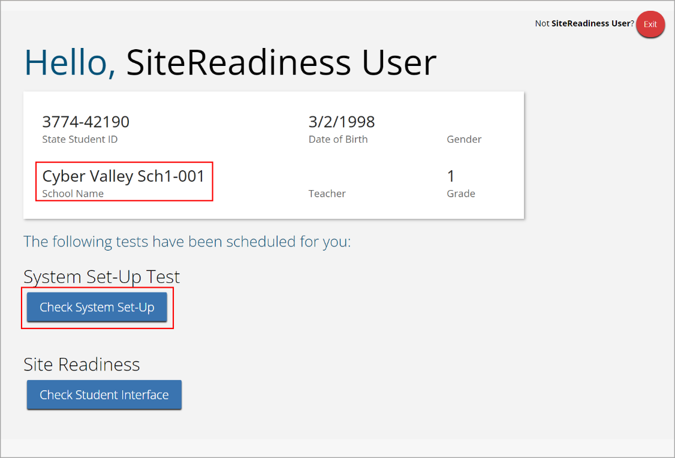
Conduct Site Readiness: System Set-Up Test
Launch the MCAS Student Kiosk on the device.
Log in to the MCAS Student Kiosk with the Site Readiness username and password provided for the school.
Verify your school’s name underneath the username. Under System Set-Up Test, click Check System Set-Up to begin the test.

Slide 61
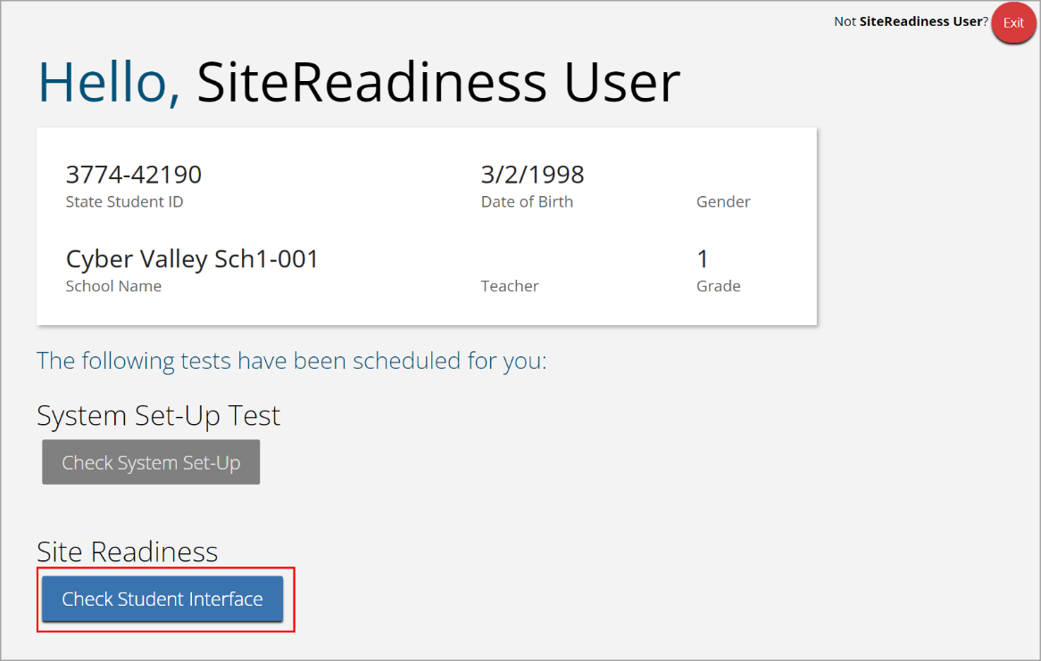
Conduct Site Readiness: Student Interface Test
If all the system checks succeed, you are ready to begin the next Site Readiness test.
  If one or more system checks fail, adjust your configuration as needed and re-run the System Set-Up test.
When the System Set-Up test is completed, click the blue Check Student Interface button.
Read the instructions on the page and then click Continue.
Confirm that you can respond to a few questions, and try a few student tools.
On the last test question page, click Finish.
On the Test Review page, click Turn In to submit your test.

Slide 62

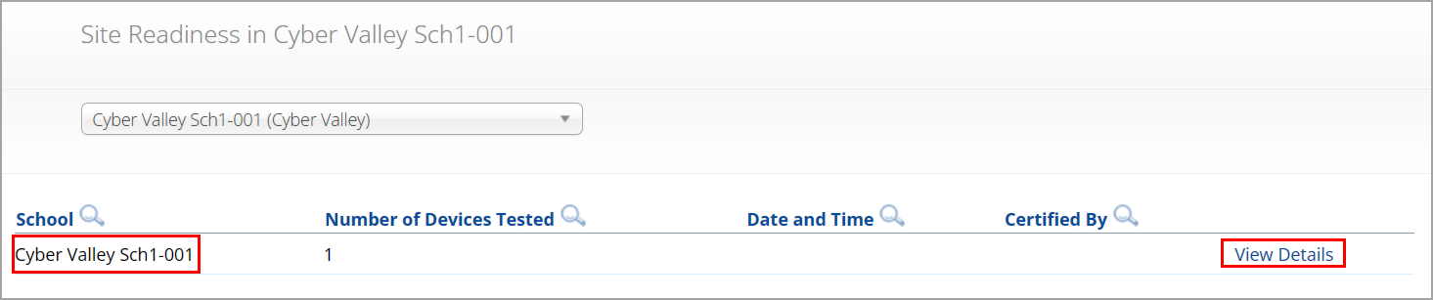
Certify Site Readiness
After all devices or device configurations for your school have successfully completed Site Readiness, the technology coordinator will certify the site for testing.
Log in to the MCAS Portal with your username and password.
  Note: Use your own username and password, not the Site Readiness credentials.
Click Administration.
Click Site Readiness at the top of the page.
On the Site Readiness page, locate the school to be certified, and then click View Details.

Slide 63
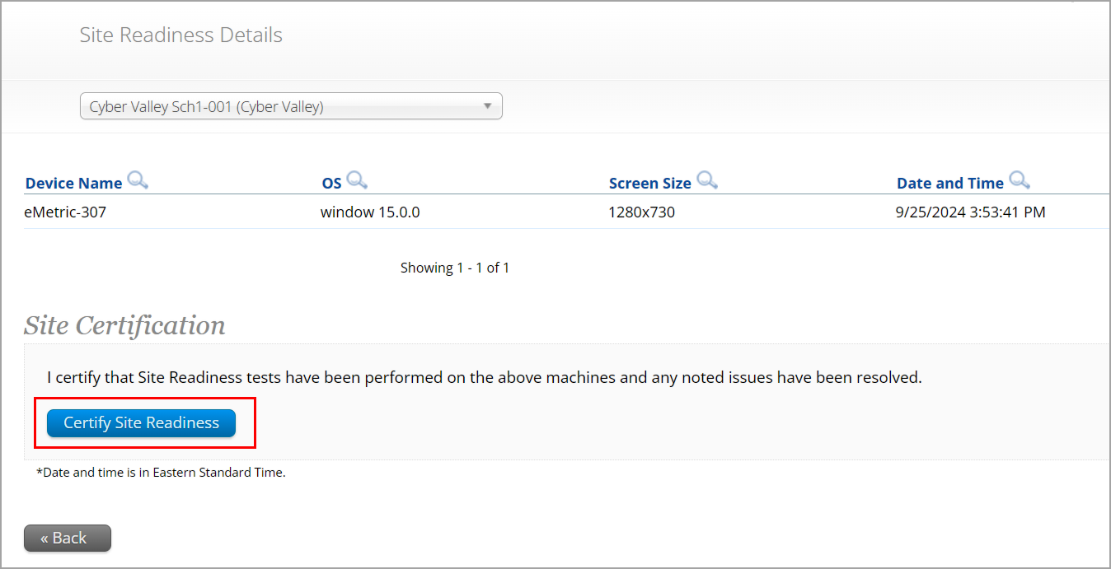
Certify Site Readiness (cont’d)
On the Site Readiness Details page, verify that all the devices or device configurations for the school have successfully run the Site Readiness tool and meet the technology requirements.
Click Certify Site Readiness and click Yes in the pop-up message to confirm.

Slide 64
Questions & Answers
Use the “Q&A” feature
to ask questions.

Slide 65
5. Tasks to Complete at least Two Weeks before Testing

Slide 66
Timeline for Technology Tasks in the MCAS Portal
At least two weeks before testing
One week before testing
During testing
If any technology changes have been made since completing Site Readiness, run it again.
Prepare devices and materials.
Familiarize yourself with common issues that may arise during testing and how to troubleshoot.
Be available to troubleshoot technology situations as they arise.

Slide 67
9. If any technology changes have been made since completing Site Readiness, complete it again.
We understand that technology setups at schools and districts may change over the course of the school year. If there are any changes such as those listed below, it is highly recommended to rerun site readiness testing.
  Operating system versions change
  New student testing devices are purchased
  New proxy, firewall, or other network setup changes have been made that could impact student testing
  New Wi-Fi or other internet setup changes have been made that could impact student testing

Slide 68
10. Prepare devices and materials.
Ensure all devices will be charged prior to each test session.
Have the following materials available, and confirm they are in working order:
  Power cords, power strips, extra batteries, extra computers
  If using tablets: external keyboards
  If students are using Text-to-Speech or screen reader: headphones (Students do not need headphones otherwise.)

Slide 69
6. Troubleshooting Technology Issues during Testing

Slide 70
Timeline for Technology Tasks in the MCAS Portal
At least two weeks before testing
One week before testing
During testing
If any technology changes have been made since completing Site Readiness, run it again.
Prepare devices and materials.
Familiarize yourself with common issues that may arise during testing and how to troubleshoot.
Be available to troubleshoot technology situations as they arise.

Slide 71
Troubleshooting Technology Issues during Testing
Technology coordinators are encouraged to familiarize themselves with common issues that may arise during testing and how to troubleshoot by reviewing Appendix A of the Principal’s Administration Manual (PAM) and Appendix B of the MCAS Student Kiosk Technology Guide.
Technology coordinators should plan to be available during testing to assist with technology issues if they arise.
For all technology issues, it is good practice to record the exact device the student is testing on.

Slide 72
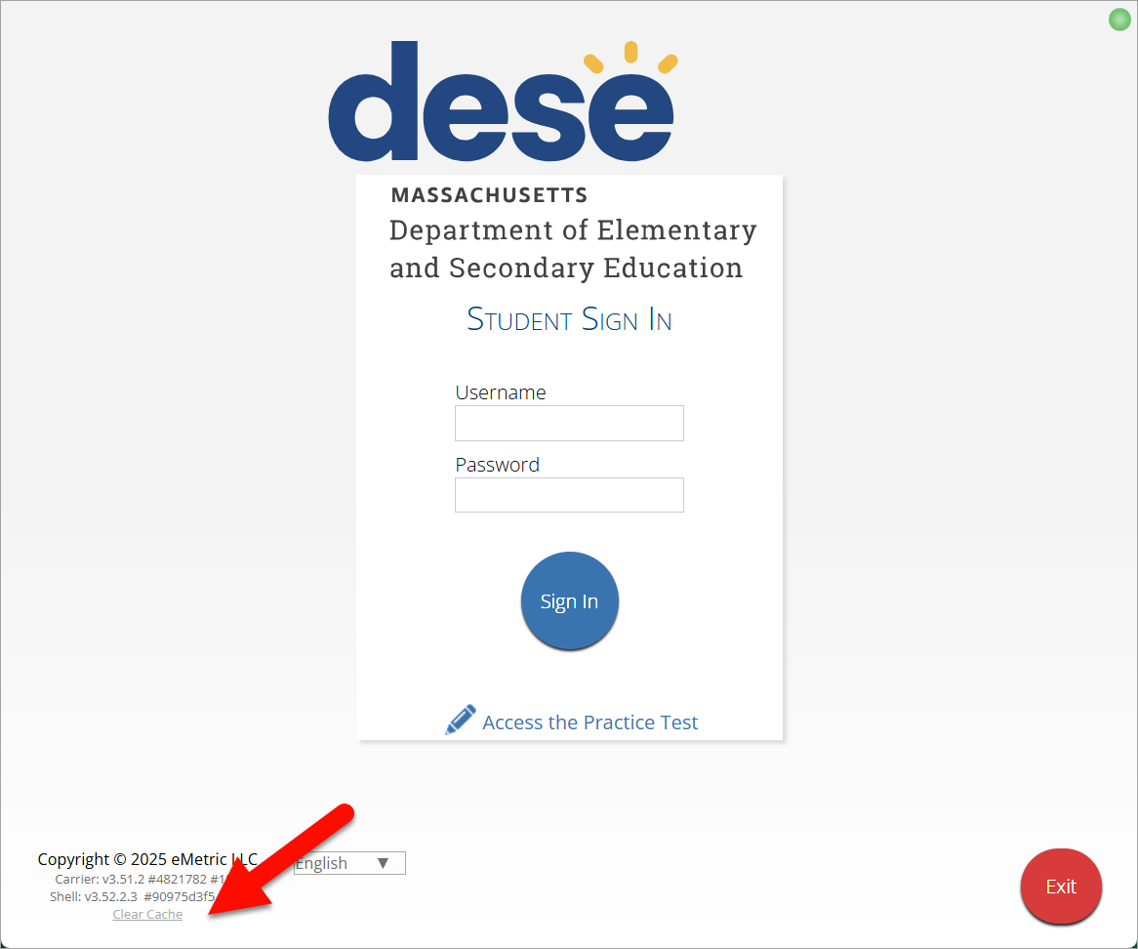
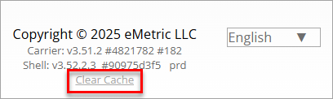
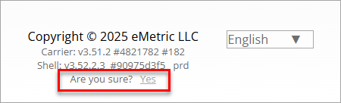
Clearing the Application Cache
In some situations, technology coordinators may clear the MCAS Student Kiosk application cache as a first step towards resolving technology issues, including the following situations:
  If an image is not rendering correctly
  If a drag-and-drop item is not operating correctly
In these cases, technology coordinators can:
  Instruct the student to log out of the test.
  Select the Clear Cache link for Windows, macOS, Linux, and ChromeOS. For iPadOS close the iTester app completely on the iPad to clear the cache.
  Instruct the student to log back in to the test.

Slide 73
Steps to Resolve Error Messages
If possible, do not power the device off until the student has exited the MCAS Student Kiosk.
Record the exact device the student is testing on.
Troubleshoot the error according to the instructions in Appendix A of the PAM.
  If your school is experiencing a high volume of error messages, contact the MCAS Service Center.
When resuming a test after an error has exited the student from the kiosk, the original testing device should be used first.
  This is so that any unsent responses on the original device can be sent to eMetric.
If the original testing device cannot be used or if the original error is still occurring, contact the MCAS Service Center for support.

Slide 74
Common MCAS Student Kiosk Error Messages
Error Message | Resolution
Invalid username/password | The student is using the incorrect password or username when trying to log in to the MCAS Student Kiosk. Verify the correct username and password in the MCAS Portal and have the student try again.
We could not establish a connection to our server, please check your internet connection. | Internet connectivity was lost after the student entered their username and password. The MCAS Student Kiosk detected the loss of internet connectivity and will not allow the student to log in until internet connectivity is reestablished. Contact your technology coordinator.
Incorrect access code. Please try again. | The student is using the incorrect access code for the session selected or typing in the access code incorrectly. Verify the correct access code in the MCAS Portal and have the student try again.
Refer to Appendix A of the PAM for a full list of error messages and instructions.

Slide 75
Common MCAS Student Kiosk Error Messages (cont’d)
Error Message | Resolution
We were unable to get your Test Session. Please check your internet connection and try again. | Internet connectivity was lost after the student logged in. The MCAS Student Kiosk will not load the test sessions until a connection to the internet is reestablished. Click Retry. If internet connectivity is established, then the student will be directed to the test session. If an internet connection is not detected, contact your technology coordinator.
We could not establish a connection to our server, please check your internet connection. | The eMetric servers cannot reach the stored response folder location due to a network connectivity failure. Contact your technology coordinator.

Slide 76
Common MCAS Student Kiosk Error Messages (cont’d)
Error Message | Resolution
Please raise your hand; your test session has timed out. | The student has timed out of their test session, meaning they have been inactive in the test for 60 minutes or more. Click Exit to go back to the sign-in page. When the student is ready to continue testing, they will log back into the student testing interface and select the session, enter the access code, and the test administrator will enter the proctor password. The student will resume testing where they left off.
A connection to the network could not be established. Your test has been saved offline. | Internet connectivity was lost after the student began testing and was not restored by the time the student completed the test. The student’s responses are saved to the local folder configured when installing the MCAS Student Kiosk. Enter the proctor password to acknowledge the message. Note the student’s device ID. Contact your technology coordinator to establish internet connection. Relaunch the MCAS Student Kiosk on the student’s device.

Slide 77
MCAS Student Kiosk: Moving Devices
If a students device becomes unusable during a test while they are connected to the internet, follow these steps when moving them to a new device.
  If possible, verify that the number of responses showing as answered on the student’s device match the number answered on the Progress View tab on the View Details/Student logins page for the test.
    If not possible, or if the number of responses do not match, contact the MCAS Service Center.
  Have the student Pause and Exit the test.
  Move the student to a new device.
  Have the student log in with their username, password, and access code.
  Student should be able to continue where they left off.

Slide 78
MCAS Student Kiosk: Internet Connectivity
Internet connectivity is required during testing only as follows:
  At the beginning of the test to authenticate student login and download the test content
  At the end of the test to submit responses for scoring
Once a student has finished reading the test session directions and the content has downloaded onto the local device, the student may continue testing regardless of internet connectivity.
Note: For grades 5 and 8 STE, internet connectivity is required for the entirety of the test.
If a student’s device loses internet connectivity:
  The student should keep testing on that device.
  Do not move a student to a new device when experiencing technical issues if the student has already begun testing.
  Student responses will be saved to the save response location indicated during MCAS Student Kiosk installation.
  Once internet connectivity resumes, the saved responses will automatically be synced to eMetric servers.
  If the student turns in the test offline, the student will receive a message to notify the test administrator.

Slide 79



MCAS Student Kiosk: Internet Connectivity
When is internet connectivity required?
Beginning of Test:
Authenticate login
Download test content
eMetric Servers
End of Test:
1. Submit responses for scoring
Note: Students with an ASL video accommodation (grade 10 Math, June Science) will need internet connectivity during the test. Content with video (grades 5 and 8 STE) will need to have internet connection to play the video.

Slide 80





MCAS Student Kiosk: Loss of Internet Connectivity During Testing
Internet connectivity indicator
Responses Sync every 45–90 seconds
Student with Internet Connectivity
eMetric Servers
Student with no Internet Connectivity
eMetric Servers
Student with restored Internet Connectivity
eMetric Servers

Slide 81

MCAS Student Kiosk: Finish the Test with No Connectivity
Internet connectivity indicator
Student finishes test with no Internet Connectivity
Student turns in test and receives prompt to notify test administrator
Test Administrator on Student Device with Internet Connectivity
eMetric Servers
Test administrator uses student testing device and relaunches the MCAS Student Kiosk

Slide 82
Loss of Network Connectivity Procedure Summary
If a student finishes and is ready to turn in the test while offline (prior to the network being restored):
  Allow student to turn in test.
  The student will receive a message to notify the test administrator.
  Record the exact device the student is testing on.
  Ensure no network management tools or system maintenance will alter that device’s files or configuration.
  When network connectivity is restored, the test administrator will need to resume internet connectivity and relaunch the MCAS Student Kiosk on the original testing device. (If you can see the student login page, the saved responses have synced.)
Verify the student now shows as Finished on the Test Scheduling page in the MCAS Portal for this test. The Progress View tab will also show all responses as answered.

Slide 83
Questions & Answers
Use the “Q&A” feature
to ask questions.

Slide 84
7. Resources, Support, and Next Steps

Slide 85
Additional Resources
Resource | Location
MCAS Resource Center | mcas.onlinehelp.cognia.org
MCAS Portal user guides | https://mcas.onlinehelp.cognia.org/portal/
Technology Information MCAS Student Kiosk Technology Guide (includes Technology Guidelines, instructions for downloading and installing updated kiosks, instructions for Site Readiness and Site Certification, and troubleshooting information) | https://mcas.onlinehelp.cognia.org/technology-setup/
Student Assessment Updates (Biweekly email with important updates about the MCAS program) | www.doe.mass.edu/mcas/updates.html If you do not already receive this email, subscribe using this link: http://eepurl.com/ghSOhH
Cybersecurity Resources | https://www.doe.mass.edu/mcas/testadmin/

Slide 86
Upcoming Training – Fall 2025
Training | Date
Office Hours for February Science Student Registration | Thursday, November 20 at 9:30–10:30 a.m.

Slide 87
Upcoming Trainings – January 2026
Training | Date
Overview of Student Registration | Thursday, January 15
Accessibility and Accommodations | Wednesday, January 21
Office Hours – Accessibility and Accommodations | Thursday, January 22
MCAS Test Administration and Security Protocols for Returning Staff | Tuesday, January 27
Office Hours – Student Registration | Wednesday, January 28
MCAS Test Administration and Security Protocols for New Staff | Thursday, January 29

Slide 88
Upcoming Trainings – February and March 2026
Training | Date
Technology Coordinator Training | Monday, February 2
Tasks in the MCAS Portal Before Testing | Wednesday, March 4
Tasks in the MCAS Portal During and After Testing | Thursday, March 12
Office Hours – MCAS Portal Tasks | Thursday, March 19

Slide 89
Next Steps
Today: Complete the evaluation form.
  Responses are associated with the name and email address used to log in.
  Email your input to mcas@mass.gov if you have problems accessing or completing the form.
Within one week:
  Receive an email with the Q&A from this session
  Recording will be available

Slide 90
Email and Phone Support
DESE Student Assessment Services
MCAS Service Center
Questions on logistics and technology
  Web: https://mcas.onlinehelp.cognia.org/
  Email: mcas@cognia.org
  Phone: 800-737-5103
  TTY: 888-222-1671
  Live chat is available at the link on the bottom of the page at the MCAS Resource Center
Policy questions (e.g., student participation, accommodations)
  Web: www.doe.mass.edu/mcas
  Email: mcas@mass.gov
  Phone: 781-338-3625
  TTY: 800-439-2370

Slide 91




THANK YOU
The Office of Student Assessment Services
781-338-3625
mcas@mass.gov
www.doe.mass.edu/mcas
135 Santilli Highway, Everett, MA 02149

