Slide 1
Overview of MCAS Administration Tasks for School and District Test Coordinators
The Office of Student Assessment Services
September 30, 2025

Slide 2
Presenters
Jodie Zalk, Manager of Test Administration and Publications
Shannon Cullen, MCAS Test Administration Coordinator
Kaelee Harper, eMetric Sr. Support Center Manager

Slide 3
Logistics for This Session
Use the Q&A feature to ask a question.
  We will answer some questions aloud at specified times during this training session, and we will email the Q&A afterwards.
  Type your questions anytime, but we may not answer them in real time as some questions may be covered during the presentation.
  Use the thumbs-up icon to “upvote” someone else’s question.
  Email student-specific questions to mcas@mass.gov instead of asking here.
This session is being recorded and will be available in about a week in the MCAS Resource Center, along with the slides.
Closed captioning has been enabled for participants who need it.
This session is being interpreted into ASL. Our interpreting team will be onscreen with the presenters.
Please be advised that DESE does not authorize attendees to record or to use AI transcription tools during the meeting and DESE does not endorse any unauthorized transcripts created by third parties of its meetings.

Slide 4
Slides for This Session
Slides were emailed to participants before this session from MCASEvents@cognia.org.
Slides are now being posted in the chat.
    If you cannot access the slides in the chat, ask in the Q&A.
After the session, we will send the slides again to participants, and they will be posted in the MCAS Resource Center along with the recording.

Slide 5
Today’s Agenda
Updates for 2025–26
Overview of Computer-Based Testing
Tasks to Complete Now
Tasks to Complete at least Two Months before Testing
Tasks to Complete One to Two Months before Testing
Tasks to Complete after Student Registration
Tasks to Complete at least Two Weeks before Testing
Tasks to Complete Two Weeks before Testing
Tasks to Complete up to One Week before Testing
Resources and Next Steps

Slide 6
Poll Question
What is your role? (Check all that apply)
  District test coordinator
  School test coordinator
  Principal
  Guidance counselor
  Technology staff
  Other district staff
  Other school staff

Slide 7
Poll Question
How many years have you coordinated MCAS test administration?
  0–This is my first year
  1 year
  2–3 years
  4–5 years
  6+ years

Slide 8
1. Updates for 2025–26

Slide 9
MCAS Policy Updates
Prescribed windows with recommended dates for high school tests​
  The November 2025 retests may be administered anytime during the window of November 5–18 for ELA and November 12–18 for Math. Recommended dates are:
    November 5: ELA Session 1
    November 6: ELA Session 2
    November 12: Math Session 1
    November 13: Math Session 2
Updated Competency Determination (CD)
  Students may not earn the CD through participation in the MCAS tests. ​
  Please email questions about the CD to Competency.Determination@mass.gov.

Slide 10
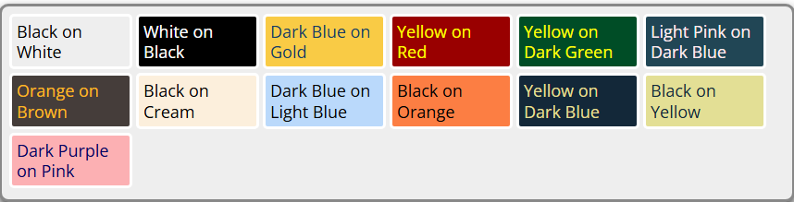
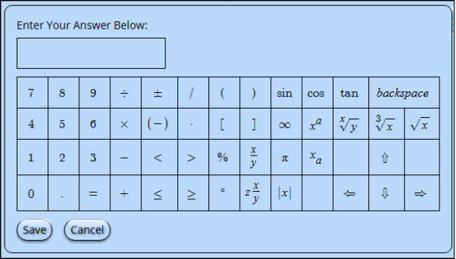
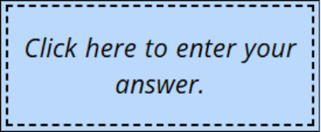
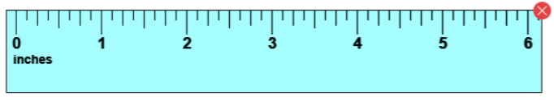
MCAS Student Kiosk Updates
The following updates are now available in the MCAS Student Kiosk:
Update | Screenshot
The names of the color contrast options have been updated to be more descriptive
When a student has selected a color contrast option, the math response questions, equation editor, and reference sheets will be in the same selected color contrast.
The rulers have been updated for better visibility and clarity. The color is now blue, the numbers have been enlarged, and the tick marks have been darkened.

Slide 11
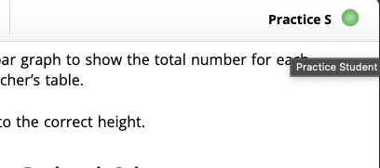
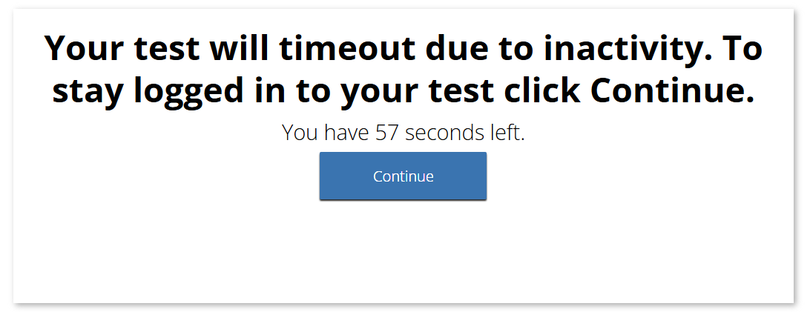
MCAS Student Kiosk Updates(cont’d)
The following additional are now available in the MCAS Student Kiosk:
Update | Screenshot
The student's name will now appear in the top right corner of the item and directions pages within a test. Hovering over the student’s first name and last initial will display the full name.
Students will be given a warning before timing out of a test, which happens after 60 minutes of inactivity. A timeout popup will appear when there are 60 seconds before the student times out of their test due to inactivity. The warning timer will count down from 60 seconds. The student may click Continue to continue testing.
All three calculator brands, TI, Desmos, and eMetric calculators have been updated to the latest versions of the calculators, and they default to degrees, not radians. | N/A
Answer eliminator is no longer available. | N/A

Slide 12

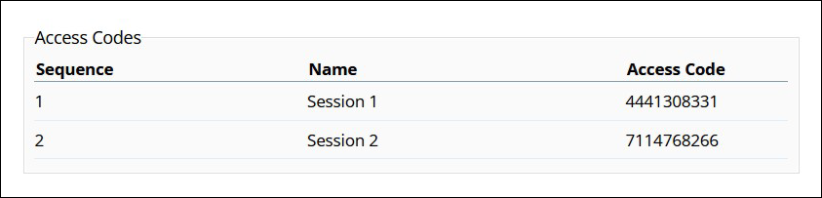
MCAS Student Kiosk Updates (cont’d)
The following additional updates are expected to be implemented prior to the November 2025 retests:
Update | Screenshot
“Session Access Code”, the code that test administrators write on the board and that students type into the Kiosk to begin their test, will be renamed “Access Code.”

Slide 13
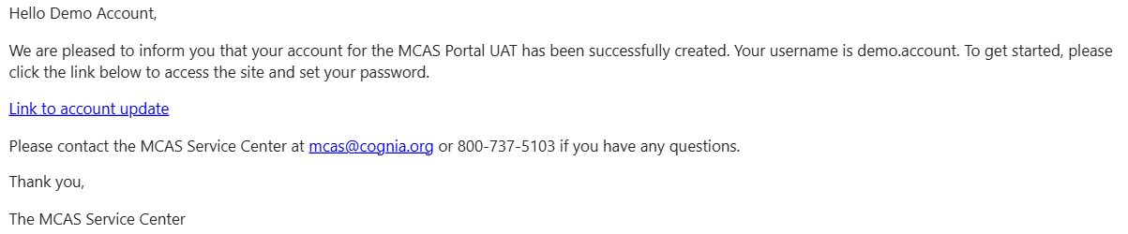
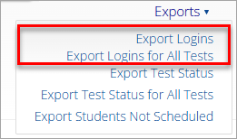
MCAS Portal Updates
The following updates are expected to be implemented prior to the November retests:
Update | Screenshot
New users will only receive one email that provides them with their username and a link to set their password, instead of two separate emails.
Users will be able to export student logins from the MCAS Portal for a single class/test, export all student logins for the selected test/school, or export all student logins for all tests within the selected content area and school.

Slide 14
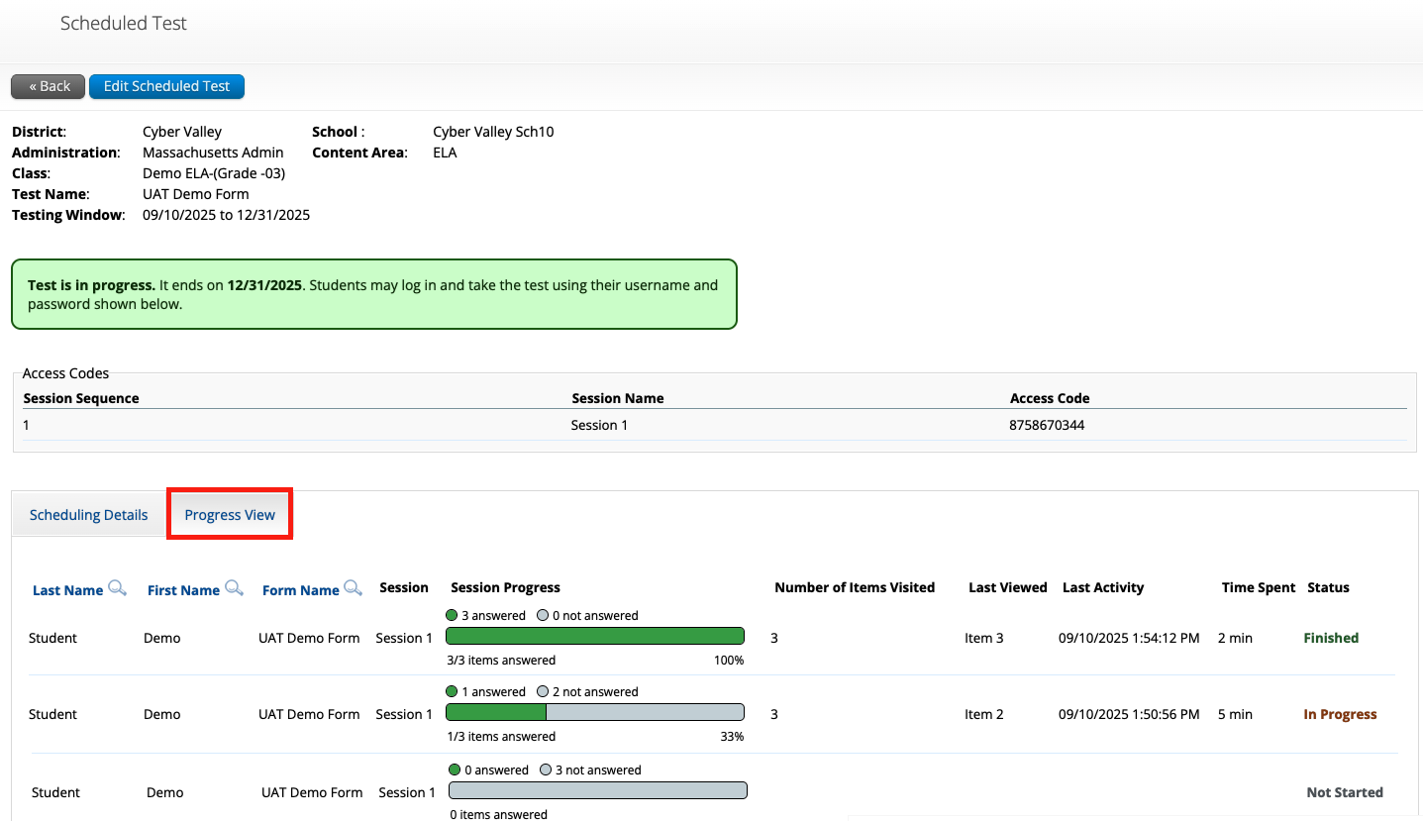
MCAS Portal Updates (cont’d)
The following update is available in the MCAS Portal:
Update | Screenshot
Test session progress metrics will be displayed for each student’s test sessions on the View Details/Student Logins screen.

Slide 15
Demonstration
Session progress metrics

Slide 16
Future Updates for the Student Kiosk and MCAS Portal
The following updates are under consideration for the future:
  Maintain highlighting and notepad after abrupt closure, pause, or log out of the MCAS Student Kiosk.
  Enrollment transfer – when a student is transferred from one school to another, previously completed test sessions will be viewable by the new school.
  Accommodations export
  Accommodations validations in the MCAS Portal user interface
  Additional features within the session progress metrics
  At the high school level, ability to group students in different grade levels in the same class

Slide 17
2. Overview of Computer-Based Testing

Slide 18
MCAS Tests in 2025–26 School Year
Fall/Winter High School Tests
Spring 2026 Tests
Grades 3–8
  ELA – all grades
  Mathematics – all grades
  STE – grades 5 and 8
  Civics – grade 8
High School
  ELA – grade 10
  Mathematics – grade 10
  Biology and Introductory Physics
November
  ELA and Mathematics retests for students attempting to qualify for the Adams Scholarship, the Koplik Certificate of Mastery Award, and/or the Seal of Biliteracy.
  Students may not earn the Competency Determination through MCAS participation.
February
  Biology and Introductory Physics
Note: March retests are discontinued.

Slide 19
Commonly Used Acronyms
CBT: Computer-based testing
PBT: Paper-based testing
EL: English learner
ELA: English Language Arts
STE: Science and Technology/Engineering
SIMS: Student Information Management System
TA: Test administrator

Slide 20
Timeline for MCAS CBT
Pre-Administration Tasks
Fall 2025
(Ongoing) Read biweekly Student Assessment Updates.
At least 2 months before testing
View online modules and participate in training sessions.
Become familiar with CBT components.
Identify the school test administration team and establish a communication plan.
Update contact info with DESE.
Confirm your access to the MCAS Portal and update user accounts.
Technology Coordinator downloads and installs the updated MCAS Student Kiosk on student testing devices.
Begin planning for accessibility features and accommodations.

Slide 21
Timeline for MCAS CBT
Pre-Administration Tasks
One to two months before testing
Complete Student Registration in the MCAS Portal.
After Student Registration, through testing window as needed.
Continue to update student information in the MCAS Portal.
Meet with the technology coordinator, who will review the technology guidelines and prepare the school’s technology.
Confirm that the technology coordinator has completed Site Readiness.
Submit and approve enrollment transfer requests as needed.
Administer student tutorial/practice tests.

Slide 22
Timeline for MCAS CBT
Pre-Administration Tasks (cont’d)
At least two weeks before testing
Prepare devices and materials.
Two weeks before testing
Create and assign students to classes in the MCAS Portal.
Up to one week before testing
Train test administrators in protocols and security requirements.
Verify assigned accommodations.
If necessary, create TA logins for Human Read-Aloud and Human Signer.
Track delivery of materials through Materials Management in the MCAS Portal.
Print student logins, summary sheets, and TA logins, if needed for Human Read-Aloud and Human Signer sessions.
Review instructions in the Principal’s Administration Manual.
Delivered to schools 2 weeks before spring ELA, and one week before each fall/winter administration
Available online beforehand
Verify form-dependent accommodations.
See Appendix A of the Student Registration Guide.
Schedule classes in the MCAS Portal.

Slide 23
Timeline for Technology Tasks in the MCAS Portal
Fall 2025
At least two months before testing
After updating the MCAS Student Kiosk
Become familiar with CBT components.
Review MCAS Student Kiosk Technology Guide.
Prepare the school’s technology.
Review cybersecurity guidance and establish a cybersecurity plan for your school.
Determine whether your school will participate in “Bring Your Own Device” (BYOD) for MCAS Testing.
Verify access to the MCAS Portal and MCAS Training Site.
Update MCAS Student Kiosk to most recent version (released September 15, 2025).
Conduct Site Readiness and complete Site Certification.

Slide 24
Timeline for Technology Tasks in the MCAS Portal
At least two weeks before testing
One week before testing
During testing
If any technology changes have been made since completing Site Readiness, run it again.
Prepare devices and materials.
Familiarize yourself with common issues that may arise during testing and how to troubleshoot.
Be available to troubleshoot technology situations as they arise.

Slide 25
3. Tasks to Complete Now

Slide 26
Timeline for MCAS CBT
Pre-Administration Tasks
Fall 2025
(Ongoing) Read biweekly Student Assessment Updates.
At least 2 months before testing
View online modules and participate in training sessions.
Become familiar with CBT components.
Identify the school test administration team and establish a communication plan.
Update contact info with DESE.
Confirm your access to the MCAS Portal and update user accounts.
Technology Coordinator downloads and installs the updated MCAS Student Kiosk on student testing devices.
Begin planning for accessibility features and accommodations.

Slide 27
1. Read Student Assessment Updates (ongoing).
Student Assessment Updates are biweekly emails with important updates about the MCAS program.
The following roles in School and District Profiles automatically receive these updates:
  Principals, MCAS test coordinators, special education directors, and EL program directors
If you do not already receive these updates, subscribe using this link: http://eepurl.com/ghSOhH

Slide 28
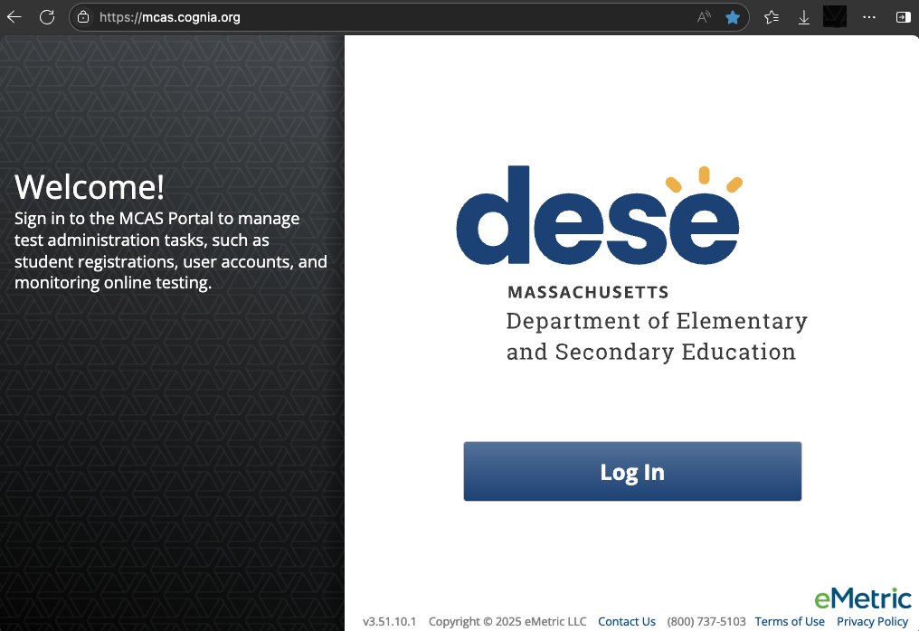
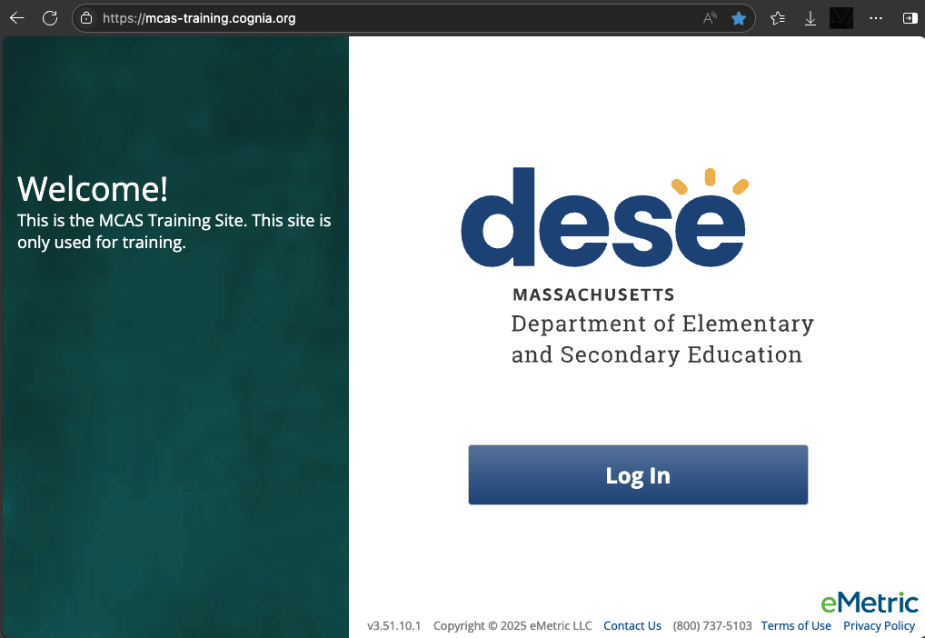
2. Become familiar with CBT components.
MCAS Portal
  Online test management system for principals, test coordinators, technology coordinators, and test administrators
    https://mcas.cognia.org/
MCAS Training Site
  Site where test coordinators, principals, technology coordinators, and test administrators can practice the tasks required in the MCAS Portal
    https://mcas-training.cognia.org/

Slide 29
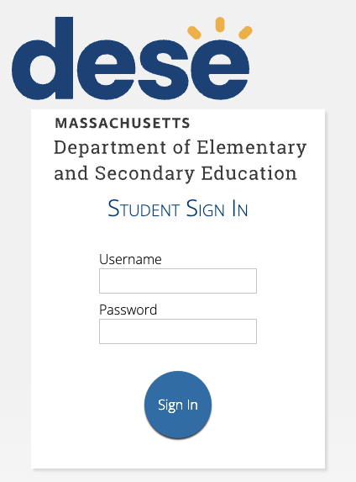
2. Become familiar with CBT components. (cont’d)
MCAS Student Kiosk
  Online testing platform used by students to take the computer-based MCAS assessments
    mcas.onlinehelp.cognia.org/
    technology-setup
Site Readiness
  Task completed by technology coordinators to verify that student devices are ready for testing.

Slide 30
Demonstration
MCAS Portal and MCAS Training Site

Slide 31
MCAS Resource Center
Can be accessed at mcas.onlinehelp.cognia.org
This website provides access to test administration information, training, practice tests, and other resources to help schools and districts prepare for and administer the MCAS tests.
Contains links to download the MCAS Student Kiosk to student devices.

Slide 32
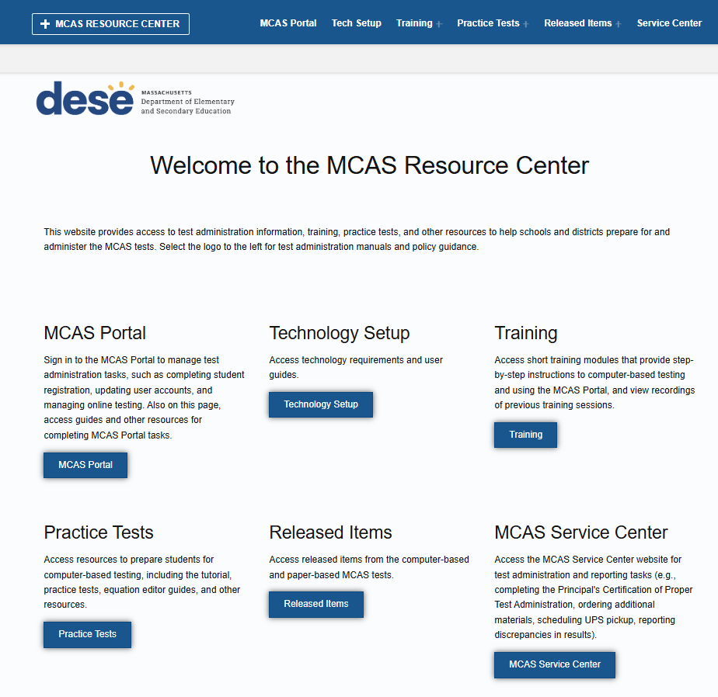
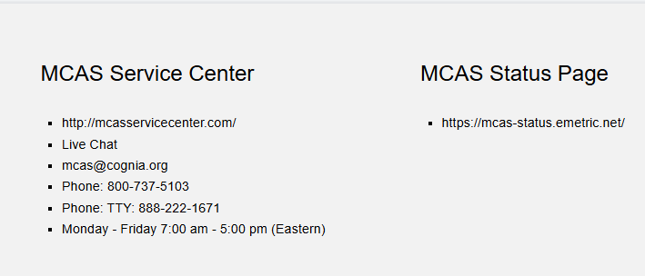
* Link to live chat at the bottom of each page

Slide 33
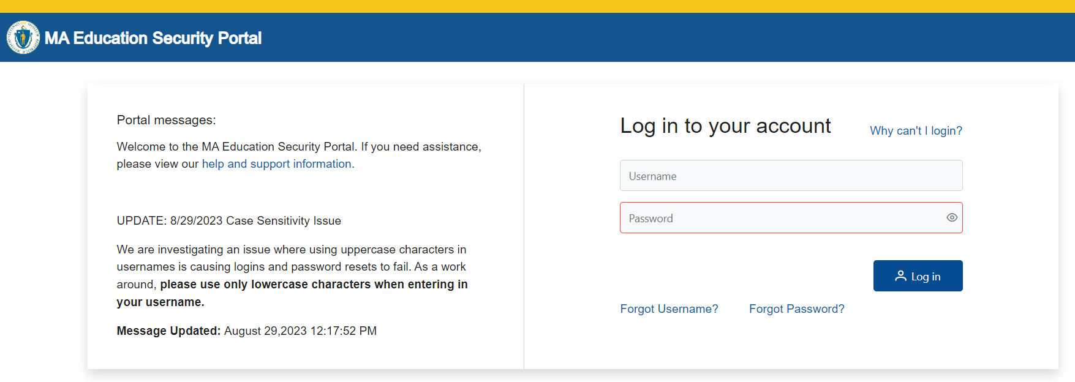
DESE Security Portal
Access Edwin and DropBox Central through the DESE Security Portal
Log in to the Security Portal at https://gateway.edu.state.ma.us/

Slide 34
3. Identify the test administration team and establish a communication plan.
Identify staff members who can help with planning and management of CBT:
  Test coordination
  Accessibility features for all students
  Accommodations for students with disabilities and English learners
  Technology set-up
Determine local responsibilities:
  Who will schedule and manage test sessions?
  Who will configure devices for testing?
  How will information be shared across the team?

Slide 35
3. Identify the test administration team and establish a communication plan. (cont’d)
Principals, MCAS test coordinators, special education directors, and EL program directors automatically receive the Student Assessment Update.
Establish a plan for sharing applicable information from the Student Assessment Update with others as needed.
  How will information be shared across the test administration team?
  Encourage test coordinators and technology coordinators to subscribe.
  Communicate information with educators, IEP teams, guidance counselors, and school-based tech staff as needed.
Consider which resources from the DESE website and MCAS Resource Center would be helpful for technology staff as well as test administrators, and share accordingly.

Slide 36
4. Update contact information with DESE.
DESE uses contact information in School and District Profiles to email the Student Assessment Update and other time-sensitive information.
Review contact information on the School and District Profiles page for:
  MCAS Test Coordinator (district- and school-level; can assign to multiple individuals)
  Educational Technology Director (district-level only)
  Principals
Instructions on Updating Contact Information with DESE
Public school districts, public schools, charter schools, collaboratives, approved special education schools, & alternative education programs | Test sites, adult education programs, out-of-state schools, SEIS-DYS programs
Submit updates to your District-Level Directory Administrator. | Email your updates to ESEDirectoryAdministrator@mass.gov. Be sure to include your 8-digit school code and school name.

Slide 37
5. Confirm your access to the MCAS Portal, and update user accounts.
MCAS Portal: the test administration and management website for district test coordinators, technology coordinators, principals/school test coordinators, test administrators, and other staff as needed
MCAS Training Site: where test coordinators, principals, technology coordinators, and test administrators can practice the tasks required in the MCAS Portal
Accounts for each site are created separately.
Passwords for each site are set separately, but DESE recommends using the same password for both the MCAS Portal and the MCAS Training Site.

Slide 38
5. Confirm your access to the MCAS Portal, and update user accounts. (cont’d)
Principals and school test coordinators should log in to the MCAS Portal to confirm access to the appropriate school(s). District test coordinators should log in to confirm access to the appropriate district(s).
If you are not able to access your MCAS Portal or MCAS Training Site account, are not able to access your school or district, or are new and need an account, users may request support as follows:
Role | Who to contact for support
Test administrators and school-level technology coordinators | Their principal or school test coordinator
Principals, school test coordinators, and district-level technology coordinators | Their district test coordinator
District test coordinators | MCAS Service Center

Slide 39
5. Confirm your access to the MCAS Portal, and update user accounts. (cont’d)
New for 2025: DESE will not create MCAS Portal user accounts. Schools and districts are responsible for adding/updating accounts as needed.
Different roles provide different levels of access in the MCAS Portal. Five roles available:​
  District test coordinator​
  School test coordinator​
  Technology coordinator​
  Test administrator​
  Reports Access Only
Review the MCAS Portal User Management Guide for information on permissions available to each role.​
Schools/districts should be sure to deactivate accounts for any users who will not be participating in MCAS testing in 2025–26.

Slide 40
6. Begin planning for accessibility features (for all students) and accommodations for students with disabilities and English learners.
Review selected accessibility features for all students and accommodations for students with disabilities and ELs.
Include selected features and accommodations in Student Registration.
  Before testing: required for student to receive correct test forms
  After testing: to update features or accommodations used during testing
Resources:
  Accessibility and Accommodations Manual (to be available soon)
  MCAS Student Registration Guide
  Register for the accessibility and accommodations training session (January 2026)
  Approved graphic organizers and supplemental Math & STE reference sheets

Slide 41
Resources: Tasks to Complete in Fall 2025
Task | Resources
(Ongoing) Read biweekly Student Assessment Updates. | https://www.doe.mass.edu/mcas/updates.html
Become familiar with CBT components. | Pre-Administration Guide (not yet available) Guide to the MCAS Portal (updated guide to be posted this fall)
Identify the school test administration team and establish a communication plan. | Pre-Administration Guide (not yet available)

Slide 42
Resources: Tasks to Complete in Fall 2025
Task | Resources
Update contact info with DESE. | Pre-Administration Guide (not yet available)
Confirm your access to the MCAS Portal and update user accounts. | MCAS Portal User Management Guide Modules: (updated modules to be posted this fall) Creating and Editing MCAS Portal User Accounts Uploading & Exporting MCAS Portal User Accounts
Begin planning for accessibility features (for all students) and accommodations for students with disabilities and English learners. | Accessibility and Accommodations Manual (updated manual to be posted this fall)

Slide 43
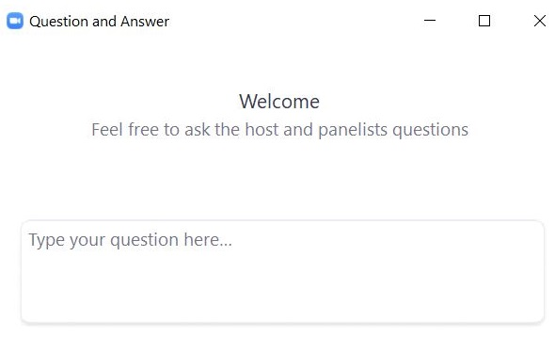
Questions & Answers
Use the “Q&A” feature
to ask questions.

Slide 44
4. Tasks to Complete at least Two Months Before Testing

Slide 45
Timeline for MCAS CBT
Pre-Administration Tasks
Fall 2025
(Ongoing) Read biweekly Student Assessment Updates.
At least 2 months before testing
View online modules and participate in training sessions.
Become familiar with CBT components.
Identify the school test administration team and establish a communication plan.
Update contact info with DESE.
Confirm your access to the MCAS Portal and update user accounts.
Technology Coordinator downloads and installs the updated MCAS Student Kiosk on student testing devices.
Begin planning for accessibility features and accommodations.

Slide 46
7. View online training modules and attend training sessions.
Visit the Training page on the MCAS Resource Center for modules as well as recordings/slides from previous live training sessions.
Modules
  Creating & Editing MCAS Portal User Accounts
  Uploading & Exporting MCAS Portal User Accounts
Previously recorded webinars
  Overview of Student Registration Tasks in the Portal: Spring 2025
  Tasks in the MCAS Portal Before Testing

Slide 47
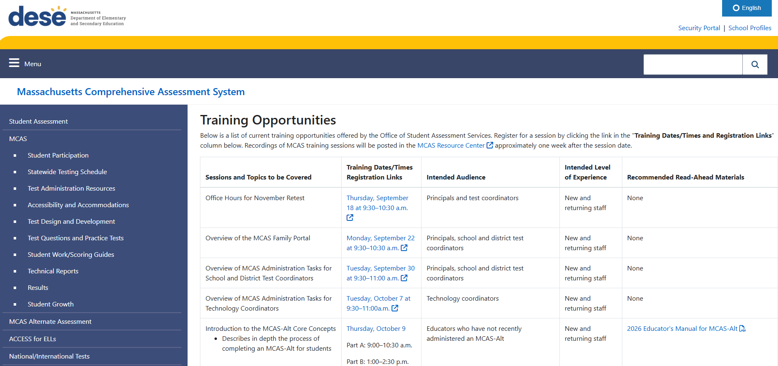
Register for upcoming training sessions at www.doe.mass.edu/mcas/training.html

Slide 48
8. Technology coordinator downloads and installs the updated MCAS Student Kiosk on student testing devices.
Ensure that student devices have been updated with the most recent MCAS Student Kiosk.
It is recommended to download and install the updated MCAS Student Kiosk as soon as it is available in the fall.
Step-by-step instructions are available in the MCAS Student Kiosk Technology Guide.

Slide 49
8. Technology coordinator downloads and installs the updated MCAS Student Kiosk on student testing devices. (cont’d)
New for ChromeOS:
  New App Required: The new PWA (Progressive Web App) must be installed on all ChromeOS devices used for testing.
  Technology teams will have additional steps to complete in order to install and update the MCAS Student Kiosk.
    Step-by-step instructions available in the MCAS Student Kiosk Technology Guide.
  Schools using ChromeOS are recommended to install the updated kiosk and complete Site Readiness as soon as possible this fall to verify that the new app has been installed correctly.

Slide 50
Resources: Tasks to complete at least two months before testing
Task | Resources
View online modules and participate in training sessions. | View modules and previously recorded webinars Register for upcoming trainings
Technology Coordinator downloads and installs the updated MCAS Student Kiosk on student testing devices. | MCAS Student Kiosk Technology Guide

Slide 51
5. Tasks to Complete One to Two Months before Testing

Slide 52
Timeline for MCAS CBT
Pre-Administration Tasks
One to two months before testing
Complete Student Registration in the MCAS Portal.
After Student Registration, through testing window as needed.
Continue to update student information in the MCAS Portal.
Meet with the technology coordinator, who will review the technology guidelines and prepare the school’s technology.
Confirm that the technology coordinator has completed Site Readiness.
Submit and approve enrollment transfer requests as needed.
Administer student tutorial/practice tests.

Slide 53
9. Complete Student Registration
Student Registration registers students for testing and places an initial order for PBT and for manuals.
Student Registration windows for each administration are listed in the Statewide Testing Schedule.
Windows are also typically announced in the Student Assessment Update.
Administration | Student Registration Window
November Retest | September 15–26
February HS Science | December 1–12
Spring Grades 3–8 | January 20–30
Spring Grade 10 | January 26–February 6
Spring HS Science | April 10–28

Slide 54
9. Complete Student Registration (cont’d)
Steps for completing Student Registration include:
  Receiving the .CSV file from DESE in the DropBox in the DESE Security Portal
  Updating the .CSV file
    Add students who were not included in the file and will participate
    Remove students who were included in the file and will not participate
    Update student demographic information as needed (be sure it matches what is in SIMS)
    Update student accommodations as needed
  Importing the .CSV file into the MCAS Portal
Step-by-step instructions are available in the MCAS Student Registration Guide.
Additional resources are available
  Student Registration Data Definitions
  Student Registration Template
  Overview of Student Registration Tasks in the Portal – January 16, 2025
DESE will hold a training demonstrating the Student Registration process in January 2026.

Slide 55
10 & 11. Meet with the technology coordinator, review technology specifications, and prepare the school’s infrastructure. Confirm that Site Readiness is complete.
Meet with the technology coordinator.
Review specifications and resources:
  MCAS Student Kiosk Technology Guide
  Note recent updates to the MCAS Portal and MCAS Student Kiosk
Confirm that the technology coordinator has completed Site Readiness on each device configuration in order to confirm that devices are ready for testing.
  It is recommended to complete Site Readiness directly after the updated MCAS Student Kiosk is downloaded in the fall, and again prior to testing.
  School and district test coordinators may view whether Site Readiness has been certified in the MCAS Portal. See the MCAS Student Kiosk Technology Guide for instructions.

Slide 56
12. Administer the student tutorial and practice tests.
Ensure the curriculum incorporates digital learning; review the DLCS Curriculum Framework
Student Tutorial
  Demonstration of the navigation, tools, and features for CBT
  Students complete it independently (no audio).
Practice tests
  Simulation of the tools and features for CBT
  Include accessibility features and special editions:
    For example, students can gain familiarity with the text-to-speech and other accommodations that are available.

Slide 57
Resources: Tasks to complete one to two months before testing
Task | Resources
Complete Student Registration in the MCAS Portal. | Student Registration Guide Student Registration Data Definitions Student Registration Template
Meet with the technology coordinator, who will review the technology guidelines and prepare the school’s technology. | MCAS Student Kiosk Technology Guide
Confirm that the technology coordinator has completed Site Readiness. | MCAS Student Kiosk Technology Guide Module: (updated modules to be posted this fall) Certifying Site Readiness

Slide 58
6. Tasks to Complete after Student Registration, through the Testing Window as Needed

Slide 59
Timeline for MCAS CBT
Pre-Administration Tasks
One to two months before testing
Complete Student Registration in the MCAS Portal.
After Student Registration, through testing window as needed.
Continue to update student information in the MCAS Portal.
Meet with the technology coordinator, who will review the technology guidelines and prepare the school’s technology.
Confirm that the technology coordinator has completed Site Readiness.
Submit and approve enrollment transfer requests as needed.
Administer student tutorial/practice tests.

Slide 60
13. Continue to update student information in the MCAS Portal as needed.
Schools should continue to update student information in the MCAS Portal, including:
  Adding new students
  Editing demographic information
  Adding or updating accommodations
There are two options for updating student information:
See the MCAS Student Registration Guide for step-by-step instructions.
Options for updating student information | When would you use this option?
Option 1: Student Registration file export and import | When updating a large number of student records
Option 2: Manually add/edit students in the MCAS Portal user interface | When updating approximately 10 or fewer student records

Slide 61
14. Complete Enrollment Transfers as needed.
An enrollment transfer request is needed when a student transfers from one district to another, and the student has already been added to the MCAS Portal.
District test coordinators are able to update student enrollment in the MCAS Portal for students who transfer schools within the same district. An enrollment transfer request is not needed.
See the Enrollment Transfer Guide for step-by-step instructions.

Slide 62
Resources: Tasks to complete after Student Registration
Task | Resources
Continue to update student information in the MCAS Portal. | Student Registration Guide Module: (updated modules to be posted this fall) Manually Adding a Student and Assigning Accommodations
Submit and approve enrollment transfer requests as needed. | Guide to Enrollment Transfers in the MCAS Portal

Slide 63
Questions & Answers
Use the “Q&A” feature
to ask questions.

Slide 64
7. Tasks to Complete at least Two Weeks before Testing

Slide 65
Timeline for MCAS CBT
Pre-Administration Tasks (cont’d)
At least two weeks before testing
Prepare devices and materials.
Two weeks before testing
Create and assign students to classes in the MCAS Portal.
Up to one week before testing
Train test administrators in protocols and security requirements.
Verify assigned accommodations.
If necessary, create TA logins for Human Read-Aloud and Human Signer.
Track delivery of materials through Materials Management in the MCAS Portal.
Print student logins, summary sheets, and TA logins, if needed for Human Read-Aloud and Human Signer sessions.
Review instructions in the Principal’s Administration Manual.
Delivered to schools 2 weeks before spring ELA, and one week before each fall/winter administration
Available online beforehand
Verify form-dependent accommodations.
See Appendix A of the Student Registration Guide.
Schedule classes in the MCAS Portal.

Slide 66
15. Prepare devices and materials.
Plan to have enough devices for test administrators and for students.
  Recommended tool: computer-based testing device planner (updated planner to be posted later this fall)
Ensure all devices will be charged prior to each test session.
Have materials available (and check to see if they are in working order):
  Power cords, power strips, extra batteries, extra computers
  If using tablets: external keyboards
  If students are using text-to-speech: headphones
Schools may request to participate in BYOD (“bring your own device”) program by emailing mcas@mass.gov. More information will be provided in future Student Assessment Updates.

Slide 67
8. Tasks to Complete Two Weeks before Testing

Slide 68
Timeline for MCAS CBT
Pre-Administration Tasks (cont’d)
At least two weeks before testing
Prepare devices and materials.
Two weeks before testing
Create and assign students to classes in the MCAS Portal.
Up to one week before testing
Train test administrators in protocols and security requirements.
Verify assigned accommodations.
If necessary, create TA logins for Human Read-Aloud and Human Signer.
Track delivery of materials through Materials Management in the MCAS Portal.
Print student logins, summary sheets, and TA logins, if needed for Human Read-Aloud and Human Signer sessions.
Review instructions in the Principal’s Administration Manual.
Delivered to schools 2 weeks before spring ELA, and one week before each fall/winter administration
Available online beforehand
Verify form-dependent accommodations.
See Appendix A of the Student Registration Guide.
Schedule classes in the MCAS Portal.

Slide 69
16. Create and assign students to classes in the MCAS Portal.
A class is a group of students in the MCAS Portal who will take the same test together.
  Up to 250 students allowed in a class in the MCAS Portal.
Certain accommodations require that students are placed in a class only with other students that have the same accommodation (Spanish/English, Human Read-Aloud, Human Signer).
Classes can be created using a Student Registration import/export, creating a Class Upload file, or manually one at a time through the MCAS Portal user interface.
Instructions available in the Guide to Creating and Managing Classes.

Slide 70
17. Verify assigned accommodations.
Test coordinators should review accommodations approximately two weeks prior to testing to ensure that they have been assigned correctly.
Prior to scheduling tests, accommodations can be verified:
  On the Edit Student page in the MCAS Portal.
  Through a Student Registration export.
After scheduling tests, accommodations can be verified in additional ways. See slide 79 for more information.
It is very important that accommodations are assigned accurately before students log in to the test.

Slide 71
18. If necessary, create test administrator logins for Human Read-Aloud and Human Signer sessions.
For the human read aloud and human signer accommodations for computer-based testing, schools may choose to have test administrators read the test over the student’s shoulder or create test administrator (TA) logins so that test administrators can log in to their own test on their own device to read aloud.
There are two options for creating a test administrator login in the MCAS Portal.
  Option 1: Manually add a student to the MCAS Portal on the Students page using the field definitions outlined on the next slide.
  Option 2: Add the test administrator login as a student during the Student Registration file upload.
Step-by-step instructions for creating test administrator logins are in the Principal’s Administration Manual and in the Accessibility and Accommodations Manual.

Slide 72
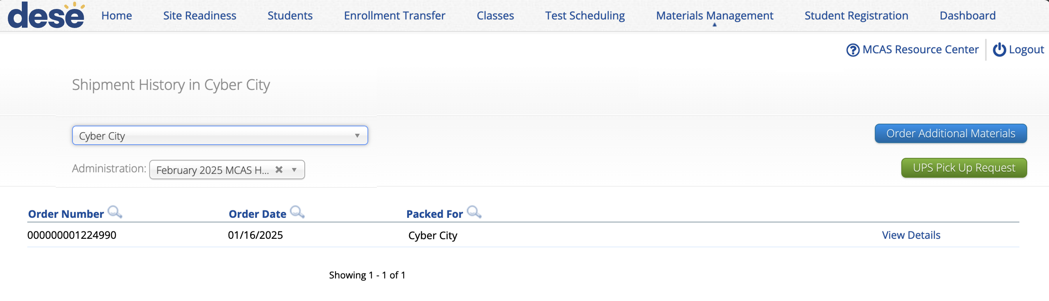
19. Track delivery of materials through Materials Management.
The Materials Management page in the MCAS Portal provides a view of shipments of materials being delivered to schools. Schools will be able to see materials shipments listed on this page once they are shipped.
This is an optional feature that schools may find useful to track shipments.
Additional information is in the Instructions for Using Materials Management.

Slide 73
Resources: Tasks to complete two weeks before testing
Task | Resources
Create and assign students to classes in the MCAS Portal. | Guide to Creating and Managing Classes Module: (updated modules to be posted this fall) Creating Classes for MCAS Creating Classes, Scheduling Tests, and Printing Student Logins
If necessary, create TA logins for Human Read-Aloud and Human Signer. | Accessibility and Accommodations Manual (updated manual to be posted this fall) Principal’s Administration Manual (not yet available)
Track delivery of materials through Materials Management in the MCAS Portal. | Instructions for Using Materials Management in the MCAS Portal (updated guide to be posted this fall)

Slide 74
9. Tasks to Complete up to One Week before Testing

Slide 75
Timeline for MCAS CBT
Pre-Administration Tasks (cont’d)
At least two weeks before testing
Prepare devices and materials.
Two weeks before testing
Create and assign students to classes in the MCAS Portal.
Up to one week before testing
Train test administrators in protocols and security requirements.
Verify assigned accommodations.
If necessary, create TA logins for Human Read-Aloud and Human Signer.
Track delivery of materials through Materials Management in the MCAS Portal.
Print student logins, summary sheets, and TA logins, if needed for Human Read-Aloud and Human Signer sessions.
Review instructions in the Principal’s Administration Manual.
Delivered to schools 2 weeks before spring ELA, and one week before each fall/winter administration
Available online beforehand
Verify form-dependent accommodations.
See Appendix A of the Student Registration Guide.
Schedule classes in the MCAS Portal.

Slide 76
20. Train test administrators in protocols and security requirements.
A sample slide deck is posted to each administration’s Resources webpage prior to the testing window.
See additional instructions in the Principal’s Administration Manual.

Slide 77
21. Schedule classes to take tests in the MCAS Portal.
Schools will need to “schedule” classes for tests to assign test forms and create student logins.
  Student logins cannot be printed until after tests are scheduled.
Test coordinators will need to schedule tests approximately one week prior to test administration.
  Scheduling tests is not available in the MCAS Portal until one week prior to test administration.
  Students taking the Spanish/English edition of a test will need to be scheduled separately for that test.
The Statewide Testing Schedule lists the dates that test scheduling should be completed for each administration.
Instructions available in the Guide to Scheduling Tests and Printing Student Logins.

Slide 78
22. Print student logins, summary sheets, and test administrator logins, if necessary.
Student logins contain the sign-in information that students need to type in to begin each test session.
  Students use the same student login for each subject area test (e.g., Jon Ward has one login for grade 4 ELA sessions 1 and 2, and a different login for grade 4 Mathematics).
Schools may print student logins up to one week in advance; DESE recommends printing student logins one to two days in advance of testing.
  Student logins are considered secure and must be tracked.
Note: Test coordinators may also need to print test administrator logins for test administrators administering the Human Read-Aloud and Human Signer accommodations.
  See instructions in Appendix C of the PAM.
Instructions available in the Guide to Scheduling Tests and Printing Student Logins.

Slide 79
23. Verify form-dependent accommodations.
The following accommodations are particularly important to verify prior to testing because they cannot be changed in the MCAS Portal after a student has signed in to a computer-based test. If a student begins testing and one of these accommodations has been assigned incorrectly, it may result in voiding the student’s test.
After classes have been scheduled, verify that students have been assigned the correct form for the following form-dependent accommodations:
  Spanish/English
  Human Read-Aloud
  Human Signer
To verify these forms have been assigned correctly, navigate to Administration > Test Scheduling > find the scheduled class > View Details/Student Logins.
The Form Name column indicates which form a student has been assigned.
After classes have been scheduled, all accommodations can also be verified on the student summary page that is printed with student logins.
ASL
Screen Reader
Compatible Assistive Technology

Slide 80
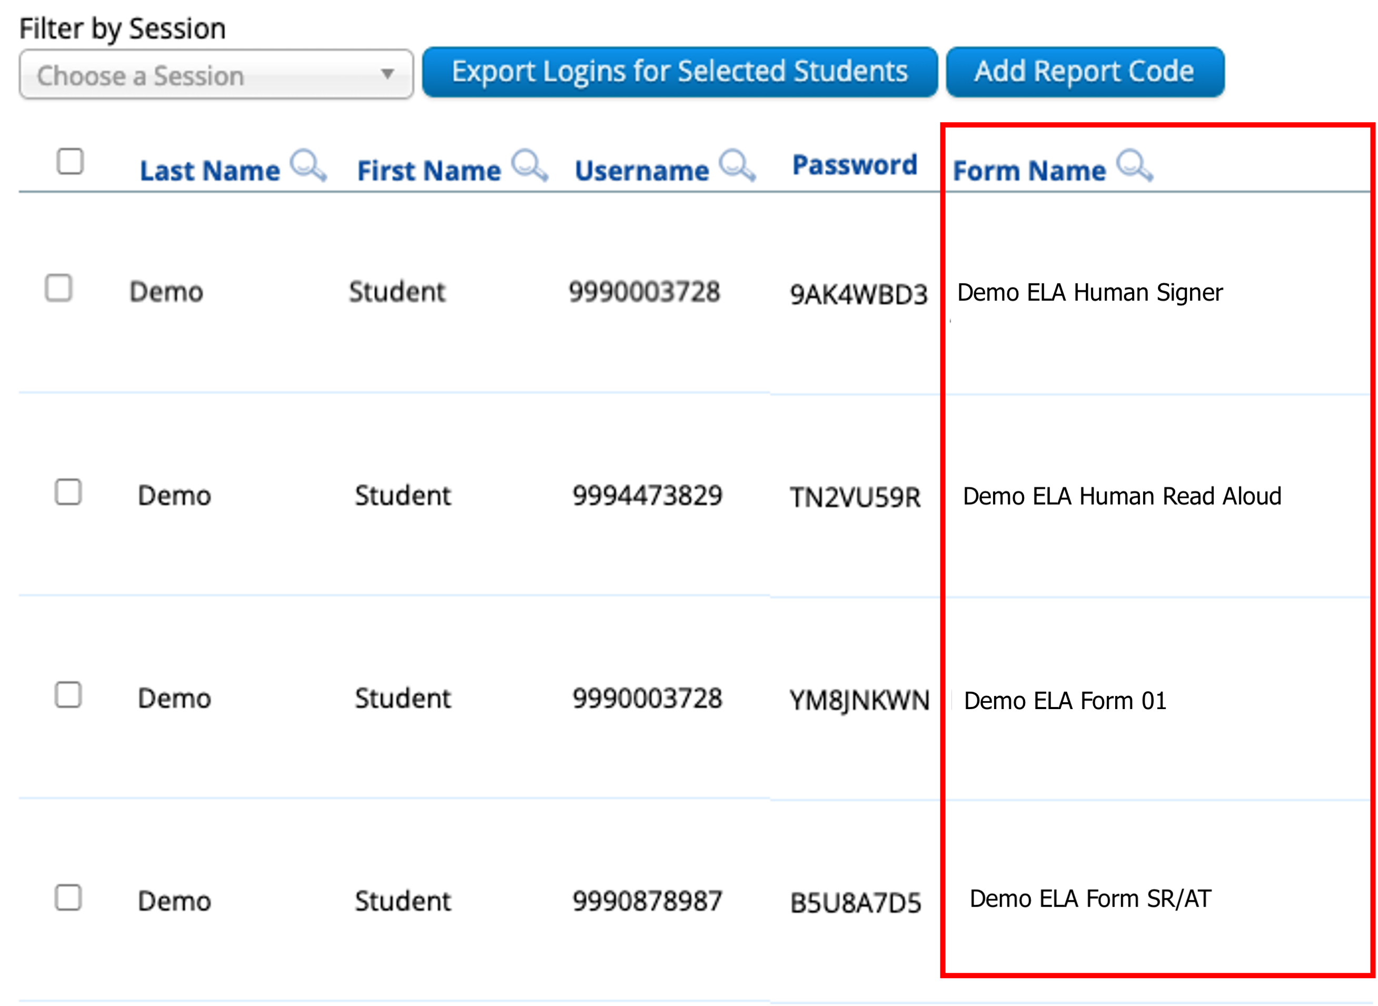
23. Verify form-dependent accommodations. (cont’d)

Slide 81
Resources: Tasks to complete two weeks before testing
Task | Resources
Train test administrators in protocols and security requirements. | Principal’s Administration Manual and Test Administrator’s Manual (not yet available)
Schedule classes in the MCAS Portal. | Guide to Scheduling tests and Printing Student Logins (updated guide to be posted this fall) Modules: (updated modules to be posted this fall) Scheduling Tests Creating Classes, Scheduling Tests, and Printing Student Logins
Print student logins, summary sheets, and TA logins, if needed for Human Read-Aloud and Human Signer sessions. | Guide to Scheduling tests and Printing Student Logins (updated guide to be posted this fall) Modules: (updated modules to be posted this fall) Exporting and Printing Student Logins Creating Classes, Scheduling Tests, and Printing Student Logins
Verify form-dependent accommodations. | Principal’s Administration Manual and Test Administrator’s Manual (not yet available)

Slide 82
Questions & Answers
Use the “Q&A” feature
to ask questions.

Slide 83
10. Resources, Support, and Next Steps

Slide 84
Additional Resources
Resource | Location
MCAS Resource Center | mcas.onlinehelp.cognia.org
MCAS Portal user guides Student Registration Guide | https://mcas.onlinehelp.cognia.org/portal/
Technology Information MCAS Student Kiosk Technology Guide | https://mcas.onlinehelp.cognia.org/technology-setup/
Student Assessment Updates (Biweekly email with important updates about the MCAS program) | www.doe.mass.edu/mcas/updates.html If you do not already receive this email, subscribe using this link: http://eepurl.com/ghSOhH

Slide 85
Upcoming Training – Fall 2025
Training | Date
Overview of MCAS Administration Tasks for Technology Coordinators | Tuesday, October 7 at 9:30–11:00a.m.
Office Hours for February Science Student Registration | Thursday, November 20 at 9:30–10:30 a.m.

Slide 86
Upcoming Trainings – January 2026
Training | Date
Overview of Student Registration | Thursday, January 15
Accessibility and Accommodations | Wednesday, January 21
Office Hours – Accessibility and Accommodations | Thursday, January 22
MCAS Test Administration and Security Protocols for Returning Staff | Tuesday, January 27
Office Hours – Student Registration | Wednesday, January 28
MCAS Test Administration and Security Protocols for New Staff | Thursday, January 29

Slide 87
Upcoming Trainings – February and March 2026
Training | Date
Technology Coordinator Training | Monday, February 2
Tasks in the MCAS Portal Before Testing | Wednesday, March 4
Tasks in the MCAS Portal During and After Testing | Thursday, March 12
Office Hours – MCAS Portal Tasks | Thursday, March 19

Slide 88
Next Steps
Today: Complete the evaluation form.
  Responses are associated with the name and email address used to log in.
  Email your input to mcas@mass.gov if you have problems accessing or completing the form.
Within one week:
  Receive an email with the Q&A from this session
  Recording will be available

Slide 89
Email and Phone Support
MCAS Service Center
DESE Student Assessment Services
Questions on logistics and technology
  Web: https://mcas.onlinehelp.cognia.org/
  Email: mcas@cognia.org
  Phone: 800-737-5103
  TTY: 888-222-1671
  Live chat is available at the link on the bottom of the page at the MCAS Resource Center
Policy questions (e.g., student participation, accommodations)
  Web: www.doe.mass.edu/mcas
  Email: mcas@mass.gov
  Phone: 781-338-3625
  TTY: 800-439-2370

