Slide 1
ELA Grades 3–8 & 10 Math Grades 3–8 & 10 STE Grades 5 & 8 Civics Grade 8 High School Science–Biology & Introductory Physics
Using MCAS Early Release Data
The Office of Student Assessment Services Recorded on June 23, 2025

Slide 2
Presenters
Shannon Cullen, MCAS Test Administration Coordinator
Scott Kelley, Reporting Specialist

Slide 3
Today’s Agenda
What is (and is not) included in the MCAS Early Release?
Demonstration: Opening Your Data & Using the Item Analysis Templates
Early Release, Preliminary Results, & Discrepancy Reporting
Resources & Support

Slide 4
What’s New for 2025?
Scaled Scores and Provisional Achievement Levels in V2 for Certain Grades and Subjects:
ELA and Math (all grades; SGP available early September)
STE grades 5 & 8
Civics grade 8 V1 (first operational year; reporting and practice categories included)
Competency Determination (CD) status not updated after Jan. 31, 2025.
Students no longer participate in high school tests/retests for CD purposes. Details in the CD Update FAQ.

Slide 5
What’s New for 2025? (cont’d)
MCAS Resource Center
Early data in MCAS Portal (replaces PearsonAccess Next)
Outplaced students are included in the district .CSV file.
Reporting Category Updates
Reporting categories (RepCat1, RepCat2, etc.) in .CSV files now in alphabetical order
See Item Analysis Template for all reporting categories.

Slide 6
1. What is (and is not) included in the MCAS Early Release?

Slide 7
Early Release Data in the MCAS Portal
.CSV data file versions
V1 Computer-Based Test (CBT) machine-scored items, short answer Math
V2 CBT and Paper-Based Test (PBT) all items
Item score; total score; total possible; percent possible points blank = no response; “–” = item not yet scored (V1)
Reporting Category results
Accommodations and accessibility features
Participation status not yet available
Tested (T), Absent (ABS), Medically documented absent (MED), Transfer (TRN), not tested first-year EL (NTL) and others updated in August preliminary file in DropBoxes

Slide 8
Early Release Data in the MCAS Portal (cont’d)
PDF Student Roster (school level only):
Item score, total points, void, not tested medical, scaled score, and provisional achievement level (certain V2 results)
Duplicate records will be resolved in August preliminary file.
ELA Released Essays
Grades 3–8 approximately 50%
High school 100%

Slide 9
Comparison Between Machine-Scored & Hand-Scored Items
Subject/ Grade | Machine-Scored Items |  |  |  | Hand-Scored Items |  |  |  | Raw Score
 | CBT V1 |  |  |  | CBT/PBT V2
ELA Grades | One-Point Selected Response (SR) | Two-point SR | Machine- Scored Points | Percent Machine- Scored | Constructed Response (CR) | Essays | Hand-Scored Points | Percent Hand- Scored | Total Points
3–4 | 24 | 5 | 34 | 77% | 1 (3 pts.) | 1 (7 pts.) | 10 | 23% | 44
5 | 24 | 5 | 34 | 71% | 0 | 2 (7 pts.) | 14 | 29% | 48
6–8 | 24 | 5 | 34 | 68% | 0 | 2 (8 pts.) | 16 | 32% | 50
10 | 21 | 6 | 33 | 67% | 0 | 2 (8 pts.) | 16 | 33% | 49

Slide 10
Comparison Between Machine-Scored & Hand-Scored Items (cont’d)

Slide 11
Using Early MCAS Results
During Data Embargo
Use results for educational planning purposes within the school and district.
Do not share results outside your organization.

Slide 12
Using Early MCAS Results (cont’d)
Identify potential discrepancies.
Report missing tests to the MCAS Service Center.
Retain potential discrepancies (incorrect SASID, accommodations, medically documented absence, first-year EL, transfer) until discrepancy reporting period (August 6–11).
Identify demographic mismatches.
Report any student name changes or discrepancies to your District SIMS Contact for resolution prior to end-of-year (June) SIMS.
Use People Search to locate your District SIMS Contact on School and District Profiles.
Note that records in the MCAS Portal cannot be updated.

Slide 13
2. Demonstration: Opening Your Data & Using the Item Analysis Templates

Slide 14
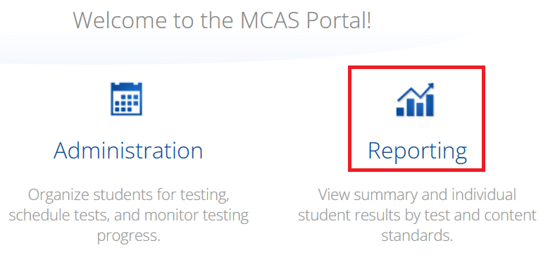
Secure Website for this Process
MCAS Portal
If you do not have a Portal account, contact your school or district test coordinator.
Call MCAS Service Center (800-737-5103) if you still cannot access the Portal.

Slide 15
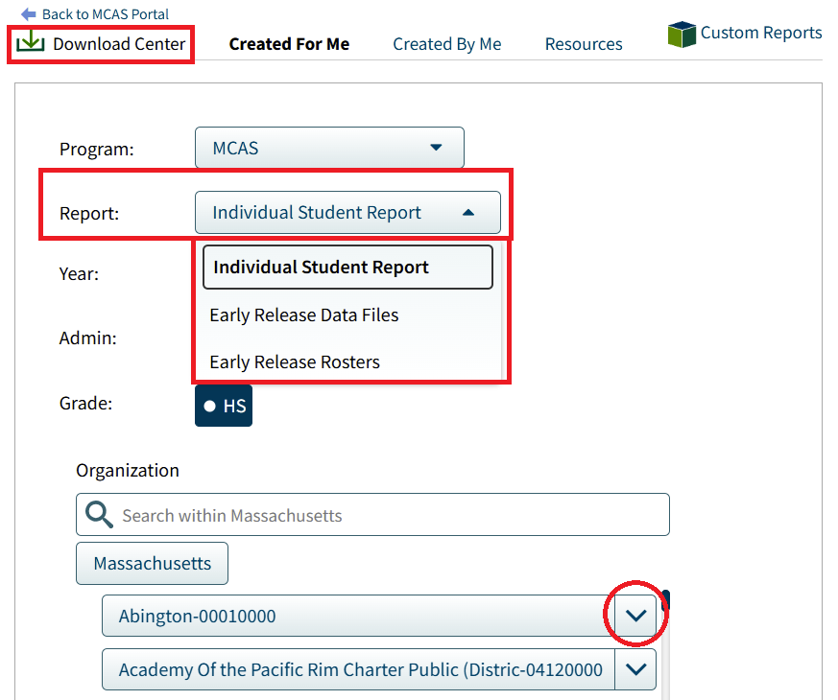
Secure Website for this Process (cont’d)
Report Selection in the Download Center
Select the Report drop-down for .CSV data files and PDF student rosters
Organization drop-down has a list of schools.
Data files available at the school and district levels; rosters available only at the school level.
Available to users with the following roles:
School or district test coordinator
Report Access Only
Test coordinators can assign the appropriate role to other users in their organization. Call the MCAS Service Center for assistance.

Slide 16
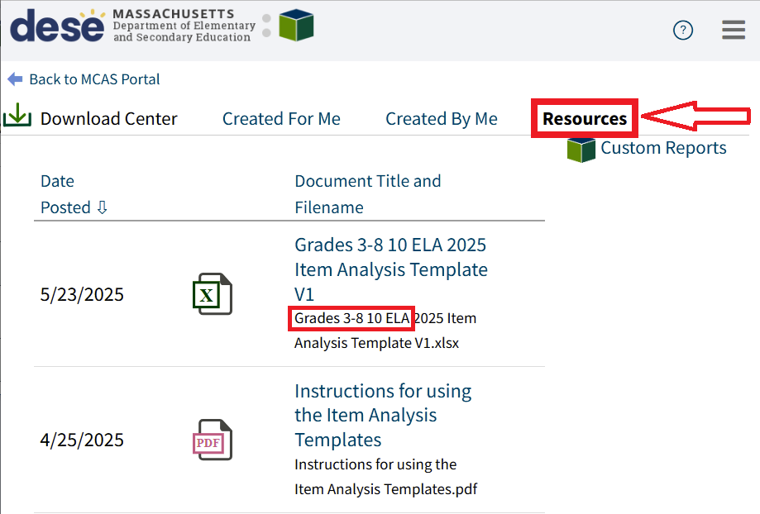
Item Analysis Template and Instructions
MCAS Portal Resources Tab
Item analysis templates are pre-populated with state item results.
Step-by-step Instructions for Using the Item Analysis Templates

Slide 17
Using the Item Analysis Template (Replicates Edwin Analytics Report IT301)
Copy average item school/district scores from the .CSV file to the template.
Use Reporting Category, Framework, Item Type filters to generate different line-graphs of the data.

Slide 18
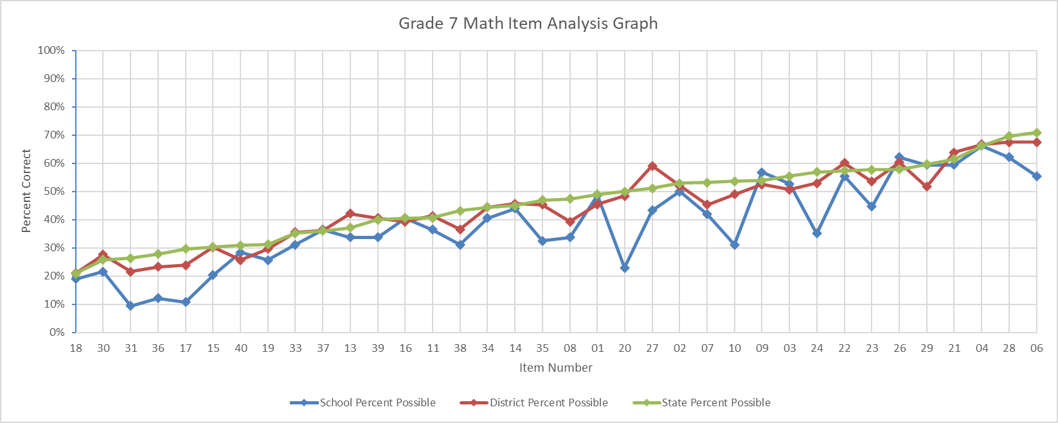
Using the Item Analysis Template (Replicates Edwin Analytics Report IT302)

Slide 19
Student PDF Roster in Download Center
Records sorted alphabetically within grade
Student counts within grade

Slide 20
Recap of Steps for Loading Data into Templates
Download your .CSV file from MCAS Portal
Insert blank rows at the top; note the last row of data in the file
Enter the subtotal formula in .CSV file: =Subtotal(1, cell range*) in a blank cell above the Item number.
Copy the subtotal formula to the row above the remaining items.
For V2, also copy the subtotal formula to the RepCat† cells.
Set filters to remove void and not tested records; use the school filter if you are a district user; set test code filter (e.g., MAT05).
Copy item subtotals from the .CSV file to the template using “Paste Special” with “values” and “transpose” selected.
Save the file as a spreadsheet (XLSX format) to preserve formulas.
*Cell Range is all records; †See Reporting Categories tab in templates for details

Slide 21
3. Early Release, Preliminary Results, & Discrepancy Reporting

Slide 22
Early Release Data Considerations
Results have not been filtered; all students who attempted at least one item are included.
The following data are included in early release files, but results will not be aggregated with school/district for official reporting:
First-year ELs (validation file in DropBoxes in mid/late August)
Void/medical absence
Partially tested (didn’t attempt at least one item in each session)
Test status codes (absent, medical, security breach, transfer) and typed response accommodation (PBT only) will appear in the preliminary file in August (MCAS 2025 DropBoxes).

Slide 23
Preliminary Results
Date | Preliminary Results | Location
Early August | Grades 3–8, 10 ELA/Math; Grades 5 & 8 STE; Civics; high school science (scaled scores and achievement levels for all except Civics) | MCAS 2025 DropBoxes in the DESE Security Portal
Mid-August | Grades 3–8 10 ELA/Math; Grades 5 & 8 STE; Civics; high school science (scaled scores and achievement levels for all except Civics) | Edwin Analytics in the DESE Security Portal
Mid-September | SGP & official embargoed results (includes Civics) | MCAS 2025 DropBoxes in the DESE Security Portal

Slide 24
Discrepancy Reporting
Date | Discrepancy Reporting Period | Location
Early August | Examine student rosters and data files for potential discrepancies (missing results; incorrect SASID; incorrect participation status). Details forthcoming in Student Assessment Update | MCAS Service Center (passwords in MCAS 2025 DropBoxes in the DESE Security Portal)

Slide 25
4. Resources & Support

Slide 26
Resources
Resource | Location
MCAS Resource Center | mcas.onlinehelp.cognia.org
MCAS Portal, Portal Guide, User Guide | mcas.onlinehelp.cognia.org/portal
Modules and recordings of previous trainings | mcas.onlinehelp.cognia.org/training
Released item information and student work (posted as available) | mcas.onlinehelp.cognia.org/released-items
Student Assessment Updates (Biweekly email with important updates about the MCAS program) | www.doe.mass.edu/mcas/updates.html Subscribe using this link: http://eepurl.com/ghSOhH

Slide 27
Email and Phone Support
MCAS Service Center
DESE Student Assessment Services
Questions on logistics and technology
Web: https://mcas.onlinehelp.cognia.org/
Email: mcas@cognia.org
Phone: 800-737-5103
TTY: 888-222-1671
Live chat is available at the link on the bottom of the page at the MCAS Resource Center
Policy questions (e.g., student participation, accommodations)
Web: www.doe.mass.edu/mcas
Email: mcas@mass.gov
Phone: 781-338-3625
TTY: 800-439-2370

Slide 28
THANK YOU
The Office of Student Assessment Services
781-338-3625
mcas@mass.gov
www.doe.mass.edu/mcas
135 Santilli Highway, Everett, MA 02149

