Slide 1
Tasks in the MCAS Portal During and After Testing
The Office of Student Assessment Services
March 5, 2025

Slide 2
Presenters
Jodie Zalk, Manager of Test Administration and Publications
Shannon Cullen, MCAS Test Administration Coordinator
Abbie Currier, eMetric Sr. Project Manager

Slide 3
Logistics for This Session
Use the Q&A feature to ask a question.
We will answer some questions aloud at specified times during this training session, and we will email the Q&A afterwards.
Type your questions anytime, but we may not answer them in real time as some questions may be covered during the presentation.
Use the thumbs-up icon to “upvote” someone else’s question.
Email student-specific questions to mcas@mass.gov instead of asking here.
This session is being recorded and will be available in about a week in the MCAS Resource Center, along with the slides.
Closed captioning has been enabled for participants who need it.
Please be advised that DESE does not authorize attendees to record or to use AI transcription tools during the meeting and DESE does not endorse any unauthorized transcripts created by third parties of its meetings.

Slide 4
Slides for This Session
Slides were emailed to participants before this session from MCASEvents@cognia.org.
Slides are now being posted in the chat.
If you cannot access the slides in the chat, ask in the Q&A.
After the session, we will send the slides again to participants, and they will be posted in the MCAS Resource Center along with the recording.

Slide 5
Today’s Agenda
Timeline of Tasks in the MCAS Portal
Monitoring Student Testing
Resolving Incorrect Accommodations
Make-Up Testing Procedures
Additional Tasks During Testing
Tasks After All Testing Is Completed
Test Administrator Tasks During and After Testing
Resources, Support, and Next Steps
Live “Sandbox” Time with Additional Demonstrations

Slide 6
Poll Question—3
What is your role? (Check all that apply)
District test coordinator
School test coordinator
Principal
Guidance counselor
Technology staff
Other district staff
Other school staff

Slide 7
Poll Question—3
How many years have you coordinated MCAS test administration?
0–This is my first year.
1 year
2–3 years
4–5 years
6+ years

Slide 8
1. Timeline of Tasks in the MCAS Portal

Slide 9
Timeline of Tasks in the MCAS Portal to Complete Before Testing for Principals/Test Coordinators
2 weeks before testing
●Create and assign students to classes
●Verify accommodations in the MCAS Portal
●Create test administrator logins if necessary (for certain accom.)
●Track delivery of materials through Materials Management
Up to one week before testing
●Schedule classes to tests
●Print student logins and summary sheets
Now
●Continue to update student registration information
●Enrollment Transfer Requests (as needed)

Slide 10
Timeline of Tasks in the MCAS Portal to Complete During and After Testing for Principals/Test Coordinators
During Testing
●Resolve incorrect accommodations
●Manage make-up testing
●Void tests as needed
●Unlock locked test questions (in certain circumstances)
After Testing
●Fill in Report codes as needed
●Void tests as needed
Test Day
●Distribute student logins and summary sheets to test administrators
●Monitor student testing status in the MCAS Portal

Slide 11
Timeline of Tasks in the MCAS Portal to Complete Before and During Testing for Test Administrators
Up to 2 days before testing
Test Day
●Verify accommodations
●Distribute student logins to students
●Provide session access codes to students
●Enter proctor password as needed
●Monitor student testing status in the MCAS Portal
●Assist with testing issues as needed

Slide 12
Timeline of Tasks to Complete for Technology Coordinators
Winter 2025
●Review Appendix A of the PAM
●Check the updated technology guidelines to verify that devices meet technology requirements
●Install updated kiosks if needed
●Verify access to MCAS Portal and MCAS Training Site
During Testing
●Troubleshoot issues as they arise
●Contact the MCAS Service Center with technology questions
Fall 2024
●Verify that devices meet the technology requirements
●Add provided URLs to exempt lists
●Download and install the MCAS Student Kiosk
●Conduct Site Readiness
Additional information was shared in the MCAS Tasks for Technology Coordinators training session from February 28.

Slide 13
2. Monitoring Student Testing

Slide 14
Monitoring Student Testing in the MCAS Portal
Test coordinators can monitor student testing status in the following ways in the MCAS Portal:
Viewing test session details from the Test Scheduling page
Exporting reports from the Test Scheduling page
Viewing the dashboards on the Dashboard page

Slide 15
Exports in the MCAS Portal
Schools may find the following reports useful in tracking preparation and completion of testing.
Export Test Status: a .CSV file listing every student and their completion status per session of the selected school and test.
Export Test Status for All Tests: a .CSV file listing every student and their completion status per session for all tests in the selected district/school, program, and content area.
Export Students Not Scheduled: a .CSV file listing every student not scheduled for the selected school and test. (Only available at the school level).

Slide 16
Demonstration
Monitoring test status on the Test Scheduling page
Exports on the Test Scheduling page

Slide 17
Monitoring Tests
Log in to the MCAS Portal and click Administration.
Select the Test Scheduling page.
Select the school, content area, program (grades 3–8 or high school), and test name.
Locate the test session you wish to monitor and click View Details/Student Logins.

Slide 18
Exports on the Test Scheduling Page
Log in to the MCAS Portal.
Select Administration.
Select Test Scheduling.
Use the drop-down menus (Organization, Program, Subject, and Test Name) to filter for the scheduled test.
Select Exports, and select the export from the drop-down menu.

Slide 19
MCAS Portal Dashboards
A new dashboard is available for test coordinators to monitor overall testing progress through the testing window.
After logging in to the MCAS Portal, select Administration and select Dashboard in the top menu.

Slide 20
MCAS Portal Dashboards (continued)
A series of graphs and reports are available to district test coordinators, school test coordinators, and technology coordinators.
A new guide will be posted to the MCAS Resource Center soon.

Slide 21
Demonstration
Using the MCAS Portal dashboard

Slide 22
MCAS Portal Dashboards
Report | Details | Updated
Real Time Metrics | Displays a line graph of the number of students actively testing by hour for the program and organization selected. | Every 2 minutes
Testing Activity by Hour | Displays three charts: Tests Started by Hour, Tests Completed by Hour, and Tests Paused by Hour for the program, organization, and date selected | Hourly
Testing Activity by Day | Displays a chart of the Tests Started and Completed by Day for the program, organization, and date selected | Hourly
Test Summary | Displays two charts: Tests Scheduled and Completed and the Percent of Tests Completed for the program and organization selected | Hourly
Field Stats | Displays an Operating Systems Summary and Site Readiness Information for the program and organization selected. | Hourly
Portal Activity | Portal Activity will display the Number of Portal Users by Day for the selected organization and by date | Hourly

Slide 23
Resources
Additional Tasks on the Test Scheduling Page of the MCAS Portal: Adding Report Codes, Reactivating Tests, and Exports

Slide 24
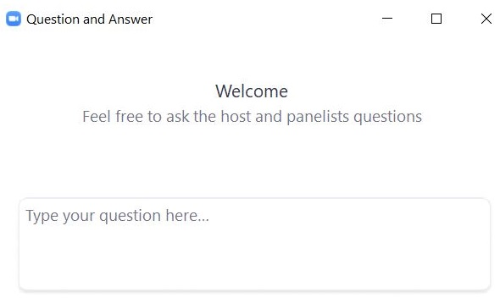
Questions and Answers
Use the “Q&A” feature to ask questions.

Slide 25
3. Resolving Incorrect Accommodations

Slide 26
Resolving Incorrect Accommodations
Test coordinators and test administrators are encouraged to review accommodations prior to testing in order to avoid situations in which a student begins a test with the incorrect accommodations.
If a test administrator or test coordinator finds that an accommodation was assigned incorrectly, there are different instructions to follow based on:
Whether the accommodation is a form-dependent accommodation (human read aloud, human signer, ASL, Spanish/English, screen reader/compatible assistive technology [AT])
Whether the student has signed in to the test

Slide 27
Resolving Incorrect Accommodations (cont’d)
Scenario | Resolution if the student has not logged in to the test | Resolution if the student has logged in to the test
Student is assigned an accommodation they should not have or student is missing an accommodation they should have and the accommodation is form dependent (human read aloud, human signer, ASL, Spanish/English, screen reader/compatible AT). | Edit the student’s incorrect accommodation(s). Return to the test session details page and click the “Add/update student(s)” button. Print the student’s new login. | Have the student log out of the test completely. Edit the student’s incorrect accommodation(s). Add the Void report code for the test session the student already logged into. Add the student to a new class. Schedule the new class to take the test and print the student’s new login.
Student is assigned an accommodation they should not have or student is missing an accommodation they should have and the accommodation is not form dependent. | Edit the student’s incorrect accommodation(s). Reprint the student’s login (if you want the summary sheet updated with the correct accommodation[s]). | Have the student log out of the test completely. Edit the student’s incorrect accommodation(s). Have the student log back in to the test and resume testing.

Slide 28
Demonstration
Resolving incorrect form-dependent accommodations
Before a student logs in
After a student logs in

Slide 29
Resolving Incorrect Form-Dependent Accommodations: Before a Student Logs In
Step 1: Edit the student’s incorrect accommodation(s).
Log in to the MCAS Portal and click Administration.
Click Students in the top menu.
Locate the student you wish to edit and click Edit.
Update the accommodation for the student and click Save.

Slide 30
Resolving Incorrect Form-Dependent Accommodations: Before a Student Logs In
Step 2: Return to the test session details page and click the “Add/update student(s)” button.
Click Test Scheduling in the top menu.
Select the correct school, content area, program (grades 3-8 or high school), and test name.
Locate the test session you wish to update and click View Details/Student Logins.
Click Add or Update Students.

Slide 31
Resolving Incorrect Form-Dependent Accommodations: Before a Student Logs In
Step 3: Print the student’s new login.
Select the checkbox next to the student with the updated accommodation.
Click Export Logins for Selected Students.
Select PDF or CSV.
Click Export.

Slide 32
Resolving Incorrect Form-Dependent Accommodations: After a Student Logs In
Step 1: Have the student log out of the MCAS Student Kiosk completely.
Step 2: Edit the student’s incorrect accommodation(s).
Log in to the MCAS Portal and click Administration.
Click Students in the top menu.
Locate the student you wish to edit and click Edit.
Update the accommodation for the student and click Save.

Slide 33
Resolving Incorrect Form-Dependent Accommodations: After a Student Logs In
Step 3: Add the Void report code for the test session the student already logged into.
Click Test Scheduling in the top menu.
Select the correct school, content area, program (grades 3–8 or high school), and test name.
Locate the class you wish to update and click View Details/Student Logins.
Locate the student with the incorrect accommodation. Click the + button to add a void report code for that test.
Select Void (wrong accommodation) and click Save.
Note: The student’s test will remain In Progress.

Slide 34
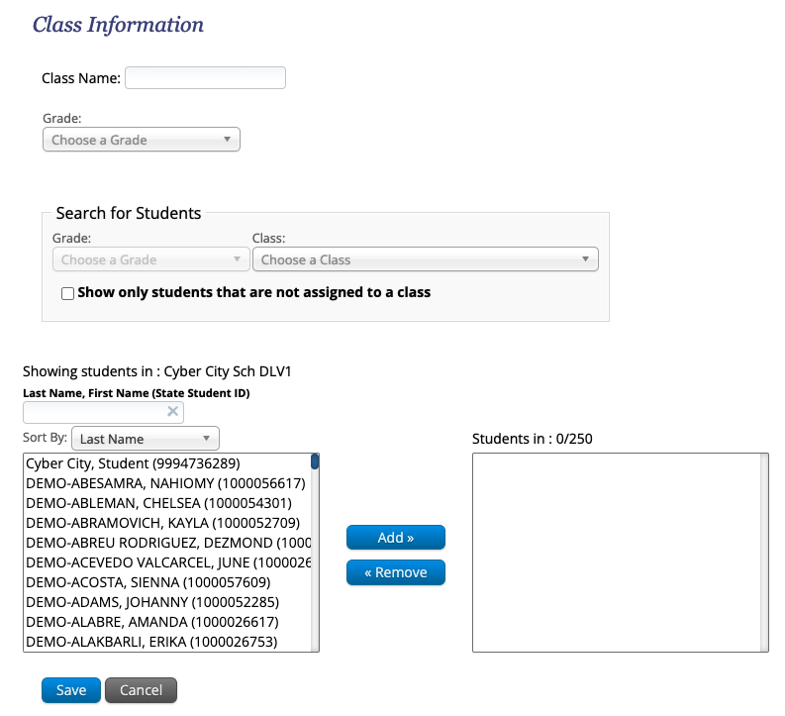
Resolving Incorrect Form-Dependent Accommodations: After a Student Logs In
Step 4: Add the student to a new class.
Click Classes in the top menu.
Select an organization from the organization drop-down list, and then select a subject from the subject drop-down list.
Select Create Grade Level Class.
Type the name of the class in the Class Name field.
Select a grade from the Choose a Grade drop-down list.
Unselect the checkbox for “Show only students that are not assigned to a class” so that you can locate the student you need to add to the class.
Select the student and click Add.
Click Save.

Slide 35
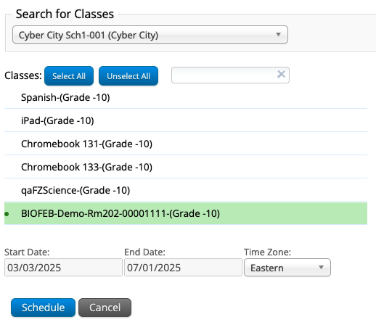
Resolving Incorrect Form-Dependent Accommodations: After a Student Logs In
Step 5: Schedule the new class to take the test and print the student’s new login.
Select Test Scheduling in the top menu.
Select the correct school, content area (civics, ELA, mathematics, or science), program (grades 3–8 or high school), and test name.
Select Schedule New Test.
Select the name of the class just created and click Schedule.

Slide 36
Questions and Answers
Use the “Q&A” feature to ask questions.

Slide 37
4. Make-Up Testing Procedures

Slide 38
Logistics for Make-Up Testing
Students who are absent on the day of testing should be scheduled to make up the session.
All make-up testing must be completed within the windows listed in the Statewide Testing Schedule.
If students have started testing, schools must leave students in their original classes.
Moving students between classes after they have started testing would create duplicate student records that must be removed.
Note: this is different than in previous years.
If a student has not started testing, the school may choose to move the student to a new make-up class.

Slide 39
Moving Students Between Classes
Students should ONLY be moved between classes if they will be testing in a different group than the one originally assigned and they have not started testing.
Students who are moved to a new class will need a new student login.
Only principals/test coordinators and technology coordinators are able to move students between classes; test administrators do not have this permission in the MCAS Portal.

Slide 40
Demonstration
Moving a student between classes

Slide 41
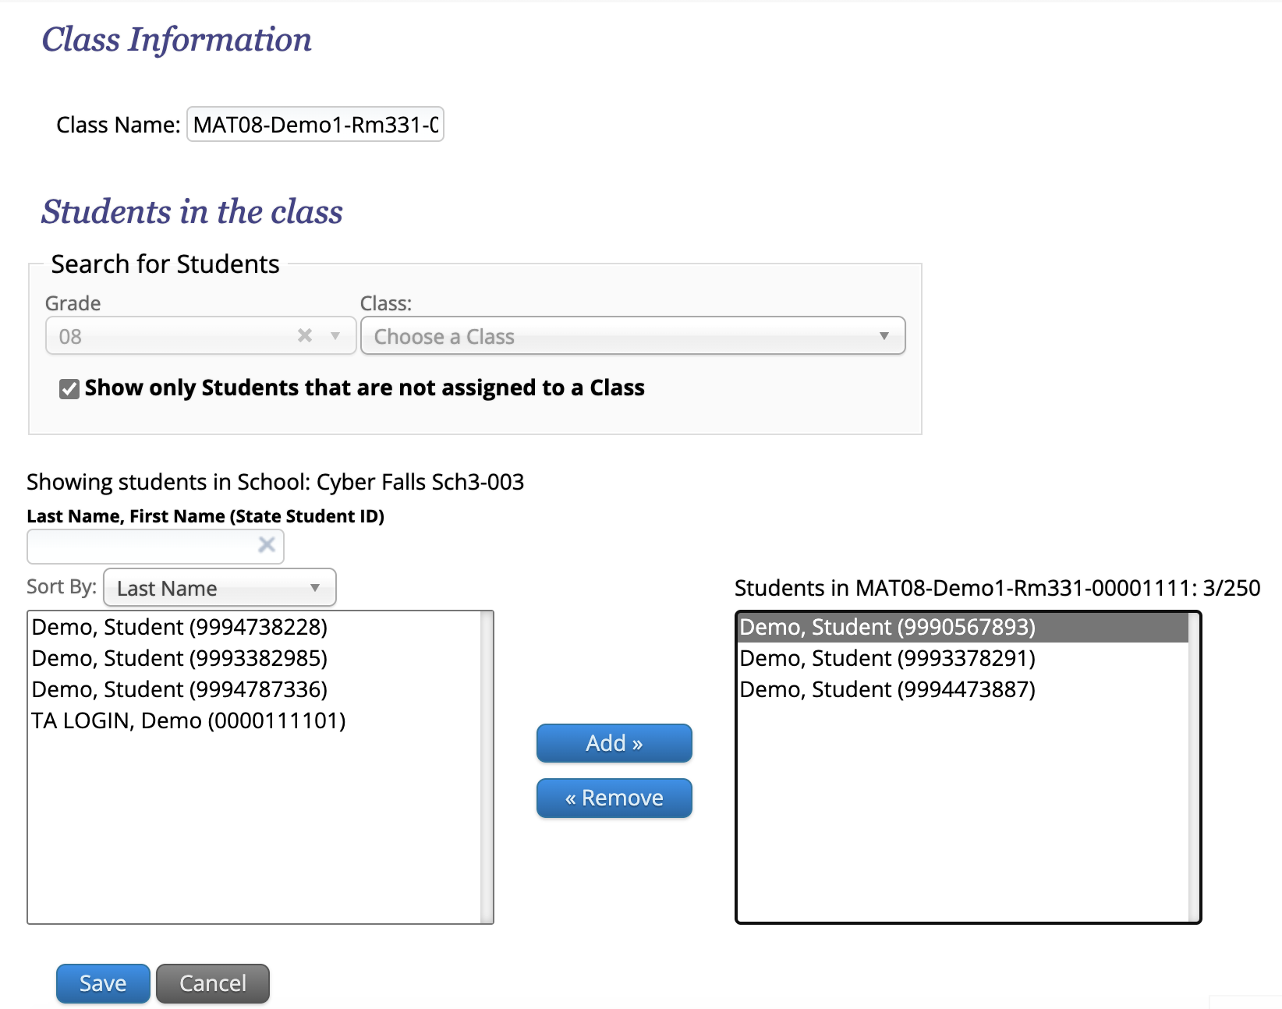
Before Testing Only: Remove the Student from the Original Class
Log in to the MCAS Portal and click Administration.
Click Classes in the top menu.
Select an organization and subject.
Locate the class the student is currently assigned to.
Click Edit.
Select the student name in the list on the right.
Click Remove.
Click Save.

Slide 42
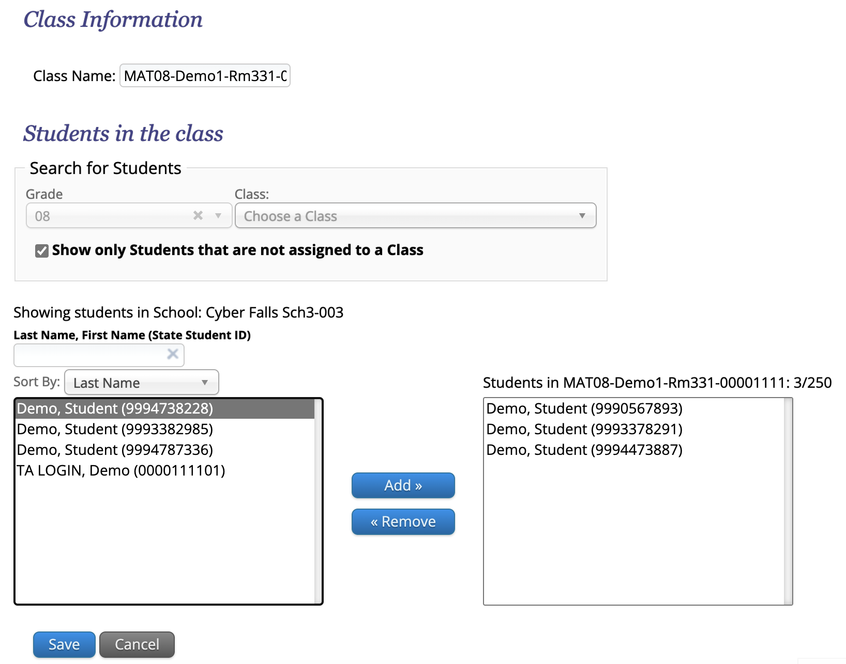
Adding a Student to an Existing Class
Log in to the MCAS Portal and select Administration.
Click Classes in the top menu.
Select an organization and subject.
Locate the class the student should be added to.
Click Edit.
Select the student name in the list on the left.
You may need to uncheck the option “Show only students that are not assigned to a Class"
Click Add.
Click Save.

Slide 43
5. Additional Tasks During Testing

Slide 44
Additional Tasks During Testing
School and district test coordinators may need to complete the following tasks during testing:
Access the proctor password
Change the proctor password
Unlock locked test questions
Unlock test sections for grades 5 and 8 STE and grade 8 Civics
District test coordinators may also need to reactivate student tests during testing.

Slide 45
What is a proctor password and when is it needed?
A proctor password is an extra security measure that is required in any of the following situations:
A student is idle in the test for more than 60 minutes. A student is “idle” if they do not interact in any way with the kiosk. This includes the use of any accommodation or tool, navigating through the test, or interacting with any of the on-screen widgets and answer choices.
A student pauses or exits the test and attempts to log back in to the test after more than 60 minutes have passed.
The MCAS Student Kiosk has experienced an abrupt closure, such as a loss of power, or the device is turned off while testing.
The proctor password will always be required on the Options page for students with the accommodation “Compatible Assistive Technology.”
The proctor password is available to test coordinators and administrators in the MCAS Portal.

Slide 46
Updating the Proctor Password
The proctor password is the same for the whole school and is reset nightly.
If individuals or a small group of students need to enter the proctor password, the test administrator should type it in for each student.
If a larger group (such as a whole class) needs to enter the proctor password, then it can be read aloud or written on the board.
If the proctor password is given to a large group of students, it should subsequently be changed in the MCAS Portal by the principal or test coordinator.

Slide 47
Demonstration
Viewing the proctor password
Changing the proctor password

Slide 48
Proctor Password
To view the proctor password:
Log in to the MCAS Portal and select Administration.
Scroll to the bottom of the home page.
Locate the proctor password for the school.
To change the proctor password:
Log in to the MCAS Portal and select Administration.
Scroll to the bottom of the home page.
Locate the proctor password for the school and click Change.
Note: The proctor passwords are automatically updated nightly.

Slide 49
Unlocking Student Test Questions
In certain circumstances, a student may need to re-enter a test in the MCAS Student Kiosk.
In some cases, questions that a student has previously answered will be automatically locked when the student signs back in. The student will not be able to return to those questions unless they are unlocked by a school or district test coordinator.

Slide 50
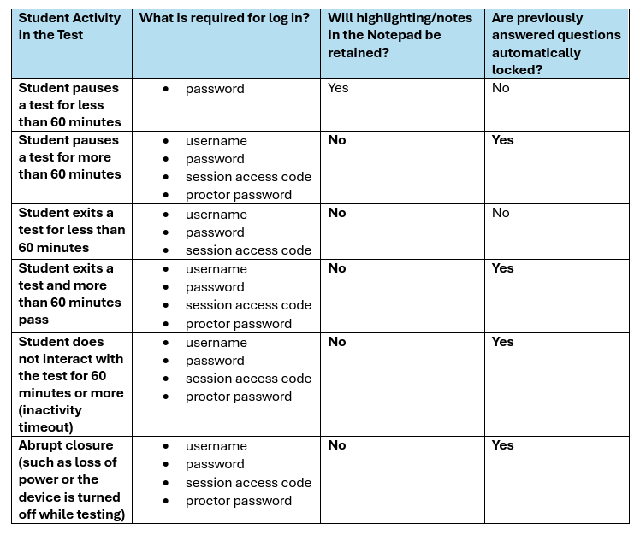
When will test questions lock?

Slide 51
Reactivating Student Test Sessions
If a student accidentally submits their test prior to finishing, district test coordinators are able to reactivate the test to allow the student to sign back in.
Only users with the district test coordinator role have this ability in the MCAS Portal.
Schools should contact their district test coordinator who can reactivate the test with the following steps.

Slide 52
Section Unlocking – Grade 5 STE and Grade 8 Civics and STE
Within the Grade 5 STE, and Grade 8 Civics and STE tests, there are two sessions (Session 1 and Session 2 for STE, the State-Level Performance Task and the End-of-Course (EOC) for Civics).
Within each session, there are two sections. Once a student has completed the first section, they will not be able to return to it.
The student will see a message at the end of the section:
If a student accidentally continues past the section but did not actually finish it, the test coordinator or test administrator may unlock the student's section.

Slide 53
Demonstration
Unlocking locked questions
Reactivating test sessions
Unlock a test section for grades 5 and 8 STE and grade 8 Civics

Slide 54
Unlocking Locked Questions
The student will log in to the test again.
The test coordinator will unlock the test session.
Log in to the MCAS Portal and click Administration.
Click Test Scheduling.
Select the school, content area, program (grades 3–8 or high school), and test.
Locate the student’s class and click View Details/Student Logins.
Locate the student and click Unlock.

Slide 55
Reactivating Test Sessions
Log in to the MCAS Portal and click Administration.
Click Test Scheduling.
Select the school, content area, program (grades 3–8 or high school), and test.
Locate the student’s class and click View Details/Student Logins.
Locate the student and click Reactivate.

Slide 56
Section Unlocking for Grades 5 and 8 STE and Grade 8 Civics
Log in to the MCAS Portal and click Administration.
Select Test Scheduling in the top menu.
Select the correct school, content area, program (grades 3–8), and test name.
Locate the class the student is in and select View Details/Student Logins.
Locate the student and select Reopen Sections.

Slide 57
Troubleshooting Scenarios that May Occur During Testing
Scenario | Issue | Resolution
The student is logging in to the test and sees the following message on the sign in page: Invalid username/password | The student is using the incorrect password or username when trying to log into the MCAS Student Kiosk. | Verify the correct username and password in the MCAS Portal and have the student retry. Note that student passwords will be printed in all caps, but the passwords themselves are case insensitive.
The student has successfully logged in with their username and password. On the student profile page, the student receives a message after entering the session access code: Incorrect session access code. Please try again. | The student is using the incorrect session access code for the session selected or typing in the session access code incorrectly. | Verify the correct session access code in MCAS Portal and have the student retry.

Slide 58
Troubleshooting Scenarios that May Occur During Testing (cont’d)
Scenario | Issue | Resolution
While the student is taking the test, the student sees the message: Please raise your hand; your test session has timed out. | The student has timed out of their test session, meaning they have been inactive in the test for 60 minutes. | Click Exit and you will be brought back to the student testing interface sign in page. When the student is ready to continue testing, they will log back into the student testing interface and select the session they wish to continue and the proctor will enter the proctor password. The student will resume testing where they left off.
When the student turns in the test, the student sees the message: A connection to the network could not be established. Your test has been saved offline. | Internet connectivity was lost after the student began testing and was not restored by the time the student completed the test. The student completed the test session and clicked Turn in Test. The student’s responses will be saved to the local folder configured when the MCAS Student Kiosk was initially installed. | Enter the proctor password to acknowledge the message. Note the student’s device ID. Contact your technology coordinator to establish internet connection. Relaunch the MCAS Student Kiosk on the student’s device.

Slide 59
Student Questionnaire
The questionnaire should be administered after the final test session:
Mathematics Session 2 for grades 4 and 10
STE Session 2 for grades 5 and 8
Students will need to enter a separate session access code in order to sign in to the questionnaire.
If a school is not administering the questionnaire, there are no additional steps to take in the MCAS Portal.
This is different than in previous years where tests needed to be marked complete.

Slide 60
Resources
Additional Tasks on the Test Scheduling Page of the MCAS Portal: Adding Report Codes, Reactivating Tests, and Exports
Instructions for Unlocking Test Questions in the MCAS Student Kiosk

Slide 61
Questions and Answers
Use the “Q&A” feature to ask questions.

Slide 62
6. Tasks After All Testing Is Completed

Slide 63
Updating Accommodations After Testing for Students Who Did Not Use an Accommodation
Update accommodations in the MCAS Portal for each content area test if a student refused or did not use an accommodation.
Test coordinators may edit the individual student by going to the Students page, locating the student and clicking Edit, or export the student registration file and re-import with updated accommodations.
Accommodations can also be updated during the discrepancy period.
More information about the 2025 discrepancy period will be shared in future Student Assessment Updates.
Important for accurate data reporting.

Slide 64
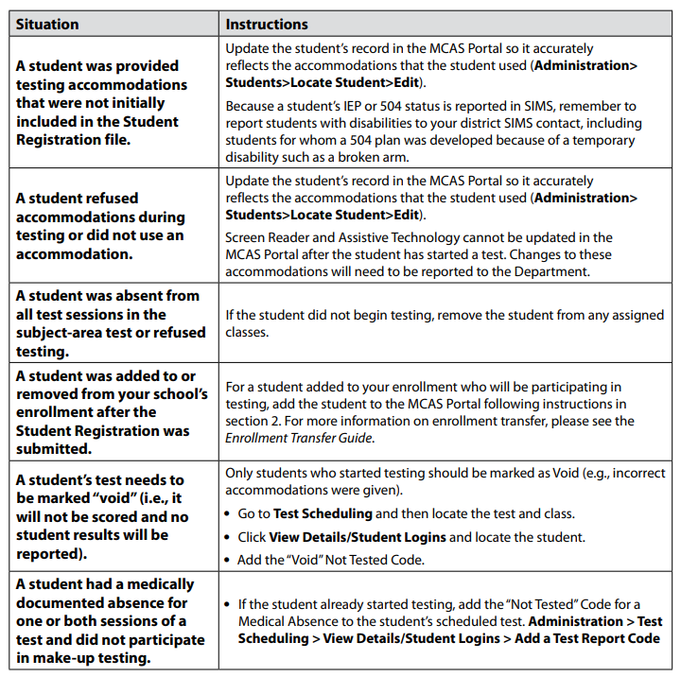
Confirm All Students Participated in Testing and Update Student Information
Check rosters and confirm that all students participated in testing.
Refer to table on page 121 of the PAM for instructions on updating student information.

Slide 65
Voiding a Student Test
In some circumstances, a student’s test may need to be voided. Voided tests will not be scored.
For certain situations involving incorrect accommodations
Test administrator logins for human read aloud and human signer
A void code can either be added for the whole test or to a specific session of the test.
After adding a void code, the student's test or session will remain In Progress.
Schools should contact DESE before voiding student tests.

Slide 66
Demonstration
Adding test and session report codes
Medical absence
Technical issue
Void (wrong accommodation)
Void (other)
Bulk-adding report codes for one or more students

Slide 67
Voiding a Student Test
If necessary, add a Void report code for the test the student already logged into.
Select Test Scheduling in the top menu.
Select the correct school, content area, program (grades 3–8 or high school), and test name.
Locate the class you wish to update and click View Details/Student Logins.
Locate the student who requires the test be voided and click the + button.
Select Void (wrong accommodation) or Void (other) and click Save.

Slide 68
Voiding a Student Test Session
If necessary, add a Void report code for the test session the student already logged into.
Select Test Scheduling in the top menu.
Select the correct school, content area, program (grades 3–8 or high school), and test name.
Locate the test session you wish to update and click View Details/Student Logins.
Locate the student who requires the test session be voided. Click Session Report Codes.
Select the appropriate code and click Save.

Slide 69
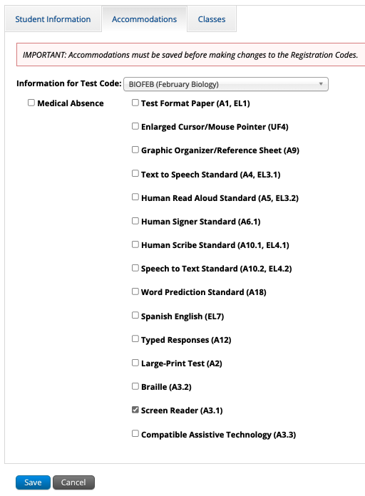
Adding Medical Absence for an Individual Student
Log in to the MCAS Portal and select Administration.
Select Students in the top menu.
Locate the student to be edited and click Edit.
On the Accommodations tab, check the box for Medical Absence for the correct test code and click Save.

Slide 70
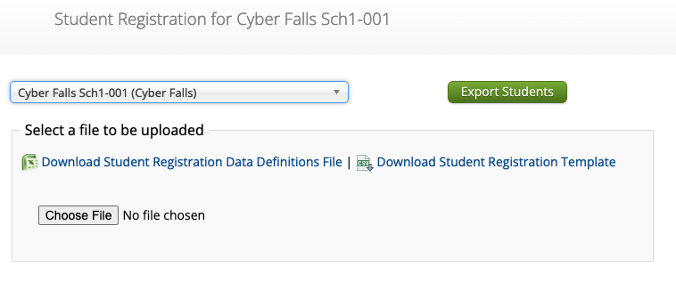
Bulk-Adding Medical Absence
Log in to the MCAS Portal and select Administration.
Select Student Registration in the top menu.
Select the school or district and click Export Students.
Update column M, Not_Tested_Reason, for the appropriate students.
Y = medical absence, blank = no medical absence.
This field is not available for March Retest.
Import the edited file on the Student Registration page.

Slide 71
Additional Tasks After Test Administration
Follow the steps listed in the PAM for all the tasks to complete after test administration.
Checklist of tasks after test administration appears on page 40.
The steps/descriptions begin on page 51.
Steps for completing the Principal’s Certification of Proper Test Administration (PCPA) and updating Student Registration are provided in the PAM, and the deadline dates for completing these tasks are included in the Statewide Testing Schedule.

Slide 72
Deadlines to Complete the Principal’s Certification of Proper Test Administration (PCPA)
Administration | PCPA Deadline
March Retests | March 14
Spring Grades 3–8 (ELA, Mathematics, STE, and Civics) | June 9
Grade 10 ELA and Mathematics | May 29
Spring High School Science | June 13

Slide 73
Resources
Student Registration Guide
Additional Tasks on the Test Scheduling Page of the MCAS Portal: Adding Report Codes, Reactivating Tests, and Exports

Slide 74
7. Test Administrator Tasks During and After Testing

Slide 75
Timeline of Tasks in the MCAS Portal to Complete Before and During Testing for Test Administrators
Up to 2 days before testing
Test Day
●Verify accommodations
●Distribute student logins to students
●Provide session access codes to students
●Enter proctor password as needed
●Monitor student testing status in the MCAS Portal
●Assist with testing issues as needed

Slide 76
Session Access Codes
Test administrators will provide students with a session access code that students will enter while signing in to each test.
Test administrators may not provide session access codes for a session other than the one being administered.
Session access codes are available:
On the View Details/Student Logins page in the MCAS Portal
On the student summary page (first page of PDF of printed student logins)

Slide 77
Tasks During Testing for Test Administrators
Test administrators may need to enter the proctor password in certain circumstances (slides 45–48)
Test administrators may monitor student testing status on the View Details/Student Progress page of the MCAS Portal (slides 16–17).

Slide 78
Questions and Answers
Use the “Q&A” feature to ask questions.

Slide 79
8. Resources, Support, and Next Steps

Slide 80
Additional Resources
Resource | Location
MCAS Resource Center | mcas.onlinehelp.cognia.org
MCAS Portal user guides Additional Tasks on the Test Scheduling Page of the MCAS Portal: Adding Report Codes, Reactivating Tests, and Exports Instructions for Unlocking Test Questions in the MCAS Student Kiosk | https://mcas.onlinehelp.cognia.org/portal/
Technology Information | https://mcas.onlinehelp.cognia.org/technology-setup/
Student Assessment Updates (Biweekly email with important updates about the MCAS program) | www.doe.mass.edu/mcas/updates.html If you do not already receive this email, subscribe using this link: http://eepurl.com/ghSOhH

Slide 81
Upcoming Office Hours Sessions for Principals and Test Coordinators (All Levels of Experience)
Session | Date and Registration Link | Recommended Read-Ahead Materials
Office Hours: Tasks in the MCAS Portal For Grades 3–8 | Wednesday, March 19 at 9:30–10:30 a.m. | Guide to the MCAS Portal Guide to Creating and Managing Classes Guide to Scheduling Tests and Printing Student Logins Instructions for Using Materials Management in the MCAS Portal Additional Tasks on the Test Scheduling Page of the MCAS Portal: Adding Report Codes, Reactivating Tests, and Exports Instructions for Unlocking Test Questions in the MCAS Student Kiosk
Office Hours: Tasks in the MCAS Portal For High Schools | Thursday, March 20 at 9:30–10:30 a.m. | Same as above
Office Hours: Tasks During and After Testing | Friday, March 28 at 9:30–10:30 a.m. | Guide to the MCAS Portal Additional Tasks on the Test Scheduling Page of the MCAS Portal: Adding Report Codes, Reactivating Tests, and Exports Instructions for Unlocking Test Questions in the MCAS Student Kiosk

Slide 82
Next Steps
Today: Complete the evaluation form.
Responses are associated with the name and email address used to log in.
Email your input to mcas@mass.gov if you have problems accessing or completing the form.
Within one week:
Receive an email with the Q&A from this session
Recording will be available

Slide 83
Email and Phone Support
MCAS Service Center
DESE Student Assessment Services
Questions on logistics and technology
Web: https://mcas.onlinehelp.cognia.org/
Email: mcas@cognia.org
Phone: 800-737-5103
TTY: 888-222-1671
Live chat is available at the link on the bottom of the page at the MCAS Resource Center
Policy questions (e.g., student participation, accommodations)
Web: www.doe.mass.edu/mcas
Email: mcas@mass.gov
Phone: 781-338-3625
TTY: 800-439-2370

Slide 84
9. Live “Sandbox Time”

Slide 85
Poll Question—
Which demonstrations would you like to see again?
Monitoring test status on the Test Scheduling page
Exports on the Test Scheduling page
Using the MCAS Portal dashboard
Resolving incorrect form-dependent accommodations
Move a student between classes
Viewing and updating the proctor password
Adding report codes (Medical absence, Void)
Reactivating test sessions
Unlocking locked questions
Unlock test section for grades 5 and 8 STE and grade 8 Civics

Slide 86
THANK YOU
The Office of Student Assessment Services
781-338-3625
mcas@mass.gov
www.doe.mass.edu/mcas
135 Santilli Highway, Everett, MA 02149

