Slide 1
Tasks in the MCAS Portal Before Testing
The Office of Student Assessment Services
March 4, 2025

Slide 2
Presenters
Jodie Zalk, Manager of Test Administration and Publications
Shannon Cullen, MCAS Test Administration Coordinator
Abbie Currier, eMetric Sr. Project Manager

Slide 3
Logistics for This Session
Use the Q&A feature to ask a question.
We will answer some questions aloud at specified times during this training session, and we will email the Q&A afterwards.
Type your questions anytime, but we may not answer them in real time as some questions may be covered during the presentation.
Use the thumbs-up icon to “upvote” someone else’s question.
Email student-specific questions to mcas@mass.gov instead of asking here.
This session is being recorded and will be available in about a week in the MCAS Resource Center, along with the slides.
Closed captioning has been enabled for participants who need it.
Please be advised that DESE does not authorize attendees to record or to use AI transcription tools during the meeting and DESE does not endorse any unauthorized transcripts created by third parties of its meetings.

Slide 4
Slides for This Session
Slides were emailed to participants before this session from MCASEvents@cognia.org.
Slides are now being posted in the chat.
If you cannot access the slides in the chat, ask in the Q&A.
After the session, we will send the slides again to participants, and they will be posted in the MCAS Resource Center along with the recording.

Slide 5
Today’s Agenda
Timeline of Tasks in the MCAS Portal
Updates to Student Registration
Creating and Managing Classes
Scheduling Tests and Printing Student Logins
Materials Management
Accessibility and Accommodations
Test Administrator Tasks Before Testing
Resources and Next Steps
Live “Sandbox” Time with Additional Demonstrations

Slide 6
Poll Question—3
What is your role? (Check all that apply.)
District test coordinator
School test coordinator
Principal
Guidance counselor
Technology staff
Other district staff
Other school staff

Slide 7
Poll Question—3
How many years have you coordinated MCAS test administration?
0–This is my first year.
1 year
2–3 years
4–5 years
6+ years

Slide 8
1. Timeline of Tasks in the MCAS Portal

Slide 9
Timeline of Tasks in the MCAS Portal to Complete Before Testing for Principals/Test Coordinators
2 weeks before testing
●Create and assign students to classes
●Verify accommodations in the MCAS Portal
●Create test administrator logins if necessary (for certain accom.)
●Track delivery of materials through Materials Management
Up to one week before testing
●Schedule classes to tests
●Print student logins and summary sheets
Now
●Continue to update student registration information
●Enrollment Transfer Requests (as needed)

Slide 10
Timeline of Tasks in the MCAS Portal to Complete During and After Testing for Principals/Test Coordinators
During Testing
●Resolve incorrect accommodations
●Manage make-up testing
●Void tests as needed
●Unlock locked test questions (in certain circumstances)
After Testing
●Fill in Report codes as needed
●Void tests as needed
Test Day
●Distribute student logins and summary sheets to test administrators
●Monitor student testing status in the MCAS Portal

Slide 11
Timeline of Tasks in the MCAS Portal to Complete Before and During Testing for Test Administrators
Up to 2 days before testing
Test Day
●Verify accommodations
●Distribute student logins to students
●Provide session access codes to students
●Enter proctor password as needed
●Monitor student testing status in the MCAS Portal
●Assist with testing issues as needed

Slide 12
Timeline of Tasks to Complete for Technology Coordinators
Winter 2025
●Review Appendix A of the PAM
●Check the updated technology guidelines to verify that devices meet technology requirements
●Install updated kiosks if needed
●Verify access to MCAS Portal and MCAS Training Site
During Testing
●Troubleshoot issues as they arise
●Contact the MCAS Service Center with technology questions
Fall 2024
●Verify that devices meet the technology requirements
●Add provided URLs to exempt lists
●Download and install the MCAS Student Kiosk
●Conduct Site Readiness
Additional information was shared in the MCAS Tasks for Technology Coordinators training on February 28 – to be posted to the MCAS Resource Center soon.

Slide 13
2. Updates to Student Registration

Slide 14
Manually Updating Student Information
Recommended when adding or updating fewer than 10 student records
Log in to the MCAS Portal with your username and password.
Select Administration.​
Select Students.
Select the Add Student button or locate the student to be edited and select Edit.
Add/edit student information as needed.
If the student has accommodations, select the Accommodations tab to enter the accommodations by test code. ​Note that students with accommodations for multiple tests will need the accommodations entered for multiple test codes.
Select Save.
Note:
The same fields provided through the student registration file may be entered manually.
If schools add or update a student taking PBT after the Student Registration deadline, they may need to place an additional materials order. See Appendix B of the PAM: Procedures for Paper-Based Testing for information.

Slide 15
Exporting and Reimporting Student Registration Files
Recommended when updating more than 10 student records
Log in to the MCAS Portal with your username and password.
On the MCAS Portal homepage, select Administration.
Select Student Registration from the top menu bar.
Select the organization from the organization drop-down.
Select Export Students. The exported file will be downloaded locally.
Use the Student Registration Data Definitions File to assist in updating the exported Student Registration file.
Update the fields in the Student Registration export file that need updating.
Save the file as a .CSV. The file is now ready for import.

Slide 16
Overview of Enrollment Transfers
Students are loaded to the MCAS Portal once per school year, regardless of which administration(s) they are taking.
Schools will use the Enrollment Transfer feature in the MCAS Portal for transfer students who need to be registered for testing at their new school, who already exist in the MCAS Portal.
When a school receives a transfer student who needs to be registered for testing, the first step should be to search for the student using the Enrollment Transfer page in the MCAS Portal.
Note: This is different from the previous test administration management system, PearsonAccess Next (PAN).

Slide 17
Resources
Student Registration Resources
Student Registration Guide
Student Registration Data Definitions
Student Registration Template
Enrollment Transfer Resources
Guide to Enrollment Transfers in the MCAS Portal
Recordings of previous training sessions:
Overview of Student Registration Tasks in the Portal: Spring 2025
Student Registration for Grades 3–8 Office Hours
Student Registration for High School Office Hours

Slide 18
3. Creating and Managing Classes

Slide 19
What are classes in the MCAS Portal?
A class is a group of students in the MCAS Portal who will take the same test together.
Up to 250 students allowed in a class in the MCAS Portal.
Each class is grade and subject specific.
For the following accommodations, students are required to be assigned to a separate class specifically designated for that accommodation:
Human Read Aloud
Human Signer
Spanish/English
Classes can be created during or anytime after student registration. DESE recommends creating classes approximately two weeks before testing to minimize changes needed.

Slide 20
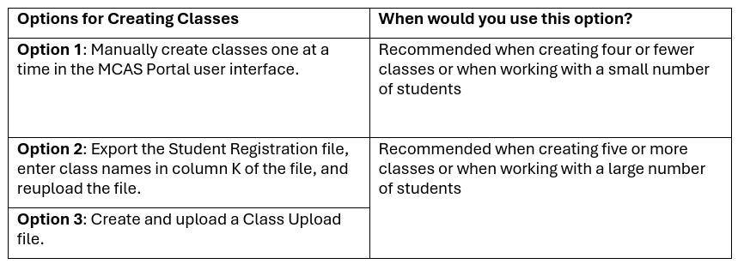
Creating Classes
There are three ways to create classes in the MCAS Portal:
For additional information on creating, editing, and deleting classes, see the Guide to Creating and Managing Classes in the MCAS Portal.

Slide 21
Class Naming Conventions
When creating classes, DESE recommends that schools use a naming convention that will help test administrators quickly and easily find the test they are administering.
It is suggested that class names include the following information:
test code (see information on test codes on pages 15–16 of the MCAS Student Registration Guide)
test administrator name
testing location
school code
Note that class names in the MCAS Portal must be unique across the state. DESE recommends including the school code in the class name in order to meet this requirement.
Note: When creating classes through the Student Registration file import, schools are recommended to include only the test administrator name and testing location in the class name field; the MCAS Portal will automatically add the test code and school code to the class name.

Slide 22
Demonstration
Manually creating a class
Uploading multiple classes via Class Upload file
Uploading multiple classes via Student Registration file

Slide 23
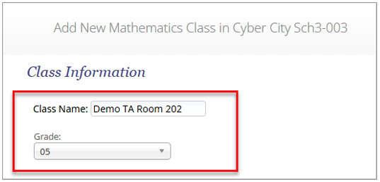
Manually Create a Class in the MCAS Portal
Log in to the MCAS Portal.
Select Administration.
Select Classes from the top menu bar.
Select an organization from the organization drop-down list, and then select a subject from the subject drop-down list.
Select Create Grade Level Class.
Type the name of the class in the Class Name field.
Select a grade from the Choose a Grade drop-down list. Note that all grades and subjects, including those in high school, will need to select a grade.

Slide 24
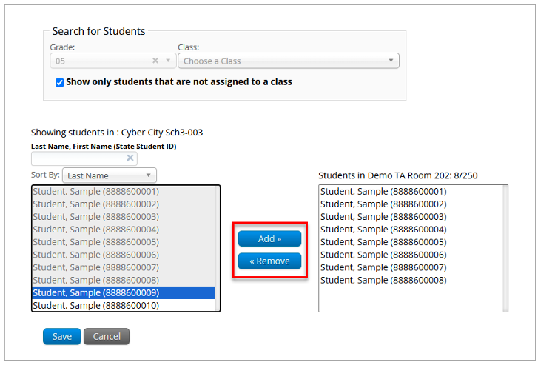
Manually Create a Class in the MCAS Portal
By default, the Show only students that are not assigned to a class checkbox is checked. Schools should keep this checkbox checked when assigning students to classes so that students are not mistakenly assigned to multiple classes for the same subject.
Note: Students can be added to multiple classes per subject in the Portal. Schools should be sure to only assign each student to one class per subject area.

Slide 25
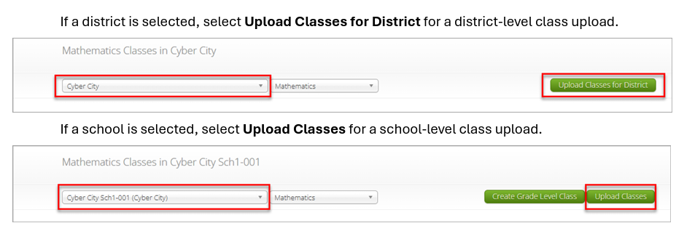
Uploading Multiple Classes via Class Upload file
Log in to the MCAS Portal.
Select Administration.
Select Classes.
Select a school or district from the organization drop-down menu. If a district is selected, select Upload Classes for District for a district-level class upload.

Slide 26
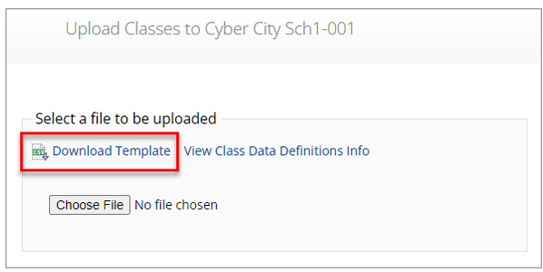
Uploading Multiple Classes via Class Upload file
On the Upload Classes page, select Download Template. Note that there are two separate templates: one for schools and one for districts.
Populate the fields in the template using the permitted values as outlined in the Class Data Definitions Info.
On the Upload Classes page, select View Class Data Definitions Info to view the headers and permitted values for each column in your Class Upload file.
The district template includes an additional column for the school code. The school code can be found on the School and District Profiles website if needed.
Save the file in CSV format.
Note: there is a limit of 10,000 records for each upload file.

Slide 27
Class Data Definitions Information
ClassName: Enter a class name. See the Class Naming Conventions in section I of the Guide to Creating and Managing Classes on the MCAS Resource Center for additional information.
ContentArea: Enter the content area for the class: Mathematics, ELA, Science, or Civics.
ClassType: Enter “grade” for class type.
Grade: Enter the grade. Leading zeros will be required for grades 3 through 9.
SchoolCode: Only applicable to district-level class uploads. The School Code column will require the format of “district code-school code”. For example, if the district code is 00990000 and the school code is 00999987, the School Code column should be entered as 00990000-00999987.
State Student ID: Enter the students’ SASID.

Slide 28
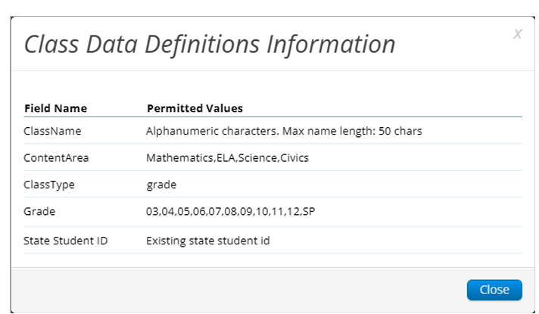
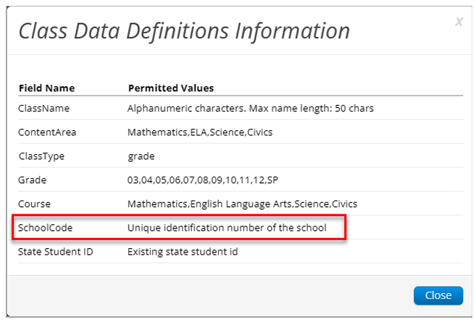
Uploading Multiple Classes via Class Upload File
Class Data Definitions Information for Schools:
Class Data Definitions Information for Districts:

Slide 29
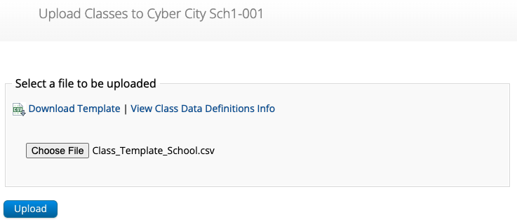
Uploading Multiple Classes via Class Upload File (cont’d)
On the Upload Classes page in the MCAS Portal, click Choose File, select the .CSV file you saved locally, and then click Upload.

Slide 30
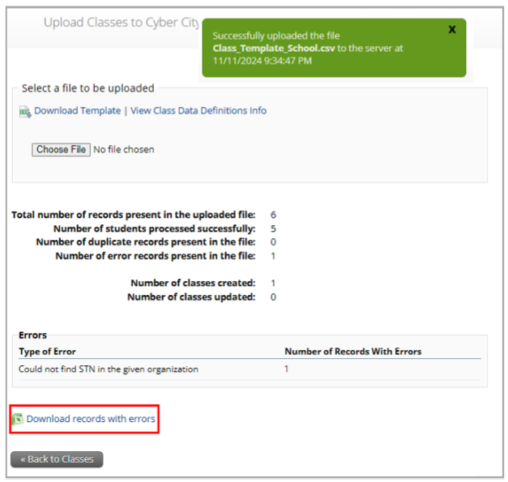
Uploading Multiple Classes via Class Upload File (cont’d)
After the upload has been processed, you will see the following information on the screen:
A green success message at the top of the page letting you know that your file has been uploaded and processed.
Number of students processed successfully
Number of duplicate records present in the file
Number of error records present in the file
A table showing the records in the file.
Click Download records with errors to download a file of the errors found.

Slide 31
Class File Upload: Error Messages
Error | How to Resolve the Error
The uploaded file is not in the expected format. Please download and use the template provided via the Download Template link. | Verify that the file is in .CSV format, and make sure the headers in the file match the template.
Could not find SASID in the given organization | Correct the student’s SASID in the .CSV file.
Length of class name cannot exceed 50 characters | Update the Class name(s) in the .CSV file to a name with 50 characters or less.
Class name is missing | Add the Class name(s) to the .CSV file.
Grade does not exist or Invalid Grade | Correct the Grade to a permitted grade number. (03, 04, 05, 06, 07, 08, 09, 10, 11, 12, SP)
Grade is missing | Add a valid Grade.
Invalid ClassType | Correct the ClassType to grade.
Invalid ContentArea | Correct the ContentArea to a permitted value. Content areas must match the Class Data Definitions exactly.
Student grade does not match with class grade | Verify that the student’s grade matches the grade of the class being created.

Slide 32
Uploading Classes via Student Registration Export/Import
Log in to the MCAS Portal with your username and password.
On the MCAS Portal homepage, select Administration.
Select Student Registration from the top menu bar.
Select the organization from the organization drop-down.
Select Export Students. The exported file will be downloaded locally.
Fill in column K with the class names.
Save the file as a .CSV.
Follow the instructions in the Student Registration Guide to import the updated file.

Slide 33
Resources
Guide to Creating and Managing Classes
Instructional video on Creating Classes, Scheduling Tests, and Printing Student Logins

Slide 34
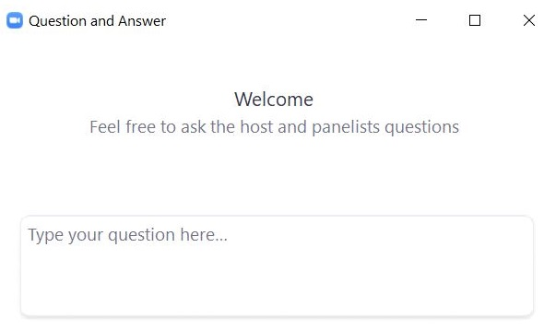
Questions & Answers
Use the “Q&A” feature to ask questions.

Slide 35
4. Scheduling Tests and Printing Student Logins

Slide 36
Scheduling tests
Schools will need to “schedule” classes for tests in order to assign test forms and create student logins.
Student logins cannot be printed until after tests are scheduled.
Test coordinators will need to schedule tests approximately one week prior to test administration.
The Statewide Testing Schedule lists the dates that test scheduling should be completed for each administration.

Slide 37
Printing Student Logins
Student logins contain the sign-in information that students need to type in to begin each test session.
Students use the same student login for each subject area test (e.g., Jon Ward has one login for grade 4 ELA sessions 1 and 2, and a different login for grade 4 Mathematics).
Schools may print student logins up to one week in advance; DESE recommends printing student logins one to two days in advance of testing.
Student logins are considered secure and must be tracked.
Note: Test coordinators may also need to create and print test administrator logins for test administrators administering the Human Read-Aloud and Human Signer accommodations.
See instructions in Appendix C of the PAM.

Slide 38
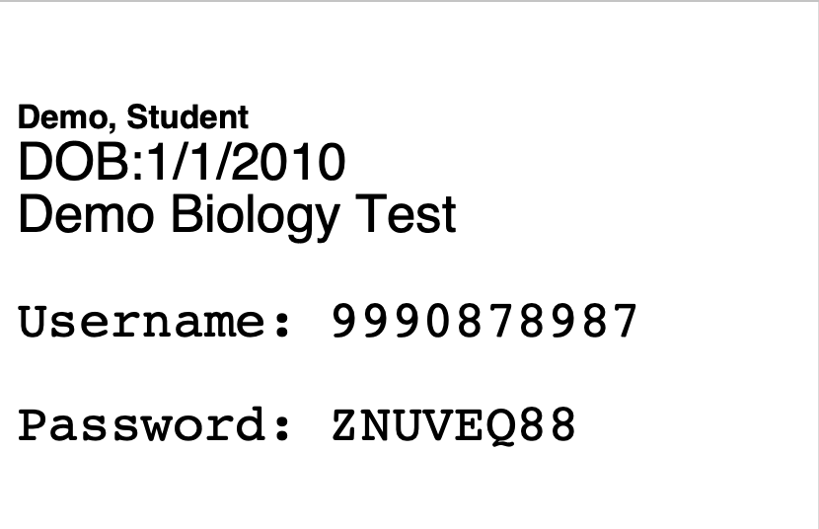
Student Logins
Advise your test administrators to check that each student has the correct student login.
Students should verify their name and date of birth on the student login.
Students can also verify their name on the Hello screen in the MCAS Student Kiosk.

Slide 39
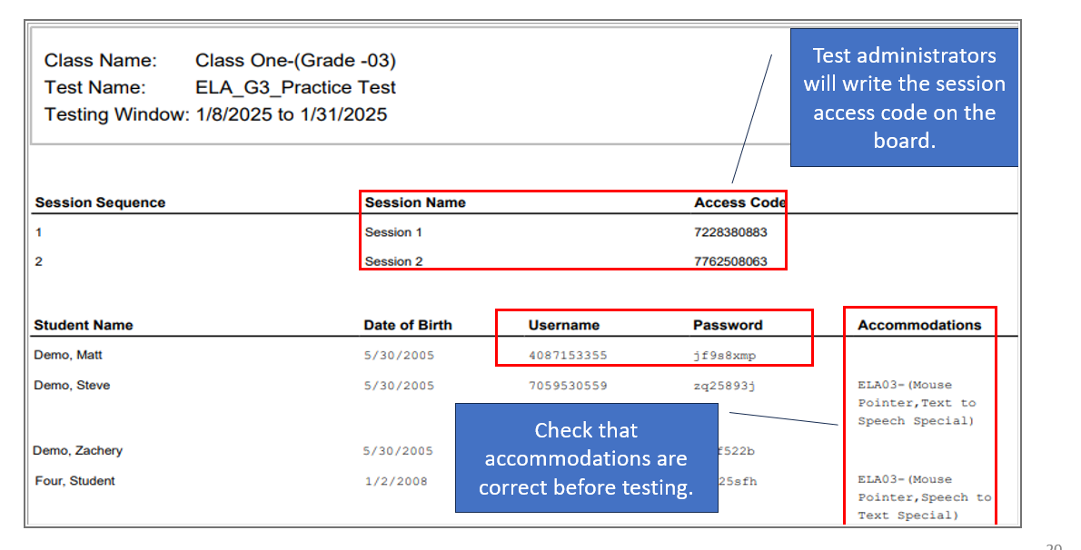
Student Summary Pages
When printing student logins as a PDF, the first page of the document will be a student summary page.

Slide 40
Demonstration
Scheduling a test for multiple classes
Scheduling a Spanish/English test
Printing student logins and summary pages

Slide 41
Scheduling a test for multiple classes
Log in to the MCAS Portal and select Administration.
Select Test Scheduling.
Select the correct school, content area (ELA, mathematics, science, or civics), program (high school or grades 3–8), and test name.
Select Schedule New Test.

Slide 42
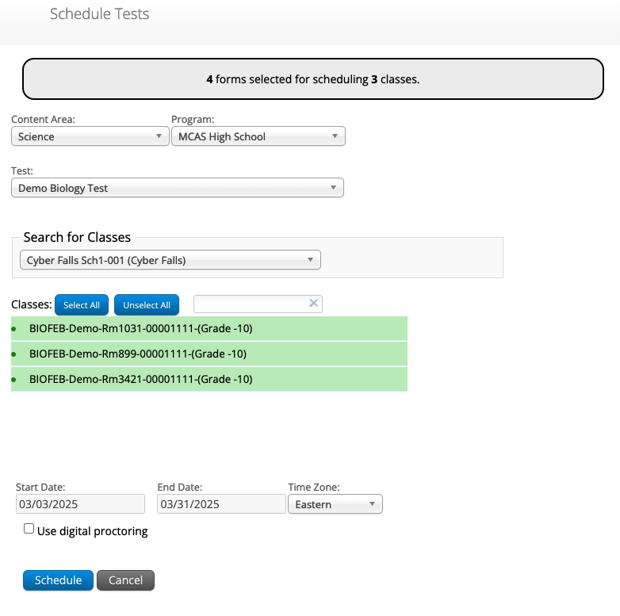
Scheduling a test for multiple classes (cont'd)
5. Select the classes to be scheduled.
6. Click Schedule.
Note: Do not check the checkbox for “Use digital proctoring.”

Slide 43
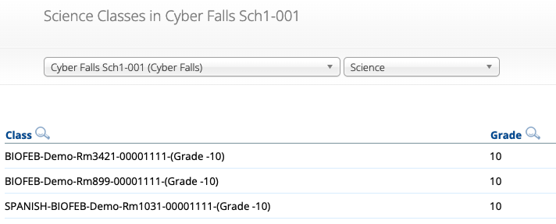
Scheduling a Spanish/English test
Create a separate class for all students taking a Spanish/English test for that grade and content area.
Include the word “SPANISH” at the beginning of the class name.
Schedule the Spanish class to take the Spanish/English test.
Ensure the correct class is scheduled for the correct test.
The class name should include the word “SPANISH.”
The test name should include the words “Spanish/English.”

Slide 44
Printing student logins and summary pages
Log in to the MCAS Portal and select Administration.
Select Test Scheduling.
Select the correct school, content area (ELA, mathematics, science, or civics), program (high school or grades 3–8), and test name.
Select View Details/Student Logins.

Slide 45
Printing Student Logins
5. Select the student logins to print or select the checkmark in the column heading to select all students.
6. Select Export Logins for Selected Students.
7. Select either a PDF or CSV file.
When selecting PDF, select 1, 8, or 27 student logins per page.

Slide 46
Resources
Guide to Scheduling Tests and Printing Student Logins
Instructional Video on Creating Classes, Scheduling Tests, and Printing Student Logins

Slide 47
Questions & Answers
Use the “Q&A” feature to ask questions.

Slide 48
5. Materials Management

Slide 49
Materials Management
New for 2025, the Materials Management page in the MCAS Portal provides a view of shipments of materials being delivered to schools. Schools will be able to see materials shipments listed on this page once they are shipped.
This is an optional feature that schools may find useful to track shipments.

Slide 50
Materials Management
Select the Order Additional Materials or UPS Pick Up Request buttons to navigate to the MCAS Service Center to complete these tasks.
Schools may also continue to navigate to the MCAS Service Center website directly to complete these tasks as in previous years.
Select View Details to view the Shipment Details page for each shipment. The Shipment Details table displays the following information about your order:
Box ID Number: the ID number of the individual boxes in the order. The Box ID Number, also known as the MP Ship Code, will be needed to place an additional materials order.
Shipped Date: date when the order was shipped
Last Updated: the date and time when the shipment information was last updated by UPS.
Item Code, Quantity, and Description: information about the contents of each box in your order. Note the Item Code will not be used by schools.
UPS Tracking: the UPS tracking number, with a link to the UPS tracking website

Slide 51
Demonstration
Materials Management

Slide 52
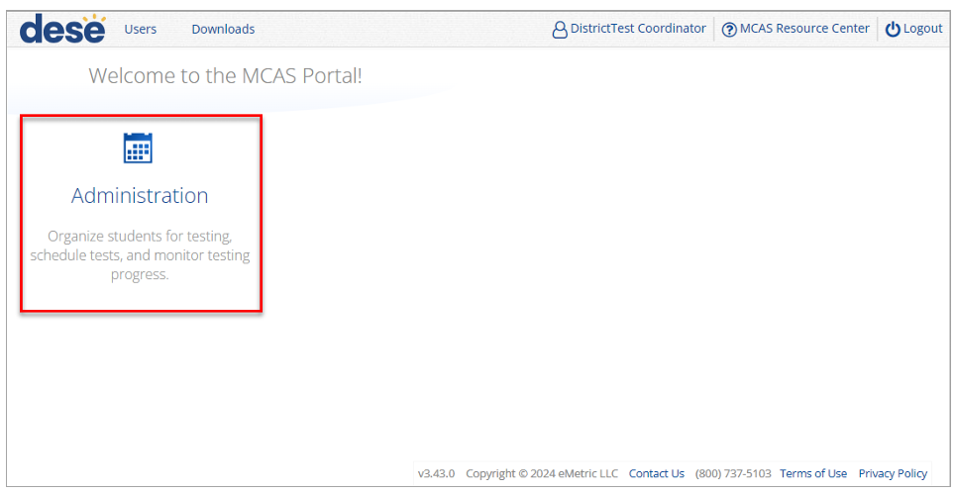
Navigating the Materials Management Page
To access the Materials Management page, follow the steps below:
1. Log in to the MCAS Portal with your username and password.
2. On the MCAS Portal homepage, select Administration.
3. Select Materials Management from the top menu bar.

Slide 53
Resources
Instructions for Using Materials Management in the MCAS Portal

Slide 54
6. Accessibility and Accommodations

Slide 55
Verifying Accommodations
Test coordinators should review accommodations approximately two weeks prior to testing to ensure that they have been assigned correctly.
Accommodations can be verified in four ways:
On the Edit Student page in the MCAS Portal.
Through a Student Registration export.
On the summary page that is printed with student logins.
Accommodated forms such as Screen Reader, Human Read-Aloud, and Human Signer can be confirmed on the View Details/Student Logins page in the MCAS Portal.

Slide 56
Demonstration
Verifying accommodations

Slide 57
Verifying Form-Dependent Accommodations
Log in to the MCAS Portal and select Administration.
Select Test Scheduling.
Select the correct school, content area (ELA, mathematics, science, or civics), program (high school or grades 3–8), and test name.
Select View Details/Student Logins.

Slide 58
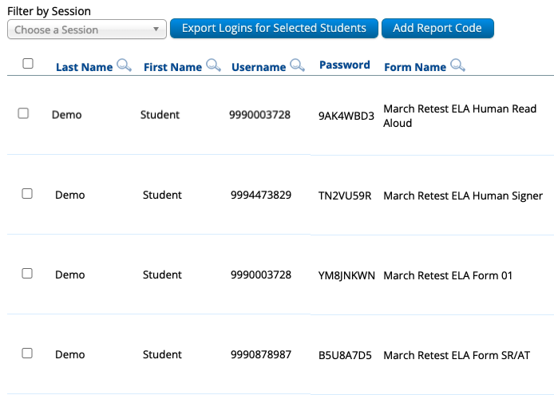
Verifying Form-Dependent Accommodations
5. Review the "Form Name" column and ensure the form-dependent accommodations are indicated in the form name (e.g., human read aloud, human signer, screen reader, ASL).

Slide 59
Verifying Accommodations: Single Student
Log in to the MCAS Portal and select Administration.
Select Students.
Locate the student you wish to review and click Edit.
Select the Accommodations tab
Review and edit the accommodations as necessary.
Select Save.

Slide 60
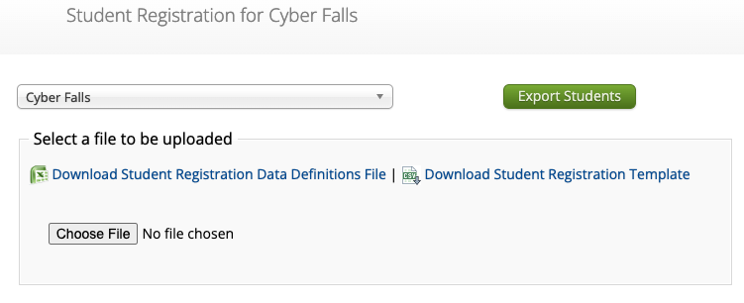
Verifying Accommodations: Student Registration Export
Log in to the MCAS Portal and select Administration.
Select Student Registration.
Select the correct school or district.
Select Export Students.
Review the accommodations for each student in the export.

Slide 61
Verifying Accommodations: Summary Sheet
Follow the steps in slides 44–45 to print student logins.
Note: Be sure to print the student logins as a PDF. The first page of the PDF will be a summary page that lists students’ accommodations.

Slide 62
Test Administrator Logins
For the human read aloud and human signer accommodations for computer-based testing, schools may choose to have test administrators read the test over the student’s shoulder, or create test administrator logins so that test administrators can log in to their own test on their own device in order to read aloud.
There are two options for creating a test administrator login in the MCAS Portal.
Option 1: Manually add a student to the MCAS Portal on the Students page using the field definitions outlined on the next slide.
Option 2: Add the test administrator login as a student during the Student Registration file upload.

Slide 63
Test Administrator Logins
Column of Student Registration File | Field Name | Field notes
A | District code | The testing district
B | School code | The testing school
C | SASID | Begin with your 8-digit school code. Add “01”, “02”, etc. to the end of your school code for each test administrator login needed. Example: For a school whose code is 77665555, their test administrator login SASIDs would be 7766555501, 7766555502, 7766555503, etc.
D | Student grade | The grade level for the test that is being administered
E | Last name | Enter in “TA LOGIN”
F | First name | The test administrator’s first name
I | Date of birth | Enter in “01/01/1900”
J | Test code | The test code for the test that is being administered
L | Test format | “O”
T | Human Read Aloud Standard | “Y” if administering Math, STE, or Civics
Z | Human Read Aloud Special | “Y” if administering ELA
U | Human Signer Standard | “Y” if administering Math, STE, or Civics
AA | Human Signer Special | “Y” if administering ELA

Slide 64
Test Administrator Logins
Once the test administrator logins have been added to the MCAS Portal, create a class for the students requiring a human read aloud or human signer accommodation for that content area.
Add the appropriate student(s) to the class.
Add the test administrator login to the class.
Save the class.
Schedule the class to take the appropriate test.

Slide 65
Test Administrator Logins – After Testing
Once testing is complete, all test administrator login tests should be voided.
See the Additional Tasks on the Test Scheduling Page of the MCAS Portal: Adding Report Codes, Reactivating Tests, and Exports for instructions on voiding a test.

Slide 66
Resources
Principal’s Administration Manual
Verifying accommodations: pages 46-47
Test administrator logins: pages 104–105

Slide 67
7. Test Administrator Tasks Before Testing

Slide 68
Timeline of Tasks in the MCAS Portal to Complete Before and During Testing for Test Administrators
Up to 2 days before testing
Test Day
● Verify accommodations
● Distribute student logins to students
● Provide session access codes to students
● Enter proctor password as needed
● Monitor student testing status in the MCAS Portal
● Assist with testing issues as needed

Slide 69
Verifying Accommodations
Test administrators should review accommodations prior to testing to ensure that they have been assigned correctly.
Test administrators can verify form-dependent accommodations on the View Details/Student Logins page.
Test administrators can verify other accommodations on the student summary page (the first page of the PDF of exported student logins).

Slide 70
Questions & Answers
Use the “Q&A” feature to ask questions.

Slide 71
8. Resources, Support, and Next Steps

Slide 72
Additional Resources
Resource | Location
MCAS Resource Center | mcas.onlinehelp.cognia.org
MCAS Portal user guides Guide to Creating and Managing Classes Guide to Scheduling Tests and Printing Student Logins Instructions for Using Materials Management in the MCAS Portal | https://mcas.onlinehelp.cognia.org/portal/
Technology Information | https://mcas.onlinehelp.cognia.org/technology-setup/
Student Assessment Updates (Biweekly email with important updates about the MCAS program) | www.doe.mass.edu/mcas/updates.html If you do not already receive this email, subscribe using this link: http://eepurl.com/ghSOhH

Slide 73
Next Steps
Today: Complete the evaluation form.
Responses are associated with the name and email address used to log in.
Email your input to mcas@mass.gov if you have problems accessing or completing the form.
Within one week:
Receive an email with the Q&A from this session
Recording will be available

Slide 74
Email and Phone Support
MCAS Service Center
DESE Student Assessment Services
Questions on logistics and technology
Web: https://mcas.onlinehelp.cognia.org/
Email: mcas@cognia.org
Phone: 800-737-5103
TTY: 888-222-1671
Live chat is available at the link on the bottom of the page at the MCAS Resource Center for the 2025 tests
Policy questions (e.g., student participation, accommodations)
Web: www.doe.mass.edu/mcas
Email: mcas@mass.gov
Phone: 781-338-3625
TTY: 800-439-2370

Slide 75
9. Live “Sandbox Time”

Slide 76
Poll Question—
Which demonstrations would you like to see again?
Manually creating a class
Uploading multiple classes via Class Upload file
Uploading multiple classes via Student Registration file
Scheduling a test for multiple classes
Scheduling a Spanish/English test
Printing student logins and summary pages
Verifying accommodations
Creating test administrator logins

Slide 77
THANK YOU
The Office of Student Assessment Services
781-338-3625
mcas@mass.gov
www.doe.mass.edu/mcas
135 Santilli Highway, Everett, MA 02149

