Slide 1
MCAS Portal Tasks: High School Office Hours
The Office of Student Assessment Services
March 20, 2025

Slide 2
Presenters
Shannon Cullen, MCAS Test Administration Coordinator
Abbie Currier, eMetric Sr. Project Manager

Slide 3
Logistics for This Session
Use the Q&A feature to ask a question.
We will answer some questions aloud at specified times during this training session, and we will email the Q&A afterwards.
Type your questions anytime, but we may not answer them in real time as some questions may be covered during the presentation.
Use the thumbs-up icon to “upvote” someone else’s question.
Email student-specific questions to mcas@mass.gov instead of asking here.
This session is being recorded and will be available in about a week in the MCAS Resource Center, along with the slides.
Closed captioning has been enabled for participants who need it.
Please be advised that DESE does not authorize attendees to record or to use AI transcription tools during the meeting and DESE does not endorse any unauthorized transcripts created by third parties of its meetings.

Slide 4
Slides for This Session
Slides were emailed to participants before this session from MCASEvents@cognia.org.
Slides are now being posted in the chat.
If you cannot access the slides in the chat, ask in the Q&A.
After the session, we will send the slides again to participants, and they will be posted in the MCAS Resource Center along with the recording.

Slide 5
Today’s Agenda
Resources
Q&A and Additional Demonstrations
Support and Next Steps

Slide 6
1. Resources

Slide 7
Resources on Using the MCAS Portal
Resource | Location
MCAS Resource Center | mcas.onlinehelp.cognia.org
MCAS Portal User Guides Guide to the MCAS Portal Student Registration Guide MCAS Portal User Management Guide Guide to Creating and Managing Classes Guide to Enrollment Transfers Guide to Scheduling Tests and Printing Student Logins Instructions for Using Materials Management Additional Tasks on the Test Scheduling Page | https://mcas.onlinehelp.cognia.org/portal/
MCAS Training Site User Guides Guide to Conducting a Practice Test through the MCAS Training Site Guide for Reviewing Reports of Results for Practice Tests Conducted in the MCAS Training Site | https://mcas.onlinehelp.cognia.org/portal/
MCAS Student Kiosk Guides Instructions for Unlocking Test Questions in the MCAS Student Kiosk | https://mcas.onlinehelp.cognia.org/technology-setup/

Slide 8
Modules and Recordings of Previous Training Sessions
Resource | Location
MCAS Portal Modules and Video Demonstrations Video demonstration: Creating Classes and Scheduling Tests | https://mcas.onlinehelp.cognia.org/training-modules/
Recordings of previous training sessions | https://mcas.onlinehelp.cognia.org/training-webinars/
Slide template for training test administrators | https://www.doe.mass.edu/mcas/testadmin/training/slides.pptx
Test administrator tasks in the MCAS Portal Recording (begins at 36:05) Slides 43–51 | https://mcas.onlinehelp.cognia.org/training-webinars/

Slide 9
Technology Resources
Resource | Location
Technology Information Technology Guidelines for MCAS Computer-Based Testing Guide to Installing the MCAS Student Kiosk and Conducting Site Readiness | https://mcas.onlinehelp.cognia.org/ technology-setup/
Previously recorded webinars Introduction to the MCAS Portal: Tasks for Technology Coordinators MCAS Technology Coordinator Training | https://mcas.onlinehelp.cognia.org/training-webinars/

Slide 10
Resources on the DESE Website
Resource | Location
Test Administration Resources Manuals Sample materials | www.doe.mass.edu/mcas/testadmin/
Statewide Testing Schedule | www.doe.mass.edu/mcas/cal.html
Accessibility and Accommodations Manual | www.doe.mass.edu/mcas/accessibility/default.html
Student Assessment Updates (Biweekly email with important updates about the MCAS program) | www.doe.mass.edu/mcas/updates.html If you do not already receive this email, subscribe using this link: http://eepurl.com/ghSOhH

Slide 11
2. Q&A and Additional Demonstrations

Slide 12
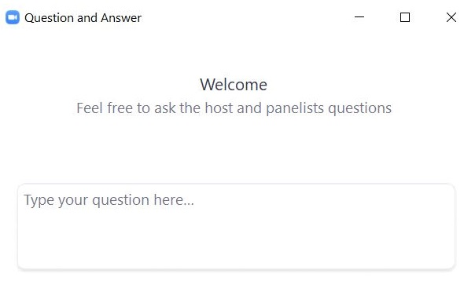
Questions & Answers
Use the “Q&A” feature to ask questions.

Slide 13
3. Support and Next Steps

Slide 14
Upcoming “Office Hours” Session
Session | Date and Registration Link | Intended Audience | Recommended Read-Ahead Materials
Tasks During and After Testing | Friday, March 28 at 9:30–10:30 a.m. | Principals and test coordinators | Guide to the MCAS Portal Additional Tasks on the Test Scheduling Page of the MCAS Portal: Adding Report Codes, Reactivating Tests, and Exports Instructions for Unlocking Test Questions in the MCAS Student Kiosk

Slide 15
Next Steps
Today: Complete the evaluation form.
Responses are associated with the name and email address used to log in.
Email your input to mcas@mass.gov if you have problems accessing or completing the form.
Within one week:
Receive an email with the Q&A from this session
Recording will be available

Slide 16
Email and Phone Support
MCAS Service Center
DESE Student Assessment Services
Questions on logistics and technology
Web: https://mcas.onlinehelp.cognia.org/
Email: mcas@cognia.org
Phone: 800-737-5103
TTY: 888-222-1671
Live chat is available at the link on the bottom of the page at the MCAS Resource Center
Policy questions (e.g., student participation, accommodations)
Web: www.doe.mass.edu/mcas
Email: mcas@mass.gov
Phone: 781-338-3625
TTY: 800-439-2370

Slide 17
THANK YOU
The Office of Student Assessment Services
781-338-3625
mcas@mass.gov
www.doe.mass.edu/mcas
135 Santilli Highway, Everett, MA 02149

