Slide 1
MCAS Test Administration and Security Protocols for New Staff
Note: This training session will be geared toward new staff.
Experienced test coordinators may want to attend the training on January 30. Registration is available.
The Office of Student Assessment Services
January 28, 2025

Slide 2
Presenters
Shannon Cullen, Test Administration Coordinator
Robert Pelychaty, Manager of Inclusive Assessment
David Ragsdale, Test Security Specialist
Jodie Zalk, Manager of Test Administration and Publications
Abbie Currier, eMetric Sr. Project Manager

Slide 3
Logistics for This Session
Use the Q&A feature to ask a question.
We will answer some questions aloud at specified times during this training session, and we will email the Q&A afterwards.
Type your questions anytime, but we may not answer them in real time as some questions may be covered during the presentation.
Use the thumbs-up icon to “upvote” someone else’s question.
Email student-specific questions to mcas@mass.gov instead of asking here.
This session is being recorded and will be available in about a week in the MCAS Resource Center, along with the slides.
Slides were also emailed out beforehand, and are being posted in the chat.
Closed captioning has been enabled for participants who need it.

Slide 4
Slides for This Session
Slides were emailed to participants before this session from MCASEvents@cognia.org.
Slides are now being posted in the chat.
If you cannot access the slides in the chat, ask in the Q&A.
After the session, we will send the slides again to participants, and they will be posted in the MCAS Resource Center along with the recording.

Slide 5
Today’s Agenda
Introduction and Resources
Test Administration Protocols
Preparation for Computer-Based Testing
Test Security Requirements
Accessibility and Accommodations
Additional Resources, Support, and Next Steps
Protocols for Paper-Based Testing (PBT)

Slide 6
Poll Question
Have you attended any of DESE’s MCAS training sessions this school year?
3 or more
1 or 2
This is my first one.

Slide 7
1. Introduction and Resources

Slide 8
Introduction to MCAS Computer-Based Testing
Crosswalk of Terminology for MCAS Tests Beginning in 2025
MCAS Portal: The test administration and management website used by test coordinators, technology coordinators, and test administrators.
MCAS Training Site: Test coordinators, technology coordinators, and test administrators may use this site to practice with MCAS Portal tasks and administer practice tests.
MCAS Student Kiosk: Student testing platform

Slide 9
Commonly Used Acronyms
CBT: Computer-based testing
PBT: Paper-based testing
SIMS: Student Information Management System
EL: English learner
ELA: English Language Arts
STE: Science and Technology/Engineering

Slide 10
Delivery Dates for Manuals and Materials for Paper-Based Testing (PBT)
Grades 3–8:
March 10: Receive all manuals, and ELA PBT materials
April 14: Receive Math/STE/Civics PBT materials
Grade 10:
March 11: Receive manuals for ELA and Math, and ELA PBT materials
May 6: Receive Math PBT materials
High School Science:
May 21: Receive manuals and PBT materials

Slide 11
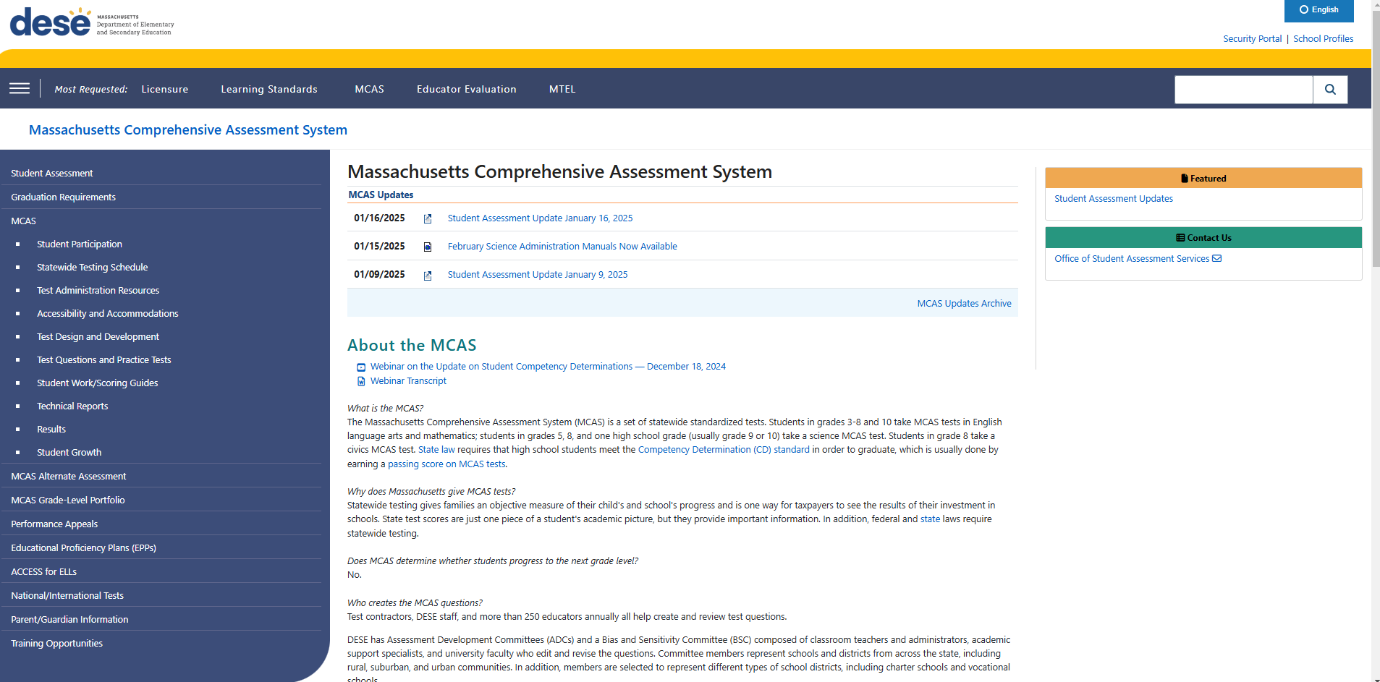
MCAS Page on the DESE Website

Slide 12
Spring 2025 MCAS Test Administration Resources for Grades 3–8 and High School
Test Administration Manuals
Principal’s Administration Manual (PAM) and Test Administrator’s Manuals (TAMs) to be available soon
Test Administration Sample Forms and Materials
Additional Policies/Resources
Technology-Related Resources for Computer-Based Testing
High School Participation Guidelines and FAQ on Student Competency Determinations

Slide 13
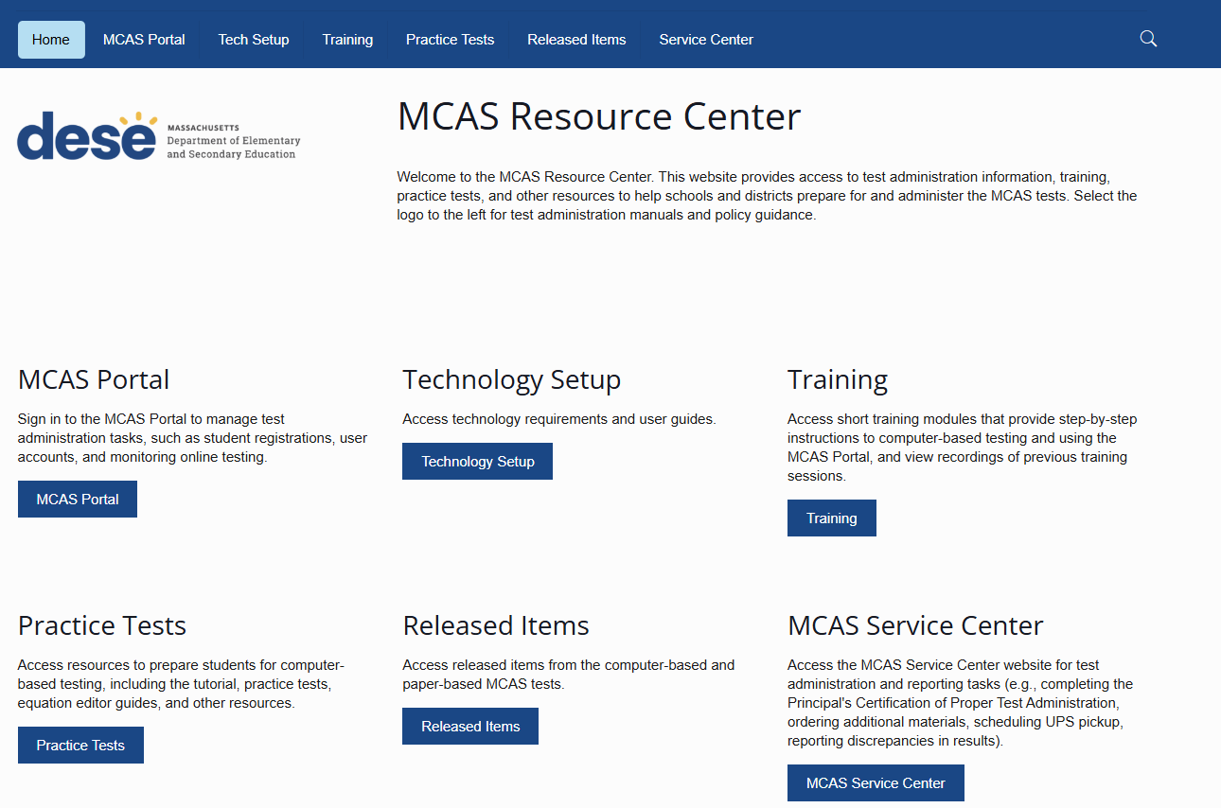
MCAS Resource Center

Slide 14
MCAS Resource Center
MCAS Portal page
Live links to the MCAS Portal and MCAS Training Site
Guide to the MCAS Portal
MCAS Portal User Management Guide
Technology Setup page
Technology Guidelines for MCAS Computer-Based Testing
Guide to Installing the MCAS Student Kiosk and Conducting Site Readiness
Training page
Contains links to previously recorded webinars and accompanying slides and training modules
Introduction to the MCAS Portal: Tasks for School and District Test Coordinators
Practice Tests page
High school science practice tests available now.
Additional practice tests and student tutorial expected to be posted by mid-February.

Slide 15
Orientation to the Principal’s Administration Manual (PAM)
Icons:
Front matter: purpose of the PAM, contact information and information on online accounts, testing schedule, updates
Part I: MCAS Test Security Requirements – page 1
Part II: Student Participation – page 11
Page III: MCAS Test Administration Protocols – page 15
Part IV: Tasks to Complete for Test Administration – page 37; Checklist of tasks – page 38
Appendix A: Tasks and Guidance for Technology Coordinators– page 53
Appendix B: Procedures for Paper-Based testing – page 67
Appendix C: Accessibility and Accommodations – page 87
Appendix D: Procedures Related to Student Information and Guidance on Reporting – page 119
Appendix E: Selected Forms – page 127

Slide 16
2. Test Administration Protocols

Slide 17
General Timeline for MCAS CBT
Pre-Administration Tasks
Beginning in Fall 2024
(Ongoing) Read biweekly Student Assessment Updates.
At least 2 months before testing
Update user accounts the MCAS Portal and create additional accounts.
At least 2 weeks before testing
Prepare students for online testing.
Become familiar with CBT components.
Identify the school test administration team.
Update contact info with DESE.
View online modules and participate in training sessions.
Meet with the technology coordinator, who will review the tech specs and prepare the school’s technology, including Site Readiness.
Review instructions in the Principal’s Administration Manual.
Plan for accessibility features and accommodations.
Prepare devices and materials.
Delivered to schools 2 weeks before spring ELA, and one week before each fall/winter administration. Available online beforehand.
Train test administrators in protocols and security requirements.
Establish a communication plan with the test administration team.
Complete Student Registration.

Slide 18
Identify Your Test Administration Team
Meet with the technology coordinator and begin technology preparations.
Consider assignments for test administrators.
Develop your communication plan for technology and administration.
Update contact information with DESE and in the MCAS Portal as needed.
See the MCAS Portal User Management Guide for guidance on updating MCAS Portal accounts.

Slide 19
Identify “Who,” “Where,” and “When” (Late Winter/Early Spring)
Particularly for high schools, identify all students participating in each grade’s tests.
High school participation guidelines now available
Assign accessibility features and accommodations.
Plan for where accommodations will be administered (e.g., students with a one-to-one administration).
Establish testing locations and develop staffing plans.
Prepare list of test administrators and students for school records, and assign/update user roles in the MCAS Portal (details on upcoming slide).
Begin training plans for test administrators and staff.
Plan for secure testing environments.
Slide template for training test administrators to be updated by mid-Feb.; template for February Science available

Slide 20
Scheduling Considerations
The MCAS Student Kiosk will be available between 7:00 a.m. and 4:00 p.m., Monday–Friday, except the week of April school vacation; request special access to test outside these hours (see PAM page 24).
Grades 4 and 10 Math, and grades 5 and 8 STE:
Decide whether to administer the optional questionnaire directly after Session 2 or another time.
Plan logistics related to scheduling.
One break per session, around 3–5 minutes, at test administrator’s discretion.
Make plans for students who finish early and students who need extra time, including students who work through lunch; consider using dismissal waves.

Slide 21
Scheduling Considerations (cont’d)
If needed for efficiency, you can group together students in different grades taking the same subject-area test for make-up testing, as long as the TAM script matches.
ELA: Grades 3–8
Math: Grades 3 and 4, grades 5 and 6, grades 7 and 8
STE: Grades 5 and 8
Do not group together students doing CBT and any students doing PBT.
Note that in the MCAS Portal, classes are grade and subject-specific. Students in different grades will need to be placed in different classes in the MCAS Portal, each with their own session access code.

Slide 22
Update Student Information
In SIMS (DESE Student Information Management System)
In the MCAS Portal
Go to the People Search page on the Profiles website, select SIMS Contact from the Function menu, and click Get Results
Data source: School Interoperability Framework (SIF) for Student Registration for districts that use SIF (October SIMS for non-SIF districts)
Pre-administration Student Registration deadlines for PBT test materials and CBT/PBT manuals are as follows:
January 31 for the March retests
January 31 for grades 3–8
February 7 for grade 10 ELA and Mathematics
April 29 for High school Science

Slide 23
Poll Question
Where do you work?
At an elementary school
At a middle school
At a combined middle/high school
At a high school
At a district office
Other

Slide 24
2025 Grades 3–8 Administration Schedule
ELA testing window | March 24–April 18 (Note that ELA will be administered earlier than Mathematics and STE.)
Mathematics testing window | April 28–May 23
STE testing window (grades 5 and 8) | April 28–May 23
Civics testing window (grade 8) | April 28–June 6
These testing windows include all make-up testing.
The sequence for administering tests should be as follows, when possible
first ELA
followed by Mathematics
followed by STE
Civics can be administered at any time between April 28 and June 6.

Slide 25
Recommended Testing Times for Grades 3–8
MCAS Subject Area Test for Grades 3–8 | Recommended Testing Times for Spring 2025 (2 sessions per test)
ELA | 2 to 2½ hours per session
Mathematics | 1½ hours per session
Grades 5 and 8 STE | 1 to 1½ hours per session
Grade 8 Civics | State-level performance task: 1 hour End-of-course (EOC) test: 1 hour
Each test session must be administered simultaneously to all students taking that particular test in your school except for students who receive DF10 (Specific Time of Day) or DF3 (Frequent Breaks). See Part III, section C, of the PAM for scheduling guidance.

Slide 26
2025 Grade 10 Prescribed Administration Schedule
Grade 10 ELA | ELA Session 1 ELA Session 2 Last date for all make-up testing | March 25 March 26 April 3
Grade 10 Mathematics | Mathematics Session 1 Mathematics Session 2 Last date for all make-up testing | May 20 May 21 May 28
High schools should test the maximum number of students who can participate concurrently on the prescribed dates. On the next two dates, schools can test any remaining students who did not participate due to technology/device limitations, or they can begin make-up testing.

Slide 27
2025 High School Science Prescribed Administration Schedule
Science Session 1 | June 4
Science Session 2 | June 5
Last date for all make-up testing | June 12
High schools should test the maximum number of students who can participate concurrently on the prescribed dates. On the next two dates, schools can test any remaining students who did not participate due to technology/device limitations, or they can begin make-up testing.

Slide 28
Recommended Testing Times for High Schools
MCAS Subject Area Test for High School | Recommended Testing Times for Spring 2025 (2 sessions per test)
Grade 10 ELA | Session 1: 2½ hours Session 2: 1½ to 2 hours
Grade 10 Mathematics | 1½ to 2 hours per session
High School Science | 1½ hours per session

Slide 29
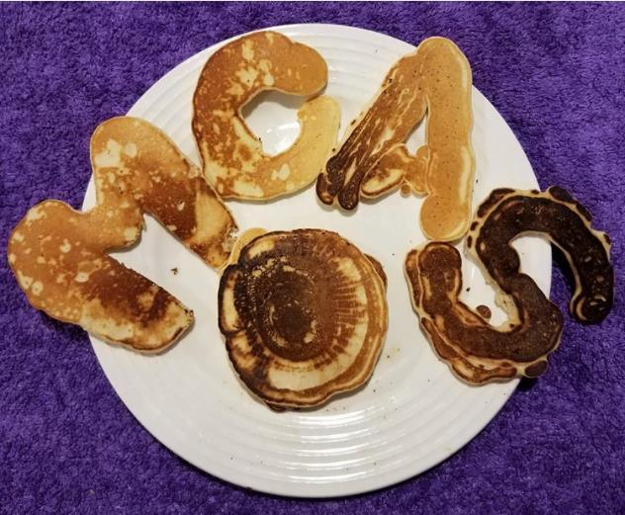
Preparing Students and Families for CBT
Student tutorial (expected to be available by mid-February)
Demonstration of the navigation, tools, and features for CBT
Students complete it independently (no audio)
Practice tests (expected to be available by mid-February)
Simulation of the tools and features for CBT
Include accessibility features and accommodated test forms
Equation editor guides and reference sheets for Math and STE
Digital Item Library (previously released items)
Sample student work from previous MCAS tests
Resources for parents/guardians
Topics in the PAM for students and parents/guardians; newsletter or meetings (pages 32–35)

Slide 30
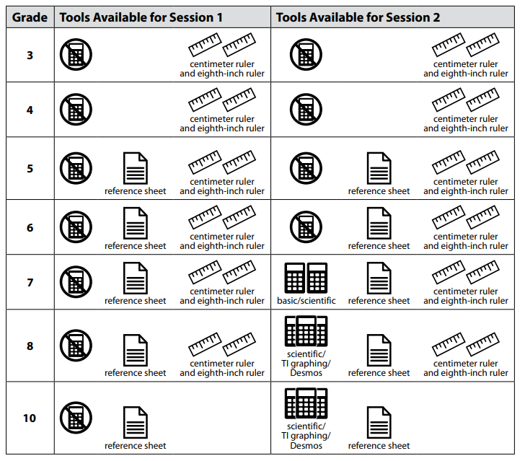
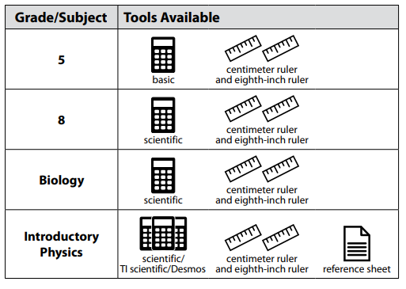
Prepare Materials that Your School Will Provide to Students
For the list of materials that are required or permitted for testing, and materials prohibited from testing, refer to the PAM beginning on page 20.

Slide 31
3. Preparation for Computer-Based Testing

Slide 32
Test Coordinator Tasks in the MCAS Portal – Before Testing
Fall 2024
●Create/update MCAS Portal user accounts
●Download the MCAS Student Kiosk to student devices and conduct Site Readiness (tech. coordinators)
Approx. 2 months before testing
Submit Student Registration
Approx. 2 weeks before testing
●Create classes in the MCAS Portal
●Verify accommodations
One week before testing
Schedule classes to tests
Up to 2 days before testing
Print student logins

Slide 33
Test Coordinator Tasks in the MCAS Portal – During and After Testing
During Testing
●Resolve incorrect accommodations and other issues
●Manage makeup testing
●Void tests as needed
After Testing
●Fill in not tested codes
●Void tests as needed

Slide 34
Poll Question
As a principal or school test coordinator, who should you contact if you don’t have an MCAS Portal account?
Another principal or test coordinator
Technology coordinator
Call the MCAS Service Center
District test coordinator

Slide 35
CBT Technology Preparations – Technology Coordinator
Technology Coordinator tasks include:
Install the MCAS Student Kiosk on testing devices (fall 2024).
Conduct Site Readiness (fall 2024).
Instructions in the Guide to Installing the MCAS Student Kiosk and Conducting Site Readiness
Review the Technology Guidelines for MCAS Computer-Based Testing.
Review Appendix A of the PAM for additional tasks.
Review the Introduction to the MCAS Portal: Tasks for Technology Coordinator training session.
Principals/test coordinators should meet with the technology coordinator to confirm they have completed the tasks listed above, and plan for set-up and troubleshooting during test administration.
See PAM page 41 (section B, step 1), and Appendix A (page 53).
Prepare devices, hardware, and network settings.
Can use the Computer-based Testing Device Planner
e.g., power strips, battery adapters, extension cords, extra devices for each testing area, external keyboards for tablets, headphones for text-to-speech accommodation

Slide 36
Site Readiness
Site readiness is a process conducted by technology coordinators to:
Confirm that installation of the MCAS Student Kiosk was done correctly on student devices
Confirm that testing devices meet the minimum requirements and have been properly configured
Confirm that test content reaches student devices without issue
Identify any potential technology-related issues before testing begins
Site readiness should have been conducted in fall 2024. Please confirm with your technology coordinators.
If the school’s technology setup has changed since conducting Site Readiness, it is recommended to conduct Site Readiness again prior to testing.
General steps for Site Readiness:
Technology coordinators complete two-part test on each device type
Technology coordinators certify Site Readiness in the MCAS Portal.
School and district test coordinators confirm that technology coordinators have completed Site Certification.

Slide 37
Test Administrator Tasks in the MCAS Portal
Approx. 3 weeks before testing
Verify access to MCAS Portal account
Up to 2 days before testing
Verify that students have the correct form-dependent accommodations in the MCAS Portal (slide 42)
Before students arrive
●Verify student roster
●Verify accommodations on student summary page
During testing
●Distribute student logins
●Monitor student testing status in the MCAS Portal
●Enter proctor password as needed
Note: Schools may choose to have the test coordinator complete these tasks instead of test administrators.

Slide 38
CBT Preparations – Test Administrators
Familiarize test administrators with tasks they may need to complete in the MCAS Portal (slides 39–45)
Instructions and troubleshooting steps: CBT TAM Appendix E
If there is a technology situation in which a student is waiting more than 15–20 minutes, schedule the student to complete the session at another time, after calling the MCAS Service Center for support (800-737-5103).

Slide 39
Demonstrations – Test Administrator Tasks in the MCAS Portal
Accessing the proctor password
Viewing scheduled tests
Verifying accommodated form assignments
Verifying accommodations on student summary sheet
Accessing the session access codes
Monitoring student testing status

Slide 40
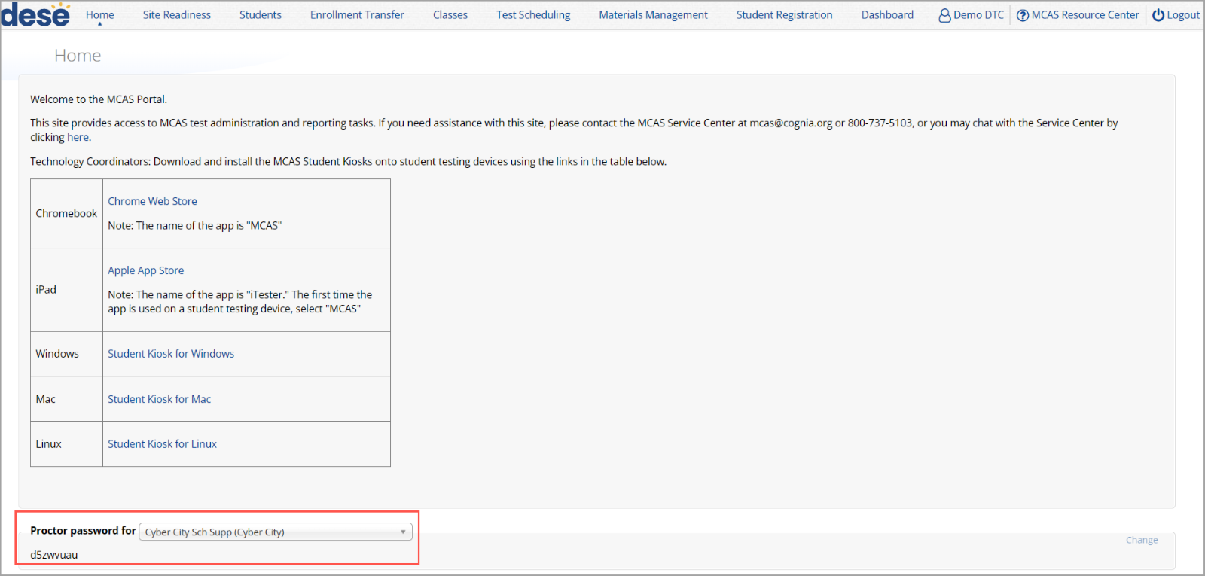
Accessing the Proctor Password
Log in to the MCAS Portal.
Click Administration.
Scroll down to view the Proctor Password.

Slide 41
Viewing Scheduled Tests
Log in to the MCAS Portal.
Click Administration.
Click Test Scheduling.
Use the drop-down menus (Organization, Program, Subject, and Test Name) to filter for the scheduled test.
Locate the scheduled class in the scheduled tests table and click View Details/Student Logins to view the scheduled test details.

Slide 42
Verifying Accommodations
Included in the TAM instructions: Verify accommodations
Verify that the correct accommodated forms such as Screen Reader, Human Read-Aloud, and Human Signer are assigned to students, if applicable. This can be confirmed on the View Details/Student Logins page in the MCAS Portal.
Also verify that students’ other accommodations such as Text-to-Speech are listed, if applicable. This can be confirmed on the Edit Student page in the MCAS Portal or the summary page you were given with your student logins.

Slide 43
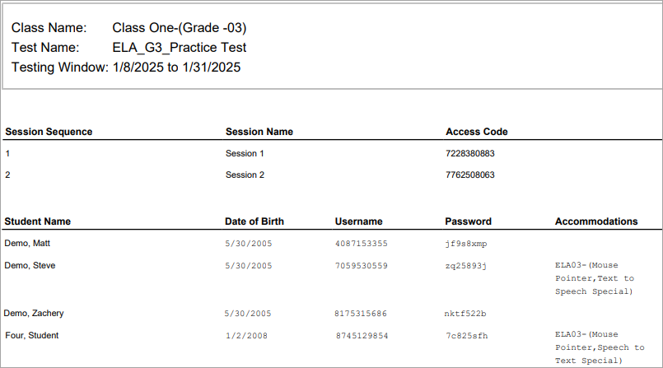
Sample Student Summary Page
Test administrators will write the session access code on the board.
Check that accommodations are correct before testing.

Slide 44
Accessing the Session Access Codes
Sign in to the MCAS Portal and click Administration.
Go to Test Scheduling and use the drop-down menus to filter for the scheduled test.
Locate the scheduled class in the scheduled tests table and click View Details/Student Logins. The session access codes will be listed at the top of the page.

Slide 45
Monitoring Student Testing Status
Sign in to the MCAS Portal and click Administration.
Go to Test Scheduling and use the drop-down menus to filter for the scheduled test.
Locate the scheduled class in the scheduled tests table and click View Details/Student Logins. The table will list the status of each student (Not Started, In Progress, or Finished)

Slide 46
Steps to Complete for Principals/Test Coordinators During and After Testing
CBT tasks for principals/test coordinators:
Tasks to complete during testing: beginning on PAM page 48
Tasks to complete after testing: beginning on PAM page 51
Ask the district SIMS contact to update student data as necessary.
Be prepared to check preliminary data according to the reporting schedule, which will be provided in a spring edition of the Student Assessment Update.
Additional training sessions will be held later this winter.

Slide 47
Go online to the MCAS Service Center website to complete the PCPA.
Principals must complete the PCPA to certify that the school has followed proper MCAS test security protocols.
See PAM page 51 (section I, step 3) for steps to complete the PCPAs.
Note: The PCPA may not be completed by a designee.
Use your school’s 2025 password for the MCAS Service Center website to access the PCPA.
Password letters are in DropBox Central in DESE’s Security Portal.
See the Dec. 10 Student Assessment Update for details.
Schools that do not find their password in their DropBox should email mcas@mass.gov, and questions about completing the PCPA should be sent to mcas@cognia.org.
Deadline dates for submitting the PCPAs:
Grades 3–8: June 9
Grade 10 ELA and Math: May 29
High school Science: June 13

Slide 48
Resources for MCAS Portal Tasks
General MCAS Portal Resources
Guide to the MCAS Portal
MCAS Portal User Management Guide
Recordings of recent training sessions
Register for future trainings and office hours sessions
Resources for Completing (and Updating) Student Registration
MCAS Student Registration Guide
Student Registration Data Definitions
Student Registration Template
Guide to Enrollment Transfers in the MCAS Portal
Resources for Pre-Administration Tasks in the MCAS Portal
Guide to Creating and Managing Classes
Guide to Scheduling tests and Printing Student Logins
Instructional video on creating classes, scheduling tests, and printing student logins

Slide 49
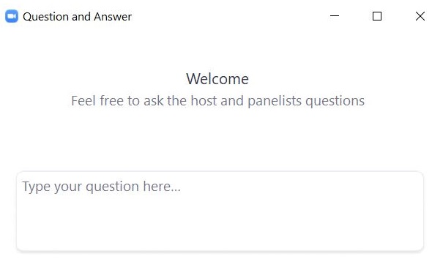
Questions and Answers
Use the “Q&A” feature to ask questions.

Slide 50
4. Test Security Requirements

Slide 51
Poll Question
Which of these are testing irregularities? (Select all that apply.)
wearing a smartwatch during testing
word prediction on the ELA test for a student who has accommodation A18 in their IEP
supplemental Mathematics reference sheet for a student who does not receive accommodation A9
using a calculator on a Science test
students passing notes during testing
copying another student’s work/answers
wearing wireless earbuds

Slide 52
The Framework for Test Security
Prevent
The foundation of a test security plan is always prevention. Most issues can be anticipated and prevented.
Detect
How do you detect incidents? By looking for them.
Investigate
Gather all the facts you can.
Report
Call DESE to report testing irregularities.

Slide 53
The Importance of Leadership
Teachers and students take their cues from above – leaders set the tone.
Superintendents
should review their principals’ test security plans and be comfortable with the procedures in their buildings (PAM, page 3)
are encouraged to visit their schools and observe testing
Principals
must establish school-wide expectations for a proper test administration
must ensure that test administrators are properly trained
must ensure that MCAS protocols are being followed
must ensure that accommodations are correctly given
must sign the Principal’s Certification of Proper Test Administration (PCPA) and attest to a proper test administration

Slide 54
Poll Question
Which of the following materials are secure? (Select all that apply.)
blank scratch paper
student logins
reference sheets
test & answer booklets
used scratch paper
test administrator logins

Slide 55
Secure Content and Materials for CBT
Secure content
MCAS questions not publicly released by DESE
including reading passages, diagrams, writing prompts and other information on testing screens and (for PBT) in testing booklets
student responses to test questions
Secure materials
student logins and test administrator logins
summary pages from the student login PDFs
used scratch paper after testing (until it is securely destroyed)
booklets containing test content or student responses (for PBT)

Slide 56
Confidentiality of Secure Test Content
Principals, test administrators, and others are prohibited from
Viewing test content (on screens or in booklets)
Duplicating or reproducing test content
Technology staff may not take photographs of computer screens.
Discussing test content with anyone before, during, or after testing
Exception for a student reporting a concern about a test question

Slide 57
Exceptions to Prohibition of Test Administrators Viewing MCAS Content
Administering certain accommodations (MCAS Nondisclosure Acknowledgment required)
Accommodations A2, A3.1, A3.2, A3.3, A5, A6.1, A8, A10.1, A10.2, A11, A12, A13, A14, A15
Special access accommodations SA1.2, SA2, SA3.1, SA3.2, SA6
English learner accommodations EL3.2, EL4.1, EL4.2
Assisting a student with the computer interface during testing
Reading a word or phrase aloud on Mathematics, Science, or Civics tests – Universal Accessibility Feature 11 (UF11)
See page 89 of the PAM for the description of UF11

Slide 58
If a Student Has a Concern about a Test Question
If a student reports a concern with a test question (e.g., the student thinks there is a flaw in the question or the student is uncomfortable with the content of the question for a nonacademic reason), the school should do the following:
The test administrator should note the question number, the student’s form number, and the nature of the concern.
The test administrator should report the concern to the principal.
The principal should report the concern to DESE.
School staff should refrain from discussing the content of the test question.
See also page 31 of the PAM.

Slide 59
Handling and Storage of Secure Materials
Store all secure materials in a secure central location.
locked when tests are not being administered
restricted access
Maintain chain of custody of materials during test administration.
Internal tracking forms
Schools can develop their own tracking forms, as long as they adhere to the requirements described on pages 16–17 of the PAM.
Independent counts of secure materials
Do not leave materials unattended.

Slide 60
A Secure Testing Environment – Out of the Room
Students must be supervised when out of the testing room.
e.g., using the restroom, visiting the nurse, moving to a test completion room or supervised lunch
A few options
hallway monitors
monitors stationed at restrooms with lines of sight to testing rooms
staff who escort students to and from the restroom
Optional scripts in Test Administrator’s Manuals (TAMs) to read prior to
the transition to a test completion room
a supervised lunch break
students visiting the restroom

Slide 61
A Secure Testing Environment – In the Room
Cover or remove prohibited classroom displays.
No unauthorized visitors in testing rooms
parents, media, non-testing students
teachers not assigned to the room as test administrators
Testing rooms may be entered by
technology staff for troubleshooting
school administrators (including the testing coordinator)
district personnel
DESE observers
When possible, use two test administrators in the room.

Slide 62
Secure Room Set-up for Computer-Based Testing
Students must not be able to view any screen but their own.
Set up rooms in advance to test out different seating arrangements (e.g., spreading desks out, staggering students, turning students in different directions).
Consider physical barriers (partitions, privacy screens, cardboard taped to the side of monitors).
Have an administrator walk around at the start of testing and check all the rooms.

Slide 63
Prohibited Materials
Make sure students understand they are not allowed to have
cell phones and other electronic devices (e.g., wireless ear buds, smartwatches)
calculators on noncalculator tests and sessions
notes or reference material beyond what they’re given, such as additional reference sheets, graphic organizers, multiplication grids (exceptions for certain accommodations)
dictionaries
A poster showing examples of prohibited materials is available for download and printing
New resource from the MA attorney general – "Cell Phones and Social Media in Schools: A Toolkit for School Leaders and Communities"

Slide 64
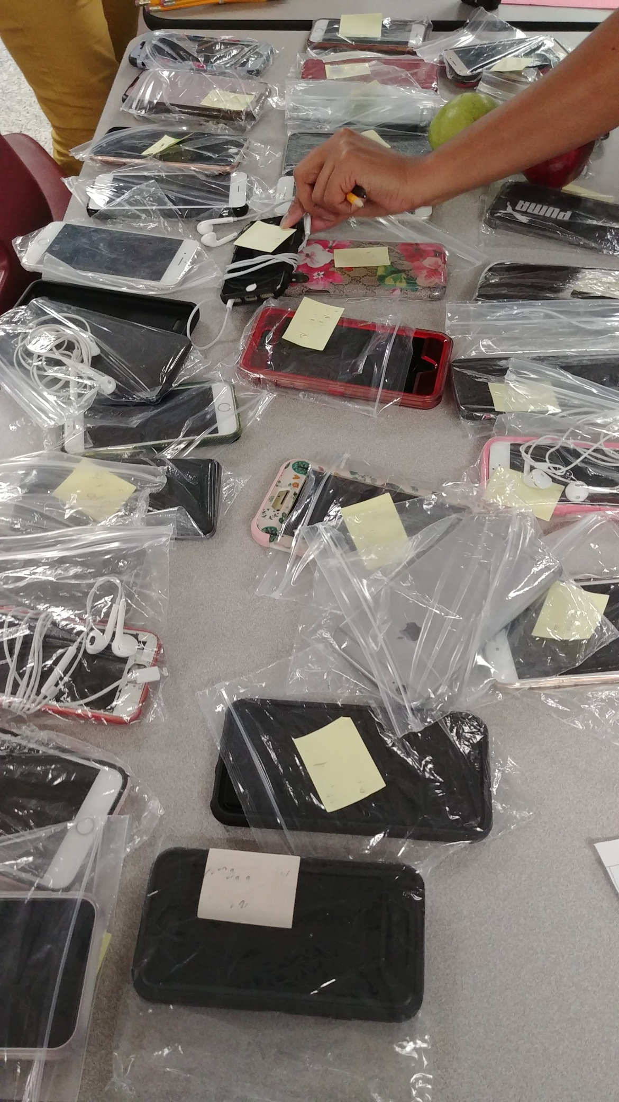
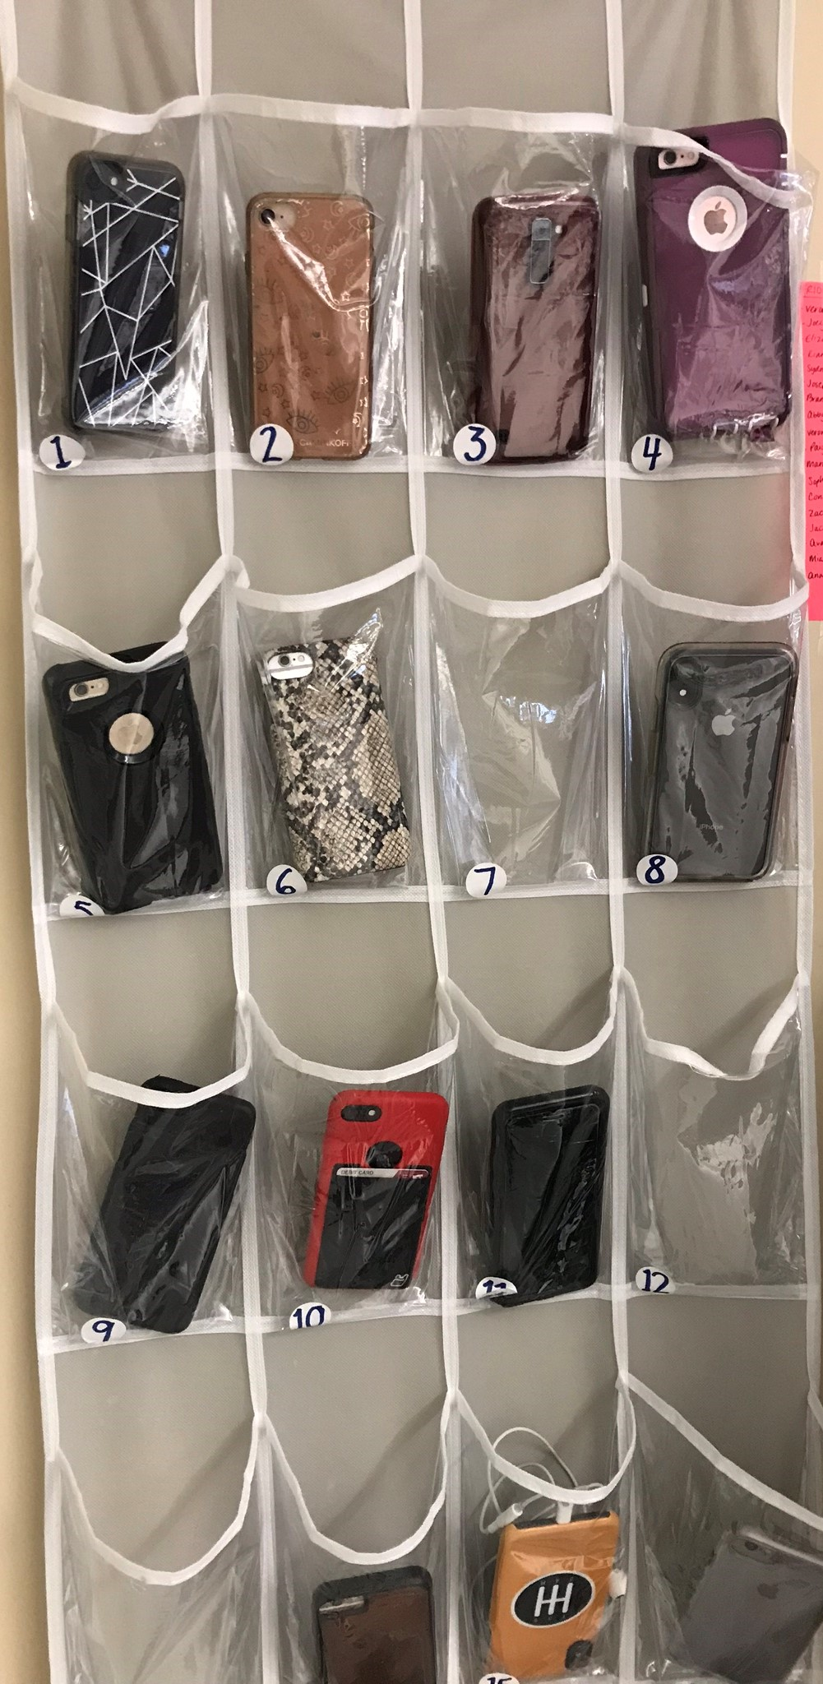
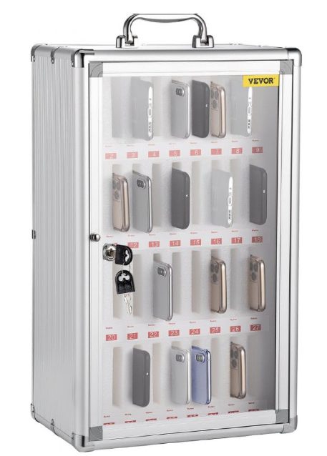
Examples of Collecting Cell Phones
Thanks to New Bedford High School
Thanks to Swampscott High School
Thanks to Lowell High School

Slide 65
Poll Question
How do you ensure students don’t have access to cell phones during testing? (Select all that apply.)
Students put phones in backpacks and put backpacks to the side/back of the room.
Phones are collected and kept at the front of the room with the test administrator.
Phones are put in lockers and not allowed in the testing room.
Students are not allowed to bring phones to school.
Student phones are locked away during the school day (e.g., in storage cases or Yondr pouches).
Other

Slide 66
Training Test Administrators and Other Personnel
All individuals involved in MCAS administration must participate in a school-provided training session.
MCAS test security requirements (Part I of the PAM)
MCAS test administration protocols (Part III of the PAM)
School-specific procedures and logistics
Sample slides for training test administrators (to be posted soon)

Slide 67
Training Test Administrators and Other Personnel – Documentation
Test administrators must sign forms to acknowledge the following:
participation in training
receipt of TAMs
combined sample form
Test administrators who will administer certain accommodations to students with disabilities or ELs must sign an MCAS Nondisclosure Acknowledgment
See page 20 of the CBT TAM, page 20 of the PBT TAM, or page 91 of the PAM for the list of accommodations this requirement applies to (also listed on slide 57).

Slide 68
Test Administrator Responsibilities
Test administrators must
Maintain the chain of custody of secure materials.
Make sure students have the correct materials for each session.
Follow instructions in the TAMs and read scripts verbatim.
Circulate throughout the room to prevent cheating and the use of prohibited materials – active proctoring.
Focus their full attention on the testing room.
Refrain from coaching students or influencing their responses in any way.

Slide 69
Poll Question
Which of the following are examples of coaching? (Select all that apply.)
“Don't forget to use specific examples in your essay.”
“You need to write more.”
“Just do your best.”
“Give your best effort.”
“Remember what we talked about in class last week.”
“You’ve got this.”

Slide 70
What is Coaching?
Providing hints or clues
“Think about what we studied in class last week.” “What’s the acronym for order of operations?” “Consider it from the main character’s perspective.” “Don’t forget to use specific examples in your essay.”
Indicating in any way that a student has answered a question incorrectly:
“You should look at that one again.”
“Check your work” (to a specific student on a specific question)
Defining or spelling words
Explaining, simplifying, or paraphrasing any part of the test
Suggesting that a student write more
Influencing a student’s response through gestures, facial expressions, nods, body language, or changes in voice inflection

Slide 71
What is Permitted?
Assisting students with technology-related problems
helping a student sign in to the MCAS Student Kiosk (this is the only situation in which a test administrator may type directly into a student’s test)
pointing to a tool button if a student is unable to find it
explaining to a student how to enter a result in the equation editor
explaining how to navigate to a test question from the review screen
Re-reading part of the TAM script to students
E.g., As students finish, can read script to students to check their work.
Encouraging students if they have questions about test content:
“Just do your best.” “Just give your best effort.” “Do the best you can.”

Slide 72
Test Security Requirements for Students
Students’ results may be invalidated if they engage in any of the following activities:
duplicating any portion of secure test content
accessing prohibited materials such as cell phones or other electronic devices
communicating with other students (e.g., talking, whispering, writing notes)
looking at any other student’s computer screen or answer booklet
asking for or receiving help from anyone (except for reporting a concern about a test question to a test administrator)
providing help to another student
consulting notes, books, or instructional materials during testing
discussing test content with a student who hasn’t tested yet.
See sample form for students and a sample letter to send to parents (recommended for grades 6 and up)

Slide 73
Poll Question
What should you do first if a testing irregularity happens at your school?
Call DESE’s Office of Student Assessment Services.
Call the MCAS Service Center.
Contact the student’s parents/guardians.
Email an irregularity report to DESE.

Slide 74
Reporting Requirements for Certain Irregularities after Students Have Completed Their Tests
Irregularities involving benign use of electronic devices after students have submitted their tests in the MCAS Student Kiosk (or turned in PBT materials) do not need to be reported to DESE.
These situations can be handled locally, with any school-based consequences at the discretion of the principal.
This is not a change to any of the policies on prohibited devices described in slide 63 and on pages 21–22 of the PAM – it is only a change in reporting requirements.
As always, schools can call DESE to consult.

Slide 75
Steps to Take after a Security Incident or Irregularity
Call DESE at 781-338-3625.
Investigate the incident.
Talk to the test administrator(s) involved.
Talk to any students involved.
Collect documents (e.g., notes, extra reference sheets).
If reporting a read-aloud violation, determine how much of the test was read.
If reporting a calculator violation, determine which items were solved with the calculator.
Submit a report if instructed to.
Take any local action that is appropriate.

Slide 76
Questions and Answers
Use the “Q&A” feature to ask questions.

Slide 77
5. Accessibility and Accommodations

Slide 78
Resources for Accessibility and Accommodations
Category | Resources
Test administration manuals | Appendix C of the Principal’s Administration Manual Appendices F, G, and H of the CBT Test Administrator’s Manual Appendices E–J of the PBT Test Administrator’s Manual
Other guidance materials | Accessibility and Accommodations Manual and other resources Procedures During Testing for Students Who Use a Cell Phone or Smartwatch to Monitor Medical Information Expansion of Bilingual Spanish/English MCAS Tests in 2025
Previous trainings and modules | Recordings and slides in the MCAS Resource Center on the Training page January 16: Overview of Student Registration January 21 and 22: MCAS Accessibility and Accommodations

Slide 79
Participation of Students with Disabilities and EL Students
Students with disabilities
Participate according to IEP or 504 plan
Paper-based tests are available as an accommodation for students with disabilities who are unable to use a computer for testing.
English learners (ELs) are required to participate in MCAS or MCAS-Alt in all subjects required their grade.
Exception: First-year ELs have option to participate in ELA testing for diagnostic purposes only.
“First-year EL” is a student whose name does not appear in March 2024 SIMS.
Paper-based tests available as an accommodation for first-year ELs unfamiliar with technology
Bilingual word-to-word dictionaries available for current ELs and students who were ever EL
Spanish/English tests available for all grades and subjects except ELA
See Appendix C of the PAM for more information.

Slide 80
Test Preparation
Students should:
Become familiar with features and basic functionality of MCAS Student Kiosk.
Take online practice tests prior to test administration.
Review student tutorial, expected to be available by mid-February.
Schools should:
Plan for testing students with accommodations.
Schedule testing locations, test administrators, and testing time.
Set up specialized computers/Assistive Technology (AT) after reviewing IEPs, 504 plans, and local EL accommodations forms.
Plan to monitor accommodations.

Slide 81
Prohibitions for Accommodations
Test administrators may NOT:
Students’ results may be invalidated for these situations:
Provide accommodations not listed in
a student’s IEP or 504 plan
Appendix C of the PAM, without prior DESE approval
Provide a student with a modified version of a test or a test for a different grade.
Coach or assist a student with their responses
E.g., “Write more” or “Go back and review”
Provide clues/assistance/definitions
Using an English-language dictionary for ELA
Reading aloud the ELA test to a student who does not have this Special Access accommodation in their IEP
Giving a calculator on noncalculator session of the Mathematics test to a student who does not have this Special Access accommodation in their IEP
Test administrator coaching or assisting a student

Slide 82
Questions and Answers
Use the “Q&A” feature to ask questions.

Slide 83
6. Additional Resources, Support, and Next Steps

Slide 84
Additional Resources
Resource | Description
ELA | Mathematics | STE | Civics | Test designs
Sample materials from schools | Locally developed test administration materials from schools/districts
Cybersecurity information | Guidance on cybersecurity
Civics topic assignment | Grade 8 Civics topic assignment and resources for schools
January 23 Student Assessment Update | Updates to test designs

Slide 85
Upcoming Training Sessions
Session | Date and Registration Link | Intended Audience | Recommended Read-Ahead Materials
Student Registration Office Hours for High Schools | Wednesday, January 29 at 9:30–10:30 a.m. | High school principals and school test coordinators, district test coordinators | MCAS Student Registration Guide
MCAS Test Security and Administration Protocols​ ​ for Returning Staff​ | Thursday, January 30 at 9:30–11:15 a.m.​ | Principals and school test coordinators, district test coordinators | The Spring 2025 MCAS Principal's Administration Manual is planned to be available in advance of this session. Participants are encouraged to review Part I — MCAS Test Security Requirements prior to the training session.
Office Hours — MCAS Portal Tasks for February Science | Friday, January 31 at 9:30–10:30 a.m. | High school principals and school test coordinators, district test coordinators | MCAS Student Registration Guide Guide to the MCAS Portal Guide to Creating and Managing Classes

Slide 86
Test Admin Workgroup Input: “What advice would you give to a new test coordinator?”
Be thorough in knowing every facet of the process.
Make your own list of activities and estimate how much time it may take you and other departments to produce any information you may need. Ensure that you're not caught out-of-time.
Start creating one test box for a testing room and put everything you think a test administrator may need in this box. Review the materials and make lists of what every box needs, then replicate it.
Make cheat sheets for what you may need to get done during testing and have that information readily available during testing.
Attend trainings, ask your district for support, read through the manuals.

Slide 87
Next Steps
Today: Complete the evaluation form.
Responses are associated with the name and email address used to log in.
Email your input to mcas@mass.gov if you have problems accessing or completing the form.
Within one week:
Receive an email with the Q&A from this session
Recording will be available

Slide 88
Email and Phone Support
MCAS Service Center
DESE Student Assessment Services
Questions on logistics and technology
Web: https://mcas.onlinehelp.cognia.org/
Email: mcas@cognia.org
Phone: 800-737-5103
TTY: 888-222-1671
Live chat is available at the link on the bottom of the page at the MCAS Resource Center
Policy questions (e.g., student participation, accommodations)
Web: www.doe.mass.edu/mcas
Email: mcas@mass.gov
Phone: 781-338-3625
TTY: 800-439-2370

Slide 89
7. Protocols for PBT - Accommodations A1 and EL1

Slide 90
Booklets for Spring 2025
Grades/Subjects | Type of booklets | # of booklets and description
Grades 3–8 tests | Combined test & answer booklets | One booklet per subject (both sessions for each subject in a single booklet)
Grade 10 ELA and Mathematics, Biology and Introductory Physics | Combined test & answer booklets | One booklet per session (two booklets total)
Spanish/English editions (grades 3–8 and 10 Mathematics, grades 5 and 8 STE, grade 8 Civics, high school Biology and Introductory Physics) | Separate test booklets and answer booklets | One test booklet for each session, and one answer booklet for each session (four booklets total)
Secure PBT materials include these booklets, test questions not publicly released by DESE, and student responses.

Slide 91
Receive Test Materials and Prepare for Distribution
Account for secure materials using ID #s on packing slips, and document the counts on internal tracking forms and Materials Summary.
DESE recommends having 2 people present to count materials upon receipt.
Affix Student ID Labels to answer booklets before testing
Labels based on SIMS/SIF as well as Student Registration updates
Can open packages of answer booklets up to two days prior to apply labels
Can open packages of test & answer booklets one day prior to apply labels, and then seal in envelopes until the day of testing. Document the count on the envelopes.
See PAM page 76, step 5.

Slide 92
Order Materials for Newly Enrolled Students
A small overage is shipped to schools; check your shipment to determine if you have extra materials.
Order additional materials if the overage doesn’t cover your testing needs
Materials are shipped for receipt on the following business day if the order is received before 12:00 p.m. (two business days otherwise).
Remember to update Student Registration in the MCAS Portal.

Slide 93
Additional Preparations for PBT
Additional resources for preparing students
Released PBT questions
Gridded response guidelines for Mathematics
PBT edition of the student questionnaire
Tools available for students taking Mathematics and STE
Lists on pages 85–87 of the PAM

Slide 94
Steps During and After Testing
After each test session, verify that all materials have been returned to you.
Independently count materials after each test administrator counts their materials.
Double-check central storage area.
In the bottom of a bin and in between file folders
Find original shipping cartons to return materials.
See the PAM for packing instructions and lists of materials for school files, to recycle/discard, and to securely destroy.

Slide 95
Important Reminders for Packing PBT Materials
Review “Special Instructions” included with Braille, and large-print materials to avoid problems with scoring.
Review tables in the PAM on pages 80 and 81 to determine whether to assign booklets for students, and instructions on student information on booklet covers.
If necessary, return the following materials in the Special Handling Envelope:
All large-print booklets, along with corresponding standard booklets with transcribed work
Typed responses, printed and slipped inside standard booklets (see pages 107–109 of the PAM for the header information for each page).
If necessary, return booklets that should not be scored in the Void Envelope.
Fill in “void booklet” circle on outside back cover (follow transcription instructions if needed).
Return all other used and unused booklets (except for Braille) in the Return Envelope marked with the corresponding subject.
All materials will be shipped back to the contractor in their original packing cartons.

Slide 96
The Return Shipment
Complete the Materials Summary and retain it for school files.
Reconcile quantities of secure materials received vs. returned.
Maintain security of materials while preparing for pickup.
Use correct UPS labels.
Do not take materials to UPS or remove from building.
Do not leave materials unattended.
Prescheduled automatic pickups
A UPS driver will automatically come to the school on the pickup deadline date for each administration. Schedule earlier pickup if ready.
Grades 3–8 ELA: April 29; Grades 3–8 Math/STE: May 27; Grade 8 Civics: June 10
Grade 10 ELA: April 7
Grade 10 Mathematics: May 30
High School Science: June 13

Slide 97
THANK YOU
The Office of Student Assessment Services
781-338-3625
mcas@mass.gov
www.doe.mass.edu/mcas
135 Santilli Highway, Everett, MA 02149

