Slide 1
Student Registration for High Schools Office Hours
The Office of Student Assessment Services
January 29, 2025

Slide 2
Presenters
Jodie Zalk, Manager of Test Administration and Publications
Shannon Cullen, MCAS Test Administration Coordinator
Abbie Currier, eMetric Sr. Project Manager

Slide 3
Logistics for This Session
Use the Q&A feature to ask a question.
We will answer some questions aloud at specified times during this training session, and we will email the Q&A afterwards.
Type your questions anytime, but we may not answer them in real time as some questions may be covered during the presentation.
Use the thumbs-up icon to “upvote” someone else’s question.
Email student-specific questions to mcas@mass.gov instead of asking here.
This session is being recorded and will be available in about a week in the MCAS Resource Center, along with the slides.
Closed captioning has been enabled for participants who need it.

Slide 4
Slides for This Session
Slides were emailed to participants before this session from MCASEvents@cognia.org.
Slides are now being posted in the chat.
If you cannot access the slides in the chat, ask in the Q&A.
After the session, we will send the slides again to participants, and they will be posted in the MCAS Resource Center along with the recording.

Slide 5
Today’s Agenda
Enrollment Transfer Process
Q&A and Additional Demonstrations

Slide 6
1. Enrollment Transfer Process

Slide 7
Overview of Enrollment Transfers
Students are loaded to the MCAS Portal once per school year, regardless of which administration(s) they are taking.
Schools will use the Enrollment Transfer feature in the MCAS Portal for transfer students who need to be registered for testing at their new school, who already exist in the MCAS Portal.
When a school receives a transfer student who needs to be registered for testing, the first step should be to search for the student using the Enrollment Transfer page in the MCAS Portal.
Note: This is different from the previous test administration management system, PearsonAccess Next (PAN).

Slide 8
Overview of Enrollment Transfers – New for 2025
Schools will use the Enrollment Transfer page in the Portal as the first step when receiving a new student to determine whether the student exists in the MCAS Portal.
This page will tell you whether the student already exists in the MCAS Portal.
All school and district test coordinators associated with the sending school will receive email notifications for pending enrollment transfer requests.
Student test sessions do not transfer from one school to another. The sending school will use the Transfer Notes feature to indicate which sessions a student has already completed.
The receiving school will use this information to determine which test(s), if any, have already been taken.
Schools may need to complete enrollment transfers more often in the MCAS Portal.

Slide 9
Enrollment Transfer Overview
MCAS Portal Section | Tasks to Complete in this Section | Who will complete these tasks?
Enrollment Transfer | Request to transfer a student into your school and district. | STCs and DTCs may request to transfer a student.
 | Approve transfers other schools and districts have requested. | STCs and DTCs may approve student transfers. If a student does not currently belong to an organization, the MCAS Service Center will approve student transfers.
When a receiving school requests a student transfer, the DTC and STC users associated with the sending school will receive an email notification.

Slide 10
Demonstration
Transferring students within your district

Slide 11
Transferring Students within a District
These steps can only be completed by a district test coordinator.
Sign in to the MCAS Portal and select Administration.
Click Students.
Locate the student you wish to update and click Enrollment Info.
Click Unenroll to unenroll the student from the current school and click Yes to confirm.

Slide 12
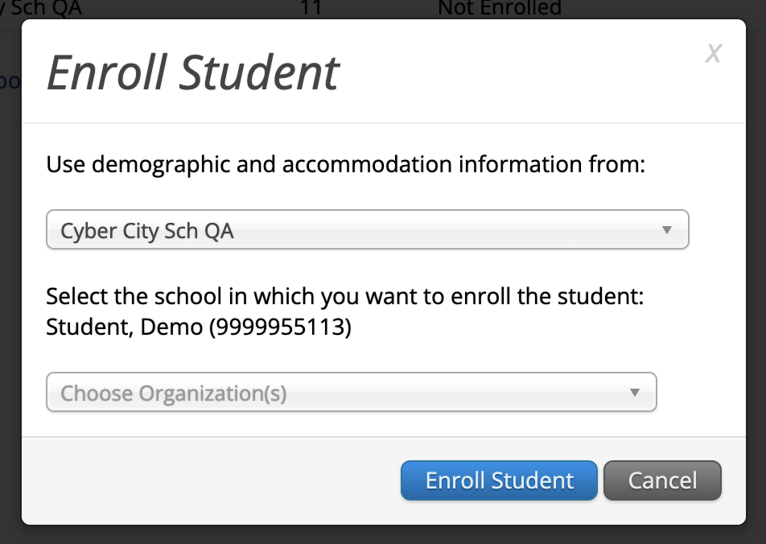
Transferring Students within a District (cont’d)
5. Click Enroll student in a different school.
6. Select the new school from the organization drop-down and click Enroll Student.
7. Ensure the student’s information is correct and click Save.
Note that only District Test Coordinators may transfer students within a district. School test coordinators should contact their DTC for assistance.

Slide 13
Demonstrations
Transferring students outside your district
Requesting student transfers
Approving student transfer requests
Entering and reviewing transfer notes

Slide 14
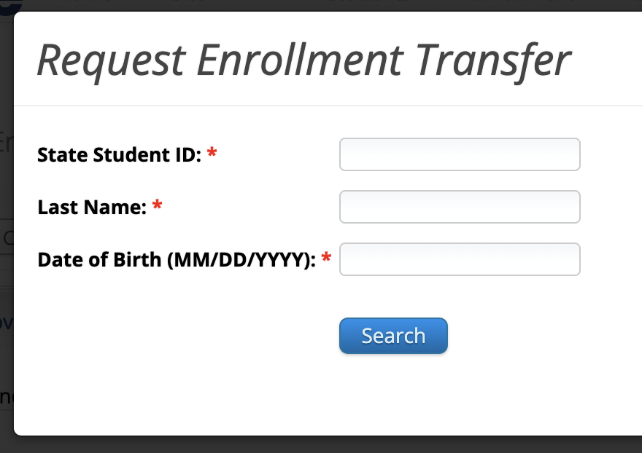
Transferring Students from Outside Your District: Requesting a Student Enrollment Transfer
Sign in to the MCAS Portal and select Administration.
Select Enrollment Transfer.
On the Enrollment Transfer page, select Request Transfer.
Enter the student’s SASID, last name, and date of birth.
Select Search.

Slide 15
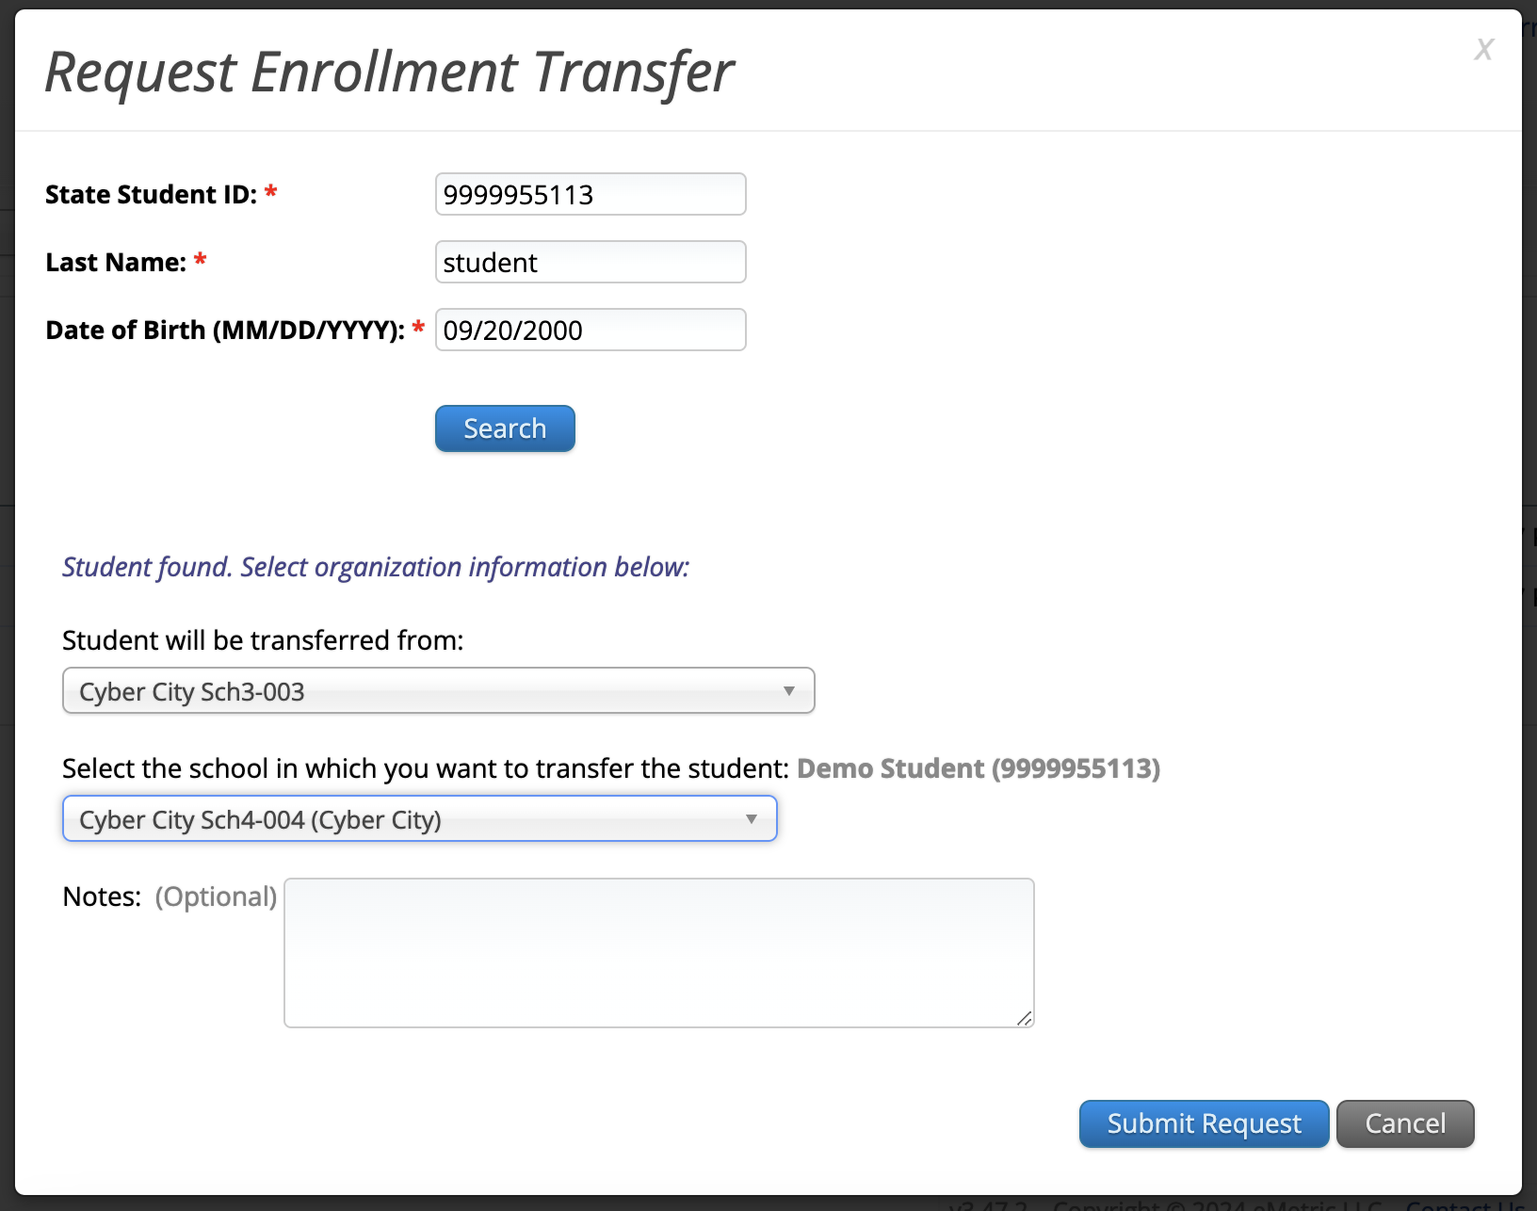
Transferring Students from Outside Your District: Requesting a Student Enrollment Transfer (cont’d)
If the student is found, select the school into which you want to transfer the student.
If this request is during the testing window, use the Notes to ask questions as needed.
Select Submit Request.

Slide 16
Transferring Students from Outside Your District: Requesting a Student Enrollment Transfer (cont’d)
Any student transfers you have initiated will appear on the Requests tab.
Select Cancel to cancel the transfer request.

Slide 17
Approving a Student Enrollment Transfer
Any student transfers waiting for your approval will appear on the Approvals tab.
DTCs and STCs will be notified of enrollment transfers that need their review via email and on the Administration home page.
Review the request and add transfer notes. Click Approve to approve the transfer or click Reject to reject the request.

Slide 18
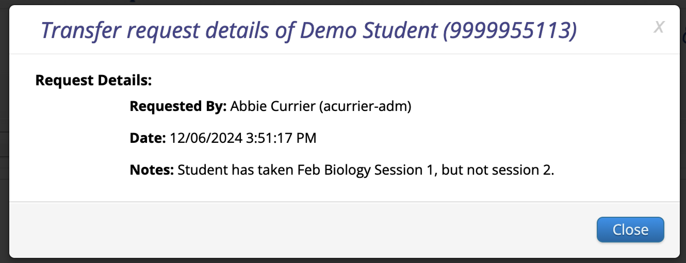
View Details
Student test sessions do not move from one school to another in the MCAS Portal. Schools will use the Transfer Notes feature to note any test sessions the student has already completed.
Schools can refer to the View Details screen at any time to view the Transfer Notes for an enrollment transfer.

Slide 19
2. Q & A and Additional Demonstrations

Slide 20
Additional Resources
Resource | Location
MCAS Resource Center | mcas.onlinehelp.cognia.org
MCAS Portal User Guides Student Registration Guide MCAS Portal User Management Guide Guide to Creating and Managing Classes Guide to Enrollment Transfers Guide to Scheduling Tests and Printing Student Logins | https://mcas.onlinehelp.cognia.org/portal/
MCAS Portal Modules and Video Demonstrations Video demonstration: Creating Classes and Scheduling Tests | https://mcas.onlinehelp.cognia.org/training-modules/
Technology Information Technology Guidelines for MCAS Computer-Based Testing Guide to Installing the MCAS Student Kiosk and Conducting Site Readiness | https://mcas.onlinehelp.cognia.org/ technology-setup/
Student Assessment Updates (Biweekly email with important updates about the MCAS program) | www.doe.mass.edu/mcas/updates.html If you do not already receive this email, subscribe using this link: http://eepurl.com/ghSOhH

Slide 21
Student Registration Deadlines
Administration | Initial Student Registration Window Important for receiving manuals on time and Student ID Labels for PBT
March Retests | January 21–31
Grade 10 ELA and Mathematics | January 27–February 7
Spring High School Science | April 11–29
See the Statewide Testing Schedule for the following:
Extended deadlines for CBT
Deadlines for updating student registration information (as needed) after administration
If a high school will not have any students participating in an administration, the school needs to email mcas@cognia.org to let them know by the deadlines listed in the table above.

Slide 22
Registered Students Who Will Not Participate
If a school has registered a student for a test administration and that student will not participate:
Remove the student from any class for that test they were assigned to.
There are no further steps the school needs to take.
See the Guide to Creating and Managing Classes for information on removing students from classes.

Slide 23
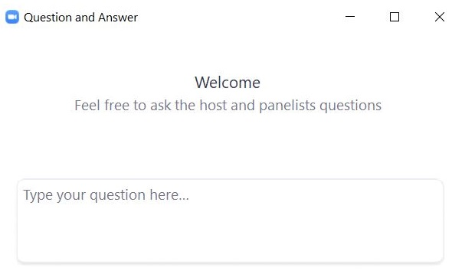
Questions & Answers
Use the “Q&A” feature to ask questions.

Slide 24
Next Steps
Today: Complete the evaluation form.
Responses are associated with the name and email address used to log in.
Email your input to mcas@mass.gov if you have problems accessing or completing the form.
Within one week:
Receive an email with the Q&A from this session
Recording will be available

Slide 25
Email and Phone Support
MCAS Service Center
DESE Student Assessment Services
Questions on logistics and technology
Web: https://mcas.onlinehelp.cognia.org/
Email: mcas@cognia.org
Phone: 800-737-5103
TTY: 888-222-1671
Live chat is available at the link on the bottom of the page at the MCAS Resource Center
Policy questions (e.g., student participation, accommodations)
Web: www.doe.mass.edu/mcas
Email: mcas@mass.gov
Phone: 781-338-3625
TTY: 800-439-2370

Slide 26
THANK YOU
The Office of Student Assessment Services
781-338-3625
mcas@mass.gov
www.doe.mass.edu/mcas
135 Santilli Highway, Everett, MA 02149

