Slide 1
Overview of Student Registration Tasks for the MCAS Portal: Spring 2025
The Office of Student Assessment Services
January 16, 2025

Slide 2
Presenters
Jodie Zalk, Manager of Test Administration and Publications
Robert Pelychaty, Manager of Inclusive Assessment
Shannon Cullen, MCAS Test Administration Coordinator
Abbie Currier, eMetric Sr. Project Manager

Slide 3
Logistics for This Session
Use the Q&A feature to ask a question.
We will answer some questions aloud at specified times during this training session, and we will email the Q&A afterwards.
Type your questions anytime, but we may not answer them in real time as some questions may be covered during the presentation.
Use the thumbs-up icon to “upvote” someone else’s question.
Email student-specific questions to mcas@mass.gov instead of asking here.
This session is being recorded and will be available in about a week in the MCAS Resource Center, along with the slides.
Closed captioning has been enabled for participants who need it.

Slide 4
Slides for This Session
Slides were emailed to participants before this session from MCASEvents@cognia.org.
Slides are now being posted in the chat.
If you cannot access the slides in the chat, ask in the Q&A.
After the session, we will send the slides again to participants, and they will be posted in the MCAS Resource Center along with the recording.

Slide 5
Today’s Agenda
Introduction
Overview of the Student Registration Process
Preparing the Initial File for Import
Steps for Completing the Initial Import
Steps after the Initial Import
Resources, Support, and Next Steps
Live “Sandbox” Time with Additional Demonstrations
Note: This training will not cover enrollment transfers, creating classes, test scheduling, or navigating the MCAS Student Kiosk. These topics will be covered in future training sessions.

Slide 6
Poll Question—3
What is your role? (Check all that apply)
District test coordinator
School test coordinator
Principal
Guidance counselor
Technology staff
Other district staff
Other school staff

Slide 7
Poll Question—3
How many years have you coordinated MCAS test administration?
0–This is my first year.
1 year
2–3 years
4–5 years
6+ years

Slide 8
1.Introduction

Slide 9
New Systems for MCAS Computer-Based Testing Beginning in 2025
Crosswalk of terminology:
www.doe.mass.edu/mcas/testadmin/crosswalk-of-terminology.pdf
New MCAS Portal for 2025 and pre-administration tasks (fall 2024):
October 18 Student Assessment Update https://us14.campaign-archive.com/?u=d8f37d1a90dacd97f207f0b4a&id=69d17e38c8
MCAS training sessions on tasks in the MCAS Portal:
For test coordinators: https://mcas.onlinehelp.cognia.org/training-webinars/
For technology coordinators: https://mcas.onlinehelp.cognia.org/training-webinars-portal-tasks-tech-coordinator/
Additional resources in the new MCAS Resource Center:
https://mcas.onlinehelp.cognia.org/

Slide 10
What’s New for 2025?
General updates
Civics is a required assessment for students in grade 8, and accessibility features and accommodations are available for the Civics MCAS assessment.
High school participation
Based on the update to the Competency Determination, students will not participate in the high school tests/retests for Competency Determination purposes.
Refer to the high school participation guidelines for new eligibility criteria: www.doe.mass.edu/mcas/highschool.html
New accommodations in Student Registration
Beginning in 2025, MCAS tests will be translated into Spanish for Mathematics, Science, and Civics tests at grades 3–8 (in addition to the high school tests in Mathematics and Science).

Slide 11
Fall 2024 Tasks
Task | Person responsible | Recommended Deadline
Create and edit MCAS Portal user accounts | Test coordinators | November 15 for test coordinator and technology coordinator accounts; Three weeks before test administration for test administrator accounts
Download and install the MCAS Student Kiosk on student testing devices | Technology coordinator | November 15 for high schools; December 13 for grades 3–8
Conduct Site Readiness to certify that technology infrastructure is ready for testing | Technology coordinator | November 15 for high schools; December 13 for grades 3–8

Slide 12
Tasks to Complete in the MCAS Portal During Test Administration for School Test Coordinators
Task | Timeframe for completing task
Student registration (with extended window to follow for CBT) | Approximately 2 months before administration
Assigning and managing accommodations | During Student Registration and throughout testing
Create and assign students to “classes” | Approximately 2 weeks before administration
“Schedule” classes in the MCAS Portal for CBT | Available one week before administration
Printing student logins | 1–2 days before testing
Monitoring test administration Test coordinators and test administrators view student statuses, and test coordinators can view dashboards. | During testing
Note: Schools and districts will also use the MCAS Portal after testing to access reports of results.

Slide 13
2. Overview of the Student Registration Process

Slide 14
What is Student Registration?
Student Registration is a collection of student-level data, including
student demographic data
information on selected accommodations that a student will use during testing
Student Registration must be completed to determine the basis for the initial shipment of materials to schools, including
test administration manuals (CBT and PBT)
Student ID Labels for paper-based tests (PBT)
PBT test and answer booklets, including special test editions
Student Registration determines initial test orders and provides a record of students tested and the accommodations they used.
District and school test coordinators and technology coordinators have permissions in the MCAS Portal to upload and edit student data.

Slide 15
Resources for Completing Student Registration
MCAS Student Registration Guide
Instructions for completing the initial process
Instructions for updating student information after the initial file upload
Field Definitions, Notes, and Validations section:
Describe each of the columns in the Student Registration file.
Indicates which columns are required for import.
Includes details on test codes (column J)
Describe eligibility to receive the accommodation and describe how to complete that field.
Expected Values indicate options for column input.
Appendix A: MCAS Portal Guidance for Form-Dependent Accommodations
Student Registration Data Definitions
Includes the same information as the Field Definitions, Notes and Validations section of the MCAS Student Registration Guide
Student Registration Template
All resources are available on the MCAS Resource Center.

Slide 16
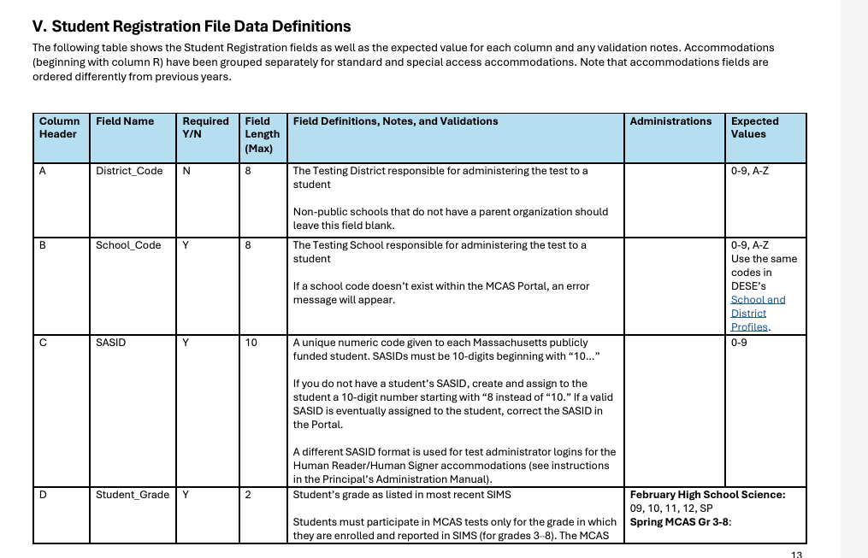
Field Definitions, Notes, and Validations

Slide 17
Overview of Steps to Complete Student Registration
Download the .CSV file prepared by DESE from Dropbox Central in the DESE Security Portal (available on the first day of each Student Registration window).
Delete students from the file who are no longer enrolled in your school, and add rows for students who were not included in the file and will be testing.
Verify and update students’ accessibility features and accommodations.
Save as a .CSV file, and import file into the MCAS Portal.
Resolve any errors that occur.
Update student information as needed, through file export/import process or through the user interface.

Slide 18
For what reasons and when should we update Student Registration?
1. Initial Student Registration Window
2. Extended Student Registration Window for CBT
3. Test Administration Window
4. Deadline for Updating Student Registration information
Add students.
Remove students/ test assignments.
Edit accommodations.
Edit demographic info.
Same as 1, but additional steps are required for some accommodations (see slide 21)
Same as 1, but may need to order additional paper-based tests
Edit accommodations that were not used.
Edit demographic info.

Slide 19
Student Registration Deadlines
Administration | Initial Student Registration Window Important for receiving manuals on time and Student ID Labels for PBT
March Retests | January 21–31
Spring Grades 3–8 (ELA, Mathematics, STE, and Civics) | January 21–31
Grade 10 ELA and Mathematics | January 27–February 7
Spring High School Science | April 11–29
See the Statewide Testing Schedule for the following:
Extended deadlines for CBT
Deadlines for updating student registration information (as needed) after administration
If a high school will not have any students participating in an administration, the school needs to email mcas@cognia.org to let them know by the deadlines listed in the table above.

Slide 20
MCAS Accessibility and Accommodations
Review the Accessibility and Accommodations Manual.
Remember to assign accessibility features and accommodations appropriately:
Accessibility features available to all students
Accommodations available only for students with disabilities and ELs
All accommodations with the “SR” designation in the Accessibility and Accommodations Manual must be selected prior to testing.
Some accommodations cannot be changed after a student signs in to the test.
If the correct accommodations are not selected before a student signs in, additional steps during testing will be required.
Use Appendix A in the Accessibility and Accommodations Manual for a crosswalk of accessibility feature and accommodation numbers and the Student Registration column to assign them correctly.

Slide 21
Form-Dependent Accommodations
The following accommodations must be assigned correctly before testing. If not assigned correctly, a student’s test will need to be stopped and a new test will need to be set up, and the student may need to retake a portion of the test.
Form-dependent accommodations for CBT:
ASL video (spring grade 10 Math and June high school Science)
Compatible assistive technology
Human read-aloud
Human signer
Screen reader
Spanish/English (Math, Science, and Civics)
Form-dependent accommodations for PBT:
Large print
Braille
Spanish/English
New for 2025:
Text-to-speech is not a form-dependent accommodation. The accommodation can be added during testing if necessary, without voiding the student’s test.

Slide 22
Accessibility Features and Accommodations That Must Be Included in Student Registration Prior to Testing
Accommodation # | Description
UF4 | Enlarged cursor/Mouse pointer tool
A1 or EL1 | Paper-based edition (for students unable to use a computer)
A2 | Large-print edition
A3.1 or A3.2 | Screen reader or Braille edition for a student who is blind or visually impaired
A3.3 | Assistive Technology
A4 or EL3.1 | Text-to-speech (TTS) for Mathematics, STE, and Civics (not ELA)
A5 or EL3.2 | Human read-aloud for Mathematics, STE, and Civics (not ELA)
A6.1 or A6.2 | Human signer for Math, STE, Civics, or ELA test questions only (but not ELA reading passages) or ASL video for spring grade 10 Math and June high school Science – CBT only
A9 | Graphic organizer, checklist, or supplemental reference sheet
A10.1 or A10.2 EL4.1 or EL4.2 | Scribe responses or speech-to-text for Mathematics, STE, and Civics (not ELA)
A12 | Typed responses – PBT only
A18 or EL8 | Word prediction for Mathematics, Science, and Civics (not ELA)
EL7 | Spanish/English editions of the Mathematics, STE, or Civics tests
Refer to Appendix A of the MCAS Student Registration Guide for additional instructions for these accommodations.

Slide 23
Special Access Accommodations That Must Be Included in Student Registration Prior to Testing
Accommodation # | Description
SA1.1 | Text-to-speech for ELA only
SA1.2 | Human read-aloud for ELA only
SA2 | Human signer for ELA only
SA3.1 or SA3.2 | Human scribe or speech-to-text device for ELA only
SA4 | Calculator device (or arithmetic table) for noncalculator Math session
SA5 | Spell-checker for ELA only
SA6 | Word prediction for ELA only
Refer to Appendix A of the MCAS Student Registration Guide for additional instructions for these accommodations.

Slide 24
Poll Question—3
Schools should verify that all accommodations are correctly assigned in the MCAS Portal prior to testing. Why is it especially important to verify form-dependent accommodations prior to testing?
If they are not assigned correctly, the student will not be able to complete testing.
If they are not assigned correctly, the MCAS Student Kiosk will shut down.
If they are not assigned correctly, the student will receive the wrong grade-level test.
If they are not assigned correctly, the student test will need to be stopped, a new test set up, and the student may need to retake a portion of the test.

Slide 25
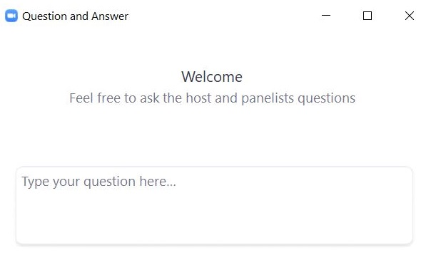
Questions and Answers
Use the “Q&A” feature to ask questions.

Slide 26
3. Preparing the Initial File for Import

Slide 27
Overview of Steps to Complete Student Registration
Download the .CSV file prepared by DESE from DropBox Central in the DESE Security Portal (available on the first day of each Student Registration window).
Delete students from the file who are no longer enrolled in your school, and add rows for students who were not included in the file and will be testing.
Verify and update students’ accessibility features and accommodations.
Save as a .CSV file, and import file into the MCAS Portal.
Resolve any errors that occur.
Update student information as needed, through file export/import process or through the user interface.

Slide 28
Secure Websites for this Process
DESE Security Portal: where to find the .CSV files that can be used as the basis for the Student Registration file
https://gateway.edu.state.ma.us/
If you cannot access the Security Portal, contact your Directory Administrator (www.doe.mass.edu/InfoServices/data/diradmin/list.aspx).
MCAS Portal: where to import the student registration file
https://mcas.cognia.org/ (black login page)
For operational testing, please be sure to use the MCAS Portal and not the MCAS Training Site (green login page).

Slide 29
Frequently Asked Questions
What if I am not able to log in to the MCAS Portal?
If you know your username but not your password, you can use the “Forgot Password” link on the Log In page.
Then, users may request support as follows:
What if I need to create more users for the MCAS Portal?
Refer to the MCAS Portal User Management Guide.
What if I’m unable to log in to the DESE Security Portal?
Contact your District Directory Administrator.
Role | Who to contact for support
Test administrators and school-level technology coordinators | Their principal or school test coordinator
Principals, school test coordinators, and district-level technology coordinators | Their district test coordinator
District test coordinators | MCAS Service Center

Slide 30
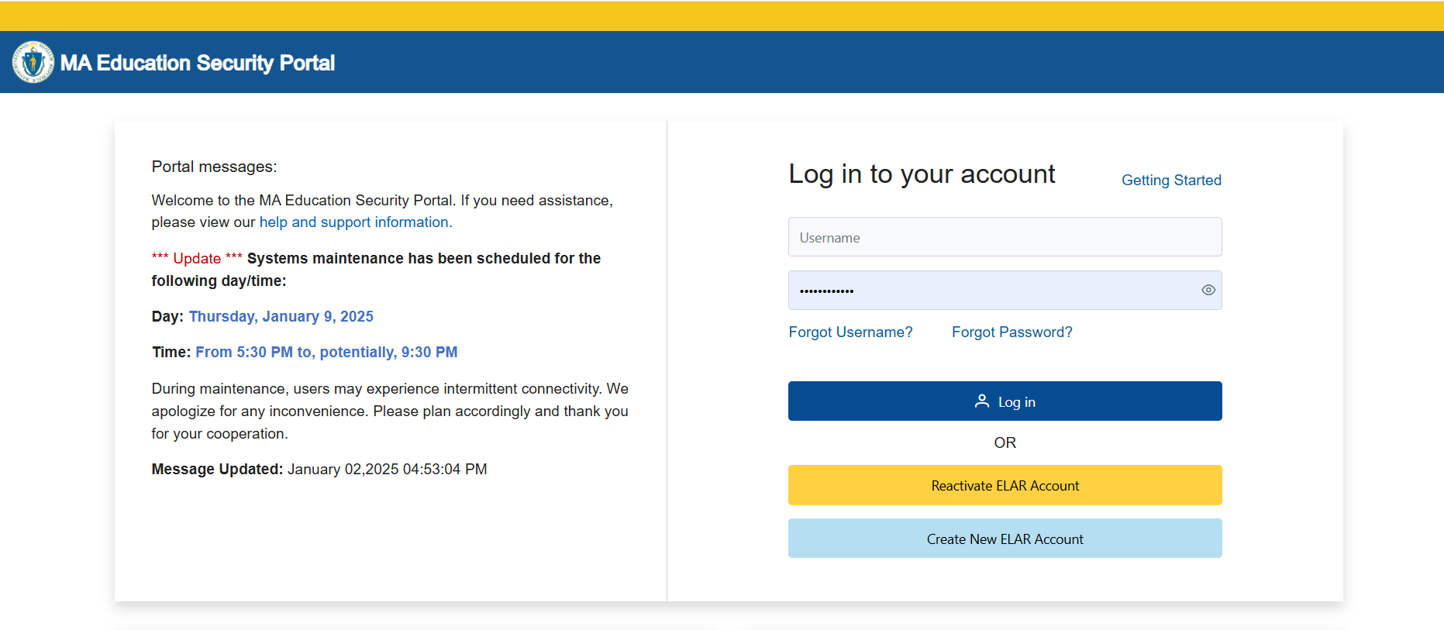
Logging in to the DESE Security Portal
Log in to the Security Portal at https://gateway.edu.state.ma.us/

Slide 31
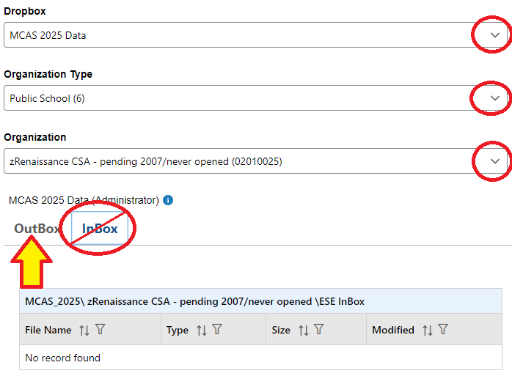
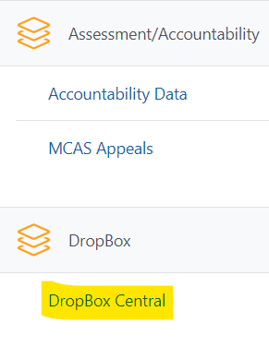
Accessing DropBox Central in the Security Portal
Enter your username and password.
You will then see an Application List.
Select DropBox Central.
Select MCAS 2025 Data.
Click OutBox.

Slide 32
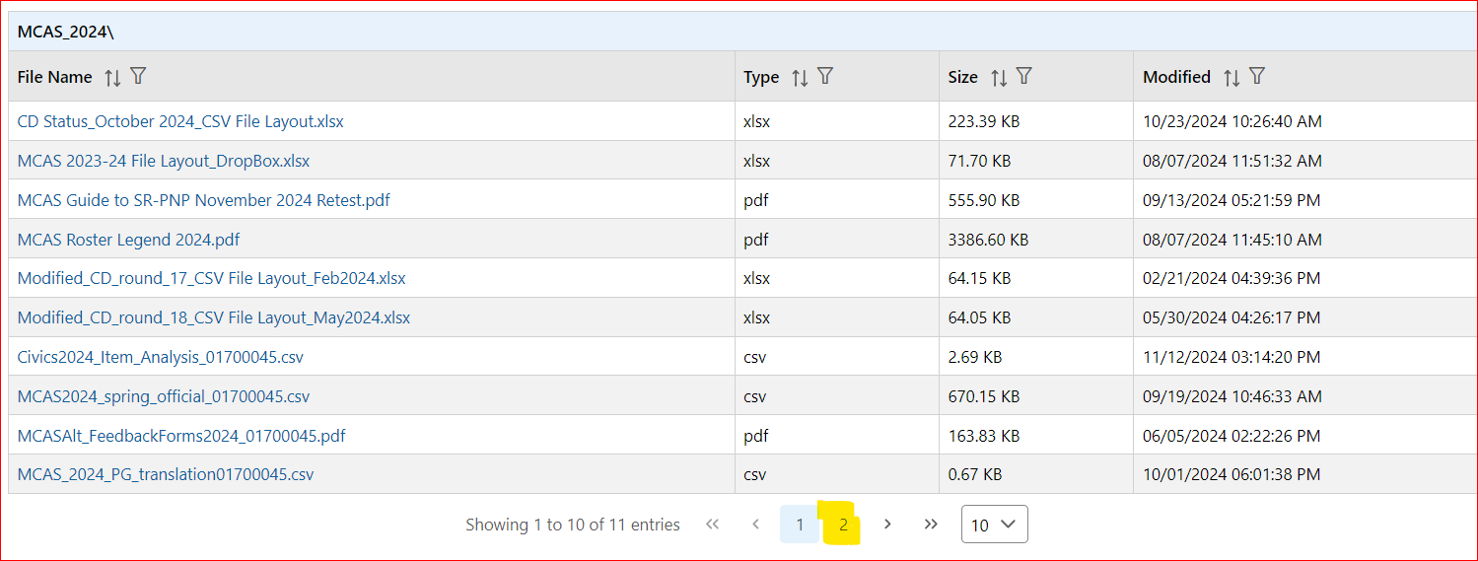
Accessing DropBox Central in the Security Portal (cont’d)
Scroll down to the bottom to click additional page numbers, if needed.

Slide 33
The .CSV File for MCAS Test Administrations
DESE will post .CSV files to DropBoxes on the first day of the Student Registration window of each administration.
Locate the .CSV file (e.g., “Spring2025…Registration) and save it to your computer.
The .CSV files reflect enrollment as of approximately 2–3 weeks before the opening of each window.
Selected accommodations are prepopulated as follows (note: grade 3 accommodations are not prepopulated).
Subject | Spring 2025 Grades | Source of Accommodations Data
ELA and Math | Grades 4–8 | Grades 3–7 Spring 2024 in those subjects
ELA and Math | Grade 10 | Grade 8 Spring 2023 in those subjects
STE for grades 5 and 8 | Grades 5 and 8 | Grades 4 and 7 Math Spring 2024
Civics | Grade 8 | Grade 7 Math Spring 2024
High School Science | Grades 9 and 10 | Grade 8 STE Spring 2023

Slide 34
Frequently Asked Questions
What if a student doesn’t have a SASID?
Search for claimed students in Edwin Analytics Student Profile Report (PR600).
If not found in PR600, call your district SIMS contact to create a new SASID, or locate the student’s existing SASID from the prior school, if applicable.
If you do not have a student’s SASID by the file import deadline, assign a “fake” 10-digit SASID starting with “8” (instead of “10”). Update the SASID in the MCAS Portal as soon as you receive the actual SASID.

Slide 35
Demonstrations: Tasks before Importing the File
Locating the MCAS Student Registration Guide
Opening the .CSV file downloaded from DropBox Central
Adding/removing rows for students who will or will not participate
Optional: using column P to identify and remove first-year ELs who will not participate in the ELA test as needed
Add test codes (only needed for high school Science)
Updating a student’s accommodations
Ensure formatting of cells is correct
Retain leading zeros for district code, school code, and grade
Ensure DOB is in proper format
Saving the .CSV file

Slide 36
Student Registration Initial Import – Step A: Prepare the File
Log in to the Security Portal (https://gateway.edu.state.ma.us/) to find the .CSV file posted in DropBox Central in the MCAS 2025 folder.
District and school files are available the same day that the Student Registration window opens.
Your spreadsheet program may prompt you to “remove leading zeroes” when opening the file. Always select “No.”
Delete rows of students who will not participate; add rows for new students who will participate.
Optional: Use column P to remove first-year ELs who will not participate in the ELA test.
Column P shows the student’s first-year EL status projected to March 1, 2025, based on historical SIMS.
Note that first-year ELs must participate in spring Mathematics, STE, and Civics.
Update accommodations, as needed.
(High School Science only) Add test codes for the high school science subject test.
Save the updated file as a .CSV file.

Slide 37
Poll Question
Which two sites will you use to complete Student Registration?
The MCAS Portal and the MCAS Training Site
The MCAS Training Site and the MCAS Student Kiosk
The DESE Security Portal and the MCAS Portal
The DESE Security Portal and the MCAS Student Kiosk

Slide 38
Questions and Answers
Use the “Q&A” feature to ask questions.

Slide 39
4. Steps for Completing the Initial Import

Slide 40
Overview of Steps to Complete Student Registration
Download the .CSV file prepared by DESE from DropBox Central in the DESE Security Portal (available on the first day of each Student Registration window).
Delete students from the file who are no longer enrolled in your school, and add rows for students who were not included in the file and will be testing.
Verify and update students’ accessibility features and accommodations.
Save as a .CSV file, and import file into the MCAS Portal.
Resolve any errors that occur.
Update student information as needed, through file export/import process or through the user interface.

Slide 41
Demonstration
Initial file import
Resolving errors

Slide 42
Student Registration: Import the File
In the MCAS Portal, select Administration and then Student Registration.
Select Choose File and select the previously saved file on your computer.
Select Upload.
Confirm that all records have been successfully imported.

Slide 43
Initial File Import
Once the file has been uploaded, processing may take about 5–10 minutes (depending on its size).
The file status will be “Pending” until the file is processed.
Users will need to refresh the page to see the updated status of the file.
Once the file is processed, you will see one of these statuses:
“Processed” if there are no errors. If your file is “Processed”, there are no further steps to take.
“Validation Errors” if there are errors. If your file has “Validation Errors”, download the Validation Errors link for a list of errors to correct.
“Error: Contact eMetric”
If your file receives the “Error: Contact eMetric” status, please contact the MCAS Service Center for support.

Slide 44
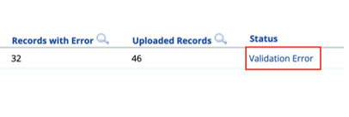
Addressing File Errors
If your file returns the status of “Validation Error,” click the link for Validation Error to view a list of errors for each record in the file.
Using the Data Definitions File, address each error in the file by updating the Validation Error file or the initial Student Registration file.
“Student Enrollment” error: if a student record returns this error, remove that row and complete an Enrollment Transfer Request (step-by-step instructions available in the Enrollment Transfer Guide).
Save the new file once all errors have been addressed.
Upload the updated file to the MCAS Portal.

Slide 45
Important Notes
Schools and districts can upload up to 75,000 student records in one Student Registration file.
DESE recommends leaving column K (Class name) blank during the initial import.
Schools can export the file, add Class names, and reimport the file approximately two weeks prior to testing.
The Guide to Creating and Managing Classes is available on the MCAS Resource Center and contains additional information.
After Student Registration and prior to testing, it is recommended to export all of your student registration information to verify accuracy.
This can be done using the Export Students button on the Student Registration page in the MCAS Portal.
Test coordinators should confirm that their files have been processed in MCAS Portal after uploading. Automated confirmation emails are not sent after processing.
There are no administrations in the MCAS Portal as there were in PearsonAccess Next.

Slide 46
Poll Question
Why should the initial Student Registration file import be completed by the initial window deadlines?
Students cannot be registered after the initial window deadlines.
The import must be done by the initial deadlines for schools to receive an initial order of manuals (for PBT and CBT) as well as PBT tests and Student ID Labels.
For CBT students, import must be done by the initial deadlines for schools to receive Student ID labels.
For all students, accommodations cannot be entered after the initial Student Registration deadlines.

Slide 47
Important Reminders
For operational testing, confirm you are in the MCAS Portal and not the MCAS Training Site.
School and district test coordinators and technology coordinators can import a Student Registration file.
Test administrators do not have permission to do so.
If columns are hidden or frozen, be sure to unhide and unfreeze them prior to import.
Do not make changes to the format of the file.
Do not add a title to the file using row 1 of the spreadsheet – this will cause an error during upload.

Slide 48
Questions & Answers
Use the “Q&A” feature to ask questions.

Slide 49
5. Steps after the Initial Import

Slide 50
Overview of Steps to Complete Student Registration
Download the .CSV file prepared by DESE from DropBox Central in the DESE Security Portal (available on the first day of each Student Registration window).
Delete students from the file who are no longer enrolled in your school, and add rows for students who were not included in the file and will be testing.
Verify and update students’ accessibility features and accommodations.
Save as a .CSV file, and import file into the MCAS Portal.
Resolve any errors that occur.
Update student information as needed, through file export/import process or through the user interface.

Slide 51
Update SIMS Data
If you update any student demographic data in the MCAS Portal (SASID, spelling of student’s name, grade, DOB), you must also update student information in SIMS.
Contact the district’s SIMS contact.
To find the contact for your district, go to https://profiles.doe.mass.edu/search/search.aspx?leftNavId=11239 Select “SIMS Contact” from the Function menu, and click “Get Results.”

Slide 52
Managing Students
When adding or editing student records in the MCAS Portal, schools are recommended to manually add/edit students in the user interface for a small number of students. For adding/editing ten or more students, schools are recommended to do a Student Registration file export/import.
On the Students page, users can manually add a new student, edit an existing student, and add or edit student accommodations.
Manually adding and editing students is recommended when making changes to ten or fewer student records.
The same fields provided through the student registration file may be entered manually.
Accommodations are entered for each test code. Students with accommodations for multiple tests will need the accommodations entered for multiple test codes.

Slide 53
Demonstration
Manually adding a new student
Updating an existing student

Slide 54
Manually Adding a Student
Log in to the MCAS Portal.
Select Administration.
Select Students
Select the Add Student button.

Slide 55
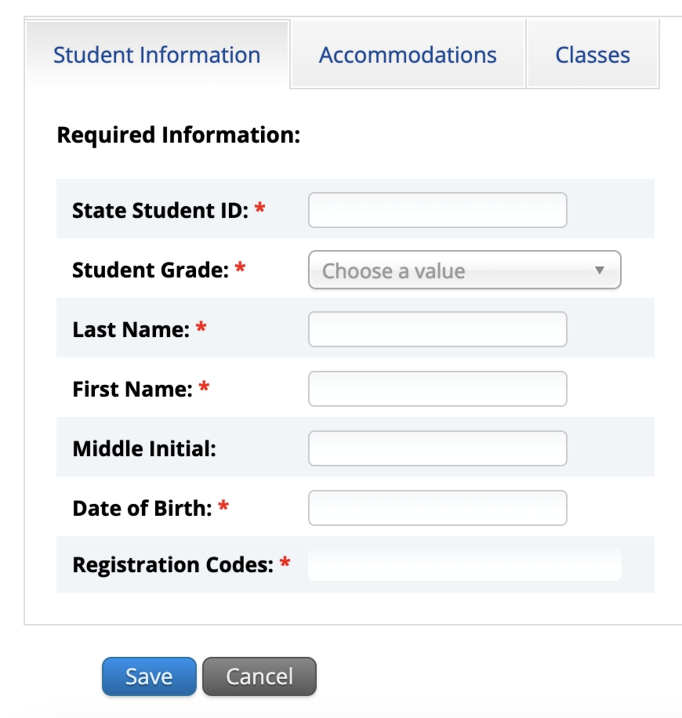
Manually Adding a Student
5. Add student information in the required fields marked with a red asterisk. Be sure to enter the registration codes (test codes) for every test the student will take. Test codes are listed in column J of part V of the MCAS Student Registration Guide.

Slide 56
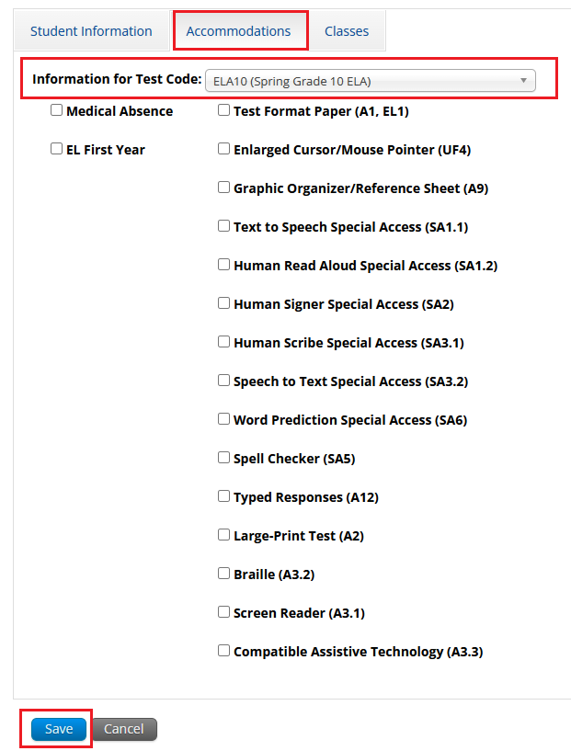
Manually Adding a Student
6. If the student has accommodations, select the Accommodations tab to enter the accommodations by test code.
7.Select Save.

Slide 57
Editing a Student in the MCAS Portal
On the Students page, locate the student record to be edited.
Select Edit.

Slide 58
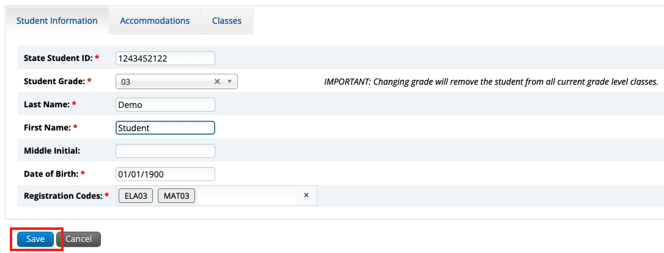
Editing a Student in the MCAS Portal
3. Update the student information.
4. Click Save.

Slide 59
Adding/Editing Student Accommodations
On the Students page, locate the student record to be edited.
Select Edit.

Slide 60
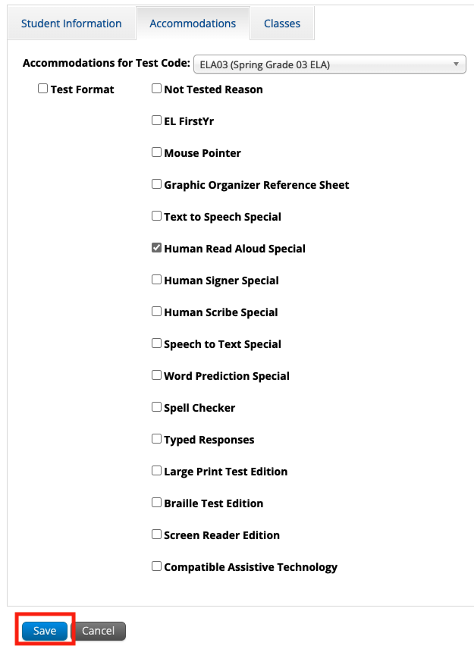
Adding/Editing Student Accommodations
3. Update the student’s accommodation for each test code. Use the drop-down update accommodations for another subject area test.
4. Select Save.

Slide 61
Updating PBT Tests
If you need to add a student taking PBT, or if you need to update a student’s PBT test accommodations after the initial Student Registration window, you may need to place an additional materials order through the MCAS Service Center.
See Appendix B of the PAM: Procedures for Paper-Based Testing for information.

Slide 62
Demonstration
Exporting and reimporting Student Registration

Slide 63
Exporting and Reimporting Student Registration Files
Recommended when updating more than 10 student records
Log in to the MCAS Portal with your username and password.
On the MCAS Portal homepage, select Administration.
Select Student Registration from the top menu bar.
Select the organization from the organization drop-down.
Select Export Students. The exported file will be downloaded locally.
Use the Student Registration Data Definitions File to assist in updating the exported Student Registration file.
Update the fields in the Student Registration export file that need updating.
Save the file as a .CSV. The file is now ready for import.

Slide 64
Questions & Answers
Use the “Q&A” feature to ask questions.

Slide 65
6. Resources, Support, and Next Steps

Slide 66
Upcoming Training Sessions
Session | Date and Registration Link | Intended Audience | Recommended Read-Ahead Materials
MCAS Accessibility and Accommodations All levels of experience | Tuesday, January 21 at 9:30–11:00 a.m. and Wednesday, January 22 at 1:00–2:30 p.m. | Principals and school test coordinators, district test coordinators, special education supervisors | Accessibility and Accommodations Manual
MCAS Test Security and Administration Protocols for New Staff | Tuesday, January 28 at 9:30–11:15 a.m. | Principals and school test coordinators, district test coordinators | The Spring 2025 MCAS Principal's Administration Manual is planned to be available in advance of this session. Participants are encouraged to review Part I — MCAS Test Security Requirements prior to the training session.
MCAS Test Security and Administration Protocols for Returning Staff | Thursday, January 30 at 9:30–11:15 a.m.

Slide 67
Upcoming “Office Hours” Sessions
Session | Date and Registration Link | Intended Audience | Recommended Read-Ahead Materials
Student Registration Office Hours for Grades 3–8 | Monday, January 27 at 9:30–10:30 a.m. | Principals and school test coordinators for grades 3–8 schools, district test coordinators | MCAS Student Registration Guide
Student Registration Office Hours for High Schools | Wednesday, January 29 at 9:30–10:30 a.m. | High school principals and school test coordinators, district test coordinators
Office Hours — MCAS Portal Tasks for February Science | Friday, January 31 at 9:30–10:30 a.m. | High school principals and school test coordinators, district test coordinators | MCAS Student Registration Guide Guide to the MCAS Portal Guide to Creating and Managing Classes

Slide 68
Upcoming Steps for Test Coordinators
Subscribe to the Student Assessment Update, if you have not already.
Review the administration deadlines.
Establish a communication plan with your staff — including technology coordinators.
Review guides and modules as they become available on the MCAS Resource Center and share them with your teams.
Ensure site readiness is certified by Technology Coordinators on time.
Create and assign students to classes approximately two weeks prior to testing. Schedule tests approximately one week prior to testing. These topics will be covered in future trainings.
High schools administering the February Science tests are encouraged to join the Office Hours for MCAS Portal Tasks webinar on January 29 to ask questions about these tasks.

Slide 69
Steps for Technology Coordinators
Review Technology Guidelines for MCAS Computer-Based Testing
Confirm whether all devices planned for testing will meet these specifications.
Download the MCAS Student Kiosk on all testing devices.
Conduct Site Readiness to certify that the school is ready for testing.

Slide 70
Additional Resources
Resource | Location
MCAS Resource Center | mcas.onlinehelp.cognia.org
MCAS Portal Guides MCAS Portal User Management Guide Guide to the MCAS Portal Guide to Creating and Managing Classes Enrollment Transfer Guide | https://mcas.onlinehelp.cognia.org/ portal/
Technology Information Technology Guidelines for MCAS Computer-Based Testing Guide to Installing the MCAS Student Kiosk and Conducting Site Readiness | https://mcas.onlinehelp.cognia.org/ technology-setup/
Student Assessment Updates (Biweekly email with important updates about the MCAS program) | www.doe.mass.edu/mcas/updates. html If you do not already receive this email, subscribe using this link: http://eepurl.com/ghSOhH

Slide 71
Next Steps
Today: Complete the evaluation form.
Responses are associated with the name and email address used to log in.
Email your input to mcas@mass.gov if you have problems accessing or completing the form.
Within one week:
Receive an email with the Q&A from this session
Recording will be available

Slide 72
Email and Phone Support
MCAS Service Center
DESE Student Assessment Services
Questions on logistics and technology
Web: https://mcas.onlinehelp.cognia.org/
Email: mcas@cognia.org
Phone: 800-737-5103
TTY: 888-222-1671
Live chat is available at the link on the bottom of the page at the MCAS Resource Center
Policy questions (e.g., student participation, accommodations)
Web: www.doe.mass.edu/mcas
Email: mcas@mass.gov
Phone: 781-338-3625
TTY: 800-439-2370

Slide 73
7. Live Sandbox Time

Slide 74
Poll Question—
Which demonstrations would you like to see again?
Adding/removing rows for students in the file
Adding a student’s accommodations in the initial .CSV file
Ensuring that the cell formatting is correct in the initial file
Importing the file
Resolving validation errors
Manually adding/editing a student on the Students page
Updating a large number of student records via export/import

Slide 75
THANK YOU
The Office of Student Assessment Services
781-338-3625
mcas@mass.gov
www.doe.mass.edu/mcas
135 Santilli Highway, Everett, MA 02149

