Slide 1
MCAS Portal Tasks for February Science Office Hours
The Office of Student Assessment Services
January 31, 2025

Slide 2
Presenters
Shannon Cullen, MCAS Test Administration Coordinator
Abbie Currier, eMetric Sr. Project Manager

Slide 3
Logistics for This Session
Use the Q&A feature to ask a question.
We will answer some questions aloud at specified times during this training session, and we will email the Q&A afterwards.
Type your questions anytime, but we may not answer them in real time as some questions may be covered during the presentation.
Use the thumbs-up icon to “upvote” someone else’s question.
Email student-specific questions to mcas@mass.gov instead of asking here.
This session is being recorded and will be available in about a week in the MCAS Resource Center, along with the slides.
Closed captioning has been enabled for participants who need it.

Slide 4
Slides for This Session
Slides were emailed to participants before this session from MCASEvents@cognia.org.
Slides are now being posted in the chat.
If you cannot access the slides in the chat, ask in the Q&A.
After the session, we will send the slides again to participants, and they will be posted in the MCAS Resource Center along with the recording.

Slide 5
Today’s Agenda
Exports in the MCAS Portal
Q&A and Additional Demonstrations

Slide 6
1. Exports in the MCAS Portal

Slide 7
Exports in the MCAS Portal
Schools may find the following reports useful in tracking preparation and completion of testing.
Export Test Status: a .CSV file listing every student and their completion status per session of the selected school and test.
Export Test Status for All Tests: a .CSV file listing every student and their completion status per session for all tests in the selected district/school, program, and content area.
Export Students Not Scheduled: a .CSV file listing every student not scheduled for the selected school and test. (Only available at the school level).

Slide 8
Demonstration
Exports in the MCAS Portal
Export Test Status
Export Test Status for All Tests
Export Students Not Scheduled

Slide 9
Exports on the Test Scheduling Page
Log in to the MCAS Portal.
Click Administration.
Click Test Scheduling.
Use the drop-down menus (Organization, Program, Subject, and Test Name) to filter for the scheduled test.
Select Exports, and select the export from the drop-down menu.

Slide 10
2. Q & A and Additional Demonstrations

Slide 11
Additional Resources
Resource | Location
MCAS Resource Center | mcas.onlinehelp.cognia.org
MCAS Portal User Guides Student Registration Guide MCAS Portal User Management Guide Guide to Creating and Managing Classes Guide to Enrollment Transfers Guide to Scheduling Tests and Printing Student Logins Instructions for Using Materials Management | https://mcas.onlinehelp.cognia.org/portal/
MCAS Portal Modules and Video Demonstrations Video demonstration: Creating Classes and Scheduling Tests | https://mcas.onlinehelp.cognia.org/training-modules/
Technology Information Technology Guidelines for MCAS Computer-Based Testing Guide to Installing the MCAS Student Kiosk and Conducting Site Readiness | https://mcas.onlinehelp.cognia.org/ technology-setup/
Student Assessment Updates (Biweekly email with important updates about the MCAS program) | www.doe.mass.edu/mcas/updates.html If you do not already receive this email, subscribe using this link: http://eepurl.com/ghSOhH

Slide 12
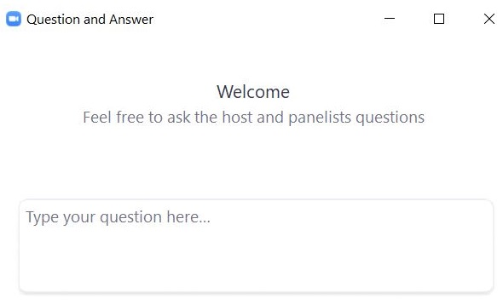
Questions & Answers
Use the “Q&A” feature to ask questions.

Slide 13
Next Steps
Today: Complete the evaluation form.
Responses are associated with the name and email address used to log in.
Email your input to mcas@mass.gov if you have problems accessing or completing the form.
Within one week:
Receive an email with the Q&A from this session
Recording will be available

Slide 14
Email and Phone Support
MCAS Service Center
DESE Student Assessment Services
Questions on logistics and technology
Web: https://mcas.onlinehelp.cognia.org/
Email: mcas@cognia.org
Phone: 800-737-5103
TTY: 888-222-1671
Live chat is available at the link on the bottom of the page at the MCAS Resource Center
Policy questions (e.g., student participation, accommodations)
Web: www.doe.mass.edu/mcas
Email: mcas@mass.gov
Phone: 781-338-3625
TTY: 800-439-2370

Slide 15
THANK YOU
The Office of Student Assessment Services
781-338-3625
mcas@mass.gov
www.doe.mass.edu/mcas
135 Santilli Highway, Everett, MA 02149

