Slide 1
MCAS Accessibility and Accommodations for 2025 MCAS Tests
The Office of Student Assessment Services
January 22, 2025

Slide 2
Presenters
Robert Pelychaty, DESE Manager of Inclusive Assessment
Shannon Cullen, DESE MCAS Test Administration Coordinator
Abbie Currier, eMetric Senior Project Manager

Slide 3
Logistics for This Session
Use the Q&A feature to ask a question.
We will answer some questions aloud at specified times during this training session, and we will email the Q&A afterwards.
Type your questions anytime, but we may not answer them in real time as some questions may be covered during the presentation.
Use the thumbs-up icon to “upvote” someone else’s question.
Email student-specific questions to mcas@mass.gov instead of asking here.
This session is being recorded and will be available in about a week in the MCAS Resource Center, along with the slides.
Closed captioning has been enabled for participants who need it.

Slide 4
Slides for This Session
Slides were emailed to participants before this session from MCASevents@cognia.org.
Slides are now being posted in the chat.
If you cannot access the slides in the chat, ask in the Q&A.
After the session, we will send the slides again to participants, and they will be posted in the MCAS Resource Center along with the recording.

Slide 5
Today’s Agenda
Participation Requirements
Important Updates
Student Registration
Accessibility Features and Accommodations
Preparation for Testing
Live “Sandbox Time”

Slide 6
1. Participation Requirements

Slide 7
MCAS Participation Requirements
All publicly-funded students must participate in MCAS tests required for their grade.
Includes students in public schools, charter schools, virtual schools, out-of-district placements, SEIS, DYS, and other students receiving instruction with public funds.
IEP teams determine necessary accommodations for students with disabilities. IEPs and 504 plans list accommodations decisions. Only Students with the Most Significant Cognitive Disabilities may participate in the MCAS-Alt.
See the updated Accessibility and Accommodations Manual available at www.doe.mass.edu/mcas/accessibility/.

Slide 8
English Learners – Participation Guidelines
ELs are required to participate in all MCAS tests scheduled for their grade, with one exception:
First-year ELs are not required to take the MCAS ELA test but may participate at principal’s discretion.
First-year ELs are those who enrolled after March 1, 2024. Check status in SIMS.
EL accommodations: School staff familiar with the student should meet and
Review available accessibility features and accommodations for ELs.
Consider EL students’ language needs, learning characteristics, and preferences.

Slide 9
Poll Question
What are you most interested in learning about?
How to assign accommodations and accessibility features to students in the Student Registration system
A general overview of accommodations and accessibility options for MCAS tests
A review of how accessibility features and accommodations appear in the new MCAS Student Kiosk
Eligibility for Special Access Accommodations

Slide 10
2. Important Updates

Slide 11
Important Updates
Additional universal accessibility features: general masking and reverse contrast, notepad tool for all tests
Bilingual Spanish/English test for Mathematics, Science, and Civics (grades 3–8 and high school)
MCAS ELA tests are not translated
Refer to Expansion of Bilingual Spanish/English MCAS Tests in 2025 website for more info.
Civics is a required test for students in grade 8.
Accessibility features and accommodations are available.
IEP Team must complete: Companion document: Alternate Assessment Participation Tool for students taking the MCAS-Alt
Approved graphic organizers, checklists, and supplemental reference sheets posted to the DESE website are now provided in PDF format.
Spanish/English Translations to be posted

Slide 12
Important Updates (continued)
The MCAS Student Kiosk is the new computer-based testing platform for students.
Very similar to previous computer-based platform
Student Registration will be completed in the MCAS Portal, which is the new test administration and management website for the MCAS tests.
Text-to-speech is no longer a form-dependent accommodation. TTS can be added or removed during testing, if necessary, without voiding the student’s test.
Embedded Speech-to-Text and Word Prediction accommodation tools are available on MCAS Mathematics, Science, and Civics tests, in addition to ELA tests.

Slide 13
IEP Team Decisions Needed Before Testing
Team members should review all accessibility and accommodations policies.
Important decisions required for each student with (and without) a disability taking spring test(s):
All students are eligible for accessibility features.
Which accessibility features and accommodations will be needed?
For students with disabilities:
Before testing and making decisions, give opportunity to view a student tutorial and take practice tests (expected by mid-February).
If read-aloud is needed, use text-to-speech (TTS) or human read-aloud. Schools may list “text-to-speech is preferable, but human reader is acceptable.”
Paper-based tests are available and must be listed as an accommodation in IEP or 504 plan for students unable to take computer-based tests.

Slide 14
3. Student Registration (SR)

Slide 15
What is the Student Registration Process (SR)?
Similar to the previously used SR/PNP, Student Registration is a collection of student-level test data, including
students’ demographic information
registration information for specific tests
necessary for selected accommodations used for MCAS tests (Note: Some information can be changed up until end of testing window)
Used as the basis for initial shipment of test materials to schools, which includes:
Student ID Labels
Test Administration Manuals
Standard booklets, if needed
Special test editions (large-print, Braille, Spanish/English, etc.)
Use Appendix A in the Accessibility and Accommodations Manual for a crosswalk of accessibility feature and accommodation numbers and the Student Registration column to assign them correctly.

Slide 16
SR: Special Test Forms and Selected Accessibility Features and Accommodations
Special Test Forms
Large Print Test Edition
Braille Test Edition
Screen Reader Edition
Compatible Assistive Technology
American Sign Language Video (ASL edition)
Spanish/English (Math, STE, Civics)
Human Read-Aloud
Human Read-Aloud (Special Access - ELA)
Human Signer
Human Signer (Special Access - ELA)
Selected Accommodations
Text-to-Speech Special Access ELA
Text-to-Speech (Math, STE, Civics)
Human Scribe (Math, STE, Civics)
Human Scribe (Special Access - ELA)
Speech-to-Text (Math, STE, Civics)
Speech-to-Text (Special Access - ELA)
Graphic Organizer/Reference Sheet
Typed Responses
Calculation Device on Non-Calculator test session(s) (Math only)
Spell-Checker (Special Access - ELA)
Word Prediction (Math, STE, Civics)
Word Prediction (Special Access - ELA)
Accessibility Features
Alternate Mouse/Cursor

Slide 17
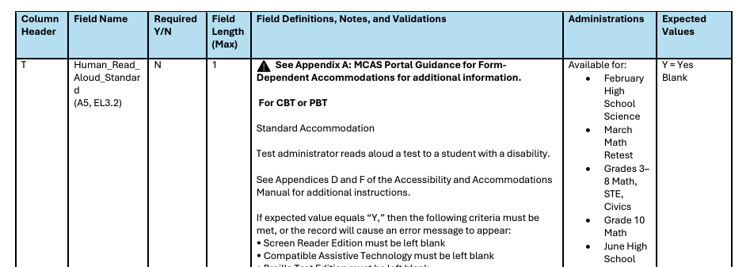
MCAS Student Registration Guide
Available on the MCAS Resource Center
Field Definitions, Notes, and Validations column describes each accommodation and indicates other accommodations that cannot be co-selected.
Administrations lists availability on specific tests.
Expected Values indicates options for column input.

Slide 18
4. Accessibility Features and Accommodations

Slide 19
Accessibility Features and Accommodations
See the Accessibility and Accommodations Manual for a list of:
Universal Accessibility Features (UF): Available to all students, either on computer-based tests or as a paper-based equivalent
Designated Accessibility Features (DF): Flexible test administration procedures available to any student, at the discretion of principal
Includes changes in test location, group size, seating, scheduling
Accommodations (A): Specific supports available only to students with disabilities and English learners
Special Access Accommodations: These accommodations may be only be provided to students who meet specific criteria.

Slide 20
Universal Accessibility Features (UF) for All Students
Computer | Paper
Highlighter
Color contrast | Colored overlays
Screen zoom tool | Magnification tool/device
Enlarged Cursor/Mouse (SR) | Enlarged pencil/modified writing instrument
Line reader tool | Tracking device/straight edge
Answer masking | Mask using blank card
Answer eliminator | Use pencil to eliminate answer choices
Item flag/bookmark | Place marker
Audio aids
Notepad | Scratch paper
Human read-aloud (or sign) selected words as requested by student (not permitted for ELA tests)
Redirects student’s attention to test
Test administrator repeats/clarifies test direction
General Masking | Masking
Reverse Contrast | N/A

Slide 21
Important Note
Notes entered in the notepad and any highlights made by a student with the highlighter tool will be lost if a student pauses a test for more than 60 minutes, signs out of a test, submits a test, or if there is a circumstance that abruptly closes the kiosk (e.g., the device shutting down due to low battery).

Slide 22
Demonstration
Universal accessibility features

Slide 23
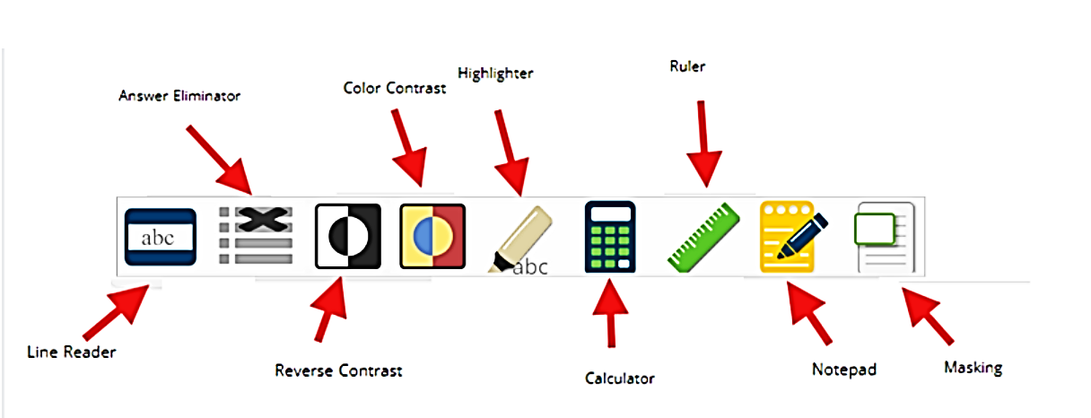
General Tools for All Students

Slide 24
Enlarged Cursor (SR)
The enlarged cursor/mouse is selected in Student Registration prior to the student logging into the test.
Students with this tool may select the size and color of the mouse pointer at any time during the test. Students do NOT need to log out.

Slide 25
Highlighter

Slide 26
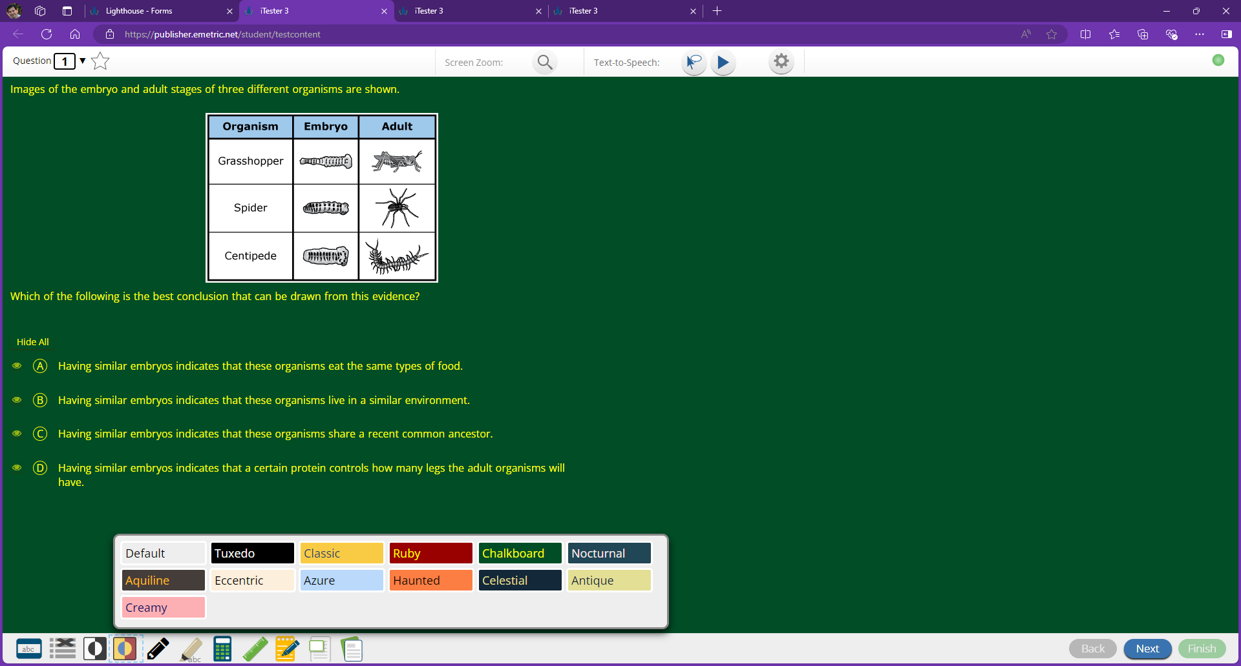
Color Contrast

Slide 27
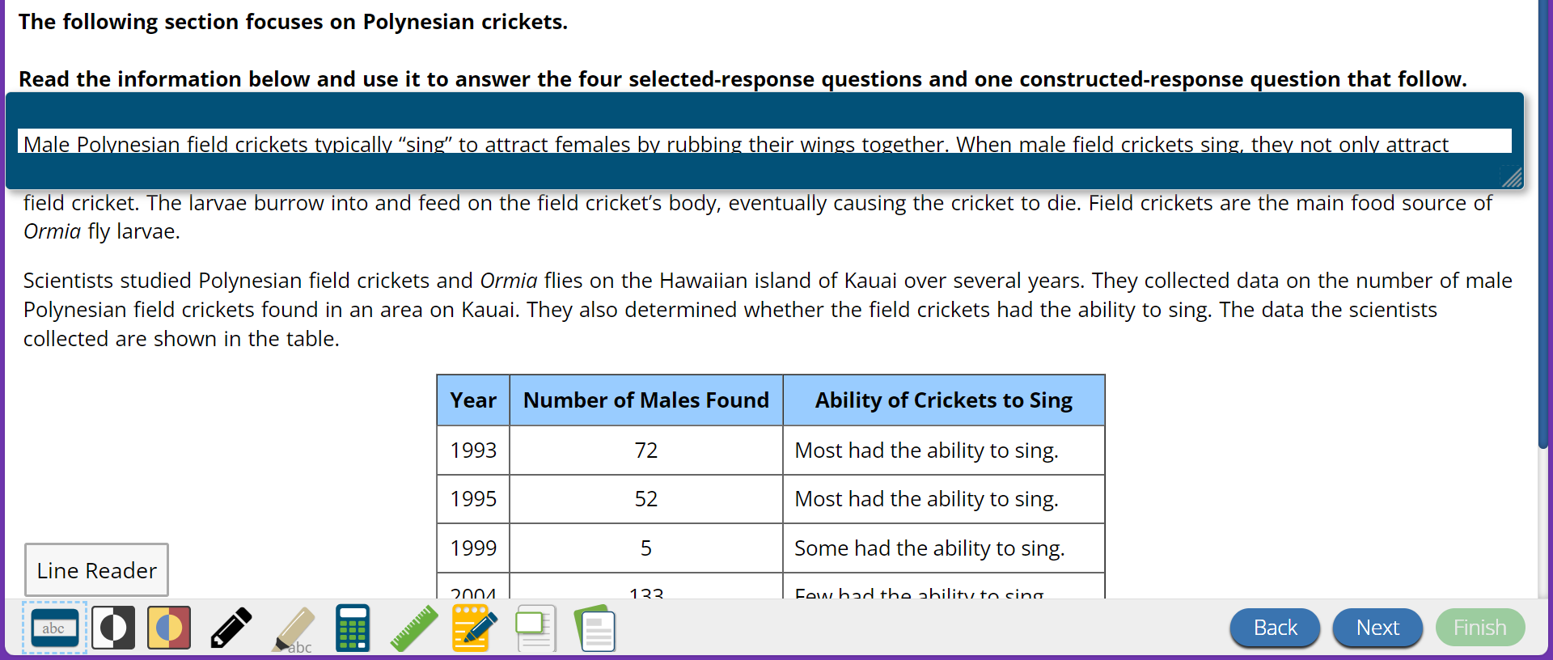
Line Reader

Slide 28
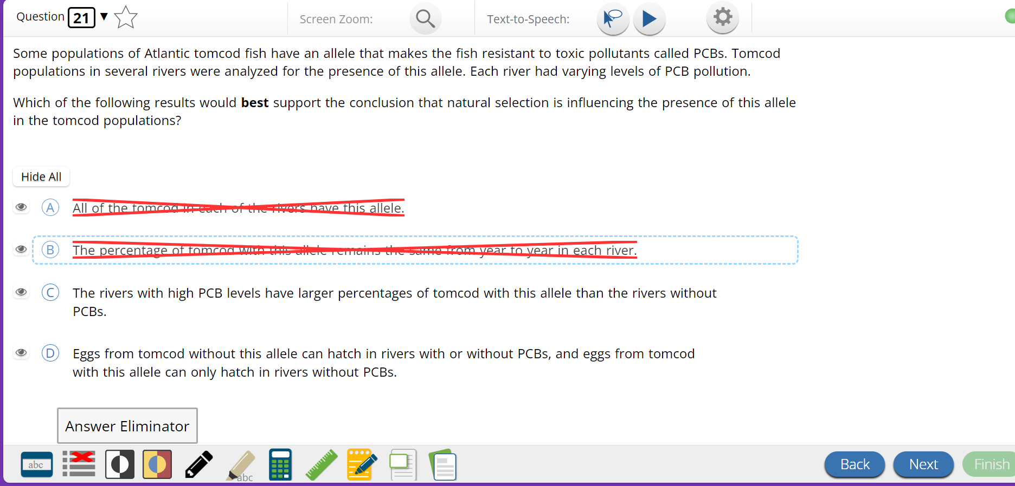
Answer Eliminator

Slide 29
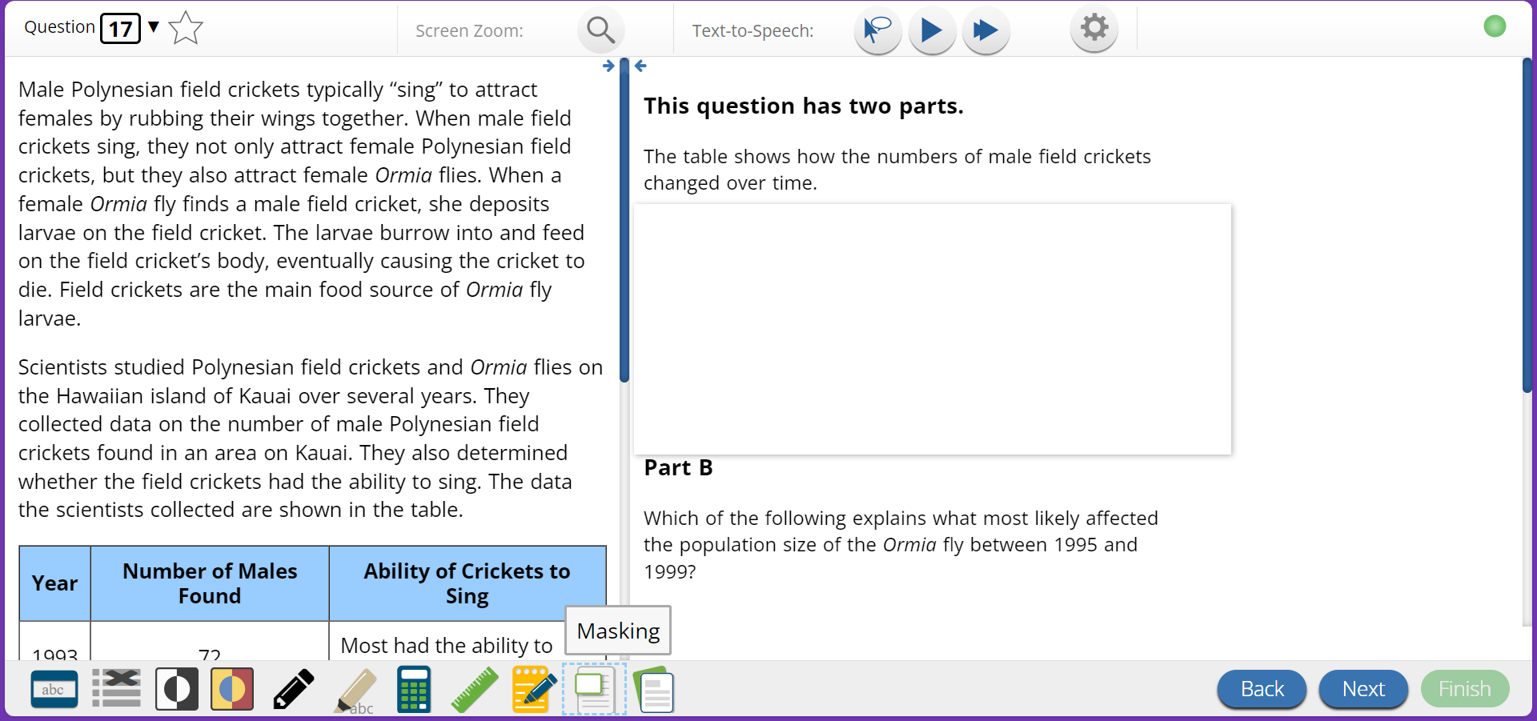
Masking tool

Slide 30
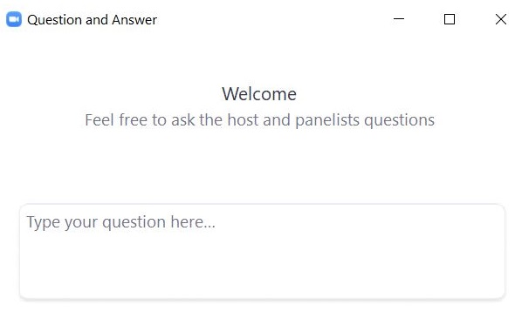
Questions and Answers
Use the “Q&A” feature to ask questions.

Slide 31
Designated Accessibility Features (DF) for Any Student, at Principal’s Discretion
Computer or Paper
Small group test administration (up to 10 students)
Individual (one-to-one) test administration
Frequent supervised breaks
Test in separate location
Seating in a specified area of room, including study carrel
Adaptive or specialized furniture or lighting
Noise buffer/noise-cancelling earmuffs/headphones (no music)
Familiar test administrator
Student reads test aloud to self
Specific time of day
“Stop Testing” policy: If student is not responding to test questions after 15−20 minutes, test administrator may ask if student is finished. If so, collect the student’s test materials. Student may sit quietly or be excused.

Slide 32
Accommodations for Students with Disabilities
Presentation Accommodations
Computer-Based | Paper-Based
Paper test, if unable to use computer (SR) | N/A
N/A | Large print test (SR)
Screen reader only for student who is blind and uses a school owned program (SR) | Braille test (SR)
Text-to-Speech or Human read-aloud for Math, STE, or Civics (SR) | Human read-aloud for Math, STE, or Civics (SR)
Human signer for Math, STE, Civics and test questions only for ELA or ASL test forms available of grade 10 math and June Science (SR) | Human signer for Math, STE, Civics and test questions only for ELA (SR)
Test administrator helps student track test items

Slide 33
Accommodations for Students with Disabilities (Continued)
Response Accommodations
Computer-Based | Paper-Based
Department-provided ELA graphic organizer or Math/STE reference sheets (For STE, Customized reference sheet allowed, if approved by DESE) (SR) (available here)
Human scribe or speech-to-text device for Math/Science/Civics (SR)
New for 2025: Word Prediction for Mathematics, Science, and Civics (not ELA) Note: See Appendix E Accessibility and Accommodations Manual. (SR)
N/A | Answers recorded in test booklet or special paper
N/A | Typed responses (SR) (Transcription not needed)
Responses recorded (audio or video), then transcribed by student during playback
Monitor placement of test responses
Braille writer, note-taker, or refreshable Braille display

Slide 34
Special Access Accommodations
Computer and Paper
Text-to-speech/Human reader for ELA (SR)
Signing the ELA reading passages (SR)
Scribe responses or speech-to-text for ELA (SR)
Calculator or other mathematics tool, device, or manipulatives on noncalculator session of Math (SR)
Spell-checker for ELA (SR) (Note: available to all students for Math, STE, and Civics)
Word prediction for ELA (SR)

Slide 35
Criteria for Providing Special Access Accommodations
Special Access Accommodations may be provided only to a limited number of students who:
Demonstrated substantial deficits in reading, calculating, writing, or spelling AND
Receive ongoing intervention for these skills
These students must require the supports consistently access classroom work.
Special Access Accommodations may not be provided if student is simply performing “below grade level.”
Scores may be invalidated if ineligible students are provided Special Access Accommodations.
Use of Special Access Accommodations will be reported with a notation on
Parent/Guardian Reports
School and District Rosters

Slide 36
Poll Question
Do students need their own software/web-application for text-to-speech, speech-to-text or word prediction MCAS CBT accommodations?
Yes
No

Slide 37
Demonstration
Text-to-speech
Spell-checker
Speech-to-text
Word prediction

Slide 38
Text-to-Speech (SR)
Text-to-Speech Selector
Play/Pause
Speech Settings

Slide 39
Spell-Checker (SR)
Spell-checker is automatically available for Math, Science and Civics.

Slide 40
Speech-to-text (SR)
Student must be tested in separated space.
Student should be familiar with speech-to-text prior to providing as an accommodation.
Standard accommodation for available for Math, Science, and Civics

Slide 41
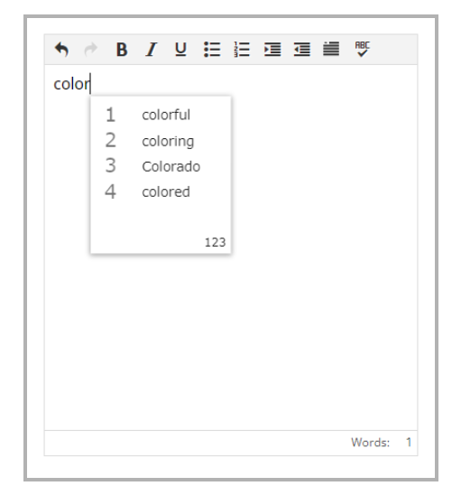
Word Prediction (SR)
As student types, a choice of words becomes available.
Student should have prior experience using word prediction prior to testing
Standard accommodation available for Math, Science, and Civics

Slide 42
Accommodations for English Learners (ELs)
Computer and Paper
Approved Bilingual Word-to-Word Dictionary or Glossary (also available for Former English Learners)
Paper-based Test (SR)
Text-to-speech/human reader for Math, Science, and Civics (in English) (SR)
Scribe/Speech-to-text for Math, Science, Civics (SR)
Word Prediction for Math, Science, Civics (SR)
Spanish/English edition of Math, Science and Civics (if enrolled for less than 3 years) (SR)
Read aloud/repeat/clarify test directions in student’s native language
“Stop testing” policy

Slide 43
Form-Dependent Accommodations
The following accommodations must be assigned correctly before testing. If not assigned correctly, a student’s test will need to be stopped and a new test will need to be set up, and the student may need to retake a portion of the test.
Form-dependent accommodations for CBT:
ASL video (spring grade 10 Math and June high school Science)
Compatible assistive technology
Human read-aloud
Human signer
Screen reader
Spanish/English (Math, Science, and Civics)
Form-dependent accommodations for PBT:
Large print
Braille
Spanish/English PBT
New for 2025:
Text-to-speech is not a form-dependent accommodation. The accommodation can be added during testing if necessary, without voiding the student’s test.

Slide 44
5. Preparation for Testing

Slide 45
Ensuring Accommodations are Assigned
Test coordinators can verify accommodations using the Export Students feature on the Student Registration page in the MCAS Portal. (Administration > Student Registration > Export Students)
This will provide a .CSV file with all students and accommodations for the school.
Test coordinators and test administrators can view assigned accommodated forms on the View Details/Student Logins page in the MCAS Portal. (Administration > Test Scheduling > select the scheduled test > View Details/Student Logins)
Test coordinators and test administrators can view other assigned accommodations on the summary page that is provided with student logins.
Individual student accommodations can be viewed on the Edit Students page in the MCAS Portal. (Administration > Students > search for the student > Edit)

Slide 46
Preparing for Test Administration
Provide training to those who will provide accommodations.
Test administrators
Other professional staff
Develop plan to monitor accommodations that require 1:1 test administration.
Provide students opportunities to view Student Tutorial and take online Practice tests using accommodated format, if appropriate (expected mid-February).
Attend DESE Trainings listed on the Training Opportunities webpage.

Slide 47
REMINDER: Provide to all students during testing
Untimed test sessions
Blank scratch paper (including blank, lined, or graph paper)
Assistance from test administrator, as needed, to navigate the computer-based testing platform

Slide 48
Reminders for Paper-Based Testing
Review and follow Special Instructions included with special test forms (e.g., Braille, large-print) to ensure tests are scored properly.
Designate test administrators to transcribe large-print, Braille, and other responses into standard booklet and included with original in Special Handling Envelope.
See Appendix C: Procedures for Scribing and Transcribing Student Responses of the Accessibility and Accommodation Manual
Typed responses:
One item response per page
Each response must not exceed one page
Each page must include all parts of each item (e.g., a., b., c., d…)
Include student information in header/footer according to Appendix C of the Principal’s Administration Manual

Slide 49
If a Student Refuses an Accommodation…
Document student’s refusal in writing; keep in student’s file.
Sample refusal form — available at www.doe.mass.edu/mcas/accessibility/
Continue to make accommodation available, if needed, for remainder of test administration.
Do not make student sign waiver of their right to receive the accommodation.
Notify parent/guardian of student’s refusal.
Amend IEP/504 plan for future testing.
If appropriate, list accommodation in the IEP/504 plan “as requested by student,” or remove it.
Update the information in student’s Student Registration if an accommodation was entered incorrectly or was not used.

Slide 50
Upcoming Training Sessions
Session | Date and Registration Link | Intended Audience | Recommended Read-Ahead Materials
MCAS Test Security and Administration Protocols for New Staff | Tuesday, January 28 at 9:30–11:15 a.m. | Principals and school test coordinators, district test coordinators | The Spring 2025 MCAS Principal's Administration Manual is planned to be available in advance of this session. Participants are encouraged to review Part I — MCAS Test Security Requirements prior to the training session.
MCAS Test Security and Administration Protocols for Returning Staff | Thursday, January 30 at 9:30–11:15 a.m.

Slide 51
Upcoming “Office Hours” Sessions
Session | Date and Registration Link | Intended Audience | Recommended Read-Ahead Materials
Student Registration Office Hours for Grades 3–8 | Monday, January 27 at 9:30–10:30 a.m. | Principals and school test coordinators for grades 3–8 schools, district test coordinators | MCAS Student Registration Guide
Student Registration Office Hours for High Schools | Wednesday, January 29 at 9:30–10:30 a.m. | High school principals and school test coordinators, district test coordinators
Office Hours — MCAS Portal Tasks for February Science | Friday, January 31 at 9:30–10:30 a.m. | High school principals and school test coordinators, district test coordinators | MCAS Student Registration Guide Guide to the MCAS Portal Guide to Creating and Managing Classes

Slide 52
Questions and Answers
Use the “Q&A” feature to ask questions.

Slide 53
6. Live “Sandbox” Time

Slide 54
Poll Question—
Which would you to see more information on?
How students use text-to-speech
How students use speech-to-text
How to ensure accommodations are correctly assigned

Slide 55
Next Steps
Today: Complete the evaluation form.
Responses are associated with the name and email address used to log in.
Email your input to mcas@mass.gov with any questions.
Next week:
Receive an email with the Q&A from this session
Recording will be available on the MCAS Resource Center.

Slide 56
Email and Phone Support
MCAS Service Center
DESE Student Assessment Services
Questions on logistics and technology
Web: https://mcas.onlinehelp.cognia.org/
Email: mcas@cognia.org
Phone: 800-737-5103
TTY: 888-222-1671
Live chat is available at the link on the bottom of the page at the MCAS Resource Center
Policy questions (e.g., student participation, accommodations)
Web: www.doe.mass.edu/mcas
Email: mcas@mass.gov
Phone: 781-338-3625
TTY: 800-439-2370

Slide 57
THANK YOU
The Office of Student Assessment Services
781-338-3625
mcas@mass.gov
www.doe.mass.edu/mcas
135 Santilli Highway, Everett, MA 02149

