Slide 1
MCAS ELA Middle School Session:
Grades 6-8
Essays
2024

Slide 2
Today’s agenda
Overview of MCAS test development and scoring process
Analysis of a grade 7 Essay (ES) question with student responses
Practice with scoring student responses
Review of resources available on the Department’s website

Slide 3
DESE's Strategic Objectives
DESE partners with districts, schools, and programs to:
Strategic Objective 2 - "Deeper Learning"
Strategic Objective 3 - "Diverse and Effective Workforce"
Develop and sustain a workforce that is diverse, culturally responsive, well-prepared, and committed to continuous improvement, so that all students have equitable access to effective educators.
Promote deeper learning so that all students engage in grade-level work that is real-world, relevant, and interactive.
Cultivate systems to support the whole student and foster joyful, healthy, and supportive learning environments so that all students feel valued, connected, nourished, and ready to learn.
Strategic Objective 1 - "Whole Student"

Slide 4
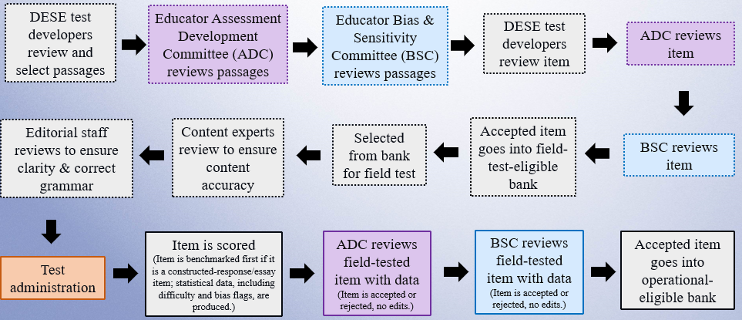
Life Cycle of an English Language Arts (ELA) Item

Slide 5
Scoring Materials
Scoring Guide (Rubric)
  Includes specific descriptions of expectation at each score point
Anchor Papers
  Show a range of real student responses based on the scoring guide (rubric) and scoring notes (educator committees assist with the development of these notes)
Annotations
  Present a brief explanation of the expectations at the score point based on the language of the rubric

Slide 6
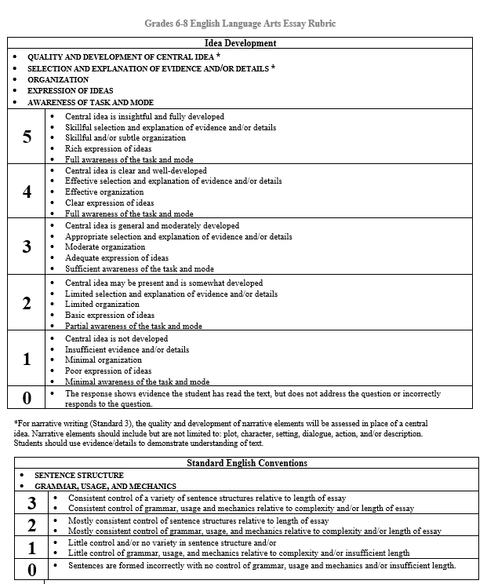
Essay Scoring Guide (Rubric)

Slide 7
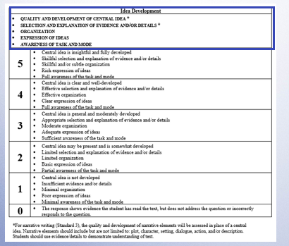
Essay Scoring Guide (Rubric)

Slide 8
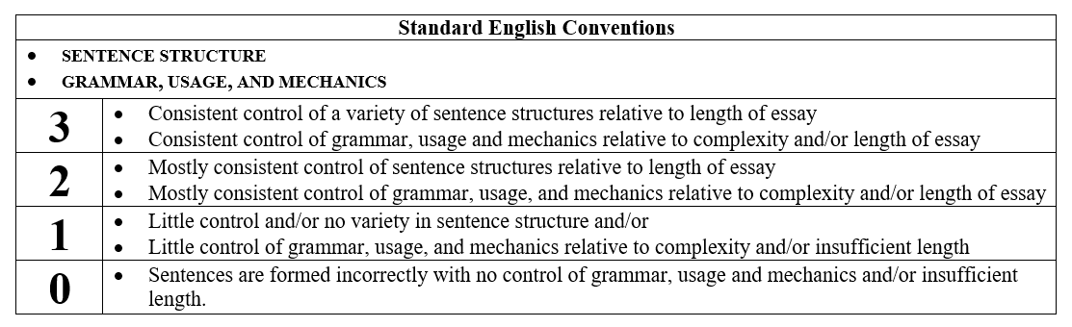
Essay Scoring Guide (Rubric)

Slide 9
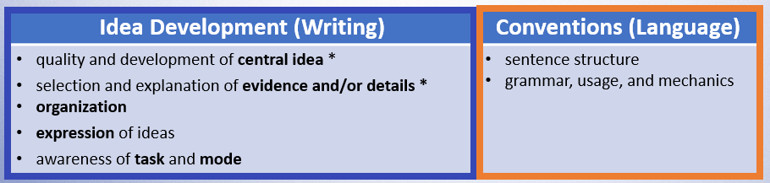
General Language of Essay Scoring Guide (Rubric)
* For narrative writing, the quality and development of narrative elements will be assessed in place of a central idea. Narrative elements should include, but are not limited to: plot, character, setting, dialogue, action, and/or description. Students should use evidence/details to demonstrate understanding of text.

Slide 10
MCAS Student Essay Expectations
Essay must address the question and writing mode.
Essay must be based on information from the passage(s).
Essay should include multiple paragraphs to receive higher scores.

Slide 11
MCAS Essay Scoring
Summaries of passage(s) will receive a zero for Idea Development but may receive up to 3 points for Conventions.
Writing in the wrong mode will receive a zero for Idea Development but may receive up to 3 points for Conventions.
Direct copy from the prompt or passage with no original words from the student will result in a zero score.

Slide 12
Scoring Overview: Scorer process
For each MCAS essay response, scorers
participate in specific training for essay responses
qualify to score each question
use the passage, question, scoring notes, scoring guide, anchor papers and annotations
are monitored by measures such as read-behinds and embedded responses to ensure accuracy

Slide 13
Direction Lines and Questions
Are standardized for each writing mode
Include expectations for what to include in each essay
Questions (prompts) mention specific information to include in the essay and remind students to use details/information from the passage

Slide 14
Narrative Essays
Students are expected to know the term “narrative.” (G5 and above)
Responses should include narrative elements addressing characters, dialogue, plot, and setting that logically extend the passage.
Responses that begin, “I think that…” and list predictions of what might happen will receive a zero for Idea Development.

Slide 15
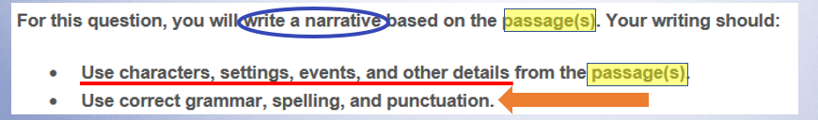
Narrative Direction Lines (grades 5 and above)

Slide 16
Explanatory and Argument Essays
Questions will include words such as “explain,” “evidence,” “details,” or “argue.”
Responses should be based on the passage(s) and not include outside information or personal information on the topic.
Responses should include a central idea with evidence/details from the passage.

Slide 17
Today’s Process for Grade 7 Essay question
Review passage, question and direction lines.
Revisit the scoring guide.
Read and analyze anchor paper(s) at each score point.

Slide 18
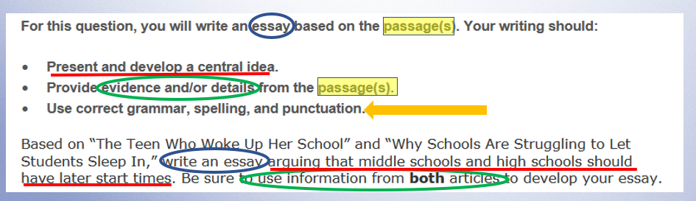
Grade 7 Question

Slide 19
Essay Scoring Guide (Rubric)

Slide 20
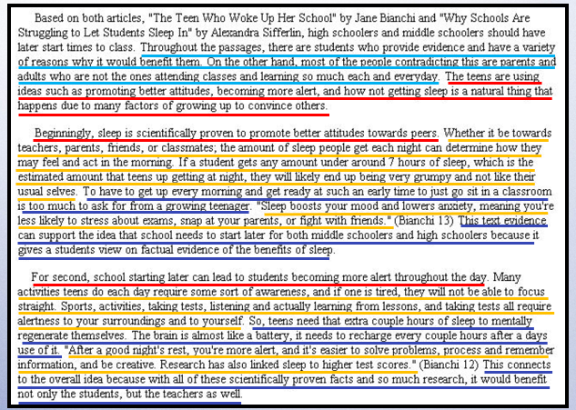

Score: 5/3

Slide 21
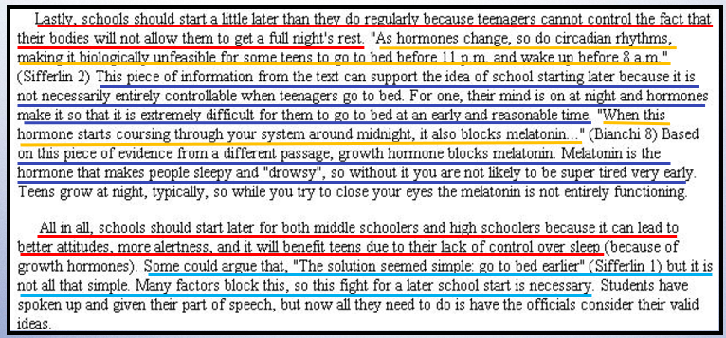

Score: 5/3

Slide 22
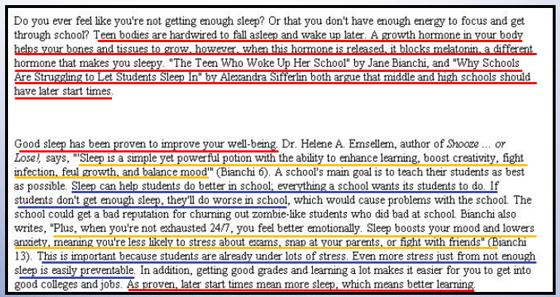
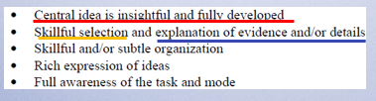
Score: 5/3

Slide 23
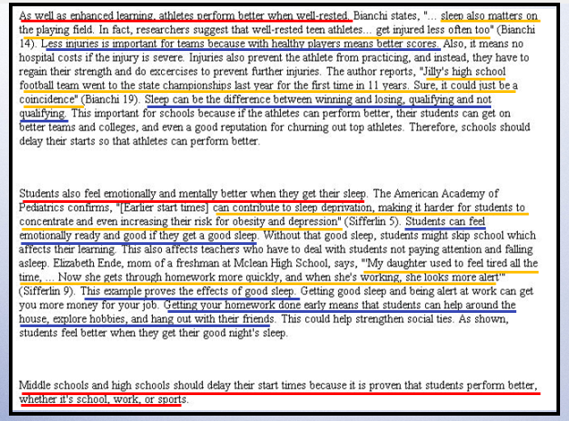


Score: 5/3

Slide 24
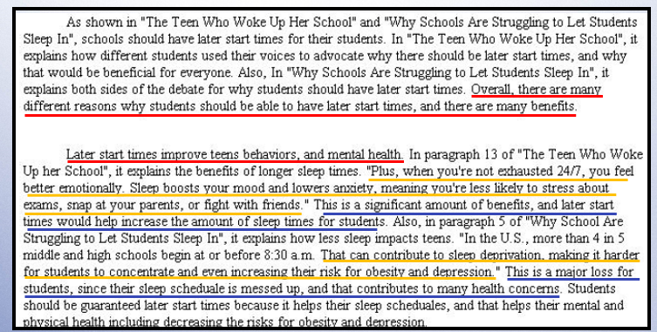
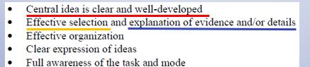
Score: 4/3

Slide 25
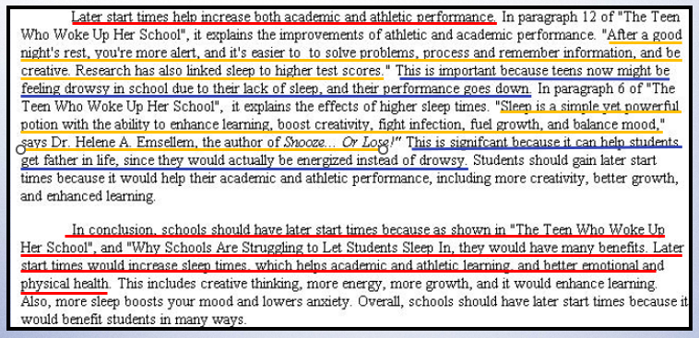
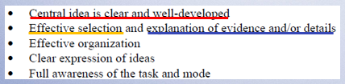
Score: 4/3

Slide 26
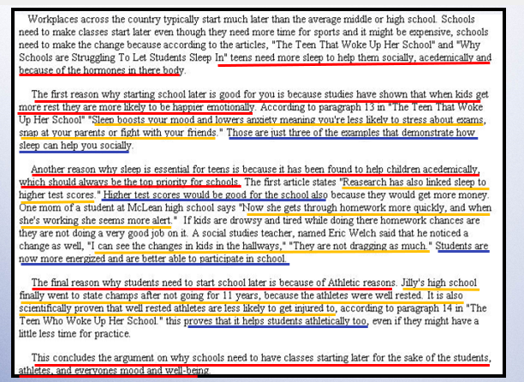


Score: 3/3

Slide 27
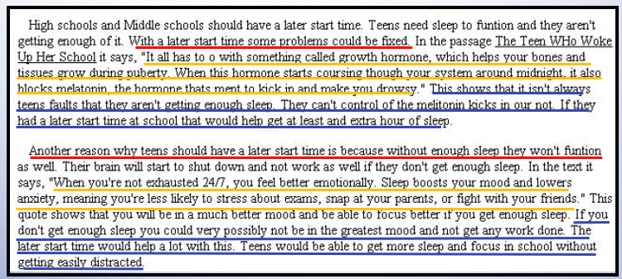


Score: 2/2

Slide 28
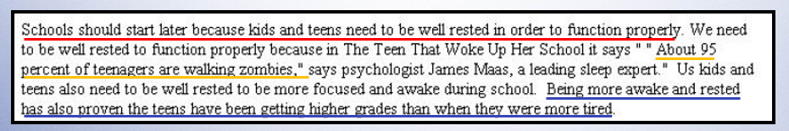
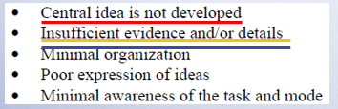
Score: 1/1

Slide 29

Score: 0/0

Slide 30
Takeaways
Idea Development:
Quality and development of central idea
  should be developed throughout the essay
Selection and explanation of evidence and/or details
  evidence from the passage(s) can be quoted, paraphrased, or a mix of both
Organization
  can be organized by ideas, passage, or other
Expression of ideas
  should be evident throughout essay
Awareness of task and mode
  should be evident immediately in the introduction and throughout the essay
Conventions:
Control of sentence structure
Control of grammar, usage, and mechanics

Slide 31
Practice of Grade 7 ES question
Revisit the question and passage.
Read the essay response.
Use the anchor papers and scoring guide to score the essay response.
Choose the score that you think best represents the essay response.

Slide 32
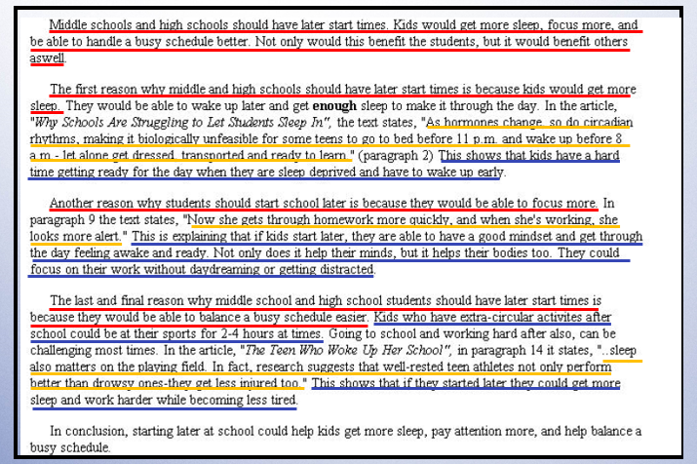
Response A
Idea Development Score: 3
Conventions Score: 3

Slide 33
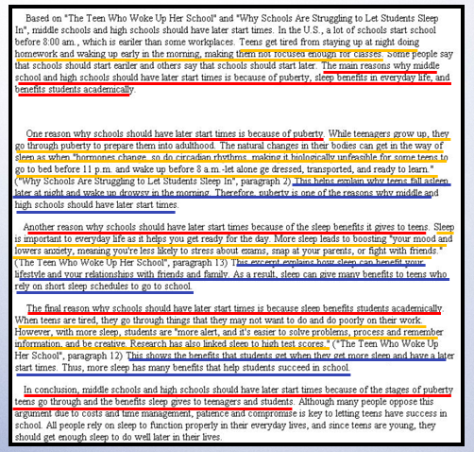
Response B
Idea Development Score: 4
Conventions Score: 3

Slide 34
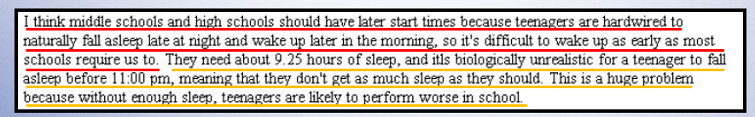
Response C
Idea Development Score: 1
Conventions Score: 1

Slide 35
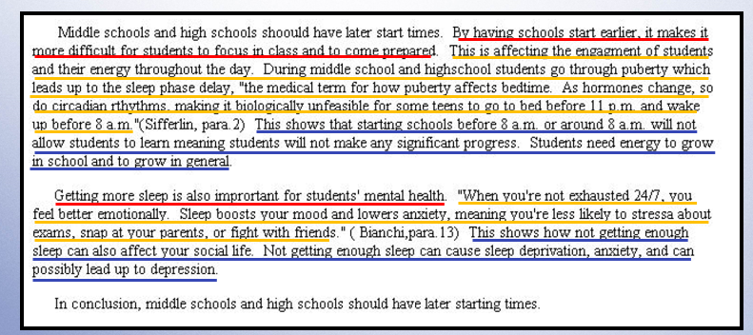
Response D
Idea Development Score: 2
Conventions Score: 2

Slide 36

Response E
Idea Development Score: 0
Conventions Score: 0

Slide 37
MCAS ELA Resources on DESE Website
MCAS Resource | Link
ELA Rubrics | https://www.doe.mass.edu/mcas/tdd/ela.html?section=rubrics
Student Work Samples and Annotations | https://www.doe.mass.edu/mcas/student/default.html
Released Questions | http://mcas.pearsonsupport.com/released-items/ela/
ELA Test Designs | https://www.doe.mass.edu/mcas/tdd/ela.html?section=testdesign
Information about MCAS ELA Essay Scoring | https://www.doe.mass.edu/mcas/tdd/ela.html?section=other

Slide 38
Contact Information
DESE Office of Student Assessment for policy questions (e.g., test designs, accommodations)
Web: www.doe.mass.edu/mcas
Phone: 781-338-3625
Email: mcas@mass.gov
MCAS Service Center
Web: http://mcasservicecenter.com/
Phone: 1-800-737-5103

Slide 39

Thank you

