Slide 1
Student Registration for February Science Office Hours
The Office of Student Assessment Services
December 13, 2024

Slide 2
Presenters
Jodie Zalk, Manager of Test Administration and Publications
Scott Kelley, Data and Reporting Specialist
Shannon Cullen, MCAS Test Administration Coordinator
Abbie Currier, eMetric Sr. Project Manager

Slide 3
Logistics for This Session
Use the Q&A feature to ask a question.
We will answer some questions aloud at specified times during this training session, and we will email the Q&A afterwards.
Type your questions anytime, but we may not answer them in real time as some questions may be covered during the presentation.
Use the thumbs-up icon to “upvote” someone else’s question.
Email student-specific questions to mcas@mass.gov instead of asking here.
This session is being recorded and will be available in about a week in the MCAS Resource Center, along with the slides.
Closed captioning has been enabled for participants who need it.

Slide 4
Slides for This Session
Slides were emailed to participants before this session from MCASEvents@cognia.org.
Slides are now being posted in the chat.
If you cannot access the slides in the chat, ask in the Q&A.
After the session, we will send the slides again to participants, and they will be posted in the MCAS Resource Center along with the recording.

Slide 5
Today’s Agenda
February Science Student Participation Guidelines and Registration File
Enrollment Transfer Process
Q&A and Additional Demonstrations

Slide 6
1. February Science Student Participation Guidelines and Registration File

Slide 7
Student Registration Deadlines
Administration | Initial Student Registration Window Important for receiving manuals on time and Student ID Labels for PBT
February Science | December 12, 2024–January 8, 2025
March Retests | January 21–31
See the Statewide Testing Schedule for the following:
Extended deadlines for CBT
Deadlines for updating student registration information (as needed) after administration
If a high school will not have any students participating in an administration, the school needs to email mcas@cognia.org to let them know by the above deadlines.

Slide 8
General Participation Guidelines for February Science
Students can participate in either Biology or Introductory Physics during the February Science administration.
Students must participate in a high school Science test by the end of grade 10 for accountability purposes, and can test in grade 9 or 10.
Students may participate in February for accountability purposes as well as for Adams Scholarship and Koplik Award eligibility.
Adams Scholarship eligibility is based on a student’s first test attempt, but students may retake a test to attempt to raise their score for the Koplik Award.
For additional guidance
High school participation guidelines: www.doe.mass.edu/mcas/highschool.html
Update on Student Competency Determinations: www.doe.mass.edu/commissioner/spec-advisories/2024-1211student-cd-update.html

Slide 9
The .CSV File for February Science
Student Registration files from DESE
DESE creates .CSV files that schools can use as the basis for completing Student Registration.
Files follow the new file format for the MCAS Portal.
Accommodations are prepopulated from spring 2023 and 2024 STE.
Student records included in the files
students in grades 9–11 who have not previously taken a high school science test
a very small number of students in grade 12 who were listed as grade 9 in June 2024 SIMS (These grade 12 students must participate in February or June Science for accountability purposes.)
Student records not included in the files
students who were previously counted for accountability purposes
students who took the MCAS-Alt
students granted an appeal in high school Science

Slide 10
Using the .CSV File for February Science
Access your school’s .CSV file in the MCAS 2025 folder in DropBox Central in the DESE Security Portal on the first day of the Student Registration window (December 12).
Files will follow the format “Feb2025_Sci_Student_Registration_xxxxxxxx.csv” where x’s refer to your school and district code.
Save the file locally, and update it based on which students will participate in the February administration.

Slide 11
Frequently Asked Questions
What if a student is listed in the .CSV file, but has already earned a scaled score on a high school science test?
Contact mcas@mass.gov (please do not send SASIDs via email).
What if I need a transfer student’s prior MCAS scores?
In most cases, students’ MCAS history is available in Edwin Analytics, once students are “claimed” by the new district.
View the Student Assessment History Summary report (PE613).
Edwin Analytics is available on the Department's Security Portal.
See the Steps to Retrieve Students’ MCAS Assessment History in Edwin Analytics on the MCAS Results web page for additional details.

Slide 12
2. Enrollment Transfer Process

Slide 13
Overview of Enrollment Transfers
Students are loaded to the MCAS Portal once per school year, regardless of which administration(s) they are taking.
Schools will use the Enrollment Transfer feature in the MCAS Portal for transfer students who need to be registered for testing at their new school, who already exist in the MCAS Portal.
When a school receives a transfer student who needs to be registered for testing, the first step should be to search for the student using the Enrollment Transfer page in the MCAS Portal.
Note: This is different from the previous test administration management system, PearsonAccess Next (PAN).

Slide 14
Overview of Enrollment Transfers – New for 2025
Schools will use the Enrollment Transfer page in the Portal as the first step when receiving a new student to determine whether the student exists in the MCAS Portal.
This page will tell you whether the student already exists in the MCAS Portal.
All school and district test coordinators associated with the sending school will receive email notifications for pending enrollment transfer requests.
Student test sessions do not transfer from one school to another. Schools will use the Transfer Notes features to indicate which sessions a student has already completed.
Schools may need to complete enrollment transfers more often in the MCAS Portal.

Slide 15
Enrollment Transfer Overview
MCAS Portal Section | Tasks to Complete in this Section | Who will complete these tasks?
Enrollment Transfer | Request to transfer a student into your school and district. | STCs and DTCs may request to transfer a student.
 | Approve transfers other schools and districts have requested. | STCs and DTCs may approve student transfers. If a student does not currently belong to an organization, the MCAS Service Center will approve student transfers.
When a receiving school requests a student transfer, the DTC and STC users associated with the sending school will receive an email notification.

Slide 16
Demonstration
Transferring students within your district

Slide 17
Transferring Students within a District
Sign in to the MCAS Portal and select Administration.
Click Students.
Locate the student you wish to update and click Enrollment Info.
Click Unenroll to unenroll the student from the current school and click Yes to confirm.

Slide 18
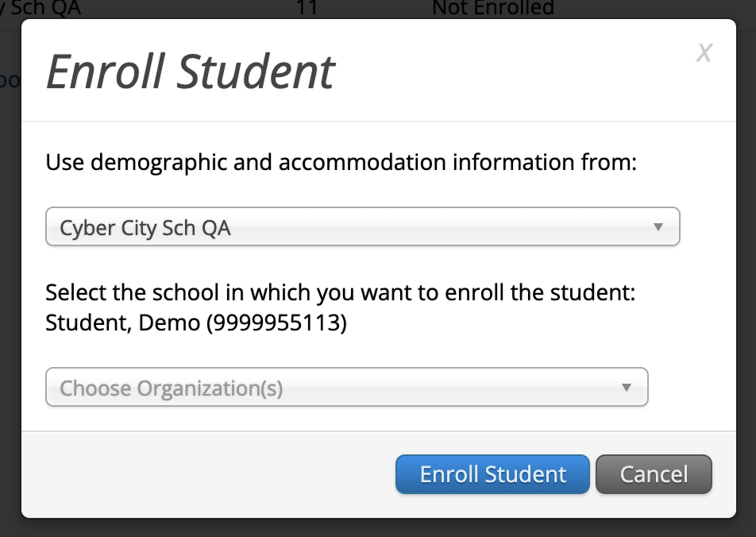
Transferring Students within a District (cont’d)
5. Click Enroll student in a different school.
6. Select the new school from the organization drop down and click Enroll Student.
7. Ensure the student’s information is correct and click Save.
Note that only District Test Coordinators may transfer students within a district. School test coordinators should contact their DTC for assistance.

Slide 19
Demonstrations
Transferring students outside your district
Requesting student transfers
Approving student transfer requests
Entering and reviewing transfer notes

Slide 20
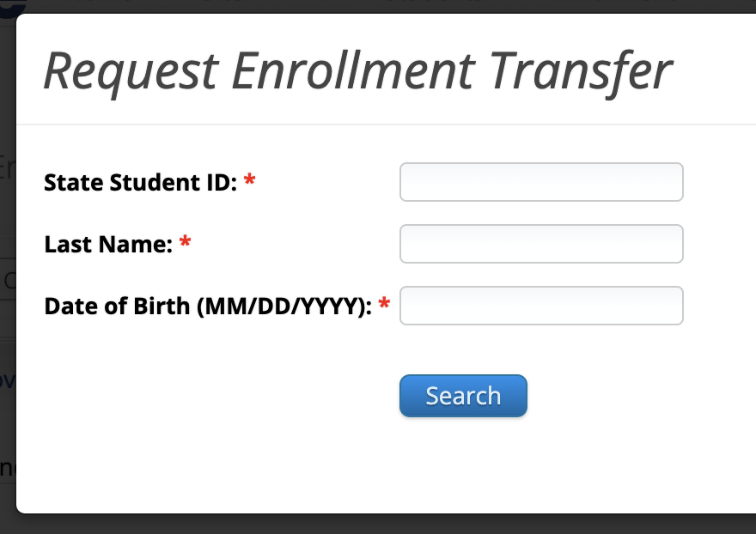
Transferring Students from Outside Your District: Requesting a Student Enrollment Transfer
Sign in to the MCAS Portal and select Administration.
Select Enrollment Transfer.
On the Enrollment Transfer page, select Request Transfer.
Enter the student’s SASID, last name, and date of birth.
Select Search.

Slide 21
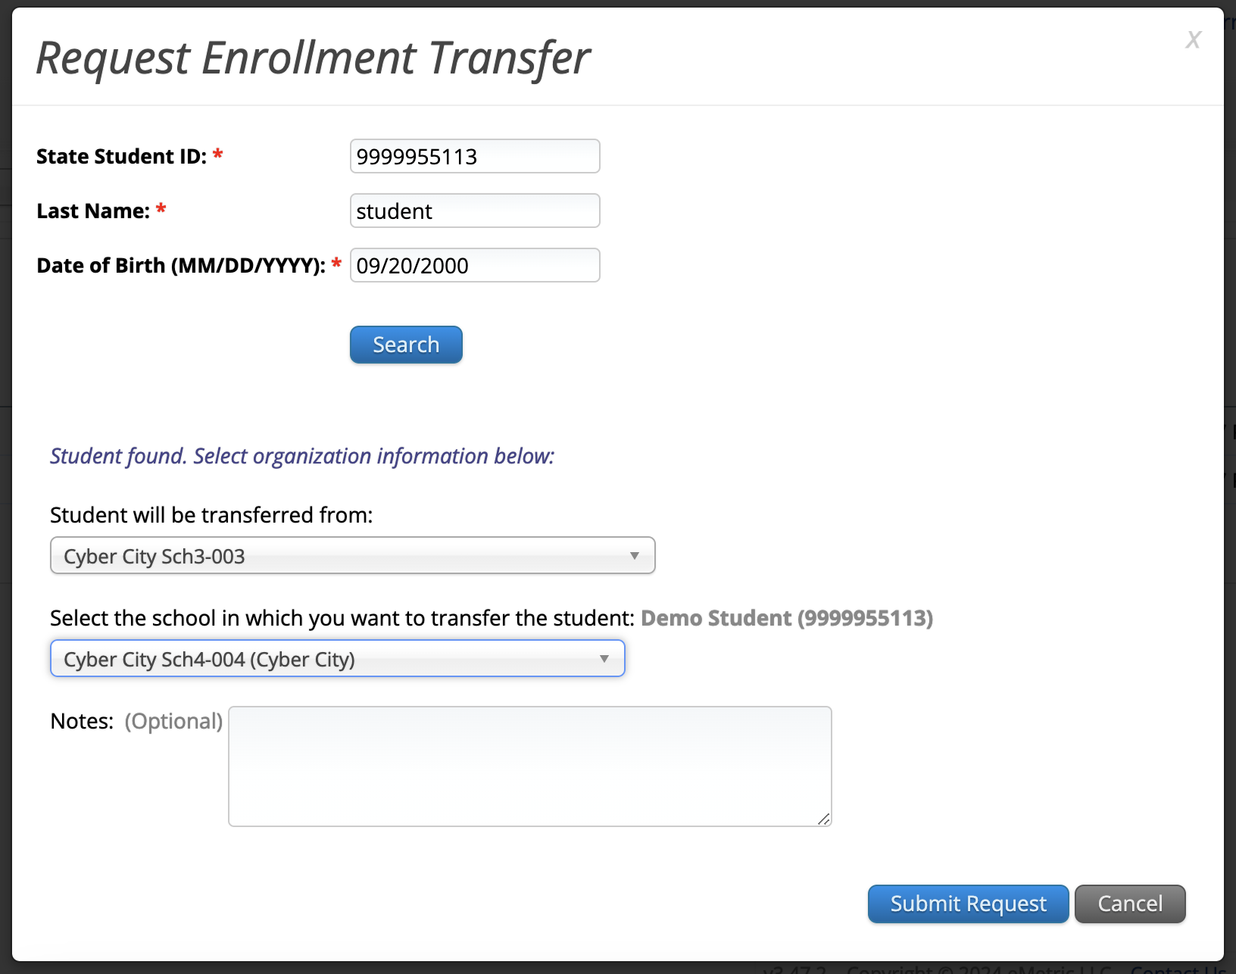
Transferring Students from Outside Your District: Requesting a Student Enrollment Transfer (cont’d)
If the student is found, select the school into which you want to transfer the student.
If this request is during the testing window, use the Notes to ask questions as needed.
Select Submit Request.

Slide 22
Transferring Students from Outside Your District: Requesting a Student Enrollment Transfer (cont’d)
Any student transfers you have initiated will appear on the Requests tab.
Select Cancel to cancel the transfer request.

Slide 23
Approving a Student Enrollment Transfer
Any student transfers waiting for your approval will appear on the Approvals tab.
DTCs and STCs will be notified of enrollment transfers that need their review via email and on the Administration home page.
Review the request and add transfer notes. Click Approve to approve the transfer or click Reject to reject the request.

Slide 24
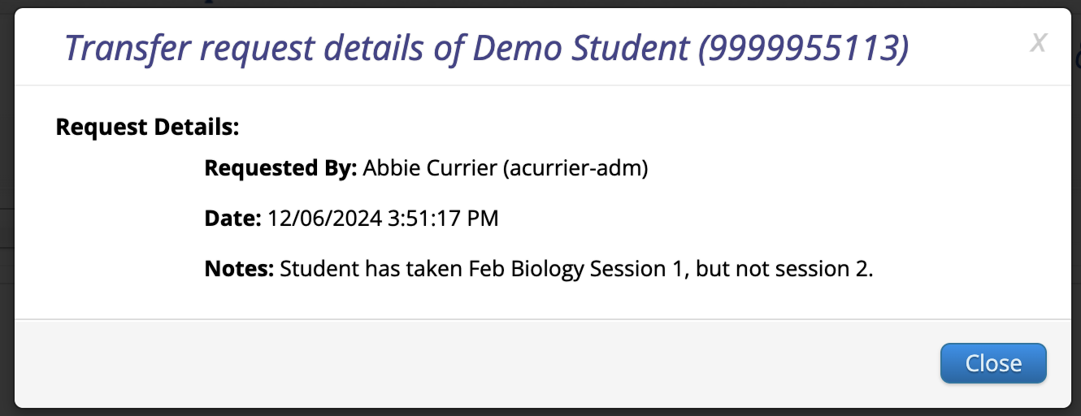
View Details
Student test sessions do not move from one school to another in the MCAS Portal. Schools will use the Transfer Notes features to note any test sessions the student has already completed.
Schools can refer to the View Details screen at any time to view the Transfer Notes for an enrollment transfer.

Slide 25
3. Q & A and Additional Demonstrations

Slide 26
Additional Resources
Resource | Location
MCAS Resource Center | mcas.onlinehelp.cognia.org
MCAS Portal user guides Student Registration Guide MCAS Portal User Management Guide | https://mcas.onlinehelp.cognia.org/portal/
Technology Information Technology Guidelines for MCAS Computer-Based Testing Guide to Installing the MCAS Student Kiosk and Conducting Site Readiness | https://mcas.onlinehelp.cognia.org/ technology-setup/
Student Assessment Updates (Biweekly email with important updates about the MCAS program) | www.doe.mass.edu/mcas/updates.html If you do not already receive this email, subscribe using this link: http://eepurl.com/ghSOhH

Slide 27
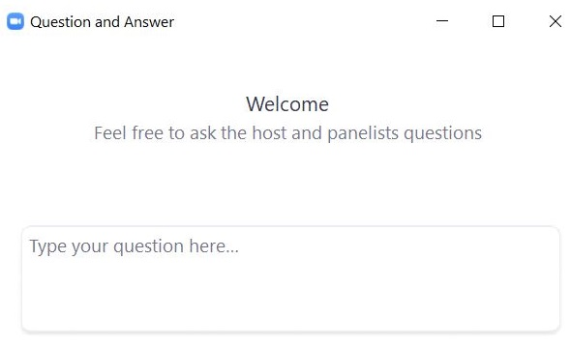
Questions & Answers
Use the “Q&A” feature to ask questions.

Slide 28
Next Steps
Today: Complete the evaluation form.
Responses are associated with the name and email address used to log in.
Email your input to mcas@mass.gov if you have problems accessing or completing the form.
Within one week:
Receive an email with the Q&A from this session
Recording will be available

Slide 29
Email and Phone Support
MCAS Service Center
DESE Student Assessment Services
Questions on logistics and technology
Web: https://mcas.onlinehelp.cognia.org/
Email: mcas@cognia.org
Phone: 800-737-5103
TTY: 888-222-1671
Live chat is available at the link on the bottom of the page at the MCAS Resource Center
Policy questions (e.g., student participation, accommodations)
Web: www.doe.mass.edu/mcas
Email: mcas@mass.gov
Phone: 781-338-3625
TTY: 800-439-2370

Slide 30
THANK YOU
The Office of Student Assessment Services
781-338-3625
mcas@mass.gov
www.doe.mass.edu/mcas
135 Santilli Highway, Everett, MA 02149

