Slide 1
Overview of Student Registration Tasks for the MCAS Portal: February Science and March Retest Administrations
The Office of Student Assessment Services
November 26, 2024

Slide 2
Presenters
Jodie Zalk, Manager of Test Administration and Publications
Robert Pelychaty, Manager of Inclusive Assessment
Scott Kelley, Data and Reporting Specialist
Shannon Cullen, MCAS Test Administration Coordinator
Abbie Currier, eMetric Sr. Project Manager

Slide 3
Logistics for This Session
Use the Q&A feature to ask a question.
We will answer some questions aloud at specified times during this training session, and we will email the Q&A afterwards.
Type your questions anytime, but we may not answer them in real time as some questions may be covered during the presentation.
Use the thumbs-up icon to “upvote” someone else’s question.
Email student-specific questions to mcas@mass.gov instead of asking here.
This session is being recorded and will be available in about a week in the MCAS Resource Center, along with the slides.
Closed captioning has been enabled for participants who need it.
This session is being interpreted into ASL. Our interpreting team will be onscreen with the presenters.

Slide 4
Slides for This Session
Slides were emailed to participants before this session from MCASEvents@cognia.org.
Slides are now being posted in the chat.
If you cannot access the slides in the chat, ask in the Q&A.
After the session, we will send the slides again to participants, and they will be posted in the MCAS Resource Center along with the recording.

Slide 5
Today’s Agenda
Introduction
Overview of the Student Registration Process
Preparing the Initial File for Import
Steps for Completing the Initial Import
Steps after the Initial Import
Resources, Support, and Next Steps
Live “Sandbox” Time with Additional Demonstrations
Note: This training will not cover enrollment transfers, creating classes, test scheduling, or navigating the MCAS Student Kiosk. These topics will be covered in future training sessions. In addition, this training will not cover updates to the Competency Determination (see the November 6 Special Edition Update for additional information on the CD).

Slide 6
Future Training Topics
December Office Hours Sessions
Wednesday, December 11 9:30 – 10:30 a.m.
Participation guidelines for the February Science administration
Enrollment transfers
Opportunity for schools to ask questions and request to see demonstrations for Student Registration
Friday, December 13 9:30 – 10:30 a.m.
Opportunity for schools to ask questions and request to see demonstrations for Student Registration
Future Training Sessions
Creating classes
Scheduling tests
Navigating the MCAS Student Kiosk

Slide 7
Poll Question—3
What is your role? (Check all that apply)
District test coordinator
School test coordinator
Principal
Guidance counselor
Technology staff
Other district staff
Other school staff

Slide 8
Poll Question—3
How many years have you coordinated MCAS test administration?
0–This is my first year.
1 year
2–3 years
4–5 years
6+ years

Slide 9
1.Introduction

Slide 10
New Systems for MCAS Computer-Based Testing Beginning in 2025
Crosswalk of terminology:
www.doe.mass.edu/mcas/testadmin/crosswalk-of-terminology.pdf
New MCAS Portal rollout and tasks to complete in fall 2025:
October 18 Student Assessment Update https://us14.campaign-archive.com/?u=d8f37d1a90dacd97f207f0b4a&id=69d17e38c8
MCAS training sessions on tasks in the MCAS Portal
For test coordinators: https://mcas.onlinehelp.cognia.org/training-webinars/
For technology coordinators: https://mcas.onlinehelp.cognia.org/training-webinars-portal-tasks-tech-coordinator/
Additional resources in the new MCAS Resource Center
https://mcas.onlinehelp.cognia.org/

Slide 11
Tasks to Complete in Fall 2024
Task | Person responsible | Recommended Deadline
Create and edit MCAS Portal user accounts | Test coordinators | November 15 for test coordinator and technology coordinator accounts; Three weeks before test administration for test administrator accounts
Download and install the MCAS Student Kiosk on student testing devices | Technology coordinator | November 15 for high schools
Conduct Site Readiness to certify that technology infrastructure is ready for testing | Technology coordinator | November 15 for high schools

Slide 12
Tasks to Complete in the MCAS Portal During Test Administration for School Test Coordinators
Task | Timeframe for completing task
Student registration (with extended window to follow for CBT) | Approximately 2 months before administration February Science: December 11–19 March Retests: January 21–31
Assigning and managing accommodations | During Student Registration and throughout testing
Create and assign students to “classes” | Approximately 2 weeks before administration Recommended deadlines: February Science: January 21 March Retests: February 19
“Schedule” classes in the MCAS Portal for CBT | February Science: January 28–February 3 March Retest ELA: February 27–March 5 March Retest Math: March 3–10
Printing student logins | 1–2 days before testing
Monitoring test administration Test coordinators and test administrators view student statuses, and test coordinators can view dashboards. | During testing
Note: Schools and districts will also use the MCAS Portal after testing to access reports of results.

Slide 13
2. Overview of the Student Registration Process

Slide 14
What is Student Registration?
Student Registration is a collection of student-level data, including
student demographic data
information on selected accommodations that a student will use during testing
Student Registration must be completed to determine the basis for the initial shipment of materials to schools, including
test administration manuals (CBT and PBT)
Student ID Labels for paper-based tests (PBT)
PBT test and answer booklets, including special test editions
Student Registration determines initial test orders and provides a record of students tested and the accommodations they used.
District and school test coordinators and technology coordinators have permissions in the MCAS Portal to upload and edit student data.
The MCAS Student Registration Guide, available on the MCAS Resource Center, contains step-by-step instructions on how to complete Student Registration in the MCAS Portal.

Slide 15
Overview of Steps to Complete Student Registration
Download the .CSV file prepared by DESE from Dropbox Central in the DESE Security Portal (available on the first day of each Student Registration window).
Delete students from the file who are no longer enrolled in your school, and add rows for students who were not included in the file and will be testing.
Verify and update students’ accessibility features and accommodations.
Save as a .CSV file and import file into the MCAS Portal.
Resolve any errors that occur.
Update student information as needed, through file export/import process or through the user interface.

Slide 16
Student Registration Deadlines
Administration | Initial Student Registration Window Important for receiving manuals on time and Student ID Labels for PBT
February Science | December 11–19
March Retests | January 21–31
See the Statewide Testing Schedule for the following:
Extended deadlines for CBT
Deadlines for updating student registration information (as needed) after administration
If a high school will not have any students participating in an administration, the school needs to email mcas@cognia.org to let them know by the deadline listed above.

Slide 17
For what reasons and when should we update Student Registration?
1. Initial Student Registration Window
2. Extended Student Registration Window for CBT
3. Test Administration Window
4. Deadline for Updating Student Registration information
Add students
Remove students/test assignments
Edit accommodations
Edit demographic info
Same as 1, but additional steps are required for some accommodations (see slide 19)
Same as 1, but may need to order additional paper-based tests for new PBT accommodations
Edit accommodations that were not used
Edit demographic info

Slide 18
MCAS Accessibility and Accommodations
All accommodations with the “SR” designation in the Accessibility and Accommodations Manual must be selected prior to testing.
Some accommodations cannot be changed after a student signs in to the test. If the correct accommodations are not selected before a student signs in, additional steps during testing will be required.
Review the Accessibility and Accommodations Manual (to be available soon)
Remember to assign accessibility features and accommodations appropriately:
Accessibility features available to all students
Accommodations available only for students with disabilities and ELs

Slide 19
Form-Dependent Accommodations
The following accommodations must be assigned correctly before testing. If not assigned correctly, a student’s test will need to be stopped and a new test will need to be set up, and the student may need to retake a portion of the test.
Form-dependent accommodations for CBT:
ASL
Compatible assistive technology
Human read-aloud
Human signer
Screen reader
Spanish/English
Form-dependent accommodations for PBT:
Large-print
Braille
New for 2025:
Text-to-speech is not a form-dependent accommodation. The accommodation can be added during testing if necessary without voiding the student’s test.

Slide 20
Accessibility Features and Accommodations That Must Be Included in Student Registration Prior to Testing
Accommodation # | Description
UF4 | Alternate Cursor/Mouse Pointer tool
A1 or EL1 | Paper test, if unable to use computer
A2 | Large-print edition
A3.1 or A3.2 | Screen reader or Braille edition for a student who is blind or visually impaired
A4 or EL3.1 | Text-to-speech (TTS) for Mathematics or STE tests
A5 or EL3.2 | Human read-aloud for Mathematics or STE tests
A6.1 or A6.2 | Human signer for Math, STE, or ELA test questions only (or ASL video for spring grade 10 Math and high school Biology and Introductory Physics–CBT only)
A9 | Supplemental graphic organizer or reference sheet
A10.1 or A10.2 EL4.1 or EL4.2 | Human scribe or embedded speech-to-text device for Math and/or STE
A12 | Typed responses for PBT only
Refer to Appendix A of the MCAS Student Registration Guide for additional instructions for these accommodations.

Slide 21
Special Access Accommodations That Must Be Included in Student Registration Prior to Testing
Accommodation # | Description
SA1.1 | Text-to-Speech (for ELA tests only)
SA1.2 | Human read-aloud (for ELA tests only)
SA2 | Human signer for ELA passages
SA3.1 or SA3.2 | Human scribe or speech-to-text device for ELA
SA4 | Calculation device or arithmetic table for noncalculator Math test session
SA5 | Spell-checker for ELA
SA6 | Word prediction for ELA
Refer to Appendix A of the MCAS Student Registration Guide for additional instructions for these accommodations.

Slide 22
MCAS Student Registration Guide
Includes:
Instructions for completing the initial process
Instructions for updating student information after the initial file upload
Field Definitions, Notes, and Validations section:
Describe each of the columns in the Student Registration file.
Indicates which columns are required for import.
Includes details on test codes (column J)
Describe eligibility to receive the accommodation and describe how to complete that field.
Expected Values indicate options for column input.
Appendix A: MCAS Portal Guidance for Form-Dependent Accommodations
Available on the MCAS Resource Center

Slide 23
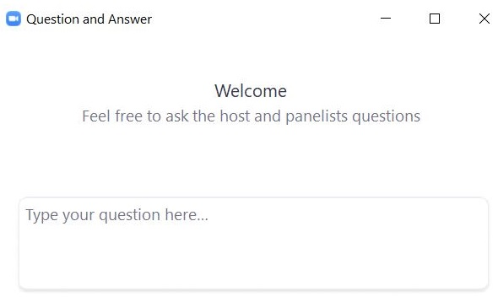
Questions and Answers
Use the “Q&A” feature to ask questions.

Slide 24
3. Preparing the Initial File for Import

Slide 25
Overview of Steps to Complete Student Registration
Download the .CSV file prepared by DESE from DropBox Central in the DESE Security Portal (available on the first day of each Student Registration window).
Delete students from the file who are no longer enrolled in your school, and add rows for students who were not included in the file and will be testing.
Verify and update students’ accessibility features and accommodations.
Save as a .CSV file and import file into the MCAS Portal.
Resolve any errors that occur.
Update student information as needed, through file export/import process or through the user interface.

Slide 26
Secure Websites for this Process
DESE Security Portal: where to find the .CSV files that can be used as the basis for the Student Registration file
https://gateway.edu.state.ma.us/
If you cannot access the Security Portal, contact your Directory Administrator (www.doe.mass.edu/InfoServices/data/diradmin/list.aspx).
MCAS Portal: where to import the student registration file
https://mcas.cognia.org/
For operational testing, please be sure to use the MCAS Portal and not the MCAS Training Site.

Slide 27
Available Resources
MCAS Portal page
Live links to the MCAS Portal and MCAS Training Site
MCAS Student Registration Guide
Student Registration page in the MCAS Portal
MCAS Student Registration Template
Student Registration Data Definitions file

Slide 28
Frequently Asked Questions
What if I am not able to log in to the MCAS Portal?
If you know your username but not your password, you can use the “Forgot Password” link on the Sign In page.
Then, users may request support as follows:
What if I need to create more users for the MCAS Portal?
Refer to the MCAS Portal User Management Guide.
What if I’m unable to log in to the DESE Security Portal?
Contact your District Directory Administrator.
Role | Who to contact for support
Test administrators and school-level technology coordinators | Their principal or school test coordinator
Principals, school test coordinators, and district-level technology coordinators | Their district test coordinator
District test coordinators | MCAS Service Center

Slide 29
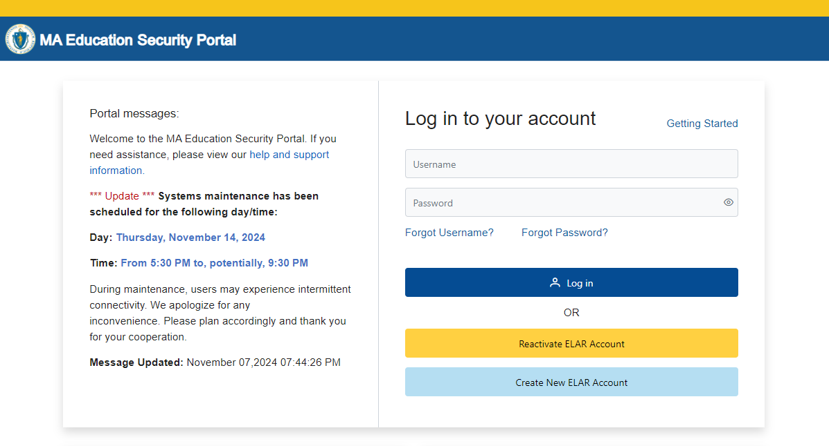
Logging in to the DESE Security Portal
Log in to the Security Portal at https://gateway.edu.state.ma.us/

Slide 30
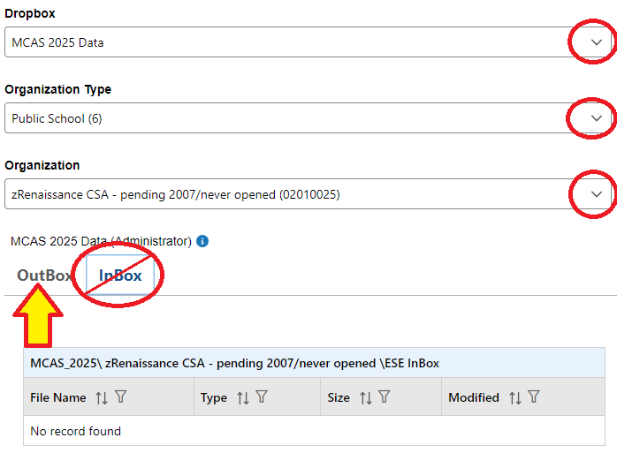
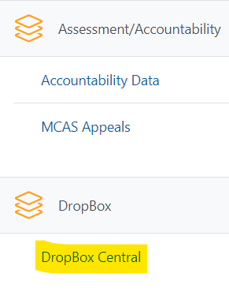
Accessing DropBox Central in the Security Portal
Enter your username and password.
You will then see an Application List.
Select DropBox Central.
Select MCAS 2025 Data.
Click OutBox.

Slide 31
Frequently Asked Questions
What if a student doesn’t have a SASID?
Search for claimed students in Edwin Analytics Student Profile Report (PR600).
If not found in PR600, call your district SIMS contact to create a new SASID, or locate the student’s existing SASID from the prior school, if applicable.
If you do not have a student’s SASID by the file import deadline, assign a “fake” 10-digit SASID starting with “8” (instead of “10”). Update the SASID in the MCAS Portal as soon as you receive the actual SASID.
SASIDs cannot be newly assigned for students 22 years of age or older.

Slide 32
Demonstrations: Tasks before Importing the File
Locating the MCAS Student Registration Guide
Opening the .CSV file downloaded from DropBox Central
Adding/removing rows for students who will or will not participate
Adding test codes for High School Science
Updating a student’s accommodations
Saving the .CSV file

Slide 33
Student Registration Initial Import – Step A: Prepare the File
Log in to the Security Portal (https://gateway.edu.state.ma.us/) to find the .CSV file posted in DropBox Central in the MCAS 2025 folder.
District and school files are available the same day that the Student Registration window opens.
Your spreadsheet program may prompt you to "remove leading zeroes" when opening the file. Always select "No."
Delete rows of students who will not participate; add rows for new students who will participate.
Update any accommodations, as needed.
(High School Science Only) Add test codes for the high school science subject test.
Save the updated file as a .CSV file.

Slide 34
Questions and Answers
Use the “Q&A” feature to ask questions.

Slide 35
4. Steps for Completing the Initial Import

Slide 36
Overview of Steps to Complete Student Registration
Download the .CSV file prepared by DESE from DropBox Central in the DESE Security Portal (available on the first day of each Student Registration window).
Delete students from the file who are no longer enrolled in your school, and add rows for students who were not included in the file and will be testing.
Verify and update students’ accessibility features and accommodations.
Save as a .CSV file and import file into the MCAS Portal.
Resolve any errors that occur.
Update student information as needed, through file export/import process or through the user interface.

Slide 37
Demonstration
Initial file import
Resolving errors

Slide 38
Student Registration: Import the File
In the MCAS Portal, select Administration and then Student Registration.
Select Choose File and select the previously saved file on your computer.
Select Upload.
Confirm that all records have been successfully imported.

Slide 39
Initial File Import
Once the file has been uploaded, the processing may take approximately 5–10 minutes depending on the size of the Student Registration file. The file status will be “Pending” until the file is processed. Users will need to refresh the page to see the updated status of the file.
Once the file is processed, the status will be updated to one of the following:
“Processed” if there are no errors. If your file is “Processed”, there are no further steps to take.
“Validation Errors” if there are errors. If your file has “Validation Errors”, download the Validation Errors link for a list of errors to correct.
“Error: Contact eMetric”
If your file receives the “Error: Contact eMetric” status, please contact the MCAS Service Center for support.

Slide 40
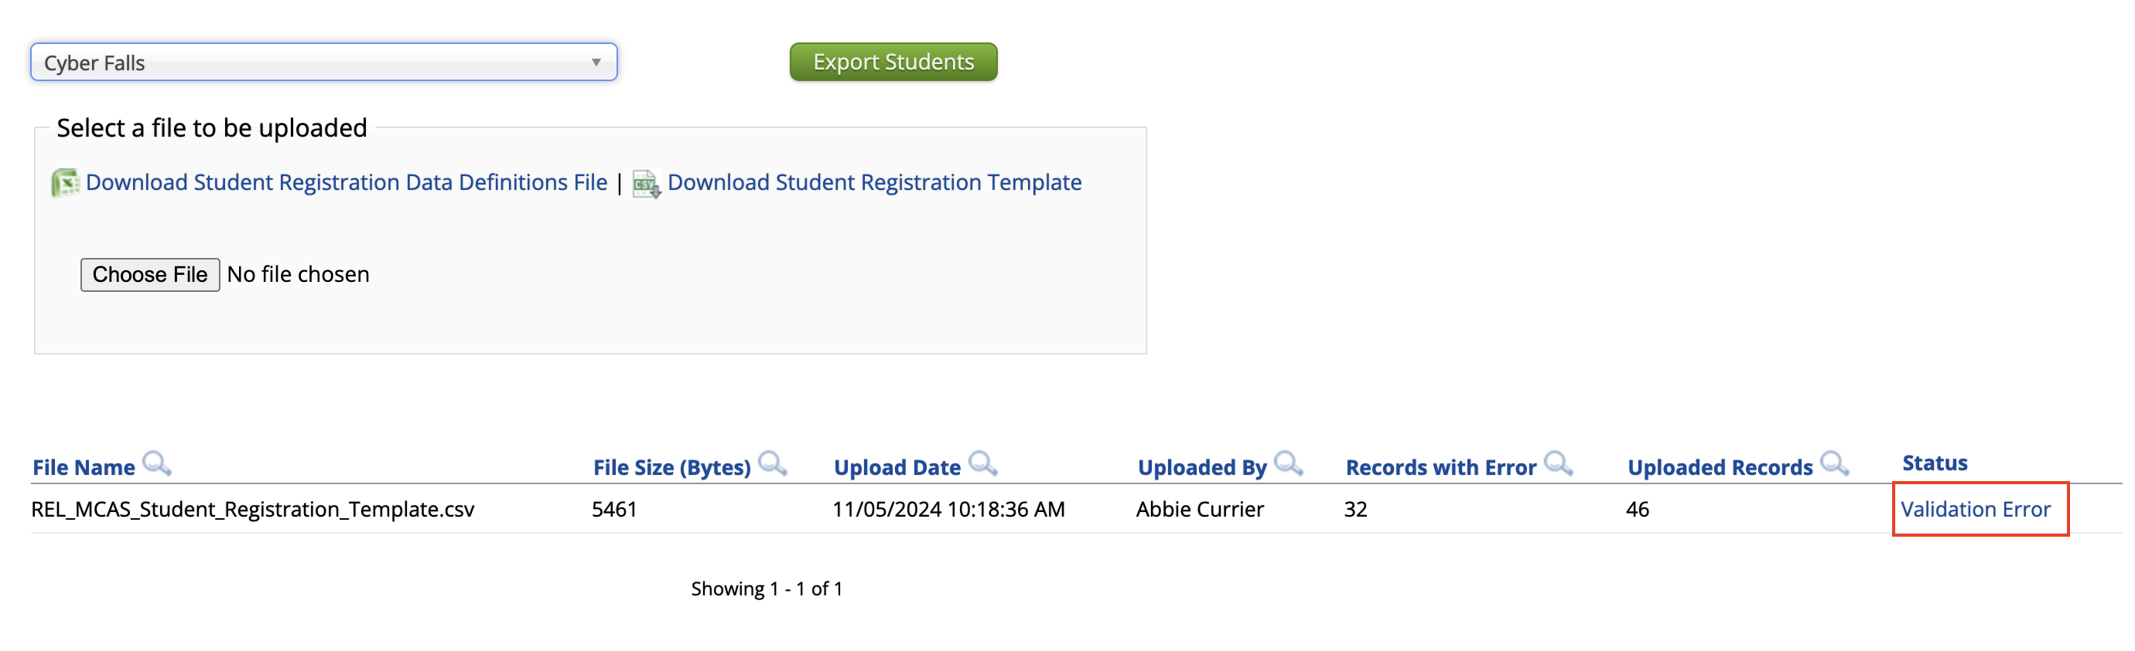
Addressing File Errors
If your file returns the status of “Validation Error”, click the link for Validation Error to view a list of errors for each record in the file.
Using the Data Definitions File, address each error in the file by updating the Validation Error file or the initial Student Registration file.
Save the new file once all errors have been addressed.
Upload the updated file to the MCAS Portal.

Slide 41
Important Notes
Schools and districts can upload up to 75,000 student records in one Student Registration file.
DESE recommends leaving column K (Class name) blank during the initial import.
Schools can export the file, add Class names, and reimport the file approximately two weeks prior to testing.
Additional guidance on creating classes will be shared soon.
After Student Registration and prior to testing, it is recommended to export all of your student registration information to verify accuracy.
This can be done using the Export Students button on the Student Registration page in the MCAS Portal.

Slide 42
Important Reminders
For operational testing, confirm you are in the MCAS Portal and not the MCAS Training Site.
School and district test coordinators and technology coordinators can import a Student Registration file.
Test administrators do not have permission to do so.
If columns are hidden or frozen, be sure to unhide and unfreeze them prior to import.
Do not make changes to the format of the file.
Do not add a title to the file using row 1 of the spreadsheet – this will cause an error during upload.
The Student Registration file import must be done by the initial deadlines for schools to receive an initial order of manuals and PBT tests and Student ID Labels.
Schools can update Student Registration (e.g., accommodations) but must also place an additional order for materials if needed.

Slide 43
Questions & Answers
Use the “Q&A” feature to ask questions.

Slide 44
5. Steps after the Initial Import

Slide 45
Overview of Steps to Complete Student Registration
Download the .CSV file prepared by DESE from DropBox Central in the DESE Security Portal (available on the first day of each Student Registration window).
Delete students from the file who are no longer enrolled in your school, and add rows for students who were not included in the file and will be testing.
Verify and update students’ accessibility features and accommodations.
Save as a .CSV file and import file into the MCAS Portal.
Resolve any errors that occur.
Update student information as needed, through file export/import process or through the user interface.

Slide 46
Update SIMS Data
If you update any student demographic data in the MCAS Portal (SASID, spelling of student’s name, grade, DOB), you must also update student information in SIMS.
Contact the district’s SIMS contact.
To find the contact for your district, go to https://profiles.doe.mass.edu/search/search.aspx?leftNavId=11239 Select “SIMS Contact” from the Function menu, and click “Get Results.”

Slide 47
Managing Students
On the Students page, users can manually add a new student, edit an existing student, and add or edit student accommodations.
Manually adding and editing students is recommended when making changes to ten or fewer student records.
The same fields provided through the student registration file may be entered manually.
Accommodations are entered by test code. Students with accommodations for multiple tests will need the accommodations entered for multiple test codes.

Slide 48
Demonstration
Manually adding a new student
Updating an existing student

Slide 49
Manually Adding a Student
Log in to the MCAS Portal.
Select Administration.
Select Students
Select the Add Student button.

Slide 50
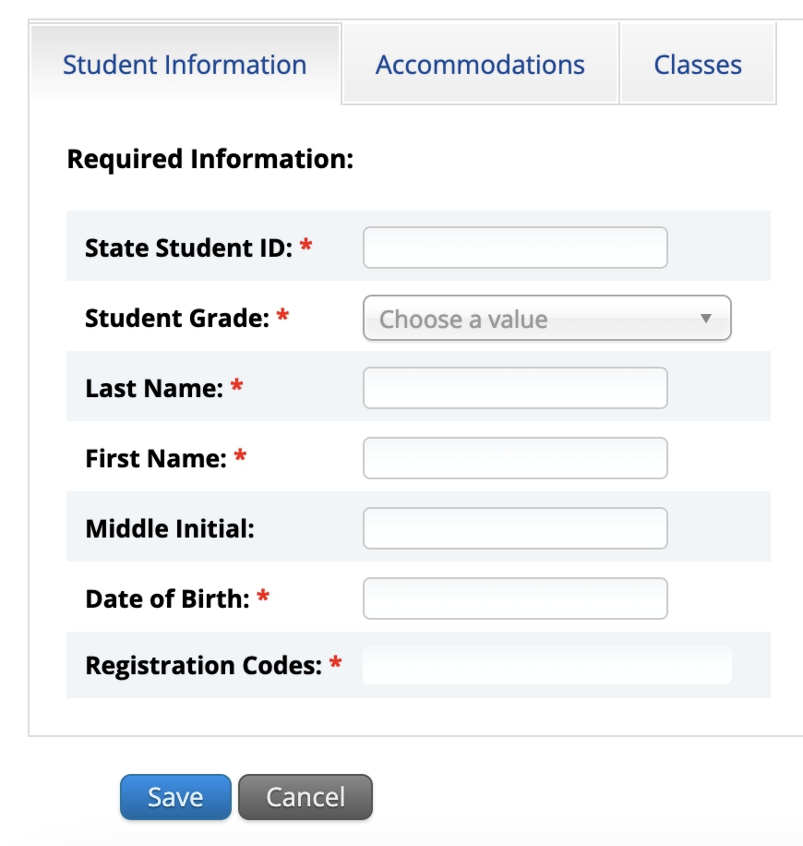
Manually Adding a Student
5. Add student information in the required fields marked with a red asterisk. Be sure to enter the registration codes (test codes) for every test the student will take.

Slide 51
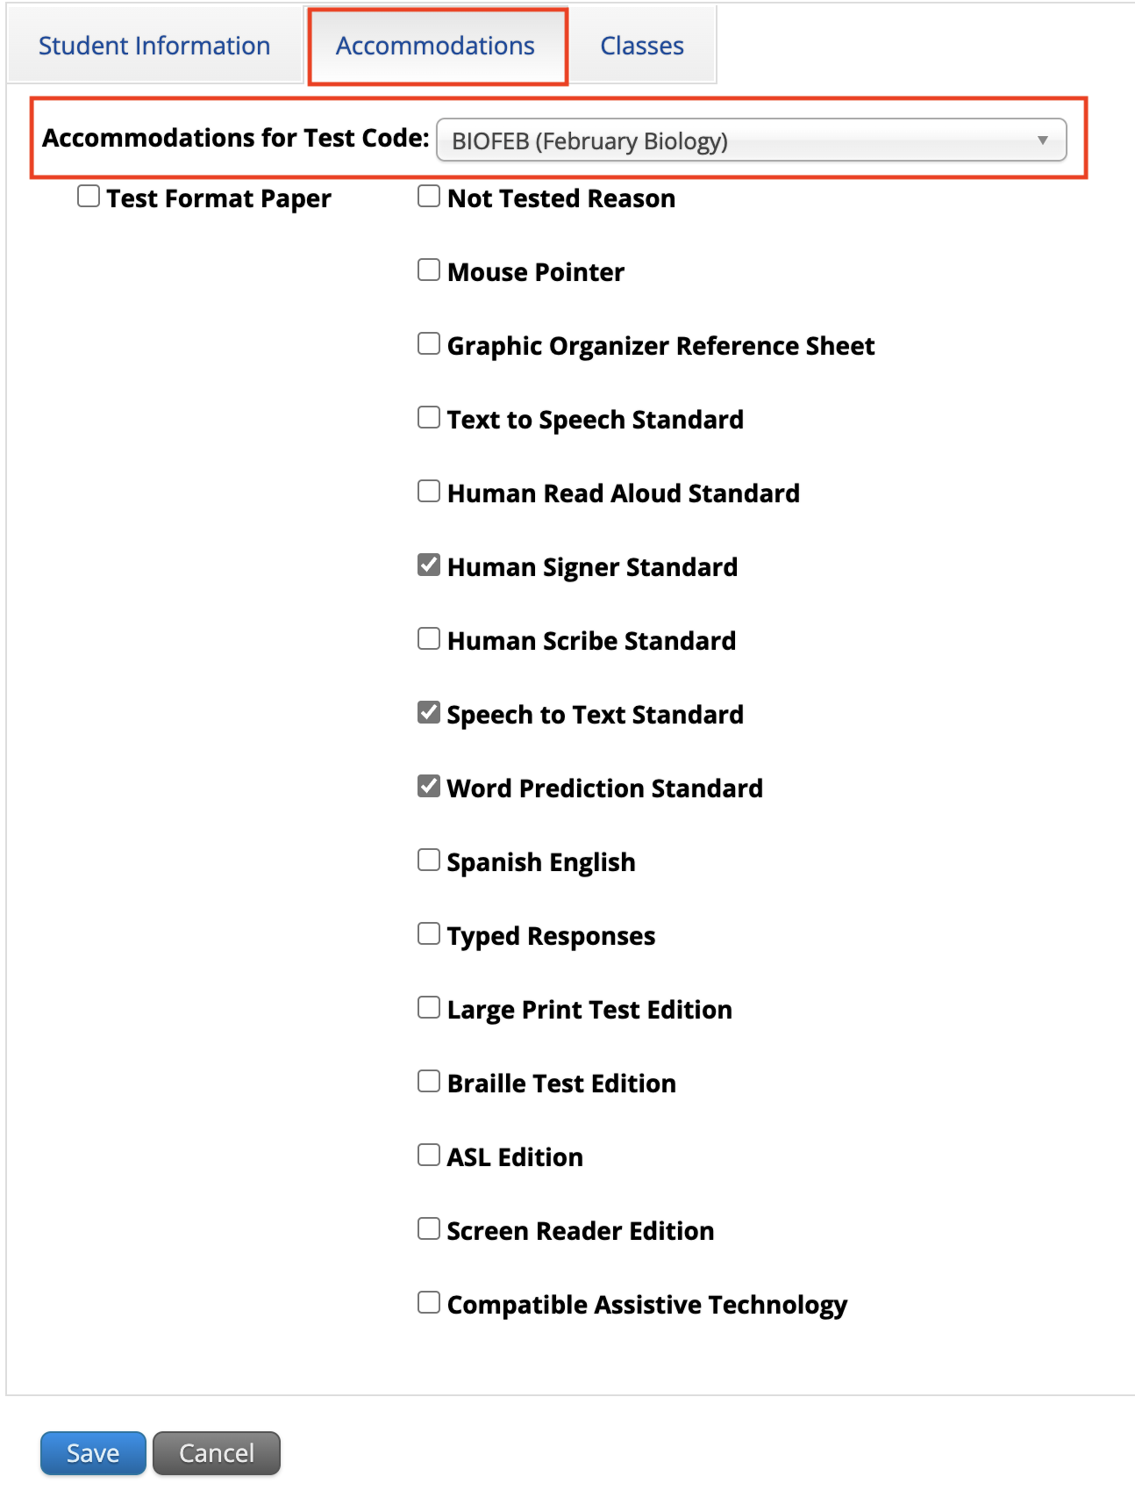
Manually Adding a Student
6. If the student has accommodations, select the Accommodations tab to enter the accommodations by test code.
7.Select Save.

Slide 52
Editing a Student in the MCAS Portal
On the Students page, locate the student to be edited.
Select Edit.

Slide 53
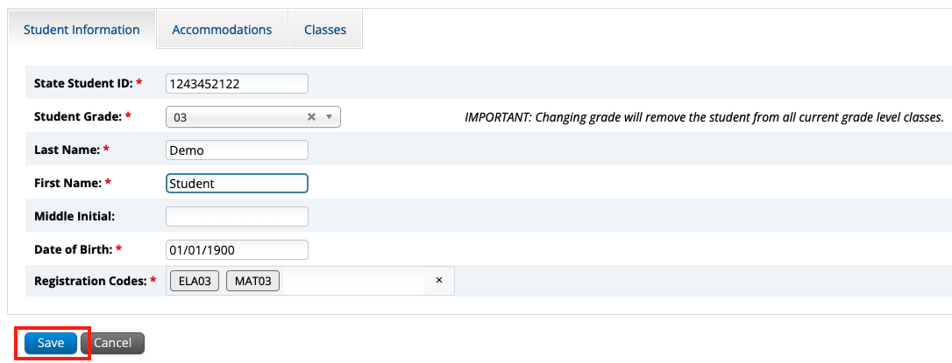
Editing a Student in the MCAS Portal
3. Update the student information.
4. Click Save.

Slide 54
Adding/Editing Student Accommodations
On the Students page, locate the student to be edited.
Select Edit.

Slide 55
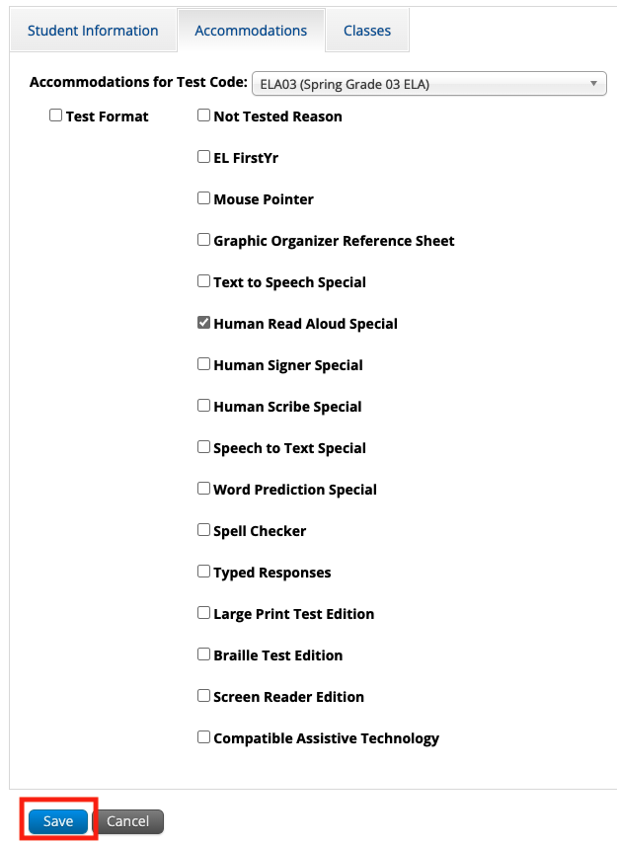
Adding/Editing Student Accommodations
3. Update the student’s accommodation by test code.
4. Select Save.

Slide 56
Updating PBT Tests
If you need to add a student taking PBT, or if you need to update a student’s PBT test accommodations after the initial Student Registration window, you may need to place an additional materials order through the MCAS Service Center.
See Appendix B of the PAM: Procedures for Paper-Based Testing for information.

Slide 57
Demonstration
Exporting and reimporting Student Registration

Slide 58
Exporting and Reimporting Student Registration Files
Recommended when updating more than 10 student records
Log in to the MCAS Portal with your username and password.
On the MCAS Portal homepage, select Administration.
Select Student Registration from the top menu bar.
Select the organization from the organization drop-down.
Select Export Students. The exported file will be downloaded locally.
Use the Student Registration Data Definitions File to assist in updating the exported Student Registration file.
Update the fields in the Student Registration export file that need updating.
Save the file as a .CSV. The file is now ready for import.

Slide 59
Questions & Answers
Use the “Q&A” feature to ask questions.

Slide 60
6. Resources, Support, and Next Steps

Slide 61
Upcoming Steps for Test Coordinators
Subscribe to the Student Assessment Update, if you have not already.
Establish a communication plan with your staff — including technology coordinators.
Review guides and modules as they become available on the MCAS Resource Center and share them with your teams.
Ensure site readiness is certified by Technology Coordinators on time.
High schools: review the February and March administration deadlines.
Creating and assigning classes and scheduling tests – these topics will be covered in a future training.

Slide 62
Upcoming Office Hours for Test Coordinators
Rescheduled: Student Registration Office Hours
Wednesday, December 11 9:30–10:30 a.m.: DESE will provide updated guidance on student registration and guidance on enrollment transfers for the February Science administration. Schools will have the opportunity to ask questions and see additional demonstrations.
Friday, December 13 9:30–10:30 a.m.: Schools will have the opportunity to ask questions and see additional demonstrations.
Registration for both sessions is available.

Slide 63
Steps for Technology Coordinators
Review Technology Guidelines for MCAS Computer-Based Testing
Confirm whether all devices planned for testing will meet these specifications.
Download the MCAS Student Kiosk on all testing devices.
Conduct Site Readiness to certify that the school is ready for testing.

Slide 64
Additional Resources
Resource | Location
MCAS Resource Center | mcas.onlinehelp.cognia.org
MCAS Portal user guides MCAS Student Registration Guide MCAS Portal User Management Guide | https://mcas.onlinehelp.cognia.org/portal/
Technology Information Technology Guidelines for MCAS Computer-Based Testing Guide to Installing the MCAS Student Kiosk and Conducting Site Readiness | https://mcas.onlinehelp.cognia.org/ technology-setup/
Student Assessment Updates (Biweekly email with important updates about the MCAS program) | www.doe.mass.edu/mcas/updates.html If you do not already receive this email, subscribe using this link: http://eepurl.com/ghSOhH

Slide 65
Next Steps
Today: Complete the evaluation form.
Responses are associated with the name and email address used to log in.
Email your input to mcas@mass.gov if you have problems accessing or completing the form.
Within one week:
Receive an email with the Q&A from this session
Recording will be available

Slide 66
Email and Phone Support
MCAS Service Center
DESE Student Assessment Services
Questions on logistics and technology
Web: https://mcas.onlinehelp.cognia.org/
Email: mcas@cognia.org
Phone: 800-737-5103
TTY: 888-222-1671
Live chat is available at the link on the bottom of the page at the MCAS Resource Center for the 2025 tests
Policy questions (e.g., student participation, accommodations)
Web: www.doe.mass.edu/mcas
Email: mcas@mass.gov
Phone: 781-338-3625
TTY: 800-439-2370

Slide 67
7. Live Sandbox Time

Slide 68
Poll Question—
Which demonstrations would you like to see again?
Adding/removing rows for students in the file
Adding a student’s accommodations in the initial .CSV file
Importing the file
Resolving validation errors
Manually adding/editing a student on the Students page
Updating a large number of student records via export/import

Slide 69
THANK YOU
The Office of Student Assessment Services
781-338-3625
mcas@mass.gov
www.doe.mass.edu/mcas
135 Santilli Highway, Everett, MA 02149

