Slide 1
Introduction to the MCAS Portal: Tasks for Technology Coordinators
The Office of Student Assessment Services
October 31, 2024

Slide 2
Presenters
Jodie Zalk, Manager of Test Administration and Publications
Shannon Cullen, MCAS Test Administration Coordinator
Abbie Currier, eMetric Sr. Project Manager

Slide 3
Logistics for This Session
Use the Q&A feature to ask a question.
We will answer some questions aloud at specified times during this training session, and we will email the Q&A afterwards.
Type your questions anytime, but we may not answer them in real time as some questions may be covered during the presentation.
Use the thumbs-up icon to “upvote” someone else’s question.
Email student-specific questions to mcas@mass.gov instead of asking here.
This session is being recorded and will be available in about a week in the MCAS Resource Center, along with the slides.
Slides were also emailed out beforehand, and are being posted in the chat.
Closed captioning has been enabled for participants who need it.

Slide 4
Slides for This Session
Slides were emailed to participants before this session from MCASEvents@cognia.org.
Slides are now being posted in the chat.
If you cannot access the slides in the chat, ask in the Q&A.
After the session, we will send the slides again to participants, and they will be posted in the MCAS Resource Center along with the recording.

Slide 5
Today’s Agenda
Overview of New Systems
Introduction to the New MCAS Resource Center
Introduction to the MCAS Portal
Technology Guidelines and Downloading the MCAS Student Kiosk
Conducting Site Readiness
Additional Information for Technology Coordinators
Resources and Next Steps
Live “Sandbox” Time with Additional Demonstrations
Note: Agenda topics 1–3 will cover similar material as discussed in the October 28 training. Additional trainings on other technology-related topics will be provided later this school year.

Slide 6
Poll Question—3
What is your role? (Check all that apply)
District test coordinator
School test coordinator
Principal
Guidance counselor
Technology staff
Other district staff
Other school staff

Slide 7
Poll Question—3
How many years have you been involved in MCAS test administration?
0–This is my first year
1 year
2–3 years
4–5 years
6+ years

Slide 8
1. Overview of New Systems

Slide 9
Crosswalk of Terminology
Old Terminology | New Terminology | Description
PearsonAccess Next (PAN) | MCAS Portal | Test administration and management website for district test coordinators, technology coordinators, principals/school test coordinators, test administrators, and other staff as needed
TestNav | MCAS Student Kiosk/iTester (Apple app store only) | Student testing platform
MCAS Resource Center | Same term – MCAS Resource Center | Website with guides and other resources on administering MCAS computer-based tests

Slide 10
Crosswalk of Terminology
Old Terminology | New Terminology | Description
MCAS Service Center | Same site – MCAS Service Center | Website that principals and test coordinators use to access tasks related to test administration and reporting (e.g., the Principal’s Certification of Proper Test Administration form [PCPA], order additional materials, schedule UPS pickup, report discrepancies in results)
PAN Training Site | MCAS Training Site | Website where test coordinators, principals, technology coordinators, and test administrators can practice the tasks required in the MCAS Portal
App Check/Preliminary System Test | Site Readiness | Tool used to verify that testing devices meet the minimum requirements and have been properly configured
Student testing tickets | Student logins | Tickets that contain student usernames and passwords that they need to sign in to the MCAS Student Kiosk

Slide 11
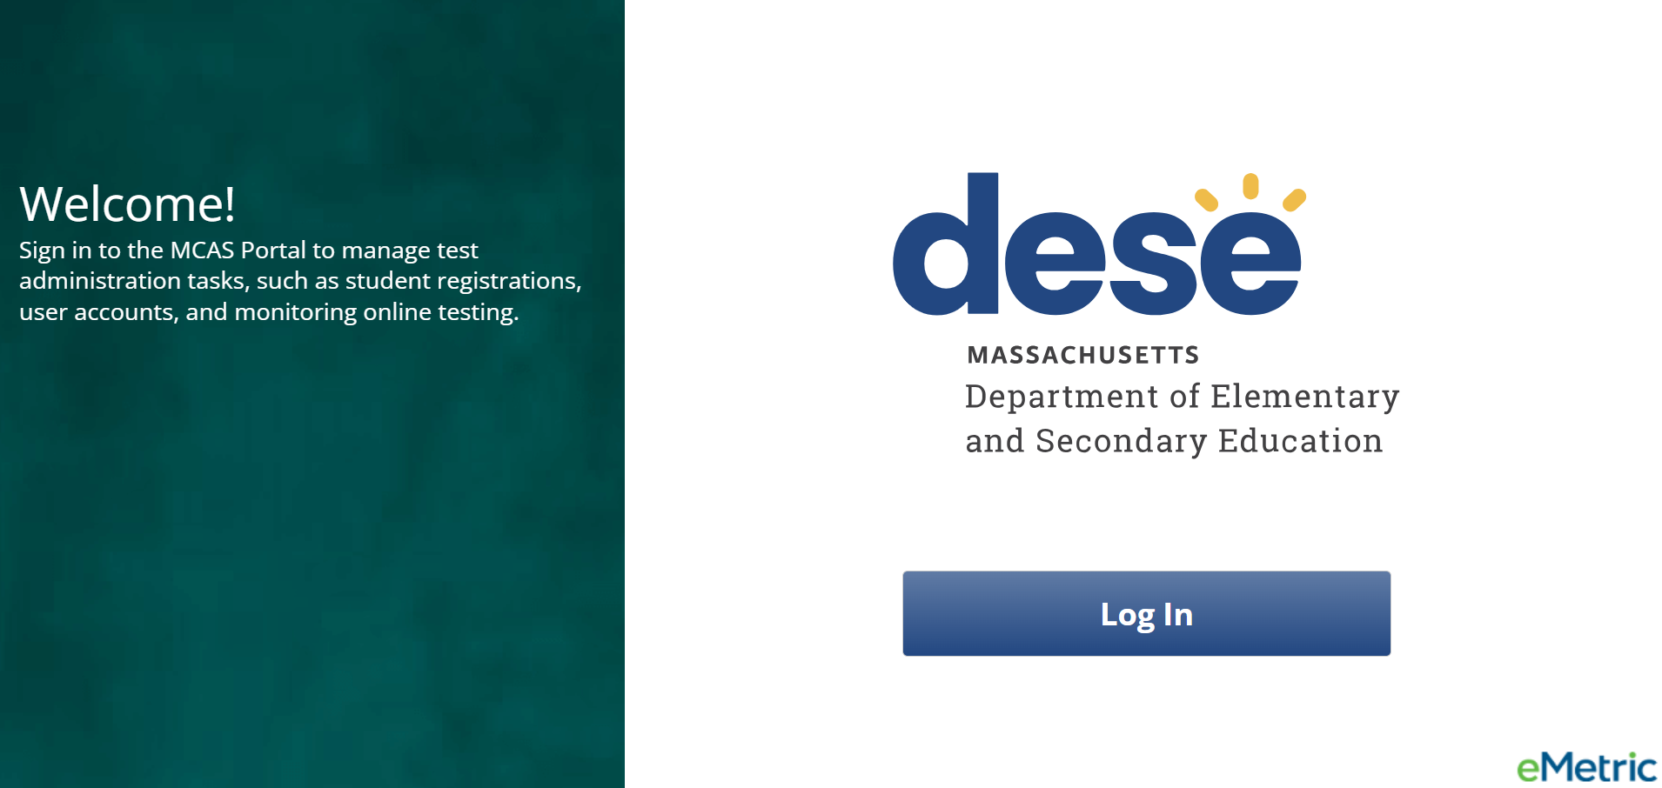
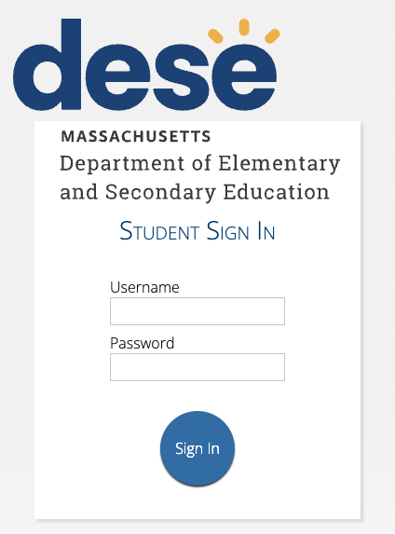
MCAS Portal and the MCAS Student Kiosk
MCAS Portal
Online test management system for principals, test coordinators, technology coordinators, and test administrators
https://mcas.cognia.org/
MCAS Student Kiosk
Online testing platform used by students to take the computer-based MCAS assessments
mcas.onlinehelp.cognia.org/ technology-setup

Slide 12
Tasks to Complete in Fall 2024
Task | Person responsible | Recommended Deadline
Create and edit MCAS Portal user accounts | Test coordinators | November 15 for test coordinator and technology coordinator accounts; Three weeks before test administration for test administrator accounts
Download and install the MCAS Student Kiosk on student testing devices | Technology coordinator | November 15 for high schools; December 13 for grades 3–8
Conduct Site Readiness to certify that technology infrastructure is ready for testing | Technology coordinator | November 15 for high schools; December 13 for grades 3–8
Note: The icon is used to denote areas of focus for technology coordinators on slides where there is also information for test coordinators.

Slide 13
2. Introduction to the New MCAS Resource Center

Slide 14
MCAS Resource Center
Can be accessed at mcas.onlinehelp.cognia.org
This website provides access to test administration information, training, practice tests, and other resources to help schools and districts prepare for and administer the MCAS tests.
Contains links to download the MCAS Student Kiosk to student devices.

Slide 15
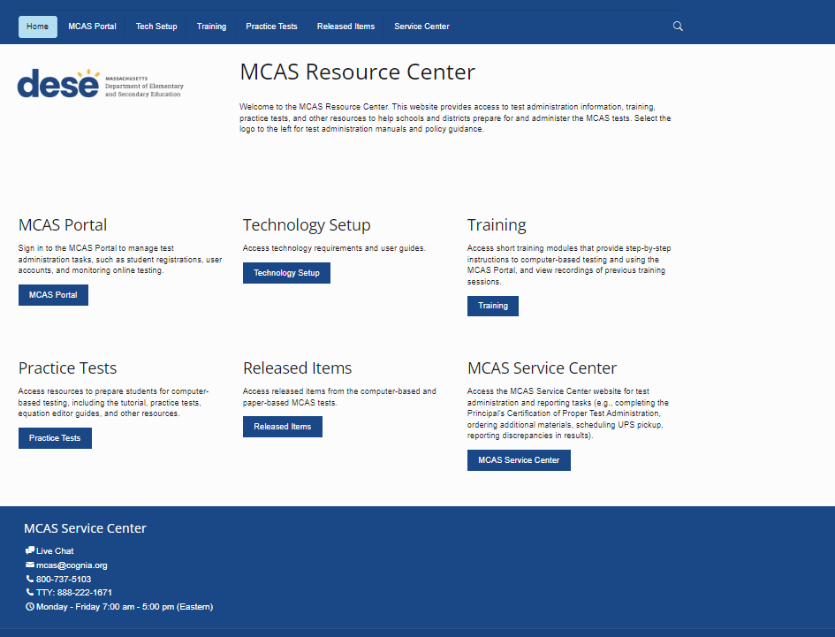
Search bar at the top of each page
Link to live chat at the bottom of each page

Slide 16
Demonstration
MCAS Resource Center

Slide 17
Available Resources
MCAS Portal page
Live links to the MCAS Portal and MCAS Training Site
MCAS Portal User Management Guide
Technology Setup page
Technology Guidelines for MCAS Computer-Based Testing
Guide to Installing the MCAS Student Kiosk and Conducting Site Readiness
Training page
MCAS Content Area Informational Webinars on Constructed Responses and Essays from winter 2024

Slide 18
Available Resources (continued)
Practice Tests page
Links to paper-based practice tests
Released Items page
A link to paper-based released items on the DESE website
A link to sample-student work on the DESE website
Service Center page
A link to the MCAS Service Center website, which is used during test administration

Slide 19
Resources Expected to be Available
Projected Availability | Resources
Early- to Mid-November | Modules for the following topics: Creating and editing user accounts in the MCAS Portal Conducting Site Readiness Guides for the MCAS Portal and MCAS Training Site Guides and modules on Student Registration Guides and modules on student tools and accommodations
Late Fall/Early Winter | Guides and modules on completing other pre-administration tasks Student Tutorial CBT Practice Tests High school science practice tests expected to be available first
Summer 2025 | Reporting pages will become available.

Slide 20
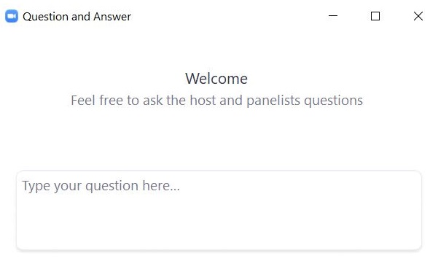
Questions & Answers
Use the “Q&A” feature to ask questions.

Slide 21
3. Introduction to the MCAS Portal

Slide 22
MCAS Portal and MCAS Training Site
MCAS Portal: the test administration and management website for district test coordinators, technology coordinators, principals/school test coordinators, test administrators, and other staff as needed
MCAS Training Site: where test coordinators, principals, technology coordinators, and test administrators can practice the tasks required in the MCAS Portal
Accounts for each site are created separately.
Unlike PAN, passwords for each site are set separately, but DESE recommends using the same password for both the MCAS Portal and the MCAS Training Site.

Slide 23
MCAS Portal and MCAS Training Site User Accounts
DESE created an initial set of user accounts for the MCAS Portal and MCAS Training Site on October 21–23.
The initial list of users was created based on information in PearsonAccess Next and School and District Profiles.
For details on how DESE created the initial accounts, refer to the October 18 Student Assessment Update.
Users received two emails from mcas@cognia.org for the MCAS Portal: one with their username, and one with their password.
Usernames will be your email address.
Users also received two emails from mcas@cognia.org for the MCAS Training Site.

Slide 24
Instructions for Obtaining User Login Credentials
If you did not receive automated emails containing your username and password, first check all your email folders (including spam and junk folders).
Recommended to add mcas@cognia.org as “Trusted” email sender
If you know your username but not your password, you can use the “Forgot Password” link on the Sign In page.
Then, users may request support as follows:
Role | Who to contact for support
Test administrators and school-level technology coordinators | Their principal or school test coordinator
Principals, school test coordinators, and district-level technology coordinators | Their district test coordinator
District test coordinators | MCAS Service Center

Slide 25
Getting Started: Logging In
Browser specifications for the MCAS Portal*:
Chrome™ 130 or newer
Firefox® 131 or newer
Microsoft Edge 130 or newer
Safari® 18 or newer
*Refer to the Technology Guidelines for MCAS Computer-Based Testing posted on the MCAS Resource Center for latest updates.
When you log in for the first time with your initial password, you will be prompted to update your password.
Passwords are valid for 365 days.

Slide 26
Annual Tasks to Complete in the MCAS Portal
Who’s responsible | Task | Timeframe for completing task
District and school test coordinators | Creating/assigning user accounts | Recommended deadlines: November 15 for test coordinators, principals, and technology coordinators At least three weeks prior to test administration for test administrators
Technology coordinators | Downloading/installing the MCAS Student Kiosk Conducting Site Readiness to ensure devices and network are configured for testing | Recommended deadlines: November 15 for high schools December 13 for grades 3–8

Slide 27
Sections Currently Available in the MCAS Portal
MCAS Portal Section | Tasks to Complete in this Section | Who will complete these tasks?
Users | Create, edit, and manage user accounts | School and district test coordinators
Administration | Access links to download the MCAS Student Kiosk Access Site Readiness credentials | School and district technology coordinators
Additional sections and features will be released as we approach test administration.

Slide 28
Demonstrations
Signing in to the MCAS Portal
Overview of the MCAS Portal
MCAS Portal vs. MCAS Training Site

Slide 29
Questions & Answers
Use the “Q&A” feature to ask questions.

Slide 30
4. Technology Guidelines and Downloading the MCAS Student Kiosk

Slide 31
Technology Guidelines for MCAS Computer-Based Testing
Available on the MCAS Resource Center on the Technology Setup page
Outlines the operating systems (OS) versions supported for testing, student kiosk device specifications, and MCAS Portal browser specifications
OS support
As new OS versions and subversions are released throughout the school year, eMetric conducts testing to confirm that they will be supported for testing.
Technology coordinators should check the Technology Guidelines for MCAS Computer-Based Testing prior to each test administration.
Schools should not update device OS versions during spring testing windows. If schools update device OS versions after running Site Readiness this fall, they should run Site Readiness again prior to spring testing.

Slide 32
Student Device Specifications
System Requirements – All Hardware
Connectivity | Student devices must be able to connect to the internet via wired or wireless networks.
Screen Size | 9.7” screen size or larger/“10-inch class” tablets or larger
Screen Resolution | 1024 x 768 or larger
Browser Requirements
Browsers (used for practice tests only) | Chrome 130 or newer Firefox 131 or newer Microsoft Edge 130 or newer Safari 18 or newer
Desktop and Laptop Specific Requirements
CPU | 1.3 GHz
Memory | 2 GB (4GB is strongly recommended for best performance)

Slide 33
ChromeOS Support Plan
eMetric supports the latest three versions of ChromeOS that are released on the Stable channel and the latest versions on the LTS channel.
Schools are not recommended to use beta versions of ChromeOS, as this may result in errors.
Operating System | Version | Version Release Date | End of Support Date | MCAS Administrations Supported
ChromeOS™ | 130 | October 2024 | February 2025 | 2025 February High School Science only
 | 131 | December 2024 | March 2025
 | 132 | January 2025 | June 2025 | 2025 February High School Science and March Retests and Spring
 | 133 | February 2025 | June 2025
 | 134 | March 2025 | June 2025
 | 126 LTS | October 2024 | April 2025 | 2025 February Science and March Retests and Spring
 | 132 LTS | April 2025 | October 2025 | 2025 Spring
Red box above indicates end of support before spring 2025 testing.
See pages 2–3 of the Technology Guidelines for MCAS Computer-Based Testing.

Slide 34
iPadOS Support Plan
eMetric supports the latest three major versions that are supported by Apple.
The latest subversion will be specified in the Technology Guidelines after being fully tested.
Operating System | Version | Version Release Date | End of Support Date
iPadOS® | 16.X Currently confirmed up to 16.7 | May 2024 | End of 2024–25 school year
 | 17.X Currently confirmed up to 17.6 | May 2024 | End of 2025–26 school year
 | 18.x | Expected fall 2024 | End of 2026–27 school year
See pages 2–3 of the Technology Guidelines for MCAS Computer-Based Testing.

Slide 35
Support for Linux, macOS, and Windows
Operating System | Version | Version Release Date | End of Support Date | eMetric Support Policy
Linux®, Fedora™ | 40 | April 2024 | End of 2024–25 school year | eMetric supports the latest version of Fedora.
macOS ® | 13.x | January 2023 | End of 2024–25 school year | eMetric supports the latest three major versions that are supported by Apple. The latest subversion will be specified in the table below after being fully tested.
 | 14.x | September 2023 | End of 2025–26 school year
 | 15.x | Expected fall 2024 | End of 2026–27 school year
Windows® | 10 (21H2, 22H2) | July 2015 | October 2025 | eMetric supports major versions of Windows that are supported by Microsoft. The latest supported minor versions of Windows are supported.
 | 11 (22H2, 23H2) | October 2021 | October 2031
See pages 2–3 of the Technology Guidelines for MCAS Computer-Based Testing.

Slide 36
Network Requirements and Guidelines
Firewalls
Allow traffic through ports 80 and 443
Proxy and Content Filter Servers
List of URLs to allow on ports 80 and 443 available on page 2 of the Guide to Installing the MCAS Student Kiosk and Conducting Site Readiness. https://mcas.onlinehelp.cognia.org/technology-setup/
Sandboxing Applications
Choose network folder or local folder that is not touched by the sandboxing applications
Applicable for both stored response and kiosk installation folders
See pages 2–3 of the Guide to Installing the MCAS Student Kiosk and Conducting Site Readiness.
https://mcas.onlinehelp.cognia.org/technology-setup/
Turn off operating system auto-updates

Slide 37
Download and Install MCAS Student Kiosks
Available for download from the MCAS Portal for Chromebook, iPad, Linux, Mac, and Windows
Use the direct links to access the apps on the Apple App Store and Chrome Web Store.
Be sure to download the correct MCAS Student Kiosk for each device type.
Scripted installations and other methods of installation are provided in the Guide to Installing the MCAS Student Kiosk and Conducting Site Readiness (pages 4–31).

Slide 38
Questions & Answers
Use the “Q&A” feature to ask questions.

Slide 39
5. Conducting Site Readiness

Slide 40
Overview of Site Readiness
What are the purposes of conducting Site Readiness and Site Certification?
For technology coordinators to:
Confirm that installation of the MCAS Student Kiosk was done correctly on student devices
Confirm that testing devices meet the minimum requirements and have been properly configured
Confirm that test content reaches student devices without issue
Identify any potential technology-related issues before testing begins
For communication of these steps to district and school test coordinators that testing devices are ready
When is Site Readiness conducted?
After installing the MCAS Student Kiosk on testing devices; recommended deadlines:
November 15 for high schools
December 13 for grades 3–8

Slide 41
Overview of Site Readiness (continued)
What are the general steps involved?
Technology coordinators will sign in to the MCAS Portal to retrieve their Site Readiness credentials (i.e., username and password).
Credentials are school-specific. District technology coordinators will need to select the school from their drop-down to see a location’s credentials.
Technology coordinators launch the MCAS Student Kiosk on each student testing device configuration (i.e., each device type and operating system).
Use the Site Readiness credentials to run the test.
Note: Site Readiness tests must be conducted using the secure MCAS Student Kiosk.
Site Readiness will not be conducted on browser-based practice tests in the MCAS Resource Center and the MCAS Training Site.
Technology coordinators complete the two-part test on each device type:
System Set-Up Test
Student Interface Test

Slide 42
Overview of Site Readiness (continued)
What are the general steps involved (continued)?
Technology coordinators go back to the MCAS Portal to complete the Site Certification step.
Technology coordinators communicate with their principal/school test coordinator to let them know Site Readiness has been completed and certified.
School and district coordinators confirm that their technology coordinators have completed the Site Certification for their schools by the deadlines listed on the previous slide.
The Site Readiness procedures take approximately 5–10 minutes per device.
It is recommended to conduct Site Readiness again prior to testing if your school experiences any changes to technology.
See pages 31–41 of the Guide to Installing the MCAS Student Kiosk and Conducting Site Readiness for additional information.

Slide 43
Site Readiness Tests
Site Readiness is a two-part test that allows technology coordinators to ensure the MCAS Student Kiosk has been properly installed.
Site Readiness Tests | Purpose of Test
System Set-Up Test | Verifies and confirms the following: network connectivity screen resolution text-to-speech how many students may begin testing at the same time
Student Interface Test | Provides sample test questions to determine whether the device is capable of correctly displaying and navigating test content in the MCAS Student Kiosk. The Student Interface Test also allows technology coordinators to test the student tools, including the Line Reader, Answer Eliminator, Text Highlighter, and Notepad, to ensure those are functioning properly.

Slide 44
Certifying Site Readiness
After all device configurations for your school have successfully completed Site Readiness, certify the site for testing.
Site Certification is done in the MCAS Portal.
Technology coordinators certify Site Readiness to signal to school and district test coordinators that the school technology has been confirmed as ready for testing.
See pages 39–41 of the Guide to Installing the MCAS Student Kiosk and Conducting Site Readiness.
DESE will follow up with schools that do not complete Site Readiness.

Slide 45
Demonstration
Retrieving Site Readiness credentials
Conducting the Site Readiness test
Certifying Site Readiness

Slide 46
Retrieving Site Readiness Credentials
Log in to the MCAS Portal with your username and password.
On the Portal home page, click Administration. The Site Readiness account information appears at the bottom of the Administration home page.
Make a note of the username and password for the school, which you will use to log in to the MCAS Student Kiosk.

Slide 47
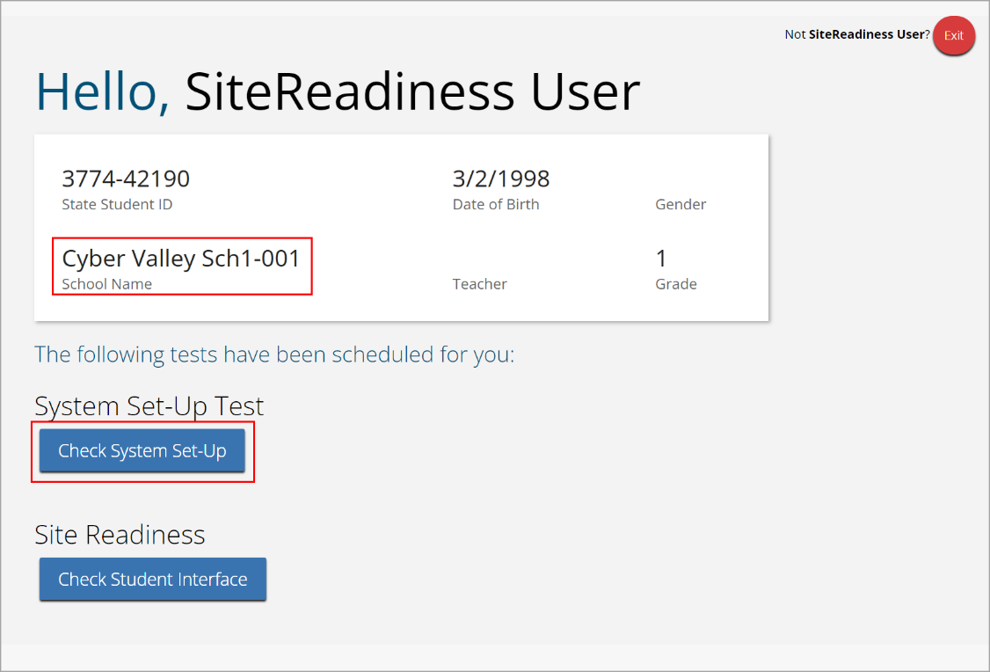
Conduct Site Readiness: System Set-Up Test
Launch the MCAS Student Kiosk on the device.
Log in to the MCAS Student Kiosk with the Site Readiness username and password provided for the school.
Verify your school’s name underneath the username. Under System Set-Up Test, click Check System Set-Up to begin the test.

Slide 48
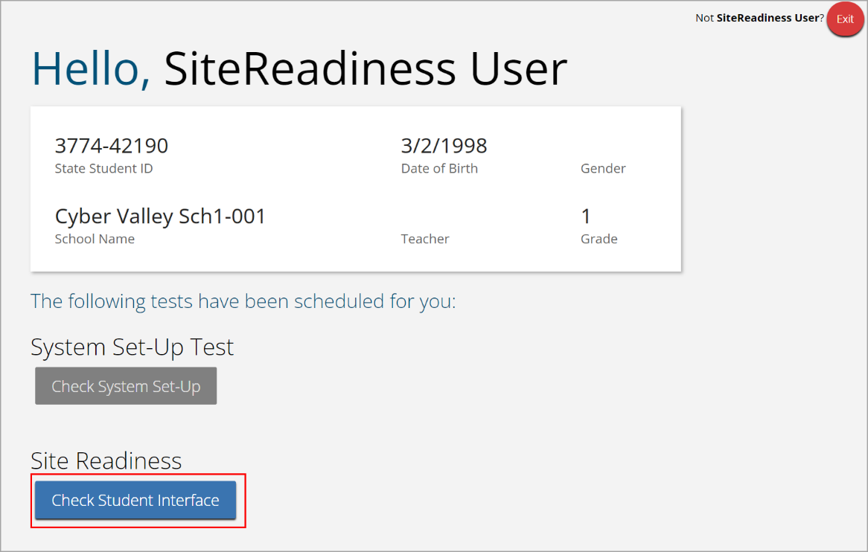
Conduct Site Readiness: Student Interface Test
If all the system checks succeed, you are ready to begin the next Site Readiness test.
If one or more system checks fail, adjust your configuration as needed and re-run the System Set-Up test.
When the System Set-Up test is completed, click the blue Check Student Interface button.
Read the instructions on the page and then click Continue.
Confirm that you can respond to a few questions, and try a few student tools.
On the last test question page, click Finish.
On the Test Review page, click Turn In to submit your test.

Slide 49
Certify Site Readiness
After all devices or device configurations for your school have successfully completed Site Readiness, the technology coordinator will certify the site for testing.
Log in to the MCAS Portal with your username and password.
Note: Use your own username and password, not the Site Readiness credentials.
Click Administration.
Click Site Readiness at the top of the page.
On the Site Readiness page, locate the school to be certified, and then click View Details.

Slide 50
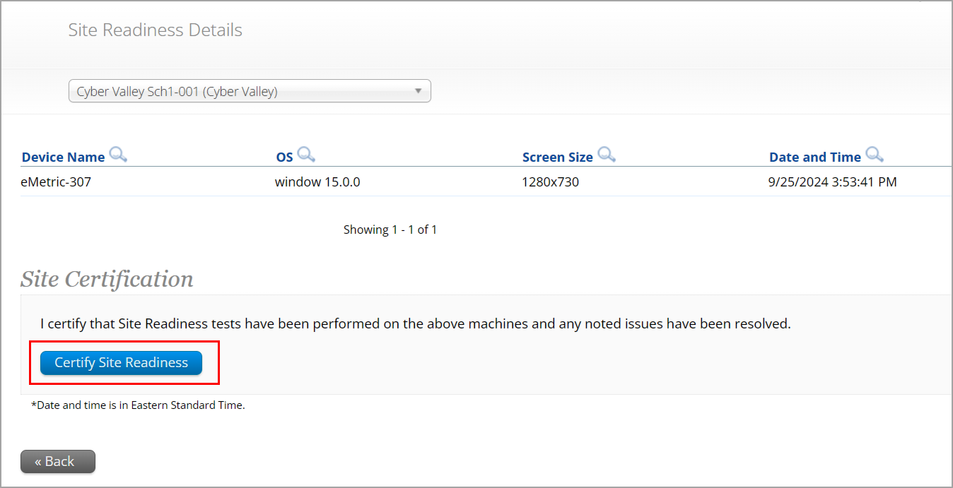
Certify Site Readiness (cont’d)
On the Site Readiness Details page, verify that all the devices or device configurations for the school have successfully run the Site Readiness tool and meet the technology requirements.
Click Certify Site Readiness and click Yes in the pop-up message to confirm.

Slide 51
Questions & Answers
Use the “Q&A” feature to ask questions.

Slide 52
6. Additional Information for Technology Coordinators

Slide 53
MCAS Student Kiosk: Internet Connectivity
Internet connectivity is required during testing only as follows:
At the beginning of the test to authenticate student login and download the test content
At the end of the test to submit responses for scoring
Once a student has finished reading the test session directions and the content has downloaded onto the local device, the student may continue testing regardless of internet connectivity.
If a student’s device loses internet connectivity:
The student should keep testing on that device.
Do not move a student to a new device when experiencing technical issues if the student has already begun testing.
Student responses will be saved to the save response location indicated during MCAS Student Kiosk installation.
Once internet connectivity resumes, the saved responses will automatically be synced to eMetric servers.
If the student turns in the test offline, the student will receive a message to notify the test administrator.

Slide 54
MCAS Student Kiosk: Internet Connectivity
When is internet connectivity required?
Beginning of Test:
Authenticate login
Download test content
eMetric Servers
End of Test:
1. Submit responses for scoring
Note: Students with an ASL video accommodation (grade 10 Math, June Science) will need internet connectivity during the test. Content with video (grades 5 and 8 STE) will need to have internet connection to play the video.

Slide 55
MCAS Student Kiosk: Loss of Internet Connectivity During Testing
Internet connectivity indicator
Responses Sync every 45-90 seconds
Student with Internet Connectivity
eMetric Servers
Student with no Internet Connectivity
eMetric Servers
Student with restored Internet Connectivity
eMetric Servers

Slide 56
MCAS Student Kiosk: Finish the Test with No Connectivity
Internet connectivity indicator
Student finishes test with no Internet Connectivity
Student turns in test and receives prompt to notify test administrator
Test Administrator on Student Device with Internet Connectivity
eMetric Servers
Test administrator uses student testing device and relaunches the MCAS Student Kiosk

Slide 57
Loss of Network Connectivity Procedure Summary
If a student finishes and is ready to turn in the test while offline (prior to the network being restored):
Allow student to turn in test.
The student will receive a message to notify the test administrator.
Record the exact device the student is testing on.
Ensure no network management tools or system maintenance will alter that device’s files or configuration.
When network connectivity is restored, the test administrator will need to resume internet connectivity and relaunch the MCAS Student Kiosk. (If you can see the student login page, the saved responses have synced.)
If you are unsure of the status of the student responses, call the MCAS Service Center.
Step-by-step instructions will be included in guidance documents on the MCAS Resource Center later this school year.

Slide 58
Questions & Answers
Use the “Q&A” feature to ask questions.

Slide 59
7. Resources, Support, and Next Steps

Slide 60
Additional Resources
Resource | Location
MCAS Resource Center | mcas.onlinehelp.cognia.org
MCAS Portal user guides MCAS Portal User Management Guide | https://mcas.onlinehelp.cognia.org/portal/
Technology Information Technology Guidelines for MCAS Computer-Based Testing (Check prior to each test administration.) Guide to Installing the MCAS Student Kiosk and Conducting Site Readiness | https://mcas.onlinehelp.cognia.org/technology-setup/
Student Assessment Updates (Biweekly email with important updates about the MCAS program) | www.doe.mass.edu/mcas/updates.html If you do not already receive this email, subscribe using this link: http://eepurl.com/ghSOhH
Cybersecurity Resources | https://www.doe.mass.edu/mcas/testadmin/

Slide 61
Next Steps
Today: Complete the evaluation form.
Responses are associated with the name and email address used to log in.
Email your input to mcas@mass.gov if you have problems accessing or completing the form.
Within one week:
Receive an email with the Q&A from this session
Recording will be available

Slide 62
Email and Phone Support
MCAS Service Center
DESE Student Assessment Services
Questions on logistics and technology
Web: https://mcas.onlinehelp.cognia.org/
Email: mcas@cognia.org
Phone: 800-737-5103
TTY: 888-222-1671
Live chat is available at the link on the bottom of the page at the MCAS Resource Center for the 2025 tests
Policy questions (e.g., student participation, accommodations)
Web: www.doe.mass.edu/mcas
Email: mcas@mass.gov
Phone: 781-338-3625
TTY: 800-439-2370

Slide 63
8. Live “Sandbox Time”

Slide 64
Poll Question—
Which demonstrations would you like to see again?
Signing in to the MCAS Portal
Overview of the MCAS Portal
MCAS Portal vs. MCAS Training
Retrieving Site Readiness credentials
Conducting the Site Readiness test
Certifying Site Readiness

Slide 65
THANK YOU
The Office of Student Assessment Services
781-338-3625
mcas@mass.gov
www.doe.mass.edu/mcas
135 Santilli Highway, Everett, MA 02149

